Slide 1
Semicolons;

Slide 2
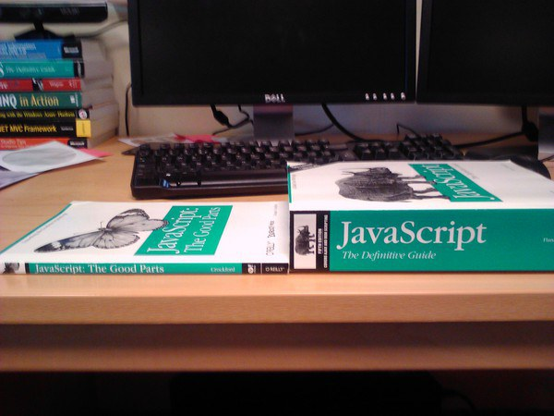

Slide 3


