Slide 1
Annotated XMLs Guidance

Slide 2
Purpose
Scope
The annotated XML sample pack meets the following requirements:
The samples are provided as exemplars of XML payloads and notifications for scenarios that demonstrate the functionality of CDS.
DE 2/5 (LRN) must be unique for each payload, so we expect developers and traders to update this value when the samples are used.
The notifications included with the samples are examples of the responses received for the scenario and are provided in folders named 'Example Notifications’.
Note that for some minor changes to samples only the payloads or notifications may be updated so the LRNs in the payloads and notifications may not match.
Annotations
Annotations embedded inside the XMLs themselves, in order to:
Closely align descriptions with data inputs.
Reduce duplication of work and possibility of documents becoming out of sync
Reduce confusion on when to concatenate data element entries
Make XMLs accessible to non-technical users.
Explain inputs that are not data elements e.g. ‘AcceptanceDateTime’.
Explain additional messages included with each declaration.
The following document will act as a guide for how to interpret the annotated XML payloads in order for them to provide maximum value for Developers and Traders looking to understand XML declarations

Slide 3
The naming for the annotated Trade Test samples
The naming convention allows multiple scenarios to be shown using a single base payload, demonstrating more realistic declaration journeys
A reference spreadsheet is included to describe the base payloads and additional scenarios
Scenario names progress with a number indicating a new ‘base payload’ that additional scenarios could be developed from
TT_IM02a
Annotated Sample Name | Procedure Code | Category | Scenario Description | Movement Messages | Expected Notification Messages
TT_IM02a | 4071 | H1 | Imports Type Z declaration where the agent has standing authority to use the trader’s DAN | - | DMSACC, DMSTAX_DMSCLE
TT_IM02b | N/A | n/a | TT_IM02a declaration, with a subsequent amendment to item price | - | DMSACC, DMSCLE, DMSRCV, DMSREQ, DMERES, DMSTAX
EX indicates Exports
FI indicate Finance
IM indicates Imports
01 indicates first of the new annotated base payloads
These will increase sequentially
Type of declaration can be looked up in reference spreadsheet
‘a’ indicates this is the first of the scenarios created for this base payload
Additional scenario descriptions can be looked up in attached reference sheet, alongside associated notifications
Excerpt from reference spreadsheet

Slide 4
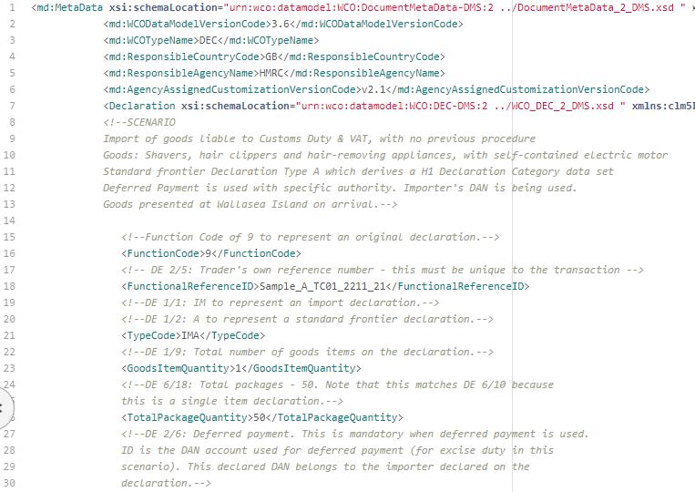
Annotations are embedded for every data entry within the declarations
Annotations
Data Entries
All annotated information is listed between <!-- and --> for each data entry within the declaration. This ‘comments out’ the annotation within, making it no longer functional code
The Scenario description has been embedded at the top of the declaration for both Imports and Exports, outlining the key functionality being demonstrated in the test, alongside the declaration category and key information including commodity declared
Comments by data element could be extracted and shared without the xml data entries, in a similar format to previous scenario documents
Additional declaration tags have also been annotated, that do not align to a specific data element. E.g. Function code
CDS Data Elements have been annotated e.g. DE 6/18, with information about the context and meaning of each entry below
Annotations have also been embedded to further explain additional messages e.g.
Amendments
Cancellation Messages
Movement Messages
Notifications

Slide 5
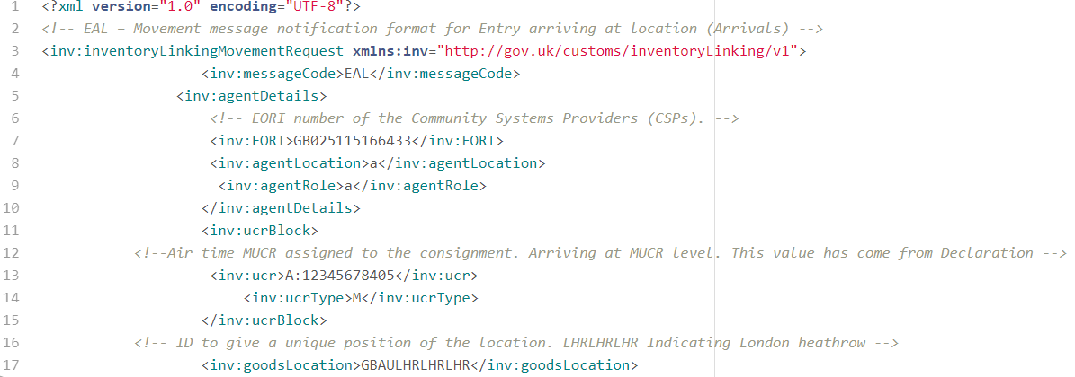
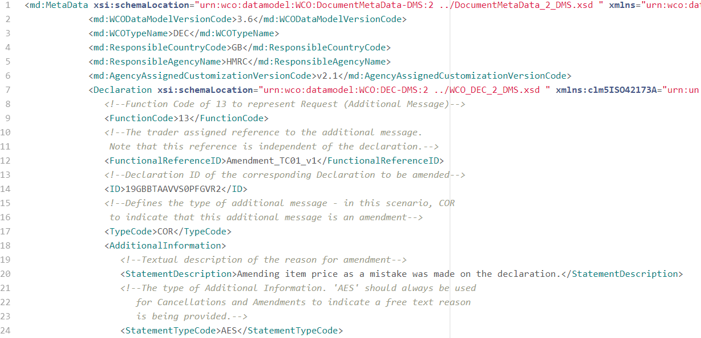
Annotations are also embedded in additional messages
Movement Messages
Additional Messages
Annotations have also been embedded within additional messages in order to put the scenarios in context of how they could be declared . E.g.
Amendments
Cancellation Messages
Movement Messages
Notifications
These also allow multiple scenarios to be created based on a singular payload, e.g. TT_IM02a is a type Z Supplementary Declaration, which is also included with an amendment payload TT_IM02b, amending the item price
Example movement messages and notifications have also been annotated, to include data requiring updating and information on how to interpret tags
This provides a more complete declaration journey for each scenario

