Slide 1

Making PowerPoint documents as accessible as possible
Angela Cockburn
CDIO Digital Inclusion, Standards and Culture team
20 May 2020
Notes:
Welcome, My name is Angela Cockburn, I’m part of CDIO Digital Inclusion, Standards and Culture
Thank you for coming along to my session on tips to help you make your PowerPoint presentations as accessible as possible.
It is part of the series of events that we in CDIO’s Digital Inclusion, Standards and Culture team are doing as part of Global Accessibility Awareness Day.

Slide 2
Background
This set of slides summarises the tips shared during the ‘Making PowerPoint documents as accessible as possible’ session CDIO’s Digital Inclusion, Standards and Culture team ran as part of Global Accessibility Awareness Day 2020.
Angela Cockburn
CDIO, Digital Inclusion, Standards and Culture

Slide 3
Font and font size
Font: Use a font such as Arial or Calibri – NOT Times New Roman
Font size: Have your main text no smaller than 14pt – ideally minimum of 18pt
Angela Cockburn
CDIO, Digital Inclusion, Standards and Culture
Notes:
Font: Arial and Calibri are 'sans serif' fonts which means they do not have tails or embellishments that can appear 'fuzzy’.
Size: You are working in PowerPoint so if you are needing to go much smaller maybe you are trying to put too much on a slide, or is PowerPoint the right medium to use.

Slide 4

Formatting your text
Don’t justify your text
Use the features provided by Microsoft such as bullet lists or numbered lists
Add space before and after paragraphs rather than having blank lines. Use the line spacing feature on the Home menu
Angela Cockburn
CDIO, Digital Inclusion, Standards and Culture
Notes:
Don’t justify your text: having uneven/jagged ends to lines of text is easier to read and scan – justifying text presents the user with solid blocks of text
Use the facilities in Microsoft to format your text – most are commonly used features such as bullets or numbered lists, but another really good one is line spacing to create space before and after paragraphs.
This is really useful for spacing your text without the need to add blank lines – avoiding dense blocks of text is important for users who may have dyslexia or low concentration. And not having blank lines and spaces to layout your text means there is less information for a screen reader to read out meaning less clutter/noise for the person listening

Slide 5
Presenting content on your slides
Making the message you want to convey is not about restricting how you do it – making something accessible to everyone is not about being all plain text on a slide.
Just means there are a few things to think about to make sure it works for everyone.
The following slides highlight a few things to be aware of when using
Tables
Colour
Visual interpretation of data and use of images
Angela Cockburn
CDIO, Digital Inclusion, Standards and Culture

Slide 6
Tables – poor use of a table
Do not use a table for layout. Only use a table when it’s appropriate to know there are columns and rows of data and there’s a relationship between the data in the columns and rows.
Bad example of the use of a table
Better way to present the information
The data does not need to be shown in columns and rows – it would be much clearer and easier to understand presented as two bullet lists – a list of good points, and a list of things to improve
Good points | Things to improve
Coming up with ideas | Being tidy
Making unexpected connections | Staying on task
Storytelling
Angela Cockburn
CDIO, Digital Inclusion, Standards and Culture
Notes:
Tables: Don’t use tables to make your text look nice. Only use when it’s appropriate to know there are columns and rows of data and there’s a relationship between the data in the columns and rows.
Here we have a poor use of a table – the data does not need to be shown in columns and rows – it would be much clearer to be presented as two bullet lists – one list of good points, and another list of things to improve.
Users of screen reading software are informed that information is in a table, and for something like this they would be informed that there was a table, 2 columns and 4 rows. Row 1 column 1 Good points; row 1 column 2 Things to improve. Row 2 column 1 Coming up with ideas. Row 2 column 2 being tidy. And so on.
There is a lot more information given to the user and using a table when it is not needed is making following and understanding the information a more complicated experience than it needs to be.

Slide 7
Tables – appropriate use of a table
Only use a table when it’s appropriate to know there are columns and rows of data and there’s a relationship between the data in the columns and rows.
Example of an appropriate use of a table
Tax received by HMRC in 2015-16
Formatting your table of data
Give the table a title so the context of the information in the table is clear
Always have the column headings marked as a header row
Use shading on alternative rows to make it easier for users to visually track across the rows in the table
Tax regime | Tax received
Income Tax | £170 billion
National Insurance contributions | £150 billion
Corporation Tax | $48 billion
Angela Cockburn
CDIO, Digital Inclusion, Standards and Culture
Notes:
Only use a table to present information when its appropriate to know there are columns and rows of data and there’s a relationship between the data in the columns and rows.
Header row – this will mean that the column heading is read out to a user of screen reading software with the value of the cell, for example for row 2 column 2 user would be informed that it was a tax regime, and it is income tax. This gives clear awareness of information and where in the table they are – information we get visually; at a glance

Slide 8
Colour – don’t use just colour to convey a meaning
While colour can be useful to convey information, colour should not be the only way information is conveyed.
Provide additional identification that does not rely on colour perception.
Example 1: colour only
Example 2: colour and words
Risk title | Risk status
Risk 1
Risk 2
Risk 3
Risk title | Risk status
Risk 1 | Amber
Risk 2 | Green
Risk 3 | Amber
Angela Cockburn
CDIO, Digital Inclusion, Standards and Culture
Notes:
Colour – don’t use just colour to convey a meaning
The meaning will be lost for users with colour blindness, or who rely on screen reading software.
Here we have a favourite of mine - the use of the to indicate the status of something.
Example 1 – a table where the status of each risk is shown using just the colour amber or green.
Example 2 – same idea but with a bit of extra information – we still have that visual at a glance feel for the colour but now also have the word to help those for whom colour is not a good indicator of meaning.

Slide 9
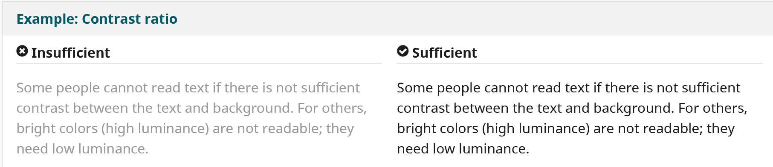
Colour and contrast
Have a clear contrast between font colour and background colour
Not everyone can read your text if there is not a sufficient contrast, for example, light grey text on a light background
Angela Cockburn
CDIO, Digital Inclusion, Standards and Culture
Notes:
Colour and contrast - Make sure there is a clear contrast between text colour and background colour.
Not everyone can read text if there is not a sufficient contrast between the text and its background, for example, light grey text on a light background.
It may be someone looking at the slide with poor lighting or glare making it harder to read, or you have shared your slides and someone you send them to has personalise their colours and other settings in Microsoft and the poor contrast means that some of the text is no longer visible.

Slide 10
Visual interpretation of data and images
For some users images and picture can make your information hard to use – but for others it is a great way to convey information.
We just need to make sure we have that happy balance.
Just means there are a few things to think about to make sure it works for everyone
Angela Cockburn
CDIO, Digital Inclusion, Standards and Culture

Slide 11
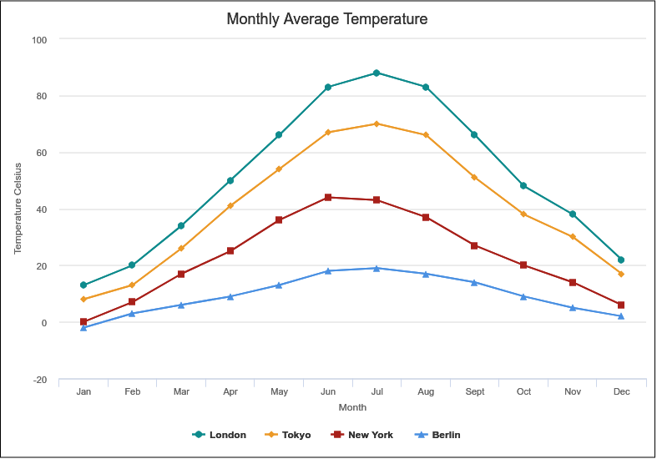
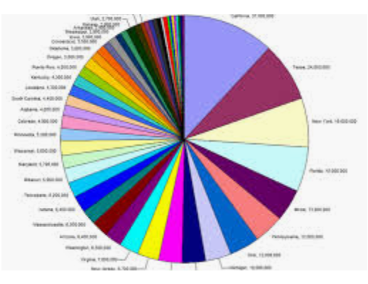
Data visualisation
Presentations often contain images that present information in a visual way.
Don't overwhelm the user with information
Do use labels and legends
Do provide context and explain the information the image is conveying
Think about interpretation when a copy of your slides are shared
Notes:
Think about interpretation when a copy of your slides are shared - when accompanied by someone talking - charts and pictures are explained, more information is given about what it is the chart is showing - but as soon as copies of slides from a presentation are shared the explanation is frequently lost.
You may need to add a slide that gives the explanation so your message from the actual presentation is not lost.

Slide 12
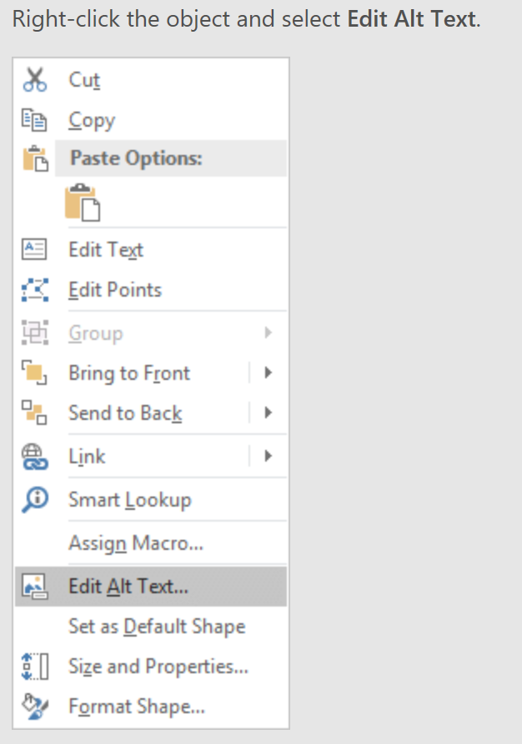
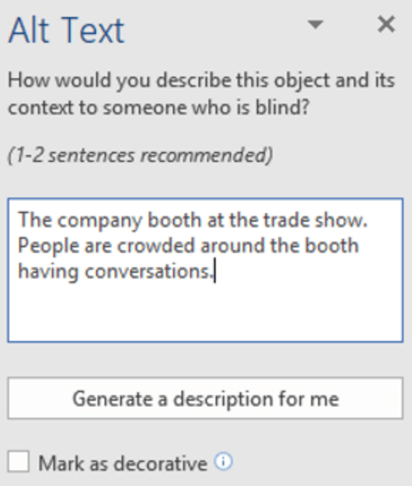
Images
For every image, write alternative text that explains the information conveyed by your use of the image or the context in which the image is used.
For purely decorative images you can mark it as being decorative.
Angela Cockburn
CDIO, Digital Inclusion, Standards and Culture
Notes:
Just read notes
Use alt tags to describe an image – it is the alt tag that gives the image context to a user of screen reading software.
If there is no alt text or it is not marked as decorative they will know there is an image there but will not have any idea what it is and whether they are missing something important or something decorative.
Your alt text should put your use of the image into context. The screenshots on this slide show the steps to add alt text. Right click on the image, then select Edit Alt Text, then enter your description of the image or select the ‘mark as decorative’ checkbox

Slide 13
Using shapes
As well as a simple text box, shapes are frequently used to display text on a slide. A common one is using the speech bubble for quotes
Presenting text like this on a slide is accessible.
Just be careful of the colours you use – make sure there is a good contrast between background colour and font colour.
To add this shape go to Insert > Shapes > Callouts
Angela Cockburn
CDIO, Digital Inclusion, Standards and Culture
Notes:
Presenting text like this is accessible. The information that you add into a callout shape or a rectangle is easily accessed and read out to users of screen reading software.

Slide 14
And finally… check your document
Make sure each slide has a title
Check the readability of your content Use the readability tools (Review > Spelling) or Hemingway app (web)
Use the accessibility check facility (Review > Check Accessibility) see also the advice on creating documents using Office 365 products from Microsoft (web)
Check the reading order of each slide (Home > Arrange > Selection pane)
Angela Cockburn
CDIO, Digital Inclusion, Standards and Culture
Notes:
The title acts as an outline of the slides in your presentation and gives feel for structure and can help a user jump to a particular slide. If you have PowerPoint open with view, Normal you will get an outline of all your slides – if you hover the mouse over each slide the title will be displayed, or the text ‘No title’ will be shown.
Check the readability of your content – make sure it is as easy to follow and understand as possible
Accessibility check – this will let you know if any of your slides don’t have a title, any images don’t have alt text, if your table does not have a header row
Reading order – the reading order is the order in which a user of screen reding software will be take through the content on the slides. and it starts from the bottom up – presumably made sense to someone – show amending the reading order

