Slide 1





Ensemble Learning in Data Streams
Master’s thesis
Supervisor: Prof. Dr. Burkhard Rost
Advisors: Dr. Eirini Ntoutsi, Dr. Lothar Richter
Hossain Mahmud
Image: claimsmag.co.uk
Image: confluence.com

Slide 2

Data Streams
Stream data arrives continuously and rapidly, and if it is not processed immediately, then it is lost forever. Moreover, the arrival speed of data is so high that it is not feasible to store it all in active storage (i.e., in a conventional database), and then process it later.
Social networks, telecommunications, WWW, scientific experiments, e-commerce systems, etc.

Slide 3
Introduction
Stream mining is different from batch mining
Significant differences include –
The underlying data distribution may evolve over time
Data cannot be considered independent or identically distributed over time
Data is time and space dependent
Model should be ready to predict anytime
Model should access data only once (or a small number of times)

Slide 4
Motivation
Number of tweets in Twitter for 5 different topics (Aug 28, 2015-Sept 28, 2015)
Topics contribute at different rates in the final stream
The target class could be balanced though
Sample sentiment classes for Football
Source: topsy.com

Slide 5
Problem Statement
Online classification of data streams, which are decomposable into varying speed sub-streams, using decision tree ensemble.
We don’t know the original substreams, our stream consists of their fusion (e.g., Twitter stream)

Slide 6
Existing Decision Tree Based Approaches and their Ensemble

Slide 7
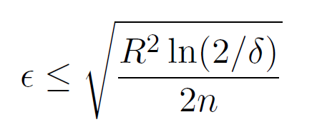

Assumption
To find the best attribute for a split in a node, it would be sufficient to consider a certain fraction of the stream [1]
Hoeffding bound provides a statistical guarantee [2]. Error bound to decide with (1- ) certainty for n random variable with R being the range of the variables
A decision taken after observing a certain amount of instances would remain the same after seeing an infinite number of instances with (1- ) certainty

Slide 8
Hoeffding Tree (HT) [3]
Decide based on the data in hand
Try to split if a leaf is impure
Use information gain/ Gini index to obtain the best two split attributes
Split if the best one performs better than the second best by at least a margin of the Hoeffding bound
Keeps updating the tree with incoming data
The tree only grows
Attr1 | Attr2 | Class
a | 1 | C1
a | 2 | C1
b | 1 | C2
b | 2 | C2
b | 2 | C1
a | 1 | C2
a | 2 | C1
Attr1
a
! a
Attr2
Attr1
1
2
b
C2 (1/2)
C1 (2/2)
Attr2
1
2
C2 (1/1)
C1 (1/2)

Slide 9
Hoeffding Tree cont.
No rule gets deleted
With time
The tree becomes to complex → overfit
The tree produces redundant rules e.g., IF x < 7 AND x < 5 AND x <3 THEN ...
The historical data dominates the decisions→difficult to adapt
t0
t1
t2
t3
tn
Decision boundary
t0
t1
t2
t3
tn

Slide 10
Adaptive Size HT (ASHT) [5]
Set bound on the maximum tree size
Start over when limit is reached
The tree forgets historical information but
Loses all information learned thus far
Tree with maximum size
Start over
t0
t1
t2
t3
t4
Decision boundary
t0
t1
t2
t3
t4

Slide 11
Adaptive HT (AdaHT) [4]
Start maintaining an alternate sub-tree when a node starts performing worse than previous
When the new sub-tree starts performing better, replace the original
If original sub-tree keeps performing better, delete the alternate sub-tree
Error increasing nodes
Alternate branch
x
t0
t1
t2
t3
t4
Performance degrading
Keep original
Switch to alternate
t0
t1
t2
t3
t4

Slide 12
Bagging Ensemble [6,7]
Generate n training sets by random sampling of the original training set
Learn a model for each training set
Use majority voting for classifying test data
All data
.
.
.
.
.
.
.
Y
.
.
.
.
.
.
Test data
.
.
X
.
.
.
Y
.
.
Training set 1
Training set 2
Training set n
X
.
.
.
.
.
.
.
.
.
…
.
.
.
Y
.
.
Y
.
.
Y
.
.
.
.
.
.
.
X
X
X
W
X
Y
Z
W
X
Y
Z
W
X
Y
Z
A
B
C
D
A
B
C
D
A
B
C
D
1st model
2nd model
nth model
W
X
Y
Z
A
B
C
D
Aggregated model
A
W
Positive Correlation
C
X
Negative Correlation

Slide 13
Bagging with ASHT (BagASHT) [5]
Bagging with Adaptive Sized Hoeffding Tree (BagASHT) [5]
Maintain an ensemble of HTs of different size limit
Allows building models for different time-frames
Smaller trees react faster to change, larger trees slower
Every time a larger tree resets, the ensemble loses significant information about “longer living” concepts
Tree3
Tree2
Tree1
1 0 0 1 0 1 1 1 0 0 1 1 1 1 0 1 0 1 0 1 1 0
time
Tree1
Tree2
Tree3
t1
reset
t2
Time
reset
t3
reset
reset
t4

Slide 14
A New Approach

Slide 15
Carry-over Bagging (BagSRHT)
Carry-over Bagging with Size Restricted Hoeffding Tree (BagSRHT)
Once the limit is reached
Move the tree to the extra list
Restrict it from growing
Start maintaining another tree
Take votes from both
Delete oldest from the extra list
When the new one is large enough
Or more trees reached their limit
Use alternate sub-tree method (AdaHT) instead of HT
Tree1
Tree2
Tree3
t1
reset
t2
Time
reset
t3
Restrict growing
Start a new
t4
Delete old one
t5

Slide 16
Data Sets
Most existing generators use a randomized approach
Random Radial Basis Function (RandRBF) generator
Not possible to generate varying speed data set
Modified the generation scheme to achieve desired properties in the data set
Varying Speed RBF (VSRBF) generator
Slow but consistent sub-streams
Fast and short lived sub-streams, etc.

Slide 17
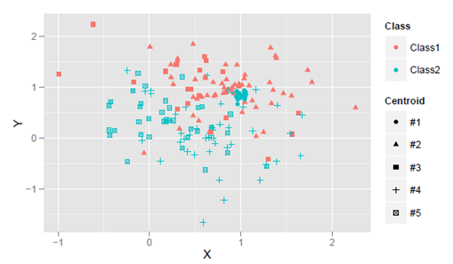
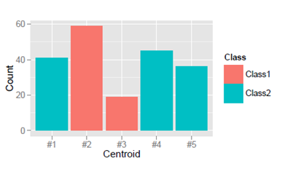
Random RBF Data Set
Centroids contribute to the final stream depending on their weights
All centroids are active all the time

Slide 18
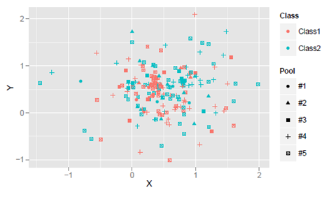
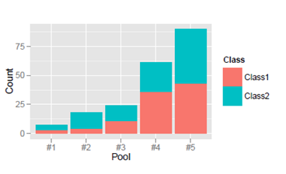
Varying Speed RBF Generator
Replace the concept of centroids with the concept of pools
Each pool contains a number of centroid and has different activation and contribution rate
Slow pools, fast pools, average speed pools, etc.

Slide 19
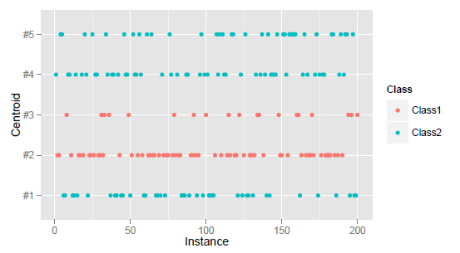
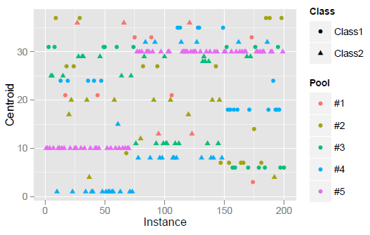
Comparison
All the concepts (centroids) are active all the time for the random RBF generator
The activation period changes in VSRBF generation scheme
Random RBF Generator
VSRBF Generator

Slide 20
Evaluation
Data generation
Random RBF generator
Varied Speed RBF generator
Prequential evaluation
Use every instance to first test and then train the model
Binary class problem
10 attributes
1 million instances

Slide 21
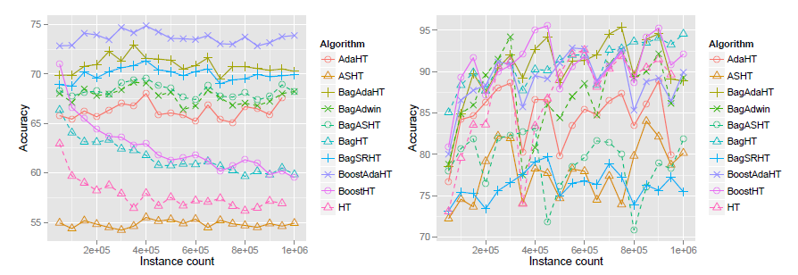
BagSRHT vs BagASHT
Performance is prone to tree reset
VSRBF performance suffers significantly more than Random RBF
BagSRHT is likely to be more stable than BagASHT
Random RBF
VSRBF

Slide 22
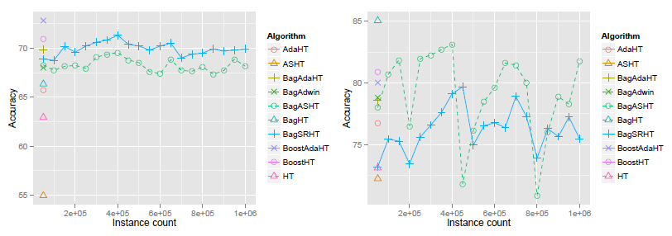
BagSRHT vs BagASHT
Performance is prone to tree reset
VSRBF performance suffers significantly more than Random RBF
BagSRHT is likely to be more stable than BagASHT
Random RBF
VSRBF

Slide 23
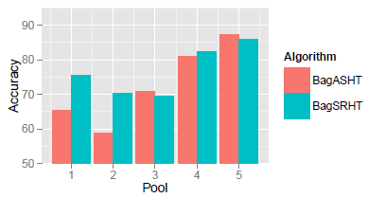
BagSRHT vs BagASHT
Bag SRHT performs better for slower sub-streams
However, increases misclassification for faster sub-streams

Slide 24
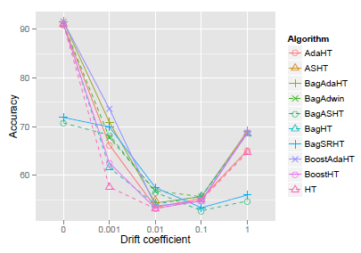
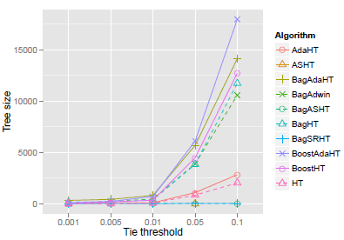
Effect of Parameters
Without any drift, all methods perform the same
With small drift ADWIN and boost variants perform best
A tie threshold may be used to break ties between two equally good attributes
Larger tie threshold causes massive trees

Slide 25
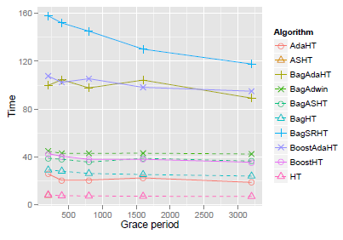
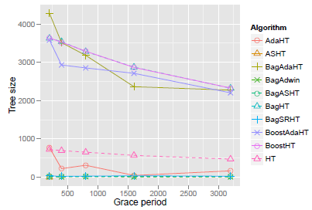
Effect of Parameters
Grace period is used to reduce unnecessary computations
Effectively reduces processing time and tree size

Slide 26
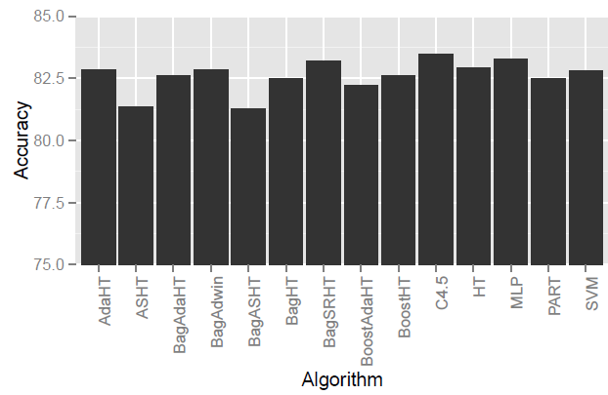
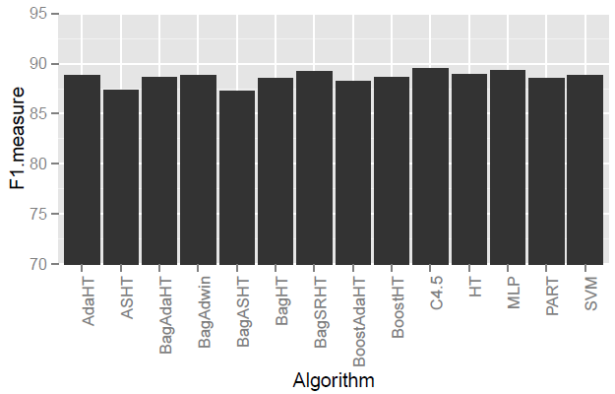
Comparison with Batch Approaches
Census income data set [8]
10 fold cross validation for batch approaches
ADWIN variants and BagSRHT reach closest to C4.5

Slide 27

Conclusion
New look at the composition of streams
New approach to generate varied-speed data streams
Improvement on ASHT bagging by introducing carry-over bagging
A comprehensive survey of the existing literature

Slide 28
Future Work
Fitting the model into text streams
Our motivation for this work is taken from text streams
Our evaluation currently is performed with numeric data
Devising an approach to select a subset of the incoming stream to learn the model
Equivalent number of instances from both slower and faster streams

Slide 29
References
Catlett, J. (1991). Megainduction: Machine learning on very large databases. In PhD thesis, University of Sydney.
Hoeffding, W. (1963). Probability inequalities for sums of bounded random variables. 58:13–30.
Domingos, P. and Hulten, G. (2000). Mining high-speed data streams. In Proceedings of the ACM KDD.
Hulten, G., Spencer, L., and Domingos, P. (2001). Mining time changing data stream. In ACM KDD, pages 97–106.
Bifet, A., Holmes, G., Pfahringer, B., Kirkby, R., and Gavaldà, R. (2009). New ensemble methods for evolving data streams. In SIGKDD, pages 139–148.
Oza, N. C. and Russell, S. (2001). Online bagging and boosting. In Artificial Intelligence and Statistics, pages 105–112.
Breiman, L. (1994). Bagging prediction.
Kohavi, R. (1996). Scaling up the accuracy of naïve-bayes classifiers: a decision tree hybrid. In Knowledge Discovery and Data Mining.

Slide 30


Slide 31
Algorithm Summary
Singleton models
HT – Hoeffding Tree – Grow indefinitely
AdaHT – Adaptive HT – Maintain alternate sub-trees
ASHT – Adaptive Size HT – Reset if limit reached
SRHT – Size Restricted HT (new method) – defer reset
Ensemble models
Bag* – Bagging using HT/AdaHT/ASHT/SRHT
Boost* – Boosting using HT/AdaHT

Slide 32
Adaptive Size HT (ASHT) cont.
Delete oldest rule i.e. root when limit is reached
Delete all the children of the root except for the one that will be new root
Retains most of the learned information
Rearranges the decision boundaries
Delete oldest rule (root)
Tree with maximum size
|
New root
t0
t1
t2
t3
t4
Decision boundary
Oldest boundaries
Deleted boundary
t0
t1
t2
t3
t4

Slide 33
Discussions Generalization Error Bound
Generalization error indicates how well a learning method generalizes to unseen data
Distance between the error on training and testing set
Averaged over all possible training sets
In stream mining, prequential evaluation uses an instance first to test and then to train the model
Used only once, no iteration
Notion of generalization error thus doesn’t apply
Rather, confidence of the model is the main focus
Allowable error for each split decision was set to 0.0000001

Slide 34
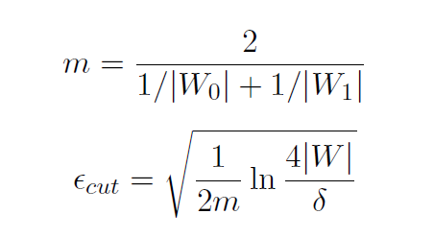
Background Change Detection
ADaptive WINdow (ADWIN) change detection method
Ensures the property there has been no change in the average value inside the window for the maximally statistically consistent length
Threshold value is calculated based on the sizes of the windows
1 0 0 1 0 1 1 1 0 0 1 1 1 1 0 1 0 1 0 1 1 0 0
time

Slide 35
Random RBF Generation
Random radial basis function (RandRBF) generator is challenging for DT based approaches
Randomly chooses user-defined number of centroids in the hyperspace
Assigns class label, drift coefficient, standard deviation, weights to each of the centroids
Instances are generated by selecting a centroid at random (weighted), and choosing a point using normal distribution

Slide 36
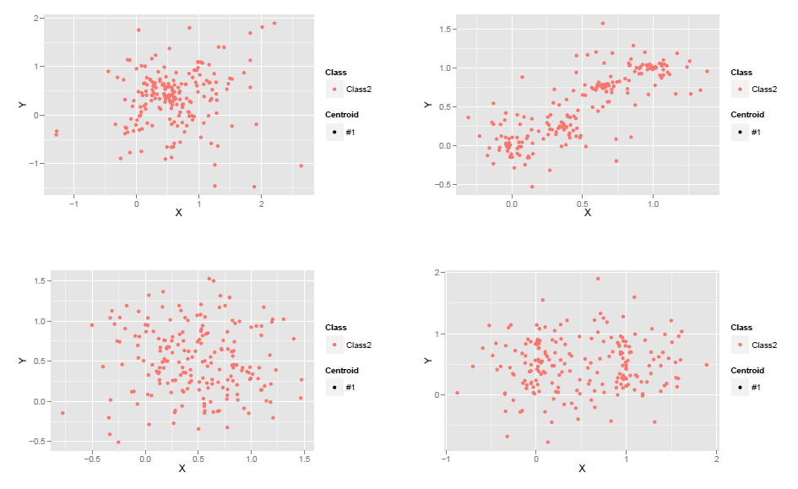
Random RBF Data Set
Drift Coefficient 0.0
Drift Coefficient 0.01
Drift Coefficient 0.1
Drift Coefficient 1.0

Slide 37
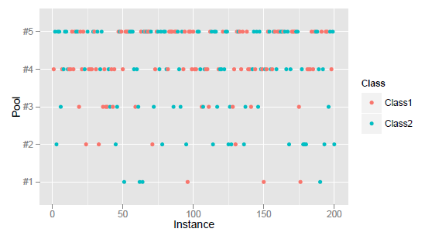
Data Set Comparison
Random RBF Generator
VSRBF Generator

Slide 38
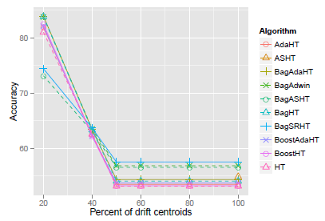
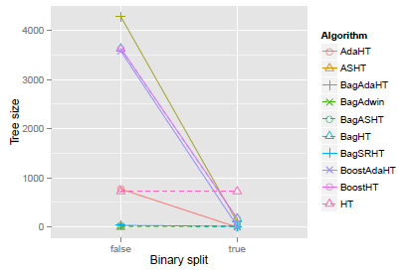
Effect of Parameters
Larger tie threshold causes massive trees
Binary splits are nearly as effective as non-binary splits
Negligible loss of accuracy (1-2%)

Slide 39
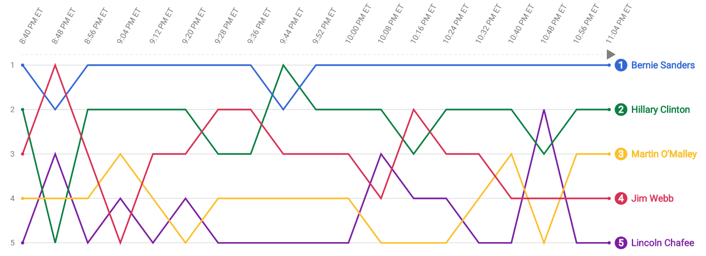
Motivation
Search interest in candidates and issues during the first Democratic Party debate, Oct 13, 2015
Rank is related to the number of searches
For Bernie Sanders number of searches was far more than Lincoln Chafee
Source: google.com/trends/story/US_cu_PviRQ1ABAAD_OM_en

Slide 40

Contents
Motivation
Problem Statement
Background
A New Ensemble Approach
Data Set Description
Results
Discussions
Image © mcraeandcompany.co.uk

Slide 41
Background Challenges
Concept drift
Underlying data distribution changes over time
Example: seasonality, faulty electrical device, etc.
Concept evolution
New class emerges
Example: Tweeter stream
Concept recurrence
Example: new year
_
_
_
_
_
_
+
_
_
+
_
_
_
_
_
+
_
_
_
+
_
_
+
+
_
_
+
_
_
+
+
_
_
+
+
+
_
_
+
+
_
+
+
+
_
+
+
+
_
+
+
+
+
_
+
+
+
_
_
_
_
_
_
_
+
_
_
_
+
_
_
_
_
_
_
_
_
_
+
_
_
+
_
_
+
_
+
+
_
_
+
+
_
*
+
_
+
+
+
+
*
_
+
+
+
+
+
*
*
_
+
*
+
+
+
+
+
_
+
+
+
*
+
*
*

Slide 42
Visualization

Slide 43
Background Hoeffding Tree
Attr1 | Attr2 | Class
a | 1 | C1
a | 2 | C1
b | 1 | C2
b | 2 | C2
b | 2 | C1
a | 1 | C2
a | 2 | C1
Attr1
a
C1

Slide 44
Background Hoeffding Tree
Attr1 | Attr2 | Class
a | 1 | C1
a | 2 | C1
b | 1 | C2
b | 2 | C2
b | 2 | C1
a | 1 | C2
a | 2 | C1
Attr1
a
! a
C1
C2

Slide 45
Background Hoeffding Tree
Attr1 | Attr2 | Class
a | 1 | C1
a | 2 | C1
b | 1 | C2
b | 2 | C2
b | 2 | C1
a | 1 | C2
a | 2 | C1
Attr1
a
! a
C1 (2/2)
Attr1
= b
C2 (2/2)

Slide 46
Background Hoeffding Tree
Attr1 | Attr2 | Class
a | 1 | C1
a | 2 | C1
b | 1 | C2
b | 2 | C2
b | 2 | C1
a | 1 | C2
a | 2 | C1
Attr1
a
! a
C1 (2/2)
Attr1
b
C2 (2/3)

Slide 47
Background Hoeffding Tree
Attr1 | Attr2 | Class
a | 1 | C1
a | 2 | C1
b | 1 | C2
b | 2 | C2
b | 2 | C1
a | 1 | C2
a | 2 | C1
Attr1
a
! a
Attr2
Attr1
1
2
b
C2 (1/2)
C1 (2/2)
Attr2
1
2
C2 (1/1)
C1 (1/2)

Slide 48

Goals

