Slide 1
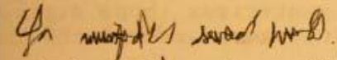
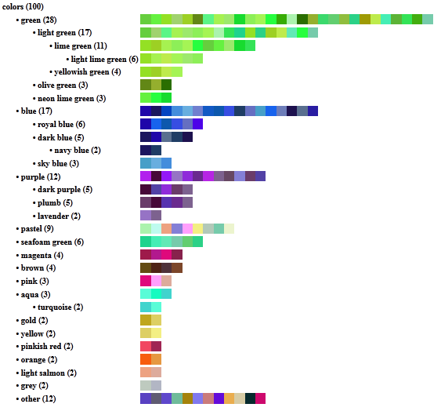
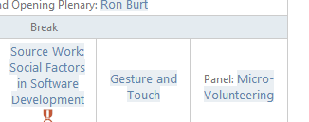
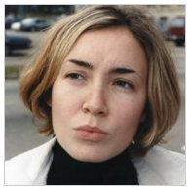
Adaptive Crowd Algorithms
For Open-Ended Problems
1
TurKit
Problems too hard for one person
2
Cascade
Problems too big for one person
3
Frenzy
Problems too ill-defined to automate
4
HumorTools
Problems that require creativity
Lydia Chilton
University of Washington
Notes:
And demonstrated that adaptive crowd algorithms can solve problems that are
hard, big, ill-defined, and require creativity.
You’ve been a great audience,
I’m happy to take your questions!

