Slide 1
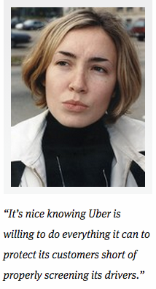
Headline:
Report: Uber Adding ‘Panic Button’ For Chicago Passengers
Response:

