Slide 1

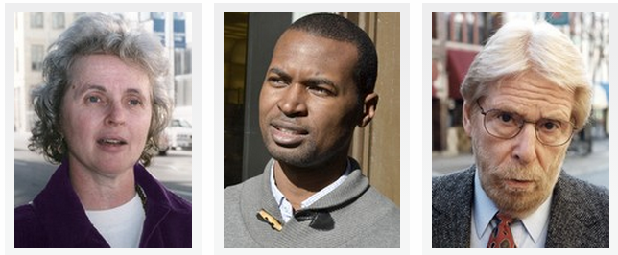
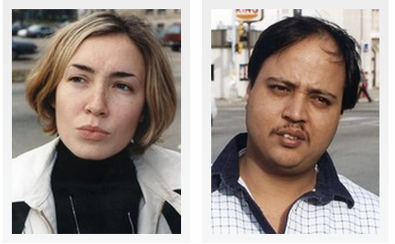
“At least carrying their lunch to the wastebasket gives them a chance to exercise.” | “Aren’t we ready to give up on these kids yet?” | “This is especially disappointing given that all the government campaigns to get adults to eat healthier have been such a success.” | “To be fair, when he visited Springfield Elemetary, Anthony Bordain did the same thing.” | “I'm personally glad to see children combating the lefist vegetarian lobby.” | “Yeah but did they properly control for the rise of anorexia?”

Slide 2


“If she thinks he’s innocent, what’s the attraction?” | “He might be 80, but he's probably still young at heart.” | “I’m sorry, but can you really trust a guy who waits seven years to propose?” | “Marriages with such a large age gap never work.” | “Every criminal deserves his day in the congugal trailor.” | “My Jimmy is still single. I'm going to send this article to him.”

Slide 3
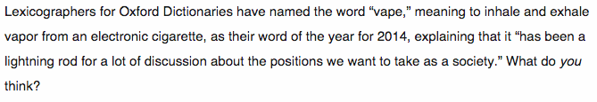
“Can’t they wait until I learn all the words that already exist before adding new ones?” | “Now you tell me! My son insisted it means 'doing homework.'” | “Never heard of it. Is it going to be on the SAT's?” | “But it’s only November. Who knows what neologisms will be coined before the year’s end?” | “This is about as bold a political statement as a dictionary company can make.” | “Already? I'm still trying to organically use last years word.”

Slide 4
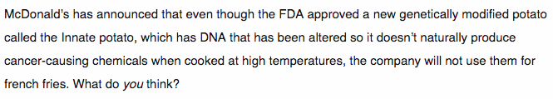
“When will these scientists stop playing God and just let food give us cancer?” | “Good call. Everyone knows a french fry’s flavor comes from its unmodified ACTGCGCATCTTGCAATATCGAGCA DNA sequence.” | “They also don't use fair trade lettuce.” | “Go home commie potatoes!” | “The carcinogens give it the flavor.” | “At least we know they use potatoes.”

Slide 5


“That’s why I limit my kids to one hour of book reading a day.” | “Really? Or is this like the time the Philip Morris Research said smoking was fine.” | “Can girl-on-girl porn do the same thing?” | “Well, that fits perfectly with how I’ve handled parenthood so far.” | “Good! I was starting to think all those years of Grand Theft Auto were wasted.” | “No wonder so much of the online discourse between gamers is so intellectually stimulating.”

Slide 6


“Look, if these people didn’t know what they were doing, they wouldn’t be managing a mall in Buffalo.” | “They run a tight ship. Their mall Santa has a ho-ho-ho quota.” | “That's terrible and I’ll be there.” | “I don't get it. It's already economically irrational to close.” | “I guess I’ll keep my store open then, but there will be no love put in these Orange Juliuses.”

Slide 7

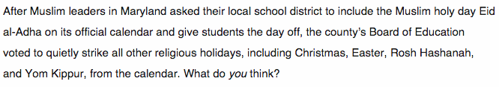
“Remember, it's not technically racism until somebody gets shot.” | “Good! More room to write on the squares.” | “Politely asking for inclusion is Muslim Terrorism 101.” | “I don’t understand why Muslims just can’t be happy celebrating holidays they don’t really believe in like the rest of us.” | “If everyone is equally ostracized, what’s the harm?” | “It sounds like the Jehovah's Witnesses are behind this.”

Slide 8

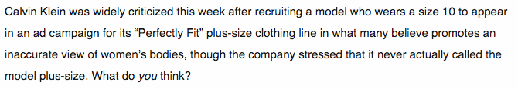
“Hilter was a size 10.” | “This just goes to show that women like to complain about failing to achieve impossible standards of beauty.” | “But if the model weighed as much as the average customer, how would anybody be psychologically manipulated into buying anything?” | “Size 10 is on that fine line between pleasantly anorexic and obese.” | “It seems like whether clothing companies promote images of extremely thin women as normal or promote images of slightly more normal-looking women as fat, they just can’t win.” | “Just tell me straight up: Is my body shameful enough to need to buy these clothes or what?”

Slide 9


“I guess going on a one-man quest to reform the KKK is still easier than having to get all those tattoos removed.” | “As the father of a gay son who has been denied knighthood for years, I say this is too little too late.” | “Makes me ashamed to be a supremacist.” | “This sort of wishy-washy crap is the reason no one takes the Klan seriously any more.” | “This is political correctness gone crazy.” | “They gave me a free arm-band just for signing up!”

