Slide 1
Functional Enrichment and Visualization of Kyoto Encyclopedia of Genes and Genomes (KEGG) Pathways
GOseq - Part II
Tom Chittenden, PhD, DPhil
Vice President of Statistical Sciences
Lecturer on Pediatrics and Biological Engineering

Slide 2
Part I - Unsupervised Biostatistical Analysis
Data Platform
Data
Normalization
Unsupervised Cluster & Network Analysis
Hypothesis Generation
RPKM
FPKM
VST
TMM
RNA-Seq Data
Weighted Correlation Network Analysis (WGCNA)
Unbiased Data Analysis
HMS RC NGS Course
R Biostatistics Course
Part II - Supervised Biostatistical Analysis
Data Platform
Data
Normalization
Differential Analysis
Gene Set
Analysis
Hypothesis Generation
Controls for Biases in Background Distribution & Transcript Length
RNA-Seq Data
TMM
edgeR
GOSeq
Notes:
LIMMA: Linear Models for Microarray Data
RPKM: Reads per kilo base per million
RPK= Number of Mapped reads/ length of transcript in kb (transcript length/1000)
RPKM = RPK/total number of reads in million (total no of reads/ 1,000,000)
Example:
Number of mapped reads =3 length of transcript=300 bp Total number of reads =10,000
RPK = 3/(300/1000) = 3/0.3 = 10
RPKM = 10 / (10,000/1,000,000) = 10/ 0.01 = 1000
RPKM =1000

Slide 3
Part II - Supervised Differential Gene Expression and Functional Enrichment Analyses
Differential Gene Expression Analysis with edgeR
Functional Enrichment of Gene Ontology Terms with GOSeq Analysis
Functional Enrichment and Visualization of Kyoto Encyclopedia of Genes and Genomes (KEGG) Pathways with GOSeq Analysis and Pathview
Robinson MD, McCarthy DJ and Smyth GK, Bioinformatics 2010
Notes:
LIMMA: Linear Models for Microarray Data
RPKM: Reads per kilo base per million
RPK= Number of Mapped reads/ length of transcript in kb (transcript length/1000)
RPKM = RPK/total number of reads in million (total no of reads/ 1,000,000)
Example:
Number of mapped reads =3 length of transcript=300 bp Total number of reads =10,000
RPK = 3/(300/1000) = 3/0.3 = 10
RPKM = 10 / (10,000/1,000,000) = 10/ 0.01 = 1000
RPKM =1000

Slide 4
edgeR (empirical analysis of DGE in R)
edgeR is a class of statistical methods for examining differential expression of replicated count data
edgeR is an overdispersed Poisson model used to account for both biological and technical variability
edgeR uses Empirical Bayes methods to moderate the degree of overdispersion across transcripts, improving the reliability of statistical inference
Robinson MD, McCarthy DJ and Smyth GK, Bioinformatics 2010
Notes:
The Poisson distribution assumes that the mean and variance are the same. Sometimes, your data show extra variation that is greater than the mean. This situation is called overdispersion and negative binomial regression is more flexible in that regard than Poisson regression (you could still use Poisson regression in that case but the standard errors could be biased). The negative binomial distribution has one parameter more than the Poisson regression that adjusts the variance independently from the mean. In fact, the Poisson distribution is a special case of the negative binomial distribution.

Slide 5
The data is fit with a negative binomial (NB) model:
Y_{gi} ∼ NB(M_{i}p_{gj} , Φ_{g})
For gene (g) and sample (i)
M_{i} = Library size (total number of reads)
Φ_{g} = Dispersion
p_{gj} = Relative abundance of gene (g)
in experimental group (j) to which sample (i) belongs
Mean = µ_{gi} = M_{i}p_{gj}
Variance = µ_{gi} (1+µ_{gi}Φ_{g})
Note: NB distribution reduces to Poisson distribution when Φ_{g} = 0
√Φ_{g} = Biological Coefficient of Variation between samples
Yunshun Chen, Davis McCarthy, Mark Robinson, Gordon K. Smyth, edgeR User’s Guide, 2014
Notes:
The Poisson distribution assumes that the mean and variance are the same. Sometimes, your data show extra variation that is greater than the mean. This situation is called overdispersion and negative binomial regression is more flexible in that regard than Poisson regression (you could still use Poisson regression in that case but the standard errors could be biased). The negative binomial distribution has one parameter more than the Poisson regression that adjusts the variance independently from the mean. In fact, the Poisson distribution is a special case of the negative binomial distribution.
√Φg = Biological Coefficient of Variation between samples. Coefficient of variation (CV) (standard deviation divided by mean).
In some DGE applications, technical variation can be treated as Poisson.

Slide 6
Mean-Variance Plot
>plotMeanVar(y)
Yunshun Chen, Davis McCarthy, Mark Robinson, Gordon K. Smyth, edgeR User’s Guide, 2010
Notes:
The Poisson distribution assumes that the mean and variance are the same. Sometimes, your data show extra variation that is greater than the mean. This situation is called overdispersion and negative binomial regression is more flexible in that regard than Poisson regression (you could still use Poisson regression in that case but the standard errors could be biased). The negative binomial distribution has one parameter more than the Poisson regression that adjusts the variance independently from the mean. In fact, the Poisson distribution is a special case of the negative binomial distribution.

Slide 7
Creating the DGEList data class
edgeR stores data in a simple list-based data object called a DGEList
If the table of counts exists as a data.frame then a DGEList object can be created by
>group <- c(rep("TNBC", 10), rep("Normal", 10))
>y <- DGEList(counts=x[,1:20], group=group)
Yunshun Chen, Davis McCarthy, Mark Robinson, Gordon K. Smyth, edgeR User’s Guide, 2014

Slide 8
Trimmed Mean of M-values (TMM) Normalization
The ‘calcNormFactors’ function normalizes for RNA composition by determining a set of scaling factors for the library sizes that minimize the log-fold changes between samples
TMM is used to compute these factors to scale original library size to the “effective library size,” which for differences in transcriptome sizes are accounted for and thus used for all downstream analyses
>y <- calcNormFactors(y)
>y$samples
Yunshun Chen, Davis McCarthy, Mark Robinson, Gordon K. Smyth, edgeR User’s Guide, 2014

Slide 9
Data exploration - Multi-dimensional Scaling (MDS) plot
The ‘plotMDS’ function produces a multi-dimensional scaling plot of the RNA samples based on leading log-fold-change distances
This plot can be viewed as a type of unsupervised Clustering, somewhat similar in principle to the HCL clustering of the WGCNA in Class 1
“Dimension 1 is the direction that best separates the samples, without regard to whether they are treatments or replicates. Dimension 2 is the next best direction, uncorrelated with the first, that separates the samples.”
Yunshun Chen, Davis McCarthy, Mark Robinson, Gordon K. Smyth, edgeR User’s Guide, 2014
Notes:
The leading log-fold-change is the average (root-mean-square) of the largest absolute log-fold-
changes between each pair of samples.

Slide 10
Data exploration - Multi-dimensional Scaling (MDS) plot
>plotMDS(y)
Yunshun Chen, Davis McCarthy, Mark Robinson, Gordon K. Smyth, edgeR User’s Guide, 2014

Slide 11
Estimating Dispersions
qCML common dispersion is calculated using the ‘estimateCommonDisp’ function
>y <- estimateCommonDisp(y, verbose=TRUE)
qCML tagwise dispersions are calculated using the ‘estimateTagwiseDisp’ function
>y <- estimateTagwiseDisp(y)
Yunshun Chen, Davis McCarthy, Mark Robinson, Gordon K. Smyth, edgeR User’s Guide, 2014

Slide 12
Plotting Estimated Dispersions
>plotBCV(y, main = "Plot of Estimated Dispersions")
Yunshun Chen, Davis McCarthy, Mark Robinson, Gordon K. Smyth, edgeR User’s Guide, 2014

Slide 13
Testing for DE Genes
The exact test for the negative binomial distribution has strong parallels with Fisher's exact test for the hypergeometric distribution
Hypothesis testing is performed with the ‘exactTest’ function, and it allows for both common dispersion and tagwise dispersion approaches
>et <- exactTest(y)
Yunshun Chen, Davis McCarthy, Mark Robinson, Gordon K. Smyth, edgeR User’s Guide, 2014

Slide 14
Plot the log-fold-changes with a smear plot, highlighting the DE genes
>plotSmear(et, de.tags=detags, main = "Smear Plot")
M
A
Yunshun Chen, Davis McCarthy, Mark Robinson, Gordon K. Smyth, edgeR User’s Guide, 2014

Slide 15
Multiple Testing Correction
Number of genes tested (N) | False positives incidence | Probability of calling 1 or more false positives by chance (100(1-0.95^{N}))
1 | 1/20 | 5%
2 | 1/10 | 10%
20 | 1 | 64%
100 | 5 | 99.4%

Slide 16
Summary Table
Correction Method | Type of Error control | Genes identified by chance after correction
Bonferroni | Family-wise error rate | If error rate equals 0.05, expects 0.05 genes to be significant by Chance.
Bonferroni Step Down
Westfall and Young Permutation
Benjamini and Hochberg | False Discovery Rate | If error rate equals 0.05, 5% of genes considered statistically significant (that pass the restriction after correction) will be identified by chance (false positives).
Notes:
LIMMA: Linear Models for Microarray Data
RPKM: Reads per kilo base per million
RPK= Number of Mapped reads/ length of transcript in kb (transcript length/1000)
RPKM = RPK/total number of reads in million (total no of reads/ 1,000,000)
Example:
Number of mapped reads =3 length of transcript=300 bp Total number of reads =10,000
RPK = 3/(300/1000) = 3/0.3 = 10
RPKM = 10 / (10,000/1,000,000) = 10/ 0.01 = 1000
RPKM =1000

Slide 17
Part II - Supervised Differential Gene Expression and Functional Enrichment Analyses
Differential Gene Expression Analysis with edgeR
Functional Enrichment of Gene Ontology Terms with GOSeq Analysis
Functional Enrichment and Visualization of Kyoto Encyclopedia of Genes and Genomes (KEGG) Pathways with GOSeq Analysis and Pathview
Young et al., Genome Biology 2010
Notes:
LIMMA: Linear Models for Microarray Data
RPKM: Reads per kilo base per million
RPK= Number of Mapped reads/ length of transcript in kb (transcript length/1000)
RPKM = RPK/total number of reads in million (total no of reads/ 1,000,000)
Example:
Number of mapped reads =3 length of transcript=300 bp Total number of reads =10,000
RPK = 3/(300/1000) = 3/0.3 = 10
RPKM = 10 / (10,000/1,000,000) = 10/ 0.01 = 1000
RPKM =1000

Slide 18
A. Clinical Ontology
B. Phenotype Ontology
C. Genomic Ontology

Slide 19
The major current issues associated with functional data-mining of high-throughput genomic data include variations in the quality and coverage of gene annotation databases, the number of genes related to each annotation, gene redundancy among annotations, dependencies between genes, and multiple testing correction.
According to Huang et al. (2009), no current statistical methods are able to fully address the complexities of high-throughput biological data-mining.
In 2005, 11,434 of the 19,490 total biological process annotations available for Homo sapiens in the GO database were exclusively inferred from electronic annotations (IEA).
Of the 18,310 GO gene annotations that were available for Homo sapiens in 2012, only 5,326 are exclusively IEA in nature.
Chittenden (2012). Quantitative Integration of Biological Knowledge for Mathematical
and Statistical Modeling of High-Throughput Genomic Data. (Doctoral dissertation).

Slide 20
The assumption is that gene expression observations are independent and identically distributed. Because expression measurements among functionally related genes are strongly correlated, this assumption is highly unlikely.
Moreover, propagation of genes across multiple GO terms (gene redundancy) cause nodes within a given path to be highly correlated. As a consequence, the enrichment statistics of current SEA and MEA methods tend to be anti-conservative.
A number of multiple testing correction methods have, therefore, been proposed for the functional analysis of high-throughput genomic data. Standard techniques such as Bonferroni and Sidack adjustments have been applied in situations when fewer than 50 functional categories are evaluated.
However, these techniques assume that variables are independent and have been shown to be overly conservative. In instances where dependencies exist, various false discovery methods and bootstrapping are highly effective.
Chittenden (2012). Quantitative Integration of Biological Knowledge for Mathematical
and Statistical Modeling of High-Throughput Genomic Data. (Doctoral dissertation).

Slide 21
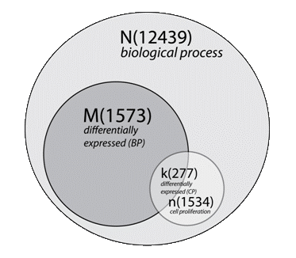
A. EASE results - cell proliferation pvalue = 4.57E-11
2x2 Contingency Table
Cell Proliferation
 | Yes | No | Total
Differential | 277 | 1296 | 1573
Non-differential | 1257 | 9609 | 10866
Total | 1534 | 10905 | 12439
(k)
(M)
(n)
(N)
Chittenden et al., Bioinformatics 2012

Slide 22
Hypergeometric Distribution: Fisher’s Exact Test
M
i
N –M
n - i
(
)
(
)
k - 1
P = 1 - Σ
N
n
(
)
i = 0
N is the total number of genes in the background distribution
(Annotated genes BP, MF, or CC)
M is the number of genes within that distribution that are annotated to the node of interest (differentially expressed genes within N: BP, MF, or CC)
n is the size of the list of genes of interest
(specific node/term of interest)
k is the number of genes within that list which are annotated to the node
(differentially expressed within n: specific node/term of interest )
Chittenden et al., Bioinformatics 2012

Slide 23
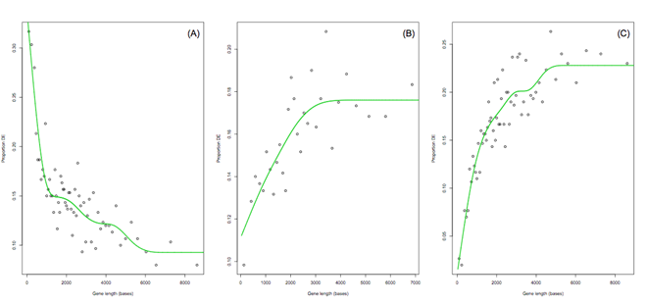
(A) log2 fold change cutoff greater than 3
(B) limma test on RPKM normalized data
(C) negative binomial exact test
Young et al., Genome Biology 2010
Notes:
LIMMA: Linear Models for Microarray Data
RPKM: Reads per kilo base per million
RPK= Number of Mapped reads/ length of transcript in kb (transcript length/1000)
RPKM = RPK/total number of reads in million (total no of reads/ 1,000,000)
Example:
Number of mapped reads =3 length of transcript=300 bp Total number of reads =10,000
RPK = 3/(300/1000) = 3/0.3 = 10
RPKM = 10 / (10,000/1,000,000) = 10/ 0.01 = 1000
RPKM =1000
It is clear from Figure S2 that different methods for determining DE can result in significantly different trends of proportion DE vs. gene length. Most strikingly, using a fold change cutoff to determine DE, results in a decreasing, rather than increasing, trend as gene length increases. This is because chance variation is relatively large for genes with fewer reads, so large fold changes are more likely by chance, especially when the transcript has zero or very few counts in one of the conditions.
More generally, the exact shape of the PWF cannot be predicted in advance. This underscores the necessity for estimating the PWF from the whole genome. It is essential that the PWF reflect the technical trend present in the actual biological data under consideration and the DE methodology being used.
The following is a simple optimization problem
min f (x) x₁² = x₂⁴ subject to: x₁ >= and x₂ =1
where denotes the vector (x₁, x₂).
In this example, the first line defines the function to be minimized (called the objective function, loss function, or cost function). The second and third lines define two constraints, the first of which is an inequality constraint and the second of which is an equality constraint. These two constraints are hard constraints, meaning that it is required that they be satisfied; they define the feasible set of candidate solutions.
Without the constraints, the solution would be (0,0), where f(x) has the lowest value. But this solution does not satisfy the constraints. The solution of the constrained optimization problem stated above is x=(1,1) , which is the point with the smallest value of f(x) that satisfies the two constraints.

Slide 24
Goseq – Three Steps
Determine differential expression – edgeR
A probability weighting function (PWF) is estimated from the data, which quantifies how the probability of a gene selected as DE changes as a function of its transcript length.
Young et al., Genome Biology 2010
Notes:
LIMMA: Linear Models for Microarray Data
RPKM: Reads per kilo base per million
RPK= Number of Mapped reads/ length of transcript in kb (transcript length/1000)
RPKM = RPK/total number of reads in million (total no of reads/ 1,000,000)
Example:
Number of mapped reads =3 length of transcript=300 bp Total number of reads =10,000
RPK = 3/(300/1000) = 3/0.3 = 10
RPKM = 10 / (10,000/1,000,000) = 10/ 0.01 = 1000
RPKM =1000

Slide 25
Goseq – Three Steps
Resampling is then performed by randomly selecting a set of genes, the same size as the set of DE genes, and counting the number of genes associated with the GO category of interest
This random selection weights the chance of choosing a gene by its length or read count, from the previously fitted probability weighting function
Young et al., Genome Biology 2010
Notes:
LIMMA: Linear Models for Microarray Data
RPKM: Reads per kilo base per million
RPK= Number of Mapped reads/ length of transcript in kb (transcript length/1000)
RPKM = RPK/total number of reads in million (total no of reads/ 1,000,000)
Example:
Number of mapped reads =3 length of transcript=300 bp Total number of reads =10,000
RPK = 3/(300/1000) = 3/0.3 = 10
RPKM = 10 / (10,000/1,000,000) = 10/ 0.01 = 1000
RPKM =1000

Slide 26
Goseq – Three Steps
The resampling is repeated many times and the resulting distribution of GO category membership is taken to approximate the shape of the true probability distribution
The sampling distribution allows calculation of a p-value for each GO category being over-represented in the set of DE genes while taking selection bias into account
Young et al., Genome Biology 2010
Notes:
LIMMA: Linear Models for Microarray Data
RPKM: Reads per kilo base per million
RPK= Number of Mapped reads/ length of transcript in kb (transcript length/1000)
RPKM = RPK/total number of reads in million (total no of reads/ 1,000,000)
Example:
Number of mapped reads =3 length of transcript=300 bp Total number of reads =10,000
RPK = 3/(300/1000) = 3/0.3 = 10
RPKM = 10 / (10,000/1,000,000) = 10/ 0.01 = 1000
RPKM =1000

Slide 27
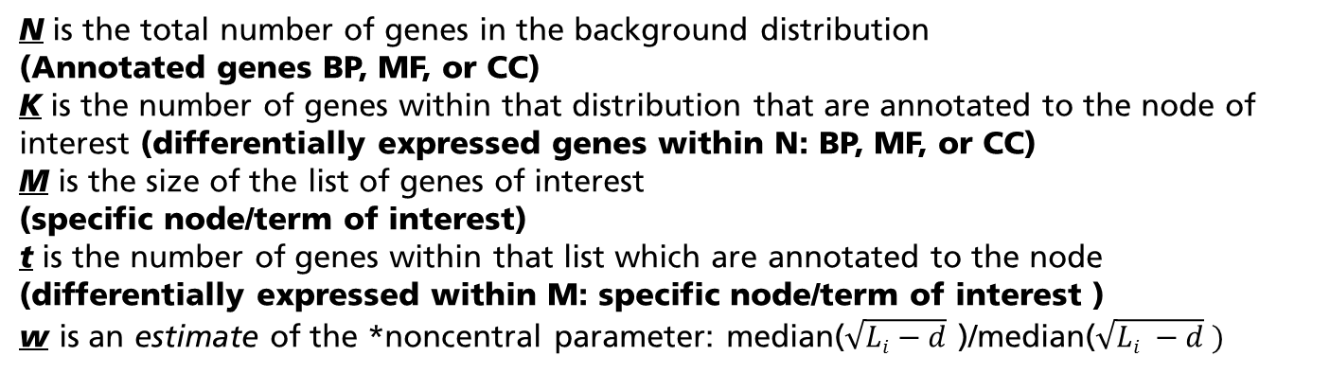

Wallenius Non-central Hypergeometric Distribution: Fisher’s Exact Test
M
t
K
K-t
(
)
)
(
min(M,K)
min(M,K)
P = Σ
= Σ
$$f\left(t| N,M, K,w\right)$$
(
)
N
M
t=T
t=T
N is the total number of genes in the background distribution
(Annotated genes BP, MF, or CC)
K is the number of genes within that distribution that are annotated to the node of interest (differentially expressed genes within N: BP, MF, or CC)
M is the size of the list of genes of interest
(specific node/term of interest)
t is the number of genes within that list which are annotated to the node
(differentially expressed within M: specific node/term of interest )
w is an estimate of the *noncentral parameter: median($\sqrt{Li−d}$ )/median($\sqrt{Li −d} )$
1 ≤ i ≤ M M < i ≤ N
*Noncentral parameter: six-knot monotonic spline
M = number of genes in GO term
N = total number of genes tested
L_{i} = transcript length of each gene
d = sequencing read length
Young et al., Genome Biology 2010

Slide 28

Lodato et al., 2015

Slide 29
Part II - Supervised Differential Gene Expression and Functional Enrichment Analyses
Differential Gene Expression Analysis with edgeR
Functional Enrichment of Gene Ontology Terms with GOSeq Analysis
Functional Enrichment and Visualization of Kyoto Encyclopedia of Genes and Genomes (KEGG) Pathways with GOSeq Analysis and Pathview
Notes:
LIMMA: Linear Models for Microarray Data
RPKM: Reads per kilo base per million
RPK= Number of Mapped reads/ length of transcript in kb (transcript length/1000)
RPKM = RPK/total number of reads in million (total no of reads/ 1,000,000)
Example:
Number of mapped reads =3 length of transcript=300 bp Total number of reads =10,000
RPK = 3/(300/1000) = 3/0.3 = 10
RPKM = 10 / (10,000/1,000,000) = 10/ 0.01 = 1000
RPKM =1000

Slide 30
Kyoto Encyclopedia of Genes and Genomes (KEGG) Pathways
In 1995, the Kanehisa Lab started the KEGG database project as a resource for biological interpretation of genome sequence data
KEGG is an integrated database resource consisting of 15 main databases maintained in an internal Oracle database
These databases are characterized by four data information classifications: systems information, genomic information, chemical information, and health information.
The number of KEGG organisms (complete genomes) is ~ 3000
Kanehisa et al., Nucleic Acids Research, 2014

Slide 31
GOseq Algorithm
Gene Ontology
>MDA2.GO.wall=goseq(MDA2.pwf,"hg19","geneSymbol", use_genes_without_cat=FALSE)
KEGG
>MDA2.KEGG.wall=goseq(MDA2.pwf,"hg19","geneSymbol", test.cats="KEGG”, use_genes_without_cat=FALSE)

Slide 32
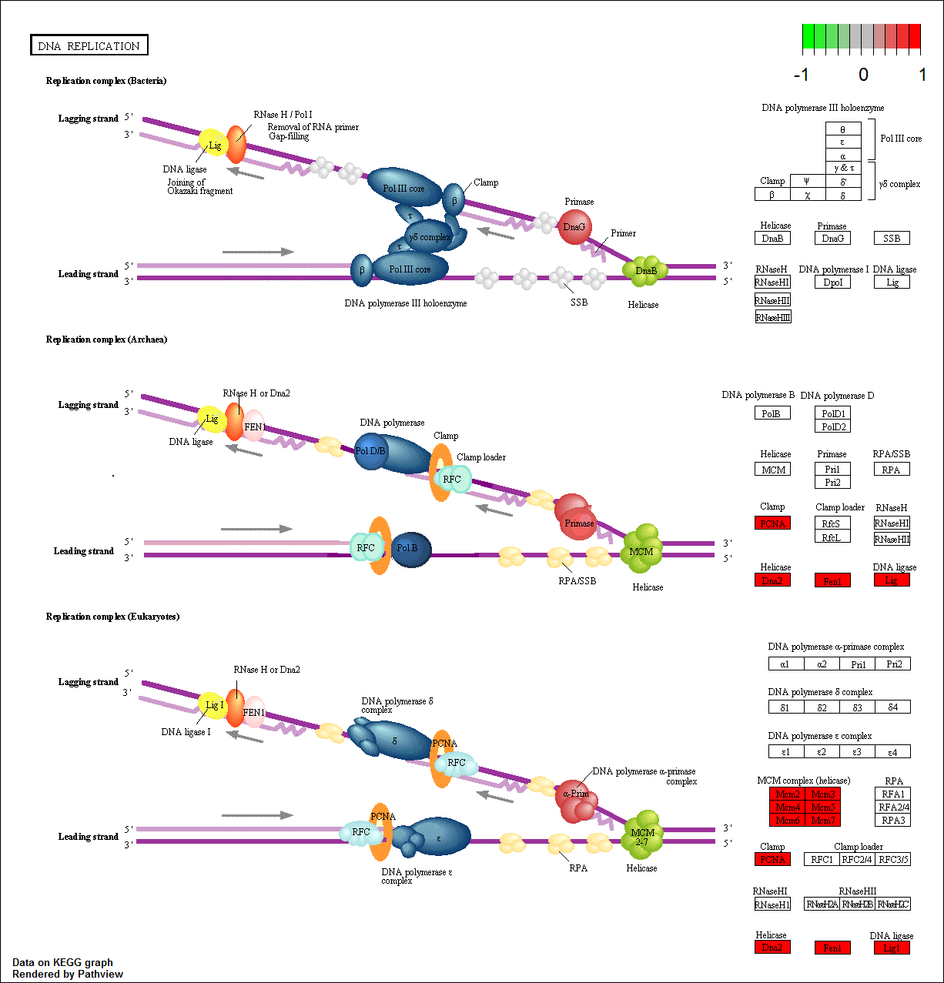
>pv.out.list<-sapply(table[,1], function(pid) pathview(gene.data=entrezids, pathway.id= pid, species = "hsa"))
Weijun Luo and Cory Brouwer, Bioinformatics, 2013

Slide 33
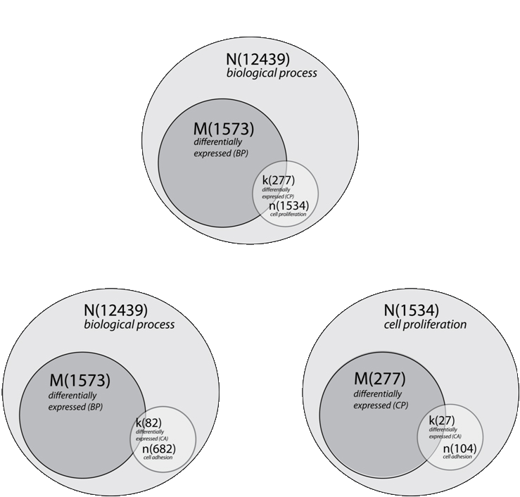
A. EASE results - cell proliferation
pvalue = 4.57E-11
Bioinformatics, 2012
Implemented in MeV 4.5
B. EASE results - cell adhesion
pvalue = 7.10E-01
C. nEASE results - cell adhesion nested within cell proliferation pvalue = 2.41E-02
Notes:
Church/Bar Analogy
8th of the genes = 82/682
In our analysis, we identified 68 upper-level enriched EASE GO terms, corresponding to 46 biological process terms, 16 cellular component terms, and six molecular function terms. According to the GO resource[5], there are currently 35,786 GO term annotations: 21,976 biological process terms, 2,960 cellular component terms, 9,237 molecular function terms, and 1,613 obsolete terms. (http://www.geneontology.org/GO.contents.ont-cont.shtml). Therefore, sub-classification of the 68 upper-level enriched EASE GO terms with nEASE analysis involved 1,113,678 individual Fisher’s Exact Tests. Because of the inheritance issue associated with the GO DAG[13, 15, 16], multiple testing correction is essential for existing SEA and MEA methods. However, to maintain a familywise error rate of 5% in the example highlighted above, Bonferroni correction would adjust the alpha level for nEASE GO term enrichment to p ≤ 4.49 x10⁻⁸.

Slide 34
GO Class | nGOseq Accession | nGOseq Term | List Hits | List Size | Pop Hits | Pop Size | Fisher's Exact | Gene Enrich | %Gene Enrich | Pvalue LogDiff | nGOseq Gene Enrich | GOseq Accession | GOseq Term
BP | 0035067 | negative regulation of histone acetylation | 2 | 795 | 2 | 2169 | 0.04 | 1.27 | 63.35 | 1.24 | 1.95 | 0007399 | nervous system development
BP | 0032462 | regulation of protein homooligomerization | 4 | 795 | 5 | 2169 | 0.04 | 2.17 | 43.35 | 1.16 | 2.42 | 0007399 | nervous system development
BP | 0050906 | detection of stimulus involved in sensory perception | 6 | 319 | 8 | 832 | 0.04 | 2.93 | 36.66 | 1.37 | 102.8 | 0007417 | central nervous system development
BP | 0072576 | liver morphogenesis | 3 | 410 | 3 | 987 | 0.04 | 1.75 | 58.46 | 1.28 | 2.29 | 0031175 | neuron projection development
BP | 2000757 | negative regulation of peptidyl-lysine acetylation | 3 | 552 | 3 | 1467 | 0.02 | 1.87 | 62.37 | 1.50 | 2.40 | 0048699 | generation of neurons
BP | 0070098 | chemokine-mediated signaling pathway | 5 | 287 | 5 | 684 | 0.01 | 2.90 | 58.04 | 1.85 | 12.17 | 0007409 | axonogenesis
Fisher’s Exact Test p-value ≤ 0.05 and positive values for each of the following classifications:
1. Gene Enrichment [k – ((M/N) x n)]
2. Percent Gene Enrichment [((k/n) – (M/N)) x 100]
3. nEASE p-value log difference [-log (nEASE p-value) – -log (EASE p-value)]
4. nEASE Gene Enrichment [Gene Enrichment – EASE Gene Enrichment]
Chittenden et al., Bioinformatics 2012
Lodato et al., 2015

Slide 35
Breast Cancer Molecular Subtypes
Subtype | Tumors Tend to Be | Prevalence
Luminal A | ER-positive and/or PR positive HERR2-negative Low Ki67 | 30-70%
Luminal B | ER-positive and/or PR positive HER2-positive (or HER2-negative with high Ki67) | 10-20%
Triple negative/basal-like | ER-negative PR-negative HER2-negative | 15-20%
HER2 type | ER-negative PR-negative HER2-positive | 5-15%
ER = Estrogen Receptor
PR = Progesterone Receptor
HER2 = Human Epidermal Growth Factor Receptor 2, HER2/neu, erbB2

Slide 36
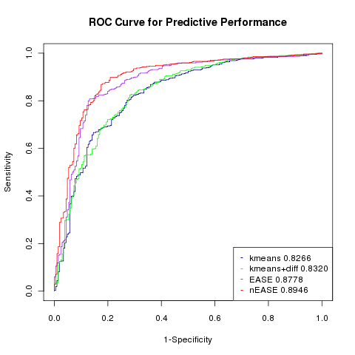
Network-Based LASSO Classification Models
ROC Curve for Predictive Performance
ROC Curve for Predictive Performance
True positive rate
ER Status
Minn et al., 2005
(n=121)
van Vliet et al., 2008
(n=947)
True positive rate
5 year Relapse Free Patient Survival
Minn et al., 2005
(n=121)
van Vliet et al., 2008
(n=947)
Sensitivity
1-Specificity
False positive rate
False positive rate
L₁-penalized General Logistic Regression Models (Variable Feature Selection)
L₁-regularized Cox Proportional Hazards Models
(Variable Feature Selection)

Slide 37
SPCA Predictors for Five Year Relapse Free Survival
GOID | Count | Size | SPCA Term | Tree | Lasso.Beta
GO:0030308 | 5 | 87 | negative regulation of cell growth | BP | -2.3442
GO:0042326 | 16 | 17 | negative regulation of phosphorylation | BP | -1.8214
GO:0007186 | 9 | 264 | G-protein coupled receptor protein signaling pathway | BP | -0.9930
GO:0006120 | 9 | 32 | mitochondrial electron transport, NADH to ubiquinone | BP | -0.6620
GO:0045995 | 7 | 9 | regulation of embryonic development | BP | -0.5256
GO:0032320 | 4 | 5 | positive regulation of Ras GTPase activity | BP | -0.4275
GO:0000079 | 13 | 36 | regulation of cyclin-dependent protein kinase activity | BP | -0.3979
GO:0007623 | 11 | 29 | circadian rhythm | BP | -0.3767
GO:0006833 | 8 | 30 | water transport | BP | -0.3572
GO:0043616 | 6 | 12 | keratinocyte proliferation | BP | -0.3569
GO:0006352 | 9 | 10 | transcription initiation, DNA-dependent | BP | -0.2750
GO:0045840 | 14 | 18 | positive regulation of mitosis | BP | -0.1646
GO:0060324 | 4 | 5 | face development | BP | 0.0003
GO:0007283 | 31 | 202 | spermatogenesis | BP | 0.0538
GO:0007601 | 19 | 167 | visual perception | BP | 0.3748
GO:0016331 | 5 | 7 | morphogenesis of embryonic epithelium | BP | 0.4772
GO:0007411 | 203 | 269 | axon guidance | BP | 0.4872
GO:0070555 | 16 | 25 | response to interleukin-1 | BP | 0.6908
GO:0051568 | 9 | 10 | histone H3-K4 methylation | BP | 0.9788
GO:0007157 | 12 | 17 | heterophilic cell-cell adhesion | BP | 1.0477
GO:0005977 | 19 | 20 | glycogen metabolic process | BP | 1.0603
GO:0006200 | 33 | 66 | ATP catabolic process | BP | 1.8566
LASSO Model: 22 SPCA GO terms - 446 unique genes
44% implicated in breast cancer, 71% implicated in cancer

Slide 38
nEASE Predictors for Five Year Relapse Free Survival
nEASE GOID | Count | Size | nEASE Term | EASE GOID | EASE Term | Tree | Lasso.Beta
GO:0051260 | 4 | 7 | protein homooligomerization | GO:0006954 | inflammatory response | BP | -0.1390
GO:0031099 | 4 | 4 | regeneration | GO:0071216 | cellular response to biotic stimulus | BP | 0.0040
GO:0070652 | 2 | 2 | HAUS complex | GO:0043231 | intracellular membrane-bounded organelle | CC | 0.0471
GO:0007162 | 7 | 17 | negative regulation of cell adhesion | GO:0030030 | cell projection organization | BP | -0.0761
GO:0031115 | 3 | 3 | negative regulation of microtubule polymerization | GO:0031175 | neuron projection development | BP | -0.0573
GO:0031115 | 3 | 3 | negative regulation of microtubule polymerization | GO:0030030 | cell projection organization | BP | -0.0297
GO:0007162 | 6 | 13 | negative regulation of cell adhesion | GO:0031175 | neuron projection development | BP | -0.0150
GO:0010639 | 8 | 21 | negative regulation of organelle organization | GO:0031175 | neuron projection development | BP | 0.0982
GO:0007568 | 7 | 18 | aging | GO:0031175 | neuron projection development | BP | 0.4001
LASSO Model: 9 nEASE GO sub-terms - 29 unique genes
72% implicated in breast cancer (p = 0.001), 80% implicated in cancer (p = 0.107)

Slide 39
True positive rate
True positive rate
SPCA
Blair and Tibshirani
PLoS Biology, 2004
Model Complexity
and Overfitting
False positive rate
False positive rate
True positive rate
EASE
Hosak et al.,
Genome Biology, 2003
True positive rate
nEASE
Chittenden et al.,
Bioinformatics, 2012
False positive rate
False positive rate

Slide 40



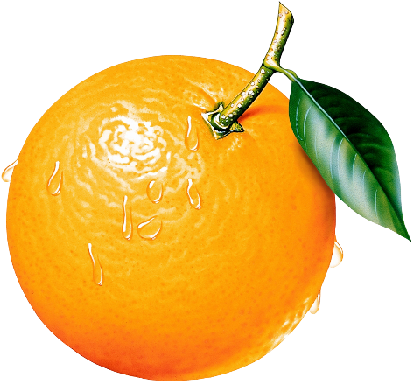
Deep Learning Applications in the Biosciences
vs.

Slide 41
Features
F₁, F₂, F₃, F₄, . . . . . . . . . ., F_{n}
Pattern
Recognition
Samples
N_{1,}
N_{2,}
N_{3,}
N_{4,}
.
.
.
.
.
.
.,
N_{n}

Slide 42
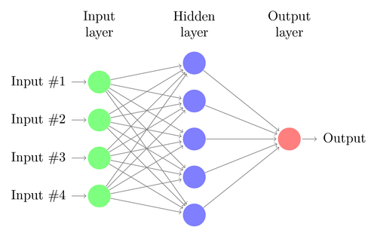
Typical Artificial Neural Network
Input pattern
Output pattern
*Deep Learning has a multiple hidden layer architecture

Slide 43
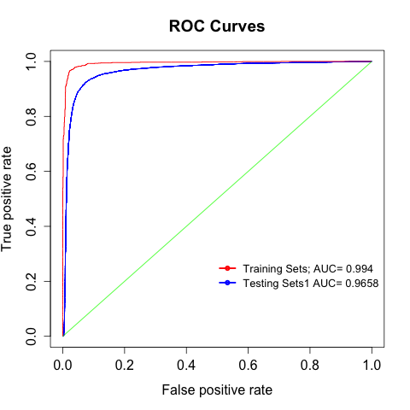
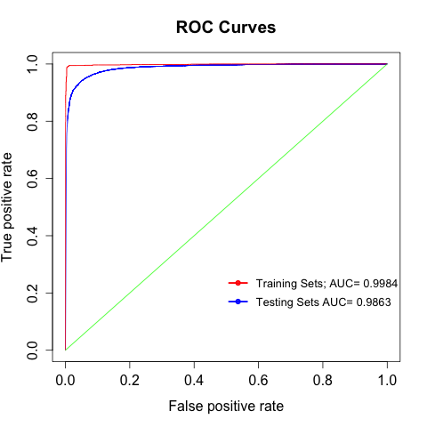

WuXi NextCODE DANN Models
WuXi NextCODE DANN Model 1
Trained and tested on ~ 6,000 Clinvar variants
WuXi NextCODE DANN Model 1
Tested on ~ 28,000 Clinvar variants
WuXi NextCODE DANN Model 2
Trained and tested on ~6, 000
variants randomly sampled from
~34,000 Clinvar variants
Tested on ~ 28,000 Clinvar variants
Notes:
Combined Annotation–Dependent Depletion (CADD), a method for objectively integrating many diverse annotations into a single measure (C score) for each variant. We implement CADD as a support vector machine trained to differentiate 14.7 million high-frequency human-derived alleles from 14.7 million simulated variants. We precompute C scores for all 8.6 billion possible human single-nucleotide variants and enable scoring of short insertions-deletions.
Missense variant classification = 0.90 AUC
Nature Genetics 46, 310–315 (2014)

Slide 44
Breast Cancer Molecular Subtypes
Subtype | Tumors Tend to Be | Prevalence
Luminal A | ER-positive and/or PR positive HERR2-negative Low Ki67 | 30-70%
Luminal B | ER-positive and/or PR positive HER2-positive (or HER2-negative with high Ki67) | 10-20%
Triple negative/basal-like | ER-negative PR-negative HER2-negative | 15-20%
HER2 type | ER-negative PR-negative HER2-positive | 5-15%
ER = Estrogen Receptor
PR = Progesterone Receptor
HER2 = Human Epidermal Growth Factor Receptor 2, HER2/neu, erbB2

Slide 45
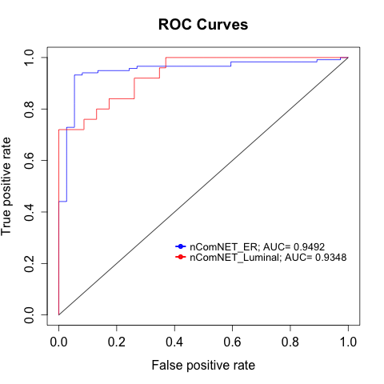
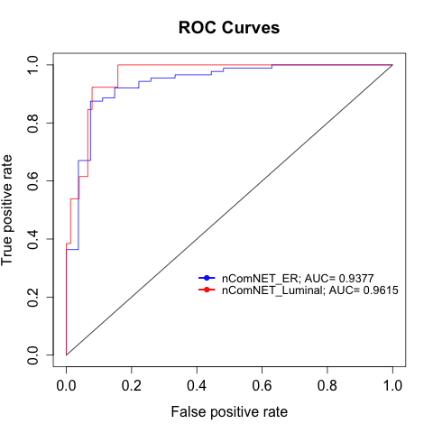
Modelling Human Breast Cancer Molecular Subtypes
825 Sample TCGA Breast Cancer Dataset
129 Sample TCGA Breast Cancer Dataset
Ciriello et al., Cell 2015
ER- vs. ER+ Breast Tumor Classification:
2 Mutated Pathways (10 genes); 5 Aberrant Expression Pathways (146 genes)
Luminal A vs. B Breast Tumor Classification:
4 Mutated Pathways (172 genes); 8 Aberrant Expression Pathways (72 genes)
*Six Gene Intersect - p = 2.12 x 10⁻¹⁰⁸

Slide 46
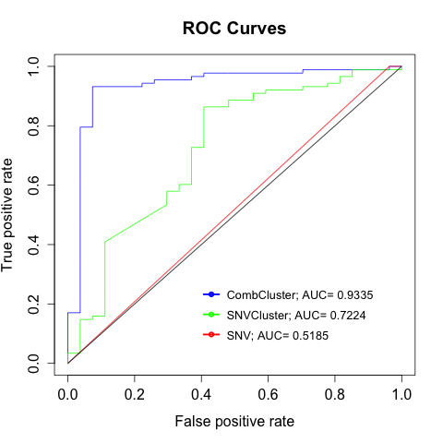
Modelling Breast Cancer Molecular Subtypes
ER- vs. ER+ Breast Tumor Classification – Unsupervised Feature selection
Nine Mutated k-means Clusters
Seven Aberrant Expression k-means Clusters
Unique Mutated Genes - 687
Unique Aberrant Expression Genes - 387
Total = 1044
The 69 gene intersect with pathway-based feature selection occurs in 6 of the 9 Mutated
k-means Clusters and 5 of the 7 Aberrant Expression k-means Clusters

Slide 47
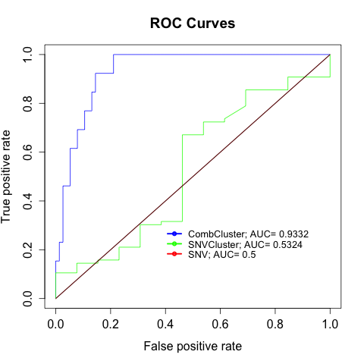
Modelling Breast Cancer Molecular Subtypes
Luminal A vs. Luminal B Breast Tumor Classification – Unsupervised Feature selection
12 Mutated k-means Clusters
12 Aberrant Expression k-means Clusters
Unique Mutated Genes - 866
Unique Aberrant Expression Genes - 946
Total = 1763
The 213 gene intersect with pathway-based feature selection occurs in 8 of the 12 Mutated
k-means Clusters and 4 of the 12 Aberrant Expression k-means Clusters

Slide 48
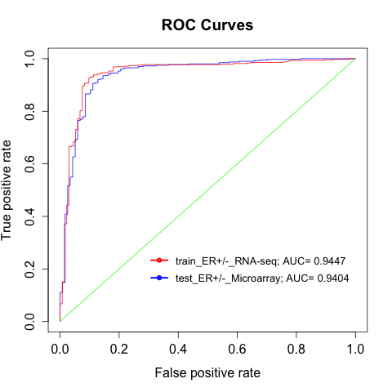
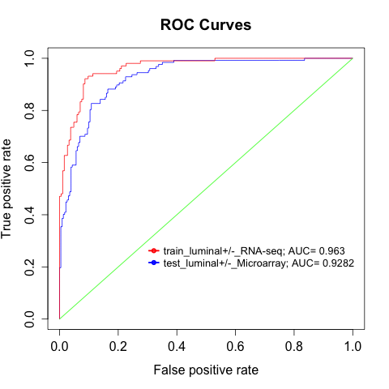
Modeling Human Breast Cancer Molecular Subtypes
528 Sample Microarray Breast Cancer Dataset
Cancer Genome Atlas Network, Nature 2012
528 Sample Microarray Breast Cancer Dataset
Cancer Genome Atlas Network, Nature 2012
ER- vs. ER+ Breast Tumor Classification:
2 Mutated Pathways (10 genes); 5 Aberrant Expression Pathways (146 genes)
Luminal A vs. B Breast Tumor Classification:
4 Mutated Pathways (172 genes); 8 Aberrant Expression Pathways (72 genes)
*Six Gene Intersect - p = 2.12 x 10⁻¹⁰⁸

Slide 49
Lung Cancer Facts
Lung cancer is the leading cancer killer in both men and women in the United States.
During 2015, an estimated 221,200 new cases of lung cancer were expected to be diagnosed, representing about 13 percent of all cancer diagnoses.
The lung cancer five-year survival rate (17.8 percent) is lower than many other leading cancers, such as the colon (65.4 percent),
breast (90.5 percent) and prostate (99.6 percent).
American Lung Association, 2016

Slide 50
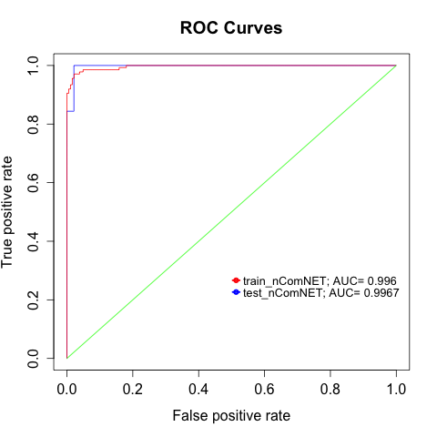
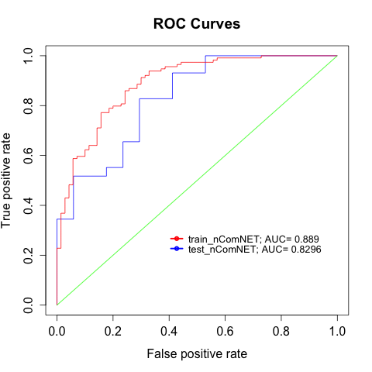
Modeling Non-small Cell Lung Cancer Molecular Subtypes
399 Sample TCGA Lung Cancer Dataset
Cancer Genome Atlas Research Network
Nature, 2012; Nature, 2014
230 Sample TCGA Lung Cancer Dataset
Cancer Genome Atlas Research Network
Nature, 2014
Squamous Cell Lung Cancer vs. Lung Adenocarcinoma
3 SNV Mutated Pathways (18 genes);
3 SV Mutated Pathways (37);
5 Aberrant Expression Pathways (51 genes)
Lung Adenocarcinoma: RTK/RAS/RAF oncogene pathway
2 SNV Mutated Pathways (13 genes);
2 SV Mutated Pathways (12);
6 Aberrant Expression Pathways (224 genes)

Slide 51
Future Directions
Disease Profile Recognition
Probabilistic Program Induction of Disease Concepts

Slide 52
Practicum – Class 3
Functional Enrichment and Visualization of Kyoto Encyclopedia of Genes and Genomes (KEGG) Pathways
Example Directory Path
“C:/Users/Owner/Documents/RCCG_HMS/RC_Biostatistics_Courses/Biostats_RNA-seq/WGCNA/Class 3”

