Slide 1
Gene Ontology Analysis for RNA-seq: Accounting for Selection Bias with GOseq
Tom Chittenden, PhD, DPhil, PStat
HMS/BCH Lecturer on Pediatrics
Chief Data Science Officer
Founding Director
Advanced AI Research Laboratory
Genuity Science
Sharvari Gujja, MS
Director, Bioinformatics
Advanced AI Research Laboratory
Genuity Science
Sweta Bajaj, MS
Machine Learning Engineer
Advanced AI Research Laboratory
Genuity Science
Lingsheng Dong, MD, MS
Senior Research Computing Consultant
HMS Research Computing

Slide 2
Supervised Biostatistical Analysis
HMS RC NGS Course
R Biostatistics Course
Data Platform
Data
Normalization
Differential Analysis
Gene Set
Analysis
Hypothesis Generation
Controls for Biases in Background Distribution & Transcript Length
RNA-Seq Data
TMM
edgeR
GOSeq
Notes:
LIMMA: Linear Models for Microarray Data
RPKM: Reads per kilo base per million
RPK= Number of Mapped reads/ length of transcript in kb (transcript length/1000)
RPKM = RPK/total number of reads in million (total no of reads/ 1,000,000)
Example:
Number of mapped reads =3 length of transcript=300 bp Total number of reads =10,000
RPK = 3/(300/1000) = 3/0.3 = 10
RPKM = 10 / (10,000/1,000,000) = 10/ 0.01 = 1000
RPKM =1000

Slide 3
Supervised Differential Gene Expression and Functional Enrichment Analyses
Differential Gene Expression Analysis with edgeR
Functional Enrichment of Gene Ontology Terms with GOSeq Analysis
Young et al., Genome Biology 2010
Notes:
LIMMA: Linear Models for Microarray Data
RPKM: Reads per kilo base per million
RPK= Number of Mapped reads/ length of transcript in kb (transcript length/1000)
RPKM = RPK/total number of reads in million (total no of reads/ 1,000,000)
Example:
Number of mapped reads =3 length of transcript=300 bp Total number of reads =10,000
RPK = 3/(300/1000) = 3/0.3 = 10
RPKM = 10 / (10,000/1,000,000) = 10/ 0.01 = 1000
RPKM =1000

Slide 4
Gene Ontology (GO) provides 3 controlled vocabularies to describe biological knowledge for genes and gene products.
Biological Process (why) - How it pertains to the organism
Cellular Component (where)- Its location
Molecular Function (what) - Tasks performed at the molecular level

Slide 5
Gene Name: GIPC1
Biological Process: G-protein coupled receptor protein signaling pathway
Cellular Component: cytoplasm, cytoplasmic membrane-bound vesicle, & membrane
Molecular Function: receptor binding

Slide 6
A. Clinical Ontology
B. Phenotype Ontology
C. Genomic Ontology

Slide 7
Three Classes of Functional Enrichment Algorithms
Singular Enrichment Analysis (SEA)
Chi-square
Fisher’s Exact Test
Binomial Probability
Hypergeometric Distribution
Gene Set Enrichment Analysis (GSEA)
Modular Enrichment Analysis (MEA)
SEA Statistics
Network Discovery Algorithms (term-to-term relationships)
Chittenden (2012). Quantitative Integration of Biological Knowledge for Mathematical
and Statistical Modeling of High-Throughput Genomic Data. (Doctoral dissertation).
Notes:
Niels Bhor – 20th Century Danish physicist – Quantum physics and theory.

Slide 8
The major current issues associated with functional data-mining of high-throughput genomic data include variations in the quality and coverage of gene annotation databases, the number of genes related to each annotation, gene redundancy among annotations, dependencies between genes, and multiple testing correction.
According to Huang et al. (2009), no current statistical methods are able to fully address the complexities of high-throughput biological data-mining.
In 2005, 11,434 of the 19,490 total biological process annotations available for Homo sapiens in the GO database were exclusively inferred from electronic annotations (IEA).
Of the 18,310 GO gene annotations that were available for Homo sapiens in 2012, only 5,326 are exclusively IEA in nature.
Chittenden (2012). Quantitative Integration of Biological Knowledge for Mathematical
and Statistical Modeling of High-Throughput Genomic Data. (Doctoral dissertation).

Slide 9
The assumption is that gene expression observations are independent and identically distributed. Because expression measurements among functionally related genes are strongly correlated, this assumption is highly unlikely.
Moreover, propagation of genes across multiple GO terms (gene redundancy) cause nodes within a given path to be highly correlated. As a consequence, the enrichment statistics of current SEA and MEA methods tend to be anti-conservative.
A number of multiple testing correction methods have, therefore, been proposed for the functional analysis of high-throughput genomic data. Standard techniques such as Bonferroni and Sidack adjustments have been applied in situations when fewer than 50 functional categories are evaluated.
However, these techniques assume that variables are independent and have been shown to be overly conservative. In instances where dependencies exist, various false discovery methods and bootstrapping are highly effective.
Chittenden (2012). Quantitative Integration of Biological Knowledge for Mathematical
and Statistical Modeling of High-Throughput Genomic Data. (Doctoral dissertation).

Slide 10
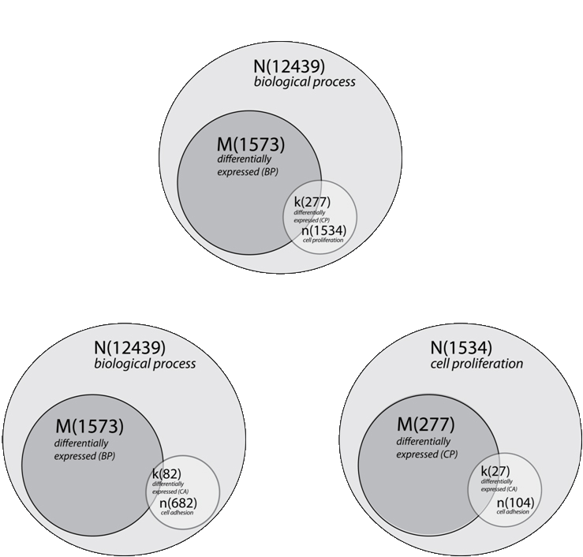
A. EASE results - cell proliferation
pvalue = 4.57E-11
Bioinformatics, 2012
Nature, 2017
B. EASE results - cell adhesion
pvalue = 7.10E-01
C. nEASE results - cell adhesion nested within cell proliferation pvalue = 2.41E-02
Notes:
Church/Bar Analogy
8th of the genes = 82/682
In our analysis, we identified 68 upper-level enriched EASE GO terms, corresponding to 46 biological process terms, 16 cellular component terms, and six molecular function terms. According to the GO resource[5], there are currently 35,786 GO term annotations: 21,976 biological process terms, 2,960 cellular component terms, 9,237 molecular function terms, and 1,613 obsolete terms. (http://www.geneontology.org/GO.contents.ont-cont.shtml). Therefore, sub-classification of the 68 upper-level enriched EASE GO terms with nEASE analysis involved 1,113,678 individual Fisher’s Exact Tests. Because of the inheritance issue associated with the GO DAG[13, 15, 16], multiple testing correction is essential for existing SEA and MEA methods. However, to maintain a familywise error rate of 5% in the example highlighted above, Bonferroni correction would adjust the alpha level for nEASE GO term enrichment to p ≤ 4.49 x10⁻⁸.

Slide 11
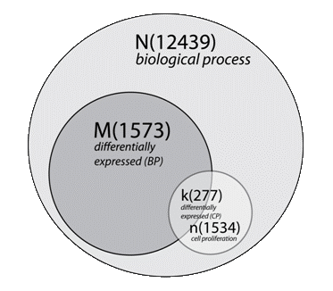
A. EASE results - cell proliferation pvalue = 4.57E-11
2x2 Contingency Table
Cell Proliferation
 | Yes | No | Total
Differential | 277 | 1296 | 1573
Non-differential | 1257 | 9609 | 10866
Total | 1534 | 10905 | 12439
(k)
(M)
(n)
(N)
Chittenden et al., Bioinformatics 2012

Slide 12
Hypergeometric Distribution: Fisher’s Exact Test
M
i
N –M
n - i
(
)
(
)
k - 1
P = 1 - Σ
N
n
(
)
i = 0
N is the total number of genes in the background distribution
(Annotated genes BP, MF, or CC)
M is the number of genes within that distribution that are annotated to the node of interest (differentially expressed genes within N: BP, MF, or CC)
n is the size of the list of genes of interest
(specific node/term of interest)
k is the number of genes within that list which are annotated to the node
(differentially expressed within n: specific node/term of interest )
Chittenden et al., Bioinformatics 2012
Notes:
Combinatorics; combinatorial mathematics

Slide 13
Binomial Distribution: Binomial Test
n
k
)
(
P=(X=k) = p^{k} (1- p)^{n-k}
N is the total number of genes in the background distribution
(Annotated genes BP, MF, or CC)
M is the number of genes within that distribution that are annotated to the node of interest (differentially expressed genes within N: BP, MF, or CC)
n is the size of the list of genes of interest
(specific node/term of interest)
k is the number of genes within that list which are annotated to the node
(differentially expressed within n: specific node/term of interest )
p is the ratio (probability) of M/N
Young et al., Genome Biology 2010

Slide 14
Goseq - Justification
The expected read count for a transcript is proportional to the gene's expression level multiplied by its transcript length
Therefore, even when two transcripts are expressed at the same level, differences in length will yield differing numbers of total reads
Young et al., Genome Biology 2010
Notes:
LIMMA: Linear Models for Microarray Data
RPKM: Reads per kilo base per million
RPK= Number of Mapped reads/ length of transcript in kb (transcript length/1000)
RPKM = RPK/total number of reads in million (total no of reads/ 1,000,000)
Example:
Number of mapped reads =3 length of transcript=300 bp Total number of reads =10,000
RPK = 3/(300/1000) = 3/0.3 = 10
RPKM = 10 / (10,000/1,000,000) = 10/ 0.01 = 1000
RPKM =1000

Slide 15
Goseq - Justification
Longer transcripts give more statistical power for detecting differential expression
More highly expressed transcripts have a greater number of reads and greater power to detect differential expression
Young et al., Genome Biology 2010
Notes:
LIMMA: Linear Models for Microarray Data
RPKM: Reads per kilo base per million
RPK= Number of Mapped reads/ length of transcript in kb (transcript length/1000)
RPKM = RPK/total number of reads in million (total no of reads/ 1,000,000)
Example:
Number of mapped reads =3 length of transcript=300 bp Total number of reads =10,000
RPK = 3/(300/1000) = 3/0.3 = 10
RPKM = 10 / (10,000/1,000,000) = 10/ 0.01 = 1000
RPKM =1000

Slide 16
Goseq - Justification
Long or highly expressed transcripts are more likely to be detected as differentially expressed compared with their short and/or lowly expressed counterparts
Statistical power increases with the number of reads is an unavoidable property of count data, which cannot be removed by normalization or re-scaling, even when working with data normalized by dividing by transcript length, such as RPKM transformed data
Young et al., Genome Biology 2010
Notes:
LIMMA: Linear Models for Microarray Data
RPKM: Reads per kilo base per million
RPK= Number of Mapped reads/ length of transcript in kb (transcript length/1000)
RPKM = RPK/total number of reads in million (total no of reads/ 1,000,000)
Example:
Number of mapped reads =3 length of transcript=300 bp Total number of reads =10,000
RPK = 3/(300/1000) = 3/0.3 = 10
RPKM = 10 / (10,000/1,000,000) = 10/ 0.01 = 1000
RPKM =1000

Slide 17
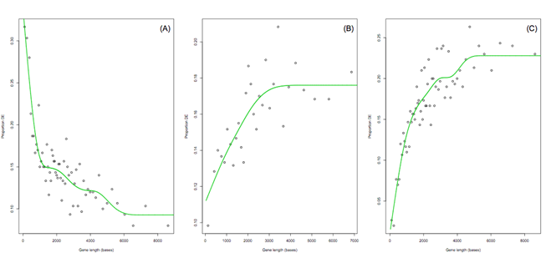
(A) log2 fold change cutoff greater than 3
(B) limma test on RPKM normalized data
(C) negative binomial exact test
Young et al., Genome Biology 2010
Notes:
LIMMA: Linear Models for Microarray Data
RPKM: Reads per kilo base per million
RPK= Number of Mapped reads/ length of transcript in kb (transcript length/1000)
RPKM = RPK/total number of reads in million (total no of reads/ 1,000,000)
Example:
Number of mapped reads =3 length of transcript=300 bp Total number of reads =10,000
RPK = 3/(300/1000) = 3/0.3 = 10
RPKM = 10 / (10,000/1,000,000) = 10/ 0.01 = 1000
RPKM =1000
It is clear from Figure S2 that different methods for determining DE can result in significantly different trends of proportion DE vs. gene length. Most strikingly, using a fold change cutoff to determine DE, results in a decreasing, rather than increasing, trend as gene length increases. This is because chance variation is relatively large for genes with fewer reads, so large fold changes are more likely by chance, especially when the transcript has zero or very few counts in one of the conditions.
More generally, the exact shape of the PWF cannot be predicted in advance. This underscores the necessity for estimating the PWF from the whole genome. It is essential that the PWF reflect the technical trend present in the actual biological data under consideration and the DE methodology being used.
The following is a simple optimization problem
min f (x) x₁² = x₂⁴ subject to: x₁ >= and x₂ =1
where denotes the vector (x₁, x₂).
In this example, the first line defines the function to be minimized (called the objective function, loss function, or cost function). The second and third lines define two constraints, the first of which is an inequality constraint and the second of which is an equality constraint. These two constraints are hard constraints, meaning that it is required that they be satisfied; they define the feasible set of candidate solutions.
Without the constraints, the solution would be (0,0), where f(x) has the lowest value. But this solution does not satisfy the constraints. The solution of the constrained optimization problem stated above is x=(1,1) , which is the point with the smallest value of f(x) that satisfies the two constraints.

Slide 18
Goseq – Three Steps
Determine differential expression – edgeR
A probability weighting function (PWF) is estimated from the data, which quantifies how the probability of a gene selected as DE changes as a function of its transcript length.
Young et al., Genome Biology 2010
Notes:
LIMMA: Linear Models for Microarray Data
RPKM: Reads per kilo base per million
RPK= Number of Mapped reads/ length of transcript in kb (transcript length/1000)
RPKM = RPK/total number of reads in million (total no of reads/ 1,000,000)
Example:
Number of mapped reads =3 length of transcript=300 bp Total number of reads =10,000
RPK = 3/(300/1000) = 3/0.3 = 10
RPKM = 10 / (10,000/1,000,000) = 10/ 0.01 = 1000
RPKM =1000

Slide 19
Goseq – Three Steps
Resampling is then performed by randomly selecting a set of genes, the same size as the set of DE genes, and counting the number of genes associated with the GO category of interest
This random selection weights the chance of choosing a gene by its length or read count, from the previously fitted probability weighting function
Young et al., Genome Biology 2010
Notes:
LIMMA: Linear Models for Microarray Data
RPKM: Reads per kilo base per million
RPK= Number of Mapped reads/ length of transcript in kb (transcript length/1000)
RPKM = RPK/total number of reads in million (total no of reads/ 1,000,000)
Example:
Number of mapped reads =3 length of transcript=300 bp Total number of reads =10,000
RPK = 3/(300/1000) = 3/0.3 = 10
RPKM = 10 / (10,000/1,000,000) = 10/ 0.01 = 1000
RPKM =1000

Slide 20
Goseq – Three Steps
The resampling is repeated many times and the resulting distribution of GO category membership is taken to approximate the shape of the true probability distribution
The sampling distribution allows calculation of a p-value for each GO category being over-represented in the set of DE genes while taking selection bias into account
Young et al., Genome Biology 2010
Notes:
LIMMA: Linear Models for Microarray Data
RPKM: Reads per kilo base per million
RPK= Number of Mapped reads/ length of transcript in kb (transcript length/1000)
RPKM = RPK/total number of reads in million (total no of reads/ 1,000,000)
Example:
Number of mapped reads =3 length of transcript=300 bp Total number of reads =10,000
RPK = 3/(300/1000) = 3/0.3 = 10
RPKM = 10 / (10,000/1,000,000) = 10/ 0.01 = 1000
RPKM =1000

Slide 21
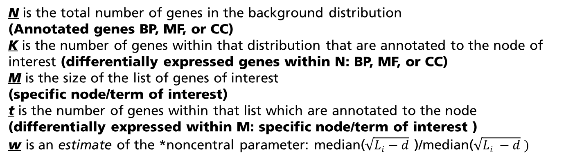

Wallenius Non-central Hypergeometric Distribution: Fisher’s Exact Test
M
t
K
K-t
(
)
)
(
min(M,K)
min(M,K)
P = Σ
= Σ
$$f\left(t| N,M, K,w\right)$$
(
)
N
M
t=T
t=T
N is the total number of genes in the background distribution
(Annotated genes BP, MF, or CC)
K is the number of genes within that distribution that are annotated to the node of interest (differentially expressed genes within N: BP, MF, or CC)
M is the size of the list of genes of interest
(specific node/term of interest)
t is the number of genes within that list which are annotated to the node
(differentially expressed within M: specific node/term of interest )
w is an estimate of the *noncentral parameter: median($\sqrt{Li−d}$ )/median($\sqrt{Li −d} )$
1 ≤ i ≤ M M < i ≤ N
*Noncentral parameter: six-knot monotonic spline
M = number of genes in GO term
N = total number of genes tested
L_{i} = transcript length of each gene
d = sequencing read length
Young et al., Genome Biology 2010

Slide 22

Lodato et al., Science 2015
Lodato et al., Science 2018

Slide 23
EASE BP Output
*Issues with Term Specificity
GO BP ID | Pvalue | BH Adj Pvalue | Odds Ratio | Exp Count | Count | Size | Term
0007067 | 1.12E-10 | 6.16E-08 | 3.18 | 18.70 | 50 | 292 | mitosis
0048285 | 1.30E-10 | 6.47E-08 | 3.08 | 19.98 | 52 | 312 | organelle fission
0007017 | 4.91E-10 | 2.22E-07 | 2.91 | 21.33 | 53 | 333 | microtubule-based process
EASE CC Output
GO CC ID | Pvalue | BH Adj Pvalue | Odds Ratio | Exp Count | Count | Size | Term
0005819 | 7.34E-09 | 3.38E-06 | 3.34 | 13.14 | 37 | 198 | spindle
0000779 | 3.53E-07 | 6.94E-05 | 5.06 | 4.57 | 18 | 69 | condensed chromosome, centromeric region
0044430 | 2.12E-06 | 0.00025 | 1.75 | 61.78 | 98 | 931 | cytoskeletal part
EASE MF Output
GO BP ID | Pvalue | BH Adj Pvalue | Odds Ratio | Exp Count | Count | Size | Term
0003777 | 6.19E-07 | 0.01 | 5.94 | 3.37 | 15 | 52 | microtubule motor activity
0005515 | 4.01E-05 | 0.02 | 1.37 | 388 | 438 | 5975 | protein binding
0003774 | 0.01 | 0.04 | 3.19 | 6.17 | 17 | 95 | motor activity
Chittenden et al., Bioinformatics 2012

Slide 24
GO Class | nGOseq Accession | nGOseq Term | List Hits | List Size | Pop Hits | Pop Size | Fisher's Exact | Gene Enrich | %Gene Enrich | Pvalue LogDiff | nGOseq Gene Enrich | GOseq Accession | GOseq Term
BP | 0035067 | negative regulation of histone acetylation | 2 | 795 | 2 | 2169 | 0.04 | 1.27 | 63.35 | 1.24 | 1.95 | 0007399 | nervous system development
BP | 0032462 | regulation of protein homooligomerization | 4 | 795 | 5 | 2169 | 0.04 | 2.17 | 43.35 | 1.16 | 2.42 | 0007399 | nervous system development
BP | 0050906 | detection of stimulus involved in sensory perception | 6 | 319 | 8 | 832 | 0.04 | 2.93 | 36.66 | 1.37 | 102.8 | 0007417 | central nervous system development
BP | 0072576 | liver morphogenesis | 3 | 410 | 3 | 987 | 0.04 | 1.75 | 58.46 | 1.28 | 2.29 | 0031175 | neuron projection development
BP | 2000757 | negative regulation of peptidyl-lysine acetylation | 3 | 552 | 3 | 1467 | 0.02 | 1.87 | 62.37 | 1.50 | 2.40 | 0048699 | generation of neurons
BP | 0070098 | chemokine-mediated signaling pathway | 5 | 287 | 5 | 684 | 0.01 | 2.90 | 58.04 | 1.85 | 12.17 | 0007409 | axonogenesis
Fisher’s Exact Test p-value ≤ 0.05 and positive values for each of the following classifications:
1. Gene Enrichment [k – ((M/N) x n)]
2. Percent Gene Enrichment [((k/n) – (M/N)) x 100]
3. nEASE p-value log difference [-log (nEASE p-value) – -log (EASE p-value)]
4. nEASE Gene Enrichment [Gene Enrichment – EASE Gene Enrichment]
Chittenden et al., Bioinformatics 2012
Lodato et al., Science 2015
Lodato et al., Science 2017

Slide 25
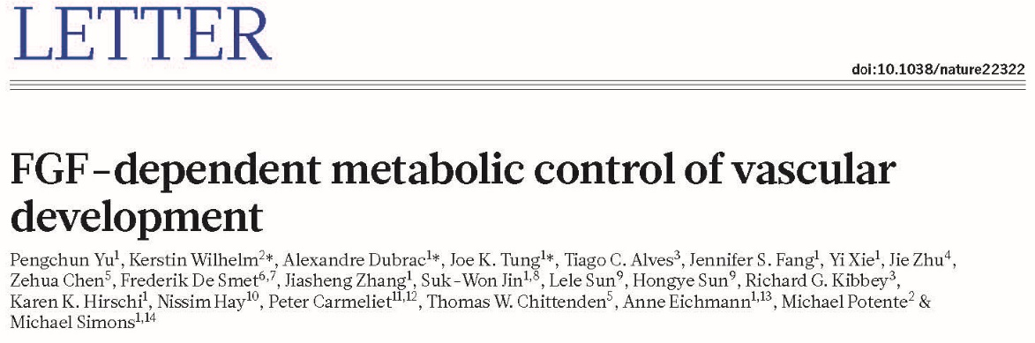
GO Class | Accession Number | nGOSeq Term | List Hits | List Size | Pop Hits | Pop Size | Fisher's Exact | Gene Enrich | %Gene Enrich | Pvalue LogDiff | nGOseq Gene Enrich | GOseq Accession | GOSeq Term
BP | 1900744 | regulation of p38MAPK cascade | 2 | 63 | 4 | 889 | 0.027 | 1.72 | 42.91 | 0.65 | 0.33 | 0007155 | cell adhesion
BP | 0060055 | angiogenesis involved in wound healing | 3 | 20 | 4 | 199 | 0.003 | 2.60 | 64.95 | 0.88 | 0.25 | 0001666 | response to hypoxia
BP | 0001935 | endothelial cell proliferation | 22 | 1127 | 72 | 7178 | 0.001 | 10.66 | 14.86 | 0.26 | 0.25 | 0044237 | cellular metabolic process
BP | 0043114 | regulation of vascular permeability | 2 | 85 | 4 | 868 | 0.050 | 1.61 | 40.21 | 0.68 | 0.54 | 0006629 | lipid metabolic process
BP | 0010573 | vascular endothelial growth factor production | 3 | 41 | 6 | 488 | 0.013 | 2.50 | 41.60 | 0.70 | 0.43 | 0033993 | response to lipid
BP | 0071604 | transforming growth factor beta production | 3 | 37 | 8 | 441 | 0.022 | 2.33 | 29.11 | 0.21 | 0.06 | 2000145 | regulation of cell motility
BP | 0006006 | glucose metabolic process | 19 | 576 | 73 | 3432 | 0.028 | 6.75 | 9.244 | 0.64 | 1.53 | 0044767 | single-organism developmental process
Chittenden et al., Bioinformatics 2012
Fang et al., Nature Communications 2017
Yu et al., Nature 2017

Slide 26
Multiple Testing Correction
Number of genes tested (N) | False positives incidence | Probability of calling 1 or more false positives by chance (100(1-0.95^{N}))
1 | 1/20 | 5%
2 | 1/10 | 10%
20 | 1 | 64%
100 | 5 | 99.4%

Slide 27
Common Methods Ranked by Stringency
Bonferroni
Bonferroni Step-Down
Westfall and Young Permutation
Benjamini and Hochberg False Discovery Rate
None
More False Negatives
More False Positives

Slide 28
Benjamini and Hochberg False Discovery Rate
This correction is the least stringent of all 4 options, and therefore tolerates more false positives. There will be also
less false negatives.
1) The p-values of each gene are ranked from largest to smallest.
2) The largest p-value remains as it is.
3) The second largest p-value is multiplied by the total number of genes in gene list divided by its rank.
Corrected p-value = p-value*(n/n-1) < 0.05
4) The third p-value is multiplied as in step 3:
Corrected p-value = p-value*(n/n-2) < 0.05

Slide 29
Benjamini and Hochberg False Discovery Rate
Example:
Let n=1000, error rate=0.05
Gene | p-value (L to S) | Rank | Correction | Is gene significant after correction?
A | 0.1 | 1000 | No correction | 0.1 > 0.05 => No
B | 0.06 | 999 | 0.06* (1000/999) = 0.06006 | 0.06006 > 0.05 => No
C | 0.04 | 998 | 0.04*(1000/998) = 0.04008 | 0.04008 < 0.05 => Yes
Notes:
LIMMA: Linear Models for Microarray Data
RPKM: Reads per kilo base per million
RPK= Number of Mapped reads/ length of transcript in kb (transcript length/1000)
RPKM = RPK/total number of reads in million (total no of reads/ 1,000,000)
Example:
Number of mapped reads =3 length of transcript=300 bp Total number of reads =10,000
RPK = 3/(300/1000) = 3/0.3 = 10
RPKM = 10 / (10,000/1,000,000) = 10/ 0.01 = 1000
RPKM =1000

Slide 30
Summary Table
Correction Method | Type of Error control | Genes identified by chance after correction
Bonferroni | Family-wise error rate | If error rate equals 0.05, expects 0.05 genes to be significant by Chance.
Bonferroni Step Down
Westfall and Young Permutation
Benjamini and Hochberg | False Discovery Rate | If error rate equals 0.05, 5% of genes considered statistically significant (that pass the restriction after correction) will be identified by chance (false positives).
Notes:
LIMMA: Linear Models for Microarray Data
RPKM: Reads per kilo base per million
RPK= Number of Mapped reads/ length of transcript in kb (transcript length/1000)
RPKM = RPK/total number of reads in million (total no of reads/ 1,000,000)
Example:
Number of mapped reads =3 length of transcript=300 bp Total number of reads =10,000
RPK = 3/(300/1000) = 3/0.3 = 10
RPKM = 10 / (10,000/1,000,000) = 10/ 0.01 = 1000
RPKM =1000

Slide 31
Practicum – Class 2
Functional Enrichment of Gene Ontology Terms with GOSeq Analysis
Example Directory Path
“C:/Users/Owner/Documents/RCCG_HMS/RC_Biostatistics_Courses/Biostats_RNA-seq/Supervised/Class 2”

