Slide 1
HASTHALAMANGALI SUPRAJA
Final Project
3/21/2024 Annual Review

Slide 2
Keylogger &Security
Keyloggers are a type of surveillance technology used to monitor and record each keystroke made on a computer or mobile device. They can be either hardware or software-based and are often used for both legitimate and malicious purposes.
Keyloggers are powerful tools that can be used for various purposes, both beneficial and harmful. Understanding how they work, how to detect them, and how to prevent them is crucial for maintaining cybersecurity and protecting personal privacy. Regular software updates, strong security practices, and awareness are essential to safeguarding against keyloggers.
Keyloggers can be broadly categorized into hardware and software types, each with unique characteristics and methods of operation.
Hardware Keyloggers: These physical devices are installed between the keyboard and the computer, intercepting keystrokes as they are transmitted. Common types include USB keyloggers, which plug into the USB port, and PS/2 keyloggers, designed for older keyboard models. More covert hardware keyloggers can be integrated directly into the keyboard or computer hardware, making them extremely difficult to detect without physical inspection.
Software Keyloggers: These are programs installed on a target device to capture keystrokes. They operate at different levels of the system
3/21/2024 Annual Review

Slide 3
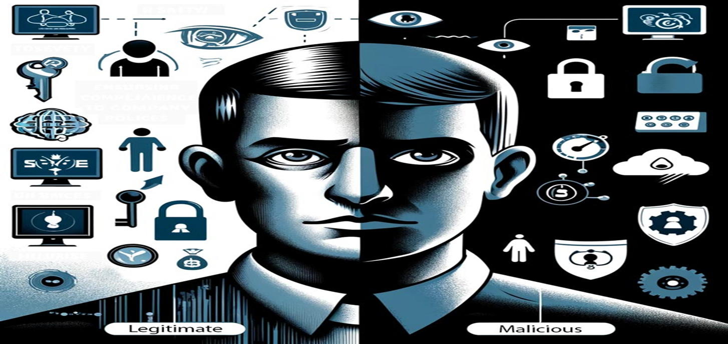
Software Keyloggers: These are programs installed on a target device to capture keystrokes. They operate at different levels of the system

Slide 4


AGENDA
Introduction to Keyloggers
Problem statement
Project overview
Who are the end users?
Solution and its value proposition
The wow in your solution
Detection of Keyloggers
Prevention and Protection Strategies
Modelling
Results
3/21/2024 Annual Review

Slide 5

PROBLEM STATEMENT
Keyloggers are a genuine danger to clients and the clients' information, which is considered exploitative movement. The problem statement is that the keyloggers can be detected using antiviruses. Installation of hardware keyloggers is difficult without the knowledge of the owner of the system
The fundamental goal of keyloggers is to meddle in the chain of occasions that happen when a key is squeezed and when the information is shown on the screen because of a keystroke. Keylogger can be used for legitimate as well as illegitimate purposes, it basically depends on user who is using it. System administrators can use keyloggers for systems, i.e. for detecting suspicious users.
3/21/2024 Annual Review

Slide 6

PROJECT OVERVIEW
Keyloggers are a particularly insidious type of spyware that can record and steal consecutive keystrokes (and much more) that the user enters on a device
Keyloggers are a common tool for corporations, which IT departments use to troubleshoot technical problems on their systems and networks—or to keep an eye on employees surreptitiously
Keyloggers come in at least two broad flavors—hardware devices and the more familiar software variety.
Hardware devices can be embedded in the internal PC hardware itself, or be an inconspicuous plugin that’s secretly inserted into the keyboard port between the CPU box and the keyboard cable so that it intercepts all the signals as you type
Software keyloggers are much easier to introduce to and install on victims’ devices, which is why that variety is much more common. Unlike other kinds of malware, software keyloggers are not a threat to the systems they infect themselves
3/21/2024 Annual Review

Slide 7

WHO ARE THE END USERS?
Law Enforcement: Keyloggers may be used by law enforcement agencies as part of criminal investigations to gather evidence related to cybercrimes or other illegal activities.
Cybercriminals: Malicious actors can use keyloggers for nefarious purposes, such as stealing personal information (e.g., passwords, credit card details) for financial gain or to compromise systems.
Security Professionals: Security experts and penetration testers may use keyloggers as a part of their security assessments to identify vulnerabilities and strengthen defenses against potential threats.
3/21/2024 Annual Review

Slide 8

YOUR SOLUTION AND ITS VALUE PROPOSITION
Use Antivirus and Anti-malware Software:
Install reputable antivirus and anti-malware software on your devices. Keep them updated to detect and remove keyloggers and other malicious software.
Keep Software Updated:
Regularly update your operating system, software applications, and browsers to close security vulnerabilities that keyloggers could exploit.
Exercise Caution with Email Attachments and Links:
Avoid opening attachments or clicking on links from unknown or suspicious sources, as these can be vectors for installing keyloggers.
Use Firewall Protection:
Enable and maintain a firewall to monitor and control incoming and outgoing network traffic, which can help detect and block keylogger activity.
Implement Strong Passwords and Authentication:
Use strong, unique passwords for your accounts and enable two-factor authentication (2FA) where possible to add an extra layer of security.
3/21/2024 Annual Review

Slide 9

THE WOW IN YOUR SOLUTION
Visualize the Threat: Describe scenarios or real-life examples where keyloggers have been particularly damaging, emphasizing the importance of taking preventive measures.
Highlight Innovation: Mention cutting-edge technologies or approaches in cybersecurity, such as advanced behavioral analysis or AI-powered detection methods, that can detect and mitigate keyloggers effectively.
Empower Users: Provide step-by-step guides or tools that empower users to take control of their cybersecurity, making them feel more capable and secure.
3/21/2024 Annual Review
9

Slide 10
Import Required Modules: Use Python's keyboard module to capture keystrokes. Optionally, use other modules for logging, encryption, or network communication. Set Up Logging: Configure logging settings to specify the format and destination of log files.
MODELLING
Define Keylogger Function:
Create a function to capture and log keystrokes.
Use the keyboard.on_press() method to register a callback function to capture each key press event.
Main Function:
Create a main function to start the keylogger and keep it running indefinitely.
Testing and Deployment:
Test the keylogger program to ensure it captures keystrokes correctly.
Deploy the keylogger on target systems if necessary, ensuring compliance with legal and ethical considerations.
3/21/2024 Annual Review
10

Slide 11
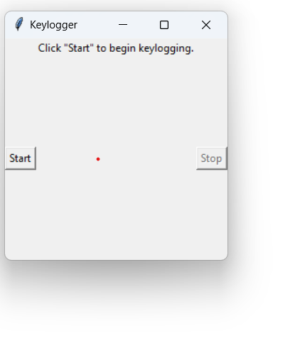
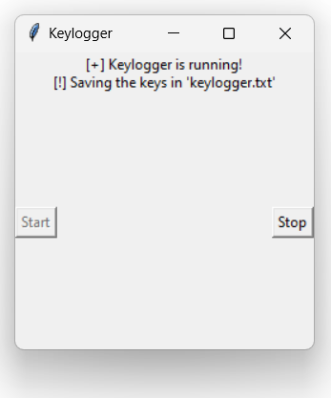
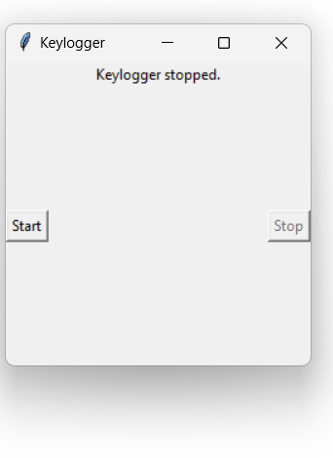
RESULTS
3/21/2024 Annual Review
11

Slide 12
Project Link
https://github.com/hmsupraja/hmsupraja_apssdc_project.git

