Slide 1
Final project
Project 1, 2
Member:
Huỳnh Minh Trí.
Võ Kỳ Quốc Anh.
Đoàn Đình Phúc.
MENTOR: Trần Minh Thiện

Slide 2
Project requirement
Add/modify/disable and remove account.
Search accounts.
Change state account.
Add/transfer/withdraw funds from account.
View account balance amount and transactions in a given period.

Slide 3
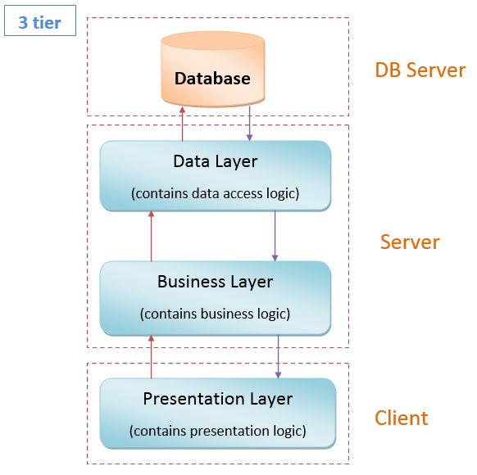
3-Tier Architecture

Slide 4
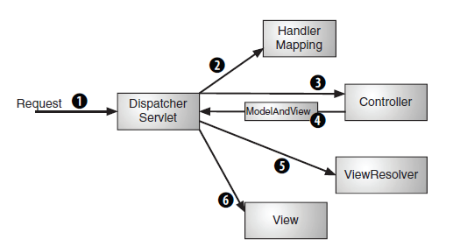
MVC model

Slide 5
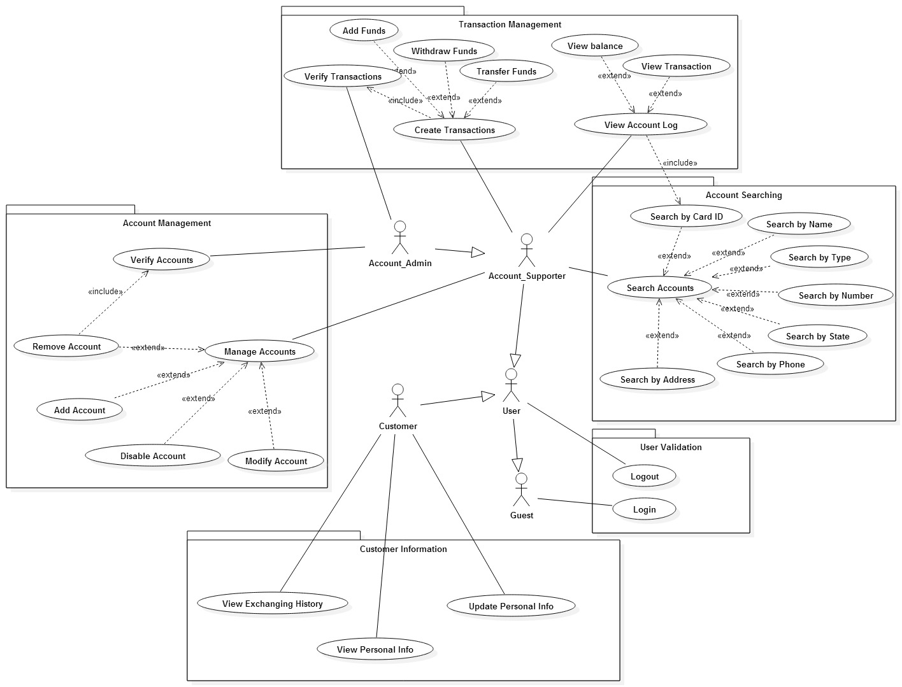
Use case

Slide 6
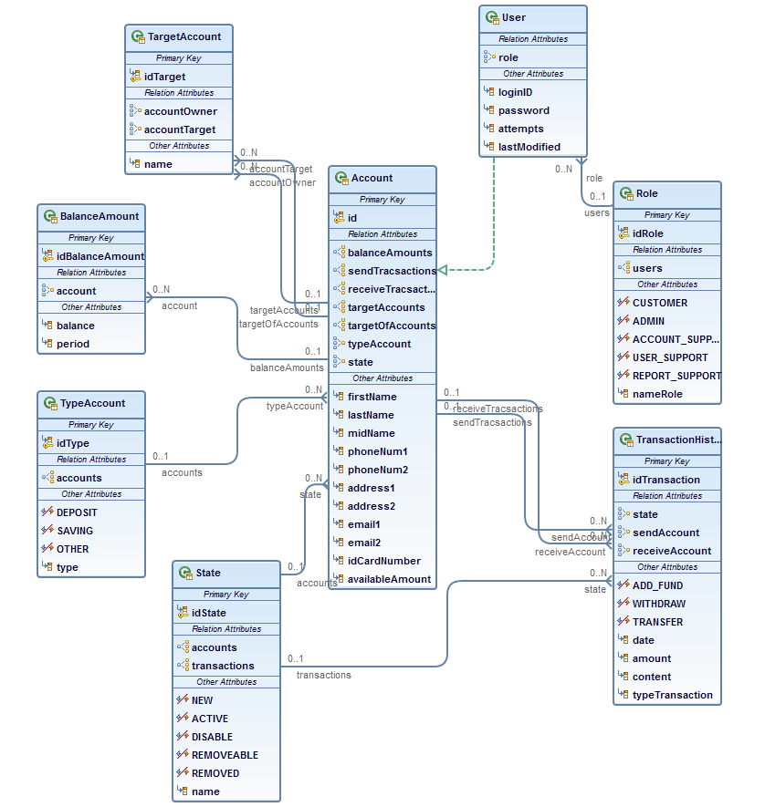
Entity class diagram

Slide 7
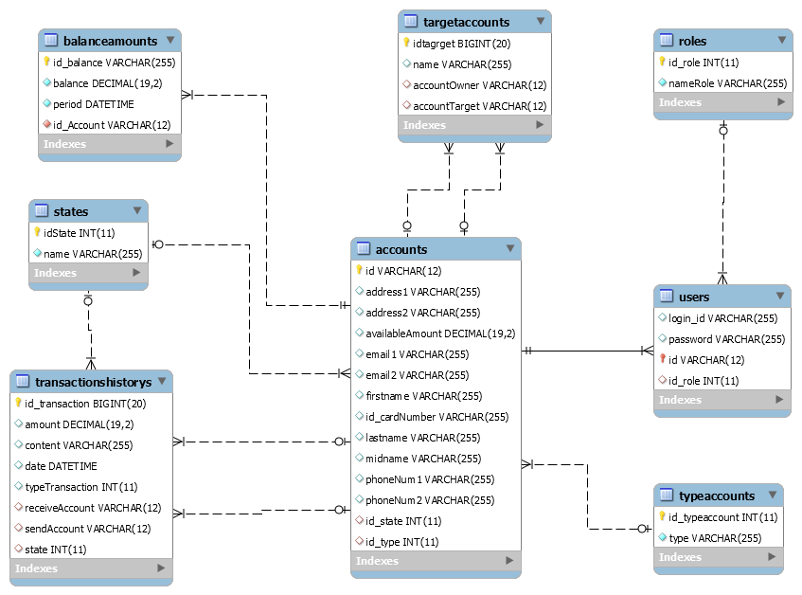
Database

Slide 8
Task assignment
Member | Task
Huỳnh Minh Trí | Addfund, withdraw, transfer by support, transfer by user, transfer in targetAccount by user, verify transaction, add modify and delete targetAccount, home all user, spring security, login 3 times.
Võ Kỳ Quốc Anh | Add account, modify account, change state Active → Disable, Disable → Active, Removeable → Removed, verify account.
Đoàn Đình Phúc | View and edit personal information, change user password, view transaction and balance history for customer and supporter, search account (by account number, by Card Id, account type, account state, etc..), auto updating balance amount to balance history.

Slide 9
DEMO

Slide 10
Thank for your listening

