Slide 1
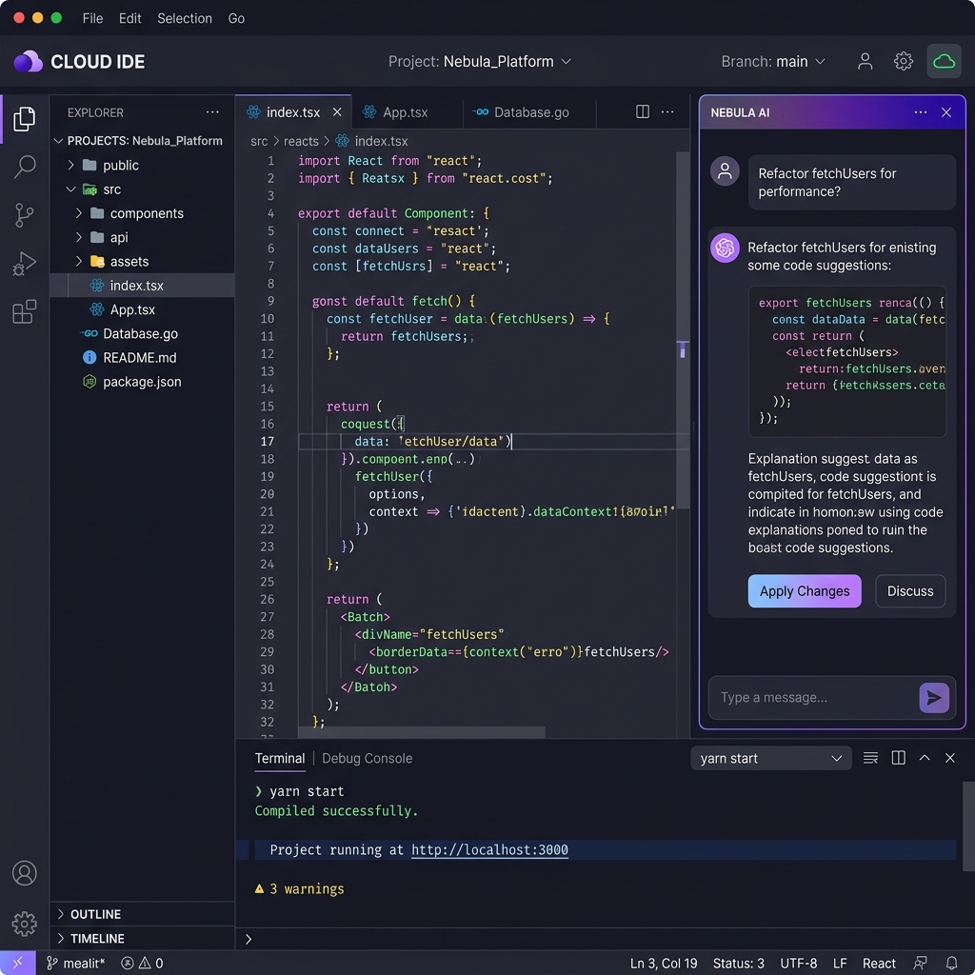
CODEFORGE AI
AI-Powered Collaborative Cloud IDE
A Full-Stack Development Environment with Real-Time Collaboration,
Multi-Language Execution Engine & AI-Powered Code Intelligence
Major Project Presentation | 2025-26
Department of Computer Science & Engineering

Slide 2
Introduction
What is CodeForge AI?
▸ A browser-based Cloud IDE built for modern developers
▸ Write, run, debug & collaborate on code — all in one place
▸ Supports 20+ programming languages with instant execution
▸ AI assistant built-in for code analysis & debugging
Why CodeForge?
▸ No setup needed — works entirely in the browser
▸ Real-time collaboration like Google Docs for code
▸ Intelligent AI assistant powered by multiple providers
▸ Secure sandboxed execution using Docker containers
2

Slide 3
Problem Statement
Current Challenges in Development
▸ Setting up development environments is time-consuming
▸ Collaborating on code requires external tools (Git, Slack, etc.)
▸ Running multiple languages needs installing separate runtimes
▸ No integrated AI assistance in traditional IDEs
▸ Security risks when executing untrusted code
Our Solution
▸ Single platform for coding, execution, collaboration & AI
▸ Zero-setup browser-based IDE with Docker sandboxing
▸ Multi-provider AI failover ensures 99.9% availability
3

Slide 4
Project Objectives
Primary Objectives
▸ Build a cloud-based IDE accessible from any browser
▸ Support 20+ programming languages with sandboxed execution
▸ Integrate AI-powered code analysis with multi-provider failover
▸ Enable real-time multi-user collaboration with WebSocket
Secondary Objectives
▸ Implement security scanning before code execution
▸ Create Docker-based isolated runtime environments
▸ Build admin dashboard with analytics & monitoring
▸ Ensure responsive UI with modern design patterns
4

Slide 5
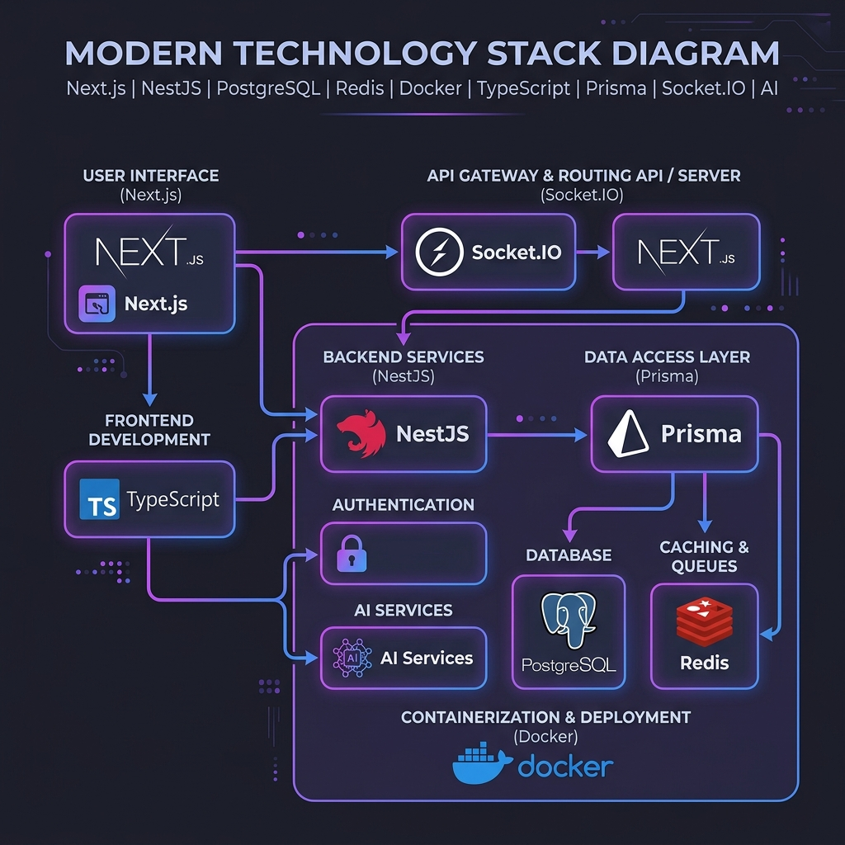
Technology Stack
Frontend
▸ Next.js 14 (React) — Server-side rendering & routing
▸ Monaco Editor — VS Code's editor engine
▸ TailwindCSS — Utility-first styling
▸ Socket.IO Client — Real-time communication
Backend
▸ NestJS (Node.js) — Enterprise-grade API framework
▸ Prisma ORM — Type-safe database access
▸ PostgreSQL — Primary relational database
▸ Redis — Caching & session management
▸ RabbitMQ — Message queue for async tasks
5

Slide 6
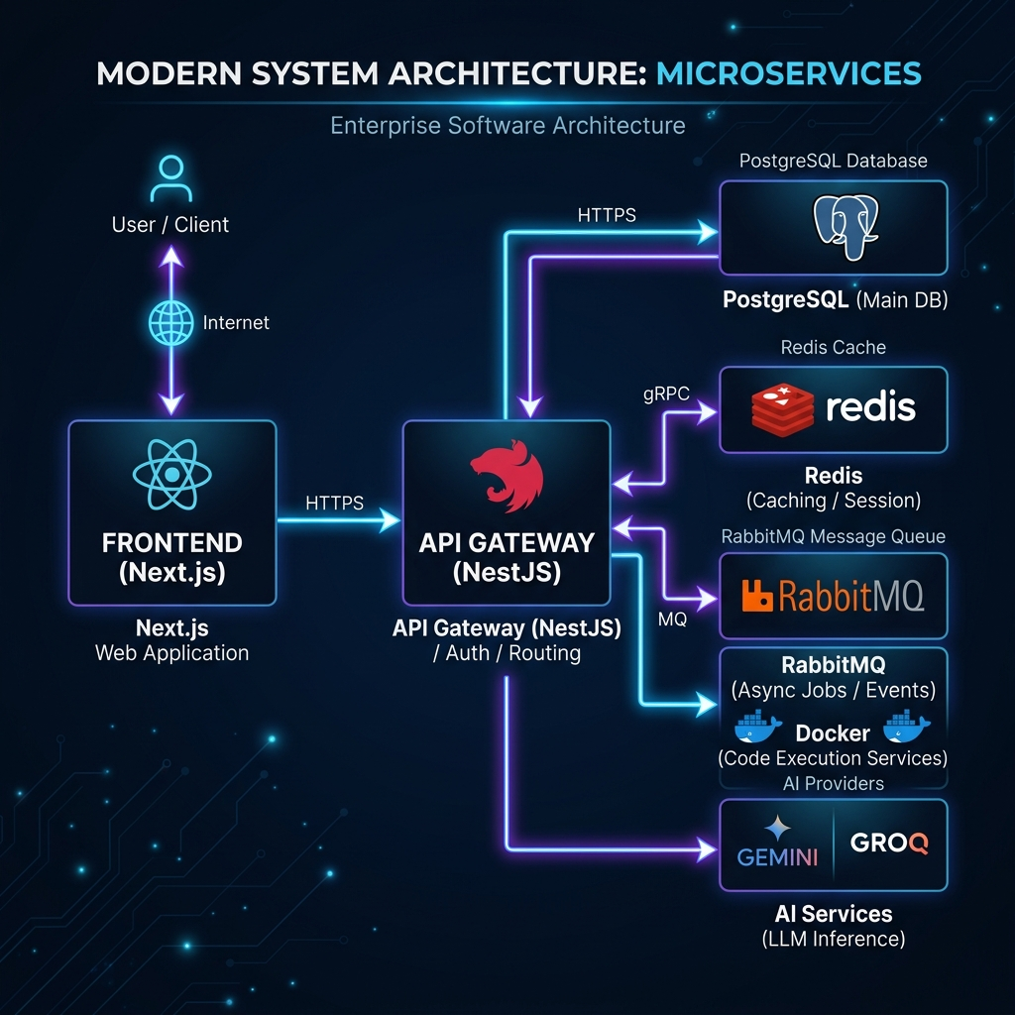
System Architecture
Microservices Architecture
▸ API Gateway — Central routing & authentication
▸ Execution Engine — Sandboxed code runners (Docker)
▸ AI Service — Multi-provider failover (Gemini, Groq)
▸ Collaboration Gateway — WebSocket real-time sync
Infrastructure
▸ Docker containers for 20 language runtimes
▸ PostgreSQL for persistent data storage
▸ Redis for caching & real-time presence
▸ RabbitMQ for event-driven microservice communication
6

Slide 7
Monaco Code Editor
Features
▸ Syntax highlighting for 20+ languages
▸ IntelliSense auto-completion
▸ Multi-cursor editing support
▸ Theme customization (Dark/Light)
▸ File explorer with tree view
Integration
▸ Real-time content sync via WebSocket (CRDT)
▸ Auto-detect language from file extension
▸ Stdin input support for interactive programs
▸ One-click Run button with console output
7

Slide 8
Multi-Language Execution Engine
20 Supported Languages
▸ JavaScript, TypeScript, Python, Java, C++, C
▸ Go, Rust, Ruby, PHP, Dart, Kotlin
▸ Scala, Swift, C#, Perl, R, Lua
▸ PowerShell, Bash
Execution Strategy
▸ Smart routing: Local runtime → Docker fallback
▸ Each language runs in isolated Docker container
▸ Memory limit: 128MB | CPU limit: 0.5 cores
▸ Automatic timeout: 30 seconds max
▸ Stdin/stdout piping for interactive programs
8

Slide 9
Docker Sandboxed Execution
Security Constraints
▸ Read-only filesystem (--read-only)
▸ No network access (--network=none)
▸ Non-root user execution (uid 1000)
▸ Process limit: 50 PIDs max (fork bomb prevention)
▸ No privilege escalation (no-new-privileges)
Container Architecture
▸ Alpine-based lightweight images (~50MB each)
▸ Separate /build directory for compiled languages
▸ Auto-cleanup after execution completes
▸ Parallel execution support for multiple users
9

Slide 10
AI-Powered Code Intelligence
10 Analysis Types
▸ Code Explanation — Understand any code instantly
▸ Bug Detection — Find logical errors & edge cases
▸ Performance Optimization — Big-O & efficiency
▸ Security Vulnerability — OWASP Top 10 scanning
▸ Code Refactoring — SOLID principles & clean code
AI Chat Assistant
▸ Real-time chat within the IDE workspace
▸ Context-aware responses with conversation history
▸ Markdown rendering for formatted code output
▸ Multi-language support (Hindi & English)
10

Slide 11
Multi-Provider AI Failover
Provider Strategy
▸ Primary: Google Gemini 2.0 Flash (1500 req/day)
▸ Backup: Groq Llama 3.1 (14400 req/day)
▸ Tertiary: OpenRouter (200 req/day)
How Failover Works
▸ Automatic rotation when provider hits rate limit
▸ 429 errors trigger instant switch to next provider
▸ Daily quota tracking per provider
▸ Smart fallback with mock responses if all fail
▸ 99.9% AI availability guaranteed
11

Slide 12

Real-Time Collaboration
Features
▸ Multi-user cursor sync with color indicators
▸ Live presence bar showing online team members
▸ Real-time code editing (WebSocket + CRDT)
▸ Workspace chat with AI assistant integration
Technical Implementation
▸ Socket.IO for bi-directional real-time communication
▸ Room-based architecture for workspace isolation
▸ Conflict-free Replicated Data Types (CRDT) for sync
▸ 30-second heartbeat for connection health
12

Slide 13

Security Architecture
Authentication & Authorization
▸ JWT + Refresh token based auth
▸ Bcrypt password hashing (12 salt rounds)
▸ Role-based access control (RBAC)
Code Execution Security
▸ Pre-execution threat scanning engine
▸ Pattern matching for dangerous code (fork bombs, etc.)
▸ Risk scoring system (0-100 scale)
▸ Auto-block for critical threats, warn for medium
▸ Docker container isolation with no network access
13

Slide 14
Database Design
PostgreSQL + Prisma ORM
▸ User — Authentication & profile data
▸ Workspace — Project containers with settings
▸ File — Source code files with versioning
▸ ExecutionJob — Code execution records & results
▸ AiRequest — AI analysis history & caching
▸ ChatMessage — Real-time collaboration messages
▸ Notification — User notification system
Key Design Decisions
▸ Prisma for type-safe queries & auto-migrations
▸ Connection pooling (17 connections) for performance
▸ Indexed queries for fast workspace lookups
14

Slide 15
Results & Demo
Key Metrics
▸ 20 languages supported & tested successfully
▸ AI response time: < 3 seconds average
▸ Code execution: < 5 seconds for most languages
▸ Real-time sync latency: < 100ms
Live Demo Highlights
▸ C++ diamond pattern with stdin input (cin >> n)
▸ AI chat responding in Hindi & English
▸ Multi-user collaboration with live cursors
▸ Security engine blocking malicious code
▸ Docker fallback for uninstalled languages
15

Slide 16
Future Scope & Conclusion
Future Enhancements
▸ OAuth login (Google, GitHub)
▸ Cloud deployment (Vercel + Railway)
▸ Git integration for version control
▸ Terminal emulator (xterm.js)
▸ Plugin marketplace for extensions
▸ Mobile responsive design
▸ AI auto-complete while typing
Thank You!
Questions & Discussion
CodeForge AI — Major Project 2025-26
Department of Computer Science & Engineering

