Slide 1
Daromad
Income evidence for borrowers who have no payslip
Mode: Partner product — MKBANK, micro & family-business credit department
Team TYS Munisbek (technical lead) · Jahongir (research & data) · Umida (compliance & business case)
Live prototype https://tys-fintech.vercel.app Repository https://github.com/hmunisbekk-droid/TYS-fintech
FinTech / AI in Finance · partners MKBANK and the Central Bank of Uzbekistan · final defence, October 2026
Notes:
Daromad, team TYS. Partner product for MKBANK's micro and family-business credit department. We remove the hour an officer spends turning a self-employed borrower's statements into an income figure the regulator accepts. [0:15]

Slide 2


The regulation names the evidence — the self-employed have exactly one line
CBU regulation on the debt-burden ratio, cl.9 — income a lender may rely on
50% cap
Employer-confirmed salary — no employer — the borrower is the business
ПДН limit for all loans since 1 Jan 2025 (cl.10); 12-month arithmetic mean of income (cl.7)
Pension — working-age applicant, not a pensioner
~140,000
Funded-pension contributions — none: contributions come through an employer
micro-projects MKBANK targets in 2026 (47,975 in 2025); 1,062 mahalla agents
Income credited to the borrower's bank accounts — the only line a self-employed borrower has
60–90 min
Taxes paid — self-employed income is untaxed; no return is filed
an officer's manual reading of 12 months of statements per application (our estimate; pilot measures it)
Interest, dividends, rental income — rarely applicable; easy to document when it is
0 lines
of official income records for ~790k registered self-employed (untaxed, unfiled, no cash register required)
Sources: lex.uz/docs/4654149 and 6809992 (CBU regulation and 2024 amendments) · spot.uz 27 Mar 2026 (MKBANK, bank's own figures) · yuz.uz (self-employed registrations, 2021) · buxgalter.uz
Notes:
Show the regulation's list of acceptable income evidence. For a self-employed borrower only one line exists: income credited to bank accounts — no employer, no pension, income untaxed and unfiled. MKBANK targets about 140,000 micro-projects this year, by its own figures. Every one of them needs a documented income assessment; the ones outside the family programme and above 50 BRV also need a ПДН under 50 percent — computed from documents like these. Fiscal receipts exist only where the business uses an online cash register; we read them as corroboration, not as the income figure. [0:45]

Slide 3
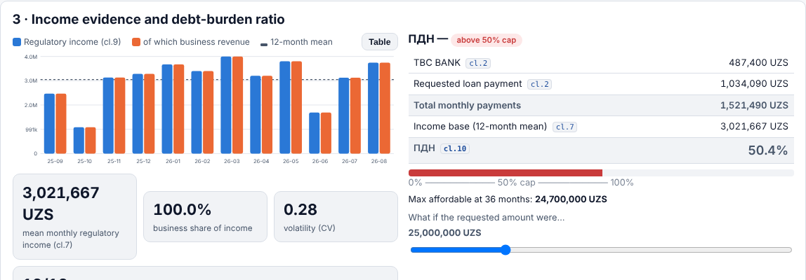



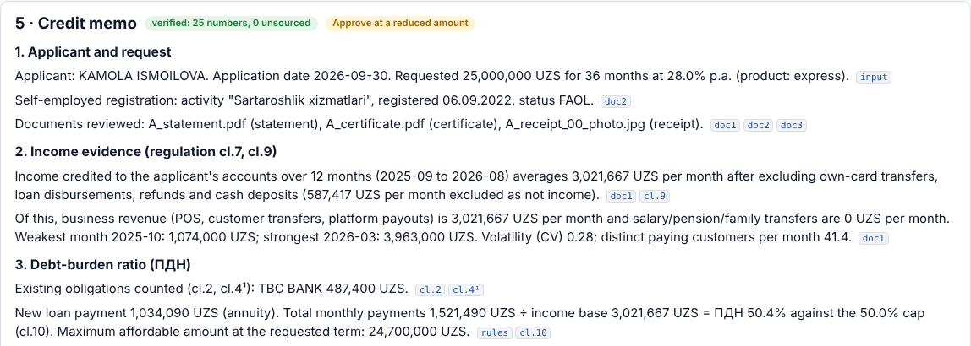

What the officer gets in under five seconds
12-month regulatory income
cl.7 mean, cl.9 definition; own-card transfers, loan proceeds, refunds and cash deposits excluded
ПДН with citations
36-month spreading, guarantor rule, 50-BRV and family-programme exemptions, 50% cap, maximum affordable amount
Integrity report
balance chain, duplicates, coverage, gaps, pre-application spikes, circular transfers, holder match
Verified memo
every number traces to its source — statement lines (click to open them), a clause, or the model; the verifier refuses unsourced numbers; hash-chained audit log
Notes:
This is the screen after Load sample A. Statement parsed in the browser, twelve months of regulatory income with business revenue separated, ПДН with each line citing its clause, maximum affordable amount, and a what-if slider. [part of demo narration]

Slide 4
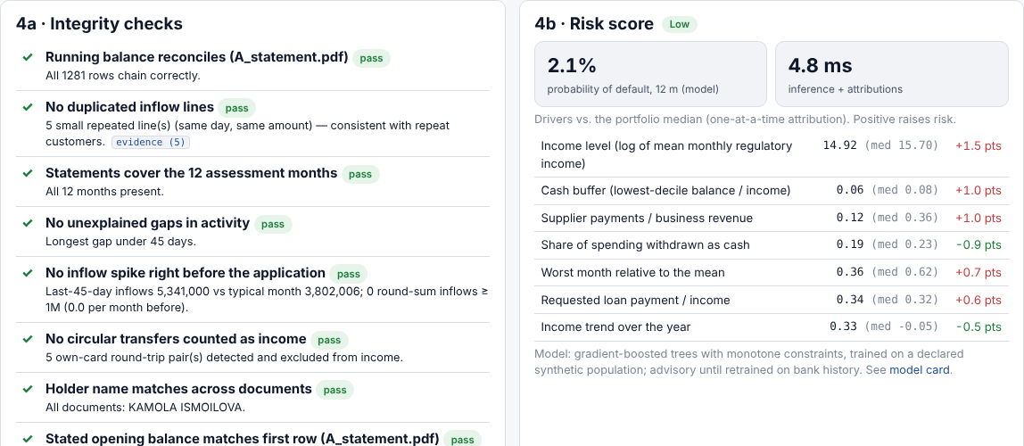

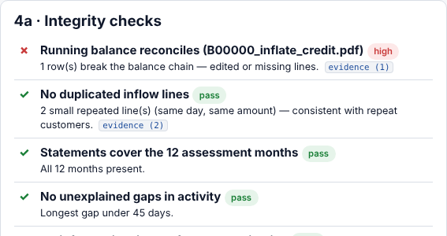
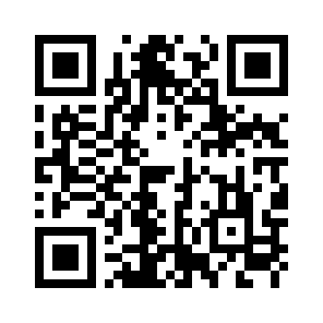
Live demo — on our samples and on anything you upload
Open on your laptop or phone
https://tys-fintech.vercel.app
1. Load sample A — statement PDF, Soliq certificate, receipt photo parse in the tab (no server, no API)
2. Income series, ПДН with clause citations, maximum affordable amount; drag the slider to cross the 50% cap
3. Integrity checks and risk score with drivers; click any evidence link to see the statement line
4. Memo: verifier badge shows how many numbers were checked and that none is unsourced
5. Record the decision; export the case with its hash-chained audit log
6. Then: Load tampered statement — the balance chain breaks at the inflated inflow; upload your own documents
Scan to open the live prototype on your phone (New case → Load sample A)
Notes:
Open the public URL. Load sample A. Narrate: statement parsed, certificate read, receipt OCR'd in Uzbek; twelve months of income; ПДН just above 50 percent, so the engine computes the maximum affordable amount; drag the slider under it; integrity checks; the memo badge shows how many numbers were checked and that none is unsourced; click a citation to open the statement lines behind a figure; record the decision; export. If a judge hands you a receipt photo or a statement, upload it. Finish with Load tampered statement (it starts a fresh case): the balance-chain check fails and names the edited line. Keep the backup video open in a second tab. [2:00]

Slide 5



Seven components, one optional language model, zero API keys
1 · Intake
2 · Categoriser
3 · Cash-flow
4 · Rule engine
pdf.js with coordinates; XLSX/CSV; tesseract.js OCR uzb+rus+eng, self-hosted; field confidence, tap-to-confirm
multilingual rules + counterparty patterns (recurring payer → family; same mask both ways → own card)
12-month series; 18 features identical in TypeScript and Python (parity test)
ПДН clause by clause: 36/180-month spreading, guarantor rule, exemptions, 50% cap, back-solved amount
5 · Risk model
6 · Integrity
7 · Memo + audit
Perimeter
XGBoost, monotone constraints, JSON trees evaluated in the browser; attributions vs portfolio median
balance chain, duplicates, coverage, gaps, round-sum spikes, circular transfers, holder match
template from a fact table; verifier rejects unsourced numbers; SHA-256 hash-chained log
Prototype: static site, every byte of a document stays in the browser. Production: the same bundle on the bank's server, SSO, audit log in the bank DB, core-banking pull for own customers. LLM optional, narrative only, behind the same verifier.
Speed: statement 1.2–1.8 s · receipt OCR 1.6 s · everything else < 50 ms · marginal cost per application: zero
Human in the loop: the engine recommends and computes the maximum affordable amount; the officer decides; an override needs a reason, written into the chain.
Notes:
This is a system, not a prompt: parsing with coordinates, a multilingual categoriser, cash-flow reconstruction, a rule engine mapped clause by clause, boosted trees with monotone constraints, integrity checks, and a template memo with a verifier. No API key exists in this product. Production is the same bundle on the bank's server — the perimeter is literal. [0:45]

Slide 6
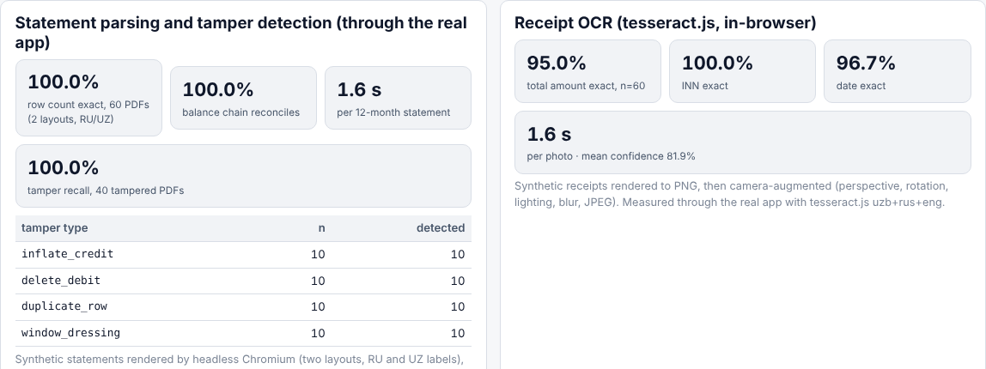
Measured through the real app, not typed into a slide
60/60
7/7
40/40
generator statement PDFs parsed with exact row count and reconciled balance chain (2 layouts, RU/UZ)
unseen layouts exact: signed-amount CSV, Kirim/Chiqim XLSX, quoted EN CSV + type column, Unicode minus, headerless, Приход/Расход TSV, Payme-style wallet export
tampered statements caught: inflated inflow, deleted debit, duplicated row, window dressing; 0 false alarms on clean ones
95%
0.965
0.902
receipt OCR — total exact on 60 camera-augmented photos; INN 100%, date 97%
risk model ROC-AUC, synthetic holdout n=500; logistic 0.963, ratio alone 0.948
ROC-AUC on real bank data (Berka, 443 loans, 44 bad, 5-fold; 95% CI ≈ 0.86–0.94) vs 0.735 for the ratio alone
Honest reading: on synthetic data the ratio already carries most of the signal by construction; on real statements the cash-flow features add +0.17 AUC over the ratio, and logistic regression comes close to the trees — we ship the trees for the monotone constraints and non-linear thresholds, not for the last 0.01. Categoriser: 99.96% on 10,481 lines of the generator's own vocabulary — will fall on real data. Memo verifier: 0 unsourced numbers across a 300-scenario sweep (amounts × terms × products × borrowers), enforced at run time.
All numbers are read from JSON produced by ml/train.py, ml/berka_validate.py, npm test and tests/*_eval.py (see the Model card page).
Caveat on the slide, not in the footnote: the risk score is advisory until retrained on the bank's own history inside the perimeter — that is the pilot's first deliverable.
Notes:
Measured through the real app: statement parsing exact on 60 of 60 generator PDFs — and, more importantly, exact on 7 of 7 layouts the parser had never seen: signed-amount CSV, Kirim/Chiqim Excel, quoted English CSV with a type column, Unicode minus, headerless, Приход/Расход TSV, and a Payme-style wallet export with a plus/minus type column and no balance. Tamper recall 40 of 40 with no false alarms on clean statements; receipt OCR 95% on totals, 100% on INN. Risk model: AUC 0.965 on our declared synthetic population — proves the pipeline, not the world. So we ran the same 18 features on real anonymised bank data, 443 loans from PKDD'99, 44 of them bad: AUC 0.90 out-of-fold, confidence interval roughly 0.86 to 0.94, versus 0.74 for the ratio alone. Logistic regression is close — we keep the trees for monotone constraints and thresholds, not for the last hundredth. [0:45]

Slide 7
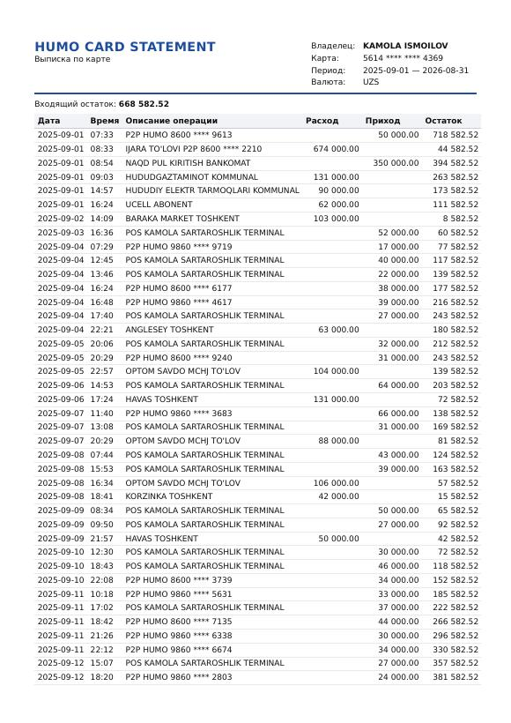
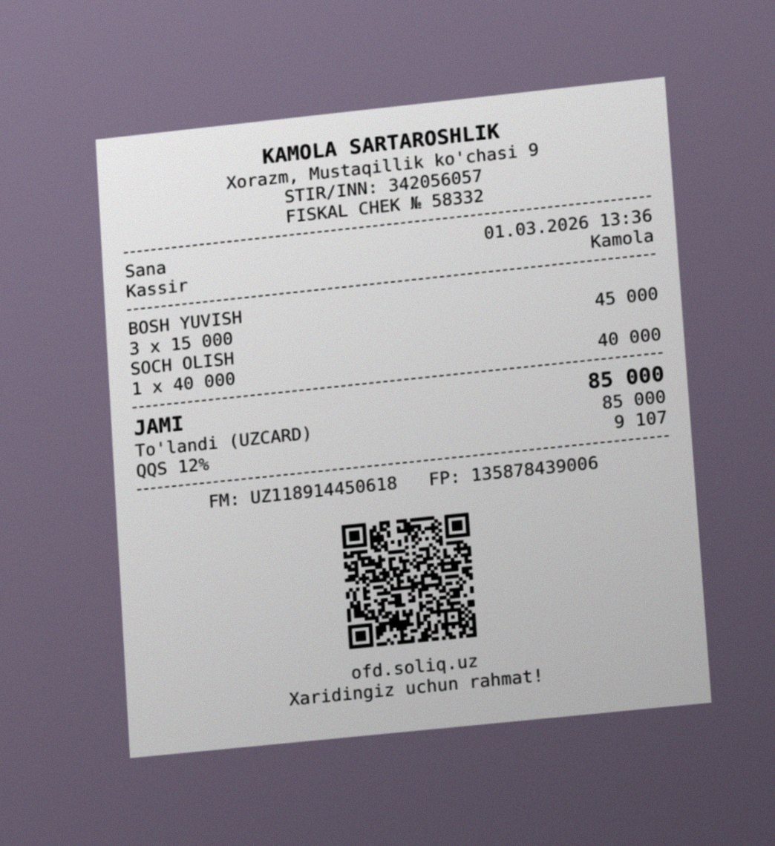
No partner data, so we built a declared generator
1
Archetypes
10 trades (tailor, taxi, dehkan farmer, grocer, reseller, tutor…) with declared seasonality, customer counts, channel mix, expense structure
2
Simulation
2,000 borrowers · 5,689,589 transactions · existing loans with annuity schedules · shocks · default label from a latent affordability score (10.5% rate)
3
Rendering
60 statement sets as PDF (text layer) + XLSX + CSV in RU and UZ layouts; 180 fiscal receipts; Soliq-style certificates with QR
4
Camera model
perspective, rotation, lighting gradient, blur, sensor noise, JPEG — then measured through the same OCR the officer uses
Synthetic statement (Humo-style layout, Russian labels) and a camera-augmented synthetic fiscal receipt. No real person is represented; names come from a short public list, card numbers are random and masked.
5
Tampering
40 statements: inflated inflow, deleted debit, duplicated row, window dressing — labelled for the integrity evaluation
Regenerate: python -m synth.cli --n 2000 --render 60 --receipts 180 --tamper 40 --seed 42
Also: methodology check on real anonymised bank data (Berka, PKDD'99) — not redistributed, downloaded by script.
Notes:
Ten archetypes anchored to stat.uz wages, 24 months of daily transactions, rendered to PDFs with a text layer in two layouts, receipts photographed through a camera model, four tamper types. Every parameter is in the repo. The jury can regenerate everything with one command. [0:30]

Slide 8
Pilot: three months, five branches, fifty mahalla agents
Cost to build and run the pilot (assumptions, UZS)
Value — the officer-hours formula (every term is a slider)
Line | Assumption | 3-month cost
Team: 3 engineers/analysts (TYS) | 3 × 3 months × 15M | 135M
Bank credit analyst, part-time | 0.5 FTE × 3 months × 15M | 22.5M
Infrastructure | 1 VM in the bank DC, no GPU | ≈ 3M
Integration (core banking, bureau) | bank IT, 20 person-days | ≈ 30M
Data, licences, API spend | none — open-source, no external API | 0
Total pilot (≈ $15k) |  | ≈ 190M
90 → 25 min
≈ 42,000 / yr
document handling per application, before → with Daromad (assumption 1; the pilot measures it)
addressable applications: 30% of MKBANK's 140,000 micro-projects (bank's own 2026 target) — those outside the family programme and above 50 BRV (assumption 2)
≈ 45,000 h
≈ 4.1 bn UZS/yr
officer-hours saved per year = 42,000 × 65 min ≈ 23 FTE-years at 2,000 h
23 FTE × 15M/month × 12 — officer time only; at a 10% addressable share ≈ 1.4 bn
Payback: the ≈ 190M pilot itself (5 of 181 branches, 3 months) does not pay back — it measures the two assumptions. After roll-out the saving of ≈ 4.1 bn/yr repays the pilot within its first month; at a 10% addressable share, within two months. Not counted: faster time-to-decision for the borrower, fewer ПДН compliance findings, better risk selection — claimed only after the pilot measures them.
Running cost per application: zero marginal (static bundle; no API, no GPU). Optional narrative LLM on one on-prem GPU: well under 1 US cent per application.
Timeline: month 1 shadow mode (engine runs beside the manual process; we measure minutes and agreement) · months 2–3 assisted mode (officer works from the memo) · success metrics: minutes per application, agreement with committee, override rate, ПДН audit findings, retrained model AUC on bank history.
Who pays: MKBANK (credit department / digital budget). Who owns: micro & family-business credit department; IT deploys; mahalla agents and loan officers use it.
Notes:
Cost: our three people plus one bank analyst, one small VM — no GPU, no licences, no API spend; marginal cost per application is zero; about 190 million for three months. Value, with two assumptions the pilot exists to measure: document handling falls from about 90 to 25 minutes, and about 30 percent of MKBANK's 140,000 micro-project applications are addressable — outside the family programme and above the 50-BRV threshold. That is 42,000 applications, 45,000 officer-hours, 23 full-time officers, about 4 billion sum a year at a 15-million loaded monthly cost. The pilot does not pay for itself in five branches; the roll-out does, within its first month. Even at a 10 percent addressable share it pays back within two months. Every term is a slider. [1:30]

Slide 9


Hard to copy in a weekend — and what comes next
The replication test — what the same LLM tools do not give you
Next steps
Statement parsers that learn columns from the data rows (two Uzbek layouts today, any text-layer PDF, XLSX, CSV) and reconcile the balance chain
A categoriser lexicon in Uzbek Latin, Cyrillic and Russian with counterparty-pattern rules — and the pilot plan to grow it on bank data
A rule engine mapped clause by clause to the live ПДН regulation, with its exemptions and the back-solved maximum amount
A memo verifier that makes unsourced numbers impossible — zero hallucination by construction, no LLM needed
A declared, calibrated synthetic population with rendered documents, a camera model and labelled tampering — a test bed the bank can keep using
Evaluation through the real app, reproducible with one command each
Week 1–2: scanned-statement OCR page by page; lexicon growth on anonymised bank descriptions; Uzbek/Russian memo templates
Month 1: shadow mode in 5 branches; core-banking pull for MKBANK's own account holders; credit-bureau REST for obligations
Month 2–3: assisted mode; retrain the risk model on bank history inside the perimeter; set risk bands with the bank's risk appetite; fairness review by region
After the pilot: Central Bank conversation — the same engine computes ПДН uniformly for any lender, a supervisory check at zero marginal cost
Product scope today: Ommabop 2, Express, Business Online 2 (ПДН applies) and family-programme loans (exempt from the cap, capacity still assessed)
Notes:
What another team cannot rebuild in a weekend: the Uzbek layout corpus and parsers, the categoriser lexicon, the clause-mapped rule engine with its exemptions, the verifier that makes unsourced numbers impossible, and the calibrated synthetic population. Next: scanned-statement OCR, core-banking pull for MKBANK's own account holders, retraining inside the perimeter. Thank you. [0:30]

Slide 10
Daromad
Income evidence for borrowers who have no payslip — regulation-native, perimeter-native, verified.
Live: https://tys-fintech.vercel.app
Repo: https://github.com/hmunisbekk-droid/TYS-fintech
Team TYS: Munisbek · Jahongir · Umida
Notes:
Thank you. Questions.

Slide 11
Appendix A · ПДН rule engine, clause by clause
Clause | Rule as implemented | Where it shows
cl.1 | ПДН = average monthly payments on loans/microloans ÷ average monthly income (borrower + co-borrower) | formula panel
cl.2 | Includes the application under review and all loan agreements with all lenders; co-borrower loans counted; excluded if amount + outstanding principal ≤ 50 BRV («…50 бараваридан ошмаганда»); 75 BRV for self-employed at MFOs; bank-level allowance: up to 15% of the number of loans to individuals may be issued outside the requirement — a quota the bank tracks, not a per-application rule | obligations table, exemption badge
cl.4 | Guarantor loans count only when payments are more than 30 days overdue («30 кундан ортиқ муддати ўтган тўловлари мавжуд бўлса») | obligations table, DPD column
cl.4¹ | Terms over 36 months: total payments spread over 36 («барча тўловлар 36 ойга тенг миқдорда тақсимланади»); mortgages over 180 months spread over 180 | per-line note
cl.6 | Calculation date within 10 calendar days of the loan date | case date
cl.7 | Average monthly income = arithmetic mean of the last 12 months; co-borrower income added | income base
cl.9 | Evidence: employer salary data, pension, funded-pension contributions, income credited to bank accounts, taxes paid, interest/dividends/rent; other data allowed | memo section 2
cl.10 | Ratio ≤ 50% from 1 January 2025 (60% between 1 July 2024 and 1 January 2025) | cap, pass/fail
cl.11 | Family-entrepreneurship programme loans exempt from the ratio requirement | exemption badge
BRV = 440,000 UZS from 1 September 2026 (previously 412,000); 50 BRV = 22,000,000 UZS. Clause mapping checked against lex.uz/docs/4654149 and 6809992 on 10 Oct 2026; quotes verbatim in docs/REGULATION_QUOTES.md.

Slide 12
Appendix B · Failure cases, perimeter, human in the loop
Known failure cases (also on the Model card page)
Perimeter, audit, human in the loop
Scanned statements without a text layer: not OCR'd page by page yet — ask for the XLSX/CSV export
One signed amount column and no balance column: signs taken from keywords only
Merchant strings outside the lexicon (mixed scripts, transliteration) → default category, visible in the table
Dark or heavily skewed receipt photos: OCR confidence < 60% → fields flagged for confirmation, never guessed
Cash-only businesses: nothing to reconstruct — the memo says so; the officer attests
Synthetic-to-real gap of the risk score until retrained inside the bank; risk bands are placeholders
Prototype: static site; documents are parsed in the browser and never transmitted; nothing is stored server-side
Production: same bundle on the bank's web server (Docker, no outbound network), SSO identity, audit log and cases in the bank DB
Own customers' statements pulled from core banking; uploads only for other banks' statements and wallets
Every analysis stamped with rule-engine, model and categoriser versions; hash-chained SHA-256 log; export with the case
The engine recommends; the officer decides; overrides require a reason; committee above branch limits
Personal data processed inside the bank with recorded consent; retention per bank policy; no gender or activity-type features in the model

Slide 13
Appendix C · Data sources and licences
Source | Used for | Licence / terms
Daromad synthetic data set (synth/, seed 42) | training, evaluation, demo samples | MIT, this repo; generator and parameters declared; no real person
Berka / PKDD'99 Financial data set (mirror github.com/jlacko/berka-dataset) | offline methodology check | academic challenge data, no licence stated; evaluation only, not redistributed
Tesseract tessdata_fast (uzb, uzb_cyrl, rus, eng); tesseract.js | receipt OCR | Apache 2.0
pdf.js; SheetJS; Next.js; React | parsing, application | Apache 2.0 / MIT
XGBoost; scikit-learn; NumPy; pandas; OpenCV; Playwright; Jinja2; qrcode | training, rendering, evaluation | Apache 2.0 / BSD-3 / MIT
CBU regulation texts (lex.uz 4654149, 6809992) | rule engine, citations | public legal information
stat.uz wages; CBU statistics; MKBANK public pages (sponsored article, bank's own figures) | calibration anchors, business case | public information, cited
Rules compliance: no hard-coded answers (every figure computed from uploaded documents at run time); no real personal or confidential data; all code written during the final by team TYS with LLM coding assistance (declared); deployment from the submitted repository; CI on every push.

