Slide 1
OLR (outgoing longwave radiation)
Solar
const.
[W/m²]
1570
1550
1500
1380
1200
Lat.
Surface temp.
Solar
const.
[W/m²]
1570
1550
1500
1380
1200
Lat.

Slide 2
OLR (outgoing longwave radiation)
Upper lim.
Solar const.
1570 [W/m²]
1550
1500
1380
1200
Lat.

Slide 3
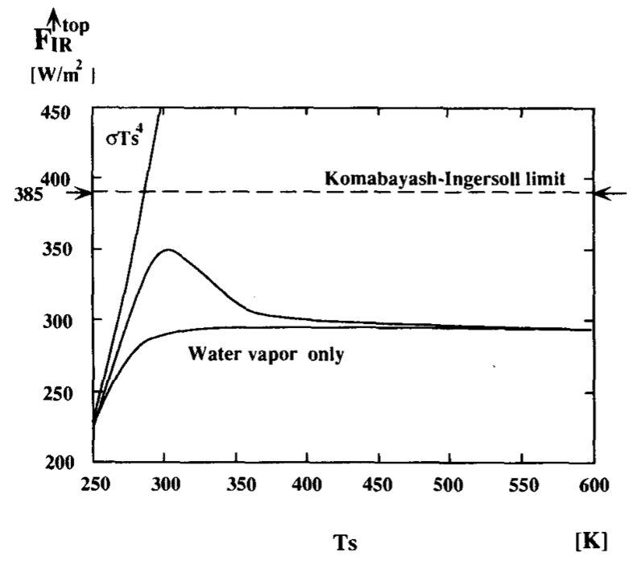
OLR (outgoing longwave radiation)
Upper lim.
Surf. Temp.

Slide 4
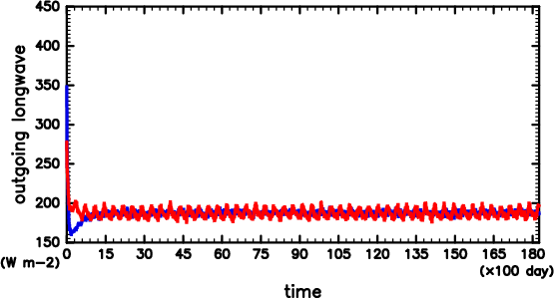
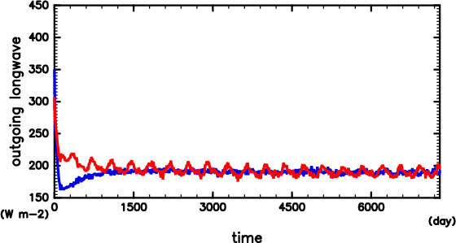
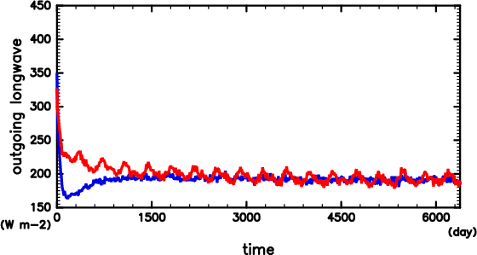
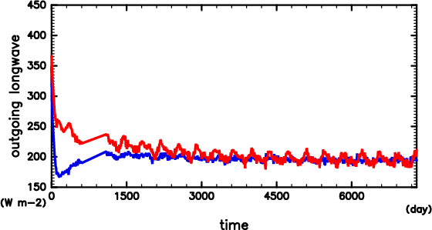
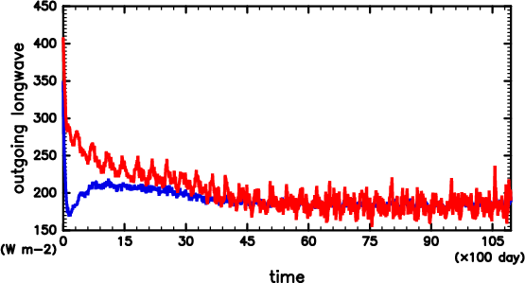
S1366
S1500
OSR
OLR
OLR
OSR
S1600
S1800
OLR
OLR
OSR
OSR
S2000
OLR
OSR

Slide 5
OLR (outgoing longwave radiation)
Surface temp.
S1500
S1600
S2000
S1366
S1800
S1800
S1600
S2000
S1500
S1366
Lat.
Lat.

Slide 6
S1366
Total
S1500
Total
Latent En.
Latent En.
Dry Stat. En.
Dry Stat. En.
S1600
Total
S1800
Total
Latent En.
Dry Stat. En.
Latent En.
Dry Stat. En.

Slide 7
S1366
S1500
S1600
S1800
Lq
V
c_{pn}T+gz

Slide 10
S1366
Mean
S1500
Mean
Total
Total
Transient Eddy
Transient Eddy
Stationaly Eddy
Stationaly Eddy
S1600
Mean
S1800
Mean
Total
Total
Transient Eddy
Transient Eddy
Stationaly Eddy
Stationaly Eddy
S2000
Mean
Total
Transient Eddy
Stationaly Eddy

Slide 11
S1366
S1500
Total
Total
Mean
Transient Eddy
Mean
Transient Eddy
Stationaly Eddy
Stationaly Eddy
S1600
S1800
Total
Total
Mean
Mean
Transient Eddy
Transient Eddy
Stationaly Eddy
Stationaly Eddy
S2000
Total
Mean
Transient Eddy
Stationaly Eddy

