Slide 1
EECS 183
Elementary Programming Concepts
Hannah Westra
hmwestra@umich.edu

Slide 2
About Me:
Junior majoring in Computer Science, minoring in Science, Technology, & Society
First Semester as EECS 183 IA
Had never programmed before 183
EECS Courses I’ve taken:
183, 203, 280, 281, 398, 370, 485
Chair of Project Flavor at the University and Interned for a Food App Last Summer

Slide 3
Your Turn!
Name, Year
Take 2-3 minutes to get to know your neighbors

Slide 4
Discussion Format:
Review of material covered in Lecture
Practice problems/code similar to project concepts and problems you will see on the exam
Tips for Testing and Projects
Come with questions!
I would love to answer any and all questions you have
Any feedback is appreciated!

Slide 5
Class Logistics:
If you have a question, check piazza first – someone probably already asked it!
If not, post a question!
Next step is to go to office hours – check the website
There are at least 3 hours of office hours every day
DON’T CHEAT!
It’s actually a much bigger deal than you might think, and the smallest infraction can result in major consequences

Slide 6
Office Hours
Office hours will be held on North Campus in the Duderstadt center, starting next Monday.
There will always be office hours from:
3-6 pm Tuesdays, and 3-8 pm M, W-F on the third floor, east end (diagram on next slide)
There will sometimes be additional office hours on the weekend – the will be posted on the website
There will be a paper sign up sheet that will arrive with the first staff member, and they will start promptly at 3, and end exactly at 8 (give or take 5 minutes)
The website will indicate which staff members are present at which time, and this will remain mostly consistent

Slide 7
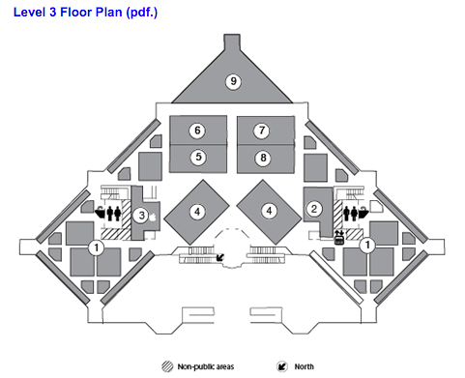

Slide 8
Meet the Staff!
Meet the staff and help with getting your laptop ready
Sunday, September 11th
1800 Chemistry Building
Bring your laptop!
Stay posted on the website for more info

Slide 9
Upcoming Due Dates:
Zyante reading – due before each lecture
Assignment 0:
This Friday, September 9th at 11:59 pm
Assignment 1:
Friday, September 16th at 11:59 pm
Always check the website for updates

Slide 10
Xcode vs. Visual Studio
What is an IDE?
Integrated Development Environment
Xcode and Visual Studio are just a couple examples
I work with Xcode
If I can’t help you with a Visual Studio question, I will find someone who can!

Slide 11
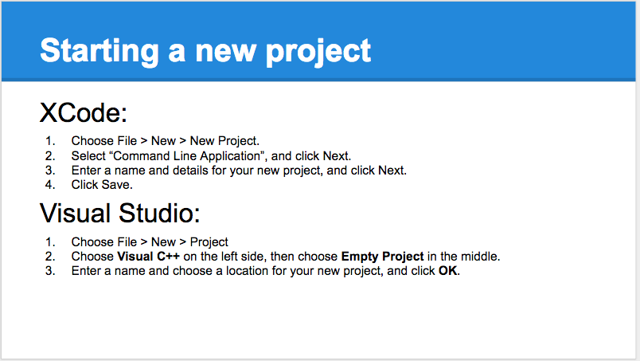

Slide 12
Basics of Programming
You will write your programs in an IDE (Xcode or Visual Studio)
These provide a code editor (where you write and edit code)
The code you write is sent through a compiler
The compiler turns your code into object code (machine language)
Source code
compiler
object code
Notes:
Compiler is software which takes the source code to object code
Machine language = binary (1s and 0s)

Slide 13
What Is An Algorithm?

Slide 14
What is an algorithm?
A specific approach to solve a problem
Counting people in a room (you did this in lecture)
Finding a certain page in a book
Picking teams with captains
Different algorithms vary in efficiency and speed
You’ll learn more about this in EECS203 and 281 if you choose to take them
Notes:
By halving the problem each time we vastly improve the search through the book

Slide 15
Questions?
Notes:
Pseudocode?
Loops
Conditions
Difference between pseudocode and source code
Code editor
Compiler
Object code (370)
Return type
Semicolons
Cout
cin
Endl
#include
Using namespace std
Variables
Data types
Operators
Int division
modulo

Slide 16
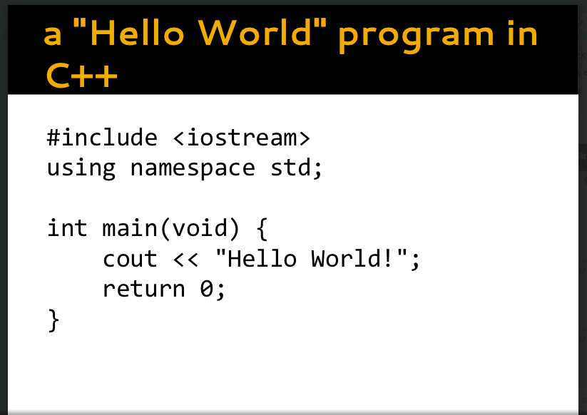
Any Reserved Words?

Slide 17
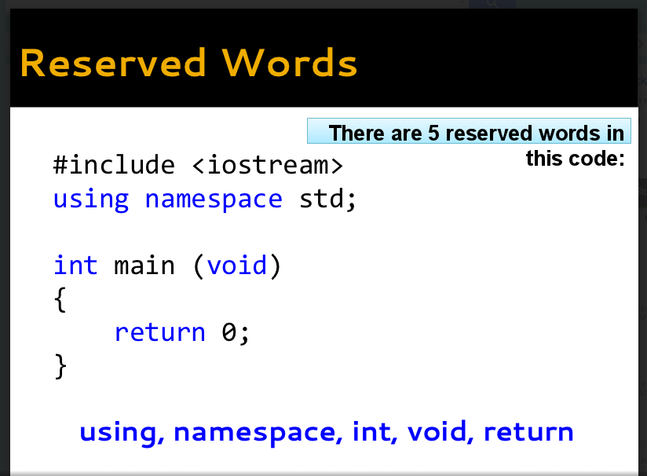

Slide 18
cin and cout
To use these program calls we need to add:
#include <iostream>
at the top of our program
This allows us access to the iostream library from which the operations cin and cout come from

Slide 19
cin and cout
What does cout do?
cout << “Hello World!”;

Slide 20
cin and cout
What does cout do?
Call to a function that prints output to standard output

Slide 21
cin and cout
What does cout do?
Prints output to standard output
What does cin do?
cin >> defined_variable;

Slide 22
cin and cout
What does cout do?
Call to a function that prints output to standard output
What does cin do?
Call to a function that reads input in from the user

Slide 23
Data Types
What is a double? An int?
5.0 is a double type, 5 is an int type
What is a char?
‘a’, ‘k’ ← denoted by single quotes
What is a string?
A collection of characters (chars)
“hello”, “me”, “a” ← denoted by double quotes
What is a bool?
Holds value true or false

Slide 24
Binary and Boolean values
The most important thing to remember:
0 is false
1 is true
Any number that isn’t 0 is also true
Look online and in lecture for more details about binary code and binary/decimal numbers
Notes:
If (3) would evaluate as true always
On board: Bring back to if (result == true) – walk through it, show how the computer reads it, and why its extra work – correct it

Slide 25
What is a variable?
int result = 0;
A element in code that has a specific type, and holds or stores values in memory
int is the type of the variable

Slide 26
Variable Naming and Initializing
Always initialize your variable to 0, or its initial value
The variable should have a descriptive name
Case-sensitive→ int result vs. int Result
Start with a letter or underscore
Make sure your variable is not a reserved word
Check the lecture slides and resources on the website for more details
Notes:
Initialization is important to avoid garbage values
Xcode and Visual Studio automatically initialize to 0, but the autograder will not!
After first letter, use any combo of letters, numbers, and underscores as long as not reserved word
Only alphanumeric and underscores!!

Slide 27
Sample Program:

Slide 28
Operations and Operators
+ - / % * =

Slide 29
Modulus Operator:
%
What does it do?

Slide 30
Modulus Operator:
%
This operator gives you the remainder of a division
What is 5 % 2?

Slide 31
Modulus Operator:
%
This operator gives you the remainder of a division
What is 5 % 2? 1
Think about: how many times does the second number go into the first?

Slide 32
Modulus Operator:
%
This operator gives you the remainder of a division
Think about: how many times does the second go into the first?
What is 2 % 5?

Slide 33
Modulus Operator:
%
This operator gives you the remainder of a division
Think about: how many times does the second go into the first?
What is 2 % 5? 2
If it doesn’t go in at all, you are left with the first number (you couldn’t do anything with it)

Slide 34
How to Succeed in 183:
Post on Piazza a lot (questions and answers)
Start Projects early (as soon as they come out) and go to office hours!
Plan before you code!
Work with others – talk through the logic out loud
There is nothing more helpful than teaching others something you just learned
Work with whiteboards

Slide 35
Feel Free to Stay and Ask Questions!
Last Minute Reminders:
Zyante reading – due before each lecture
Meet the Staff!
This Sunday, September 11th at 6pm in 1800 CHEM
Assignment 0:
This Friday, September 9th at 11:59 pm
Assignment 1:
Friday, September 16th at 11:59 pm

