Slide 1
Fine-Tuning Resources
Microsoft Project 2016
Lesson 6

Slide 2
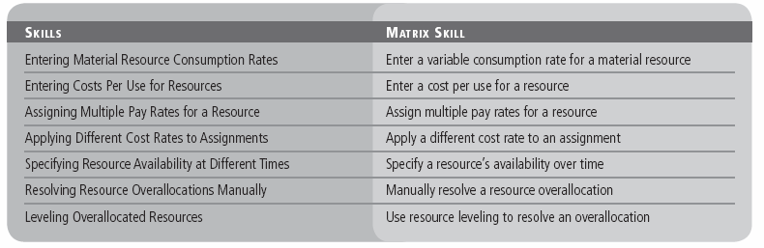
Objectives

Slide 3
Entering Material Resource Consumption Rates
In the following exercise, you will assign a variable consumption rate to a material resource. You can assign two types of consumption rates:
A fixed consumption rate means that an absolute quantity of the resources will be used, no matter the duration of the task to which the material is assigned. For example, filling a swimming pool requires a fixed amount of water to be used.
A variable consumption rate means that the amount of the material resource consumed is dependent upon the duration of the task. An advantage of using a variable rate of consumption is that as the duration of the task changes, so do the calculated amount and cost of the material resource because the rate is tied to the task’s duration.
Notes:
To accurately calculate the cost of a material resource, you also need to know its consumption rate, or how quickly it is used up.

Slide 4
Step-by-Step: Enter a Variable Consumption Rate for a Material Resource
GET READY. Before you begin these steps, open Tailspin Remote Drone 6M from the data files for this lesson. SAVE the file as Tailspin Remote Drone 6 in the solutions folder.
Press the F5 key. The Go To dialog box appears. Key 32 in the ID box and then click OK. Project displays task 35, Proof of Concept.
This is the first of a couple of tasks that require the digital camera and an SD Card to record digital video. You have determined that the initial estimates for SD consumption were incorrect. Because for each day of work you will only be recording for 2 hours, you have determined that the correct consumption rate for the SD resource is 0.25 SD Card/day (the SD Cards can record up to 8 hours).
Click the Resource tab and then click the Assign Resources button. The Assign Resources dialog box appears.

Slide 5
Step-by-Step: Enter a Variable Consumption Rate for a Material Resource
In the Assign Resources dialog box, click the Units field for the SD Card. Key 0.25/d and then press Enter. Microsoft Project changes the consumption rate of SD Cards for this task to 0.25 per day.
Move the column divider between the Units and Cost columns to expand the Units column. The Assign Resources dialog box should look similar to the figure on the next slide.
Click the Close button in the Assign Resources dialog box. You will now verify the cost and work values of the DVD assignment to task 35.
On the ribbon, click the down arrow under the Team Planner button. Click Task Usage.
Double‐click the SD Card resource assignment under task 32, Proof of Concept. The Assignment Information dialog box appears.

Slide 6
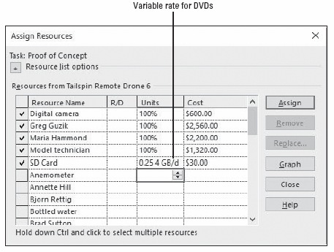
Step-by-Step: Enter a Variable Consumption Rate for a Material Resource
Select the General tab, if it is not already selected. Note the Work, Units, and Cost fields. The Assignment Information dialog box should look similar to the figure on the next slide.
Notes:
Assign Resources dialog box displaying consumption rate for SD Cards

Slide 7
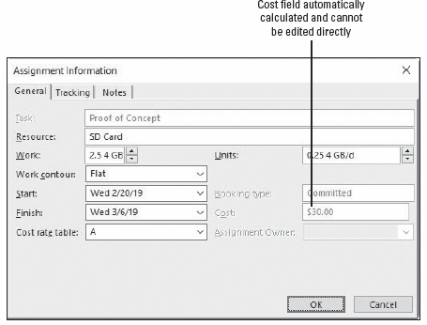
Step-by-Step: Enter a Variable Consumption Rate for a Material Resource
Click OK to close the Assignment Information dialog box.
SAVE the project schedule.
PAUSE. LEAVE Project open to use in the next exercise.
Notes:
Assignment Information dialog box with SD Card resource assignment details

Slide 8
Entering Costs Per Use for Resources
In addition to its pay or consumption rate, a resource can also have a cost associated with each use.
In the following exercise, you will enter a per‐use cost for a material resource.
Any resource can have a cost per use, in place of or in addition to the costs derived from their pay rates (work resources) or consumption rates (material resources).
You can also specify whether the per‐use cost should accrue at the beginning or end of the task to which it is assigned.

Slide 9
Step-by-Step: Enter a Cost Per Use for a Resource
GET READY. USE the project schedule you created in the previous exercise.
On the Resource ribbon, click the down arrow under the Team Planner button and then select the Resource Sheet.
On the Resource Sheet, select resource 11, Digital camera.
On the ribbon, in the Properties group, click the Information button. The Resource Information dialog box appears.
Select the Costs tab.
Under Cost rate tables, select the A (Default) tab. The Digital camera has a $20 maintenance fee every time you use it.
In the first row under Per Use Cost, key 20 and then press Enter.
Select End from the Cost accrual drop‐down box. Your screen should look similar to the figure on the next slide.

Slide 10
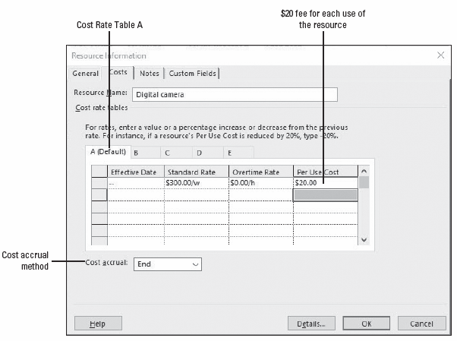
Step-by-Step: Enter a Cost Per Use for a Resource
Click OK to close the Resource Information dialog box.
SAVE the project schedule.
PAUSE. LEAVE Project open to use in the next exercise.
Notes:
Resource Information dialog box displaying cost per use for the resource

Slide 11
Assigning Multiple Pay Rates for a Resource
Sometimes, the same work resource may perform different tasks with different pay rates. Microsoft Project enables you to enter multiple pay rates for a single resource.
In the following exercise, you will enter a second cost rate table for a resource. A cost rate table is resource pay rates that are stored on the Costs tab of the Resource Information dialog box.
For a given resource, you can enter up to five cost rate tables for a resource. Each table has 25 possible entry lines (125 lines total in the five tables) so you can assign dates at which the new cost rate takes effect. After you assign a resource to a task, you can specify which rate table should apply.

Slide 12
Step-by-Step: Assign Multiple Pay Rates for a Resource
GET READY. USE the project schedule you created in the previous exercise. Because Yan Li’s rate differs depending on whether he is working on developing marketing materials or administrative tasks, you need to enter a second rate for him.
In the Resource Sheet view, click the name of resource 9, Yan Li.
On the ribbon, click the Information button. The Resource Information dialog box appears.
Click the Costs tab. Each tab of the cost rate table corresponds to one of the five pay rates a resource can have.
Under Cost rate tables, click the B tab.
Select the default entry of $0.00/h in the field directly below the Standard Rate column heading, key 15/h, and then press Enter.
Notes:
Take Note: When you enter a pay rate, if you do not key in the currency symbol, Microsoft Project will supply it for you.
Another Way: You can also double‐click the Resource Name field to activate the Resource Information dialog box.

Slide 13
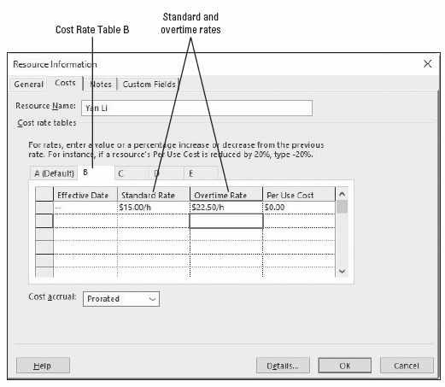
Step-by-Step: Assign Multiple Pay Rates for a Resource
In the Overtime Rate field, key 22.50/h and then press Enter. Your screen should look similar to the figure at right.
Click OK.
SAVE the project schedule.
PAUSE. LEAVE Project open to use in the next exercise.
Notes:
Resource Information dialog box showing the second rate table for Yan Li

Slide 14
Applying Different Cost Rates to Assignments
Microsoft Project enables you to enter as many as five different pay rates for a resource. These pay rates may be applied to different assignments as necessary.
In the following exercise, you will apply an alternate rate table for a resource to reflect a different pay rate for different work.
You can set up as many as five pay rates per resource. This enables you to assign different pay rates to different assignments for a resource.
By default, Microsoft Project uses Cost Rate Table A, but you can specify any time another rate table should be used.

Slide 15
Step-by-Step: Apply a Different Cost Rate to an Assignment
GET READY. USE the project schedule you created in the previous exercise.
On the Resource ribbon, click the down arrow under the Team Planner button and then click Task Usage.
Press the F5 key. Key 6 in the ID box and then click OK.
Click the View tab. Verify the Cost table is selected by clicking the Tables button, located in the Data group, and then select Cost.
Under task 9, click the row heading directly to the left of Yan Li so that Yan Li’s entire assignment is selected.
Move the vertical splitter in the table portion of the Task Usage view to the right until the Total Cost column is visible. You can see that the total cost of Yan’s assignment to this task is $228.00. Your screen should look similar to the figure on the next slide.

Slide 16
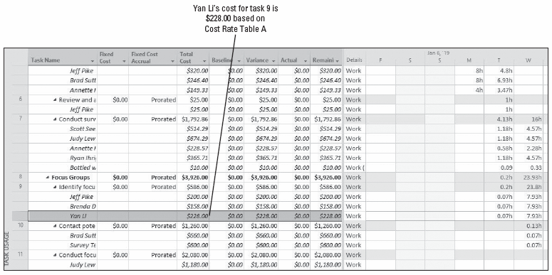
Step-by-Step: Apply a Different Cost Rate to an Assignment
Notes:
Task Usage view showing cost for Yan Li’s assignment using Cost Rate Table A

Slide 17
Step-by-Step: Apply a Different Cost Rate to an Assignment
Double‐click on Yan Li's name. The Assignment Information dialog box appears.
Click the General tab, if it is not already selected.
In the Cost rate table box, key or select B, and then click OK. Microsoft Project applies Yan Li’s Cost Rate Table B to the assignment. The new cost of the assignment, $120.00, is reflected in the Total Cost column. Your screen should look similar to the figure on the next slide.
SAVE the project schedule.
PAUSE. LEAVE Project open to use in the next exercise.
Notes:
Take Note: If you find that you are changing cost rate tables frequently, it is quicker to display the Cost Rate Table field directly in the Resource Usage or Task Usage view. To add the Cost Rate Table field, right‐click on a column heading and then select Insert Column. Select Cost Rate Table from the drop‐down list.

Slide 18
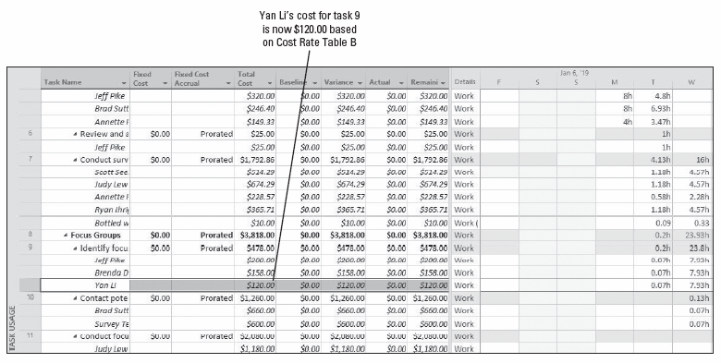
Step-by-Step: Apply a Different Cost Rate to an Assignment
Notes:
Task Usage view showing cost for Yan Li’s assignment using Cost Rate Table B

Slide 19
Specifying Resource Availability at Different Times
Sometimes, as you are working on a project schedule, you will find that a resource will have varying availability. To control this availability, Microsoft Project uses Max. Units, or the maximum capacity of a resource to accomplish tasks.
In the following exercise, you will resource availability over time using the Resource Availability grid.
Recall that a resource’s capacity to work is measured in units. The Max. Units value is the maximum capacity of a resource to accomplish tasks. A resource’s calendar determines when a resource is available to work. However, the resource’s capacity to work (measured in units and limited by their Max. Units value) determines how much that resource can work within those hours without becoming overallocated.
Notes:
You can set different Max. Units values to be applied over different time periods for any resource. Setting a resource’s availability over time enables you to control exactly what a resource’s Max. Units value is at any time.

Slide 20
Step-by-Step: Specify a Resource’s Availability Over Time
GET READY. USE the project schedule you created in the previous exercise.
On the ribbon, click the Resource Sheet button.
In the Resource Name column, double‐click click the name of resource 10, Model technician. The Resource Information dialog box appears.
Click the General tab, if it is not already selected. You originally planned that there would be two technicians available for the entire project, but you have just determined that there will only be one available from March 4 through March 8, 2019.
Under Resource Availability, in the first row of the Available From column, leave NA (Microsoft Project’s term for a null field, or a field that is blank).

Slide 21
Step-by-Step: Specify a Resource’s Availability Over Time
In the Available To cell in the first row, key or select 3/3/19.
In the Available From cell in the second row, key or select 3/4/19.
In the Available To cell in the second row, key or select 3/8/19.
In the Units cell in the second row, key or select 100%.
In the Available From cell in the third row, key or select 3/9/19.
Leave the Available To cell in the third row blank.
In the Units cell in the third row, key or select 200%, and then press Enter. Your screen should look similar to the figure on the next slide.
Notes:
Take Note: Microsoft Project will display 100% in the Max. Units field only when the current date (based on your computer’s system clock) is within the March 4–8, 2019 range. At other times, it will display 200%.

Slide 22
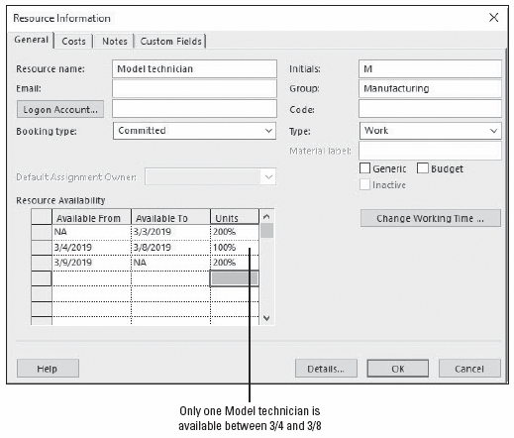
Step-by-Step: Specify a Resource’s Availability Over Time
Click OK to close the Resource Information dialog box.
SAVE the project schedule.
PAUSE. LEAVE Project open to use in the next exercise.
Notes:
Resource Information dialog box with resource availability dates

Slide 23
Resolving Resource Overallocations Manually
A resource is overallocated when it is scheduled for work that exceeds its maximum capacity to work. You can manually resolve this situation within the project schedule.
In the next exercise, you will manually resolve a resource overallocation. Recall that a resource’s capacity to work is called allocation, and a resource is said to be in one of three states:
Underallocated: The work assigned to the resource is less than the resource’s maximum capacity.
Fully allocated: The total work of a resource’s task assignments is exactly equal to that resource’s work capacity.
Overallocated: A resource is assigned to do more work than can be done within the normal work capacity of the resource.

Slide 24
Resolving Resource Overallocations Manually
Manually editing an assignment is one way to resolve a resource overallocation, but there are several other options:
You can replace the overallocated resource with another resource using the Replace button in the Assign Resources dialog box.
You can reduce the value in the Units field in the Assignment Information or Assign Resources dialog box.
If the overallocation is not extreme, you can just allow the overallocation to remain in the schedule.
In Microsoft Project 2016, overallocations are also noted when you have assigned a work resource to working times outside normal working hours. They are not truly overallocated by definition. It is simply the software’s way of notifying you that you have resources assigned work that is outside their normal working hours.
Notes:
Recall from Lesson 4 you assigned a task calendar for the overnight beach filming. This resulted in an overallocation for the work resources assigned to that task.

Slide 25
Step-by-Step: Manually Resolve a Resource Overallocation
GET READY. USE the project schedule you created in the previous exercise.
On the View ribbon, click the down arrow to the right of the Resource Sheet button, click More Views, select Resource Allocation, and then click Apply. Microsoft Project switches to the Resource Allocation view. This is a split view that displays the Resource Usage view in the top pane and the Leveling Gantt view in the bottom pane.
Press the F5 key. Key 1/10/19 in the Date box and then click OK. The Leveling Gantt pane shows the task bars for assignments.
On the ribbon, in the Zoom group, click the down arrow in the Timescale box and select days. Your screen should look similar to the figure on the next slide.

Slide 26
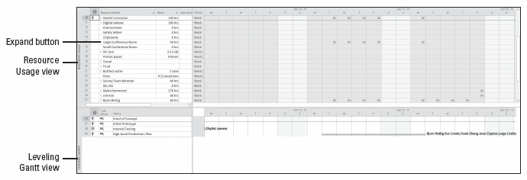
Step-by-Step: Manually Resolve a Resource Overallocation
In the Resource Usage view, scroll vertically through the Resource Name column so that you can see the names. The names you see formatted in red are overallocated resources.
Notes:
Resource Allocation view

Slide 27
Step-by-Step: Manually Resolve a Resource Overallocation
In the Resource Name column, navigate (scroll) to and select the name of resource 4, Judy Lew.
Click the expand button next to Judy Lew’s name. Scroll left to see the assignments at the beginning of the project. Your screen should look similar to the figure on the next slide.
In the upper pane, you see most all of Judy’s assignments. Notice that two of those tasks, task 7, Conduct Survey, and task 11, Conduct focus groups, are causing an overallocation.
In the lower pane, you can see the Gantt bars for the two tasks that have caused Judy to be overallocated during this time—tasks 7 and 11. This results in work on the same day of around 11.4 hours of work—beyond Judy’s capacity to work. In addition, Judy is also assigned to an hour of work for task 58, Status meeting 2.

Slide 28
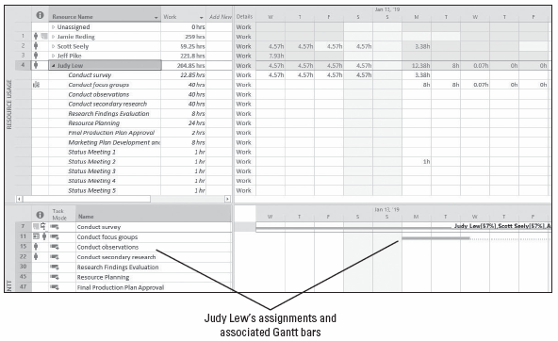
Step-by-Step: Manually Resolve a Resource Overallocation
Notes:
Resource Allocation view showing Judy Lew’s overallocated assignments

Slide 29
Step-by-Step: Manually Resolve a Resource Overallocation
In the Resource Name column, navigate (scroll) to and select the name of resource 4, Judy Lew.
Click the General tab, if it is not already selected.
In the Units box, key or select 50% and then click OK to close the Assignment Information dialog box.
Note that Judy’s daily work assignments on this task are reduced, but the task duration is increased. You want to reduce the work, but not increase the duration of the task. Also note the Actions button that has been activated next to the name of the assignment.
Click the Actions button. Review the options in the list that appears. Your screen should look similar to the figure on the next slide.

Slide 30
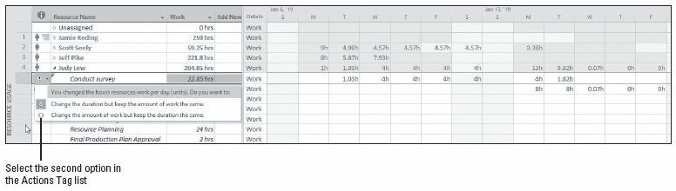
Step-by-Step: Manually Resolve a Resource Overallocation
Click Change the amount of work but keep the duration the same in the Actions option list. Microsoft Project reduces Judy’s work assignments on the task and restores the task to its original duration. Your screen should look similar to the figure on the next slide.
Notes:
Resource Allocation view with Smart Tag action list displayed

Slide 31
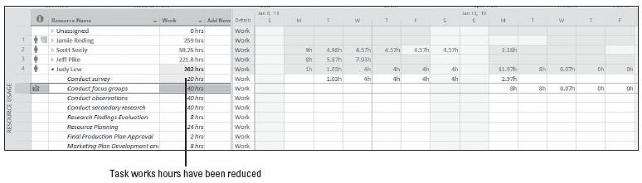
Step-by-Step: Manually Resolve a Resource Overallocation
Notice that Judy is still overallocated, so now you will reduce the assignment units on her second task.
In the Resource Name column, double‐click Judy’s second assignment, Conduct focus groups. The Assignment Information dialog box appears.
Notes:
Resource Allocation view with corrected work values

Slide 32
Step-by-Step: Manually Resolve a Resource Overallocation
Click the General tab if it is not already visible.
In the Units box, key or select 50% and then click OK to close the Assignment Information dialog box.
Click the Actions button. Click Change the amount of work but keep the duration the same in the Actions option list. Judy’s assignments on tasks 7 and 11 are now resolved. You have just manually changed Judy’s assignments to reduce the work assigned and resolve this overallocation. Your screen should look similar to the figure on the next slide.
SAVE the project schedule.
PAUSE. LEAVE Project open to use in the next exercise.

Slide 33
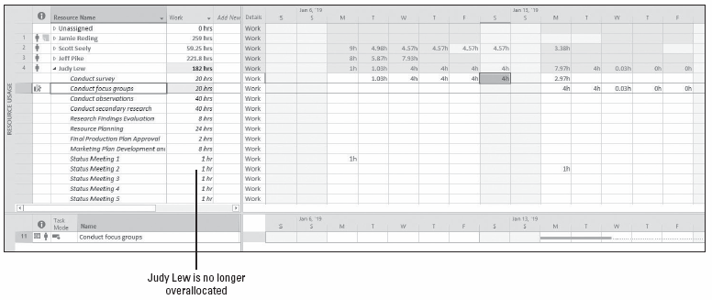
Step-by-Step: Manually Resolve a Resource Overallocation
Notes:
Resource Allocation view with Judy Lew’s over‐allocation on tasks 7 and 11 resolved

Slide 34
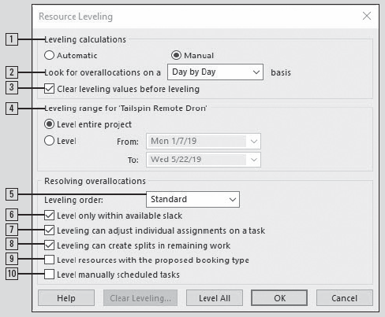
Software Orientation
The Resource Leveling dialog box, shown at right, allows you to specify the rules and options that control how Microsoft Project performs resource leveling.
The numbered options are described on the following slides.
Notes:
Resource Leveling dialog box

Slide 35
Software Orientation
The options in the Resource Leveling dialog box are:
Leveling calculations: These selections determine whether Microsoft Project levels resources constantly (Automatic) or only when you tell it to do so (Manual). Automatic leveling occurs as soon as a resource becomes overallocated.
Look for overallocations on a . . . . . basis: This selection determines the time frame in which Microsoft Project will look for overallocations. If a resource is overallocated, its name will be formatted in red. If a resource is not overallocated, there will be no indication of any overallocation.
Clear leveling values before leveling: You might have to level resources repeatedly to get the results you want. If the Clear leveling values before leveling check box is selected, Microsoft Project removes any existing delays from all tasks before leveling.

Slide 36
Software Orientation
The options in the Resource Leveling dialog box are (continued):
Leveling range for . . . : This selection determines whether you level the entire project or only those assignments that fall within a date range you specify. Leveling within a date range is advantageous when you have started tracking actual work and you want to level only the remaining assignments in a project.
Leveling order: This setting allows you to control the priority Microsoft Project uses to determine which tasks it should delay to resolve a resource conflict. There are three options: ID Only, Standard, and Priority, Standard. The ID Only option delays tasks according to their ID numbers only. The Standard option delays tasks according to their predecessor relationships, start dates, task constraints, slack, priority, and IDs. The Priority, Standard option looks at the task’s priority value before other standard criteria.

Slide 37
Software Orientation
The options in the Resource Leveling dialog box are (continued):
Level only within available slack: Clearing this setting allows Microsoft Project to extend the project’s finish date, if necessary, to resolve resource overallocations. Selecting this setting would prevent Microsoft Project from extending the project’s finish date in order to resolve resource overallocations. Instead, Project would only use the free slack of tasks, which might or might not be adequate to fully resolve resource overallocations.
Leveling can adjust individual assignments to work on a task: This setting allows Microsoft Project to add leveling delay (or, if Leveling can create splits in remaining work is selected, to split work on assignments) independently of any other resources assigned to the same task. This could cause resources to start and finish work on a task at different times.

Slide 38
Software Orientation
The options in the Resource Leveling dialog box are (continued):
Leveling can create splits in remaining work: This setting allows Microsoft Project to split work on a task in order to resolve an overallocation.
Level resources with the proposed booking type: Use this option only when Microsoft Project 2016 is being used in an enterprise environment, such as Project Server 2013. Using this option allows Microsoft Project to level resources in projects, connected to Project Server 2013, that have a proposed booking type.
Level manually scheduled tasks: If your project contains manually scheduled tasks that have overallocated resources, selecting this option allows the software split or delays these tasks. Leave this option selected if you want to maintain control and manually resolve overallocations on the manually scheduled tasks.
Notes:
Deselecting the Level resources with the proposed booking type option causes the software to ignore all resources that have a proposed booking type.

Slide 39
Leveling Overallocated Resources
To avoid an overallocation situation, you can cause a resource’s work on a specific task to be delayed through a process known as resource leveling.
In the following exercise, you will use resource leveling to resolve overallocations. Recall that resource leveling is the process of delaying or splitting a resource’s work on a task to resolve an overallocation.
The options in the Resource Leveling dialog box enable you to set parameters about how you want Microsoft Project to resolve resource overallocations. Depending on the options you choose, Microsoft Project might try to level resources by delaying the start date of an assignment or task, or splitting the work on the task.
Notes:
Even though the effects of resource leveling might sometimes be significant, resource leveling never changes who is assigned to tasks or the total work or assignment unit values of those assignments.

Slide 40
Step-by-Step: Use Resource Leveling to Resolve an Overallocation
GET READY. USE the project schedule you created in the previous exercise.
On the ribbon, in the Split View group, deselect the Details check box.
On the ribbon, in the Resource Views group, click Resource Sheet. The Resource Sheet view appears. Take note of the resource names that appear in red and have the overallocated icon in the Indicators column.
Click on the Resource tab. In the Level group, select Leveling Options. The Resource Leveling dialog box appears.
In the Resource Leveling dialog box, under Leveling calculations, select Manual, if it is not already selected.
Notes:
Take Note: All of the settings in the Resource Leveling dialog box apply to all project schedules with which you work in Microsoft Project—not just the active project schedule. It might sound easier to use automatic leveling, but it will make frequent adjustments to project schedules whether you want them to occur or not. Because of this, it is recommended that you always have Manual Leveling calculations selected.

Slide 41
Step-by-Step: Use Resource Leveling to Resolve an Overallocation
In the Look for overallocations on a . . . . . basis box, select Week by Week.
Ensure the Clear leveling values before leveling check box is checked.
Under Leveling range for, select Level entire project.
Under Resolving overallocations, in the Leveling order box, select Standard.
Clear the Level only within available slack check box.
Select the Leveling can adjust individual assignments on a task check box.
Select the Leveling can create splits in remaining work check box.
Clear the Level resources with the proposed booking type check box.
Notes:
Take Note: In most projects, leveling in detail more precise than Day by Day can result in unrealistically precise adjustments to assignments.

Slide 42
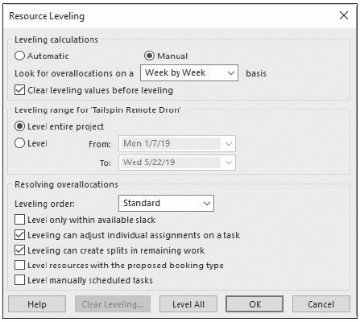
Step-by-Step: Use Resource Leveling to Resolve an Overallocation
Clear the Level manually scheduled tasks check box. Your screen should look similar to the figure at right.
Click the Level All button.
Notice that Project levels the overallocated resources.
Notes:
Some resources, such as Scott Seely, Judy Lew, Annette Hill, and Ryan Ihrig, are still formatted in red, meaning that these resources are still overallocated, probably due to being assigned work during their normal nonworking times.

Slide 43
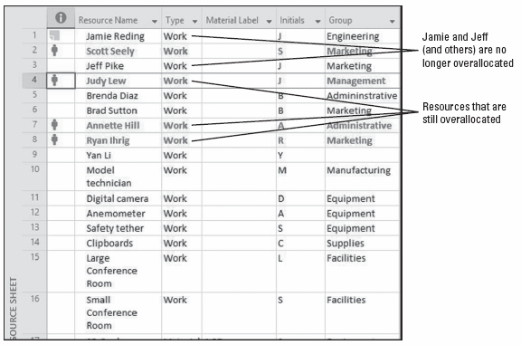
Step-by-Step: Use Resource Leveling to Resolve an Overallocation
After step 15, your screen should look similar to the figure at right.
On the ribbon, click the down arrow under the Team Planner button. Select More Views, select Leveling Gantt, and then click Apply.
Notes:
Resource Sheet view after resource leveling

Slide 44
Step-by-Step: Use Resource Leveling to Resolve an Overallocation
Press the F5 key and then key 2/17/19 in the Date box, and then click OK.
Scroll vertically so that task 13 or 14 is at the top of the task name list. Your screen should look similar to the figure on the next slide.
Notice that each task now has two bars. The tan bar on the top represents the preleveled task. The light blue bar on the bottom represents the leveled task. You can see all of the preleveled start, duration, and finish values for any task by pointing to the desired tan bar. The solid teal line to the right of any light blue bar represents the float (slack) for that task.
SAVE the project schedule and then CLOSE the file.
PAUSE. If you are continuing to the next lesson, keep Project open. If you are not continuing to additional lessons, CLOSE Project.

Slide 45
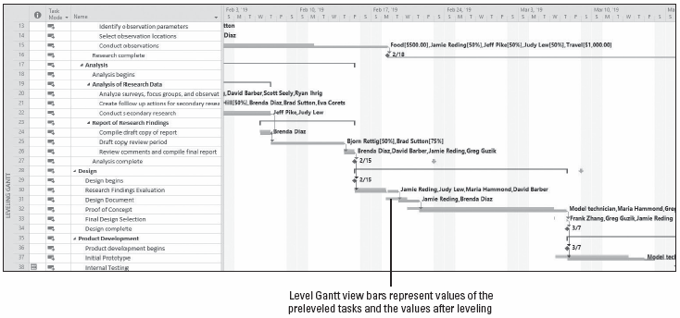
Step-by-Step: Use Resource Leveling to Resolve an Overallocation
Notes:
Leveling Gantt view showing the effects of resource leveling

Slide 46
Leveling Overallocated Resources
Resource leveling is a powerful tool, but it has limits. It can only do a few things: It adds delays to tasks, it splits tasks, and it adjusts resource assignments. It does this by following a complex set of rules and options that you specify in the Resource Leveling dialog box.
Resource leveling is useful for fine‐tuning, but it can’t replace the judgment of a project manager about task durations, relationships, and constraints, or resource availability.
Resource leveling works with the information in your project schedule, but it might not be possible to completely resolve all resource overallocations within the time frame you want without changing more basic task and resource information.

Slide 47
Skill Summary

