Slide 1
Project Information: Sorting, Grouping, and Filtering
Microsoft Project 2016
Lesson 7

Slide 2
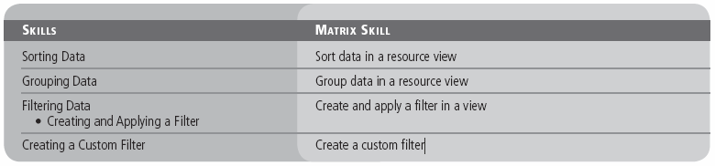
Objectives

Slide 3
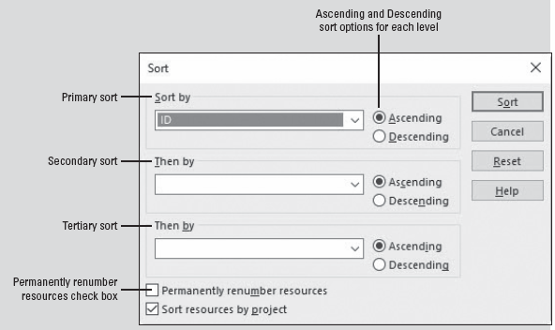
Software Orientation
In Microsoft Project, use the Sort dialog box to sort task or resource information in the current view by a specified field or fields.
The Sort dialog box enables you to select up to three fields for three levels of sorts within sorts, with options for ascending or descending order.
Notes:
The Sort dialog box also enables you to indicate whether items should be permanently renumbered according to the sort.

Slide 4
Sorting Data
It is easiest to review and use data in Microsoft Project when you have it organized to fit your needs. The simplest way to reorganize task and resource data in Project is by sorting.
In the next exercise, you will perform several sorts on project data to allow you to more closely examine certain aspects of your project.
A sort is a way of ordering task or resource information in a view by the criteria you specify.
You can sort tasks or resources using predefined criteria, or you can create your own sort order with up to three levels (a group within a group within a group).
If you need to sort data in a view with more than three criteria, start by sorting your least important factors first and then sort by your three most important factors.

Slide 5
Sorting Data
Sorting allows you to arrange data in an order that answers a question you might have, or in a way that makes more sense or is more user‐friendly to your project team.
Note that there is no visual indicator that a task or resource view has been sorted other than the order in which the rows of data appear.
You cannot save custom sort settings that you have specified.
Normally, sorting does not change the actual project schedule data. However, there is one exception, which relates to the option that Project offers to renumber resource or task IDs after sorting.
For example, at the beginning of a project, you might want to permanently renumber tasks or resources after you enter them. Once resources or tasks are renumbered by sorting, you can’t restore their original numeric order.

Slide 6
Step-by-Step: Sort Data in a Resource View
GET READY. Before you begin these steps, open Tailspin Remote Drone 7M from the data files for this lesson. SAVE the file as Tailspin Remote Drone 7 in the solutions folder.
Click the View tab and then click Resource Sheet. The default table in the Resource Sheet view is the Entry table. However, you want to look at the cost per resource, which is not displayed in the Entry table.
On the View ribbon, in the Data group, click the Tables button and then select Summary. The Summary table appears in the Resource Sheet view.
Auto‐fit the columns so the data can be easily read. Your screen should look similar to the figure on the next slide.

Slide 7
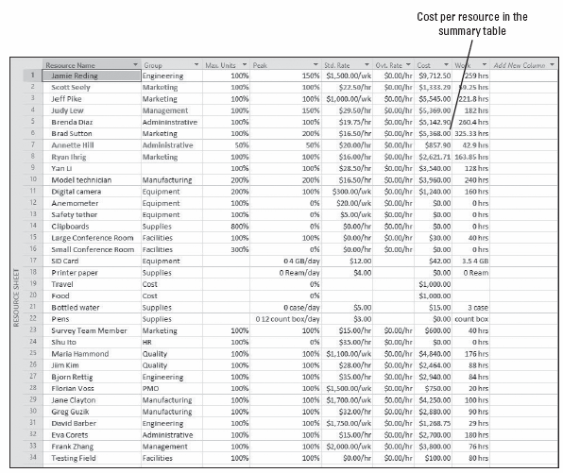
Step-by-Step: Sort Data in a Resource View
Notes:
Resource Sheet with summary table applied

Slide 8
Step-by-Step: Sort Data in a Resource View
On the View ribbon, in the Data group, click the Sort button and then click Sort By. The Sort dialog box appears.
In the Sort by section, select Cost from the drop‐down menu. Next to that, click Descending. Make sure that the Permanently renumber resources check box at the bottom of the Sort dialog box is not checked.
Click the Sort button. The Summary table is sorted from the highest to lowest value in the Cost column. This sort enables you to look at resource costs across the entire project. Your screen should look similar to the figure on the next slide.
On the View ribbon, click Sort and then click Sort by. The Sort dialog box appears.
Notes:
Take Note: The Permanently renumber resources check box (or when in a task view, Permanently renumber tasks) is a Project‐level setting. If you check this box, Project permanently renumbers resources or tasks in any Microsoft Project file in which you sort. Because you might not want to permanently renumber tasks or resources every time you sort, it is a good idea to have this option turned off.

Slide 9
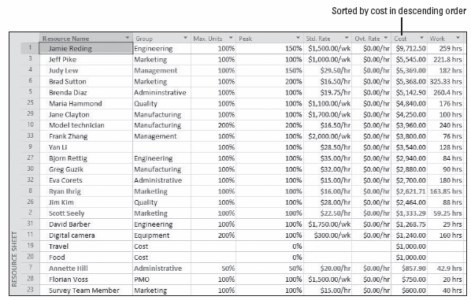
Step-by-Step: Sort Data in a Resource View
Notes:
Resource Sheet sorted with highest cost resource at top

Slide 10
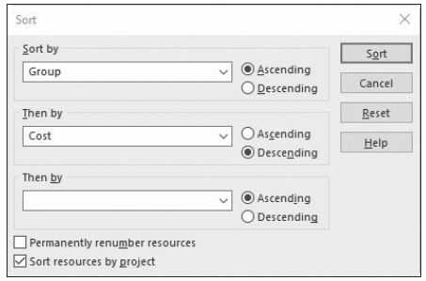
Step-by-Step: Sort Data in a Resource View
In the Sort by section, select Group from the drop‐down menu. Next to that, click Ascending.
In the Then by section, select Cost from the drop‐down menu. Then, click the radio button next to Descending. Make sure the Permanently renumber resources box is not checked. Your screen should look similar to the figure below.
Notes:
Take Note: When you sort data in your project, the sort applies to the active view, no matter which table is currently displayed in the view. For example, if you sort the Task Usage view by finish date while the Entry table is visible, and then switch to the Cost table, you will see that the tasks are still sorted by finish date in the Cost column.

Slide 11
Step-by-Step: Sort Data in a Resource View
Click the Sort button. The Resource Sheet view is sorted to display resources sorted first by Group and then by Cost within each group. Your screen should look like the figure on the next slide.
Now you will restore the data to its original order. On the Quick Access Toolbar, click the Undo button. The Undo button reverses the last sort you performed, restoring the data to the original sort order (by Cost only).
Click Undo again. The data is restored to the original order in the Summary table of the Resource Sheet view. The Multiple Level Undo enables you to undo actions or sets of actions while you are working on your project schedule.
SAVE the project schedule.
PAUSE. LEAVE the project schedule open to use in the next exercise.
Notes:
Another Idea: You can also “unsort” your data by clicking the Sort button on the View ribbon, and then clicking By ID.

Slide 12
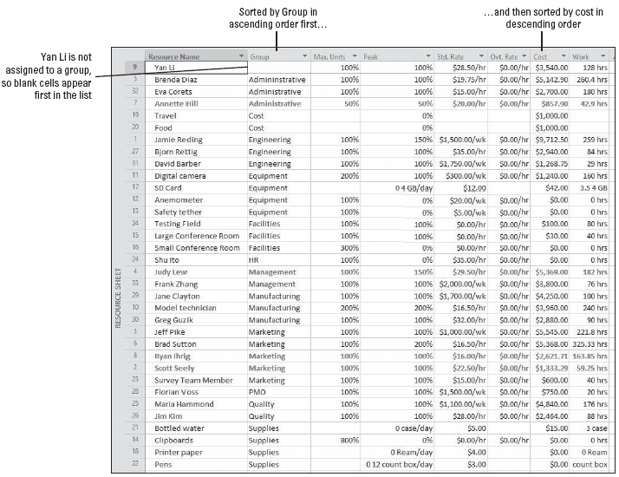
Step-by-Step: Sort Data in a Resource View
Notes:
Resource Sheet sorted by Group then by Cost

Slide 13
Sorting Data
The Multiple Level Undo function allows you to easily undo sets of actions you have performed in Microsoft Project. You can undo changes that you purposely made, or reverse mistakes that you make while working on your project schedule.
The functionality of Multiple Level Undo doesn’t stop there. It enables you to make, undo, and redo changes to views, data, and options—so you can experiment with different scenarios without causing permanent, undesired effects.
You can test several approaches to resolving a problem or optimizing a project schedule in order to fully understand the implications of each choice.
Notes:
A word of caution regarding the Multiple Level Undo feature—it will not undo all actions. For example, if you save a file, the undo feature cache is cleared and you cannot undo the save.

Slide 14
Grouping Data
Another way to organize, view, and analyze the data in your project schedule is through grouping. Grouping enables you to organize the task and resource criteria in your schedule according to various criteria that you select.
Similar to sorting, grouping only changes the way data is displayed—it does not change the data itself.
In the next exercise, you will reorganize your project data using grouping. A group is a way to reorder task or resource information in a table and to display summary values for each group according to various criteria you can choose.
Grouping goes a step beyond sorting in that grouping your project data will add summary values, called “roll‐ups,” at customized intervals.

Slide 15
Grouping Data
Grouping the data in a project schedule enables you to view your information from a variety of perspectives. It also allows for a more detailed level of data analysis and presentation.
Your project schedule helps you track the work and costs associated with your project. By using grouping, you also have the ability to look at more details—to understand not just what is happening on your project, but also why.
As with sorting, grouping does not change the fundamental structure of your project schedule but rather just reorganizes and summarizes it.
Also like sorting, grouping applies to all tables you can display in the view. You can use any of the predefined groups, customize these predefined groups, or create your own.

Slide 16
Step-by-Step: Group Data in a Resource View
GET READY. USE the project schedule you created in the previous exercise.
On the View ribbon, in the Group By box, click the down arrow and click Resource Group. Microsoft Project reorganizes the data into resource groups and presents it in an expanded outline. It also adds summary costs by group. Your screen should look like the figure on the next slide.
The summary data rows are set off with a colored background. Because the data in the summary rows is derived from subordinate data, this cannot be changed directly. To have more control over how your data is presented, you can create custom groups.

Slide 17
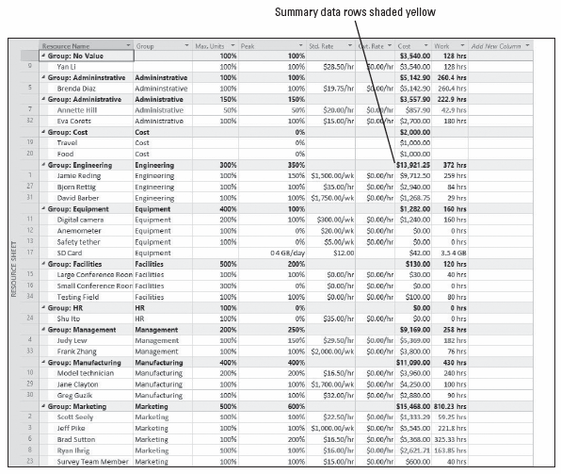
Step-by-Step: Group Data in a Resource View
Notes:
Resource Sheet with data summarized and grouped by Resource Group

Slide 18
Step-by-Step: Group Data in a Resource View
On the View ribbon, in the Group By box, click the down arrow and then click More Groups. The More Groups dialog box appears, displaying all of the predefined groups for tasks and resources available to you. You will create a new group that is similar to the Resource Group.
Select Resource Group (if it is not already selected) and then click the Copy button. The Group Definition dialog box appears.
In the Names box, key Resource Groups by Cost.
In the Field Name column, click the first empty cell below Group.
Key or select Cost.

Slide 19
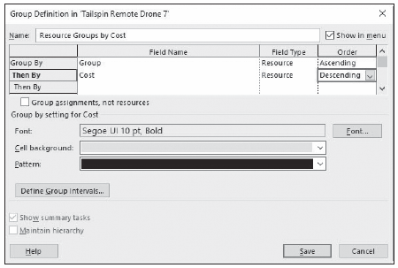
Step-by-Step: Group Data in a Resource View
In the Order column for the Cost field, click on Ascending to select it and then select Descending from the drop‐down menu. The resources will be sorted within their groups by descending cost. The Group Definition dialog box should look similar to the figure below.
Notes:
Group Definition dialog box

Slide 20
Step-by-Step: Group Data in a Resource View
In the Group Definition dialog box, click the Define Group Intervals button. The Define Group Intervals dialog box appears.
In the Group on box, select Interval from the drop‐down menu.
Key 500 in the Group interval box and then click OK.
In the Group Definition dialog box, click the Save button to close the dialog box. Resource Groups by Cost appears as a new group in the More Groups dialog box.
In the More Groups dialog box, click Apply. Microsoft Project applies the new group to the Resource Sheet view.
Right‐click the Resource Name column heading and then select Field Settings. The Field Settings dialog box appears. You want to widen the Resource Name column.

Slide 21
Step-by-Step: Group Data in a Resource View
In the Field Settings dialog box, click the Best Fit button. The Resource Name column is widened. If needed, scroll to the top of the view. Your screen should look similar to the figure on the next slide. The resources are grouped by Resource Group (the yellow shaded cells) and within each group by cost values at $500 increments (the blue shaded cells).
After you have reviewed the groupings you created, in the Group By box, click on the down arrow in the Data group, and then click [No Group]. Microsoft Project removes the groupings, restoring the original data. Displaying or removing a group has no effect on the data in the project.
SAVE the project schedule.
PAUSE. LEAVE the project schedule open to use in the next exercise.
Notes:
Another Way: You can also auto‐fit any column by placing the cursor on the right side dividing line and double‐clicking.

Slide 22
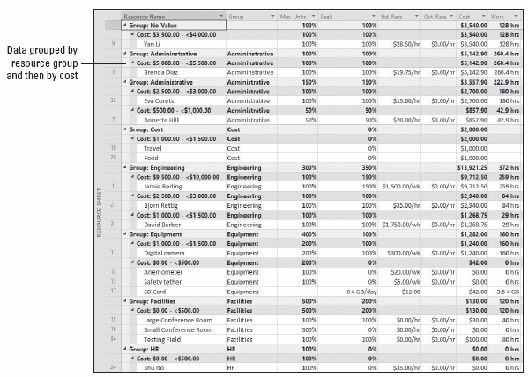
Step-by-Step: Group Data in a Resource View
Notes:
Resource Sheet with multiple level grouping applied

Slide 23
Filtering Data
The feature called filtering allows you to look only at specific task or resource data that meets specific criteria. Filtering hides task or resource data that does not meet the criteria you specify and displays only the data in which you are interested. You can use a predefined filter, AutoFilters, or create a custom filter.
In the next exercise, you will create and apply a filter to the project schedule to enable you to look at only the tasks dealing with scene shoots.
A filter is a tool that enables you to see or highlight in a table only the task or resource information that meets criteria you choose.
Filtering doesn’t change the data in your project schedule—it only changes the data’s appearance.
Notes:
You can also apply multiple column filters. For example, suppose you want to display all tasks that are more than one week in duration and start between 2/1/17 and 3/30/17. You would apply an AutoFilter of “1 week or longer” to the Duration column and then apply an AutoFilter of “Between” 2/1/17 and 3/30/17 to the Start column.

Slide 24
Creating and Applying a Filter
There are two ways to apply filters to a view—predefined filters or AutoFilters:
Predefined or custom filters allow you to see or highlight only the task or resource information that meets the criteria of the filter. For example, the Milestones filter displays only tasks that are milestones. Some predefined filters, such as the Date Range filter, require you to enter criteria (a date) to set up the filter.
AutoFilters are used for more informal or impromptu filtering. An AutoFilter is a quick way to view only the task or resource information that meets the criteria you choose. When the AutoFilter feature is turned on, small down arrows are visible adjacent to the column heading name. Clicking the arrow activates a list of criteria that can be used to filter the data.
Notes:
Take Note: If a Task or a Resource Sheet view has a filter applied to it, the name of the filter will be displayed in the Filter box on the View ribbon.

Slide 25
Step-by-Step: Create and Apply a Filter in a View
GET READY. USE the project schedule you created in the previous exercise.
On the View ribbon, in the Task Views group, click the upper portion of the Gantt Chart button. The Gantt Chart view appears.
AutoFilter is on by default in the task and resource views. You can see small, chevron‐style arrows on the right side of each column heading. You can use these arrows to select the AutoFilter option you want to use. Adjust the width of the Gantt chart so that the Task Name, Duration, and Start columns are visible. Your screen should look similar to the figure on the next slide.

Slide 26
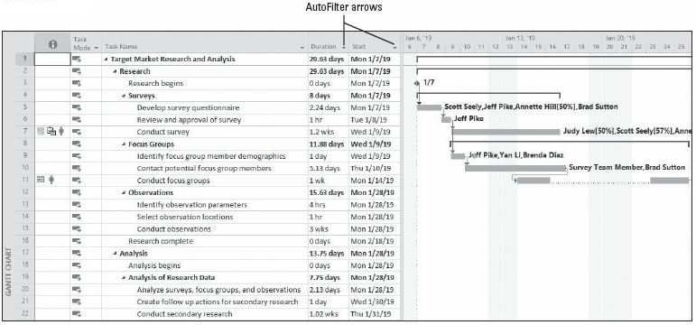
Step-by-Step: Create and Apply a Filter in a View
Notes:
Gantt Chart view displaying AutoFilter buttons on each column

Slide 27
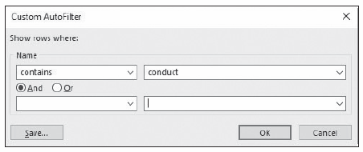
Step-by-Step: Create and Apply a Filter in a View
Click the AutoFilter arrow in the Task Name column heading, point to Filters, and then click Custom. You want to see just the tasks that contain the letter‐string of c‐o‐n‐d‐u‐c‐t.
In the Name section, select contains from the drop‐down list in the first box if it is not already visible. In the adjacent box, key conduct. The Custom AutoFilter dialog box should look similar to the figure below.
Notes:
Take Note: To turn the AutoFilter off or on, click the down arrow in the (No Filter) box in the Data Group and then select Display AutoFilter.

Slide 28
Step-by-Step: Create and Apply a Filter in a View
Click OK to apply the filter and close the Custom AutoFilter dialog box. Microsoft Project filters the task list to show only the tasks that contain the word conduct, as well as their summary tasks. Your screen should look similar to the figure on the next slide.
Note on the right side of the Task Name column, there is a small “funnel” that appears. This is a visual indicator that an AutoFilter has been applied to this column in this view.
On the ribbon, in the Data group, click the down arrow in the Filter box (currently, it has No Filter) and then select Clear Filter. The AutoFilter is cleared and all the tasks in the project schedule are displayed.
SAVE the project schedule.
PAUSE. LEAVE the project schedule open to use in the next exercise.
Notes:
Another Way: You can also use the F3 key to clear all filters.

Slide 29
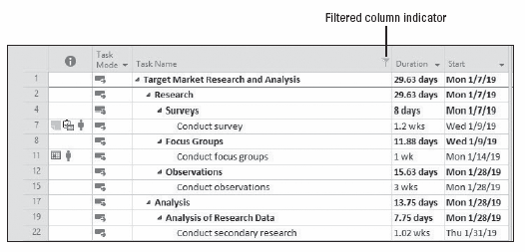
Step-by-Step: Create and Apply a Filter in a View
Notes:
Gantt Chart view with custom AutoFilter applied

Slide 30
Creating a Custom Filter
In the previous exercise, you used AutoFilter to apply a filter to data. In the following exercise, you will create a custom filter that can be used without entering the filtering criteria each time.
A custom filter works in the same way as a predefined filter, except that you have selected the filtering criterion rather than Microsoft Project.
Remember that after filtering, you might see gaps in the task or resource ID numbers. The data has not been deleted—it is only hidden until you remove the filter.
Also, as with sorting and grouping, the filtering applies to all the tables you can display in the active view. Some views that do not support tables, such as the Calendar view, do support filtering but not AutoFilters.

Slide 31
Step-by-Step: Create a Custom Filter
GET READY. USE the project schedule you created in the previous exercise.
On the View ribbon, in the Data group, click the down arrow in the Filter box (currently, it has No Filter) and then select More Filters. The More Filters dialog box appears. This dialog box shows you all of the predefined filters for tasks or resources that are available to you.
Click the New button. The Filter Definition dialog box appears.
In the Name box, key Unfinished External Research Tasks.
In the first row of the Field Name column, key or select Name.
Notes:
Another Way: You can also click the down arrow in the (No Filter) box in the Data group and then select New Filter.

Slide 32
Step-by-Step: Create a Custom Filter
In the first row of the Test column, key or select contains.
In the first row of the Value(s) column, key conduct. You have now finished entering the first criterion for the filter. Next, you enter the second criterion.
In the second row of the And/Or column, select And.
In the second row of the Field Name column, key or select Actual Finish.
In the second row of the Actual Finish column, key or select equals.
In the second row of the Value(s) column, key NA. “NA” is how Microsoft Project marks fields that do not yet have a value. In other words, any shooting task that does not yet have a value must be uncompleted. Your screen should look similar to the figure on the next slide.

Slide 33
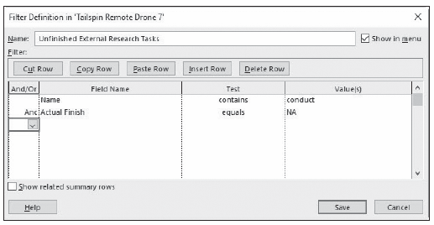
Step-by-Step: Create a Custom Filter
Notes:
Filter Definition dialog box with custom criteria entered

Slide 34

Step-by-Step: Create a Custom Filter
Click the Save button to close the Filter Definition dialog box.
Locate and select the Unfinished External Research Tasks filter in the list, if necessary. Click Apply. Microsoft Project applies the new filter to your project schedule in the Gantt Chart view. Your screen should look similar to the figure below.
Take note of the gaps in the task IDs. This is one visual way you can tell that a filter has been applied. The tasks are filtered to show uncompleted tasks. The related summary tasks have not been displayed. This is because we did not tell the filter to display them.
Notes:
Gantt Chart view with Unfinished Shoots filter applied

Slide 35
Step-by-Step: Create a Custom Filter
On the View ribbon, in the Data group, click the down arrow in the Filter box (currently, it has Unfinished External Research Tasks) and then select (No Filter). Microsoft Project removes the filter.
SAVE the project schedule. CLOSE the project schedule.
PAUSE. If you are continuing to the next lesson, keep Microsoft Project open. If you are not continuing to additional lessons, CLOSE Microsoft Project.

Slide 36
Skill Summary

