Slide 1
Project Schedule Tracking—Fundamentals
Microsoft Project 2016
Lesson 9

Slide 2
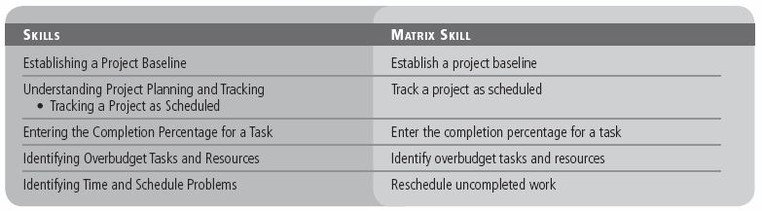
Objectives

Slide 3
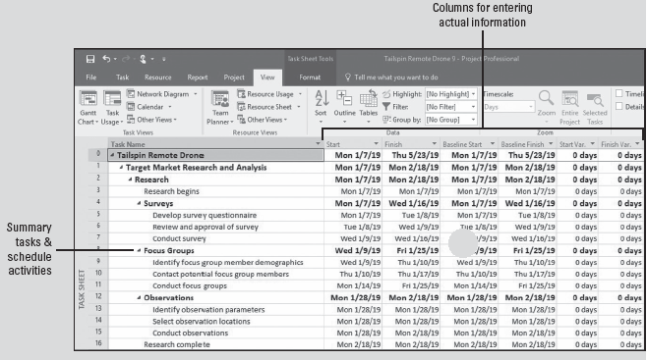
Software Orientation
The Variance table can be used to review baseline information in table format, as shown in the figure below.
Notes:
On the Variance table, you can also see the variance between the baseline start and the planned or actual start of a task. In other words, this table shows you if the project is ahead of schedule or behind schedule, on a task‐by‐task basis.

Slide 4
Establishing a Project Baseline
To evaluate how well a project is progressing, it is important to review how well it was originally planned. The schedule baseline is the project schedule that has been approved by the project sponsor. The baseline is saved and then referred to later to track project progress.
You should save a baseline when:
You have developed the project schedule as much as possible. (You can still add tasks, resources, or an assignment after the work has begun. This is usually unavoidable.)
Your project has been approved and accepted by the project sponsor.
You have not started to enter actual values, such as a percentage of completion for the task.

Slide 5
Establishing a Project Baseline
In the next exercise, you will learn how to save a baseline for your project schedule.
In project management, by definition, a baseline is the approved version of the scope, schedule, and budget of a project. In Microsoft Project, a baseline is a “snapshot” of the key values, such as the planned start and finish dates (schedule), the planned costs (budget), and the tasks (scope), at a given point in time.
You must save a baseline before you begin tracking project progress. When tracking project progress, you will notice differences between the baseline and the actuals, which is called a variance.
The table on the next slide lists the specific values saved in the baseline, which include the task, resource, and assignment fields, as well as the timephased fields, which are the task, resource, and assignment values distributed over time.

Slide 6
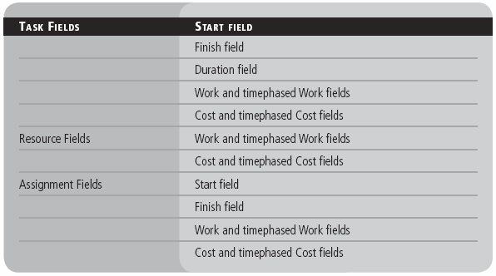
Establishing a Project Baseline
Notes:
Baseline field types saved by Project 2016

Slide 7
Step-by-Step: Establish a Project Baseline
GET READY. Before you begin these steps, open Tailspin Remote Drone 9M from the data files for this lesson. SAVE the file as Tailspin Remote Drone 9 in the solutions folder.
Click the Project tab. In the Schedule group, click the Set Baseline button and then select Set Baseline.
The Set Baseline dialog box appears. You will accept all of the default settings in this dialog box by clicking OK.
Microsoft Project saves the baseline, although there is no indication in the Gantt Chart view that anything has changed.
On the ribbon, click the View tab and then click the down arrow under Gantt Chart. Select More Views and the More Views dialog box appears.
Notes:
Take Note: You can save up to 11 baselines in a single project schedule. The baselines are named Baseline (the first baseline you would normally save) and Baseline 1 through Baseline 10. Saving multiple baselines is helpful if your project duration is especially long or if you have approved scope/schedule/cost changes. You can save multiple baselines to record different sets of baseline values, and later compare these against each other and against actual values.

Slide 8
Step-by-Step: Establish a Project Baseline
In the More Views dialog box, select Task Sheet and click Apply. Using this view, there is more room to see the fields in the table because the Gantt chart is not shown. Now, you will switch to a different table in the Task Sheet view.
On the ribbon, click Tables and then click Variance. The Variance table appears. This table includes both the Scheduled and Baseline columns so that you can compare them easily.
Auto‐fit all the columns so you can see all the data. Your screen should look similar to the figure on the next slide.
SAVE the project schedule.
PAUSE. LEAVE Project open to use in the next exercise.
Notes:
Note that at this point, the values in the Start and Baseline Start columns, as well as the values in the Finish and Baseline Finish columns, are identical. This is because no actual work has occurred and no changes to the scheduled work have been made. Once actual work has been recorded or schedule adjustments have been made, the scheduled values might differ from the baseline values. Any differences would be displayed in the Variance column.

Slide 9
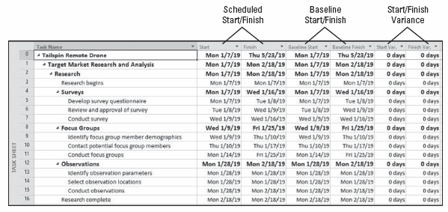
Step-by-Step: Establish a Project Baseline
Notes:
Variance table displaying scheduled and baseline information
Take Note: If any column displays pound signs (####), double‐click between the column titles to widen the column.

Slide 10
Understanding Project Planning and Tracking
The early stages of a project focus on project planning—developing and communicating the details of a project before actual work begins.
When work begins, this is sometimes called executing the project work. During this time, you will track project progress.
Tracking refers to all of the collecting, entering, and analyzing of actual project performance data, such as actual work values on tasks (usually expressed in hours), actual resource costs, and actual durations.
These details, collectively, are often called actuals and can be recorded in a Microsoft Project file.

Slide 11
Understanding Project Planning and Tracking
Accurately tracking project performance and comparing it against the baseline helps you to answer such questions as:
Are tasks starting and finishing as planned? If not, what will be the impact on the finish date?
Are resources completing the proper amount of the scope? Are they doing unapproved work? (This is called either scope creep or gold plating.)
Are resources requiring more or less than the scheduled amount of time to complete tasks?
Are tasks being completed above or below scheduled cost?

Slide 12
Understanding Project Planning and Tracking
There are several ways to track progress in Microsoft Project, depending on the level of detail or control required. You need to determine the level of detail you need. In this lesson, you will examine the following different levels of tracking:
Record project work as scheduled: This works best if everything in the project occurs exactly as scheduled, which rarely happens.
Record each task’s percentage of completion: You can do this at either precise values or at increments of 25%, 50%, 75%, and 100%.
Record the actuals: This records the actual start and finish, actual work, and actual and remaining duration for the task or assignment.
Track assignment‐level work by time period: You record actual work values by day, week, or other time interval that you select. This is the most detailed level of tracking.
Notes:
You can apply a combination of these approaches within a single project, as different parts of a project might have different tracking needs.

Slide 13
Tracking a Project as Scheduled
Once a baseline has been saved for a project schedule, the work done on the project can be tracked against the baseline values. The simplest approach to tracking is to report that the actual work is proceeding as planned.
In the following exercise, you will update the project to show that work has occurred as scheduled through a certain date. This date is sometimes called the status date—the date up to or through which all progress information is collected and entered for a project.
The progress bar in the Gantt Chart view shows how much of each task has been completed. A check mark appears in the Indicators column for tasks 2, 3, and 4 to indicate these tasks have been completed. In addition, a progress bar is drawn through the entire length of these tasks’ Gantt bars.
Notes:
Because only a portion of task 11 has been completed by January 18, the progress bar for this task only extends to January 18 and no check mark appears in the Indicators column. Also notice that because some of the recurring status meetings (summary task 56) have been completed by January 18, progress bars appear in the summary Gantt bars for these tasks.

Slide 14
Step-by-Step: Track a Project as Scheduled
GET READY. USE the project schedule you created in the previous exercise.
On the ribbon, click Gantt Chart. The Gantt Chart view appears.
Move the vertical splitter bar to a point just to the right of the Start column.
Click the Project tab. In the Status group, click Update Project. The Update Project dialog box appears.
Make sure the Update work as complete through option is selected. In the adjacent date box, key or select January 18, 2019, and then click OK. Microsoft Project records the actual work for the projects that were scheduled to start before January 18. It also draws progress bars in the Gantt bars for those tasks to show this progress visually.

Slide 15
Step-by-Step: Track a Project as Scheduled
Right‐click on the Task Name column heading and then select Insert Column. Key the word indicators and then press Enter.
Auto‐fit the new column. Your screen should look similar to the figure on the next slide.
SAVE the project schedule.
PAUSE. LEAVE the project schedule open to use in the next exercise.

Slide 16
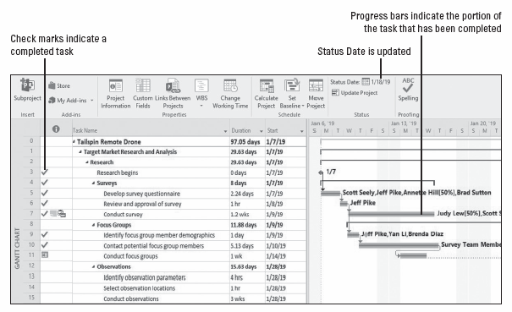
Step-by-Step: Track a Project as Scheduled
Notes:
Progress bars for completed and in‐progress tasks in the Gantt chart view

Slide 17
Entering the Completion Percentage for a Task
There are many ways to record the work that has been done on a task. One quick way is to record the completion percentage of the task.
In the following exercise, you will manually enter the completion percentage for a task. There are several ways you can quickly record task progress as a percentage:
Use one of the % complete fields in the Work or Tracking tables.
Use the preset buttons for recording 0%, 25%, 50%, 75%, and 100% completion on a task.
Use the Update Tasks dialog box (on the Task ribbon, click the Mark on Track down arrow, and then click Update Tasks).
Use the General tab of the Task Information dialog box (by double‐clicking on the task you want to update) to update the Percent Complete field.
Notes:
Using the last two methods, you can enter any percentage of completion you want. When you use any of these methods to enter a percentage other than 0% complete, Microsoft Project changes the task’s actual start date to match its scheduled start date. It also calculates actual duration, remaining duration, actual costs, and other values, based on the percentage you enter.

Slide 18
Entering the Completion Percentage for a Task
In deciding to use “percent complete” as a method of tracking progress, understand that there are four types of percent complete:
Physical % Complete: Based on some physical measurement.
Work % Complete: Based on the planned amount of work.
Cost % Complete: Based on the approved budget.
Schedule % Complete: Based on planned duration.

Slide 19
Step-by-Step: Enter the Completion Percentage for a Task
GET READY. USE the project schedule you created in the previous exercise.
Click the View tab, click the Tables button, and then select the Work table from the list.
Slide the vertical divider bar between the table and the Gantt bar chart so that more of the table columns are visible—you’ll need to auto‐fit the columns to see all the data. Notice the Work and % Work Complete columns. You will enter task completion percentages in the % Work Complete column.
In the % Work Complete column for task 11, key or select 100, and then press Enter. Microsoft Project extends the progress bar through the length of the Gantt bar for task 11 and records the actual work for the task as scheduled.

Slide 20
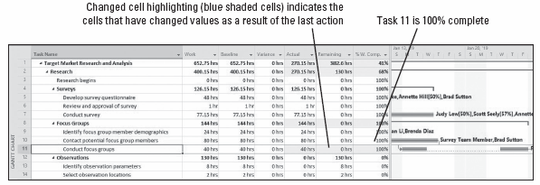
Step-by-Step: Enter the Completion Percentage for a Task
Select task 11 again. On the ribbon, in the Zoom group, click Selected Tasks. Your screen should look similar to the figure below.
Notes:
Gantt Chart view showing task 11 is 100% complete
Task Note: You can also use the schedule percent complete buttons to quickly update tasks that are 0%, 25%, 50%, 75%, and 100% complete. On the ribbon, click the Task tab. The schedule percent complete buttons are located in the Schedule group. Select the task you want to update, and then click the appropriate percentage button.

Slide 21
Step-by-Step: Enter the Completion Percentage for a Task
In the % Work Complete field for task 13, key or select 50, and then press Enter. Microsoft Project records the actual work for the task as scheduled, calculates the remaining work, and then updates the progress line through 50% of the Gantt bar.
Scroll the Gantt chart to see the Gantt bar for task 13.
SAVE the project schedule.
CLOSE the project schedule. In the next exercise, you will use an updated version of the Tailspin Remote Drone 9 project schedule to simulate the passage of time.
PAUSE. LEAVE Microsoft Project open to use in the next exercise.
Notes:
Take Note: You can view a task’s completion percentage and other tracking information by pointing to a progress bar in a task’s Gantt bar. A ScreenTip will appear.

Slide 22
Identifying Overbudget Tasks and Resources
So far, you have focused on a project’s schedule as a key part of the overall success of the project. However, another critical piece of information is the cost variance, or how the actual costs compare with the projected costs.
In the following exercise, you will use several different views and tables to identify tasks and resources that are over budget.
Project managers and stakeholders often focus on the project schedule. (For example, did tasks start and finish on time?)
For projects such as this one that include cost information, cost variance is another critical indicator of overall project health. In Microsoft Project, evaluating cost variance enables you to make incremental budget adjustments for individual tasks to avoid exceeding your project’s overall budget.

Slide 23
Step-by-Step: Identify Overbudget Tasks and Resources
GET READY. OPEN the Tailspin Remote Drone 9MA project schedule from the data files for this lesson. SAVE the file as Tailspin Remote Drone 9A in the solutions folder.
On the ribbon, click the Project tab. In the Properties group, click Project Information. The Project Information dialog box appears.
Click the Statistics button. The Project Statistics dialog box appears. Your screen should look similar to the figure on the next slide.
The Cost column displays the current, baseline, actual, and remaining cost values for the entire project:
Current cost: Sum of the actual and remaining cost values
Baseline cost: Total planned cost when the baseline was saved
Actual cost: Cost that has been incurred so far
Remaining cost: Difference between the current cost and actual cost

Slide 24
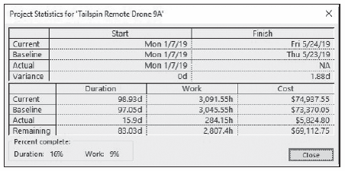
Step-by-Step: Identify Overbudget Tasks and Resources
Click the Close button. The Project Statistics dialog box closes.
Notes:
It is obvious that some cost variance has occurred, but it is not possible to tell from the Project Statistics dialog box when or where the variance occurred.

Slide 25
Step-by-Step: Identify Overbudget Tasks and Resources
On the ribbon, click View. Click on the Tables button and click Cost. The Cost table appears in the Gantt Chart view. Move the vertical divider so you can see all the available columns. Take a moment to review the columns in the Cost table.
Click the Task Name column heading. In the Data group, click the Outline button and then select Hide subtasks. Project collapses the task list to display only the Project Level task (Task ID 0).
Click the Outline button again and then select Level 1. Now, the first level of summary tasks (which, in this case, corresponds to the major phases of the project) appears. Your screen should look like the figure on the next slide.
Notes:
Note that although costs are not scheduled in the same sense that work is scheduled, costs (except fixed costs) are derived from the scheduled work.

Slide 26
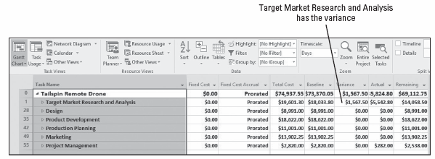
Step-by-Step: Identify Overbudget Tasks and Resources
Click the expand button next to task 1, Target Market Research and Analysis. Your screen should look similar to the figure on the next slide. Although Research and Analysis both had some variance, Analysis had the greater variance, so you will focus on that subtask.
Notes:
Gantt Chart view showing only first level summary tasks with all subtasks hidden

Slide 27
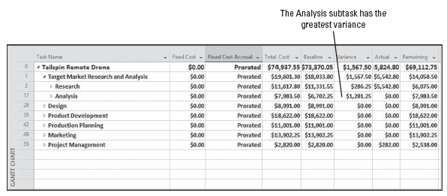
Step-by-Step: Identify Overbudget Tasks and Resources
Click the expand button next to summary task 17, Analysis. Microsoft Project expands the Analysis summary task to show all of the subtasks. Your screen should look similar to the figure on the next slide.
Notes:
Gantt Chart view with subtasks of Research (ID 2) and Analysis (ID 17)

Slide 28
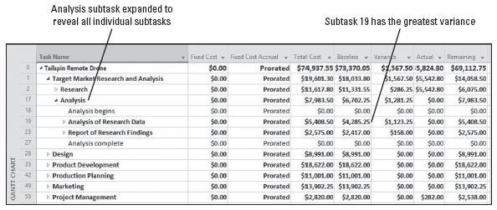
Step-by-Step: Identify Overbudget Tasks and Resources
Click the Task Name column heading.
Click the Outline button and then select the Show Subtasks button. Microsoft Project expands all of the summary tasks to show all of the tasks in the project. Another way to look for tasks that are over budget is with a filter.
Notes:
Gantt Chart view with Analysis subtask expanded to show subtasks

Slide 29
Step-by-Step: Identify Overbudget Tasks and Resources
On the View ribbon, in the Data group, click the down arrow next to the Filter: selection box. Select More Filters from the list. The More Filters dialog box appears.
Select the Cost Overbudget filter and click Apply. Microsoft Project applies the filter to the task list to show only those tasks that had actual and scheduled costs greater than their baseline costs. Your screen should look similar to the figure on the next slide.
SAVE the project schedule.
CLOSE the project schedule. In the next exercise, you will use an updated version of the Tailspin Remote Drone 9A to simulate the passage of time.
PAUSE. LEAVE Microsoft Project open to use in the next exercise.

Slide 30
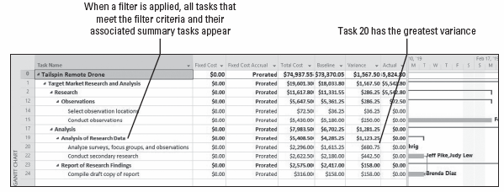
Step-by-Step: Identify Overbudget Tasks and Resources
Notes:
Gantt Chart view with the Cost Overbudget filter applied

Slide 31
Identifying Time and Schedule Problems
In the following exercise, you will reschedule an incomplete task due to an uncontrollable delay. Depending upon the length and complexity of your project, as a project manager you might see one or many of these types of interruptions. Microsoft Project handles tasks in relation to the scheduled restart date in the following ways:
If the task does not have any actual work recorded for it prior to the rescheduled date, and there is no constraint in place, the entire task is rescheduled to begin after that date.
If the task has some actual work recorded prior to but not after the rescheduled date, the task is split so that all remaining work starts after the rescheduled date. The actual work is not affected.
If the task has some actual work recorded for it prior to as well as after the rescheduled date, the task is not affected.

Slide 32
Identifying Time and Schedule Problems
Keep in mind that when you address a given problem by rescheduling a task, you might create other issues or problems in the remainder of the project.
This is why planning in a project is an iterative process: A change in one part of the schedule—be it a time, cost, or scope change—usually affects the schedule elsewhere.
When changing or correcting the schedule due to unforeseen delays, such as the scenario in this exercise, you should also place a note in the Notes field of the affected task(s) stating why the task has been changed.
These notes become helpful when looking for explanations regarding why the project is not performing to the baseline.
Notes:
In the following exercise, after you reschedule the work for task 31, notice that task 41, Product Development Complete, has a missed deadline icon appear next to it. The rescheduling of task 31 creates a problem with the deadline for task 41.

Slide 33
Step-by-Step: Reschedule Uncompleted Work
GET READY. OPEN the Tailspin Remote Drone 9MB project schedule from the data files for this lesson. SAVE the file as Tailspin Remote Drone 9B in the solutions folder.
Press the F5 key, key 31 in the ID box, and then click OK. The Gantt Chart view scrolls to display the Gantt bar for task 31, Design Document. At this point in the project, all of the research and analysis has been completed. This task has one day of actual work completed and one day of scheduled work remaining. Your screen should look similar to the figure on the next slide.
You have just been informed that the FAA has written new rules for recreational drone use. The new rules will be made available to all drone manufacturers on Friday, March 8, 2019. You and your team decide to halt work on this task until Monday, March 11, 2019.

Slide 34
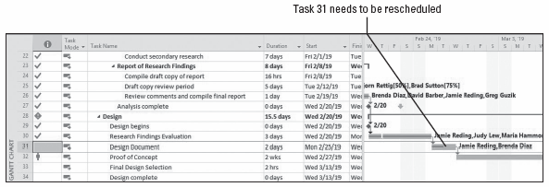
Step-by-Step: Reschedule Uncompleted Work
Press the F5 key, key 31 in the ID box, and then click OK. The Gantt Chart view scrolls to display the Gantt bar for task 31, Design Document.
Select the Reschedule uncompleted work to start after: option, and in the date box, key or select 03/08/19.
Notes:
Gantt Chart view showing task 31 prior to rescheduling the work

Slide 35
Step-by-Step: Reschedule Uncompleted Work
Click OK to close the Update Project dialog box. Microsoft Project splits task 31 so that the incomplete portion is delayed until Monday, March 11, 2019. Your screen should look similar to the figure on the next slide.
Note that although the duration of task 31 remains at two days, its finish and subsequent start dates for successor tasks have been pushed out. Remember that duration is the number of work periods required to complete a task, not elapsed time.
SAVE the project schedule. CLOSE the project schedule.
PAUSE. If you are continuing to the next lesson, keep Microsoft Project open. If you are not continuing to additional lessons, CLOSE Microsoft Project.
Notes:
Take Note: It is possible to disable the ability of Microsoft Project to reschedule uncompleted work on tasks that are showing any actual work. Click on the File tab and then select Options. In the Options dialog box, click the Schedule tab. In the section that reads, Scheduling options for this project, clear the Split in‐progress tasks check box.

Slide 36
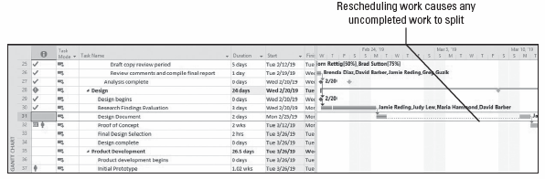
Step-by-Step: Reschedule Uncompleted Work
Notes:
Gantt Chart view after rescheduling uncompleted work on task 31

Slide 37
Skill Summary

