Slide 1
Managing Multiple Projects
Microsoft Project 2016
Lesson 15

Slide 2
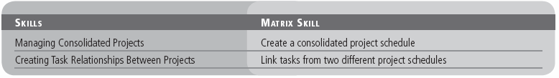
Objectives

Slide 3
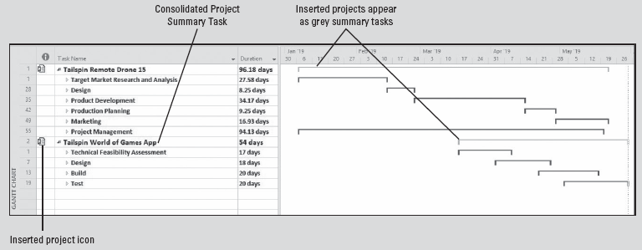
Software Orientation
The Gantt Chart view of a consolidated project, as shown below, allows you to see multiple projects collected in one project schedule, so that you can filter, sort, and group the data, as well as see task relationships between projects.
Notes:
In the Gantt Chart view of a consolidated project, the inserted projects appear as summary tasks with gray Gantt bars and an inserted project icon appears in the Indicators column.

Slide 4
Managing Consolidated Projects
In Microsoft Project, a consolidated project enables a project manager to link and manage multiple projects within one master project file.
This method allows the project manager to see the effects of one project on another single project or many other projects in the same file.
In real life, it is rare that a project manager would manage only a single, small project from beginning to end.
Usually, there are several complex projects that involve several people working on different tasks at different times and locations, and often for different supervisors.

Slide 5
Managing Consolidated Projects
Microsoft Project enables you to combine two (or more) projects to form a consolidated project. A consolidated project is a Microsoft Project file that contains more than one Microsoft Project file, called inserted projects. An inserted project is the Microsoft Project file that is inserted into another Microsoft Project file.
Consolidated projects are also known as master projects, and inserted projects are also known as subprojects.
The inserted projects do not really reside within the consolidated project. They are linked to it in such a way that they can be viewed and edited from the consolidated project.
If an inserted project is edited outside the consolidated project, the updated information appears in the consolidated project the next time it is opened.
Notes:
When you save a consolidated project, any changes you have made to inserted projects are saved in the source files as well.

Slide 6
Managing Consolidated Projects
Using a consolidated project gives you the capability to do things like:
See all of your organization’s project schedules in a single view.
“Roll up” project information to higher management levels. For example, one group’s project might be an inserted project for the department’s consolidated project, which then might be an inserted project for the company’s consolidated project.
Divide your project schedule into separate project schedules to match the nature of your project. For example, you could divide your project schedule into separate schedules by phase, component, or location. You can then group the information back together in a consolidated project schedule for a view of the complete project.
See all of the information for your projects in one location, so you can filter, sort, and group the data as needed.

Slide 7
Managing Consolidated Projects
Consolidated projects use the standard Microsoft Project outlining features. For a consolidated project, the Gantt bar for an inserted project is gray and an inserted project icon appears in the Indicators column.
Also, when you save a consolidated project, any changes you have made to inserted projects are saved in the source file as well.
Theoretically, it is possible to add an unlimited number of project schedules to a consolidated project file. However as a practical matter, and depending on the size of the files, you will notice performance issues, such as slow calculation times, as you add more inserted projects.

Slide 8
Step-by-Step: Create a Consolidated Project Schedule
GET READY. OPEN Tailspin Remote Drone 15M and Tailspin World of Games App 15M from the data files for this lesson. SAVE the files, respectively, as Tailspin Remote Drone 15 and Tailspin World of Games App 15 in the solutions folder. Make sure the Tailspin Remote Drone 15 project schedule is in the active window.
On the ribbon, click the View tab and then click New Window. The New Window dialog box appears.
In the Projects list, select the names of both open projects either by holding down the CTRL key while clicking, or by clicking and dragging to select both names. After you have selected both project schedules, click OK. Microsoft Project opens both files in a new window with the Timeline view at the top.

Slide 9
Step-by-Step: Create a Consolidated Project Schedule
On the ribbon, in the Zoom group, click Entire Project. Microsoft Project adjusts the timescale in the Gantt chart so that the full duration of both projects is visible. Auto‐fit all columns and make sure that the Name, Duration, Start, and Finish columns are visible on your screen. If necessary, double‐click the right edge of any column that display multiple pound signs (###).
Select the Outline button and then select Level 2. Your screen should look similar to the figure on the next slide.
Right‐click on the Task Mode column and select Hide Column.
SAVE the consolidated project schedule as Consolidated Project 15. When you are prompted to save changes to the inserted projects, click the Yes to All button.
Notes:
Take Note: When you point to the inserted project icon in the Indicators column, Microsoft Project displays the full path to the inserted project file.

Slide 10
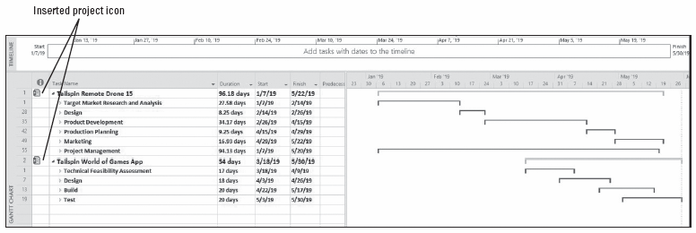
Step-by-Step: Create a Consolidated Project Schedule
On the ribbon, click the Format tab. In the Show/Hide group, click the Project Summary Task check box to activate it. Microsoft Project displays the Consolidated Project 15 summary task at the top of your Task Name column as task 0 (zero). Your screen should look similar to the figure on the next slide.
Notes:
Gantt Chart view with both inserted projects only showing level 2 summary tasks

Slide 11
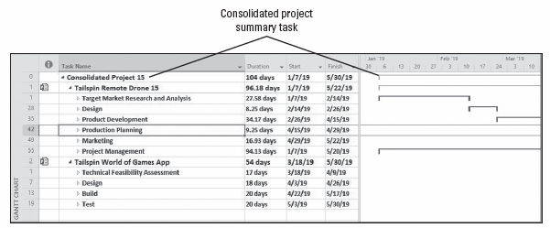
Step-by-Step: Create a Consolidated Project Schedule
The values of the consolidated project summary task represent the rolled‐up values of both inserted projects.
SAVE the consolidated project schedule, as well as the individual project schedules.
PAUSE. LEAVE Project open to use in the next exercise.
Notes:
Gantt chart with consolidated project summary task
Take Note: If you want to add more project schedules to a consolidated project, click the Project tab and then select Subproject from the Insert command group.

Slide 12
Creating Task Relationships Between Projects
Sometimes, tasks in one project might need to be linked to tasks in other projects. Microsoft Project allows you to show these task relationships by linking tasks between projects.
In the next exercise, you will link a task in one project to a task in another project to show a relationship between the two tasks and projects. Most projects are like this—they do not exist in a vacuum.
Task relationships between project files are similar to the task links (relationships) between tasks within a project file, except that external predecessor and successor tasks have gray task names and Gantt bars.
By definition, these are called external tasks and are sometimes referred to as ghost tasks because they are not linked to tasks within the project file, only to tasks in other project files.

Slide 13
Creating Task Relationships Between Projects
There are various reasons you might need to create links between projects. Some of the more common reasons are:
The completion of a task in one project might have an effect on a task in another project. For example, one project manager might need to complete a geological study before a second project manager can begin to construct a building. These two tasks may be managed in separate project files (perhaps because they are being completed by different departments of the same company, or even by two different companies), but they still have a logical relationship with each other.
A person or piece of equipment might be assigned to a task in one project, and you need to delay the start of a task in another project until that resource completes the first task. The only commonality between the two tasks is that the same resource is required for both.

Slide 14
Step-by-Step: Link Tasks from Two Different Project Schedules
GET READY. USE the project schedules you created in the previous exercise.
On the ribbon, click the View tab. In the Window group, click the Switch Windows button. Click Tailspin World of Games App 15. The Tailspin World of Games App 15 project schedule is now visible in the active window.
On the ribbon, click the Outline button and then select All Subtasks.
In the Task Name column, click the name of task 8, Design UI.
You need information from the Tailspin Remote Drone 15 project before this task can start, so you need to link task 8 to a task in the Tailspin Remote Drone 15.

Slide 15
Step-by-Step: Link Tasks from Two Different Project Schedules
On the ribbon, click the Switch Windows button and then click Tailspin Remote Drone 15.
On the ribbon, click the Outline button and then select All Subtasks.
Press the F5 key. In the ID box, key 33 and then click OK. Once the Final design selection task is complete in this project, then task 8, Design UI, can begin in the Tailspin World of Games App 15 project.
On the ribbon, click the Switch Windows button and then click Consolidated Project 15.
Scroll down in the Task Name column, to the Tailspin Remote Drone 15 project, and locate and select task 33, Final design selection.
Notes:
Another Way: When viewing a consolidated project, you can quickly create cross‐project links by pressing the F2 key.

Slide 16
Step-by-Step: Link Tasks from Two Different Project Schedules
Further down in the Task Name column, in the Tailspin World of Games App 15 project, locate the name of task 8, Design UI.
Hold down the CTRL key and select the name of task 8, Design UI.
On the ribbon, click the Task tab. In the Schedule group, click the Link the Selected Tasks button.
On the ribbon, click the View tab. In the Window group, click the Switch Windows button. Click Tailspin Remote Drone 15. The Tailspin Remote Drone ‐ 15 project schedule is now visible.
On the ribbon, in the Zoom group, click the Entire Project button.
Microsoft Project inserted a ghost task named Design UI into the project. The ghost task represents task 8 from the Tailspin World of Games App 15 project. Your screen should look similar to the figure on the next slide.
Notes:
Take Note: If you point to the Gantt bar for the ghost task, Microsoft Project will display a ScreenTip that contains details about the ghost task, including the full path to the external project where the ghost task (the external predecessor) resides.

Slide 17
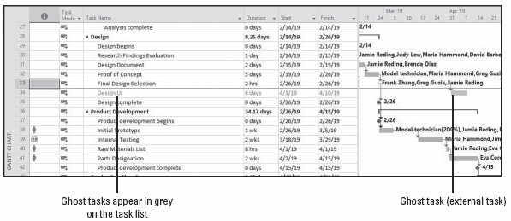
Step-by-Step: Link Tasks from Two Different Project Schedules
Now, you will switch views to look at the ghost task in the Tailspin World of Games App 15 project schedule.
Notes:
Gantt Chart view with ghost task from Tailspin World of Games App project

Slide 18
Step-by-Step: Link Tasks from Two Different Project Schedules
On the ribbon, click the Switch Windows button and then click Tailspin World of Apps 15. You can see that the ghost task 8, Final Design selection, is a predecessor for task 9, Design UI. The link between these two project schedules will remain until you break it. When you delete a task in the source schedule or the ghost task in the destination schedule, Microsoft Project also deletes the corresponding task or ghost task in the other schedule.
On the ribbon, click the Switch Windows button and then click Consolidated Project 15.
You should be able to see a visual link line between the two tasks between the projects. The cross‐project link does not appear as a ghost task because you are looking at the consolidated project file. You might need to scroll your screen to see the entire link.
Notes:
Take Note: The link you create between any project files will remain until you break it. Because the link created is the default relationship of Finish‐to‐Start, a delay in the predecessor will cause a delay in its successor task.

Slide 19
Step-by-Step: Link Tasks from Two Different Project Schedules
If you do not want to see cross‐project links, click the File tab and then click Options. Under the Advanced options, in the Cross‐project linking options section, clear the Show external successors or Show external predecessors check box.
To see that the link actually exists, move the center divider to the right until you can see the Predecessors column.
Scroll the task list until you reach task 9, Design UI. Look in the Predecessors column and you will see the external predecessor file name and task number. Your screen should look similar to the figure on the next slide.
SAVE all of the project schedules and then CLOSE all files.
PAUSE. If you are continuing to the assessments, keep Project open. If you are not continuing, CLOSE Project.
Notes:
Another Way: You can also view the links between projects by selecting the Links Between Projects button, located on the Project ribbon. This will only display links when you have the source file in the active window.
Take Note: Whenever you open a project schedule with cross‐project links, Microsoft Project will prompt you to update these cross‐project links. You can suppress this prompt if you prefer not to be reminded. You can also tell Microsoft Project to automatically accept updated data from the linked project file. To do this, click the File tab, and then click Options. Under the Advanced options, in the Cross‐project linking options section, select the options you want.

Slide 20
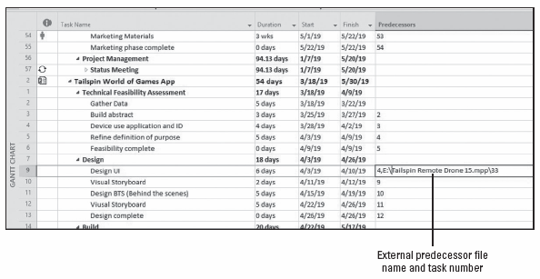
Step-by-Step: Link Tasks from Two Different Project Schedules
Notes:
External predecessor file name and task number

Slide 21
Skill Summary

