Slide 1
Working with Resource Pools
Microsoft Project 2013
Lesson 16

Slide 2
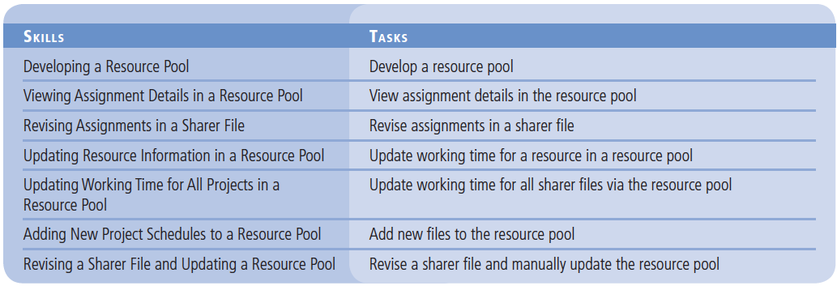
Objectives

Slide 3
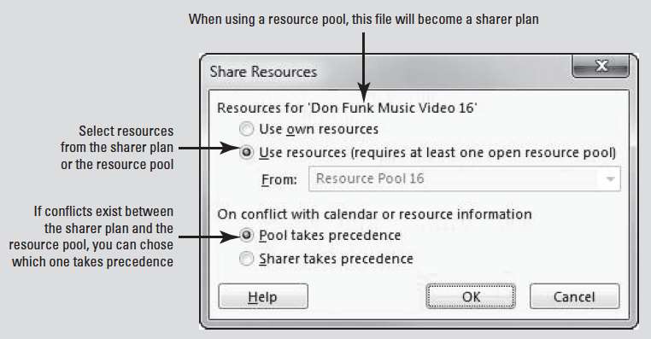
Software Orientation
In Microsoft Project, you can use the Share Resources dialog box to create a resource pool.
The Share Resources dialog box enables you to select the options you want when creating a resource pool, including the project schedule or resource pool to which you want to add your file as a sharer file and whether you want the resource pool or sharer file to take precedence in case of conflict.

Slide 4
Developing a Resource Pool
A resource pool can help a project manager see the extent to which resources are utilized across multiple and simultaneous projects.
In this exercise, you create a resource pool across two individual project schedules.
A resource pool is a project file from which other project schedules gather their resource information, and it contains only resource information.
As a project manager works to manage multiple projects, work resources are often assigned to more than one project at a time.

Slide 5
Developing a Resource Pool
A resource pool can help you monitor how resources are utilized across multiple projects.
It contains information about all resources’ task assignments from all the project schedules linked to the resource pool.
If you change resource information–such as cost rates, maximum units, and nonworking time–in the resource pool, all linked project schedules will use the updated information.
The project schedules that are linked to the resource pool are called sharer files.
If you only manage one project and your resources are not used in other projects, then using a resource pool will provide no additional benefit to you.

Slide 6
Developing a Resource Pool
However, if your organization must manage multiple projects at the same time, setting up a resource pool allows you to do such things as:
Enter resource information one time, but use it in multiple project schedules.
View resources’ assignment details from multiple projects in a single place.
View assignment costs per resource across multiple projects.
Identify resources that are over allocated across multiple projects, even if they are fully- or under allocated in individual projects.
Enter resource information, such as nonworking time, in any of the individual schedules or in the resource pool so that it is available in the other sharer files.

Slide 7
Developing a Resource Pool
A resource pool is particularly beneficial when you are working with other Microsoft Project users across a network.
The resource pool can be stored in a central location–such as a network server–and the individual owners of the sharer files share the network resource pool.
Microsoft Project consolidates the information from sharer files based on the name of the resource.
Annete Hill, for example, is listed only once in the resource pool, no matter how many sharer files list her as a resource. Keep in mind, however, that Microsoft Project can’t match variations of a resource’s name–say, Annete Hill from one sharer file and Annete L. Hill from another. It is good to develop a convention for naming a resource and stick with it.

Slide 8
Developing a Resource Pool
Any Microsoft Project schedule, with or without tasks, can serve as a resource pool.
It is considered a best practice to specify a file that does not contain tasks as the resource pool. This is because any project with tasks will come to an end at some point, and you might not want assignments for those tasks (along with their costs and other details) to be included indefinitely.
In addition, a dedicated resource pool file without tasks allows people such as line managers or resource managers to maintain some information about their resources in the resource pool.
A line manager is a manager of a group of resources and is also sometimes called a functional manager.
A resource manager oversees resource usage in project activities specifically to manage the time and cost of resources.

Slide 9
Step by Step: Develop a Resource Pool
GET READY. Before you begin these steps, launch Microsoft Project.
1. OPEN the Don Funk Music Video 16M project schedule.
2. SAVE the file as Don Funk Music Video 16.
3. OPEN the Adventure Works Promo 16M project schedule.
4. SAVE the file as Adventure Works Promo 16.
5. On the ribbon, click the File tab, and then click New. Double-click Blank Project. A blank project opens.

Slide 10
Step by Step: Develop a Resource Pool
6. On the ribbon, click the File tab, and then click Save As.
7. Locate your solution folder as directed by your instructor. The Save As dialog box appears. In the File name box, type Resource Pool 16, and then click Save.
8. On the ribbon, click the View tab, then in the Window group, click Arrange All. Microsoft Project arranges the three project schedule windows within the Microsoft Project window. (It is not necessary to arrange the project windows this way to create a resource pool, but it is helpful for viewing purposes in this lesson.)
Notes:
Take Note: Although you can choose any name you want for a resource pool, it is a best-practice to indicate that it is a resource pool as part of the file name.

Slide 11
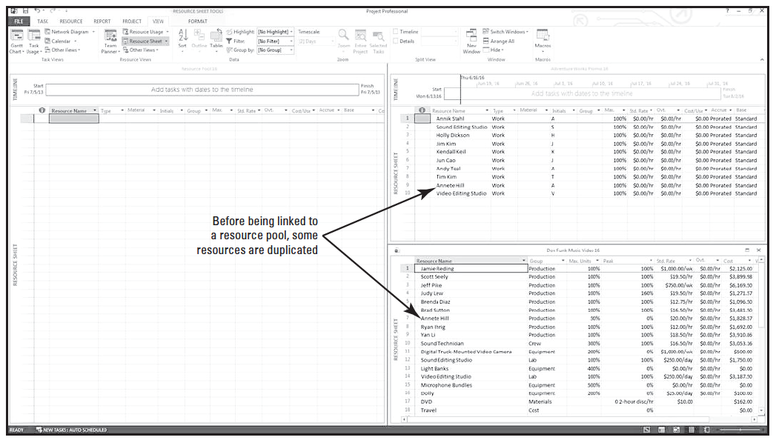
Step by Step: Develop a Resource Pool
9. On the View ribbon, click Resource Sheet. Your screen should look similar to the figure below.
Notes:
Notice that in the resource lists for the two project schedules, a few of the resources appear in both lists. These include Annete Hill, Sound Editing Studio, and Video Editing Studio. None of these resources are over allocated in either project.

Slide 12
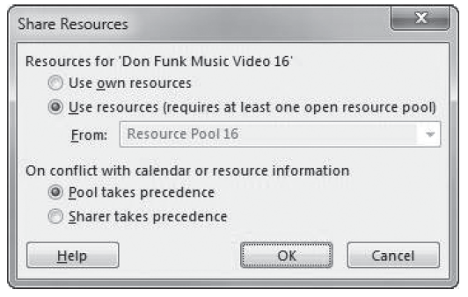
Step by Step: Develop a Resource Pool
10. Click the title bar of the Don Funk Music Video 16 window.
11. On the ribbon, click the Resource tab, then select the Resource Pool button. From the drop down list, click Share Resources. The Share Resources dialog box appears.
12. Under Resources for ’Don Funk Music Video 16,’ click Use resources. In the From: list, select Resource Pool 16 from the dropdown list if it is not already selected. Your screen should look similar to the figure at right.

Slide 13
Step by Step: Develop a Resource Pool
13. Click OK to close the Share Resources dialog box. The resource information from the Don Funk Music Video 16 project schedule appears in the Resource Pool 16 file.
14. Click the title bar of the Adventure Works Promo 16 window.
15. On the ribbon, click the Resources tab, then select the Resource Pool button. From the drop down list, click Share Resources. The Share Resources dialog box appears.
16. Under Resources for ’Adventure Works Promo 16,’ click Use resources. In the From: list, make sure that Resource Pool 16 is selected.
17. Under the On conflict with calendar or resource information label, make sure that Pool takes precedence is selected. Selecting this option causes Microsoft Project to use resource information (such as cost rates) in the resource pool rather than in the sharer file should it find any differences between the two project schedules.

Slide 14
Step by Step: Develop a Resource Pool
18. Click OK to close the Share Resources dialog box. The resource information from the Adventure Works Promo 16 project schedule appears in the resource pool. Your screen should look similar to the figure on the next slide.
19. SAVE each project schedule by clicking the title bar of each file, then clicking the File tab, and then clicking Save.
PAUSE. LEAVE Project open to use in the next exercise.
Notes:
Take Note: If you decide at some point in the future that you do not want to use a resource pool with a project schedule, you can break the link. On the ribbon, click the Resources tab, then click the Resource Pool button. From the dropdown list, click Share Resources. In the Share Resources dialog box, under Resources for ‘,current project name.’ click Use own resources.

Slide 15
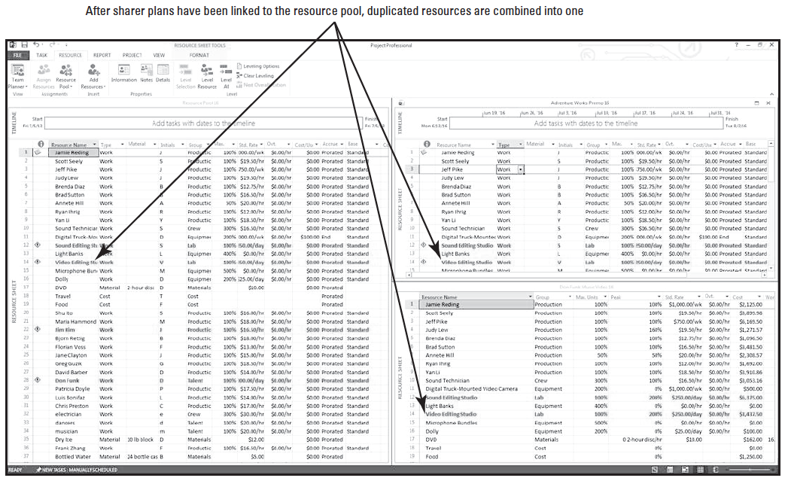
Step by Step: Develop a Resource Pool

Slide 16
Step by Step: View Assignment Details in the Resource Pool
By viewing project assignments in a resource pool, you can see, in a combined format, how all the resources for the sharer projects are allocated.
USE the project schedules you created in the previous exercise.
1. Double-click the title bar of the Resource Pool 16 window. The resource pool window maximizes to fill the active window. In the resource pool, you can view all resources from the two sharer files.
2. On the ribbon, click the View tab, and then click Resource Usage. The Resource Usage view appears.

Slide 17
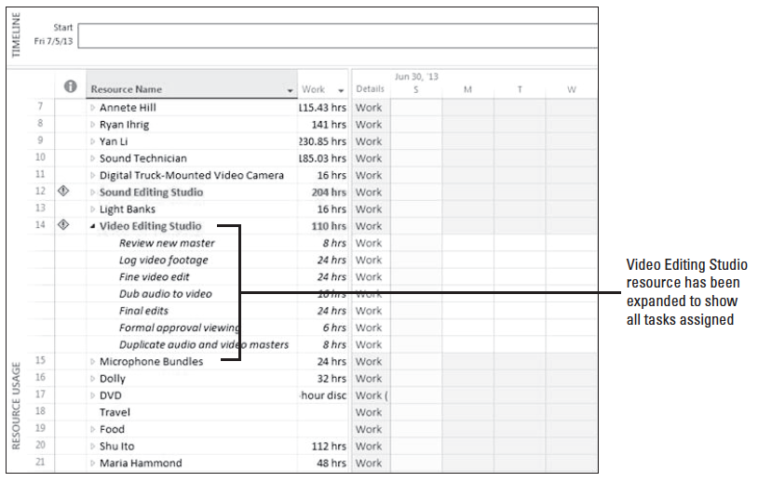
Step by Step: View Assignment Details in the Resource Pool
3. Auto fit the Resource name column and then scroll to select the name of Resource 14, Video Editing Studio. Click the expand button next to Video Editing Studio’s name to expand the assign- ment list. Your screen should look similar to the figure above.

Slide 18
Step by Step: View Assignment Details in the Resource Pool
4. [Press Ctrl+Shift+F5.] The timescale details on the right side of the active window scroll horizontally to show the Video Editing Studio’s earliest assignments.
5. Scroll the timescale details to the right until you can see the assignments for the Video Editing Studio during the weeks of July 31, 2016 and August 7, 2016.
6. On the View ribbon, click the Details check box. The Resource Usage/Resource Form combination view is activated.
Notes:
Cross Ref: For a review of resolving problems with resource allocation, see Lesson 6.

Slide 19
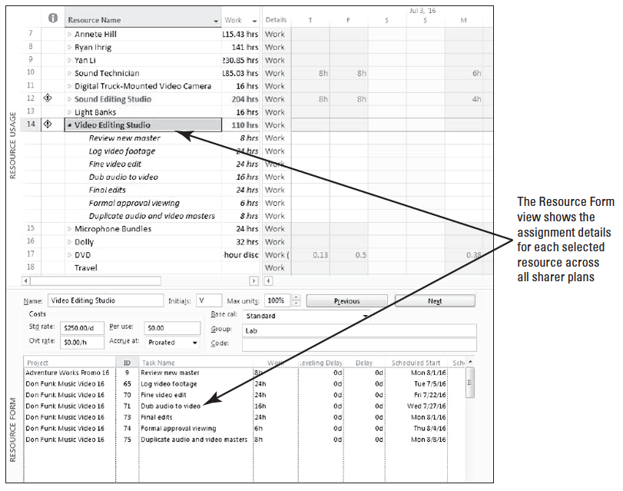
Step by Step: View Assignment Details in the Resource Pool
7. In the Resource Form portion of the view, manually expand the Project column to see the entire project name in the list. (Auto fit does not function in this view.) Your screen should look similar to the figure at right. Your projects may be listed in a different order in the Resource Form window depending on which one you opened first.

Slide 20
Step by Step: View Assignment Details in the Resource Pool
In this view, you can see all of the resources in the resource pool and their assignments (in the upper pane), as well as the additional details for the resources (in the lower pane) for all sharer files.
Note, for example, that Task 75, Duplicate audio and video masters, to which the Video Editing Studio is assigned, is from the Don Funk Music Video project, and the Review new master, Task 9, is from the Adventure Works Promo project.
While the Video Editing Studio was not over allocated in either project, it is actually over allocated when you look at its assignments across projects in this way.
Take a minute to select different resource names in the Resource Usage view to see their assignment details in the Resource Form.

Slide 21
Step by Step: View Assignment Details in the Resource Pool
8. On the ribbon, clear the Details check box.
9. SAVE the project schedule.
PAUSE. LEAVE Project open to use in the next exercise.
In this lesson, you changed the view of the resource pool to better view and analyze the information it contains.
One of the most important benefits of using a resource pool is that it enables you to see how resources are allocated across projects.
You can pinpoint resources that are over allocated across the multiple projects to which they are assigned.

Slide 22
Step by Step: Revise Assignments in a Sharer File
When you make changes to resource assignments in a sharer file, these changes will be reflected in the resource pool as well.
USE the project schedules you used in the previous exercise. Make sure that Resource Pool 16 is the project schedule in the active window.
1. In the Resource Usage view, scroll until you see Resource 48, Arlene Huff, in the Resource Name column, and then click her name.
2. On the ribbon, click the Details check box. In the lower window, you can see that Arlene Huff has no task assignments in either sharer file.

Slide 23
Step by Step: Revise Assignments in a Sharer File
3. On the ribbon, click the Switch Windows button, and then click Don Funk Music Video 16. The Don Funk Music Video 16 project is in the active window.
4. On the ribbon, click the Gantt Chart button. The Gantt Chart appears.
5. [Press the F5 key.] In the ID box, type 68, and then click OK. The Gantt Chart view scrolls to Task 68.
6. Click on the name of Task 68, Rough audio edit.

Slide 24
Step by Step: Revise Assignments in a Sharer File
7. On the ribbon, click the Resource tab, then click the Assign Resources button. The Assign Resources dialog box appears.
8. In the Resource Name column in the Assign Resources dialog box, select Arlene Huff, and then click Assign.
9. Click CLOSE to close the Assign Resources dialog box.
10. On the ribbon, click the View tab, then click the Switch Windows button.

Slide 25
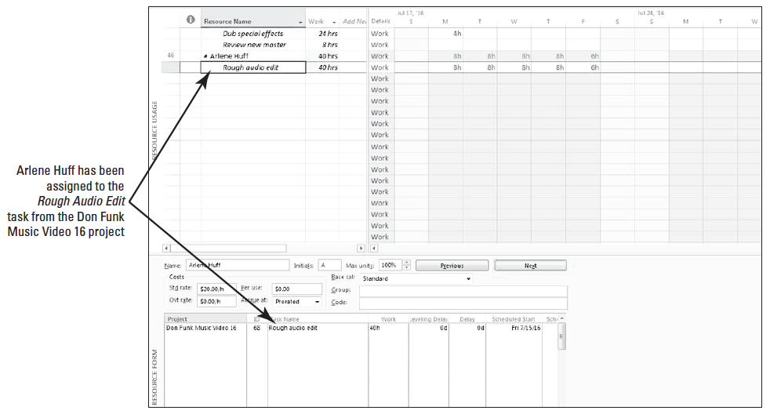
Step by Step: Revise Assignments in a Sharer File
11. From the list, click Resource Pool 16 to switch back to the resource pool. Arlene Huff’s new task assignment appears in the resource pool. You may need to scroll the upper window (the Resource Usage view) to see Arlene Huff’s name. Your screen should look similar to the figure below.

Slide 26
Step by Step: Revise Assignments in a Sharer File
12. SAVE each project schedule. (You can either use the task bar at the bottom of your screen to bring each schedule to the active window to save it, or you can click Switch Windows on the ribbon and then select each schedule.)
13. After saving the project schedules, make sure that Resource Pool 16 is in the active window.
PAUSE. LEAVE Project open to use in the next exercise.
Notes:
Another Way: You can also use the Go To dialog box (the F5 key) and enter Arlene’s resource ID number to move the view to Arlene Huff’s name.

Slide 27
Step by Step: Revise Assignments in a Sharer File
In this exercise, you made a resource assignment from the resource pool into a sharer file and then viewed the change posted to the resource pool.
Recall that an assignment is the matching of a resource to a task.
The resource’s assignment details originate in a sharer file, and Microsoft Project updates the resource pool with assignment details as you make them in the sharer file.

Slide 28
Step by Step: Update Working Time for a Resource in a Resource Pool
When a resource’s information is updated in a resource pool, it is also updated in all of the sharer files linked to that resource pool.
USE the project schedules you used in the previous exercise.
You have just been told that Jim Kim is not available to work on July 25–26, 2016, because he will be attending a training program.
1. In the Resource Name column, scroll to select resource name 22, Jim Kim.
2. Click the expand button next to Jim Kim’s name to display all of his assignments below his name. If necessary, scroll the Resource Usage view vertically so that all of Jim Kim’s assignments are visible. Note that Jim is assigned 24 hours of work on the task of Fine audio edit for the Don Funk Music Video 16 project during the week of July 24th.

Slide 29
Step by Step: Update Working Time for a Resource in a Resource Pool
3. Double-click Jim Kim’s name. The Resource Information dialog box appears. Click the General tab, if necessary.
4. Click the Change Working Time button. The Change Working Time dialog box appears.
5. Drag the vertical scroll bar or click the up and down arrows next to the calendar until July 2016 appears.
6. Select the dates July 25 and 26.
7. On the Exceptions tab below the calendar, under the Name column heading, click the first empty cell. Type Training Class and [press Enter]. Microsoft Project fills the Start and Finish cells with 7/25/2016 and 7/26/2016, respectively, and sets these dates to nonworking time. Your screen should look like the figure on the next slide.

Slide 30
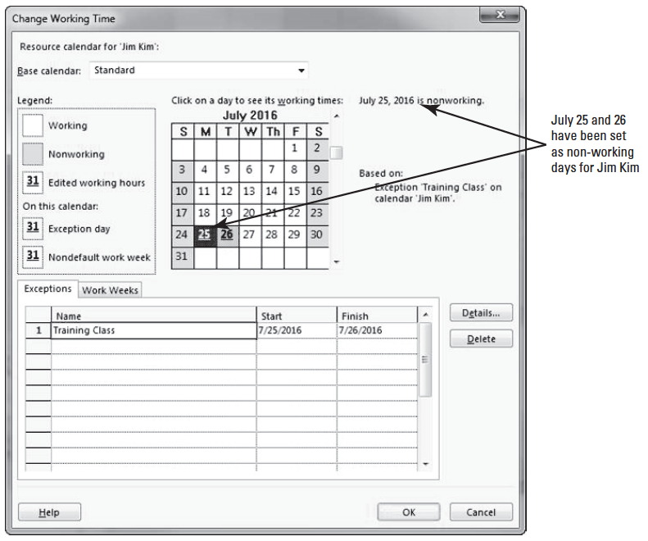
Step by Step: Update Working Time for a Resource in a Resource Pool

Slide 31
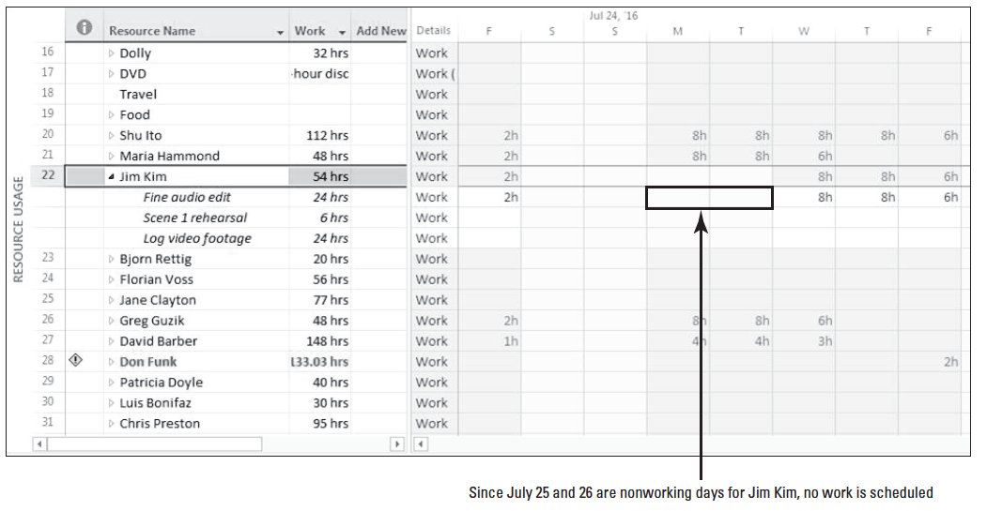
Step by Step: Update Working Time for a Resource in a Resource Pool
8. Click OK to close the Change Working Time dialog box. Click OK again to close the Resource Information dialog box. Scroll the screen so that July 25 and 26 are visible. Notice that Jim Kim now has no work scheduled for July 25 and July 26, 2016 (previously he had). Your screen should look similar to the figure below.
Notes:
Troubleshooting: Anytime you make changes in a resource pool, make sure you have it open as read-write (as it is in this lesson). When you create a resource pool, it is automatically created as read-write. When you open any resource pool, if Microsoft Project asks whether you want to open it as read-only or read-write, select read-write.

Slide 32
Step by Step: Update Working Time for a Resource in a Resource Pool
9. On the ribbon, click the Switch Windows button, and then click Adventure Works Promo 16.
10. In the Resource Name column, select the resource name of Jim Kim (resource 22).
11. Double-click Jim Kim’s name. In the Resource Information dialog box that appears, click the Change Working Time button. The Change Working Time dialog box appears.
12. Drag the vertical scroll bar or click the up and down arrows next to the calendar until July 2016 appears. Click the date July 25, and then click July 26. The notes next to the calendar indicate that both of these days are nonworking.

Slide 33
Step by Step: Update Working Time for a Resource in a Resource Pool
13. Click Cancel to close the Change Working Time dialog box. Click Cancel again to close the Resource Information dialog box.
14. SAVE all of the project schedules.
PAUSE. LEAVE Project open to use in the next exercise.

Slide 34
Step by Step: Update Working Time for a Resource in a Resource Pool
Another key benefit of using resource pools is that you have a central location to enter resource details, such as working time and cost rates, and any updates you make to the resource pool are made available in all of the sharer files.
This is particularly useful in organizations with large numbers of resources working on multiple projects. In larger organizations, employees such as line managers, resource managers, or even staff in a program office may be responsible for keeping general resource information updates.
A program office is a group that oversees a collection of projects (such as producing doors and producing engines), each of which is part of a complete deliverable (such as an automobile) and the organization’s strategic objectives. A program office may also be called a project management office or a PMO.

Slide 35
Step by Step: Update Working Time for All Sharer Files Via the Resource Pool
Any working time change that you make in the resource pool will update to all sharer files.
USE the project schedules you used in the previous exercise.
The entire company (Southridge Video) will be attending a company picnic on July 15, 2011, and you want this to be a nonworking day for all sharer projects.
1. On the View ribbon, click the Switch Windows button, and then click Resource Pool 16.
2. On the ribbon, click the Project tab, then click the Change Working Time button. The Change Working Time dialog box appears.

Slide 36
Step by Step: Update Working Time for All Sharer Files Via the Resource Pool
3. In the For calendar box, select Standard (Project Calendar) from the dropdown list.
4. Drag the vertical scroll bar or click the up and down arrows next to the calendar until July 2016 appears. Click the date July 15.
5. On the Exceptions tab below the calendar, under the Name column heading, click the first empty cell. Type Company Picnic and [press Enter]. Microsoft Project fills the Start and Finish cells with 7/15/2016 and sets the time to nonworking. Your screen should look similar to the figure on the next slide.

Slide 37
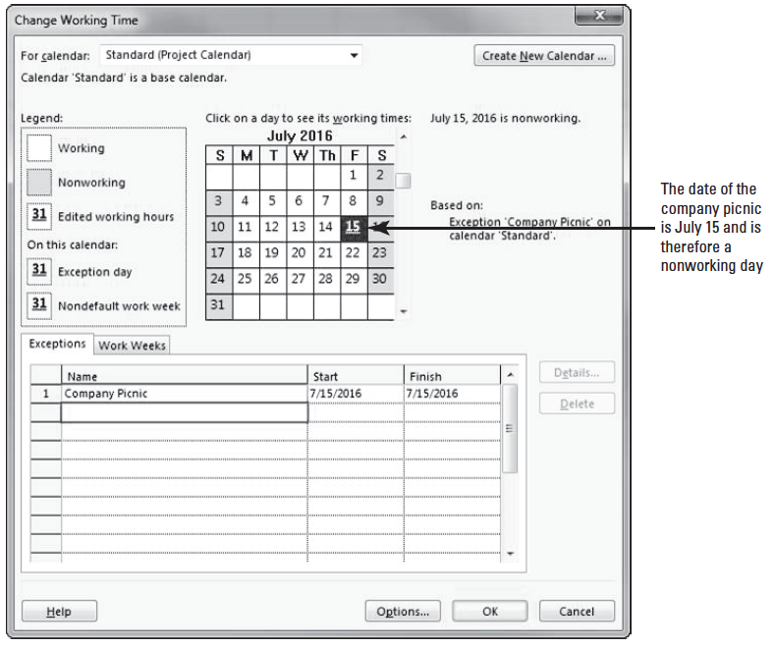
Step by Step: Update Working Time for All Sharer Files Via the Resource Pool

Slide 38
Step by Step: Update Working Time for All Sharer Files Via the Resource Pool
6. Click OK to close the Change Working Time dialog box.
7. On the ribbon, click the View tab, then click the Switch Windows button, and then click Don Funk Music Video 16.
8. On the ribbon, click the Project tab, then click the Change Working Time button. The Change Working Time dialog box appears.
9. Make sure that Standard (Project Calendar) is selected in the For calendar box, and then drag the vertical scroll bar or click the up and down arrows next to the calen- dar until July 2016 appears. Notice that July 15, 2016, is flagged as a nonworking day and the details are shown on the Exceptions tab below the calendar.

Slide 39
Step by Step: Update Working Time for All Sharer Files Via the Resource Pool
10. Click Cancel to close the Change Working Time dialog box.
If you desire, you can switch the view to the Adventure Works Promo 16 project and use the same steps to verify that July 15, 2016, is also a nonworking day for that project.
11. SAVE all project schedules and then CLOSE all files.
PAUSE. LEAVE Project open to use in the next exercise.

Slide 40
Step by Step: Update Working Time for All Sharer Files Via the Resource Pool
In this exercise, you made a change to the base calendar for the resource pool, and then verified this change in one of the sharer files.
This is another key advantage of using a resource pool. By changing the base calendar for the resource pool, the change is updated for ALL sharer files that use that calendar.
Notes:
Troubleshooting: By default, all sharer files share the same base calendars, and any changes you make in a base calendar in one sharer file are reflected in all other sharer files using that base calendar through the resource pool. If you have a certain sharer file for which you want to use different base calendar working times, you must change the base calendar that sharer file uses. This different base calendar will still be available for use in all other sharer files through the resource pool, but will only apply to those sharer files in which you select it as the base calendar.

Slide 41
Step by Step: Add New Files to the Resource Pool
Project schedules can be made into sharer files for a resource pool at any time.
For this reason, it is a good idea to make all project schedules into sharer files (once you have set up a resource pool).
GET READY. To add new files to the resource pool, do the following:
1. OPEN Resource Pool 16 from the solution files for this lesson. When prompted, click the second option to open the file as read-write, and then click OK.
2. On the ribbon, click the View tab, and then click Resource Sheet. The Resource Sheet View appears.
Notes:
Take Note: The default option is for Microsoft Project to open resource pools as read-only. You might want to choose this option if you and other Microsoft Project users are sharing a resource pool across a network. However, if you store the resource pool locally, you should open it as read-write.

Slide 42
Step by Step: Add New Files to the Resource Pool
3. On the View ribbon, clear the check box for Details in the Split View group.
4. On the ribbon, click the File tab, then select New. Double-click Blank Project. A blank project opens.
5. On the ribbon, click the File tab, and then click Save As.
6. Locate your solution folder as directed by your instructor. The Save As dialog box appears. In the File name box, key Graphic Design Project 16, and then click Save.

Slide 43
Step by Step: Add New Files to the Resource Pool
7. On the ribbon, click the Resource tab, then click the Assign Resources button. The Assign Resources dialog box appears. The Assign Resources box is currently empty because you have not yet entered any resource information into this project schedule.
8. On the ribbon, click the Resource Pool button, and then click Share Resources. The Share Resources dialog box appears.
9. Under Resources for ’Graphic Design Project 16,’ select Use Resources.

Slide 44
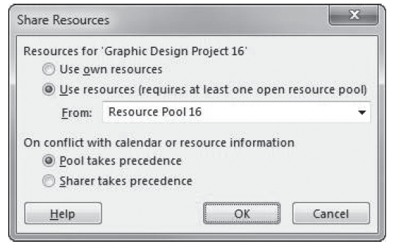
Step by Step: Add New Files to the Resource Pool
10. In the From list, make sure that Resource Pool 16 is selected in the dropdown list. Your screen should look similar to the figure below.

Slide 45
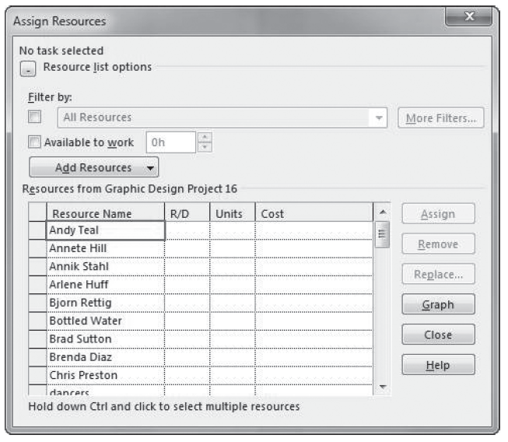
Step by Step: Add New Files to the Resource Pool
11. Click OK to close the Share Resources dialog box. In the Assign Resources dialog box, you can now see all of the resources from the resource pool. These resources are now ready for assignment to tasks in this project. Your screen should look similar to the igure at right.

Slide 46
Step by Step: Add New Files to the Resource Pool
12. Click Close to close the Assign Resources dialog box.
13. SAVE the project schedules, and then CLOSE the files.
PAUSE. LEAVE Project open to use in the next exercise.
In this exercise, you created a project schedule and made it a sharer file for the resource pool.
You can do this at any time: when initially entering the project schedule’s tasks, after you have assigned resources to tasks, or even after work has begun.
Once you have set up a resource pool, you might find it helpful to make sharer files of projects in progress and of all new projects. This is a good way to become accustomed to relying on the resource pool for resource information.

Slide 47
Revising a Sharer File and Updating a Resource Pool
Sometimes, you may have the resource pool open as read-only.
In this case, you would have to manually update resource information to the resource pool.

Slide 48
Step by Step: Revise a Sharer File and Manually Update the Resource Pool
GET READY. To revise a sharer file and manually update the resource pool, do the following:
1. OPEN Adventure Works Promo 16 (this is a project schedule you used in a previous exercise, but we want to open it now as read-only). Select the Open resource pool to see assignments across all sharer files option, and then click OK.
2. On the ribbon, click the View tab, and then click Gantt Chart.
3. In the Task Name column, click on the name of Task 6, Add head and tail titles. [Press Ctrl+Shift+F5] to bring the data into view.

Slide 49
Step by Step: Revise a Sharer File and Manually Update the Resource Pool
4. On the ribbon, click the Resource tab, and then click the Assign Resources button. The Assign Resources dialog box appears.
5. In the Resource Name column in the Assign Resources dialog box, select the name of Frank Zhang, and then click the Assign button.
6. In the Task Name column, click the name of Task 9, Review new master.
7. In the Resource Name column in the Assign Resources dialog box, scroll to locate and select Holly Dickson, and then click the Remove button.

Slide 50
Step by Step: Revise a Sharer File and Manually Update the Resource Pool
You have made two assignment changes in the sharer file. Because the resource pool is open as read-only, these changes were not automatically saved in the resource pool. You need to manually update the resource pool.
8. On the ribbon, click the Resource Pool button, and then click Update Resource Pool. Microsoft Project updates the assignment information in the resource pool file with the new details from the sharer file. If anyone opens or refreshes the resource pool from now on, the updated assignment information will be available.
9. In the Task Name column, click on the name of task 3, Sync Sound.
10. In the Assign Resources dialog box, scroll to locate and select Arlene Huff, and then click the Assign button.
Notes:
Take Note: Keep in mind that only assignment information is saved to the resource pool from the sharer file. Any changes you make to resource details, such as cost rates or Max. units, in the sharer file are not saved in the resource pool when you update. If you want to change resource details, you must open the resource pool as read-write. Once it is open as read- write, you can change resource details in either the resource pool or the sharer file, and Microsoft Project will update the other file.

Slide 51
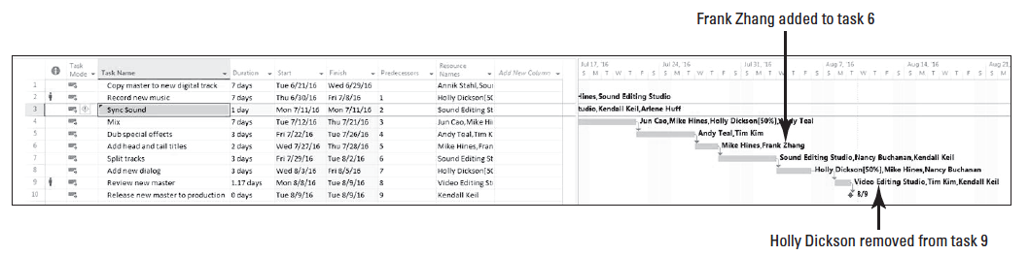
Step by Step: Revise a Sharer File and Manually Update the Resource Pool
11. Click the Close button to close the Assign Resources dialog box. Your screen should look similar to the figure below.

Slide 52
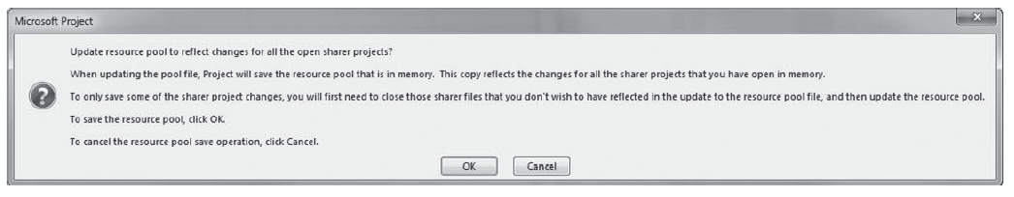
Step by Step: Revise a Sharer File and Manually Update the Resource Pool
12. On the ribbon, click the File tab, and then click Close. When prompted to save changes, click Yes. Microsoft Project determines that because the resource pool was opened as read-only, the assignment changes you just made in the sharer file have not been updated in the resource pool file. A dialog box appears, and you are offered a choice as to whether or not you want to update the resource pool. Your screen should look similar to the figure below.

Slide 53
Step by Step: Revise a Sharer File and Manually Update the Resource Pool
13. After you review the options in the dialog box, click OK. Microsoft Project updates the assignment information with the new details from the sharer file. The resource pool remains open as read-only.
14. On the ribbon, click the File tab, and then click Close. Since the resource pool was opened as read-only, Microsoft Project closes it without prompting you to save changes.
PAUSE. If you are continuing to the next lesson, keep Project open. If you are not continuing to additional lessons, CLOSE Project.

Slide 54
Step by Step: Revise a Sharer File and Manually Update the Resource Pool
In this exercise, you made changes to a sharer file and updated a resource pool that had been opened as read-only (as if you were on a network, rather than working with local files).
This is an important concept because if you are sharing a resource pool with other Microsoft Project users across a network, whoever has the resource pool open as read-write prevents others from updating resource information.
For this reason, it is a good idea to open the resource pool as read-only and to use the Update Resource Pool command only when you need to update the resource pool with assignment information.
Once this is done, anyone else who opens the resource pool will see the latest assignment information.

Slide 55
Skill Summary

