Slide 1
Advanced Project Schedule Tracking
Microsoft Project 2016
Lesson 11

Slide 2
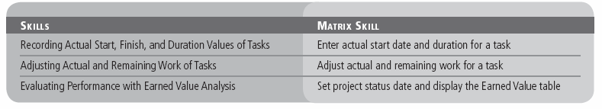
Objectives

Slide 3
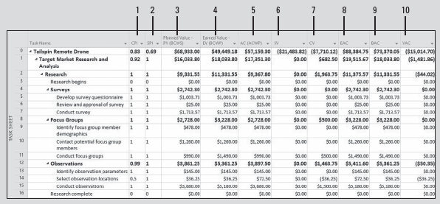
Software Orientation
The Earned Value table, shown below, displays schedule and cost indicator values that are useful in measuring a project’s progress and forecasting its outcome through earned value analysis.
Notes:
Earned Value table in the Task Sheet view (see the next two slides for descriptions of the numbered columns)

Slide 4
Software Orientation
The columns in the Earned Value table (refer to the previous slide) are:
CPI: Cost Performance Index, the ratio of budgeted to actual cost—calculated as EV divided by AC
SPI: Schedule Performance Index, the ratio of performed to scheduled work—calculated as EV divided by PV
Planned Value – PV (BCWS): The value of the work scheduled to be completed as of the status date
Earned Value – EV (BCWP): The portion of the budgeted cost that should have been spent to complete each task’s actual work performed up to the status date
AC (ACWP): Actual cost, the actual cost incurred to complete each task’s actual work up to the status date

Slide 5
Software Orientation
The columns in the Earned Value table are (continued):
SV: Schedule variance, the difference between the budgeted cost of work performed and the budgeted cost of work scheduled
CV: Cost variance, the difference between the budgeted and actual cost of work performed
EAC: Estimate at Completion, the expected total cost of a task based on performance up to the status date
BAC: Budget at Completion, the total planned cost
VAC: Variance at Completion, the difference between the BAC (Budget at Completion) or baseline cost and EAC (Estimate at Completion)

Slide 6
Recording Actual Start, Finish, and Duration Values of Tasks
Once the details of the project schedule have been finalized and work has started, the project manager can begin to track progress on the project by recording actual start, finish, and duration values.
In the next exercise, you will enter actual start dates and durations for several tasks.
Remember, as you learned in Lesson 9, tracking actuals is essential to a well‐managed project.
As the project manager, you need to know how well the project team is performing and when to take corrective action.
When you enter actual start, finish, or duration values, Project updates the schedule and calculates the task’s percentage of completion.

Slide 7
Recording Actual Start, Finish, and Duration Values of Tasks
Microsoft Project uses the following rules to update the schedule:
When you enter a task’s actual start date, different from its planned start date, Microsoft Project recalculates the scheduled finish date.
When you enter a task’s actual finish date, Microsoft Project moves the scheduled finish date to match the actual finish date.
When you enter an actual duration for a task that is less than the scheduled duration, Microsoft Project subtracts the actual duration from the scheduled duration to determine the remaining duration.
When you enter a task’s actual duration that is equal to the scheduled duration, Project sets the task to 100% complete.
When you enter an actual duration for a task that is longer than the scheduled duration, Project adjusts the scheduled duration to match the actual duration and sets the task to 100% complete.

Slide 8
Step-by-Step: Enter Actual Start Date and Duration for a Task
GET READY. Before you begin these steps, open Tailspin Remote Drone 11MA from the data files for this lesson. SAVE the file as Tailspin Remote Drone 11A in the solutions folder.
Navigate to and select task 32, Proof of concept. On the Task ribbon, click the Scroll to Task button. This task started one day ahead of schedule, so you need to record this.
On the ribbon, click the down arrow next to the Mark on Track button and select Update Tasks. The Update Tasks dialog box appears.
Under the Actual label, in the Start box, key or select March 11, 2019.
In the Actual dur box, key or select 2w, and then click OK to close the Update Tasks dialog box.

Slide 9
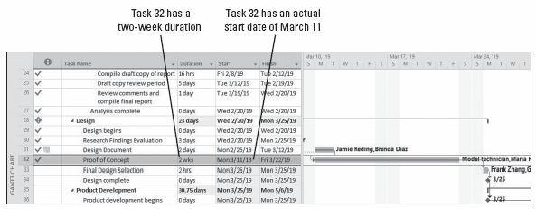
Step-by-Step: Enter Actual Start Date and Duration for a Task
If the Planning Wizard dialog box appears, click Continue. Allow the scheduling conflict. Click OK. Microsoft Project records the actual start date and duration for task 32. Your screen should look similar to the figure below.
Notes:
Gantt chart showing actual start date and duration for task 32

Slide 10
Step-by-Step: Enter Actual Start Date and Duration for a Task
In the Task Name column, select the name of task 33, Final design selection. You need to record that task 33 started on time but took a total duration of two days to complete.
On the ribbon, click the down arrow next to the Mark on Track button and select Update Tasks. The Update Tasks dialog box reappears.
In the Actual dur box, key 2d and then click OK.
Click the Scroll to Task button or scroll so that the Gantt bar for task 33 is visible in the center of the Gantt chart. Your screen should look similar to the figure on the next slide.

Slide 11
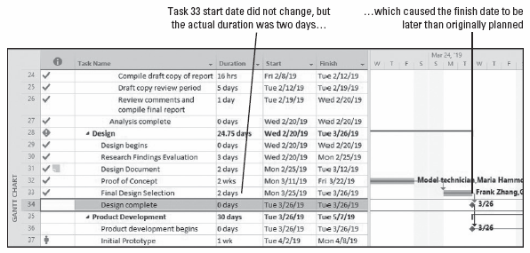
Step-by-Step: Enter Actual Start Date and Duration for a Task
Notes:
Gantt chart view showing updated progress for task 33

Slide 12
Step-by-Step: Enter Actual Start Date and Duration for a Task
Mark task 34, Design complete, and task 36, Product development begins as 100% complete, by selecting the 100% button in the Schedule command group.
Microsoft Project records the actual duration of the task. Microsoft Project assumes that task 33 started as scheduled because you did not specify an actual start date. However, the actual duration that you entered causes Microsoft Project to calculate a finish date that is later than the originally scheduled finish date. Next, you will record that task 37 started earlier than planned but took longer than scheduled to complete.
In the Task Name column, select the name of task 37, Initial prototype.
On the ribbon, click the down arrow next to the Mark on Track button and select Update Tasks.

Slide 13
Step-by-Step: Enter Actual Start Date and Duration for a Task
On the Actual side of the dialog box, in the Start: field, key 3/27/19.
In the Actual dur box, key or select 12d, and then click OK. Project records the actual start and duration of the task. Your screen should look similar to the figure on the next slide.
Select task 41, Production development complete, and then select the Scroll to Task button. You can see that the Production development phase of the Tailspin Remote Drone project is still on track to meet its deadline of May 17, 2019.
SAVE the project schedule and then CLOSE the file.
PAUSE. LEAVE Project open to use in the next exercise.

Slide 14
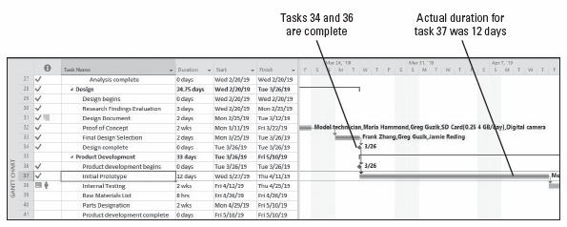
Step-by-Step: Enter Actual Start Date and Duration for a Task
Notes:
Gantt chart showing completion information for tasks 34, 36, and 37

Slide 15
Recording Actual Start, Finish, and Duration Values of Tasks
Keep in mind the following issues when evaluating project status:
For many tasks, it is difficult to evaluate a percentage of completion. For example, when is a design engineer 75% finished designing a new production process, or when is a computer engineer 50% finished coding a new software upgrade? Often, reporting work in progress is a best guess and, therefore, carries an inherent risk.
The portion of a task’s duration that has elapsed does not always equate to a percentage. A front‐loaded task might require a lot of effort initially, so that when 50% of its duration has elapsed, much more than 50% of its total work will have been completed.
The resources assigned to a task might have different criteria for what determines the task’s completion than does the project manager—or the resources assigned to successor tasks.
Notes:
To avoid or minimize these and other problems that arise in project implementation, a good project manager needs to carry out good project planning and communication. Determining how you will track project progress is a decision made during planning and this information will be clearly communicated to all team members. No matter how much planning is done, projects almost always have variance from the baseline.

Slide 16
Adjusting Actual and Remaining Work of Tasks
While tracking actual values, it is also possible to adjust the work or duration remaining on a task. Remember that only an incomplete task can have a remaining work or duration value. For example:
A task scheduled for 40 hours is partially completed. The resources have performed 30 hours of work and expect to finish the task after working 6 more hours. You would enter 30 hours of actual work and 6 hours of remaining work using the Work table.
A task that was scheduled for four days duration is partially complete. Two days have elapsed, and the resources working on the task estimate they will need three additional days to complete the task. You can enter the actual and remaining duration via the Update Tasks dialog box (on the Task ribbon, select the down arrow next to the Mark on Track button, and then click Update Tasks).
Notes:
In the next exercise, you will adjust the actual and remaining work for a task in the project schedule. In addition to adjusting work, as you track actuals, you can also adjust duration, start dates, and finish dates.

Slide 17
Adjusting Actual and Remaining Work of Tasks
It is important to remember that whenever you enter actual work values, Microsoft Project calculates actual cost values, by default, and you are not able to enter actual costs directly.
If you want to enter actual cost values yourself, click File, Options, and click Schedule. Under Calculation, set the option to OFF. In the section for Calculation options for this project, deselect the option that reads, Actual costs are always calculated by Project.
Once you turn off automatic calculation, you can enter or import task‐level or assignment-level actual costs in the Actual Cost field. You can also enter actual cost values on a daily or any other interval in any usage view, such as the Task Usage view. Exercise caution, though, anytime you enter costs manually: Entering actual costs for tasks or assignments prevents Microsoft Project from calculating costs based on resource rates and task progress.

Slide 18
Step-by-Step: Adjust Actual and Remaining Work for a Task
GET READY. To continue with this lesson, you will use an updated version of the Tailspin Remote Drone project to simulate the passage of time since you completed the previous exercise. OPEN Tailspin Remote Drone 11MB from the data files for this lesson. SAVE the file as Tailspin Remote Drone 11B in the solutions folder.
Click the View tab and then click Task Usage. The Task Usage view appears.
Press the F5 key. In the ID box, key 44 and then click OK. Microsoft Project scrolls the time‐scaled portion of the view to display the scheduled work information for task 44. Your screen should look similar to the figure on the next slide.
On the ribbon, click the Tables button and select the Work table. Microsoft Project displays the Work table in the Task Usage view.

Slide 19
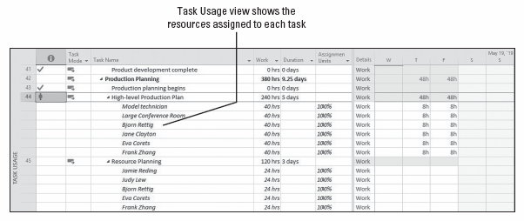
Step-by-Step: Adjust Actual and Remaining Work for a Task
Notes:
Task Usage view

Slide 20
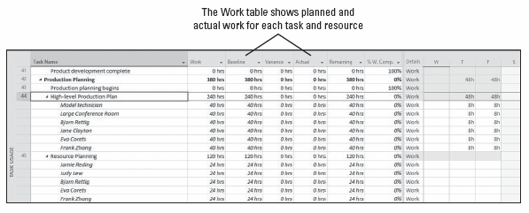
Step-by-Step: Adjust Actual and Remaining Work for a Task
Click and drag the vertical divider bar, between the Work table and the Task Usage grid, to the right until you can see all the columns, except “Add New Column” in the Work table. Your screen should look similar to the figure below.
Notes:
Work table in the Task Usage view
Take Note: The mouse pointer changes to a two‐headed arrow (pointing left and right) when it is in the correct position to drag the vertical divider bar.

Slide 21
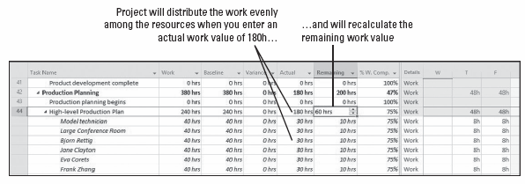
Step-by-Step: Adjust Actual and Remaining Work for a Task
In the Actual column for task 44, key 180 and then press Tab. Change highlighting shows that several things have occurred. First, because you entered the actual work at the task level, Microsoft Project distributed it equally among the assigned resources. Second, Microsoft Project recalculated the remaining work value. Your screen should look similar to the figure below.
Notes:
Work table showing the actual work completed for task 44

Slide 22
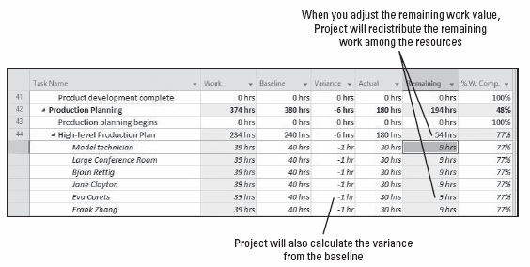
Step-by-Step: Adjust Actual and Remaining Work for a Task
In the Remaining column for task 44, key 54h and press Enter. The new remaining work value was equally distributed among the assigned resources. Your screen should look like the figure below.
SAVE the project schedule.
PAUSE. LEAVE Project open to use in the next exercise.
Notes:
Work table showing remaining work for task 44

Slide 23
Evaluating Performance with Earned Value Analysis
Earned value analysis is used to measure a project’s progress in terms of both schedule and cost, as well as to help predict its outcome.
Earned value can be used on any project, in any industry to objectively track project progress.
In the next exercise, you will set the project status date, display the Earned Value table, and add the Cost Performance Index (CPI) and the Schedule Performance Index (SPI) columns.
The status date is the date you want Microsoft Project to use when calculating the earned value numbers.

Slide 24
Evaluating Performance with Earned Value Analysis
Looking at task and resource variance throughout a project’s duration is a key project management activity. Unfortunately, it does not give you the true picture of a project’s long‐term health.
For example, a task might be over budget and ahead of schedule (possibly not good) or over budget and behind schedule (definitely not good). Looking at schedule and budget variance by themselves does not tell you very much about performance trends that might continue throughout the project.
Instead, earned value analysis gives you a more complete picture of overall project performance in relation to both time and cost. Earned value analysis is used to measure the project’s progress and help forecast its outcome. It focuses on schedule and budget performance in relation to baseline plans.

Slide 25
Evaluating Performance with Earned Value Analysis
The key difference between earned value analysis and simpler budget/schedule analysis can be thought of in this way:
“What are the current performance results we are getting?” is the question answered by simple variance analysis.
“Are we getting our money’s worth for the current performance results we are getting?” is the question answered by earned value analysis.
Although the difference is subtle, it is important. Earned value analysis allows you to look at project performance in a more detailed way. It allows you to identify two important things: the true cost of project results to date and the performance trend that is likely to continue for the rest of the project.

Slide 26
Evaluating Performance with Earned Value Analysis
Review the project schedule and steps you will perform in this exercise. In order for Project to calculate the earned value amounts for a project schedule, you must first do the following:
Save a baseline so that Microsoft Project can calculate the budgeted cost of the work scheduled before you start tracing actual work. (The baseline is already saved when you open the file for this lesson.)
Record actual work on tasks or assignments. (You did this in previous exercises in this lesson.)
Set the status date so that Microsoft Project can calculate actual project performance up to a certain point in time. If you do not specify a status date, Project uses the current date.

Slide 27
Evaluating Performance with Earned Value Analysis
Earned value analysis uses the following three key values to generate all other schedule indicator and cost indicator values:
The planned value (PV) or budgeted cost of work scheduled (BCWS). This is the value of the work scheduled to be completed as of the status date. Project calculates this value by adding up all the time‐phased baseline values for tasks up to the status date.
The actual cost (AC) or actual cost of work performed (ACWP). This is the actual cost incurred to complete each task’s actual work up to the status date.
The earned value (EV) or budgeted cost of work performed (BCWP). This is the portion of the budgeted cost that should have been spent to complete each task’s actual work performed up to the status date.
Notes:
The earned value schedule and the cost variances are directly related. The earned value cost indicator fields are in one table. The earned value schedule indicators are in another table. A third table combines the key fields of both schedule and cost indicators.

Slide 28
Evaluating Performance with Earned Value Analysis
Using the key values on the previous slide, Microsoft Project can also calculate some other important indicators of project performance:
The project’s cost variance (CV) is the difference between the earned value and the actual cost.
The project’s schedule variance (SV) is the difference between the earned value and the planned value.
It might seem strange to think of being ahead of or behind schedule in terms of dollars. However, keep in mind that dollars buy work, and work drives tasks to be completed.
You will find that viewing both cost and schedule variance in the same unit of measure makes it easier to compare the two, as well as other earned value numbers that are also measured in dollars.

Slide 29
Evaluating Performance with Earned Value Analysis
There are two other earned value numbers that are very helpful indicators:
The Cost Performance Index (CPI) is the ratio of earned value to actual cost, or EV (BCWP) divided by AC (ACWP).
The Schedule Performance Index (SPI) is the ratio of earned value to planned value, or EV (BCWP) divided by PV (BCWS).
The CPI and SPI allow you to evaluate a project’s performance and compare the performance of multiple projects in a consistent way.

Slide 30
Evaluating Performance with Earned Value Analysis
In the Remote Drone project, the CPI and SPI provide information about each task and phase in the project and the project as a whole:
The CPI for the Tailspin Remote Drone project (as of the status date) is .83. You can interpret this as every dollar’s worth of work that has been paid for, 83 cents worth of work was actually accomplished.
The SPI for the Tailspin Remote Drone project (as of the status date) is .69. This can be interpreted that for every day’s worth of work that was planned to be completed, the project is only completing 69% of it in the same time period. You can also look at this as schedule efficiency—you are progressing at 69% of your planned schedule.
Although both the SPI and CPI are different for the Tailspin Remote Drone project, keep in mind that these ratios can change as work is completed and other factors change.
Notes:
Earned value analysis is one of the more complicated things you can do in Microsoft Project, but it provides very valuable project status information. This illustrates why it is a good idea to enter task and resource cost information into a project schedule any time you have it.

Slide 31
Step-by-Step: Set Project Status Date and Display the Earned Value Table
GET READY. USE the project schedule you created in the previous exercise.
On the View tab, in the Task Views group, select Other Views and then select Task Sheet.
Click the Project tab. Click the calendar icon in the Status Date field.
In the Select date box, key or select 5/17/19 and then click OK.
Click the View tab. Click the Tables button and then select More Tables. The More Tables dialog box appears.
In the Tables list, select Earned Value and then click Apply. Microsoft Project displays the Earned Value table in the Task Sheet view. If necessary, double‐click between column headings to display all values. Your screen should look similar to the figure on the next slide.

Slide 32
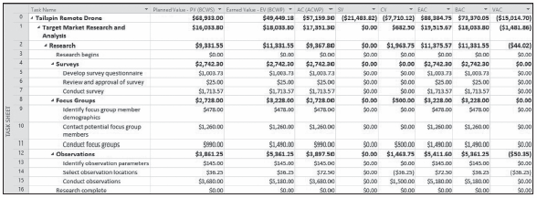
Step-by-Step: Set Project Status Date and Display the Earned Value Table
Here, you can see most of the earned value numbers detailed at the beginning of this lesson in the Software Orientation section.
Notes:
Earned Value table in the Task Sheet view

Slide 33
Step-by-Step: Set Project Status Date and Display the Earned Value Table
Right‐click on the name of the Planned Value – PV column and select Insert Column.
Key SPI and press Enter. Microsoft Project displays the SPI column in the Earned Value table.
Right‐click on the name of the SPI column and select Insert Column.
Key CPI and press Enter. Microsoft Project displays the CPI column in the Earned Value table.
Auto‐fit the two columns you just added to the table. Your screen should look similar to the figure on the next slide.
SAVE the project schedule.
PAUSE. CLOSE the project schedule. CLOSE Project

Slide 34
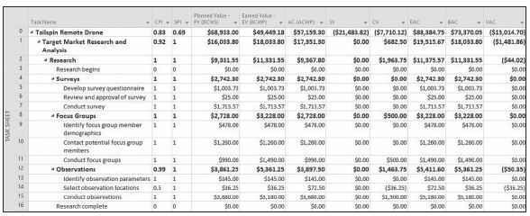
Step-by-Step: Set Project Status Date and Display the Earned Value Table
Notes:
Earned Value table in the Task Sheet view with CPI and SPI columns added

Slide 35
Skill Summary

