Slide 1
Project Schedule Optimization
Microsoft Project 2016
Lesson 13

Slide 2
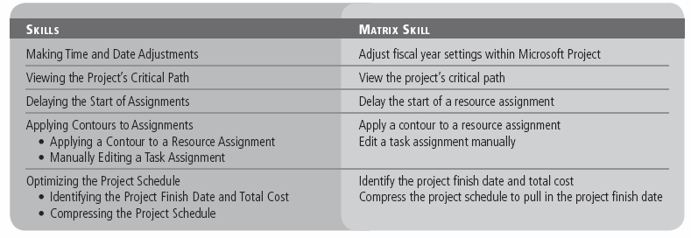
Objectives

Slide 3
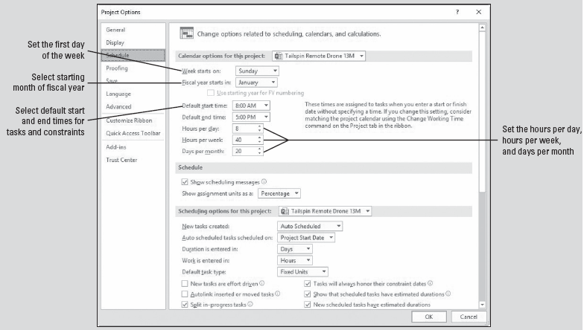
Software Orientation
Calendar Options provide basic time values, such as the hours per day or week, the fiscal year settings, and the first day of the week.
These settings affect only time conversions for task durations that you enter into Microsoft Project, not when work can or should be scheduled.
Notes:
Calendar options in the Schedule section of the Project Options dialog box

Slide 4
Making Time and Date Adjustments
As part of its project management capabilities, Microsoft Project has a scheduling engine that works with time.
Because time is always part of the “project equation,” it is critical that the project manager understand the array of time and date settings used by Microsoft Project.
In the next exercise, you will change the Timescale view to accommodate a fiscal year—any consecutive 12‐month period defined for accounting purposes—rather than a calendar year—a 12‐month period from January to December.
Using a fiscal year timescale is most appropriate if there are stakeholders who are accustomed to analyzing information in a fiscal year format. Otherwise, use the calendar year format.

Slide 5
Making Time and Date Adjustments
You use the Calendar options of the Project Options dialog box to define basic time values, such as how many hours a day or a week should equal, or how many days should equal one month. You can also control other time settings, such as which day is the first day of the week.
The Calendar options can be confusing, because they have nothing to do with the Microsoft Project base, project, resource, or task calendars. (You control these calendars through the Change Working Time dialog box.)
The Calendar settings affect only the time conversions for task durations that you enter into Microsoft Project, such as how many hours equal one day—not when work can be scheduled.

Slide 6
Making Time and Date Adjustments
The Default Start Time and Default End Time settings on the Schedule tab can also be confusing.
These settings are not related to working time values for calendars. Rather, the Default Start Time and Default End Time settings have a very specific purpose.
These settings supply the default start and end time for task constraints or for actual start and finish dates in which you enter a date but do not include a time.
For example, if you enter a Must Start On constraint value of January 14, 2019, for a task but do not specify a start time, Microsoft Project will use the Default Start Time value that is set on the Schedule tab.

Slide 7
Step-by-Step: Adjust Fiscal Year Settings within Microsoft Project
GET READY. Before you begin these steps, open Tailspin Remote Drone 13M from the data files for this lesson. SAVE the file as Tailspin Remote Drone 13 in the solutions folder.
On the Gantt chart, drag the divider bar (between the table portion and the graph portion of the Gantt chart) to the right until the Start and Finish columns are visible.
On the ribbon, click the File tab and then select Options. In the Project Options dialog box, select Schedule.
In the Calendar Options area, click the Fiscal year starts in: box, select April, and then click OK to close the Project Options dialog box.

Slide 8
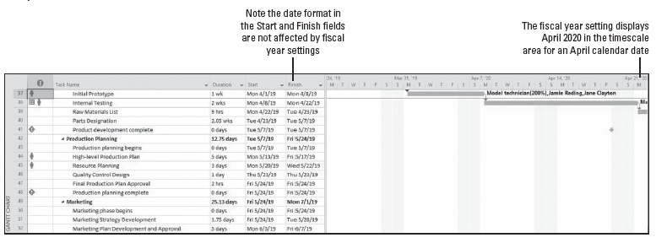
Step-by-Step: Adjust Fiscal Year Settings within Microsoft Project
Press the F5 key. In the ID box, key 37 and click OK. Your screen should look similar to the figure below.
Notes:
Gantt Chart view showing the fiscal year timescale

Slide 9
Step-by-Step: Adjust Fiscal Year Settings within Microsoft Project
When you select the starting month of the fiscal year, Microsoft Project reformats the dates on the Gantt chart timescale to use the fiscal year, not the calendar year. The months of April through December 2019 now show a 2020 year to reflect that the 2020 fiscal year runs from April 1, 2019, through March 30, 2020.
Click the Undo button twice to restore the dates to the calendar year format.
Drag the divider back to the right edge of the Duration column.
SAVE the project schedule.
PAUSE. LEAVE Project open to use in the next exercise.
Notes:
Another Way: You can restore the calendar year format by returning to the Schedule tab of the Project Options dialog box and selecting January in the Fiscal year starts in: box.

Slide 10
Viewing the Project’s Critical Path
One of the most important parts of the project schedule is the project’s critical path. The critical path is the series of tasks that affect the project’s end date.
In the next exercise, you will review the critical path of your project schedule and the free and total slack for the tasks.
Keep in mind that “critical” does not refer to the importance of these tasks in relation to the overall project, but rather to how their scheduling will affect the project’s finish date.
After a task on the critical path is complete, it is no longer critical because it can no longer affect the project finish date. During the life of the project, it is normal that the critical path will occasionally change.
Notes:
As a project manager, it is very important for you to understand how changes in schedule, resource assignments, constraints, and so forth will affect this key series of tasks that affect the project’s end date.

Slide 11
Step-by-Step: View the Project’s Critical Path
GET READY. USE the project schedule you created in the previous exercise.
On the ribbon, click the View tab. In the Task Views group, click the Other Views button. From the list, select More Views. The More Views dialog box appears.
In the More Views dialog box, select Detail Gantt and click Apply.
On the ribbon, click the Tables button and then select Entry.
Move the divider bar back to cover the Duration column.
Press the F5 key. In the ID box, key 28 and then click OK. Microsoft Project displays the Design Phase summary task at the top of your screen; this is a convenient location to view both noncritical and critical tasks.

Slide 12
Step-by-Step: View the Project’s Critical Path
On the ribbon, click the Format tab. Click the Slippage button. Select any baseline that does not have a date. Microsoft Project removes the slippage lines from in front of the tasks. Your screen should look similar to the figure on the next slide.
In the Detail Gantt view, noncritical tasks appear in blue, and critical tasks appear in red. In this view, you can also see some tasks that have slack (float). A thin, teal line represents the total slack for a given task. Why does the critical path seem to stop in the middle of the project? The answer lies in the total slack.
On the ribbon, click the View tab, click the Tables button, and then click Schedule. The Schedule table appears in the Detail Gantt view.
Drag the divider bar to the right until all columns in the Schedule table are visible and then auto‐fit all the columns as necessary.

Slide 13
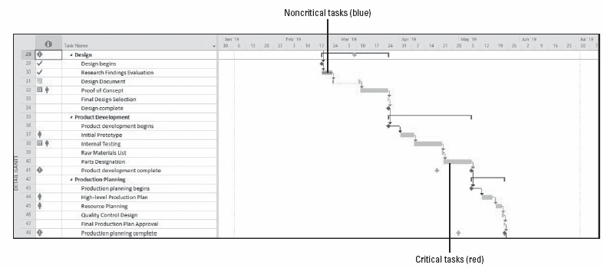
Step-by-Step: View the Project’s Critical Path
Notes:
Detail Gantt view showing critical tasks and noncritical tasks

Slide 14
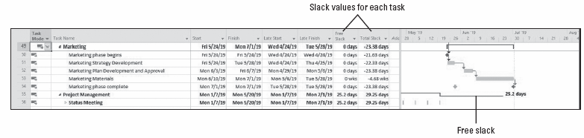
Step-by-Step: View the Project’s Critical Path
Press the F5 key and in the ID box, key 49 and click OK. Your screen should look similar to the figure below.
Review the free slack and total slack for each task. Free slack is the amount of time the finish date of a task can be delayed before the start of any successor task is affected. Total slack is the amount of time the finish date on a task can be delayed before the completion of the project will be delayed. A task may have total slack, free slack, or both. Slack can be positive, negative, or zero.
Notes:
Schedule table showing free slack and total slack for each task

Slide 15
Step-by-Step: View the Project’s Critical Path
There is a lot of negative slack in the schedule. This is primarily due to the fact that we have missed so many deadlines, which we will take care of later in this lesson.
On the ribbon, click the Tables button and then click Entry.
Drag the vertical divider bar to the right of the Duration column.
SAVE the project schedule.
CLOSE the project schedule. You will use an updated version of the Tailspin Remote Drone 13 project schedule in the next exercise.
PAUSE. LEAVE Project open to use in the next exercise.

Slide 16
Delaying the Start of Assignments
If more than one resource is assigned to a task, you might not want all the resources to start working on the task at the same time. You can delay the start of work for one or more resources assigned to a task.
In the following exercise, you will delay the start of work for a resource assigned to a task.
You can delay the start of work for any number of resources assigned to a task. However, if you need to delay the start of work for all resources on a particular task, it is better to just reschedule the start date of the task (rather than adjusting each resource’s assignment).

Slide 17
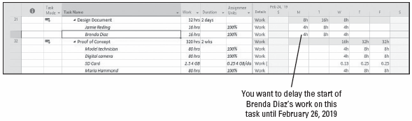
Step-by-Step: Delay the Start of a Resource Assignment
GET READY. OPEN Tailspin Remote Drone 13MA from the data files for this lesson. SAVE the file as Tailspin Remote Drone 13A in the solutions folder.
On the ribbon, click the View tab and then click Task Usage. The Task Usage view appears.
Press the F5 key. In the ID box, key 31 and then click OK. Microsoft Project displays the Design document task. Your screen should look similar to the figure below.
Notes:
Task Usage view at task 31

Slide 18
Step-by-Step: Delay the Start of a Resource Assignment
Brenda Diaz will begin reviewing the final design document after Jamie has completed his first day of work. You want to delay Brenda’s work on this task until Tuesday, February 26, 2019.
In the Task Name column, double‐click on the name of the resource Brenda Diaz. The Assignment Information dialog box appears. You can also click on the name of the resource, click the Resource tab, and then select the Information button.
Click the General tab, if it is not already selected.
In the Start box, key or select 2/26/19, and then click OK to close the Assignment Information dialog box. Microsoft Project adjusts Brenda’s assignment on this task so that she works eight hours on Wednesday. The other resources assigned to this task are not affected. Your screen should look like the figure on the next slide.

Slide 19
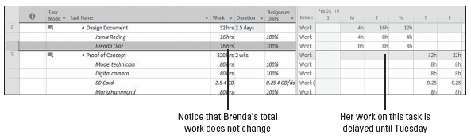
Step-by-Step: Delay the Start of a Resource Assignment
SAVE the project schedule.
PAUSE. LEAVE Project open to use in the next exercise.
Notes:
Task Usage view showing the delay in Brenda Diaz’s work

Slide 20
Applying Contours to Assignments
To optimize your project schedule, you can apply a predefined contour to a task’s assignments.
In the following exercise, you will apply a predefined work contour to an assignment. A contour determines how a resource’s work on a task is scheduled over time.
In general, predefined contours describe how work is distributed over time in terms of graphical patterns. Some options are Bell, Front Loaded, Back Loaded, Double Peak, and Turtle.
Predefined contours work best for assignments where you can estimate a probable pattern of effort. For instance, if a task might require significant ramp‐up time, a back‐loaded contour might be beneficial because the resource will be most productive toward the end of the assignment.
Notes:
Keep in mind that because Greg Guzik’s assignment to this task finishes later than the other resource assignments, Greg Guzik sets the finish date of the task. In this situation, Greg Guzik is the driving resource of this task because his assignment determines, or drives, the finish date of the task.

Slide 21
Step-by-Step: Apply a Contour to a Resource Assignment
GET READY. USE the project schedule from the previous exercise.
Use the mouse to locate and click on the task name cell of task 32, Proof of concept.
On the ribbon, click the Tables button, select the Entry table, and then bring the center divider to the left so the Duration column is the last one visible. Your screen should look similar to the figure on the next slide.
This task has three human resources assigned to it. The time‐scaled data illustrates that two of these resources are scheduled to work on this task for 8 hours each day. This is the default work contour type that Microsoft Project uses when scheduling work. You will notice that Greg Guzik is scheduled to work on this task at 50% utilization.
Notes:
You want to change Greg Guzik’s assignment on this task so that he starts with a brief daily assignment and increases his work time as the task progresses. He will still be overseeing the task as the other resources are working their assignments.

Slide 22
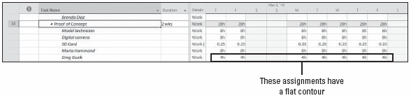
Step-by-Step: Apply a Contour to a Resource Assignment
In the Task Name column under task 32, double‐click on the task name cell of Greg Guzik. The Assignment Information dialog box appears.
Click the General tab, if it is not already selected.
Notes:
Time‐scaled data for task 32

Slide 23
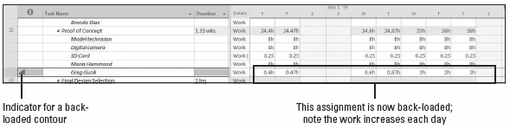
Step-by-Step: Apply a Contour to a Resource Assignment
In the Work contour box, select Back Loaded and then click OK to close the Assignment Information dialog box. Microsoft Project applies the contour to Greg Guzik’s assignment and reschedules his work on the task. Scroll your screen so that you can see most of Greg’s planned work on this task. Your screen should look similar to the figure below.
Notes:
Task Usage view with a back‐loaded contour on Greg Guzik’s assignment

Slide 24
Step-by-Step: Apply a Contour to a Resource Assignment
You might also have noticed that the duration of task 32 increased. You will correct this in the next exercise.
Point to the contour indicator in the Indicators column. Microsoft Project displays a ScreenTip describing the type of contour applied to this assignment.
SAVE the project schedule.
PAUSE. LEAVE Project open to use in the next exercise.
Notes:
Take Note: Note that applying a contour to this assignment caused the overall duration of the task to be extended. If you do not want a contour to extend a task’s duration, you need to change the task type (on the Advanced tab of the Task Information dialog box) to fixed duration before you apply the contour. When you apply a contour after changing to a task type such as fixed duration, Microsoft Project will recalculate the resource’s work value so that he or she works less in the same time period.

Slide 25
Manually Editing a Task Assignment
It is possible to manually edit the assignment values for a resource assigned to a task, rather than applying a contour. Because the reality is that a project manager would not plan Greg Guzik’s work for 24 minutes (or 0.4h) on 2/28/19, a manual editing of the assignment is necessary.
In the next exercise, you will manually edit the assignment for a resource by directly changing the assignment values in the time‐scaled grid of the Task Usage view. You might notice that when you delete the last contoured workday, the tasks after task 32 shift back to reflect the shortened duration of task 32.
You can use either predefined contours or make manual edits to a resource’s work assignments. How you contour or edit an assignment depends on what you need to accomplish. As a general rule, projects are not normally planned down to this level of detail.

Slide 26
Step-by-Step: Edit a Task Assignment Manually
GET READY. USE the project schedule from the previous exercise.
In the time‐scaled grid area, click the cell at the intersection of Greg Guzik and 2/28/19.
After conferring with Greg, you want to change this assignment to make it more realistic. Greg states that he will need to work for an hour on the first two days, 2 hours a day for two days, 3 hours for two days, 6 hours for two days, then full time at 8 hours to complete his work. Note that you are not changing Greg’s total assigned work on this task which is 40 hours.

Slide 27
Step-by-Step: Edit a Task Assignment Manually
Key the following hours in the corresponding cells:
Thursday, 2/28/19 ‐ 1
Friday, 3/1/19 ‐ 1
Monday. 3/4/19 ‐ 2
Tuesday, 3/5/19 ‐ 2
Wednesday, 3/6/19 ‐ 3
Thursday, 3/7/19 ‐ 3
Friday, 3/8/19 ‐ 6
Monday, 3/11/19 ‐ 6
Tuesday, 3/12/19 ‐ 8
Wednesday, 3/13/19 ‐ 8
Delete any remaining cells on Greg’s row after 3/13/19.

Slide 28
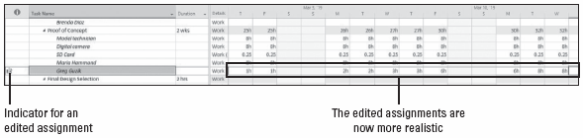
Step-by-Step: Edit a Task Assignment Manually
Point to the contour indicator in the Indicators column. Microsoft Project displays a different ScreenTip on this assignment. Notice now that Greg’s assignment is a bit more realistic. Your screen should look similar to the figure below.
SAVE the project schedule.
PAUSE. LEAVE Project open to use in the next exercise.
Notes:
Task Usage view with edited work assignments for Greg Guzik

Slide 29
Optimizing the Project Schedule
As the work continues on your project, you will be tracking actuals and updating your project schedule. An important part of project management is verifying that the project has been optimized. This might mean reducing cost, duration, scope, or any combination of these aspects.
In the next exercise, you will review project details such as the duration, finish date, and total costs. It is helpful to review this information so that you understand the nature of your project and how it can best be optimized.
Optimizing is adjusting the aspects of the project schedule, such as cost, duration, and scope (or any combination of these), to achieve a desired project schedule result. A desired result may be a target finish date, duration, or overall cost.
Notes:
To optimize a project schedule, you must first identify and understand the project’s duration, finish date, and total cost.

Slide 30
Step-by-Step: Identify the Project Finish Date and Total Cost
GET READY. USE the project schedule from the previous exercise.
On the ribbon, in the Task Views group, click the Gantt Chart button.
On the ribbon, click the Project tab and then click the Project Information button. Click the Statistics button. The Project Statistics dialog box appears. Your screen should look similar to the figure on the next slide.
The current finish date is 6/18/19. This is later than the baseline finish date of 5/23/19. You have a positive duration variance of 17.33 days, which means you are scheduled to finish more than three working weeks later than planned. The current cost appears as just over $76,949. This value is the sum of all actual costs to date and the remaining planned task and resource costs in the project.
Notes:
These include actual and planned fixed costs, per‐use costs, and the costs of resource assignments.

Slide 31
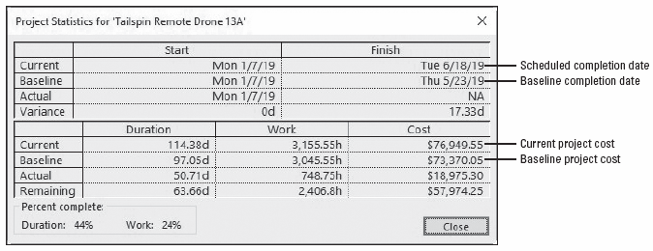
Step-by-Step: Identify the Project Finish Date and Total Cost
Click Close to close the Project Statistics dialog box.
SAVE the project schedule.
PAUSE. LEAVE Project open to use in the next exercise.
Notes:
Now, let’s look forward to the next exercise. Assume that you have shared the project details from above with the project sponsor. The sponsor expected that the project would be slightly over budget, but did not expect that it would be more than six or seven days beyond the agreed‐upon finish date. The current projected budget overrun is acceptable, and can even increase slightly, if the project manager can get the project completed by 6/11/19.

Slide 32
Compressing the Project Schedule
Now that you have reviewed the project details and notified the sponsor, you will focus on pulling in the project finish date.
In the next exercise, you will compress a project schedule by applying lead time to some tasks and allowing overtime for another task.
Optimizing a project schedule and responding to variance are issues that Microsoft Project cannot automate.
As a project manager, you must know the nature of your projects and how they should be optimized.
As you will learn in this exercise, you might need to make trade‐offs, such as cutting scope, adding resources, allowing overtime, or adjusting the relationships by inserting lead time.

Slide 33
Step-by-Step: Compress the Project Schedule to Pull in the Project Finish Date
GET READY. USE the project schedule from the previous exercise.
Press the F5 key. In the ID box, key 40 and click OK.
At the top of the screen, under Gantt Chart Tools, click the Format tab. Select the Critical Tasks check box.
Scroll through and review the task list in Product Development (tasks 36‐41). After some discussion with the heads of engineering, manufacturing, and quality control, they all agree that the development of raw materials list can finish at the same time as internal testing.
If necessary, scroll the Gantt Chart view to the right so that you can see the entire Gantt bar for task 38, Internal testing, and task 39, Raw materials list. Your screen should look similar to the figure on the next slide.

Slide 34
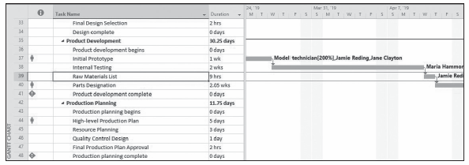
Step-by-Step: Compress the Project Schedule to Pull in the Project Finish Date
In the Task Name column, double‐click the name of task 39, Raw materials list. The Task Information dialog box appears.
Click the Predecessors tab.
Notes:
Gantt chart displaying tasks 38 and 39

Slide 35
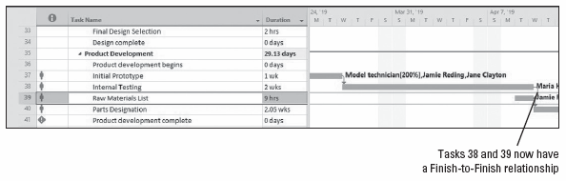
Step-by-Step: Compress the Project Schedule to Pull in the Project Finish Date
In the Type field for the predecessor task 38, click once in the box where the finish‐to‐start relationship is currently listed. Select the down arrow to reveal the submenu of relationship choices and then select the finish‐to‐finish relationship.
Click OK to close the Task Information dialog box. Your screen should look similar to the figure below.
Notes:
Gantt Chart view showing a Finish‐to‐Finish relationship has been set between tasks 38 and 39

Slide 36
Step-by-Step: Compress the Project Schedule to Pull in the Project Finish Date
This process is called fast‐tracking, which is defined as doing tasks in parallel that were originally planned to be done in series. You can review the Gantt Chart view (or display the Project Information dialog box) to see that the final task of the project still ends on 6/18/19. The reason the finish date was not impacted very much is because you fast‐tracked a very small task. To compress the project duration further, you will apply overtime work to some assignments.
On the View ribbon, click the Task Usage button. The Task Usage view appears. Click the Tables button and then select the Usage table.
Right‐click the Work column heading. On the shortcut menu that appears, select Insert Column.

Slide 37
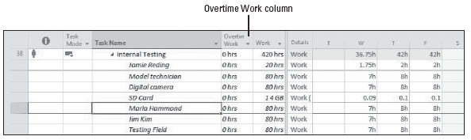
Step-by-Step: Compress the Project Schedule to Pull in the Project Finish Date
Key Over and then select Overtime Work from the list. Microsoft Project inserts the Overtime Work column between the Task Name and Work columns. Drag the divider bar between the table and chart portions of the Gantt chart to the right until the Duration column is visible.
Press the F5 key. In the ID box, key 38 and click OK. Microsoft Project scrolls the Task Usage view to display the assignments of task 38. Your screen should look similar to the figure below.
Notes:
Task Usage view with task 38 and the work data displayed

Slide 38
Step-by-Step: Compress the Project Schedule to Pull in the Project Finish Date
Currently, there are three full‐time human resources, assigned 80 hours of regular work to this task. You will notice one other resource, Jamie Reding, is assigned only 20 hours of work. You will also notice there is an equipment resource (Digital Camera), a material resource (SD Card), and another work resource called Testing Field.
To shorten the task’s duration without changing the total work in the task, you will record that 20 of the 80 hours of work is overtime work. You will enter 5 overtime hours for Jamie.
Enter 20 in the Overtime Work cell for all of the resources except Jamie Reding and the SD Card.
Enter 5 in the Overtime Work cell for Jamie Reding.

Slide 39
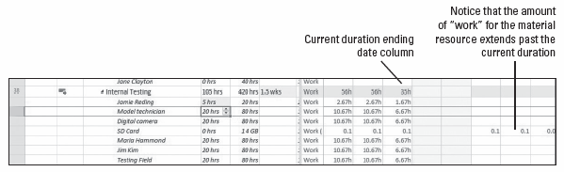
Step-by-Step: Compress the Project Schedule to Pull in the Project Finish Date
Scroll to the right in the time‐phased area to see that the SD Card work now goes past the current duration of this task, as depicted in the figure below.
Scroll back to the left in the time‐phased work area, to the beginning of the assignment for SD Card.
In the time‐phased work cell on March 27, 2019, enter the number 1 and then press Enter.
Notes:
Work for the SD Card material resource extends beyond the current duration

Slide 40
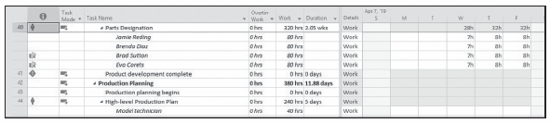
Step-by-Step: Compress the Project Schedule to Pull in the Project Finish Date
Delete the remaining work assignment data for the SD Card resource.
You will perform the same operation on one more task to see if you can get the duration to within acceptable limits.
Press the F5 key. In the ID box, key 40 and click OK. Microsoft Project scrolls the Task Usage view to display the assignments of task 40. Your screen should look similar to the figure below.
Notes:
Task Usage view with task 40 and the work data displayed

Slide 41
Step-by-Step: Compress the Project Schedule to Pull in the Project Finish Date
Currently, all four of the resources are assigned 80 hours of regular work to this task. To shorten the task’s duration without changing the total work in the task, you will record that 20 of the 80 hours of work is overtime work.
Click the Overtime Work cell for Jamie Reding, the first resource assigned to task 40.
Key 20 and press Enter.
Repeat the step above (step 21) for Brenda Diaz, Brad Sutton, and Eva Corets. Your screen should look similar to the figure on the next slide.
Notes:
Take Note: Entering overtime work for an assignment does not add work to the assignment. Rather, it indicates how much of the work assigned is overtime. Adding overtime work reduces the verall duration of the assignment.

Slide 42
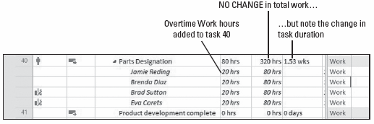
Step-by-Step: Compress the Project Schedule to Pull in the Project Finish Date
On the ribbon, click the Project tab, click Project Information, and then click the Statistics button. Note the new projected finish date of 6/11/19, which is the sponsor’s requested completion date.
SAVE the project schedule and then CLOSE the file.
PAUSE. If you are continuing to the next lesson, keep Project open. If you are not continuing to additional lessons, CLOSE Project.
Notes:
Task Usage view showing the change in task duration with overtime work added

Slide 43
Compressing the Project Schedule
Although you stopped your optimization work when you achieved your desired finish date, keep in mind that once actual work starts, variance will almost certainly appear and the critical path and project finish date are likely to change. For this reason, properly identifying and responding to variance is a key project management skill.
In previous lessons, only a single critical path per project has been emphasized: the critical path that determines the project finish date. However, as you saw in this exercise, Microsoft Project can identify a critical path within any chain of linked tasks. This is especially useful when the project is divided into distinct phases. Usually, the critical path within a phase will have a much more distinct line of tasks in it.

Slide 44
Compressing the Project Schedule
Most projects have a specific due date by which they need to be complete. If you want to shorten the duration of the project to make the end date occur sooner, you must shorten the critical path. In reality, compressing the schedule happens in various ways, but these can be classified into two categories:
Fast‐tracking: Performing two or more project tasks in parallel that would otherwise be done in series or one right after the other. By overlapping the tasks, more work gets completed in a shorter amount of time. The tasks do not necessarily have to be overlapped the entire length of their respective durations.
Crashing: Adding more resources to the critical path tasks. This could take the form of working extra shifts, working overtime, adding more work resources to a task, or outsourcing (paying to have some work done outside the organization).
Notes:
When deciding to crash a project schedule, always choose the option that costs the least per day or per week.

Slide 45
Compressing the Project Schedule
Prior to starting actual work on the project, it is critical that the project manager closely manage both the critical path and the float (called slack in Microsoft Project). This involves:
Knowing the tasks that are on the critical path and being able to evaluate the risk to project success if any of the tasks are not completed as scheduled. Any delays in completing tasks on the critical path delay the completion date of the project.
Knowing where the float is in the project. On a complex project, the critical path may change frequently. Tasks with very little free or total float might become critical as the project begins and the actuals start to vary from the schedule. In addition, tasks that had no float initially (and therefore were probably on the critical path) might gain float as other tasks move on to the critical path.

Slide 46
Skill Summary

