Slide 1











2021
Hospital
Management
System
What is a hospital management system?

Slide 2
Agenda Style
01
Definition:
Introduction for our project idea.
02
Advantages:
Hospital management system advantages
03
HMS automation
Workflow automation.
04
Marketing Strategy
05
Conclusion

Slide 3



What is HMS
Hospital management system is:
The hospital management system (HMS) is an integrated software that handles different directions of clinic workflows. It manages the smooth healthcare performance along with administrative, medical, legal and financial control.
healthcare développement
An increase in revenue
Control and reduce costs

Slide 4
HOSPITAL MANAGEMENT SYSTEM ADVANTAGES
Less time consuming
Digital medical records
Facility management
As the services and interactions are improved in all possible ways
Automation is one of the main benefits here
Hospitals authorities are able to manage their available resources
Patient self-service
Patients have their own system accounts where the list of various actions can be performed
Better customer experience
Improved Processes
Staff interaction
Since the clinic management system is patient-oriented, the treatment process can be less stressful.
Automation is one of the main benefits here.
It is vital to engage all of your employees for improved coordination and teamwork.

Slide 5
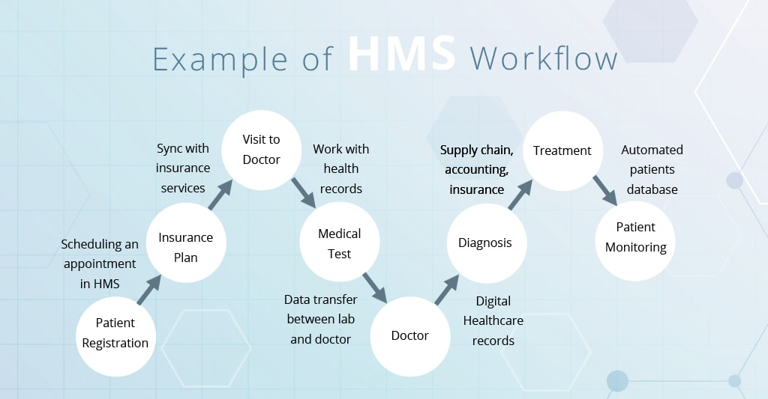
PowerPoint
Presentation
PowerPoint
Presentation
PowerPoint
Presentation

Slide 6

Marketing Strategy
Your story
Our project answers a problem experienced by every visitor to the hospitals and the problem of appointments.
Target audiences
The big hospitals and the clinic .
Goal
To give the users a platform to take appointment everywhere and anywhere they want to visit a doctor.

Slide 7
Conclusion
Taking into account all the mentioned details, we can make the conclusion that the hospital management system is the inevitable part of the lifecycle of the modern medical institution. It automates numerous daily operations and enables smooth interactions of the users. Developing the hospital system software is a great opportunity to create the distinct, efficient and fast delivering healthcare model. Implementation of hospital management system project helps to store all the kinds of records, provide coordination and user communication, implement policies, improve day-to-day operations, arrange the supply chain, manage financial and human resources, and market hospital services.
Performance
Facility
Smooth

Slide 8
Thank You
Insert the Sub Title of Your Presentation

