Slide 1
Road Surface Estimation (Planar Surfaces)
Object-oriented Programming (2020/21 WS)
Vedran BAJRAMOVIC
Hamza ZAHID
Dr. Ludwig Högner
Christian Albrecht

Slide 2
Outline
Object-oriented program
  Introduction
  Abstract Class
  Subclasses
  Visualization Class
  Main

Slide 3
Introduction
Cloud Operation
Cloud Filtering
Cloud Ransac
Cloud Segmentation
Cloud Clustering

Slide 4
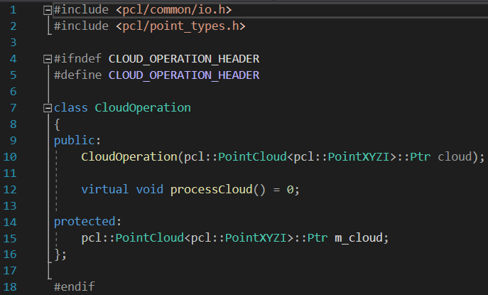
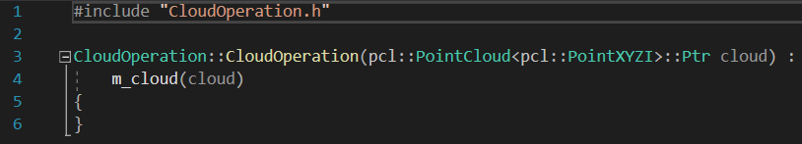
Abstract Class
Constructor which takes the Point Cloud and saves it as a protected member
One virtual function (the function without definition)
Header
Cpp

Slide 5
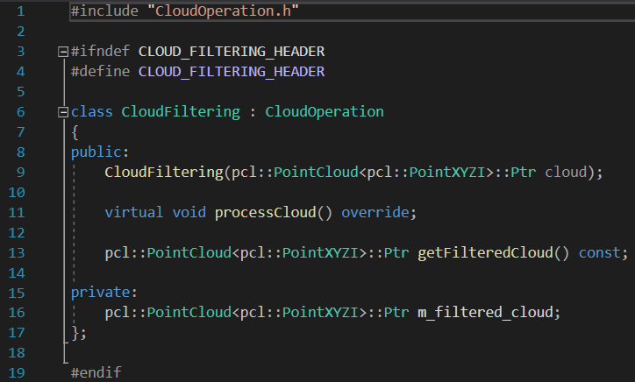
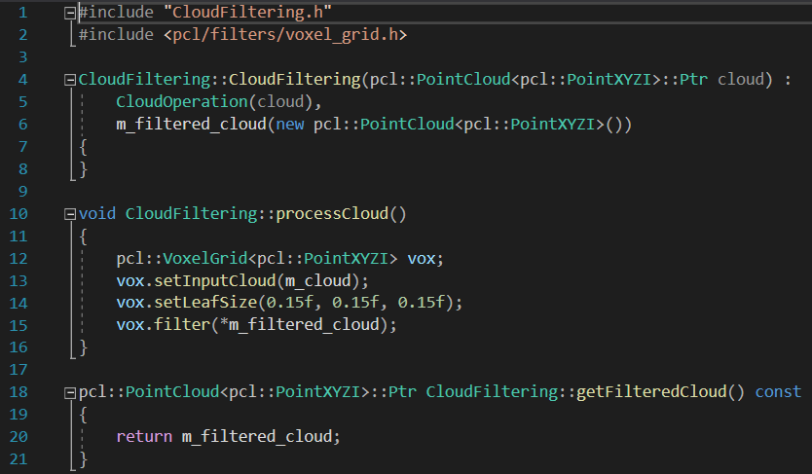
Subclasses
Classes inheriting the abstract class provide a definition for the virtual function.
Processed cloud is defined as a private member.
The same principle applies to the CloudRansac, CloudSegmentation and CloudClustering classes, but with different implemented algorithm in the processCloud function.
Header
Cpp

Slide 6
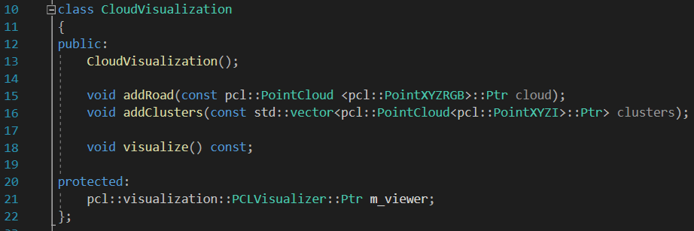
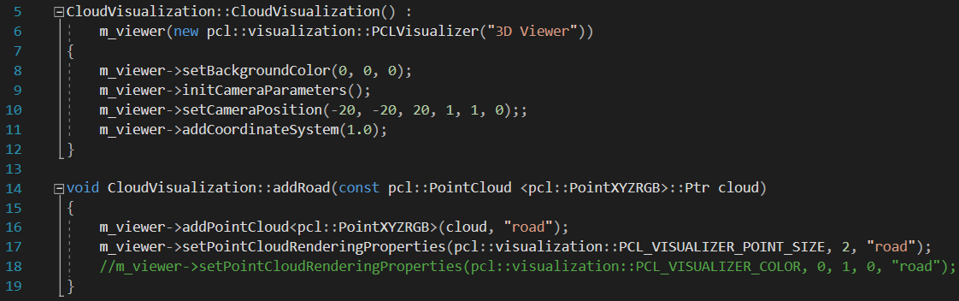
Visualization Class
The visualization class has a constructor (does not require any parameter).
Has two functions which visualize
  Road (addRoad)
  Clusters (addClusters)
Third function visualize the point cloud and has a member “m_viewer”

Slide 7
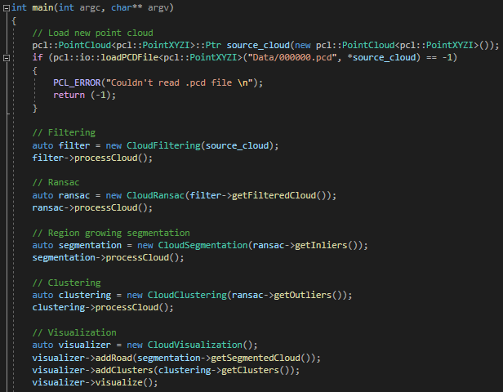
Main
The source cloud is loaded and forwarded to the cloudFiltering class.
In Ransac Class, the input parameter is the filtered cloud, and the process goes similarly until the visualization.

Slide 8
Thank You
for your attention!

