Slide 1
Temperature -analysing system
A PROJECT REPORT ON
NAME: HARSHITH SUDAR
ROLL: 21BCS097
EMAIL:21BCS097@iiitdmj.ac.in
NAME: HARSHUL NAWANI
ROLL:21BCS099
EMAIL:21BCS099@iiitdmj.ac.in
NAME: HRITIK YADAV
ROLL: 21BCS103
EMAIL:21BCS103@iiitdmj.ac.in
Department of Computer Science and Engineering
Pandit Dwarka Prasad Mishra Indian Institute of Information Technology, Manufacturing and Design ,Jabalpur , Madhya Pradesh

Slide 2
INTRODUCTION
"Temperature Monitoring and Analyzing Using Arduino", The system is designed with Arduino (microcontroller) in addition with temperature sensor.
Nowadays most of the activities in our day-to-day living have become part of information technology and we find controllers in each application. Thus, the trend is directing towards micro-control-based project works.

Slide 3
WHAT WE WANT TO ACHIEVE
1.All life forms and natural processes need some conditions to be met in order to produce efficient results and one of the most common factors among them is temperature.
2. For example if we are transporting/storing some blood samples(donation/for testing) and in the region there is no proper refrigeration and need to be cooled/monitored manually.
3.Hence our project which can run on battery(portable) can monitor the fluctuations and inform about the changing conditions
4.Same thing also applies for chemistry lab for certain reactions.

Slide 4
The Problem this project can solve
1.If there is a laboratory, can be a blood bank or a IVF centre or a chemistry lab where there are objects like cell cultures or temperature dependent equipment’s.
2. Where the role of a constant temperature range is important there we can implement our project so that if by chance there is a sudden change in temperature, it could be controlled and there would be no loss .

Slide 5
What is done in our project
1.We have designed a circuit using an Arduino which senses the temperature in the time duration which will be given by the user .
2. After the completion of one process the user can view max min, average temperature or again start a new process according to the option selected by the user.
3.There are LEDs of two colours that have been added which works as an indicator for the user to identify if temperature has risen above a particular limit.
4.this project is user defined and works according to user needs.

Slide 6
Hardware required
1.ARDUINO UNO
It is a microcontroller board. It has three types of pins Digital (14 pins), Analog(6 pins) and Power pins.
2.LM35 TEMPERATURE SENSOR
It is a chip that provides a voltage output that is linearly proportional to the temperature in °C and is, therefore, very easy to use with an Arduino.
3.KEYPAD
A basic keypad which we are using for taking input.

Slide 7
Hardware required
4. LED
We are using it as an indicator. LED has two terminals in which one is grounded and other is given power by Arduino UNO. .
5.BUZZER
It is a kind of alarm which outputs sound as an indication. .IT

Slide 8
What is to be done
1.we have to connect LCD to the above circuit which can tell us the precise temperature so that we will be able to use this project widely as we can analyse the temperature.
2. With the help of code we are taking input and calculating maximum ,minimum and average temperature which can be viewed by the user after completion of the process.
3.During the process if there is sudden rise in temperature buzzer and led will become activated and it will inform the user in runtime of the process.

Slide 9
start
If Temperature <25 degree
BUZZER->no sound
LED->Green
If temperature>=40 degree
If 25< temperature <40 degree
BUZZER->Rings alarm
LED->RED(danger)
BUZZER->no sound
LED->None

Slide 10
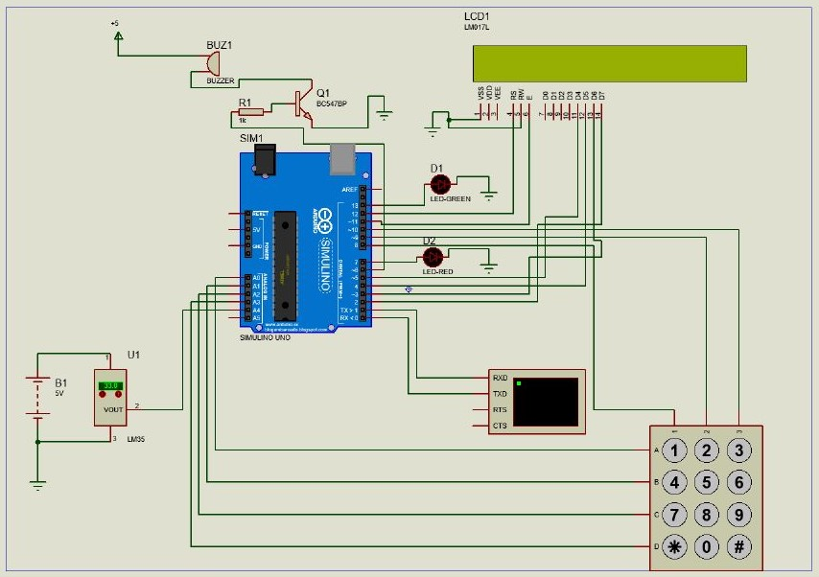
Circuit diagram

Slide 11
THE CODE
#include <LiquidCrystal.h>
#include <Keypad.h>
const int buzzer=6;
const int rs = 12, en = 11, d4 = 5, d5 = 4, d6 = 3, d7 = 2;
LiquidCrystal lcd(rs, en, d4, d5, d6, d7);
const byte ROWS = 4;
const byte COLS = 3;
char Keys[ROWS][COLS] = {
{ '1', '2', '3' },
{ '4', '5', '6' },
{ '7', '8', '9' },
{ '*', '0', '#' }
};
byte rowPins[ROWS] = { 14, 15, 16, 17 };
byte colPins[COLS] = { 8, 9, 10 };
Keypad customKeypad = Keypad(makeKeymap(Keys), rowPins, colPins, ROWS, COLS);
void setup() {
pinMode(7,OUTPUT);
pinMode(13,OUTPUT);
pinMode(buzzer,OUTPUT);
analogReference(INTERNAL);
lcd.begin(32, 2);
Serial.begin(9600);
}
float maxi = 0;
float mini = 1000;
float sum = 0;
int count = 0;
float temp;
float avg;
float avg_temp(float a, int c) {
float ans;
ans = a / c;
return ans;
}

Slide 12
int detect_keys() {
int number = 0;
int i = 2;
while (i--) {
char customKey;
customKey = customKeypad.waitForKey();
if (customKey == '*') {
break;
}
if (customKey == '1') {
number = number * 10 + 1;
}
if (customKey == '2') {
number = number * 10 + 2;
}
if (customKey == '3') {
number = number * 10 + 3;
}
if (customKey == '4') {
number = number * 10 + 4;
}
if (customKey == '5') {
number = number * 10 + 5;
}

Slide 13
if (customKey == '6') {
number = number * 10 + 6;
}
if (customKey == '7') {
number = number * 10 + 7;
}
if (customKey == '8') {
number = number * 10 + 8;
}
if (customKey == '9') {
number = number * 10 + 9;
}
if (customKey == '0') {
number = number * 10 + 0;
}
}
return number;
}
void alarm_out(int a) {
if (a <= 25) {
digitalWrite(13, HIGH);
digitalWrite(7, LOW);
noTone(buzzer);
}
if (a > 25 && a < 40) {
digitalWrite(13, LOW);
digitalWrite(7, LOW);
noTone(buzzer);
}
if (a >= 40) {
digitalWrite(13, LOW);
digitalWrite(7, HIGH);
tone(buzzer, 1000);
}
}

Slide 14
void loop() {
lcd.setCursor(1, 0);
lcd.print("* Welcome to our arduino project *");
for (int counter = 0; counter < 25; counter++) {
lcd.scrollDisplayLeft();
delay(150);
}
lcd.clear();
lcd.setCursor(1, 0);
lcd.print("Press - 1");
lcd.setCursor(1, 1);
lcd.print("for room temp");
char customKey;
customKey = customKeypad.waitForKey();
lcd.clear();
if (customKey == '1') {
lcd.setCursor(1, 0);
lcd.print("Select OPTION - ");
lcd.setCursor(1, 1);
lcd.print("1-ST 2-AVG 3-MAX MIN");
customKey = customKeypad.waitForKey();
lcd.clear();
int t = 5;
if (customKey == '1') {
lcd.setCursor(1, 0);
lcd.print("enter the time:");
t = detect_keys();
lcd.setCursor(1, 1);
lcd.print(t);
delay(1000);
lcd.clear();

Slide 15
while (t--) {
temp = (float)100 * (1.1 / 1023) * analogRead(A4);
lcd.setCursor(0, 1);
lcd.print("Press 0 to exit.");
lcd.setCursor(0, 0);
lcd.print("Room tem : ");
lcd.setCursor(9, 0);
lcd.print(temp, 2);
lcd.print(" C");
Serial.print("Room temperature : ");
Serial.print(temp, 2);
Serial.println(" deg C");
sum = sum + temp;
alarm_out(temp);
if (temp > maxi) {
maxi = temp;
}
if (temp < mini) {
mini = temp;
}
count++;
delay(1000);
lcd.clear();
}
}
if (customKey == '2') {
lcd.setCursor(0, 1);
lcd.print("Press 0 to exit.");
lcd.setCursor(0, 0);
avg = avg_temp(sum, count);
lcd.print("Avg temp : ");
lcd.setCursor(9, 0);
lcd.print(avg, 2);
Serial.print("Avg temperature ");
Serial.print(avg, 2);
Serial.println(" deg C");
while (customKey != '0') { customKey = customKeypad.waitForKey(); }
lcd.clear();
}

Slide 16
if (customKey == '3') {
lcd.setCursor(0, 1);
lcd.print("Press 0 to exit.");
lcd.setCursor(0, 0);
lcd.print("MaX ");
lcd.setCursor(4, 0);
lcd.print(maxi, 2);
lcd.print(" C");
Serial.print("Max temp : ");
Serial.print(maxi, 2);
Serial.println(" C");
lcd.setCursor(13, 0);
lcd.print("Min ");
lcd.setCursor(17, 0);
lcd.print(mini, 2);
lcd.print(" C");
Serial.print("Mintemp");
Serial.print(mini, 2);
Serial.println(" C");
while (customKey != '0') { customKey = customKeypad.waitForKey(); }
lcd.clear();
}
}
}

Slide 17
Summary
1.In this project we tried to implement and design an efficient way by which could analyse and monitor temperature in our surrounding and alarm us if temperature reaches beyond a certain limit using Arduino uno .
2. As we already discussed that temperature has its own advantages and disadvantages, and temperature beyond a certain limits can lead to many problems like overheating of devices, electrical components etc.
3. Thus its very important to analyse temperature and we have tried to provide a solution to it.

