Slide 1
Intermediate CSS3
Text, fonts, the box model, & float
Copyright© Point Of Solutions

Slide 2
Objectives
Manipulate common fonts and text properties
Include external fonts using Google Fonts
Define the Box Model and its components
Manipulate the components of the Box Model
Float Property
Copyright© Point Of Solutions
Notes:
Things like font-size and font-weight, how we actually set the font

Slide 3
Text and fonts
And how to use & manipulate them

Slide 4
Manipulating Text And Font
Font-family
Specifies the font for an element
Can hold several font names as a "fallback" system
Types of font-family values
family-name
generic-name
initial
inherit
CSS Syntax
font-family: family-name|generic-family|initial|inherit;
Copyright© Point Of Solutions

Slide 5
Google fonts
And how to use them
Copyright© Point Of Solutions

Slide 6
Manipulating text and fonts (cont’d)
Font-size controls how big or small the font is
Pixels vs EM vs. REM
Font-weight refers to how bold (thick) / lightweight (thin) the text is
Most fonts allow the use of numeric value, ranging from 100-1000
Line-height controls the height of a given line
Text-align allows to align the text left, right, or center
Text-decoration allows decoration of text
Copyright© Point Of Solutions

Slide 7
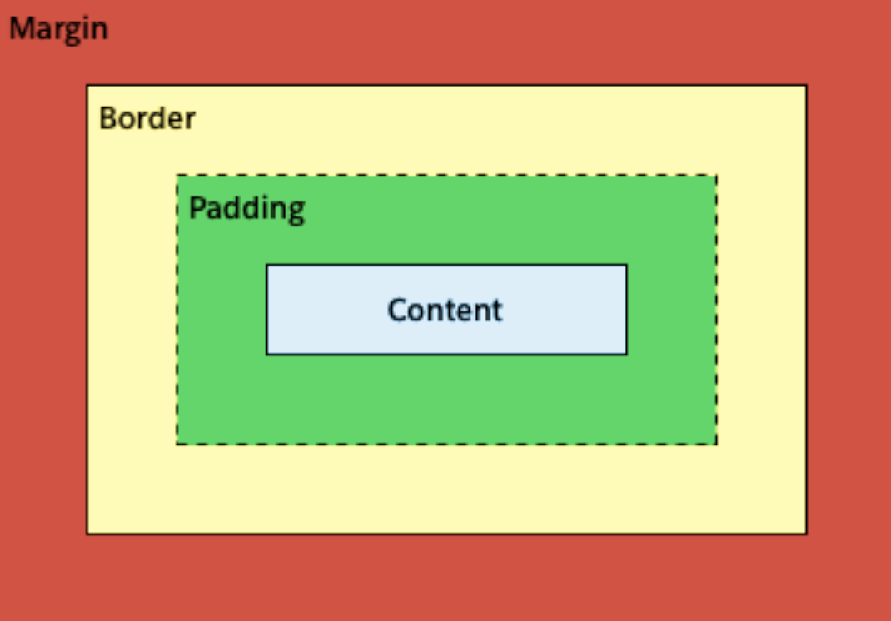
The Box model
Each element is represented as a rectangular box which is described using the “Box Model”
Each box has four edges:
Content
Padding
Border
Margin
Copyright© Point Of Solutions

Slide 8
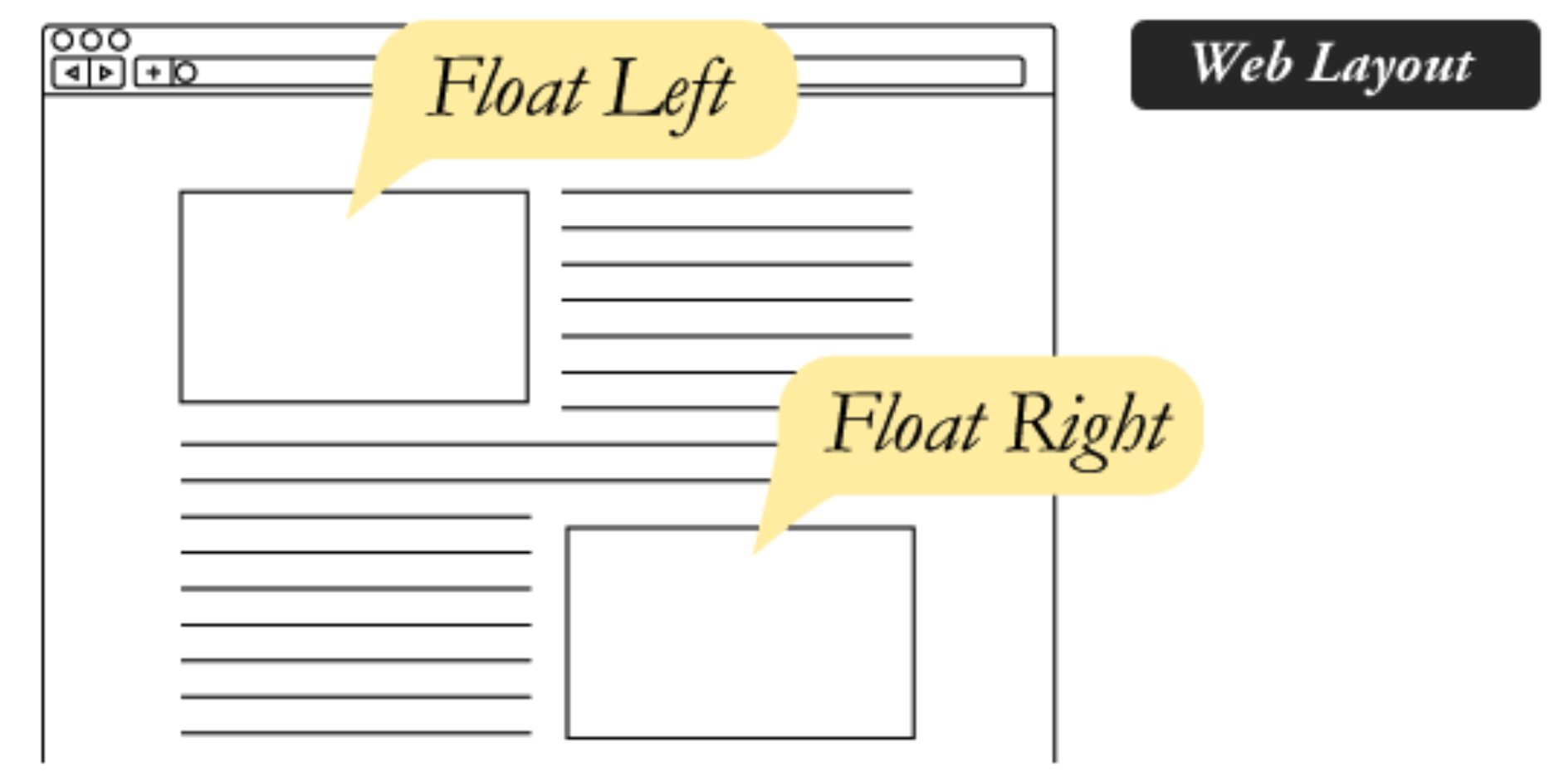
Float property
Keyword values
float: left;
float: right;
float: none;
float: inherit;
Copyright© Point Of Solutions

