Slide 1
advanced CSS3
Flexbox & css3 grid
Copyright© Point Of Solutions

Slide 2
What is flexbox?
A CSS3 layout mode that provides an easy and clean way to arrange items within a container
NO FLOATS!
Responsive and mobile friendly
Positioning child elements is MUCH easier
Flex container’s margins do not collapse with the margins of its contents
Order of elements can easily be changed without editing the source HTML
Copyright© Point Of Solutions

Slide 3
Flexible box model concept
The ability to alter item width and height to best fit in its containers available free space
Flexbox is direction agnostic
Built for small-scale layouts while the ”Grid” specification is for more large scale
Copyright© Point Of Solutions

Slide 4
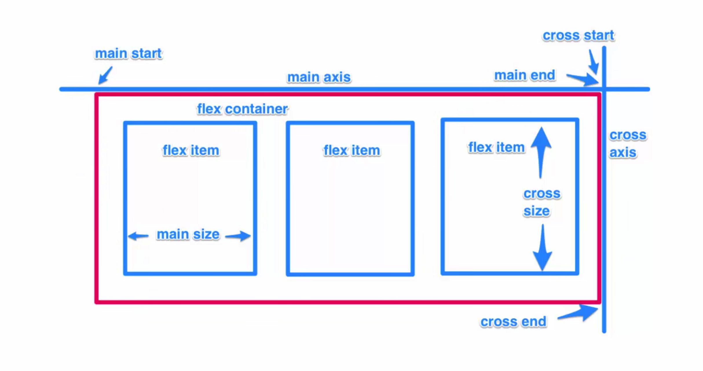
How flexbox looks
Copyright© Point Of Solutions

Slide 5
Flex properties
display: flex | inline-flex;
Flex-direction: row | column;
Flex-wrap: wrap | nowrap | wrapreverse;
Flex-basis: <length>;
Justify-content: flex-start | flex-end | center;
Align-self: flex-start | flex-end | center;
Align-items: flex-start | flex-end | center;
Alight-content: flex-start | flex-end | center;
Flex-grow: <number>;
Flex-shrink: <number>;
Flex: <integer>;
Order: <integer>;
Copyright© Point Of Solutions

Slide 6
Homework – Inline-flex
Provide a short summary/explanation of inline-flex
Create a simple application that utilizes *display: inline-flex;*

Slide 7
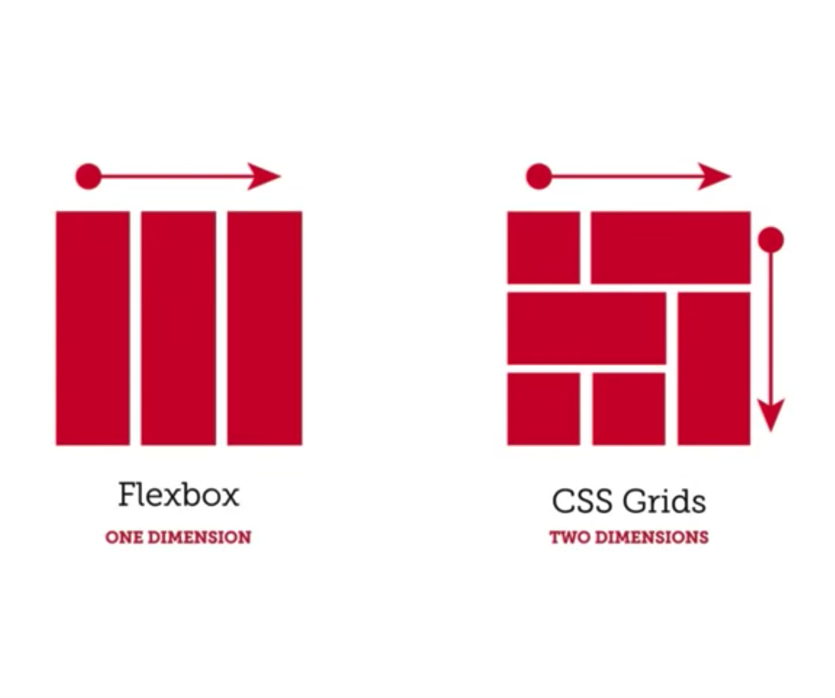
Copyright© Point Of Solutions

Slide 8
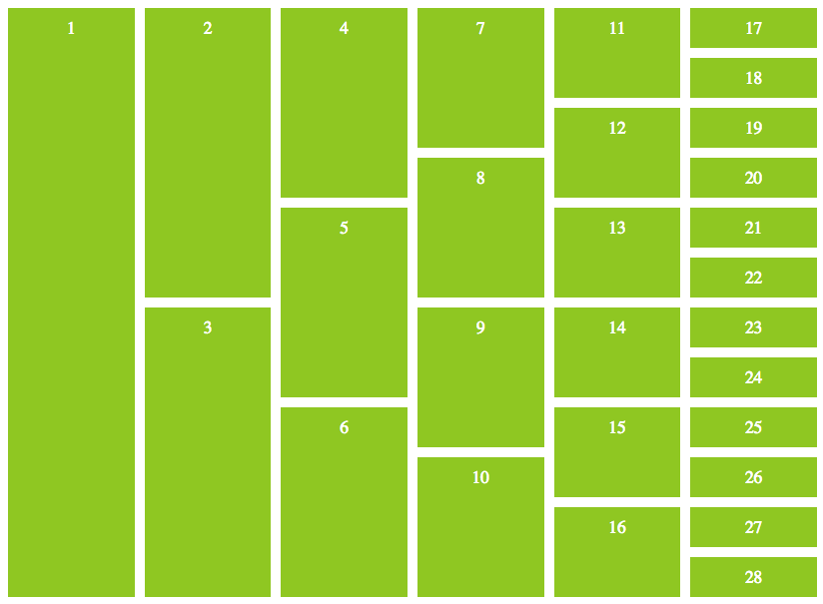
Css grid
Allows us to create two-dimensional layouts on a web-application and align items in BOTH columns and rows
All browsers now support CSS Grid functionality as of March 2017
Copyright© Point Of Solutions

Slide 9
Basic CSS grid
display: grid;
grid-template-columns: <value>;
grid-column-gap: <value>;
grid-row-gap: <value>;
grid-gap: <value>;
Copyright© Point Of Solutions

Slide 10
Intermediate CSS grid
fractionals
grid-auto-rows: <value>;
grid-auto-rows: minmax(<value>, auto);
Copyright© Point Of Solutions

Slide 11
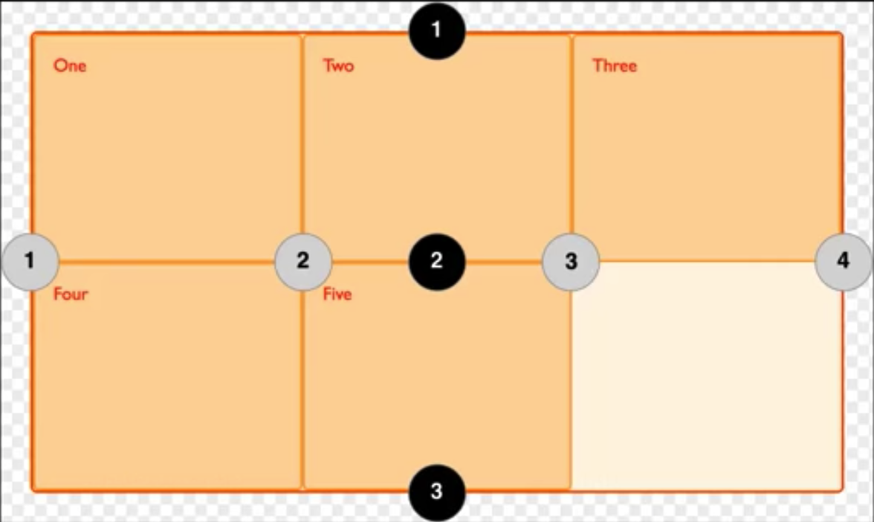
Advanced css grid
justify-items: start | center | end;
align-items: start | center | end;
justify-self: start | center | end;
align-self: start | center | end;
grid-colum
grid-row
Copyright© Point Of Solutions

