Slide 1
EPS Rating, Composite Rating, RS Rating Study
2019

Slide 2
Time Period
Q1 – First Monday of Jan, 13 weeks
Q2 – First Monday of Apr, 13 weeks
Q3 – First Monday of Jul, 13 weeks
Q4 – First Monday of Oct, 13 weeks
H1 – First Monday of Jan, 26 weeks
H2 – First Monday of Jul, 26 weeks
Year – First Monday of Jan, 52 weeks

Slide 3
Data
Price Data – Adjusted for splits, dividends. Delisted stocks included. So no survivorship bias in the study.
All stocks included
Rating data was taken on the Friday just before the study period.

Slide 4
EPS Rating

Slide 5
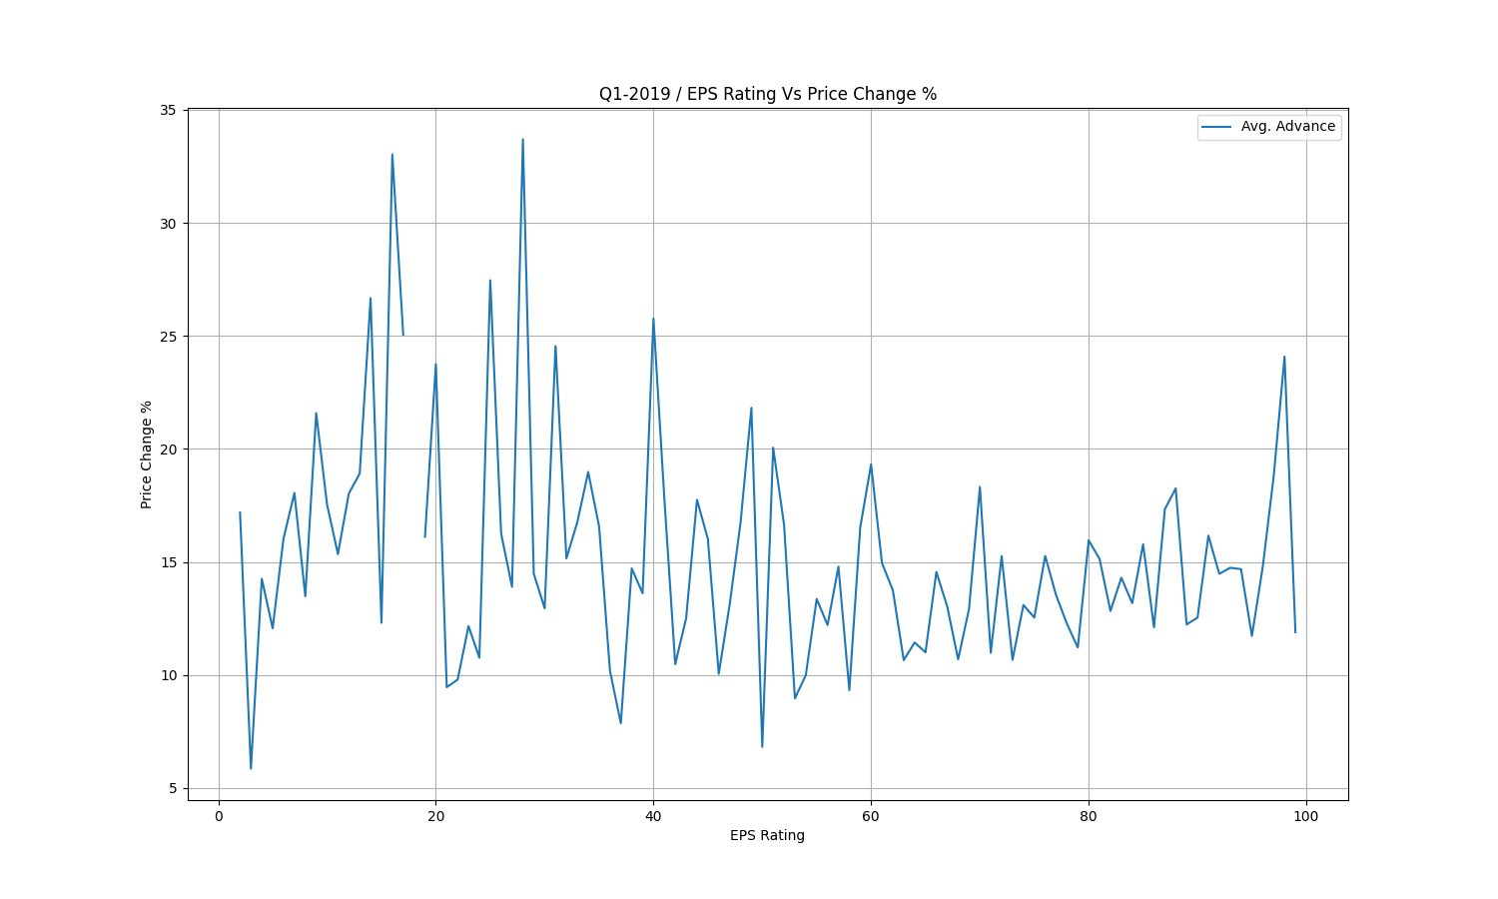

Slide 6
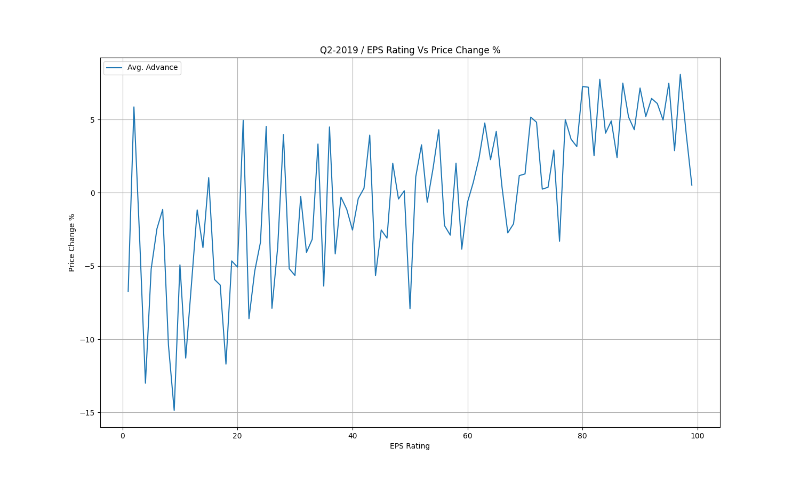

Slide 7
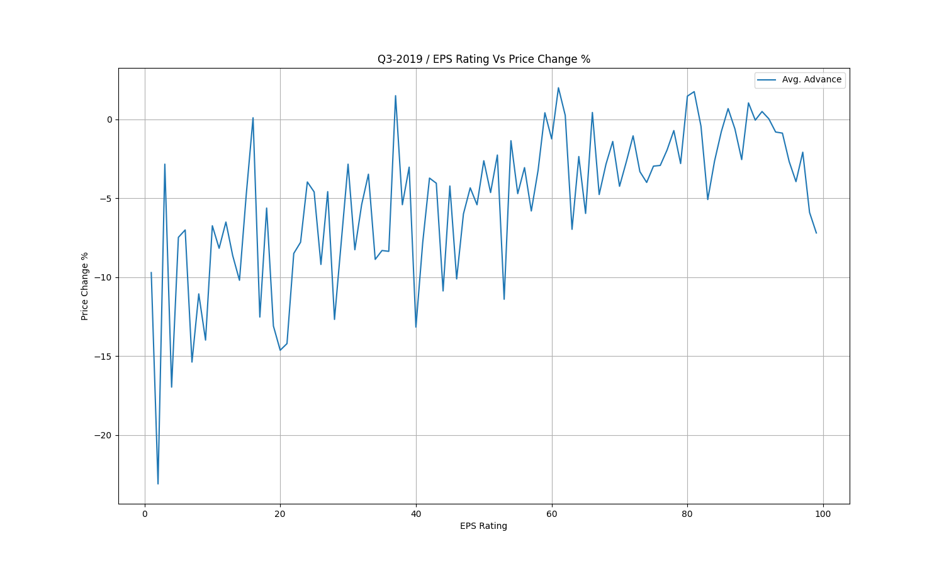

Slide 8
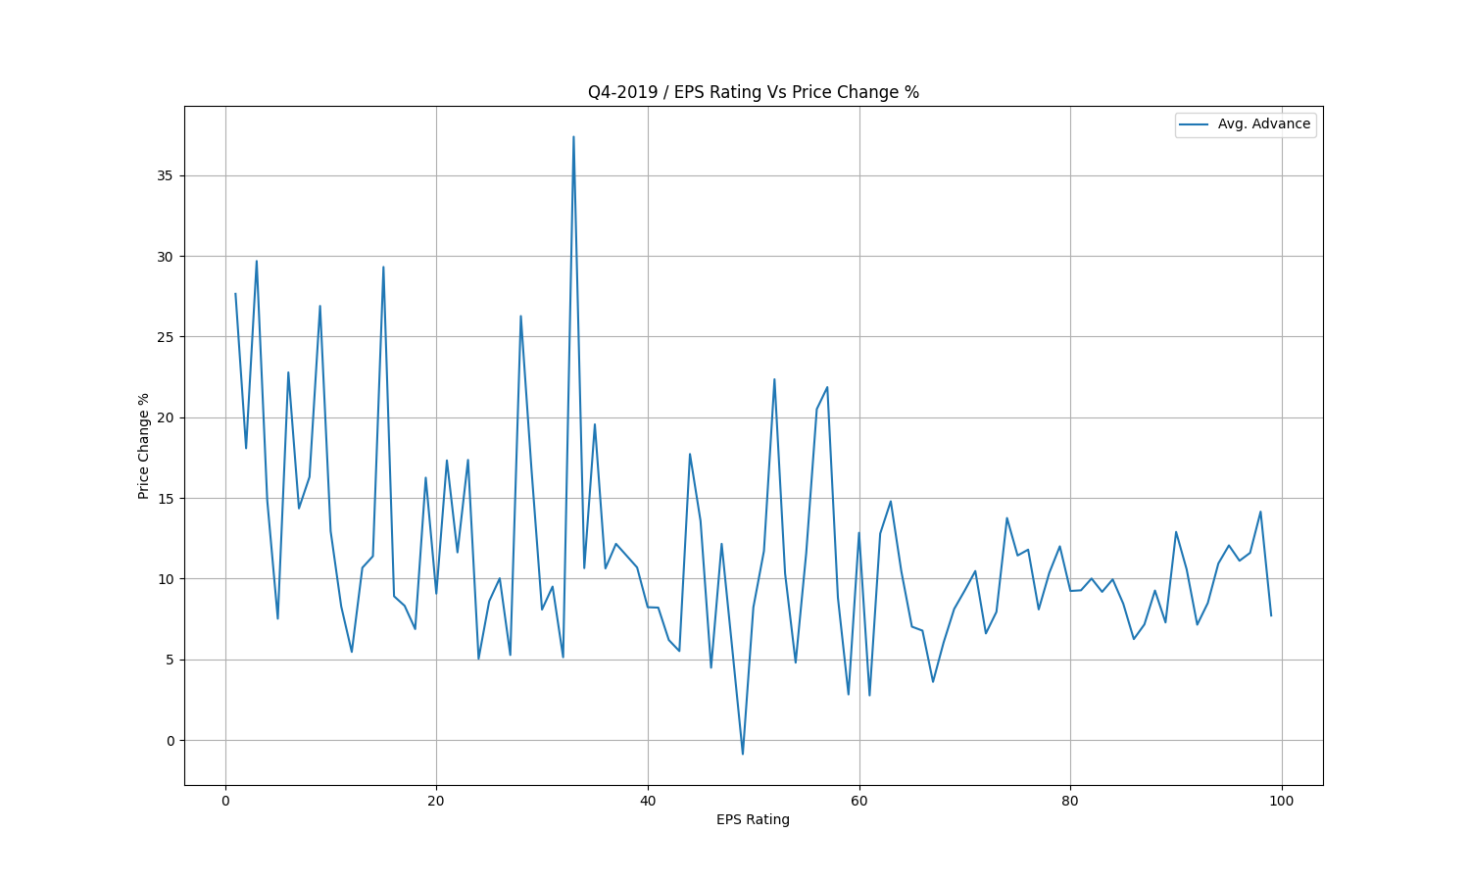

Slide 9
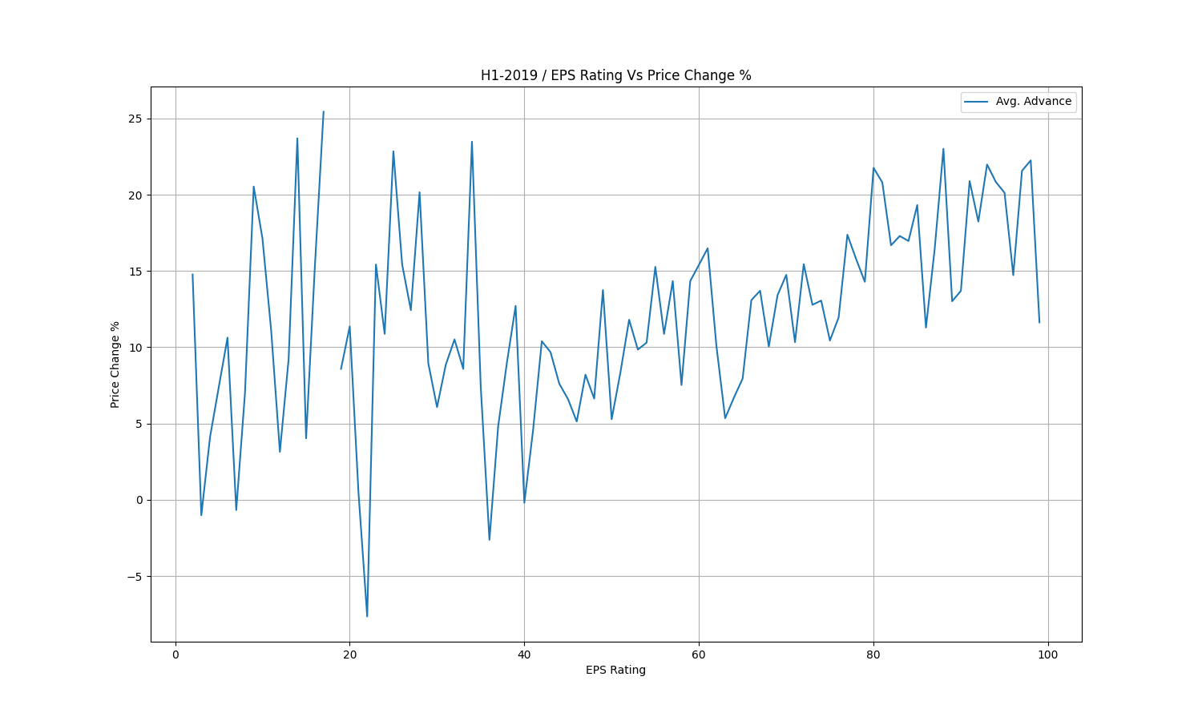

Slide 10
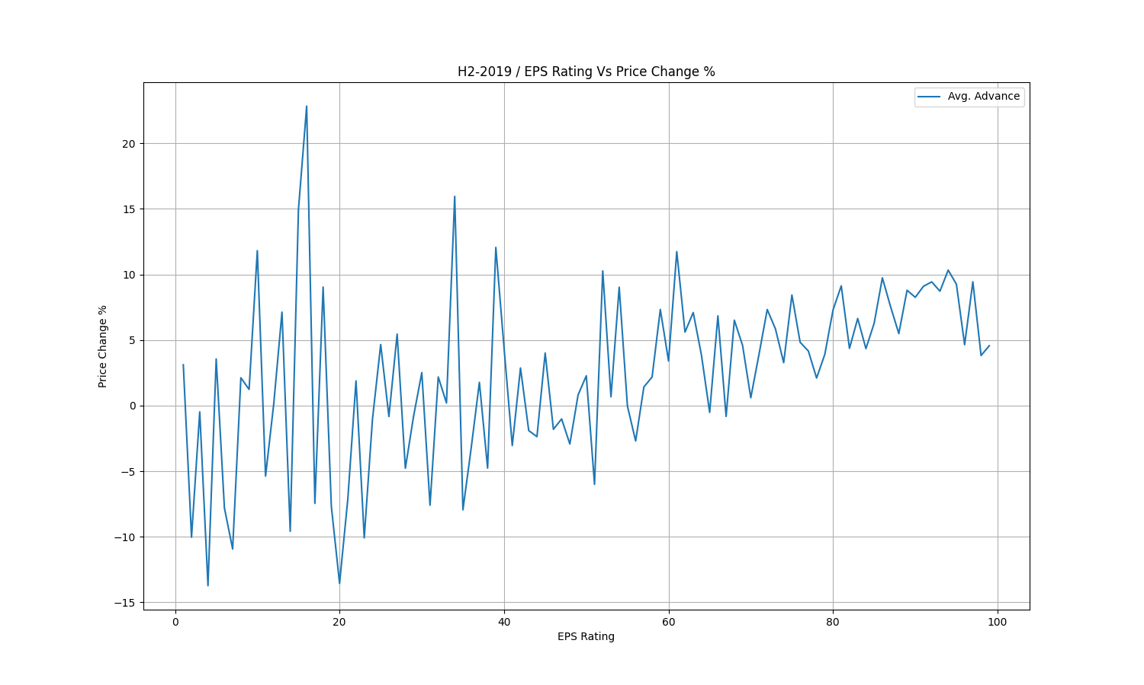

Slide 11
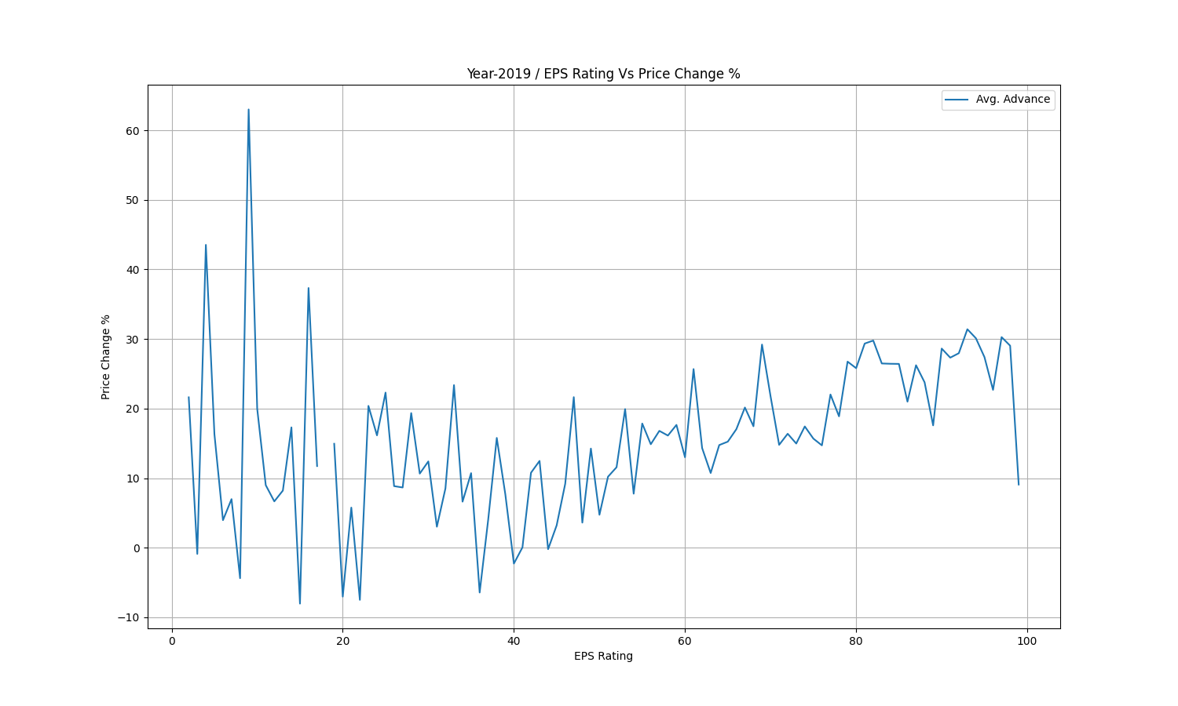

Slide 12
Composite Rating

Slide 13
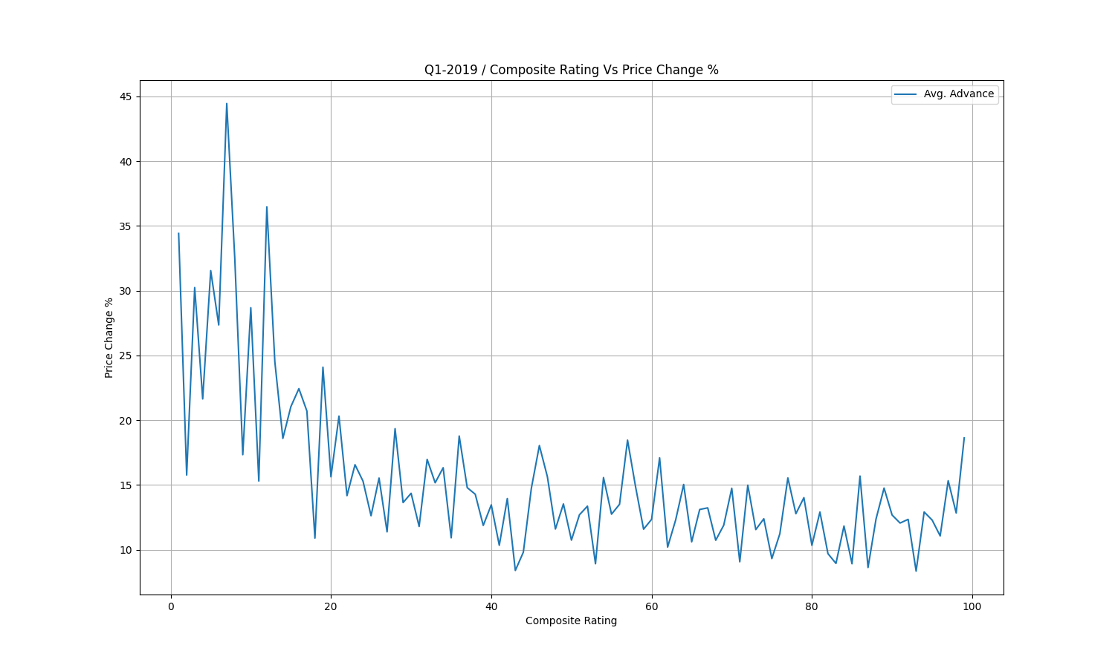

Slide 14
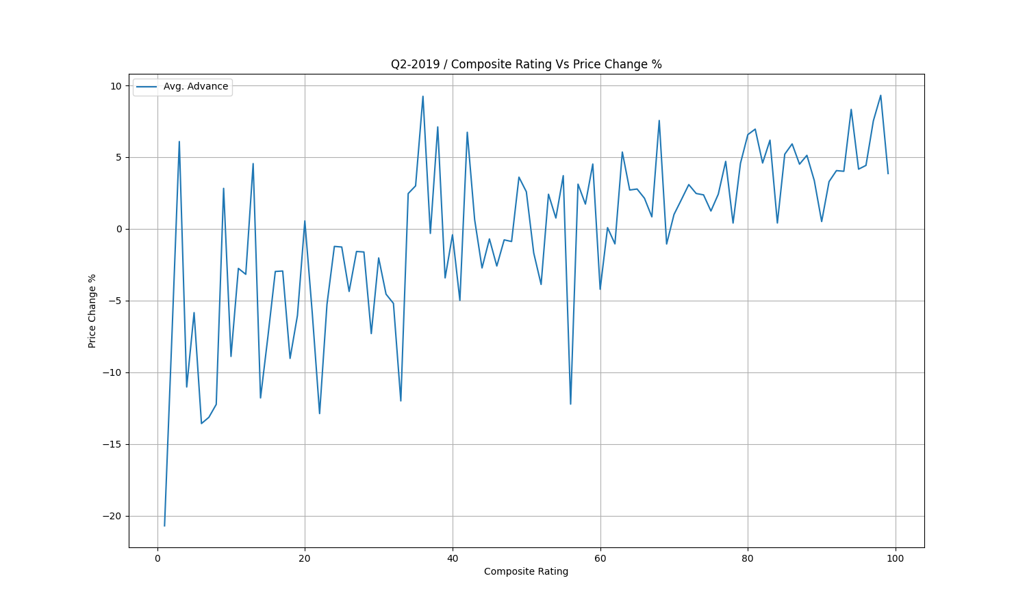

Slide 15
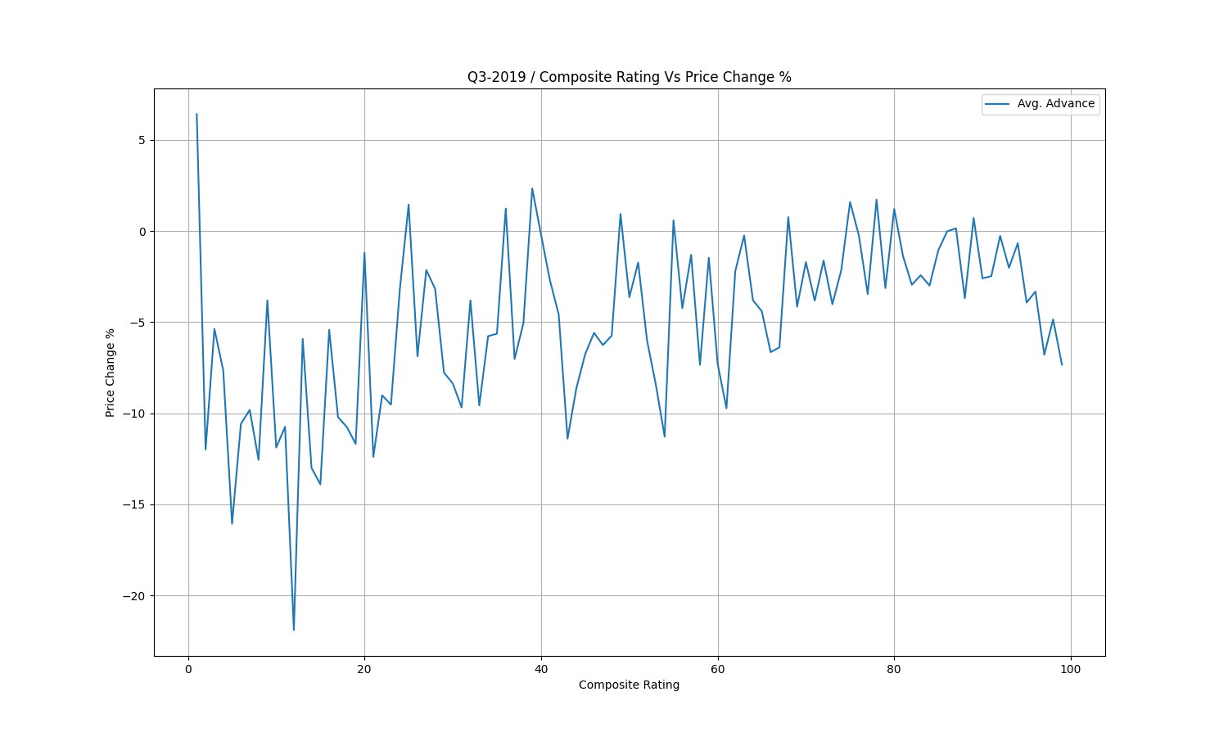

Slide 16
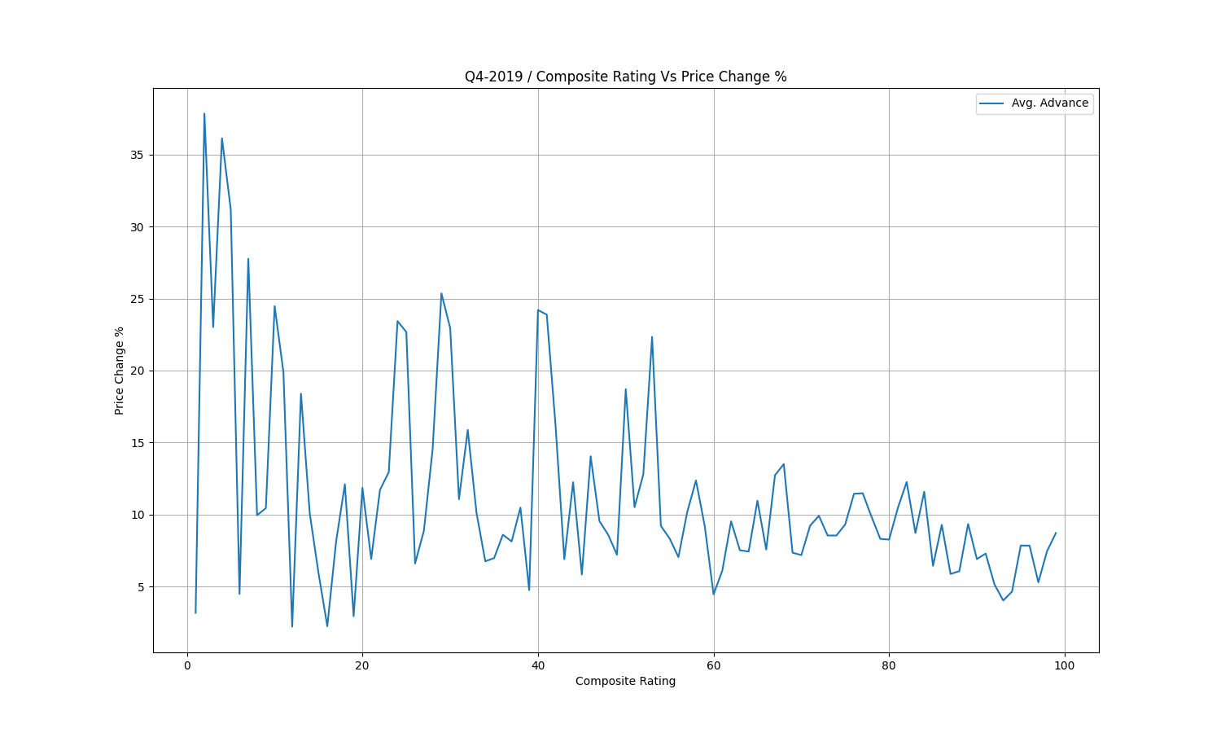

Slide 17
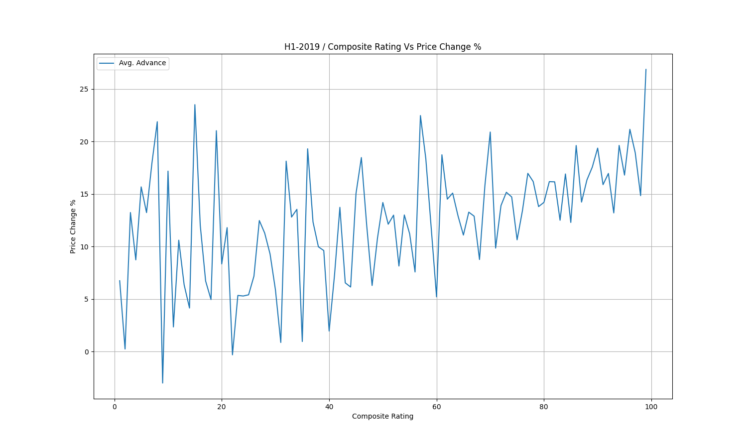

Slide 18
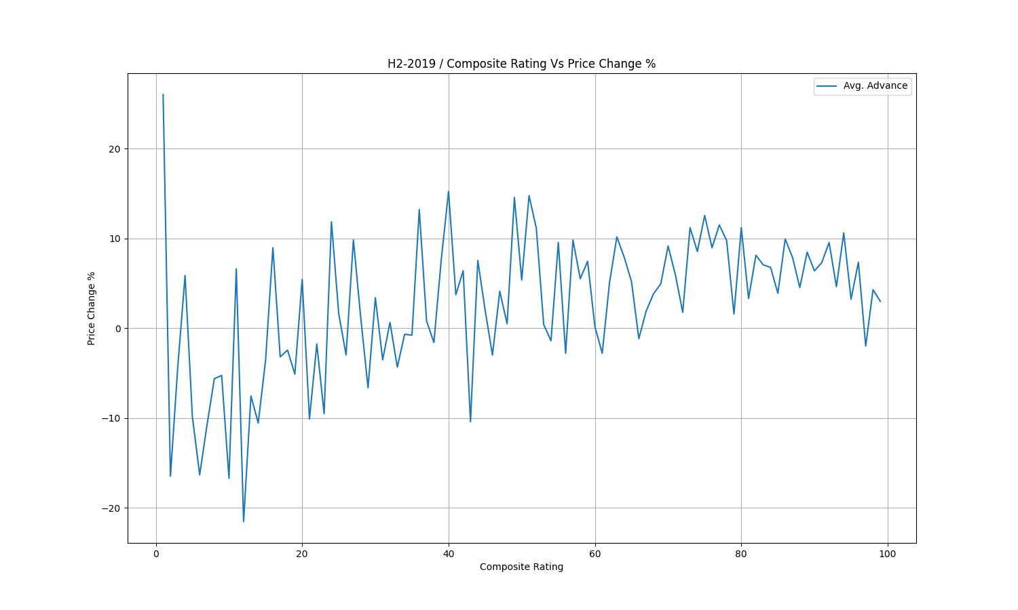

Slide 19
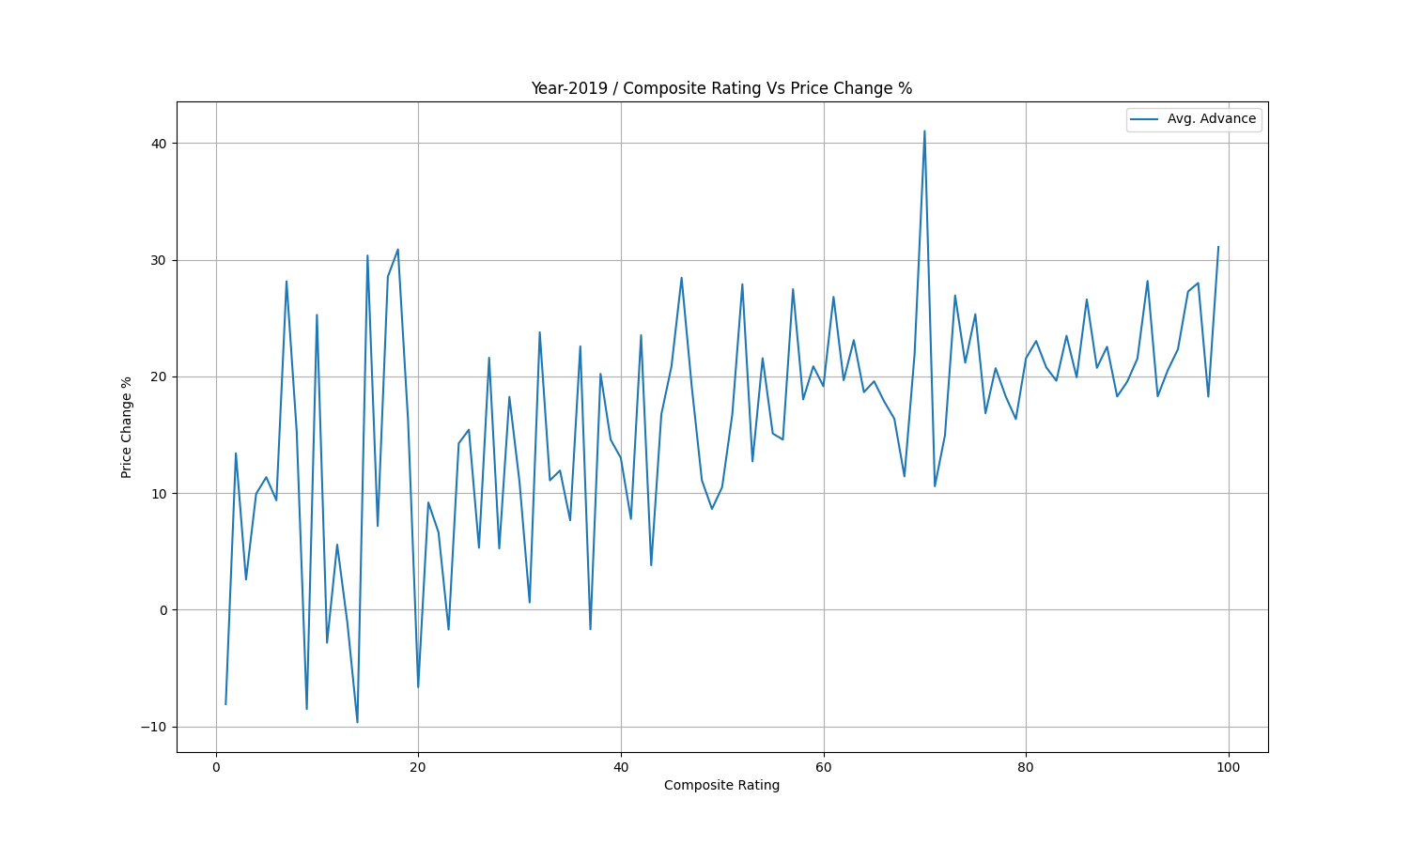

Slide 20
RS Rating
There are gaps in the plot of RS Rating because for some Rating number, there are no stocks.

Slide 21
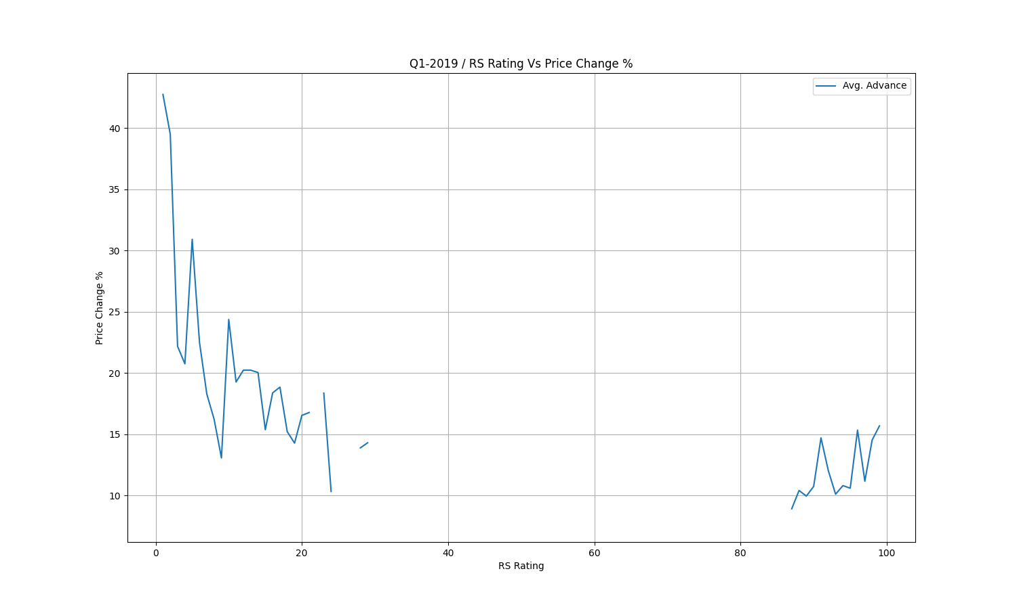

Slide 22
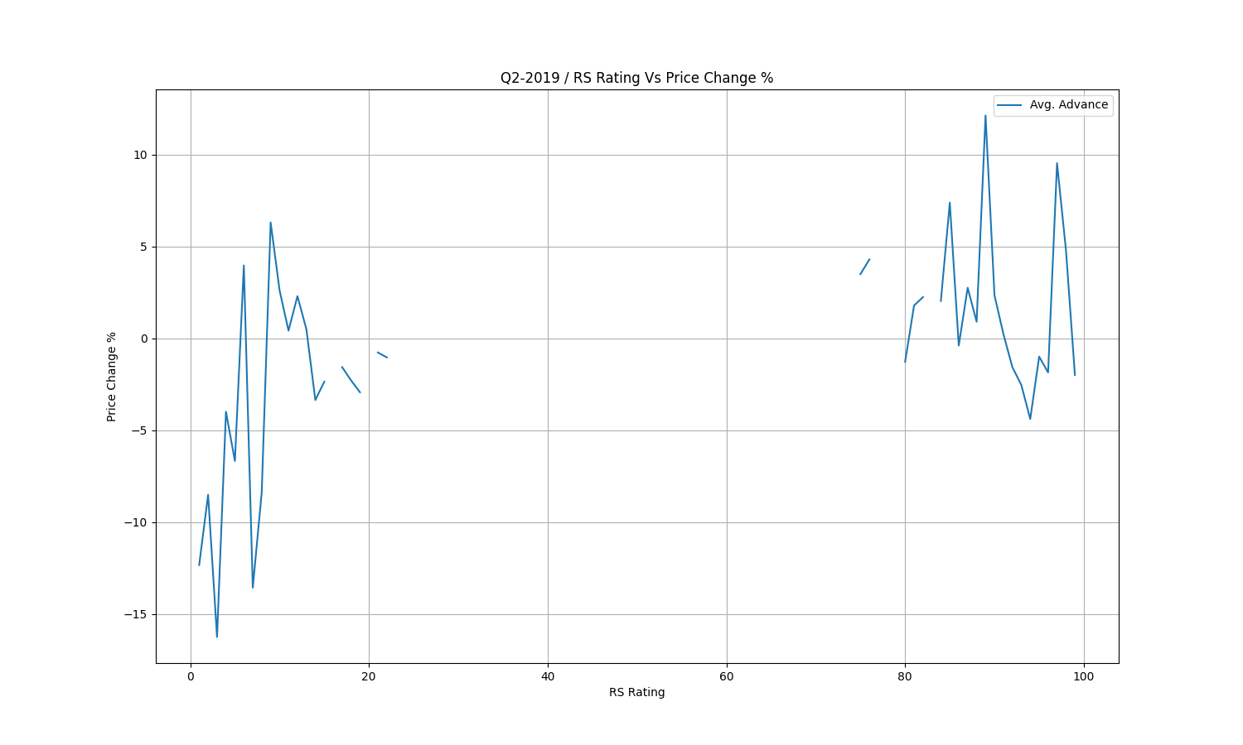

Slide 23
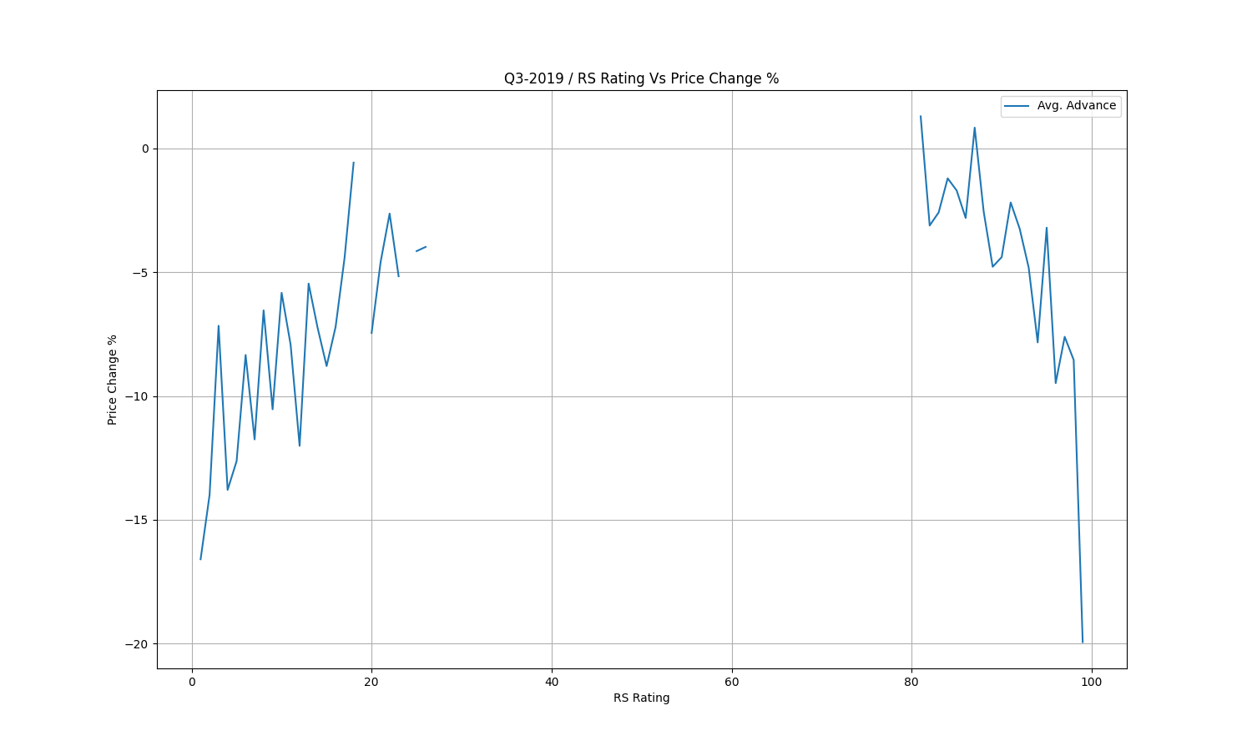

Slide 24
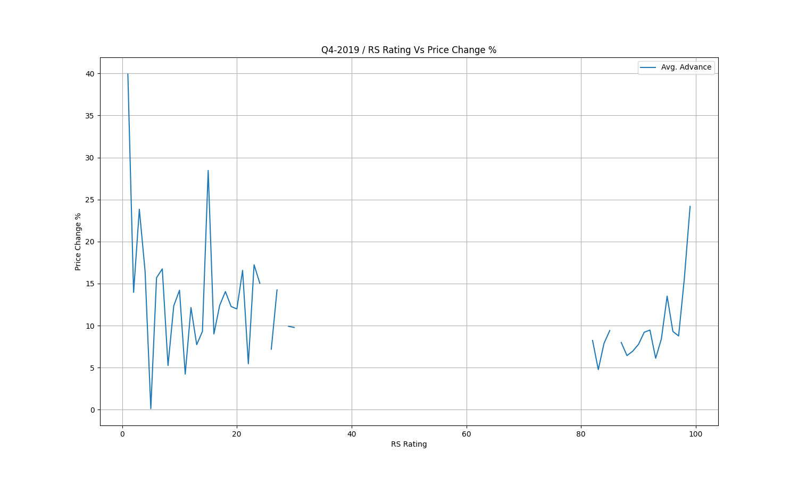

Slide 25
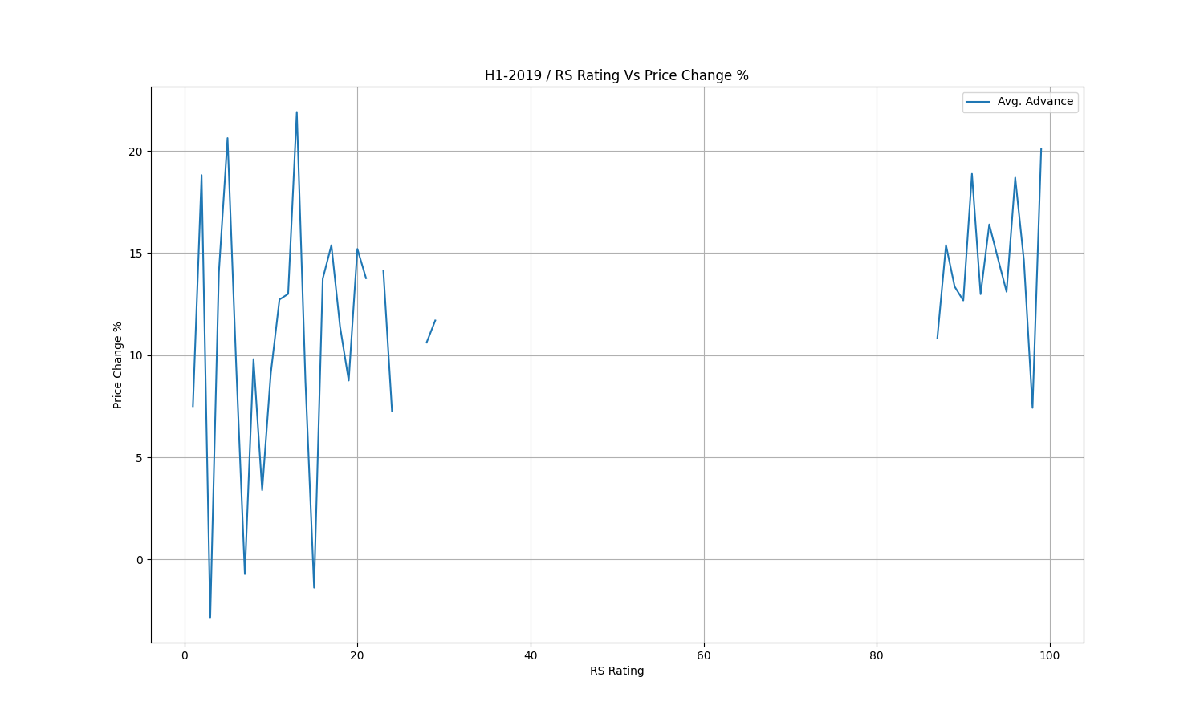

Slide 26
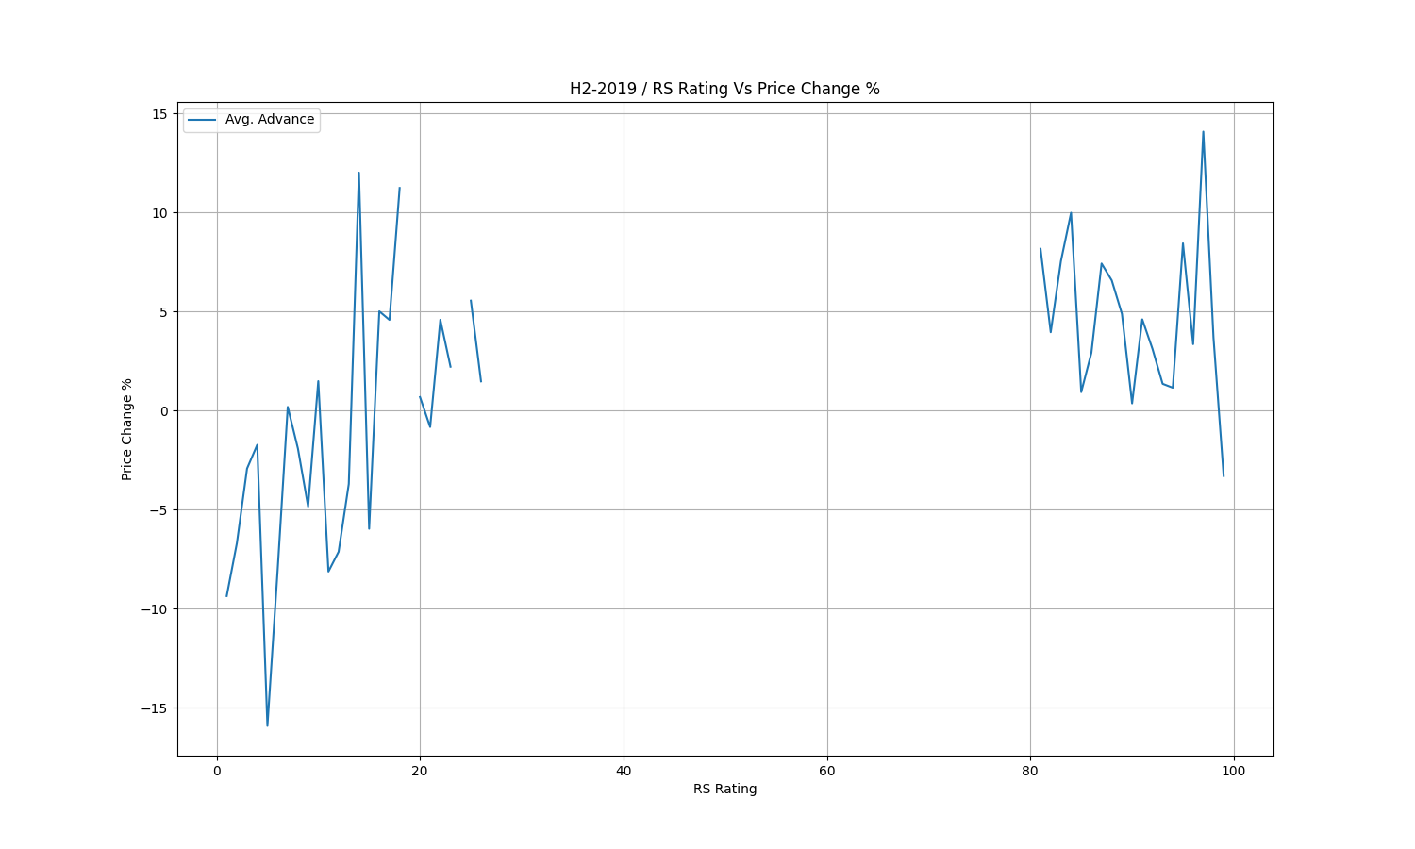

Slide 27
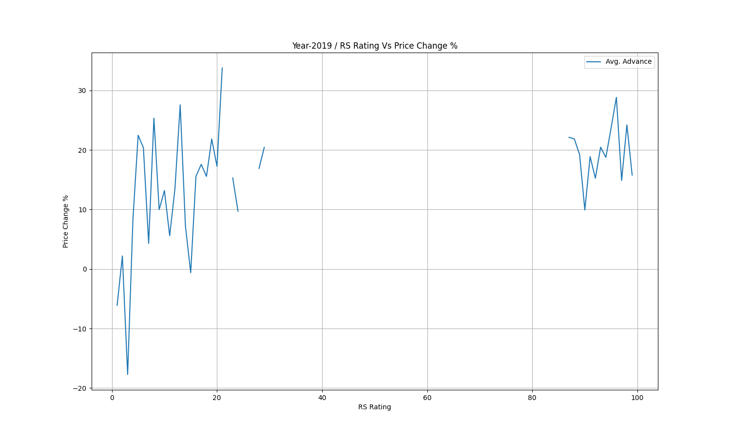

Slide 28
Combinations
There are tons of ways to combine these results and visualize them.
We will combine the data in few combinations and see if we can observe and learn something from them.

Slide 29
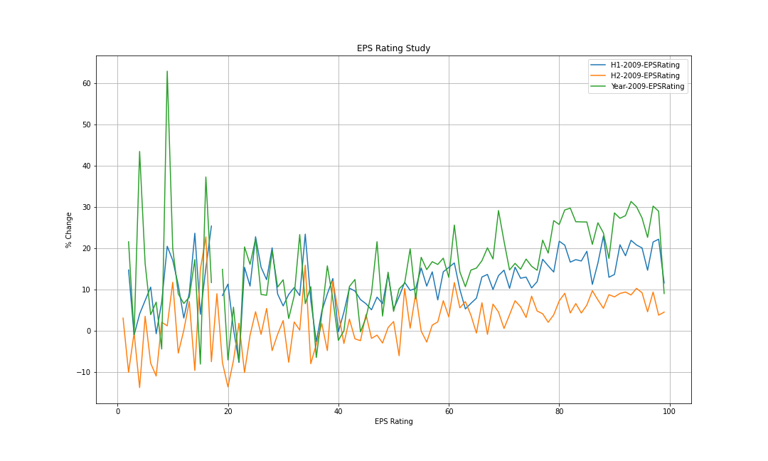

Slide 30
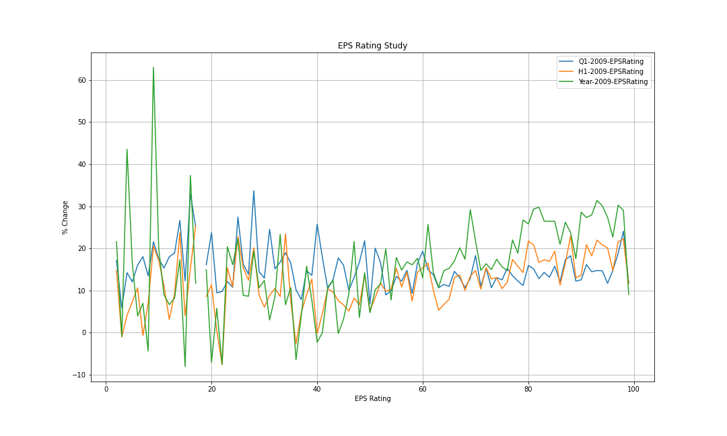

Slide 31
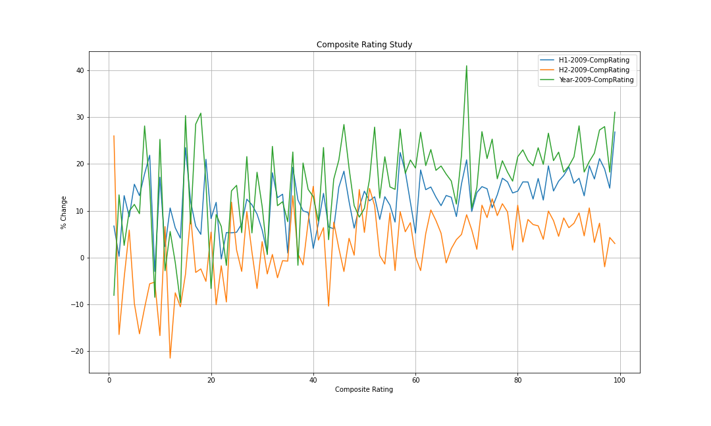

Slide 32
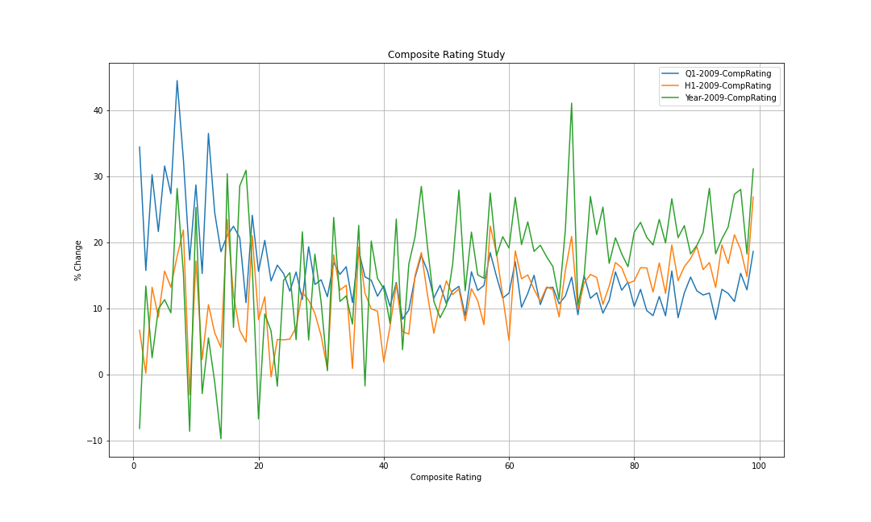

Slide 33
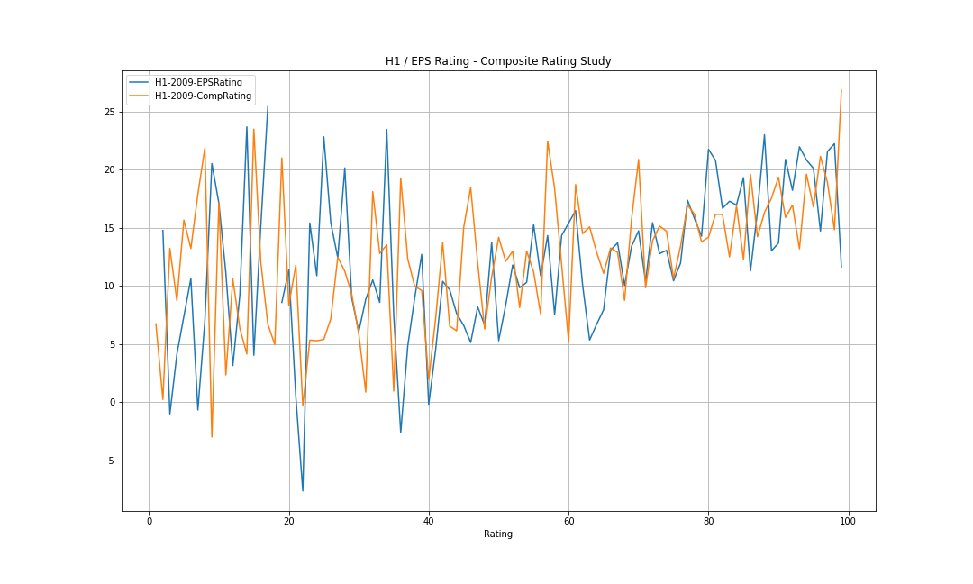

Slide 34
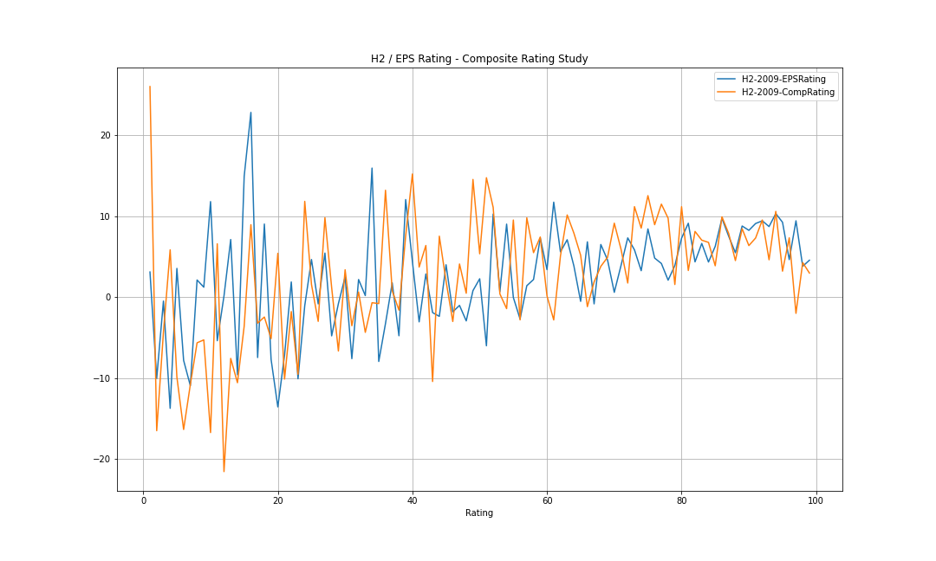

Slide 35
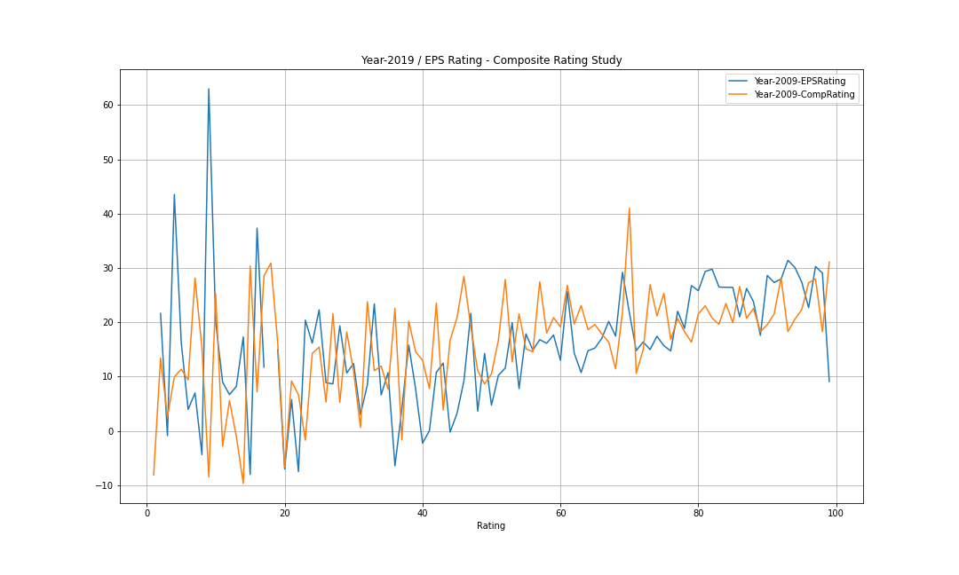

Slide 36
