Slide 1
HIMANSHU NAGAR(171500135)
&
CHAUDHARY NITIN(171500086)
Submitted To: Mr. Pankaj Kapoor

Slide 2

Full Stack web development
Full stack development refers to the development of both front end and back end portions of an application.

Slide 3
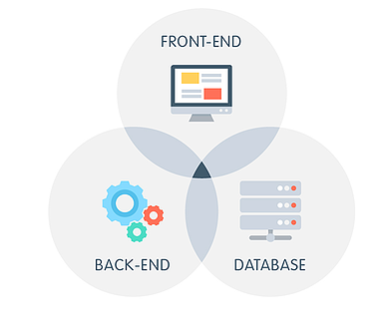
Advantages of full stack
Easy Switching
Entire Design Structure
Cost Saving
Easy to Take Ownership of Design & Implementation
Easy to Upgrade

Slide 4

Disadvantages of full stack
The solution chosen can be wrong for the project
The solution chosen can be dependent on developer skills
The solution can generate a key person risk
Being a full stack developer is increasingly complex

Slide 5
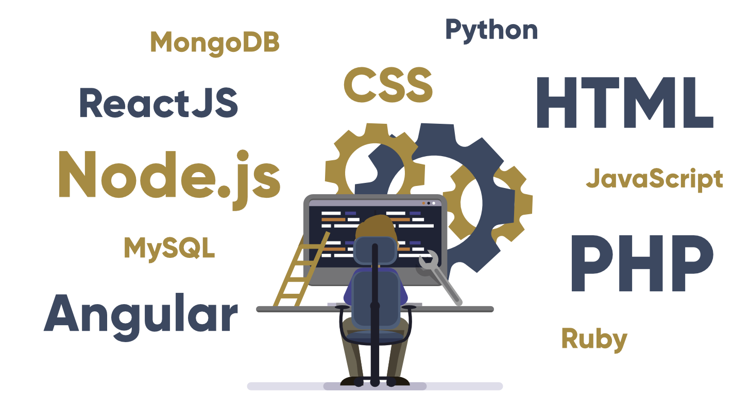
Client software (front end)
HTML
CSS
BOOTSTRAP
JAVASCRIPT
ANGULAR
REACT
EXPRESS.JS

Slide 6
SERVER SOFTWARE(BACK END)
PHP
ASP
JAVA
PYTHON
RUBY
NODE.JS

Slide 7
DOCTOR’s APPOINTMENT WEBSITE

Slide 8
OBJECTIVE
The main objective is to develop a website that can provide a better way of making appointment of doctors. It enables healthcare providers to improve operational effectiveness, reduce costs, reduce medical errors, reduce time consumption and enhance delivery of quality of care. This website will mail details of the patient and other information to the doctor.

Slide 9
FUTURE SCOPE
As the number of Clinics and Hospital are increasing day by day and new diseases are
found daily. This project can help doctor to analyse the condition of patient and can cure
them efficiently.There will be no loss of prescription.
The patients dont have to wait in a queue for it.

Slide 10
ADVANTAGES
Responsive Design
Easy Layout
Simple Algorithm
One-Click Appointment
Attractive design

Slide 11
TECHNOLOGIES USED
HTML
CSS
JAVASCRIPT
BOOTSTRAP
PHP

Slide 12
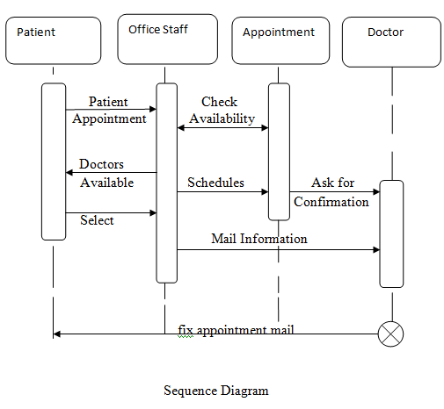
ER-DIAGRAM

Slide 13

USER INTERFACE

Slide 14
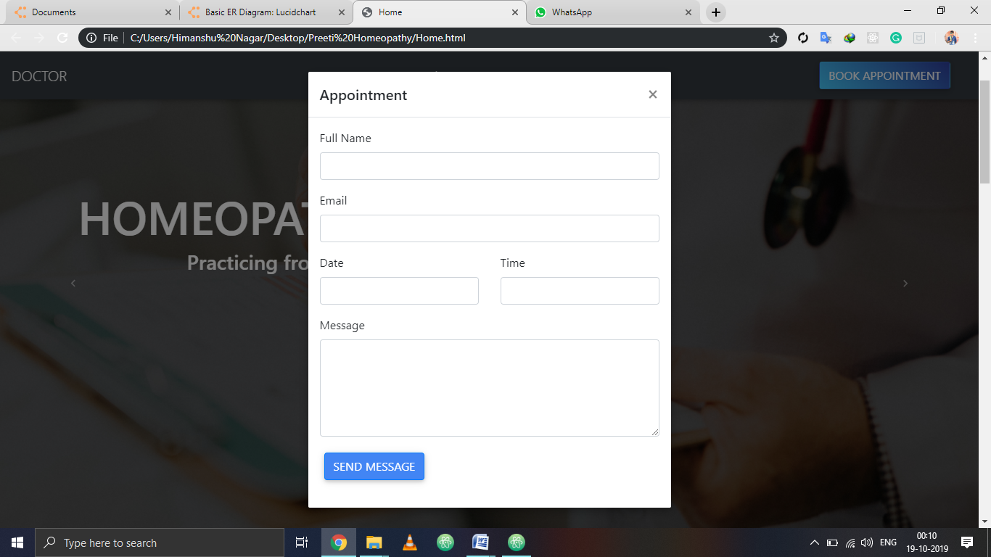
APPOINTMENT FORM

Slide 15
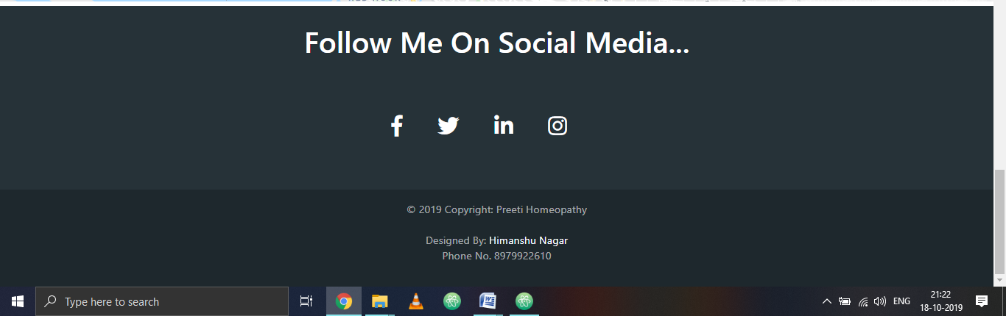
FOOTER

Slide 16
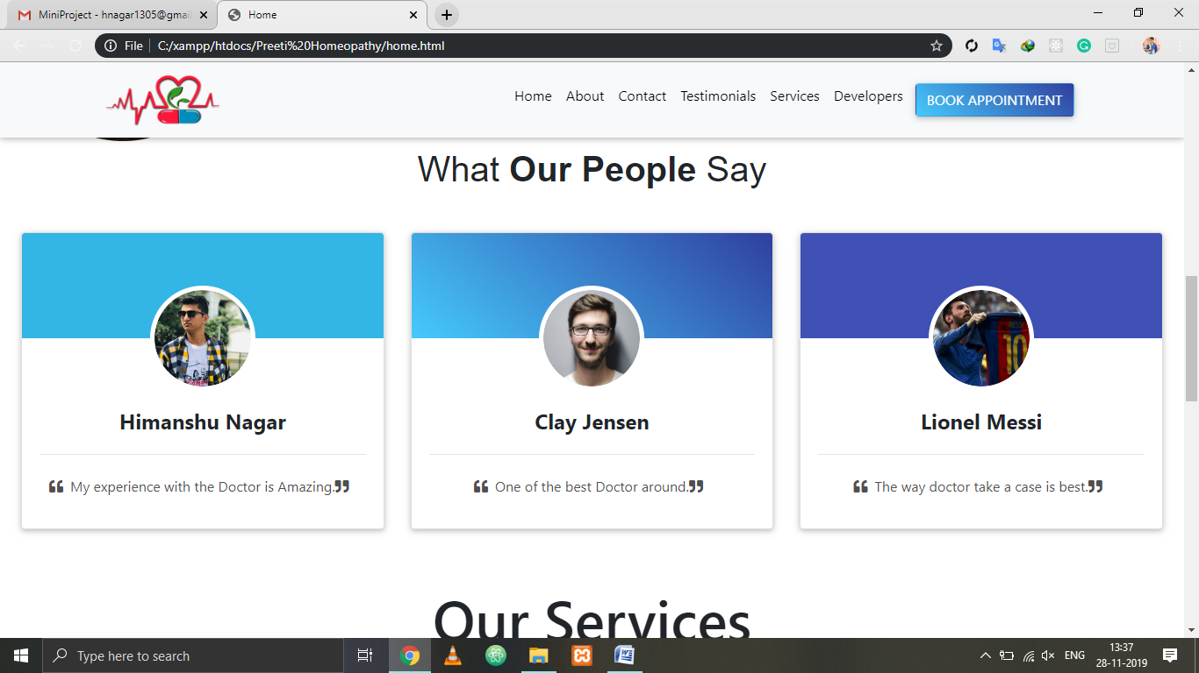
TESTIMONALS

Slide 18
THANK YOU

