Slide 1

AUCSS / DIGITAL FORENSICS 101
AUCSS Workshop – Part 1
Digital
Forensics
101
An introduction for curious beginners
01
Notes:
Welcome. Introduce yourself briefly and truthfully. Say: You already use the devices in this picture. Today we will see what traces ordinary actions can leave and how to explain what those traces support. No coding, handout, laptop or prior security knowledge is needed. Ask students to answer aloud or discuss with a neighbour. Every exercise and its answer appears on screen.
Conceptual illustrations are AI-generated; evidence tables are labelled examples.

Slide 2

AUCSS / DIGITAL FORENSICS 101
Your day leaves digital traces
Message?
Photo?
Download?
What trace might an everyday action leave?
02
Notes:
Ask: who sent a message or downloaded something today? Point to the devices. Take two examples from the room without requesting private data. Say: a browser may keep a visit record; an app may keep a message record. A trace can be on a device or in a service. Whether it remains depends on settings and retention. These are possibilities, not a promise that everything is permanently recorded.
Conceptual illustrations are AI-generated; evidence tables are labelled examples.

Slide 3
AUCSS / DIGITAL FORENSICS 101
Digital forensics
A record
What happened?
TIME | EVENT
09:02 | File opened
→
Who did it?
One record may not
answer both.
An artifact is a digital trace. This record is a fictional example.
03
Notes:
Read the one invented record: a file opened at 09:02. Ask what question it might help answer. Then introduce artifact: a digital trace, such as this record. Digital forensics means examining digital information to answer questions about events while preserving its integrity. Ask whether this single record names the person who opened the file. It does not. Explain that investigators compare records and context; they do not simply trust the first clue.
Sources:
https://csrc.nist.gov/pubs/sp/800/86/final
Conceptual illustrations are AI-generated; evidence tables are labelled examples.

Slide 4

AUCSS / DIGITAL FORENSICS 101
Where could the evidence be?
Computer
Mobile
Network
Memory
Cloud
Database
04
Notes:
Point to each recognizable object before naming its branch. Laptop: computer evidence. Phone: mobile evidence. Router: network communication. RAM module: working memory. Hosted servers: cloud activity. Database symbol: organized records. Explain database as a structured table of information. The drawings are conceptual symbols. An event can involve several branches; students need the questions, not a rigid classification system.
Sources:
https://github.com/mikeroyal/Digital-Forensics-Guide
https://csrc.nist.gov/pubs/sp/800/86/final
Conceptual illustrations are AI-generated; evidence tables are labelled examples.

Slide 5
AUCSS / DIGITAL FORENSICS 101
Computer forensics
Laptop / drive
What happened
on this device?
├─ Documents
├─ Browser records
├─ System logs
└─ External media
Files, visits, downloads,
user and device activity
Simplified tree · A record does not automatically identify a person.
05
Notes:
Begin with the visible file and folder example. Documents hold content. Browser records can describe visits or downloads. System logs are records kept by the operating system, the software that manages the computer. USB media can hold copies. Ask: if someone renames a file, has the message inside necessarily changed? Hold the answer for the upcoming content-comparison example. A browser visit does not identify the human at the keyboard.
Sources:
https://csrc.nist.gov/pubs/sp/800/86/final
https://sleuthkit.org/autopsy/docs/user-docs/4.22.0/quick_start_guide.html
Conceptual illustrations are AI-generated; evidence tables are labelled examples.

Slide 6

AUCSS / DIGITAL FORENSICS 101
Mobile forensics
Cloud
Backup
Phone
Could the same photo exist in more than one place?
06
Notes:
Point to the phone, then to the backup and cloud symbols. Say: a phone may hold messages, photos, calls and app records. A backup is a saved copy of some device information. It may differ from the phone. Ask: could a photo exist in more than one place? Yes, depending on syncing and backups. Do not imply all phone content is accessible; encryption, app design, permissions and acquisition method matter. This is a conceptual illustration, not an extraction demonstration.
Sources:
https://nvlpubs.nist.gov/nistpubs/specialpublications/nist.sp.800-101r1.pdf
Conceptual illustrations are AI-generated; evidence tables are labelled examples.

Slide 7
AUCSS / DIGITAL FORENSICS 101
Content and metadata
CONTENT
DESCRIBES THE FILE
PROPERTY | VALUE
Filename | note.txt
Type | Text file
Size | 16 bytes
Meet in
Hall A.
This information is called metadata.
Actual sample file · UTF-8 text with one final newline · Byte = a unit of stored data.
07
Notes:
Read the note on the left: Meet in Hall A. That is content. Read the file properties on the right: filename, file type and size describe the file. That descriptive information is metadata. The example file has 16 bytes: 15 ASCII characters plus one newline, encoded as UTF-8 without a byte-order mark. A byte is a unit of stored data; no counting exercise is needed. Ask whether changing the filename necessarily changes the sentence. No. Not every property is trustworthy evidence of a real-world event.
Sources:
https://sleuthkit.org/autopsy/docs/user-docs/4.22.0/quick_start_guide.html
https://csrc.nist.gov/pubs/sp/800/86/final
Conceptual illustrations are AI-generated; evidence tables are labelled examples.

Slide 8
AUCSS / DIGITAL FORENSICS 101
Network forensics
A message travels in pieces
Device A
→
1 · Meet
2 · in
3 · Hall A
→
Device B
A packet is a small unit of network communication.
Simplified analogy, not a capture · Connection details do not necessarily reveal the content.
08
Notes:
Explain the sentence at the top as a very simplified communication analogy. Devices send information in pieces; a packet is a small unit of network communication. The three numbered chunks are an illustration, not a real packet capture or a literal description of how this sentence must be split. Ask: if you know A connected to B, do you automatically know what was read? No. Logs and captures may reveal timing, endpoints and protocols (communication rules), while encryption can hide content. A network address is not a person.
Sources:
https://csrc.nist.gov/pubs/sp/800/86/final
https://www.wireshark.org/docs/wsug_html_chunked/ChUseMainWindowSection.html
Conceptual illustrations are AI-generated; evidence tables are labelled examples.

Slide 9

AUCSS / DIGITAL FORENSICS 101
Working memory and storage
Working desk → RAM
Cabinet → storage
Active right now
Saved for later
Where would a currently running program belong?
09
Notes:
Point to the open desk. This represents RAM: temporary working space for active programs. Point to the cabinet: storage is where saved files are intended to persist. A memory image is an acquired snapshot, like recording the desk at one moment; it is not a film of the whole day. Ask: which side represents a currently running browser? The desk/RAM side. Much volatile data is lost when power is removed, so real incident handling needs trained judgment. The analogy is simplified.
Sources:
https://csrc.nist.gov/pubs/sp/800/86/final
https://volatility3.readthedocs.io/en/latest/getting-started-windows-tutorial.html
Conceptual illustrations are AI-generated; evidence tables are labelled examples.

Slide 10
AUCSS / DIGITAL FORENSICS 101
Cloud and database forensics
A service keeps records elsewhere
BEFORE | AFTER
File 42: private | File 42: shared
An activity record may explain this change.
Fictional sharing example · A database is an organized set of records.
10
Notes:
Cloud means computing services hosted on other systems and accessed over a network. A database organizes records, such as a table. Read the fictional before/after sharing value: private becomes shared. An available audit record may describe that change. Ask why a laptop alone may not hold every relevant record. Service-side activity can be elsewhere. Logging, retention and authorized access determine what an examiner can actually obtain. A record of an account action is not automatic proof of a particular human.
Sources:
https://csrc.nist.gov/pubs/sp/800/86/final
Conceptual illustrations are AI-generated; evidence tables are labelled examples.

Slide 11
AUCSS / DIGITAL FORENSICS 101
Useful starting points
Missing file
→
Computer
Exchanged traffic
→
Network
Active programs
→
Memory
Useful starting points · Branches can overlap.
12
Notes:
Reveal: missing laptop file → computer; exchanged traffic → network; active programs in a captured snapshot → memory. Ask one student to explain one match. If they struggle, point back to laptop, router and working desk. This is a short understanding check, not an assessment of prior knowledge.
Sources:
https://github.com/mikeroyal/Digital-Forensics-Guide
https://csrc.nist.gov/pubs/sp/800/86/final
Conceptual illustrations are AI-generated; evidence tables are labelled examples.

Slide 12
AUCSS / DIGITAL FORENSICS 101
The examination workflow
01
02
03
04
→
→
→
Collect
Examine
Analyze
Report
Keep the material
Find records
Make sense of them
Explain the result
Acquisition = obtaining evidence appropriately · Preserve and document throughout.
13
Notes:
Walk through one arrow at a time: collect and preserve relevant material, examine it to find records, analyze what those observations mean, and report findings with limits. Acquisition is the term for obtaining evidence using an appropriate method. A copy is not necessarily a complete forensic acquisition. These four phases follow the foundational NIST SP 800-86 framework. Scope, documented handling and integrity apply throughout.
Sources:
https://csrc.nist.gov/pubs/sp/800/86/final
Conceptual illustrations are AI-generated; evidence tables are labelled examples.

Slide 13

AUCSS / DIGITAL FORENSICS 101
The original and the working copy
Preserve the original
Examine a verified copy
Like keeping an original document while working on a copy.
14
Notes:
Point to the protected USB and the laptop. Use the analogy of keeping an original document while writing on a photocopy. Say: we preserve the original and examine an appropriately acquired, verified working copy when suitable. In the next example we compare ordinary harmless text files; we are not imaging a disk. A forensic acquisition can include more than visible files. Work within authorization and do not experiment with real incident evidence.
Sources:
https://nvlpubs.nist.gov/nistpubs/ir/2022/NIST.IR.8387.pdf
Conceptual illustrations are AI-generated; evidence tables are labelled examples.

Slide 14
AUCSS / DIGITAL FORENSICS 101
Did the contents change?
note.txt
renamed.txt
Meet in
Hall A.
Meet in
Hall A.
The name changed. Did the contents?
These complete example files have identical bytes.
15
Notes:
Do not start with the word hash. Read the two short notes. The filename changed from note.txt to renamed.txt; the displayed sentence is the same. Tell students the complete files also have identical encoding and newline. Ask: did the contents change, yes or no? Pause for an answer. Then ask: comparing two short notes is easy, but what if the files are huge? We need a repeatable content check. Advance to reveal the technical term.
Sources:
https://learn.microsoft.com/en-us/powershell/module/microsoft.powershell.utility/get-filehash?view=powershell-7.5
Conceptual illustrations are AI-generated; evidence tables are labelled examples.

Slide 15
AUCSS / DIGITAL FORENSICS 101
A hash is a content check
note.txt
→
016D099A2C4C…
renamed.txt
→
016D099A2C4C…
Same bytes. Same SHA-256 value.
SHA-256 is the method used here. Only the first 12 characters of each actual result are shown.
16
Notes:
Name the concept only now: a hash is a fixed-length value calculated from bytes by a particular algorithm. SHA-256 is the algorithm used here. For the same algorithm, identical bytes produce the same value. Both actual 16-byte sample files produce the same full SHA-256; only the first 12 characters are displayed to keep the slide readable. Do not ask students to memorize the characters. Filename is not included in a normal file-content hash. Hashes are not proof of authorship and do not preserve a file on their own.
Sources:
https://learn.microsoft.com/en-us/powershell/module/microsoft.powershell.utility/get-filehash?view=powershell-7.5
Actual full SHA-256 values (UTF-8, final LF, no BOM):
016D099A2C4C95FBCCDD8172BB7F77B087AAE3B458F58BA85EF0FF0E79376027 note.txt
016D099A2C4C95FBCCDD8172BB7F77B087AAE3B458F58BA85EF0FF0E79376027 renamed.txt
03796241B047D8C6358B8B1AEF038BD4030CAFF700E558A8016C4116403A9831 changed.txt
Conceptual illustrations are AI-generated; evidence tables are labelled examples.

Slide 16
AUCSS / DIGITAL FORENSICS 101
One letter changes
Original
Edited copy
Meet in
Hall A.
Meet in
Hall B.
Will the content check stay the same?
A becomes B in a working copy.
17
Notes:
Read both sentences. In a separate working copy, Hall A becomes Hall B; everything else stays the same. Ask: will the SHA-256 content check stay the same or change? Take a show of hands. Do not require anyone to run a command. The next slide shows the actual computed result.
Sources:
https://learn.microsoft.com/en-us/powershell/module/microsoft.powershell.utility/get-filehash?view=powershell-7.5
Conceptual illustrations are AI-generated; evidence tables are labelled examples.

Slide 17
AUCSS / DIGITAL FORENSICS 101
The content check changes
Hall A
→
016D099A2C4C…
Hall B
→
03796241B047…
Does the hash tell us who wrote it?
No: it checks content, not authorship. Actual SHA-256 prefixes; full values are in the notes.
18
Notes:
Reveal the two actual SHA-256 prefixes. A versus B changed one byte in these examples and the calculated hashes differ. A matching full SHA-256 is a practical integrity comparison with a trusted reference; theoretical collisions exist, so do not call hashes mathematically unique. Ask: does either code tell us who wrote the note? No. If students answer incorrectly, repeat: hash checks content, handling records explain its history, and other evidence is needed for authorship. Full reproducible values are in the optional sample folder and notes.
Sources:
https://learn.microsoft.com/en-us/powershell/module/microsoft.powershell.utility/get-filehash?view=powershell-7.5
Actual full SHA-256 values (UTF-8, final LF, no BOM):
016D099A2C4C95FBCCDD8172BB7F77B087AAE3B458F58BA85EF0FF0E79376027 note.txt
016D099A2C4C95FBCCDD8172BB7F77B087AAE3B458F58BA85EF0FF0E79376027 renamed.txt
03796241B047D8C6358B8B1AEF038BD4030CAFF700E558A8016C4116403A9831 changed.txt
Conceptual illustrations are AI-generated; evidence tables are labelled examples.

Slide 18
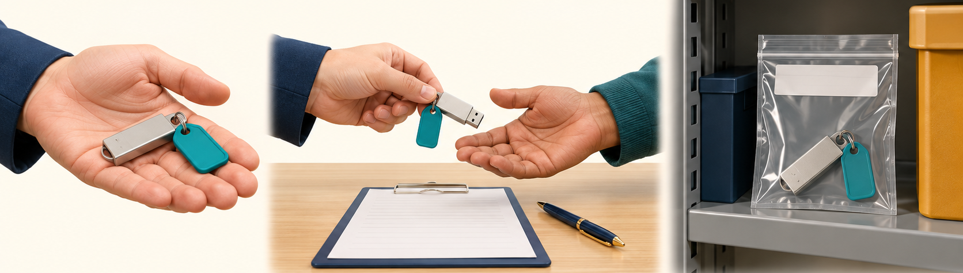
AUCSS / DIGITAL FORENSICS 101
Who handled this USB?
09:00 · Finder
09:20 · Sara
Storage
→ Sara, examiner
→ Ali, custodian
Cabinet 2
Chain of custody = documented handling history · Fictional USB E01 example.
19
Notes:
Introduce a separate fictional example. Follow the teal-tagged USB E01 across the picture: at 09:00 a finder hands it to examiner Sara; at 09:20 Sara hands it to custodian Ali for storage in Cabinet 2. Explain that a custodian is the person responsible for storage. A handling record notes the item, who gave and received it, when, why and where, along with relevant condition and integrity checks. Only now name this documented history chain of custody. The picture is conceptual; the captions are the teaching scenario.
Sources:
https://nvlpubs.nist.gov/nistpubs/ir/2022/NIST.IR.8387.pdf
Conceptual illustrations are AI-generated; evidence tables are labelled examples.

Slide 19
AUCSS / DIGITAL FORENSICS 101
One handover is missing
09:00
?
09:20
→
→
Sara receives E01
Handover missing
Ali stores E01
What would you need to ask?
Fictional record gap
20
Notes:
Show the fictional record with a missing middle step. At 09:00 Sara receives E01; at 09:20 Ali stores it. Ask: what is missing between them? Who transferred it to Ali, when, and for what purpose? Give twenty seconds for a neighbour discussion or take a spoken answer. Do not say the gap proves tampering. It creates an uncertainty in the handling history. Advance for the explanation.
Sources:
https://nvlpubs.nist.gov/nistpubs/ir/2022/NIST.IR.8387.pdf
Conceptual illustrations are AI-generated; evidence tables are labelled examples.

Slide 20
AUCSS / DIGITAL FORENSICS 101
A hash cannot fill the gap
Content matches?
Who handled it?
A hash can help
check this.
We still need the
handover record.
A missing record creates uncertainty, not proof of tampering.
21
Notes:
Contrast the two questions. A matching hash can support content consistency with the reference. It cannot tell us who handled the USB during an undocumented interval. Chain of custody is the handling history, not a mathematical operation. The missing handover calls for clarification and supporting records; it does not by itself establish alteration or guarantee any legal outcome. Understanding check: which record answers who received the item? The handling record.
Sources:
https://nvlpubs.nist.gov/nistpubs/ir/2022/NIST.IR.8387.pdf
Conceptual illustrations are AI-generated; evidence tables are labelled examples.

Slide 21
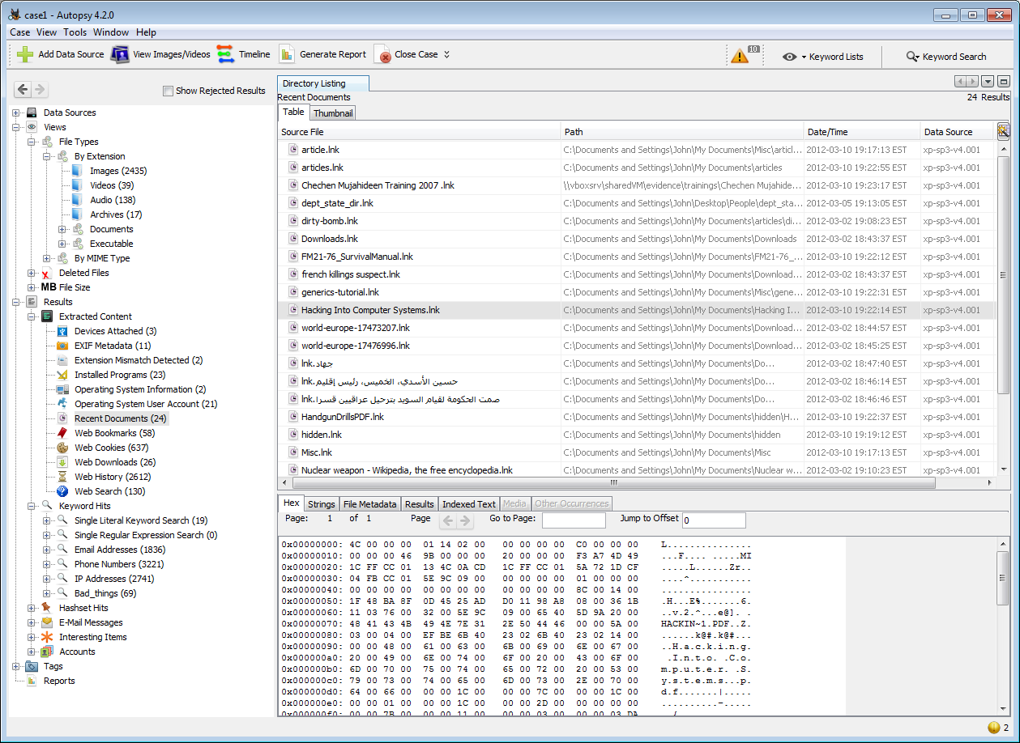
AUCSS / DIGITAL FORENSICS 101
Autopsy: computer evidence
01
Evidence tree
02
Results
03
Selected details
Official documentation screenshot · Historical Autopsy 4.2.0 interface.
22
Notes:
Start with the question: where could I look for files and records in acquired computer data? Then name Autopsy. This official documentation image depicts historical Autopsy 4.2.0. Point to the evidence tree on the left, results at upper right, and selected-item details below. Students only need the relationship between source, result and detail; do not read the sample filenames. This is not a live local run. Results still need interpretation.
Sources:
https://sleuthkit.org/autopsy/docs/user-docs/4.22.0/quick_start_guide.html
Conceptual illustrations are AI-generated; evidence tables are labelled examples.

Slide 22
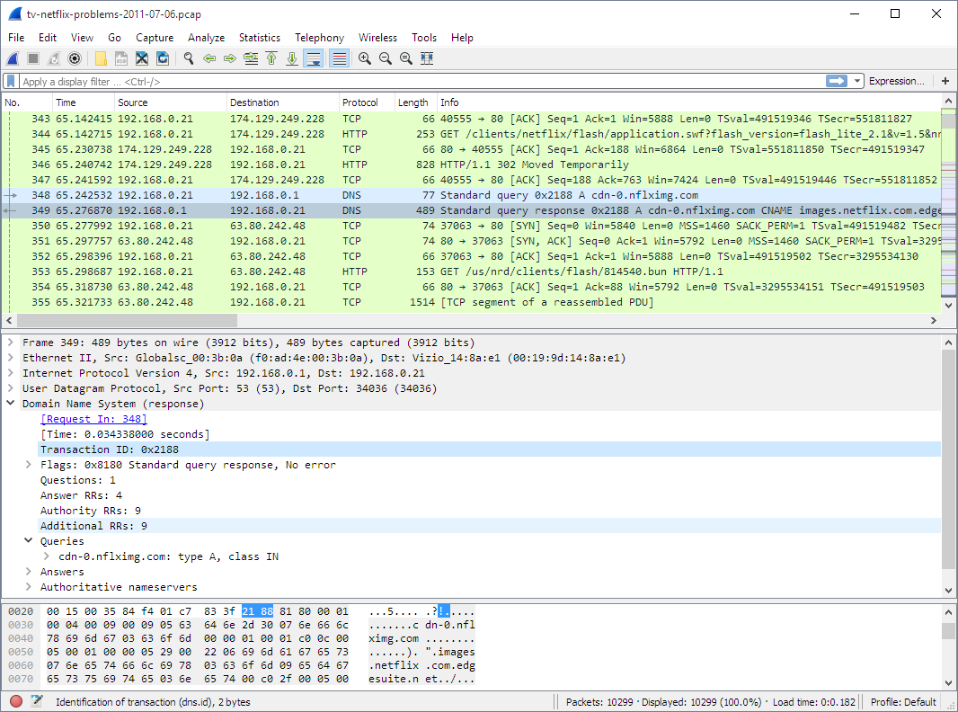
AUCSS / DIGITAL FORENSICS 101
Wireshark: network traffic
01
Packet list
02
Packet details
03
Raw bytes
Official documentation screenshot · Historical example
23
Notes:
Start with the question: how can I inspect a saved network capture? Then name Wireshark. Point to packet list, selected packet details and raw bytes. The screenshot is a historical example from the official guide, not traffic from the room. A protocol is a set of communication rules; students need not memorize the labels. Ask which pane gives the overview: the packet list. Encrypted application content is not normally made readable simply by opening this tool.
Sources:
https://www.wireshark.org/docs/wsug_html_chunked/ChUseMainWindowSection.html
Conceptual illustrations are AI-generated; evidence tables are labelled examples.

Slide 23
AUCSS / DIGITAL FORENSICS 101
Volatility: a memory snapshot
Like a list of running programs
PROCESS ID | PARENT ID | PROGRAM NAME
4 | 0 | System
276 | 4 | smss.exe
352 | 336 | csrss.exe
A process is a running program instance.
Official tutorial excerpt · PID / PPID renamed in headings for clarity · A memory snapshot is required.
24
Notes:
Start with a familiar task manager: it lists running programs. A process is a running instance of a program. PID is its identifier, like a numbered label; PPID identifies its parent process. Then show a small excerpt from the official Volatility Windows tutorial. Volatility examines acquired memory; it does not acquire the snapshot itself. These example rows are not evidence of maliciousness. The goal is recognizing what a memory tool can help examine, not learning commands.
Sources:
https://volatility3.readthedocs.io/en/latest/getting-started-windows-tutorial.html
Conceptual illustrations are AI-generated; evidence tables are labelled examples.

Slide 24
AUCSS / DIGITAL FORENSICS 101
Which tool fits the evidence?
EVIDENCE SOURCE | MATCH TO A TOOL
Computer image / files | A · Wireshark
Saved network capture | B · Volatility
Supported memory image | C · Autopsy
PAIR DISCUSSION · Match the rows. Tools assist interpretation.
25
Notes:
Read the source on the left and the three tool options on the right. Ask students to call out C, A, B for the three rows. Let them discuss for twenty seconds before advancing. No tool installation, handout or device is needed.
Sources:
https://sleuthkit.org/autopsy/docs/user-docs/4.22.0/quick_start_guide.html
https://www.wireshark.org/docs/wsug_html_chunked/ChUseMainWindowSection.html
https://volatility3.readthedocs.io/en/latest/getting-started-windows-tutorial.html
Conceptual illustrations are AI-generated; evidence tables are labelled examples.

Slide 25
AUCSS / DIGITAL FORENSICS 101
The tool follows the question
Computer data
→
Autopsy
Network capture
→
Wireshark
Memory snapshot
→
Volatility
Starting examples · No installation is needed to understand today’s session.
26
Notes:
Reveal the starting matches: computer files/image → Autopsy, saved network capture → Wireshark, supported memory snapshot → Volatility. These are examples, not exclusive product boundaries. Ask why opening the wrong kind of evidence in a tool is not a useful first step. Begin with the question and available source, then choose a tool.
Sources:
https://sleuthkit.org/autopsy/docs/user-docs/4.22.0/quick_start_guide.html
https://www.wireshark.org/docs/wsug_html_chunked/ChUseMainWindowSection.html
https://volatility3.readthedocs.io/en/latest/getting-started-windows-tutorial.html
Conceptual illustrations are AI-generated; evidence tables are labelled examples.

Slide 26
AUCSS / DIGITAL FORENSICS 101
Your two-minute examination
ROW / UTC | EVENT | VALUE
R01 · 09:00 | visit | learn.example/workshop
R02 · 09:02 | download | workshop-notes.txt
R03 · 09:05 | visit | learn.example/library
Say the download row and filename.
Does this table identify a person?
DISCUSS FOR 2 MINUTES · Everything is on screen · Synthetic records, 1 Sep 2026 UTC.
27
Notes:
Everything needed is on screen. Read the three rows aloud once. This is an invented browser teaching export, not a native Chrome database. All times are on 1 September 2026 in UTC; the audience does not need to convert them. Ask pairs to say which row records a download, give the filename, and state whether the table identifies a person. Take answers aloud; no writing or files are required. If the room is quiet, ask just the first question, then guide the rest. Allow up to two minutes, then advance.
Conceptual illustrations are AI-generated; evidence tables are labelled examples.

Slide 27
AUCSS / DIGITAL FORENSICS 101
What the records support
ROW | RECORDED EVENT
R02 | Download: workshop-notes.txt
No
Person identified?
A visit alone also does not prove a saved download.
The table does not independently establish storage, opening or reading.
28
Notes:
Reveal R02 and workshop-notes.txt. This row records a download event. A visit alone does not establish a saved file. These rows do not identify a human or independently prove successful storage, opening or reading. Ask students to complete aloud: The record supports ___, but it does not establish ___. These browser events are unrelated to the text-file hashing example; do not imply they describe those files.
Conceptual illustrations are AI-generated; evidence tables are labelled examples.

Slide 28
AUCSS / DIGITAL FORENSICS 101
True or false?
01
Deleted files are always recoverable.
02
A screenshot tells the whole story.
03
No log means no event.
Give one reason for each answer.
29
Notes:
Read each claim and take thumbs up/down. Allow students to offer one reason, then advance to the next slide for short explanations. No handout is used.
Sources:
https://csrc.nist.gov/pubs/sp/800/86/final
Conceptual illustrations are AI-generated; evidence tables are labelled examples.

Slide 29
AUCSS / DIGITAL FORENSICS 101
Why all three claims are false
Deleted = recoverable?
Recovery depends on what remains.
Screenshot = whole story?
Context and source still matter.
No log = no event?
Logging may be incomplete.
30
Notes:
Deleted files are not always recoverable: overwriting, storage behavior, encryption and available copies matter. A screenshot does not contain the whole history or establish its source on its own. No log does not prove no event: logging or retention may be incomplete. Avoid overwhelming the audience with technical exceptions. The shared lesson is that a clue has limits.
Sources:
https://csrc.nist.gov/pubs/sp/800/86/final
Conceptual illustrations are AI-generated; evidence tables are labelled examples.

Slide 30
AUCSS / DIGITAL FORENSICS 101
Skills you can build now
Files & folders
Dates & logs
Find and describe information
Read records in context
Systems & networks
Clear writing
Understand where traces arise
Explain findings and limitations
You can begin before learning to code.
31
Notes:
Turn the four areas into ordinary tasks: find a file and describe it; read a date and a simple record; learn where a system keeps information; explain an observation in a sentence. No coding is required to understand this session. Ask which of these students have already done in everyday study. Avoid implying that a single lecture qualifies someone to handle real incident evidence.
Conceptual illustrations are AI-generated; evidence tables are labelled examples.

Slide 31
AUCSS / DIGITAL FORENSICS 101
Can you explain it simply?
HASH
CHAIN OF
CUSTODY
What does it check?
What does it record?
EXPLAIN IT TO A FRIEND · No technical wording needed.
33
Notes:
Ask two volunteers: what does a hash check, and what does chain of custody record? Expected answers: file content compared with a reference; the documented handling history. If someone confuses them, return to the note comparison or USB handover. Then ask for one forensic branch and the question it helps answer. The aim is a simple accurate explanation, not recall of jargon.
Conceptual illustrations are AI-generated; evidence tables are labelled examples.

Slide 32
AUCSS / DIGITAL FORENSICS 101
Questions and next steps
Q&A
Explore after the session
github.com/mikeroyal/Digital-Forensics-Guide
nist.gov/programs-projects/computer-forensic-reference-data-sets
Optional further learning
34
Notes:
Leave the visible resource links up. The GitHub guide is a broad map for later exploration; start with the beginner examples from today before advanced topics. The NIST practice resource offers documented datasets; students should choose a small suitable example. Exact official tool and preservation references are embedded in relevant slide notes and in sources.md. All activities were contained in the slides. No handout, live command, account or Internet connection was required during delivery.
Sources:
https://github.com/mikeroyal/Digital-Forensics-Guide
https://www.nist.gov/programs-projects/computer-forensic-reference-data-sets
Conceptual illustrations are AI-generated; evidence tables are labelled examples.

