Slide 1
DESIGNING A PROCESSOR FOR A SMALL EMBEDDED SYSTEM
COAL-CS226 SEMESTER PROJECT
GROUP MEMBERS:
HUSSAIN ALI – 232095
SARDAR AHMAD ALI - 232147

Slide 2
TABLE OF CONTENTS
INTRODUCTION
DESIGN PHASE
BLOCK DIAGRAM
BUS ARCHITECTURE
DATA PATH DIAGRAM
INSTRUCTION SET
IMPLEMENTATION OF CODE
WORKING OF CODE
CONCLUSION

Slide 3
INTRODUCTION
This project focuses on the exploration, creation, and development of a simplified processor architecture customized for use in an embedded system, such as a digital calculator. The objective is to design a processor capable of executing fundamental arithmetic operations (addition, subtraction, multiplication, and division) and logical functions (AND, OR). The design process will incorporate a detailed block diagram of the processor architecture, illustrating key components like the Arithmetic Logic Unit (ALU), control unit, registers, memory, and input/output interfaces. These interfaces will enable interaction with input devices, such as a keypad, and output devices, like an LED or LCD display.

Slide 4
DESIGNING A PROCESSOR
Control Unit (CU): Coordinates and controls the execution of instructions.
Arithmetic Logic Unit (ALU): Performs arithmetic operations (add, subtract, multiply, divide) and logical operations (AND, OR).
Registers: Temporary storage locations for holding operands and results.
Memory Unit: Includes RAM for program/data storage and ROM for fixed logic storage.
Input/Output (I/O) Units: Facilitate communication with external devices such as keypads and displays.

Slide 5
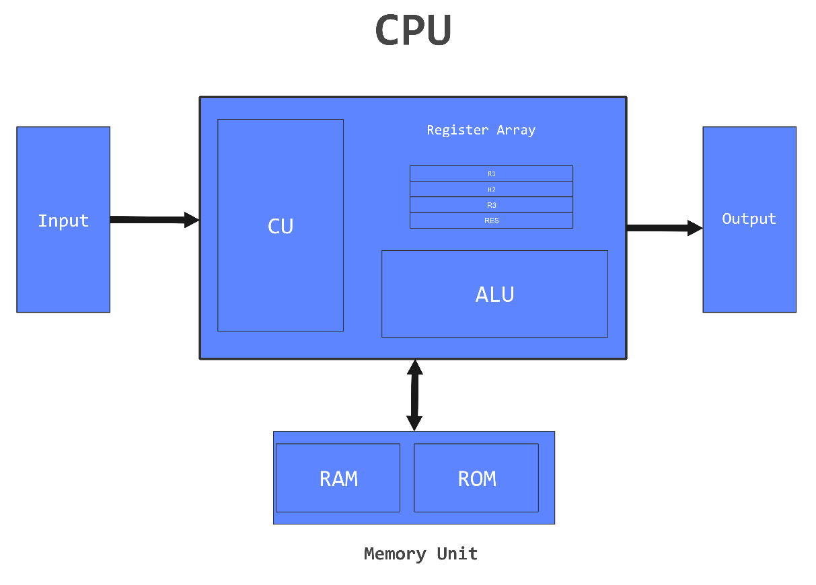
BLOCK DIAGRAM

Slide 6
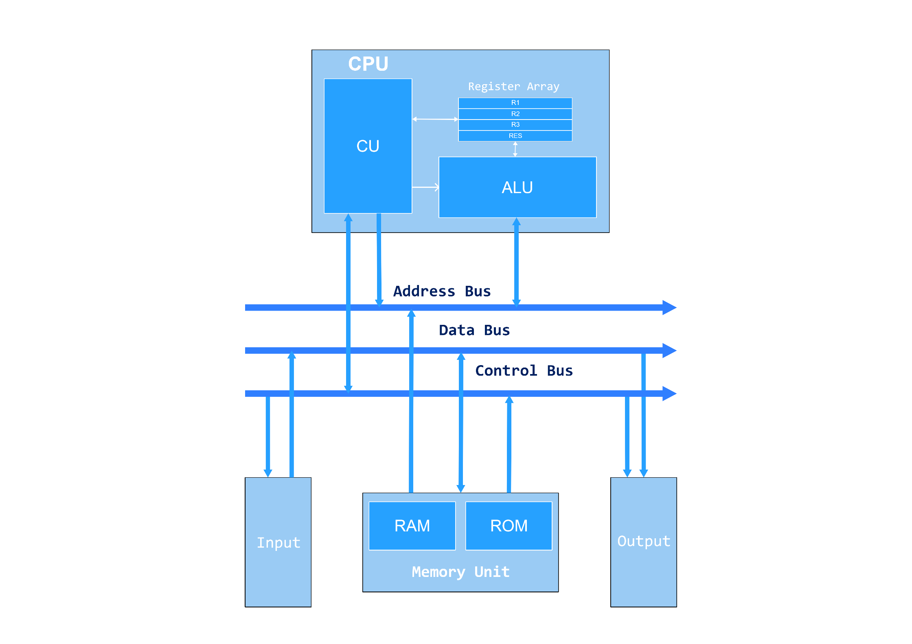
BUS ARCHITECTURE

Slide 7
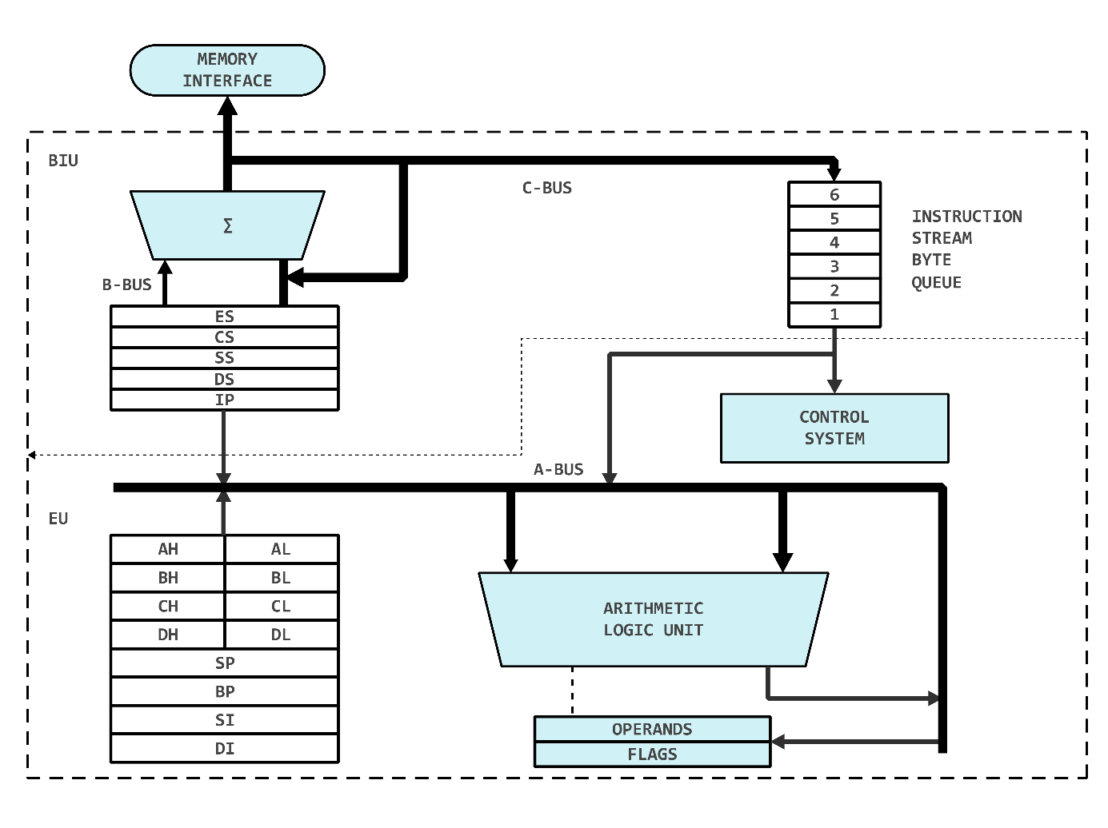
DATA PATH DIAGRAM

Slide 8
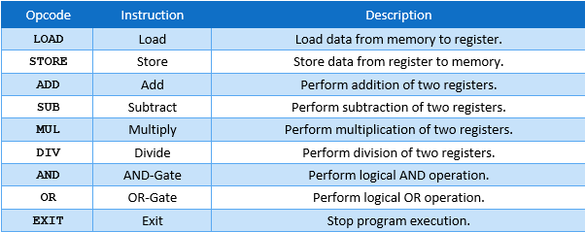
INSTRUCTION SET

Slide 9
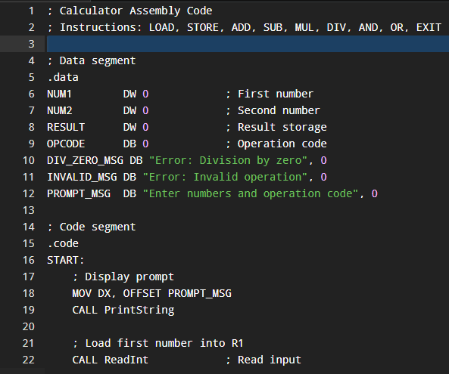
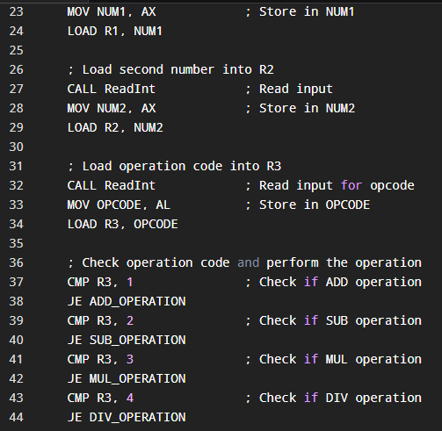

IMPLEMENTATION OF CODE

Slide 10
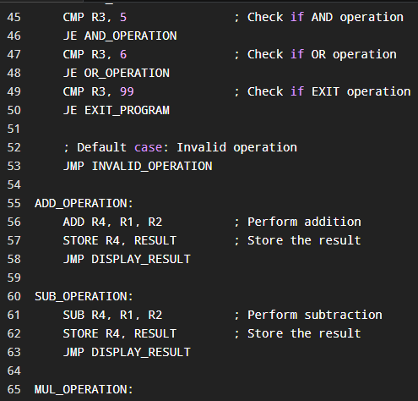
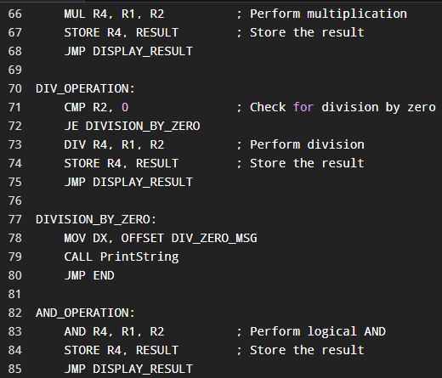
IMPLEMENTATION OF CODE

Slide 11
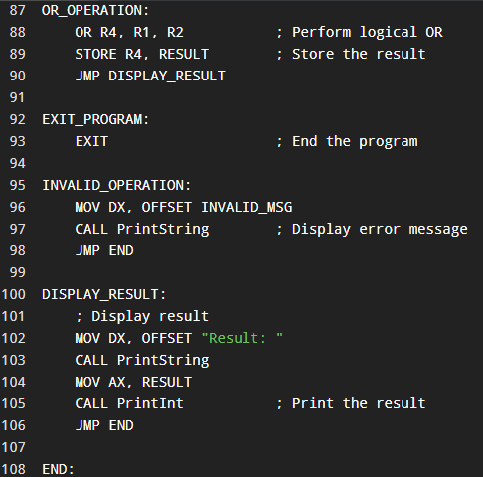
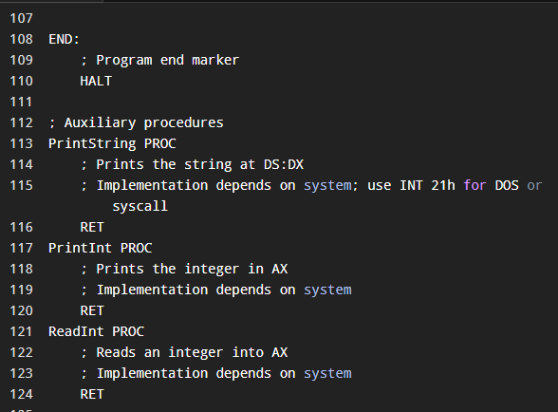
IMPLEMENTATION OF CODE

Slide 12
WORKING OF CODE
Displays a prompt for two numbers and an operation code.
Reads and stores the numbers and operation code in registers.
Compares the operation code to determine the required operation.
Executes the selected operation (ADD, SUB, MUL, DIV, AND, OR).
Handles errors like invalid operations or division by zero.
Displays the result or error message and exits on the `EXIT` code.

Slide 13
CONCLUSION
This project successfully demonstrates the design and implementation of a processor for a basic calculator. The architecture efficiently handles arithmetic and logical operations, meeting the project’s objectives. The assembly language implementation and simulations validate the feasibility of this design for embedded systems.

Slide 14
THANK YOU

