Slide 1
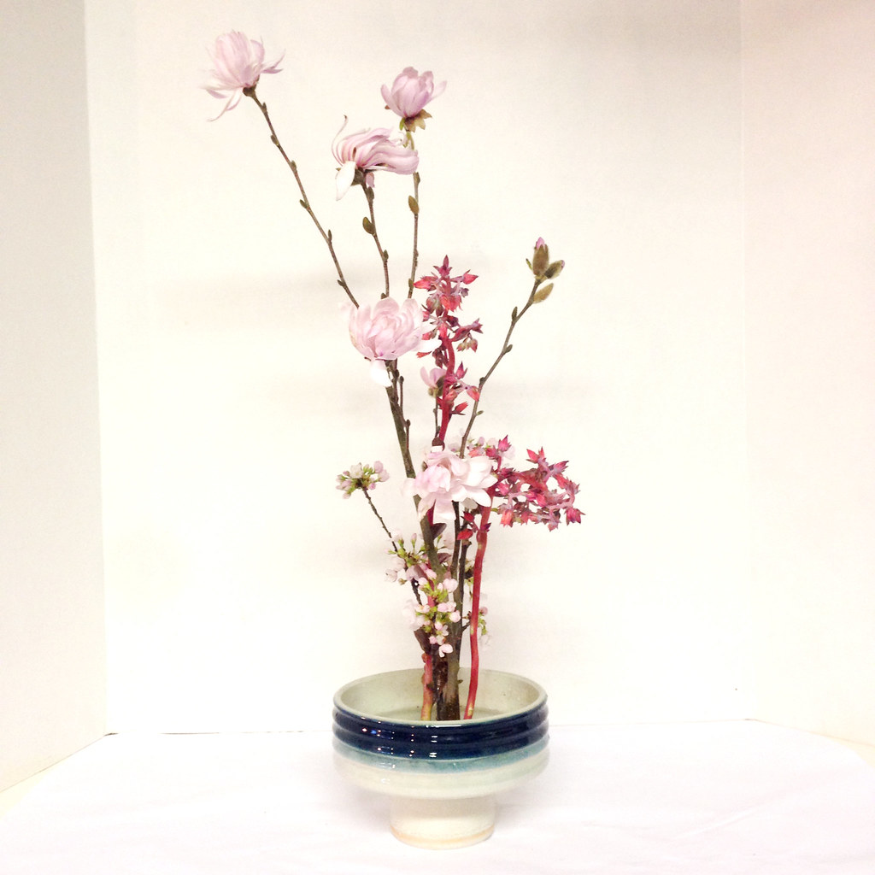
Ikebana

Slide 2
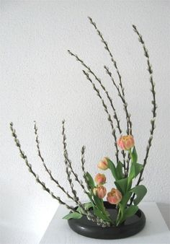
Space
- is a central component of design
Space allows other elements to “breath," to move, and connect
Silence - Slow down your busy mind.
Simplicity and minimalism

Slide 3
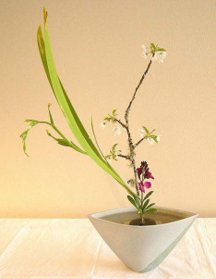
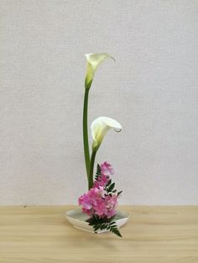
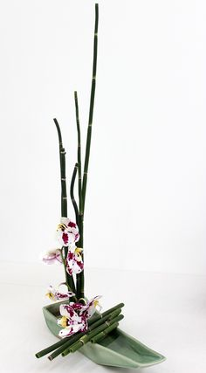
Structure
- is based on a scalene triangle
The three points represent
the three Elements:
heaven
human
earth

Slide 4
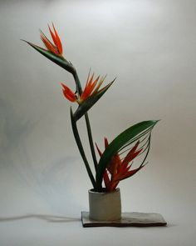
Odd Number
- keep the number of elements odd
Odd number is considered lucky
Buddhist belief that asymmetry reflects nature

