Slide 1



SketchLib: Enabling Efficient Sketch-based Monitoring on Programmable Switches
Hun Namkung
Zaoxing Liu, Daehyeok Kim, Vyas Sekar, Peter Steenkiste

Slide 2



Sketch seems promising on programmable switches
Count-sketch
UnivMon (Sigcomm ‘16)
R-HHH (Sigcomm ’17)
… and much more!
Sketching Algorithms
Languages such as P4
Implementation should be easy?
Programmable Switches

Slide 3
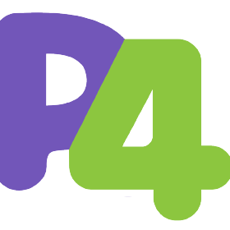

Let’s try to run sketches on programmable switches
Existing sketch code for CPU
(e.g., C++ / P4 code for BMv2)
Count-sketch
UnivMon (Sigcomm ‘16)
R-HHH (Sigcomm ’17)
Sketching Algorithms
sketch.p4
Switch out of available resources
Programmable Switches

Slide 4
Sketch is inefficient or infeasible on programmable switch
Sketching Algorithms
Existing sketch code for CPU
(e.g., C++ / P4 code for BMv2)
Difficult to program resource-efficient code for programmable switch
sketch.p4
GAP
Programmable switch has resource constraints (compiler rejects resource-heavy P4 code)
Programmable Switches

Slide 5

Our work: SketchLib bridges the gap!
Sketching Algorithms
Existing sketch code for CPU
(e.g., C++ / P4 code for BMv2)
SketchLib (https://github.com/SketchLib)
API calls with resource optimization
sketch.p4
Identified four resource bottlenecks
6 optimizations reduce resources up to 96% without accuracy degradation
Programmable Switches
API calls will automatically apply optimizations to P4 sketch codes

Slide 6
Outline
Bottleneck analysis
Optimizations and SketchLib APIs
Evaluation

Slide 7
Two background questions for bottleneck analysis
Sketching Algorithms
1. What are the common operations of sketches?
sketch.p4
GAP
Bottleneck Analysis
Programmable Switches
2. What are the hardware resources to run common operations of sketches?

Slide 8



Sketches have four common steps
Single-Level Sketch (e.g., count-sketch) vs Multi-Level Sketch (e.g., UnivMon)
Flowkey
Extraction
Hash
Computation
Memory Update
Tracking
Heavy Flowkey
Flowkey
Extraction
Hash
Computation
Memory Update
Tracking
Heavy Flowkey
Flowkey
Extraction
Hash
Computation
Counter Update
Tracking
Heavy Flowkey
Pkt header
$$h_{1}$$
3
 |  | +1
flow definition
= srcIP
Heap
$$h_{2}$$
5
 |  |  |  | +1
192.168.0.1
$$h_{3}$$
2
 | +1

Slide 9
Sketch imposes burden on hardware resources
Flowkey
Extraction
Hash
Computation
Counter Update
Tracking
Heavy Flowkey
Bottleneck 1
Bottleneck 2
Hash call
SRAM
TCAM
SALU
Difficult to realize!
Bottleneck 3
Per-stage resource
Programmable Switches
Parser
Stage 1
Stage N
Stage 1
Stage N
Deparser
…
…
Pipeline stages
Bottleneck 4
Buffer

Slide 10
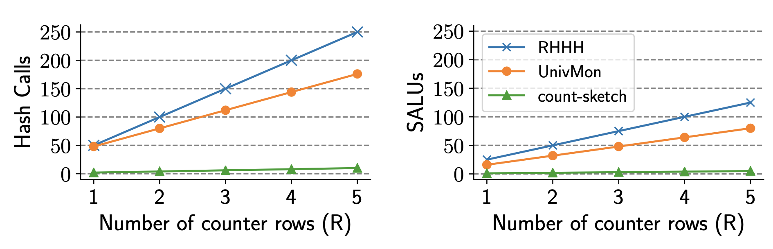
Hash calls and SALUs are resource bottlenecks
Higher accuracy
Higher accuracy
[1] (UnivMon) Liu et al, One Sketch to Rule Them All: Rethinking Network Flow Monitoring with UnivMon (Sigcomm’ 16)
[2] (R-HHH) Basat et al, Constant Time Updates in Hierarchical Heavy Hitters (Sigcomm’ 17)

Slide 11
Outline
Bottleneck analysis
Optimizations and SketchLib APIs
Evaluation

Slide 12
Overview of optimizations and SketchLib API
Resource Bottlenecks | Optimizations | SketchLib API
Hash Calls | O1. Consolidate short-bit hash calls | hash_consolidate_and_split()
 | O2. Reuse hash calls across levels | select_key_and_hash()
Pipeline Stages | O3. Remove dependencies using TCAM | tcam_optimization()
SALUs | O4. Update only one level per packet | -
 | O5. Rewrite P4 code to reduce SALUs | consolidate_update()
Resources for tracking flowkeys | O6. Hash table for tracking heavy flowkeys | heavy_flowkey_storage()

Slide 13
O1. Consolidate short hash calls
flowkey
seed
Hash Call
hash result
bit length
Short (e.g., 1-bit)
3 hash calls
1 hash call
1-bit Hash Call
0
1-bit Hash Call
0
3-bit Hash Call
0 1 0
1-bit Hash Call
1
Accuracy-preserving ✓
[Condition] same flowkeys

Slide 14
O5. Remove unnecessary SALU allocation
✗
✓
L=3
✗
SALU
SALU
SALU
SALU
SALU
SALU
SALU
SALU
SALU
SALU
SALU
SALU
9 SALUs
3 SALUs
Accuracy-preserving ✓

Slide 15
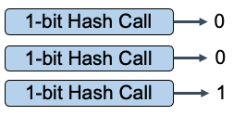
End-to-end code example
SketchLib
https://github.com/SketchLib
UnivMon.p4 without SketchLib
O1: hash_consolidate_and_split()
O5: consolidate_update()
...
h1 = hash(srcIP, seed1, 1);
h2 = hash(srcIP, seed2, 1);
h3 = hash(srcIP, seed3, 1);
...
if (L == 1)
update_array_1(L, index);
if (L == 2)
update_array_2(L, index);
if (L == 3)
update_array_3(L, index);
...
Optimized UnivMon.p4
...
hash_consolidate_and_split (
srcIP, seed1, 3, 1, 1, 1);
...
consolidate_update (L, index);
...

Slide 16
Applicability of SketchLib
https://github.com/SketchLib
# | Sketch Type | Sketch Name | Venue | Applicability of SketchLib
1 | Frequency Estimation / HeavyHitters | Count-Min Sketch | Journal of Algorithms ‘04 | O6
2 |  | Count Sketch | ICALP ‘02 | O1, O6
3 |  | MRAC | Sigmetrics ‘04 | O3, O5
4 | Hierarchical Heavy Hitters | RHHH | Sigcomm ‘17 | O1, O2, O5, O6
5 |  | HHH | VLDB ‘03 | O1, O6
6 | Cardinality | PCSA | JCSS ‘85 | O3, O5
7 |  | MRB | IMC ‘03 | O3, O5
8 |  | LogLog | ESA ‘03 | O3
9 |  | HyperLogLog | AOFA ‘07 | O3
10 | Entropy | EntropySketch | Sigmetrics ‘06 | O1
11 | Change detection | K-ary | IMC ‘03 | O1, O2, O6
12 | Super Spreader | SpreadSketch | Infocomm ‘20 | O3, O5
13 | General | UnivMon | Sigcomm ‘16 | O1, O2, O3, O4, O5, O6
14 |  | FCM | CoNEXT ‘20 | O6
15 |  | SketchLearn | Sigcomm ‘18 | O2

Slide 17
Outline
Bottleneck analysis
Optimizations and SketchLib API
Evaluation

Slide 18
SketchLib reduces resource bottlenecks

Slide 19
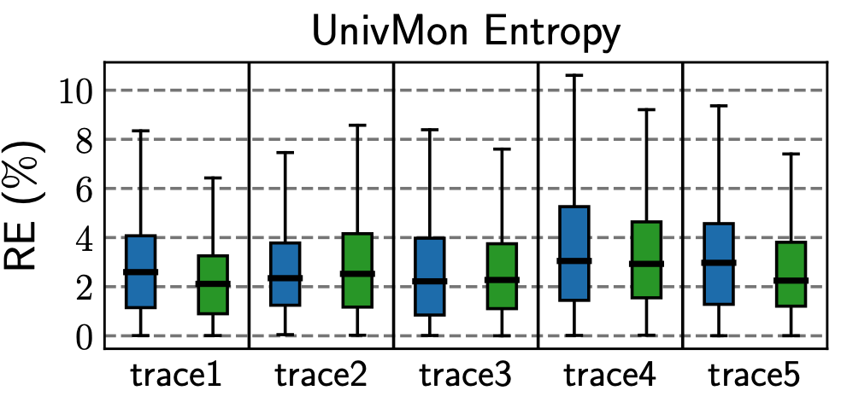
SketchLib preserves accuracy
SW baseline
SketchLib-optimized on HW
Error (%)

Slide 20

Conclusion
The promise of sketch today is still unrealized
SketchLib helps developers optimize sketch implementations on programmable switches with minimal effort
SketchLib is general across sketches
https://github.com/SketchLib

