Slide 1




Sketchovsky: Enabling Ensembles of Sketches on Programmable Switches
Hun Namkung*§ Zaoxing Liu† Daehyeok Kim‡
Vyas Sekar*§ Peter Steenkiste*
(Now at)
*
†
‡
§

Slide 2
Network measurement is essential for management
Management Tasks
Resource
Provisioning
Syn Flood Detection
Port Scan Detection
…
Diverse
Measurement Tasks
Top K flows
on 5-tuple
Unique # of flows
on srcIP
Entropy
on dstPort
…

Slide 3
Ensemble of sketches on programmable switch is promising
Control
Plane
Top K flows
on 5-tuple
Unique # of flows
on srcIP
…
Entropy
on dstPort
Sketch Ensemble
Data
Plane
Packets
Sketch
Instance 1
Sketch
Instance 2
…
Sketch
Instance N
Sketching Algorithms (Sketches)
Packet Sampling Approach (Netflow)
Programmable Switch
Fixed-Function Network Switch

Slide 4
Prior work cannot handle ensemble of sketches
Three requirements for running the sketch ensemble
Generality: any combination of measurement tasks
Low Resource: footprint on switch
High Accuracy: for measurement tasks
Prior Work | Generality | Low Resource | High Accuracy
More expressive sketches (UnivMon, CocoSketch) | ✗ | ✓ | ✓
Per-sketch optimization (SketchLib) | ✓ | ✗ | ✓
Dynamic resource allocation (P4All, FlyMon) | ✓ | ✓ | ✗

Slide 5
Per-sketch optimization has fundamental limitation for ensemble
SketchLib (NSDI’ 22)
HW resources
Can we run the sketch ensemble with sub-linear resources while preserving high accuracy?

Slide 6

Sketchovsky Overview
Sketch
Ensemble
inst1.p4
inst1.p4
sket1.p4
INPUT
Sketchovsky
An optimized
sketch code
Apply opt X to inst Y
Cross-Sketch Optimizations
Strategy
Finder
Auto-code Composition
Strategy
opt.p4
Propose five cross-sketch optimizations as building blocks
Find best strategy on how to apply building blocks
Automatically generate optimized code
→ up to 18 sketch instances by reducing up to 45% HW resource

Slide 7
Outline
Motivation
Five cross-sketch optimizations
Strategy finder
Evaluation

Slide 8



Sketches have three common workflow steps
Hash
Computation
Counter Update
Heavy Flowkey Storage
Packets
flow key = srcIP
Pkt header
$$h_{1}$$
3
 |  | +1
SRAM
Storage
$$h_{2}$$
5
 |  |  |  | +1
192.168.0.1
$$h_{3}$$
2
 | +1
Programmable Switch
Hash Unit
SALU
SRAM

Slide 9

Five cross-sketch optimizations
We can reuse hardware resources across sketch instances!
Sketch3
Heavy Flowkey
Storage
Hash
Computation
Counter Update
Sketch
Ensemble
Sketch2
Heavy Flowkey
Storage
Hash
Computation
Counter Update
Sketch1
Heavy Flowkey
Storage
Hash
Computation
Counter Update
O1. reuse hash results as-is
O2. reuse hash results with XOR
O5. reuse heavy flowkey storage
O3. reuse counter arrays
O4. reuse a SALU for two counter arrays

Slide 10


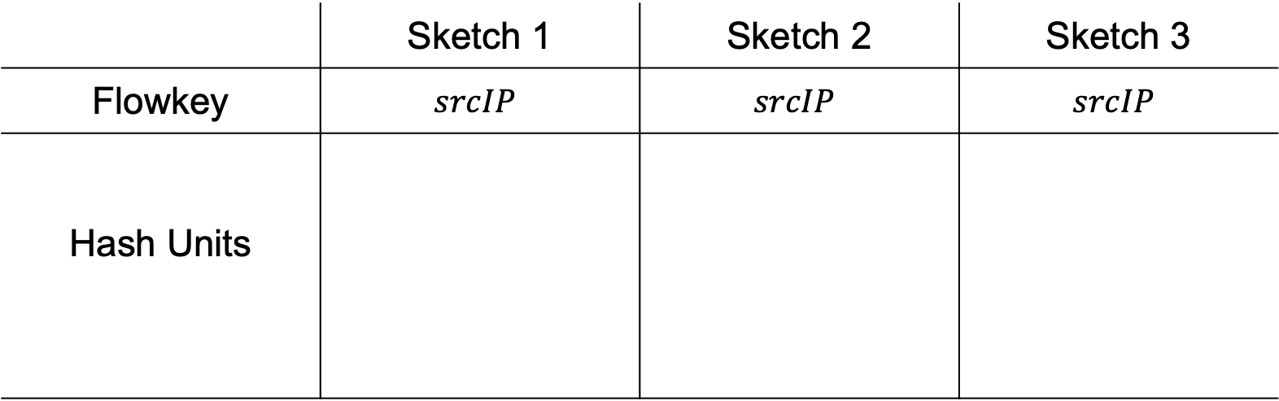








Hash1: Reusing hash results reduces hash units
Applicable condition
 | Sketch 1 | Sketch 2 | Sketch 3
Flowkey | $$srcIP$$ | $$srcIP$$ | $$srcIP$$
Hash Units
$$h_{11}\left(srcIP\right)$$
$$h_{31}\left(srcIP\right)$$
$$h_{11}\left(srcIP\right)$$
$$h_{21}\left(srcIP\right)$$
$$h_{12}\left(srcIP\right)$$
$$h_{12}\left(srcIP\right)$$
$$h_{22}\left(srcIP\right)$$
$$h_{seed}\left(flowkey\right)$$
$$h_{13}\left(srcIP\right)$$
$$h_{13}\left(srcIP\right)$$
Hash results can be reused across sketch instances!
6 hash units → 3 hash units

Slide 11

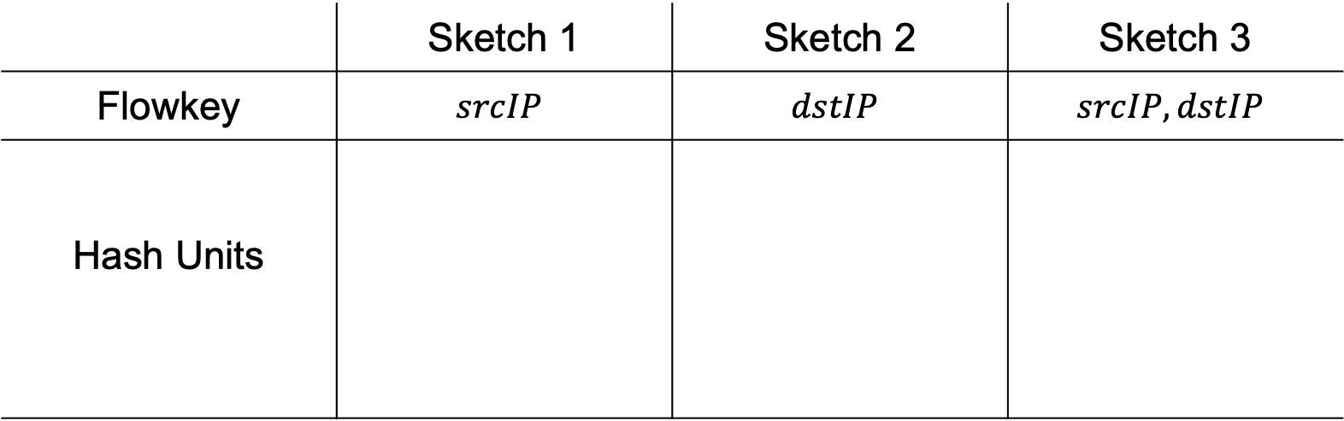






Hash2: XOR-based hash reconstruction
Applicable condition
 | Sketch 1 | Sketch 2 | Sketch 3
Flowkey | $$srcIP$$ | $$dstIP$$ | $$srcIP, dstIP$$
Hash Units
$\left\{ \right\} ∪$ { } = { }
$$h_{1}\left(srcIP\right)$$
$$h_{2}\left(dstIP\right)$$
$$h_{3}\left(srcIP, dstIP\right)$$
$$h_{seed}\left(flowkey\right)$$
$$h_{1}\left(srcIP\right)$$
$$h_{2}\left(dstIP\right)$$
$$⨁$$
Hash results can be reconstruted using XOR operation
3 hash units → 2 hash units

Slide 12






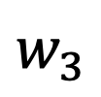



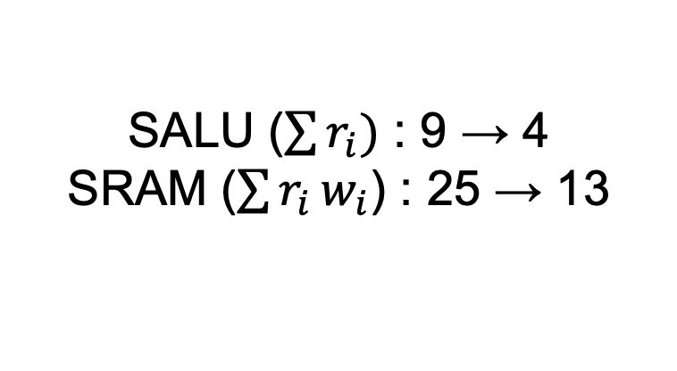

Ctr1: Reusing counter arrays can reduce memory
Accuracy is improved!
Control
Plane
Measurement
Task 1
Measurement
Task 2
Measurement
Task 3
8 SRAMs
13 SRAMs
$$w_{1}$$
$$w_{2}$$
$$w_{3}$$
$$w_{3}$$
 | +1
 | +1
$$r_{3}$$
 |  |  | +1
 |  |  | +1
$$r_{2}$$
$$w_{3}$$
Data
Plane
$$r_{1}$$
+1
+1
 |  | +1
$$r_{1}$$
 |  | +1
$$w_{2}$$
 | +1
+1
+1
$$w_{1}$$
+1
+1
Sketch 1
Sketch 2
Sketch 3
Sketch 1,2,3
SALU ($\sum{r_{i})}$ : 9 → 4
SRAM ($\sum{r_{i}}w_{i}$) : 25 → 13

Slide 13
Outline
Motivation
Five cross-sketch optimizations
Strategy finder
Evaluation

Slide 14
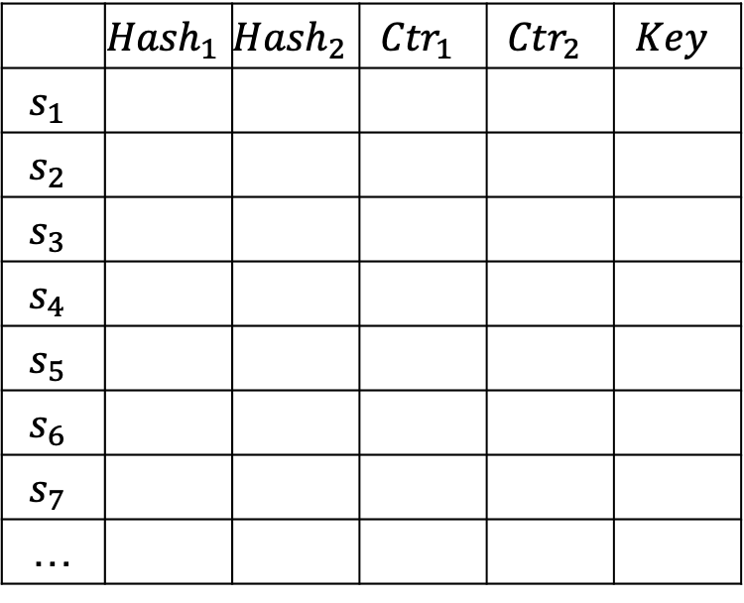

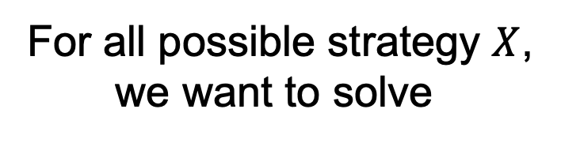
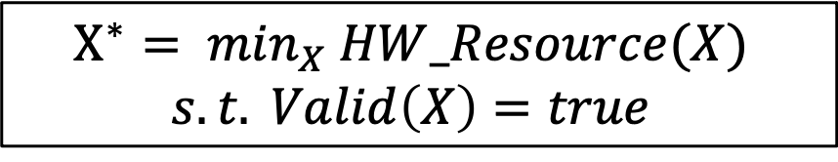
Problem formulation for strategy finder
For all possible strategy $X$,
we want to solve
$$X$$
5 Optimizations
$$X^{∗}= \min_{X} HW_Resource(X)$$
$$s.t. Valid\left(X\right)=true$$
 | $${Hash}_{1}$$ | $${Hash}_{2}$$ | $${Ctr}_{1}$$ | $${Ctr}_{2}$$ | $$Key$$
$$s_{1}$$
$$s_{2}$$
$$s_{3}$$
$$s_{4}$$
$$s_{5}$$
$$s_{6}$$
$$s_{7}$$
…
Challenge: large search space!
Sketch Ensemble

Slide 15




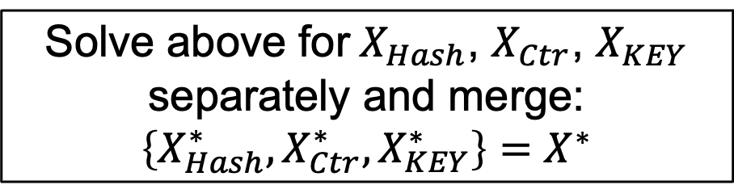
Search space decomposition across workflow steps
$$X$$
$$X_{Hash}$$
$$X_{Ctr}$$
$$X_{KEY}$$
Large search space
$$X^{∗}= \min_{X} HW_Resource(X)$$
$$s.t. Valid\left(X\right)=true$$
 | $${Hash}_{1}$$ | $${Hash}_{2}$$ | $${Ctr}_{1}$$ | $${Ctr}_{2}$$ | $$Key$$
$$s_{1}$$
$$s_{2}$$
$$s_{3}$$
$$s_{4}$$
$$s_{5}$$
$$s_{6}$$
$$s_{7}$$
…
Equivalent
Sketch Ensemble
Solve above for $X_{Hash}$, $X_{Ctr}$, $X_{KEY}$ separately and merge: $\left\{X_{Hash}^{∗},X_{Ctr}^{∗},X_{KEY}^{∗}\right\}=X^{∗}$
Small search space

Slide 16
Outline
Motivation
Five cross-sketch optimizations
Strategy finder
Evaluation

Slide 17
Sketchovsky makes previously infeasible ensembles become feasible
Higher is better

Slide 18
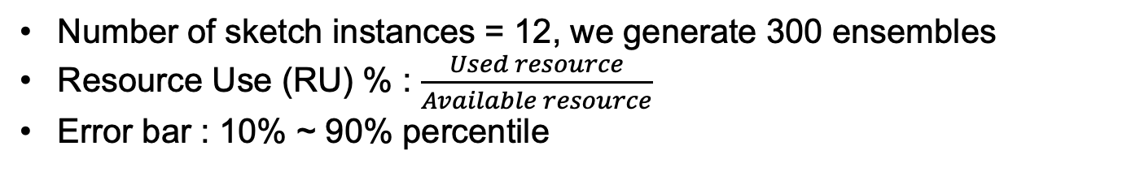
Sketchovsky reduces hardware resources
Number of sketch instances = 12, we generate 300 ensembles
Resource Use (RU) % : $\frac{Used resource}{Available resource}$
Error bar : 10% ~ 90% percentile
Lower is better

Slide 19
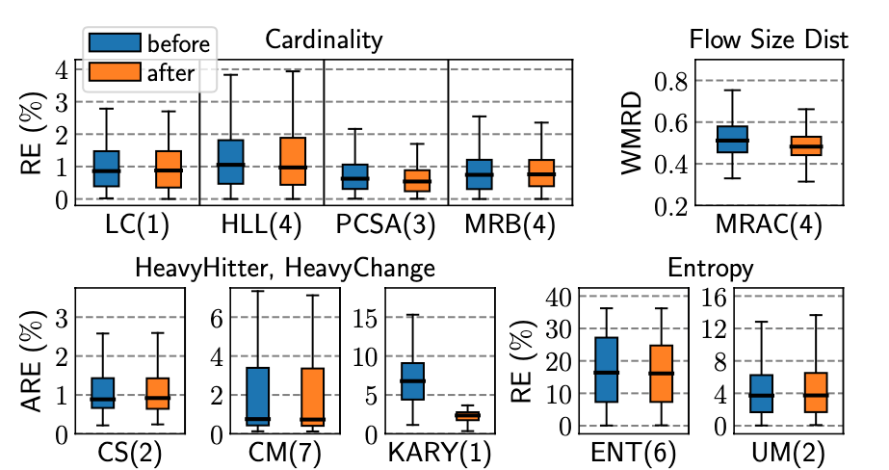
Sketchovsky preserves or improves accuracy
10 sketching algorithms
LC | Linear counting
HLL | HyperLogLog
PCSA | PCSA
MRB | Multi-resolution Bitmap
MRAC | MRAC
CS | Count-sketch
CM | Count-min sketch
KARY | K-ary sketch
ENT | Entropy sketch
UM | UnivMon
Lower is better

Slide 20
Conclusion
Diverse measurement tasks at scale are critical for management
Sketch ensemble on programmable switch is promising, but prior work has fundamental limitation
We propose a composition framework Sketchovsky that propose cross-sketch optimizations, strategy finder, and auto-code composition
Sketchovsky makes previously infeasible ensembles feasible by reducing up to 45% hardware resources without accuracy loss

