Slide 1
Telemetry Retrieval Inaccuracy in Programmable Switches Analysis and Recommendations
Hun Namkung§
Daehyeok Kim §† , Zaoxing Liu‡, Vyas Sekar§, Peter Steenkiste§
§Carnegie Mellon University
‡Boston University
†Microsoft Research

Slide 2

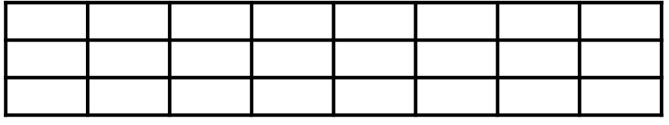
Sketches on programmable switches are promising
Network Operator
Telemetry Result
Programmable Switch (Tbps)
Sketches
Heavy hitter detection
Entropy estimation
Unique # of flows
Counter Arrays
Packet Stream

Slide 3
Sketches on programmable switches generate inaccurate results
Average Error Rate (%)
 | Counter Array Size
 | 16K | 32K | 64K
Expected | 4.1% | 1.3% | 0.3%
Observed | 7.1% | 17.0% | 34.8%
94x more error!
on count-min sketch
This inaccuracy problem also impacts other sketches!

Slide 4









Counter retrieval causes the inaccuracy problem
Switch
Control Plane
$$C_{1}$$
$$C_{1}′$$
$$C_{2}′$$
$$C_{3}′$$
$$C_{2}$$
$$C_{3}$$
counter
retrieval
counter
retrieval
Counter
Arrays
$$C_{1}$$
$$C_{2}$$
$$C_{3}$$
Data Plane
update
update
update
Packet
Stream
epoch1
epoch2
epoch3
time
This problem also impacts other telemetry tasks!

Slide 5






Read/Reset delays can cause counting errors
Switch
Control Plane
$$C_{1}$$
$$C_{2}$$
$$C_{3}$$
read
reset
read
reset
read
reset
read
reset
Counter
Arrays
$$C_{1}$$
$$C_{2}$$
$$C_{3}$$
Data Plane
update
update
update
Packet
Stream
epoch1
epoch2
epoch3
time

Slide 6



Read/Reset delays can cause counting errors
Undercounting!
Switch
Control Plane
$$C_{1}′$$
$$C_{2}′$$
$$C_{3}′$$
read
reset
read
reset
read
reset
read
Counter
Arrays
$$C_{1}$$
$$C_{2}$$
$$C_{3}$$
Data Plane
update
update
update
Packet
Stream
epoch1
epoch2
epoch3
time

Slide 7





Read/Reset delays can cause counting errors
Undercounting!
Overcounting!
Switch
Control Plane
$$C_{1}′$$
$$C_{2}′$$
$$C_{3}′$$
read
reset
read
reset
read
reset
Counter
Arrays
$$C_{1}$$
$$C_{2}$$
$$C_{3}$$
Data Plane
update
update
update
Packet
Stream
epoch1
epoch2
epoch3
time

Slide 8
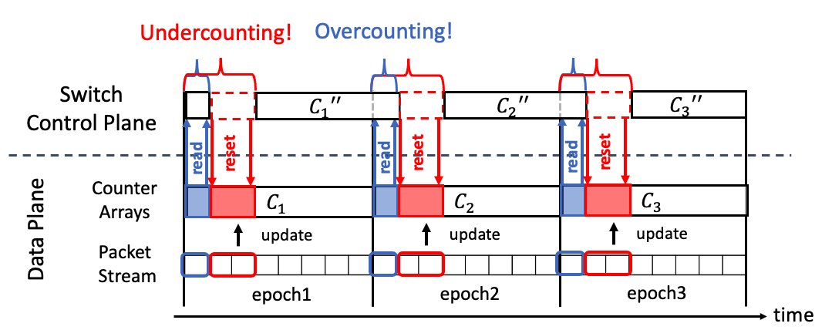


Analysis reveals two major bottlenecks
Delay contributing to undercounting (99.9%)
Delay contributing to overcounting (1%)
$$Δread$$
$$Δrst$$
62%
36%
Counter
Arrays
Counter
Arrays
100%

Slide 9








Sol 1. Use two sets of counter arrays
$$C_{1}$$
$$C_{2}$$
Switch
Control Plane
read reset
read reset
Set 1
$$C_{1}$$
$$C_{1}$$
$$C_{3}$$
Set 2
$$C_{0}$$
$$C_{2}$$
$$C_{2}$$
Data Plane
update
update
update
Packet
Stream
epoch1
epoch2
epoch3

Slide 10










Sol 2. No reset operation
$$C_{1}$$
$$C_{1}+C_{2}$$
Switch
Control Plane
…
…
read
reset
read
reset
read
reset
Counter
Arrays
$$C_{1}$$
$$C_{1}+C_{2}$$
$$C_{1}+C_{2}+C_{3}$$
Data Plane
update
update
update
Packet
Stream
epoch1
epoch2
epoch3
Linear property enables
$$C_{1}+C_{2}$$
$$−$$
$$C_{1}$$
$$=$$
$$C_{2}$$

Slide 11
Trade-offs among independent solutions and guideline
(Higher is better)
 | Generality | Delay Reduction | Memory Efficiency
Sol 1. Use two sets of counter arrays | ✓ | 100% | ✗
Sol 2. No reset operation | ✗ | 99% | ✓
Sol 3. Defer buffer read and perform bulk reset | ✓ | 95% | ✓
Resources is sufficient and/or high accuracy is required?
yes
no
Sol 1
Sketch satisfies the linear property?
yes
no
Sol 2
Sol 3

Slide 12
Evaluation Setup
Tofino Programmable Switch
Control Plane
Server
periodically read and reset
CAIDA traces
Data Plane
tcpreplay
Sketches
Multi-Resolution Bitmap
HyperLogLog
Count-min Sketch
Count-Sketch
UnivMon

Slide 13
Accuracy Improvement
Lower is better

Slide 14
Conclusion
Control plane counter retrieval problem generate inaccurate results for sketches on the programmable switch.
Our work:
We analyze and quantify the inaccuracy
We propose three solutions and they eliminate almost all the inaccuracy

