Slide 1

Secured Digital Voting System using Blockchain Technology
Phase II - Review 2
Under the guidance of
Dr. Nagaraja J
Computer Science Department
Dayananda Sagar College of Engineering.
Bhagya A Koushik [1DS19CS037]
Deekshitha R S [1DS19CS044]
Gowthami S [1DS19CS053]
Haritha Nandhini [1DS19CS055]
Department of Computer Science & Engineering, DSCE

Slide 2
INTRODUCTION TO THE PROBLEM
Blockchain is a shared tamper-proof ledger that eases the process of recording transactions and tracking assets in a business network.
Traditional voting system has various disadvantages with respect to its security, fairness and integrity.
Digital voting is a form of computer driven voting in which voters can cast their votes on a system over the internet.
It employs a decentralized blockchain network to monitor the entire election process.
SHA- 256 algorithm is used to ensure encryption of the votes and avoid any kind of manifestation of votes during the election.
It generates a user- friendly election environment over the internet to allow the users to cast their votes to their candidates of interest and also announces the final results giving information about the winner and also the election statistics.
Department of Computer Science & Engineering, DSCE

Slide 3
Contribution of Each project Members
Individual Contribution
Bhagya A Koushik
Report
Backend
Survey Paper
Smart Contract
Deekshitha R S
Report
Backend
Survey Paper
Smart Contract
cv
Gowthami S
Report
Statistics
Survey Paper
Ganache and Metamask
Haritha Nandhini
Report
Statistics
Survey Paper
User Interface
Department of Computer Science & Engineering, DSCE

Slide 4
Contribution of Each project Members
PAPER NAME | AUTHOR | ALGORITHM MODEL USED | ADVANTAGES | DISADVANTAGES
A Conceptual Secure Blockchain-Based Electronic Voting System | Ahmed Ben Ayed | SHA-256 algorithm | Provides ability to vote using any device and blockchain and is verified in such a way that it is immutable. | Liable to DDOS attack and make elections not accessable to voter. User can cast vote only once.
A Comparitive Analysis on E-Voting System Using Blockchain | Kanika Garg, Pavi Saraswat, Sachin Bisht, Sahil Kr. Aggarwal, Sai Krishna Kothuri, Sahil Gupta | Cryptography model | Different approaches to tackle the anonymity, security, availablity, fairness verfiablility is discussed. | Does not cover authentication like biometric or unique ID.
Covid-19 Implementation e-voting Blockchain Concept | Mustofa Kamil, Po Abas Sunarya, Untung Rahardja, Nuke Puji Lestari Santoso, Muhammad Iqbal | Cryptography model | Reduce the meeting of humans in election activities during pandemic. Cryptographic protocol makes the results of votes transparent and safe. | Voting is not done effortlessly other than in public network as each transaction of vote takes 15 to 20 seconds.
Implementation of Auditable Blockchain Voting System with Hyperledger Fabric | Michal Pawlak, Aneta Poniszewska Maranda | Consensus algorithm | Hyperledger fabric focuses on providing high customizability, security and modularity. | Verifying the portability of ABVS model is not implemented.
A Systematic Review of Challenges and Oppurtunities of Blockchain for E-Voting | Ruhi Tas, Omer Ozgur Tanriover | Consensus algorithm, Proof-of-Work and Proof-of-Stake model, Governance model | Contributions made for the issues like integrity, privacy and consensus. | Usage of untrusted system, scalability attack, low transparency is not discussed.
Blockchain-Based E-Voting System | Fridrik Hjalmarsson, Gunnlaugur Hreidarsson, Mohammad Hamdaqa, Gisli Hjalmtysson | Byzantine algorithm, Proof-of-Authority model | Smart contract is utilized to enable reliability and cost-effective election as well guarantees voters privacy | Additional procedures has to be taken care of while conducting voting at large number transactions per second.
cv
Department of Computer Science & Engineering, DSCE

Slide 5
Contribution of Each project Members
PAPER NAME | AUTHOR | ALGORITHM MODEL USED | ADVA25NTAGES | DISADVANTAGES
A Secure end-to-end verifiable e-voting system using blockchain and cloud server | Somnath Panja, Bimal Roy | DRE-ip tally verification algorithm, Fuzzy Vault algorithm. | This protocol has the potential for real-world deployment and provides secure voter registration and authentication. | There is no proposal to reduce the False Rejection Rate of the Fussy Vault algorithm for fingerprint.
Decentralized E-Voting Systems Based on the Blockchain Technology | Jen Ho Hsiao, Raylin Tso, Chien Ming Chen, Mu En Wu | Paillier’s homomorphic encryption algorithm | Transparency of smart contract that allow voters to record and verify ballots. | Voter qualification, protecting the anonymity of voter’s identity, non-repeatable, ballot eligibility and ballot verifiability is not discussed.
Electronic Voting Service Using Block-Chain | Kibin Lee, Joshua I James, Tekachew G Ejeta, Hyoung J Kim | SHA-256 algorithm, RIPEMD160 algorithm | Consensus attack will not be able to steal coins, consume coins or change ownership records and past transactions. | Susceptible to denial-of-service disruptions that can affect the creation of future blocks as bitcoin network has large amount of hash power.
SecEVS: Secure Electronic Voting System Using Blockchain Technology | Ashish Singh, Kakali Chatterjee | SHA-256 algorithm | Voter can be registered only once and employs decentralization. | Difficult to implement on large scale.
Digital Voting: A Blockchain-based E-Voting System using Biohash and Smart Contract | Syada Tasmia Alvi, Mohammed Nasir Uddin, Linta Islam | Hash generation algorithm from fingerprint | Smart contract is used which provides transparency and mobility. The voters information hash is stored in the chain will provide scalability. | Vote counting is not done in real time. There is no encryption technique to boost system’s security.
A Study on Decentralized E-Voting System Using Blockchain Technology | Harsha V Patil, Kanchan G Rathi, Malathi Tribhuwan | SHA-256 algorithm | Allows the voters with an option to cast a protest vote in case they are not satisfied with the current elections or candidature. | More energy is required to validate and process the votes, there will be a shift from the central election commission and building the trust factor is also a challenge.
cv
Department of Computer Science & Engineering, DSCE

Slide 6
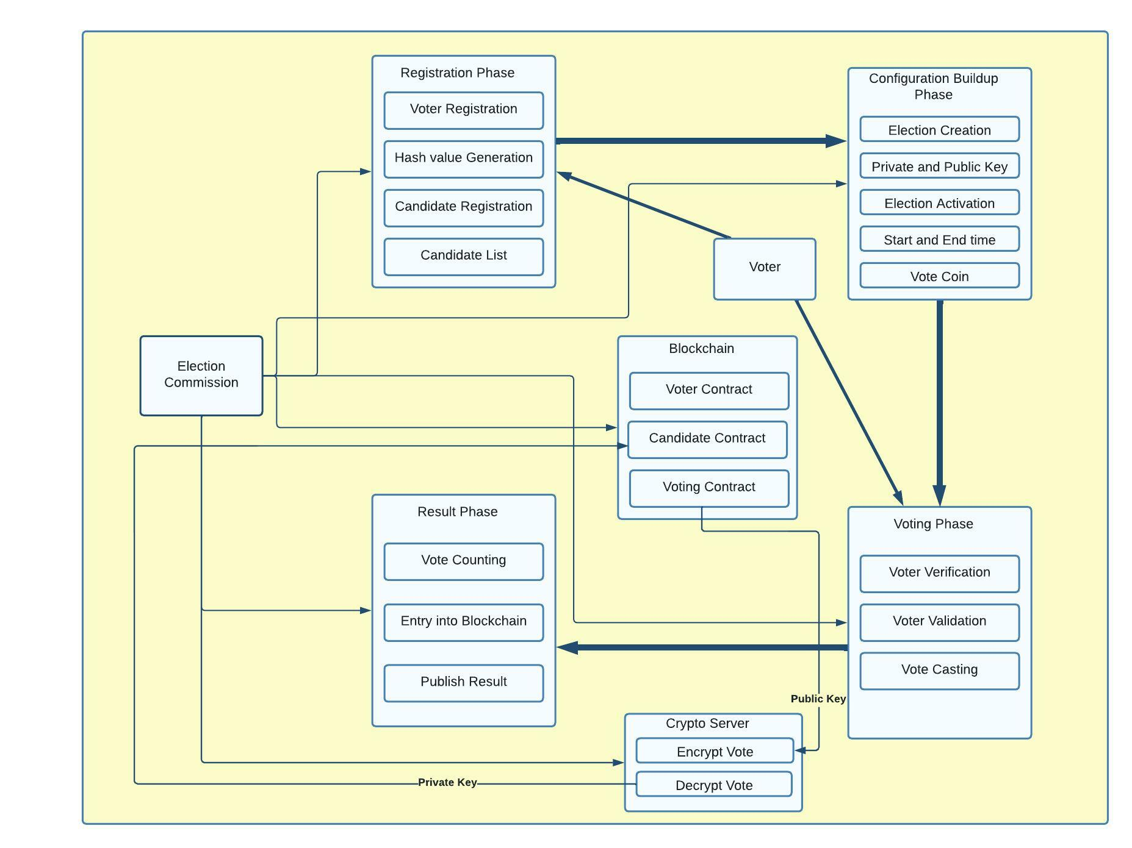
SYSTEM DIAGRAM / ARCHITECTURE:
Department of Computer Science & Engineering, DSCE

Slide 7
MODULES
The proposed voting mechanism includes four modules:
First Phase: Registration Phase
Second Phase: Voting Setup Phase
Third Phase: Voting Phase
Fourth Phase: Result Phase

Slide 8
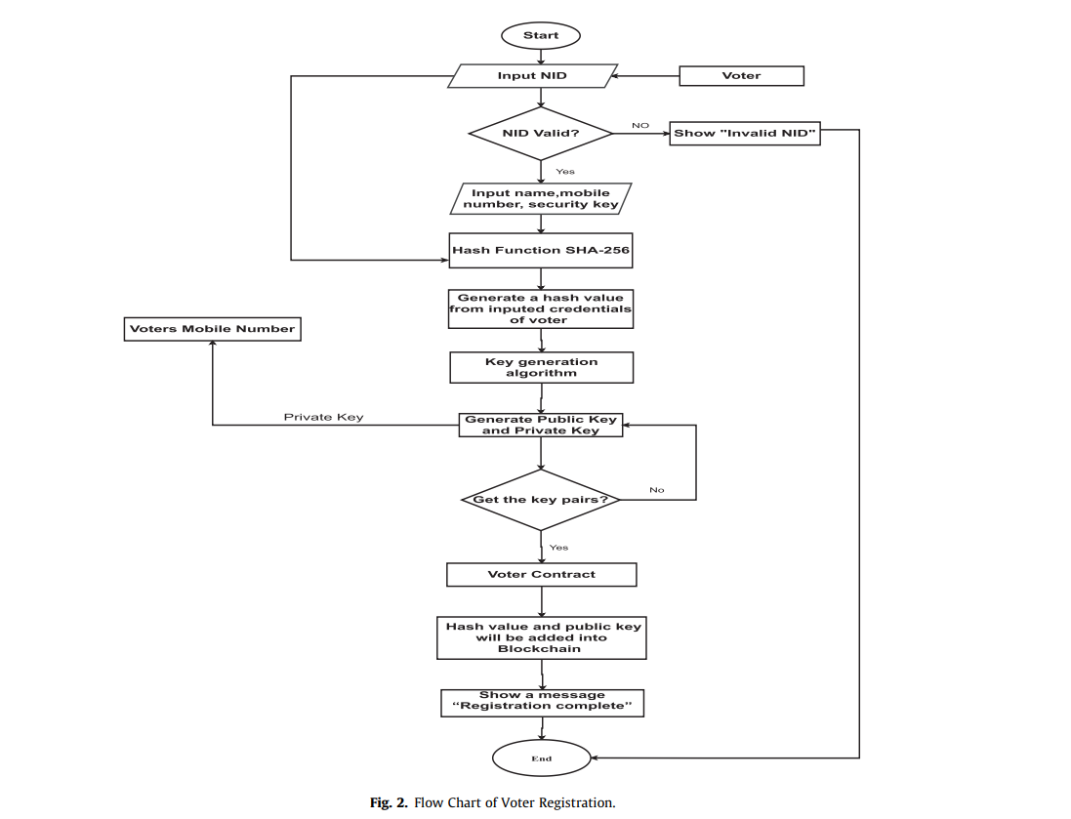
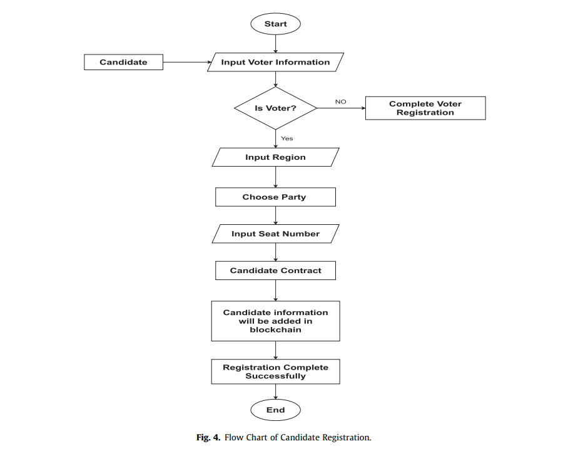
MODULES DESCRIPTIONS
First phase
The First phase of voting system consists of
Registration unit which has two parts:
Voters registration
Candidate Registration

Slide 9
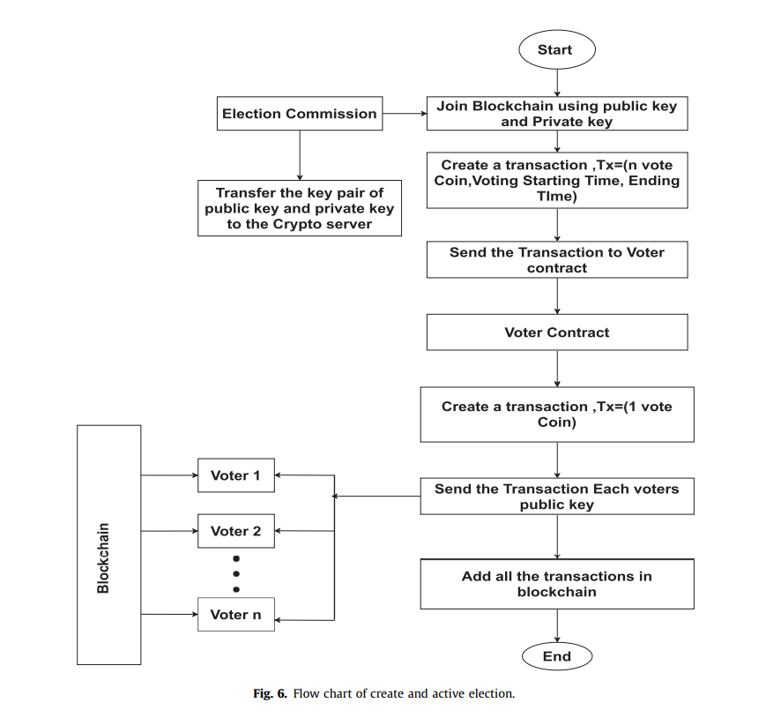
MODULES DESCRIPTIONS
Second phase
Voting Setup Phase
This phase is divided into two parts:
Create Election
Active Election

Slide 10
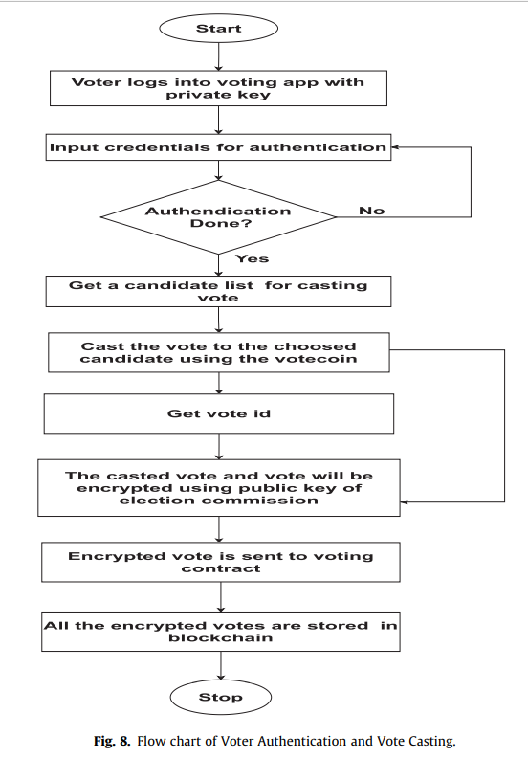
MODULES DESCRIPTIONS
Third phase
Voting Phase
This phase is divided into two parts:
Voter Authentication
Vote Casting

Slide 11
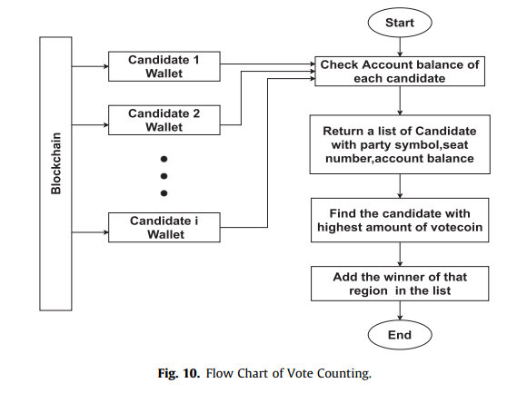
MODULES DESCRIPTIONS
Fourth phase
Result Phase
This phase consists of:
Vote Counting Unit
Publish Result

Slide 12
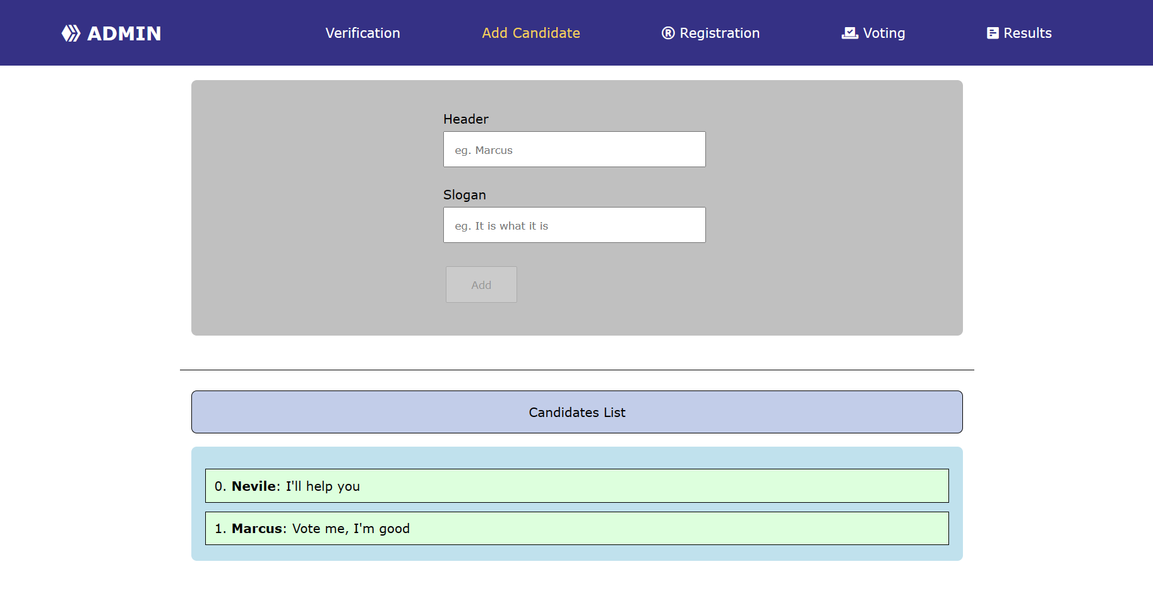
GUI DESIGN SCREENSHOTS
Adding candidates
Department of Computer Science & Engineering, DSCE

Slide 13
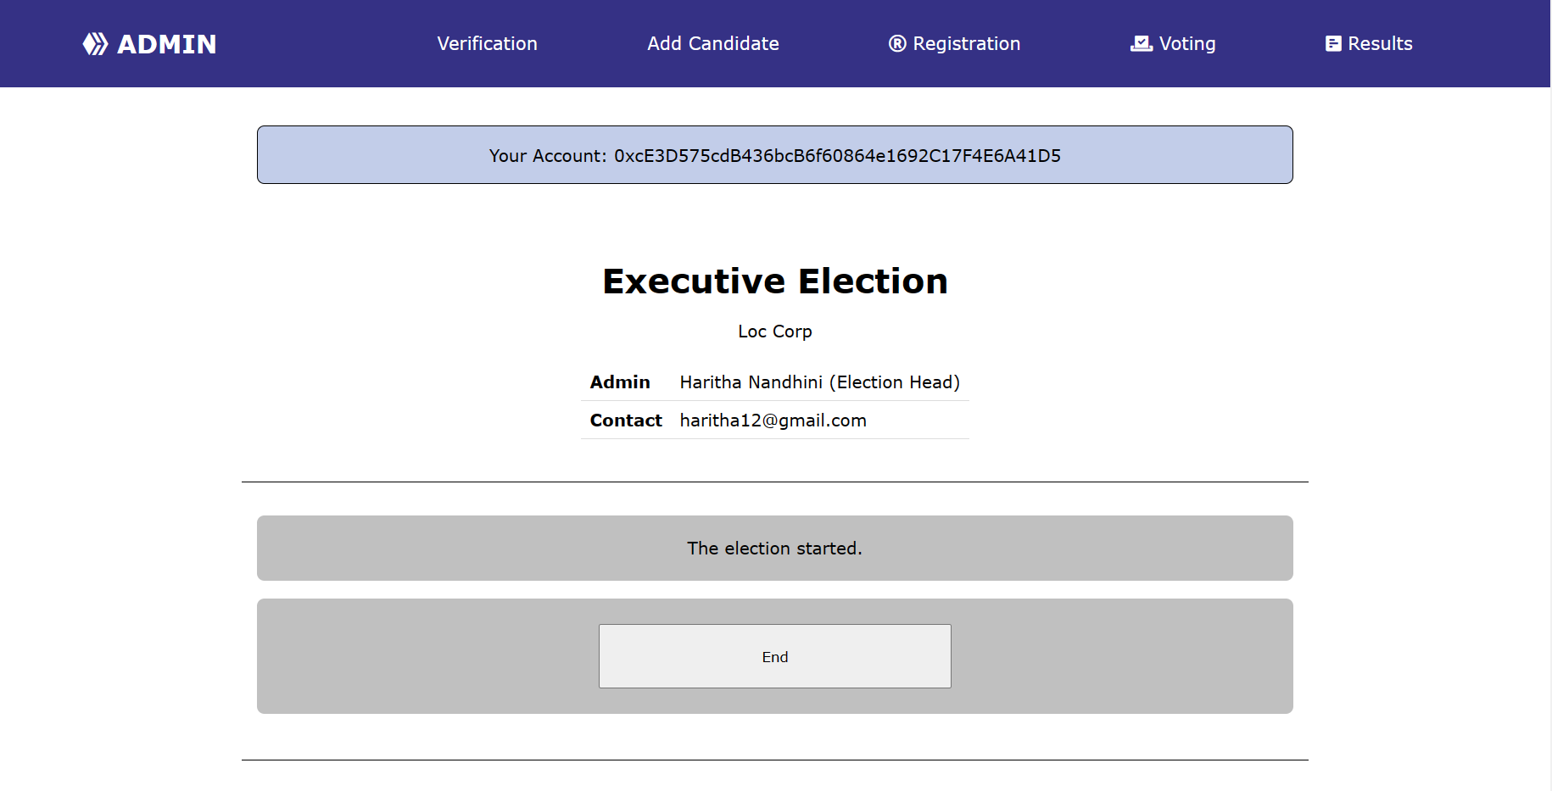
GUI DESIGN SCREENSHOTS
Starting Election
Department of Computer Science & Engineering, DSCE

Slide 14
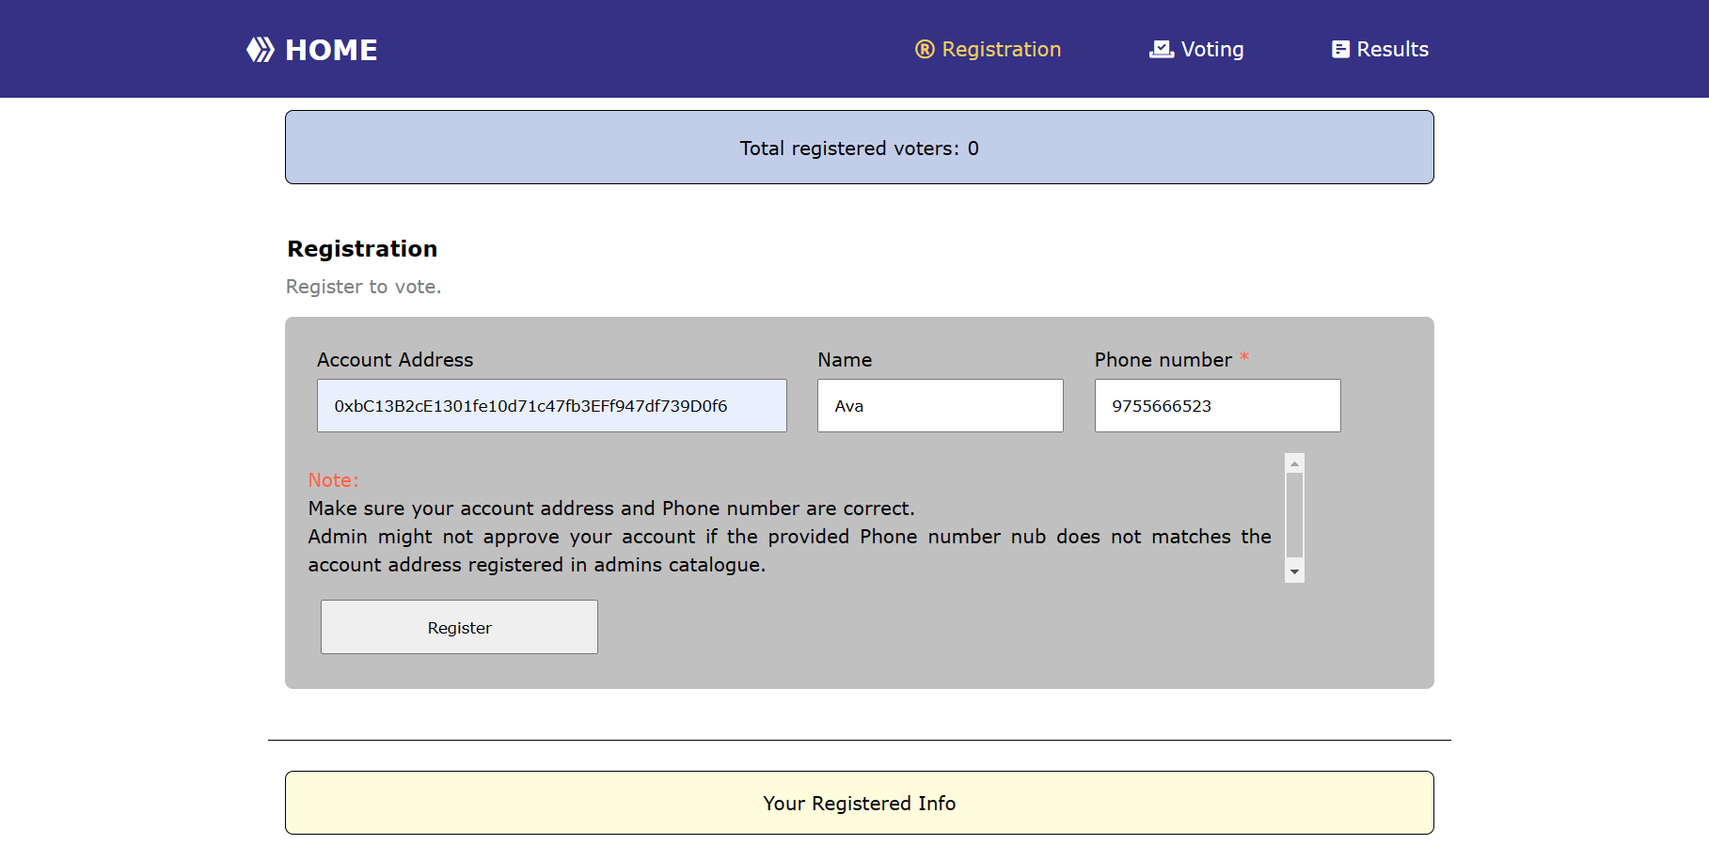
GUI DESIGN SCREENSHOTS
Voter Registration
Department of Computer Science & Engineering, DSCE

Slide 15
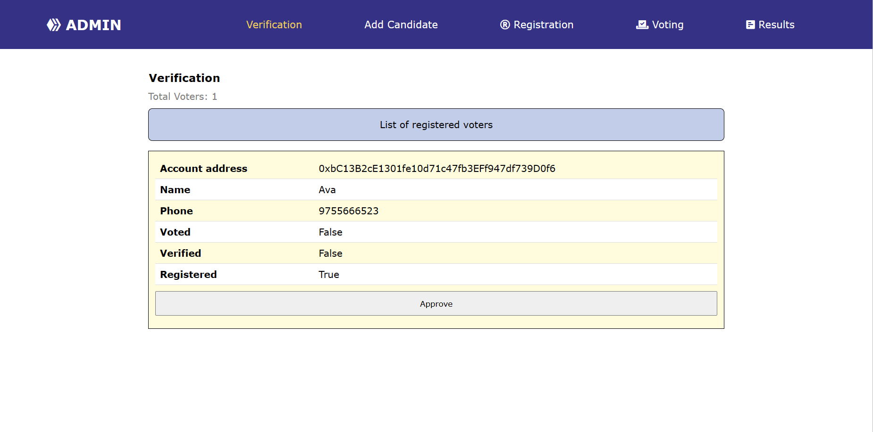
GUI DESIGN SCREENSHOTS
Voter Verification
Department of Computer Science & Engineering, DSCE

Slide 16
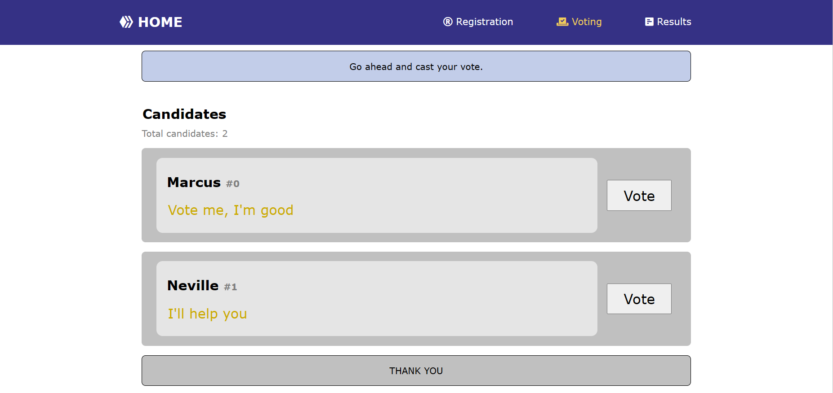
GUI DESIGN SCREENSHOTS
Voting
Department of Computer Science & Engineering, DSCE

Slide 17
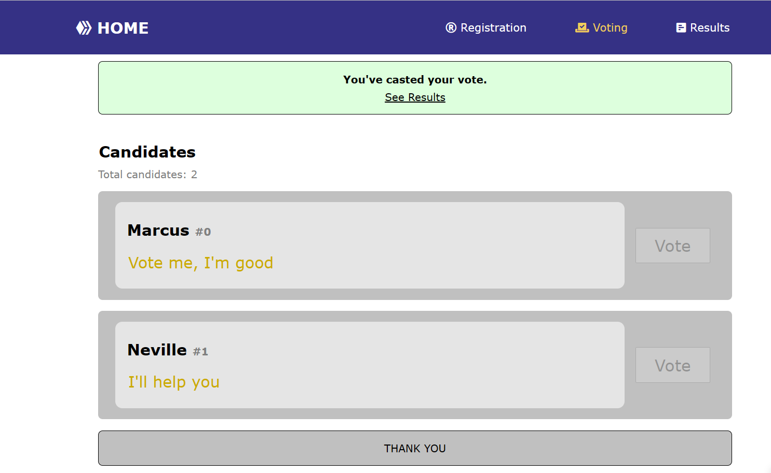
GUI DESIGN SCREENSHOTS
Suggested changes by Sparsh Kesari ( Co-guide)
Vote confirmation
Department of Computer Science & Engineering, DSCE

Slide 18
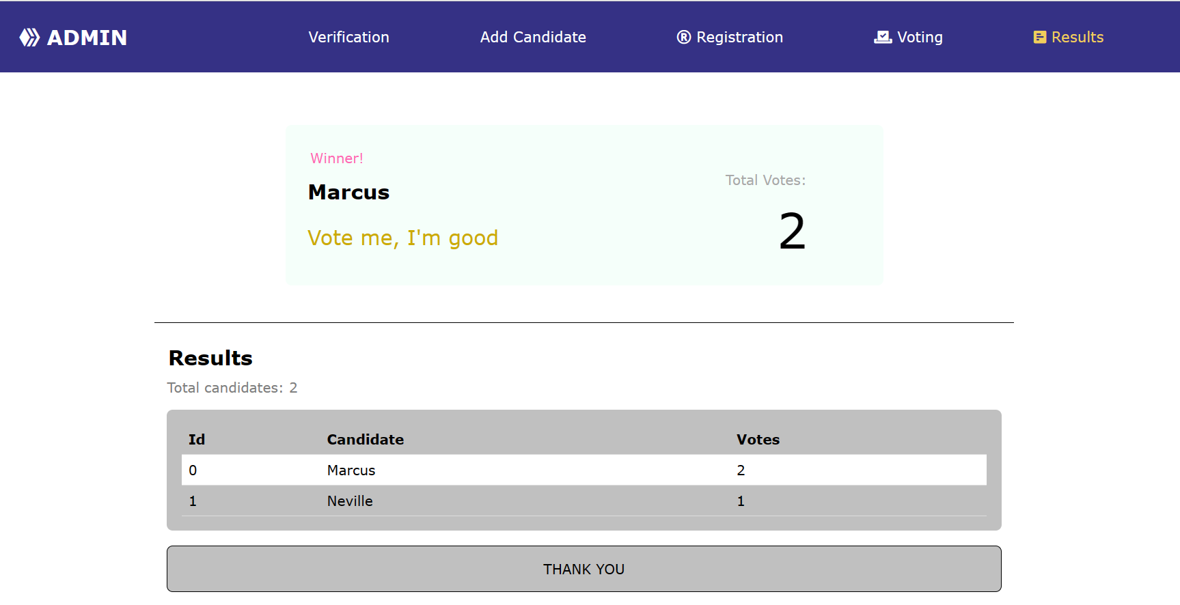
GUI DESIGN SCREENSHOTS
Election Results
Department of Computer Science & Engineering, DSCE

Slide 19
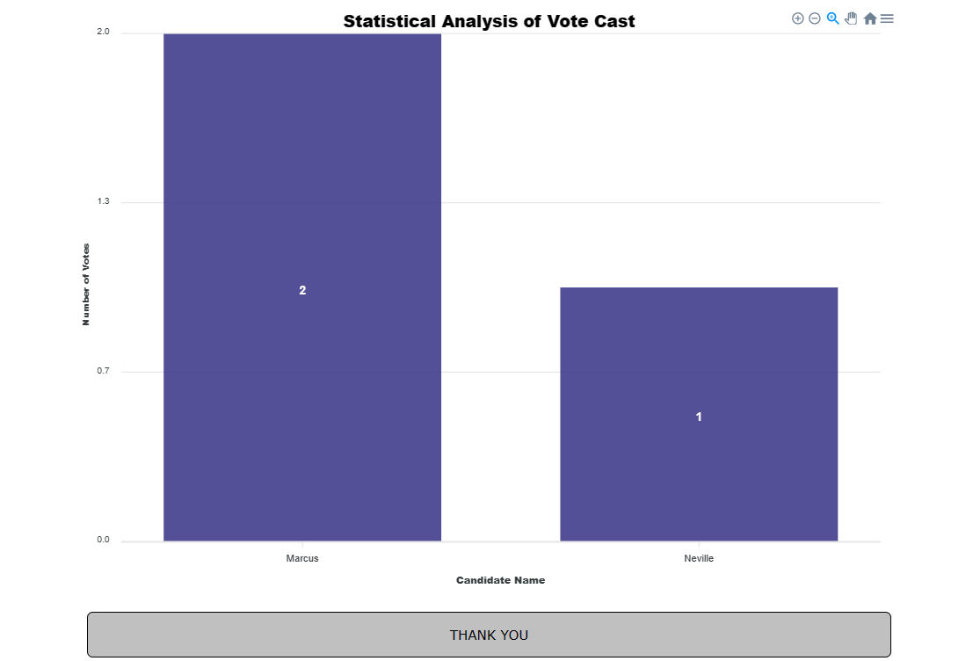
GUI DESIGN SCREENSHOTS
Analysis of Vote Cast
Department of Computer Science & Engineering, DSCE

Slide 20

PROJECT TOOL SNAPSHOT
Department of Computer Science & Engineering, DSCE

Slide 21
CONCLUSION
This framework demonstrates blockchain technology which provides a new way to overcome the limits and adoption of digital voting systems, ensuring election security and honesty, as well as laying the groundwork for openness. It is feasible to transmit hundreds of transactions per second into an Ethereum private blockchain, using every component of the smart contract to reduce the load on the blockchain. Additional steps would be required for larger nations to accommodate higher transaction volume per second.
Ethereum blockchain has been used as a part of the network along with Ganache. Without the aid of a central database, the prototype's ability to record each voting transaction on the network was demonstrated by the Ganache (local blockchain) network design. The voter can examine each voting transaction on the local blockchain to confirm the outcome of the election. This technology allows individuals to vote using smart devices from anywhere in the world. Together, these factors make it possible for businesses, organizations, or institutions to conduct voting procedures that meet high criteria for auditability and security.
Department of Computer Science & Engineering, DSCE

Slide 22
FUTURE WORK
OTP (One Time Password) generation is not implemented in our registration process which is a limitation which can be considered formerly in the on-going future work. Therefore, we target to use of sidechains in our proposed method as using duplicate currency, and sidechains expand the capabilities of blockchains by executing some activity outside them and returning the outcome to the mainchain for usage. So, we can store the encrypted vote in the sidechain and can use the decrypted result in the mainchain, which will reduce the cost.
The above framework can be scaled up to be able to handle election process on a large scale such as for a whole country so that we can obtain unbiased and faster result.
Using blockchain, even though security is a key advantage, gas consumption is a concerning issue. While fulfilling security properties like anonymity, privacy, integrity, there is a need to create a framework which will consume less gas and still produce efficient result.
This framework can be designed to include biometric encryption algorithm with improved False Rejection Rate as well as to design DRE-based voting solution without tallying authorities for more complex voting systems such as single transferable vote (STV) and Condorcet.
Department of Computer Science & Engineering, DSCE

Slide 23
REFERENCES
[1] Somnath Panja, Bimal Roy, “A secure end-to-end verifiable e-voting system using blockchainn and cloud server”, Journal of Information Security and Applications, Vol. 59, June 2021.
[2] Jen Ho Hsiao, Raylin Tso, Chien Ming Chen, Mu En Wu, “Decentralized E-Voting Systems Based on the Blockchain Technology”, Advances in Computer Science and Ubiquitous Computing, Vol. 474, pp. 305-309, Dec 2017.
[3] Kibin Lee, Joshua I James, Tekachew G Ejeta, Hyoung J Kim, “Electronic Voting Service Using Block-Chain”, The Journal Of Digital Forensics Security and Law, Vol. 11, Issue 2, Article 8, 2016.
[4] Ashish Singh, Kakali Chatterjee, “SecEVS: Secure Electronic Voting System Using Blockchain Technology”, 2018 International Conference on Computing, Power and Communication Technologies (GUCON), pp. 863-867, Sep 2017.
[5] Syada Tasmia Alvi, Mohammed Nasir Uddin, Linta Islam, “Digital Voting: A Blockchain-based E-Voting System using Biohash and Smart Contract”, 2020 Third International Conference on Smart Systems and Inventive Technology, pp. 228-233, 2020.
[6] Harsha V Patil, Kanchan G Rathi, Malathi Tribhuwan, “A Study on Decentralized E-Voting System Using Blockchain Technology”, International Research Journal of Engineering and Technology (IRJET), Vol. 5, Issue 11, pp.48-53, Nov 2018.
[7] Haibo Yi, “Securing e-voting based on blockchain in P2P network”, EURASIP Journal on Wireless Communications and Networking, Article 137, 2019.
Department of Computer Science & Engineering, DSCE

Slide 24
REFERENCES
[8] Md Razu Ahmed, F M Javed Mehedi Shamrat, Md Asraf Ali, Md Rajib Mia, Mst Arifa Khatun,”The Future Of Electronic Voting System Using Blockchain”, International Journal Of Scientific & Technology Research, Vol. 9, Issue 2, Feb 2020.
[9] Basit Shahzad, Jon Crowcroft, “Trustworthy Electronic Voting Using Adjusted Blockchain Technology”, IEEE Access, Vol. 7, pp. 24477-24488, Feb 2019.
[10] Abhishek Kaudare, Milan Hazra, Anurag Shelar, Manoj Sabnis, “Implementing Electronic Voting System With Blockchain Technology”, 2020 International Conference for Emerging Technology, pp. 1-9, 2020.
[11] Ketulkumar Govindbhai Chaudhari, “E-Voting System Using Proof of Voting (POV) Consensus Algorithm Using Block Chain Technology”, International Journal of Advanced Research in Electrical, Electronics and Instrumentation Engineering, Vol. 7, Issue 11, pp. 4051-4055, 2018.
[12] Camilo Denis Gonzalez, Daniel Frias Mena, Alexi Masso Munoz, Omar Rojas, Guillermo Sosa Gomez, “Electronic Voting System Using an Enterprise Blockchain”, Institute of Cryptography, University of Havana, Havana 10400, Cuba, Vol. 12, Issue 2, pp. 531, Jan 2022.
[13] Xuechao Yang, Xun Yi, Surya Nepal, Fengling Han, “Decentralized Voting: A Self-tallying Voting System Using a Smart Contract on the Ethereum Blockchain”, International Conference on Web Information Systems Engineering, Vol. 11233, pp. 18-35, Oct 2018.
[14] Kriti Patidar, Dr Swapnil Jain, “Decentralized E-Voting Portal Using Blockchain”, 2019 10th International Conference on Computing, Communication and Networking Technologies, pp. 1-4, 2019.
Department of Computer Science & Engineering, DSCE

Slide 25
REFERENCES
[15] Yousif Abuidris, Rajesh Kumar, Ting Yang, Joseph Onginjo, “Secure large-scale E-voting system based on blockchain contract using a hybrid consensus model combined with sharding”, Electronics and Telecommunications Research Institute (ETRI) Journal, Vol. 0(0), pp. 1-14, Nov 2020.
[16] Ahmed Ben Ayed, “A Conceptual Secure Blockchain-Based Electronic Voting System”, International Journal of Network Security & Its Application (IJNSA), Vol.9, No.3, May 2017.
[17] Kanika Garg, Pavi Saraswat, Sachin Bisht, Sahil Kr Aggarwal, Sai Krishna Kothuri, Sahil Gupta, “A Comparitive Analysis on E-Voting System Using Blockchain”, 2019 4th International Conference on Internet of Things: Smart Innovation and Usages (IoT-SIU), pp. 1-4, April 2019.
[18] Mustofa Kamil, Po Abas Sunarya, Untung Rahardja, Nuke Puji Lestari Santoso, Muhammad Iqbal, “Covid-19: Implementation e-voting Blockchain Concept”, International Journal of Artificial Intelligence Research, Vol. 5, No. 1, pp. 25-34, June 2021.
[19] Michal Pawlak, Aneta Pniszewska Maranda, “Implementation of Auditable Blockchain Voting System with Hyperledger Fabric”, International Conference on Computational Science, Vol. 12742, pp. 642-655, June 2021.
[20] Ruhi Tas, Omer Ozgur Tanriover, “A Systematic Review of Challenges and Oppurtunities of Blockchain for E-Voting”, Symmetry, Vol. 12, Issue 8, pp. 1328, July 2020.
[21] F P Hjalmarsson, G K Hreiosarsson, M Hamdaqa, G Hjalmtysson, “Blockchain-Based E-Voting System”, 2018 IEEE 11th International Conference on Cloud Computing (CLOUD), pp. 983-986, July 2018.
Department of Computer Science & Engineering, DSCE

Slide 26
THANK YOU!
Department of Computer Science & Engineering, DSCE

