Slide 1

cv
SECURED DIGITAL VOTING SYSTEM USING BLOCKCHAIN TECHNOLOGY
Team Members
1. Bhagya A Koushik- 1DS19CS037
2. Deekshitha R S- 1DS19CS044
3. Gowthami S- 1DS19CS053
4. Haritha Nandhini- 1DS19CS055
Under the Guidance of
Name of the Guide: Dr. Nagaraja J
Associate Professor
Department of Computer Science and Engineering
Base paper Title
A blockchain-based decentralized mechanism to ensure the security of digital voting system
Department of Computer Science & Engineering, DSCE

Slide 2
cv
Applications of Blockchain
Bitcoin
Banking
Payment and Transfers
Healthcare
Law Enforcement
Voting
IoT(Internet of Things)
Department of Computer Science & Engineering, DSCE

Slide 3
cv
Challenges in applications
Conventional Banking – Slow digital transformation
Payment and transfers - Susceptibility to fraud
Healthcare – Accessibility and maintenance of patient records
Law Enforcement – Duplication of effort
Voting – Breach and manipulation of data
IoT – Lack of encryption
Department of Computer Science & Engineering, DSCE

Slide 4
cv
Motivation in choosing “Digital Voting”
DDoS attacks.
Polling booth capturing.
Malware attacks.
Long Queues during elections.
Security Breaches like data leaks, vote tampering.
Lot of paperwork involved, hence less eco-friendly and time-consuming.
Difficult for differently-abled voters to reach polling booth.
Cost of expenditure on elections is high.
Requires huge amount of human resources.
Department of Computer Science & Engineering, DSCE

Slide 5
cv
Problem Formulation
The voting method is the mechanism for implementing the people's view to better administer the system.
In recent years, conventional voting systems have pleased neither people nor government authorities. Also, manually counting of votes is a tedious process and may lead to electoral fraud which is a major problem worldwide.
To solve these problems, digital voting is used in the voting phase in many nations.
Voting using blockchain will be secure, reliable, anonymous and will help increase the number of voters as well as the trust of people in their governments.
OTP generation option will be included during registration process. The data stored during vote casting will be able to access after the end of election.
Department of Computer Science & Engineering, DSCE

Slide 6
cv
Proposed Objectives
Using the three contracts, the voter’s registration process, voter authentication, and voting are done directly between the voter and the blockchain.
At first, the hash value of the voter’s information is stored by the voter contract during the registration process to secure the voter information and provide anonymity to the voter. These hash values are also used to authenticate voters during vote casting.
The candidate contract contains information for the candidates in the chain. After the election starts, voters perform the voter authentication process and then choose one of the candidates from the list of candidates provided by the candidate contract.
Department of Computer Science & Engineering, DSCE

Slide 7
cv
Proposed Objectives
The voter cast his vote using a vote coin. Here, the vote coin represents the voting status of the voter.
If the balance of the vote coin is 1, the voter doesn’t cast his vote. If the balance of the vote coin is 0, that means the voter has already casted their vote.
The casted vote is encrypted using a public key which Election Commission generates in a crypto server. The encrypted ballot is sent to the voting contract and added as a block in the chain.
Department of Computer Science & Engineering, DSCE

Slide 8
cv
Methodology
The proposed voting mechanism includes four phases:
First Phase: Registration Phase
Second Phase: Voting Setup Phase
Third Phase: Voting Phase
Fourth Phase: Result Phase
Department of Computer Science & Engineering, DSCE

Slide 9
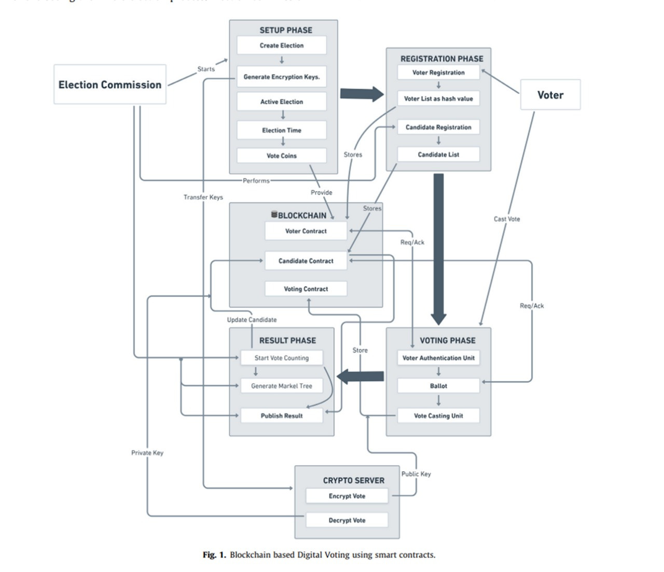
cv
Department of Computer Science & Engineering, DSCE

Slide 10
cv
First phase
The First phase of voting system consists of
Registration unit which has two parts:
(i) Voters registration
(ii) Candidate Registration
Department of Computer Science & Engineering, DSCE

Slide 11
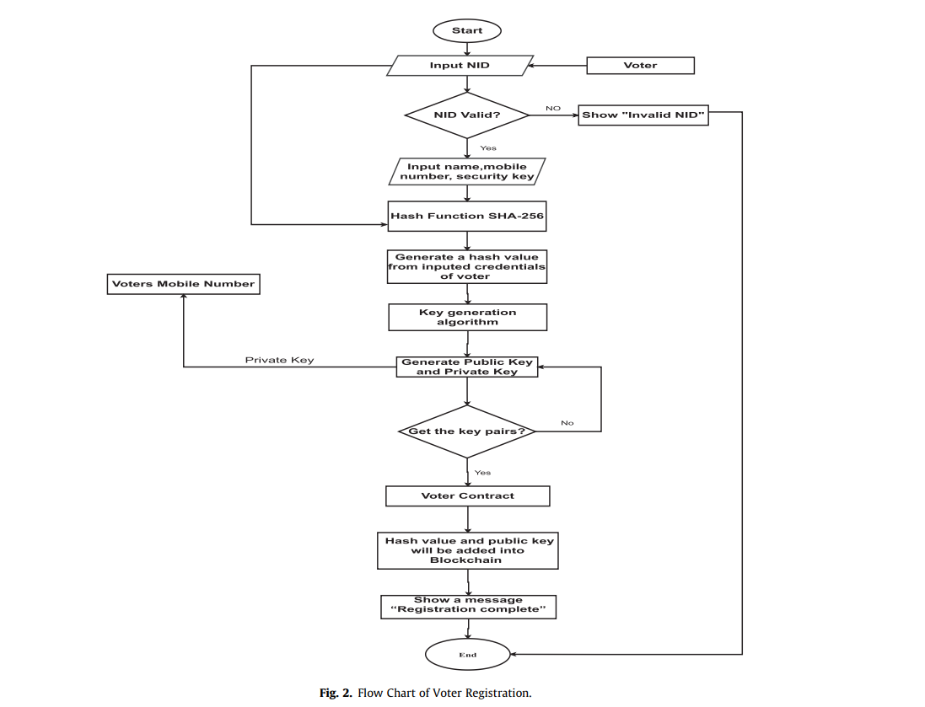
cv
Department of Computer Science & Engineering, DSCE

Slide 12
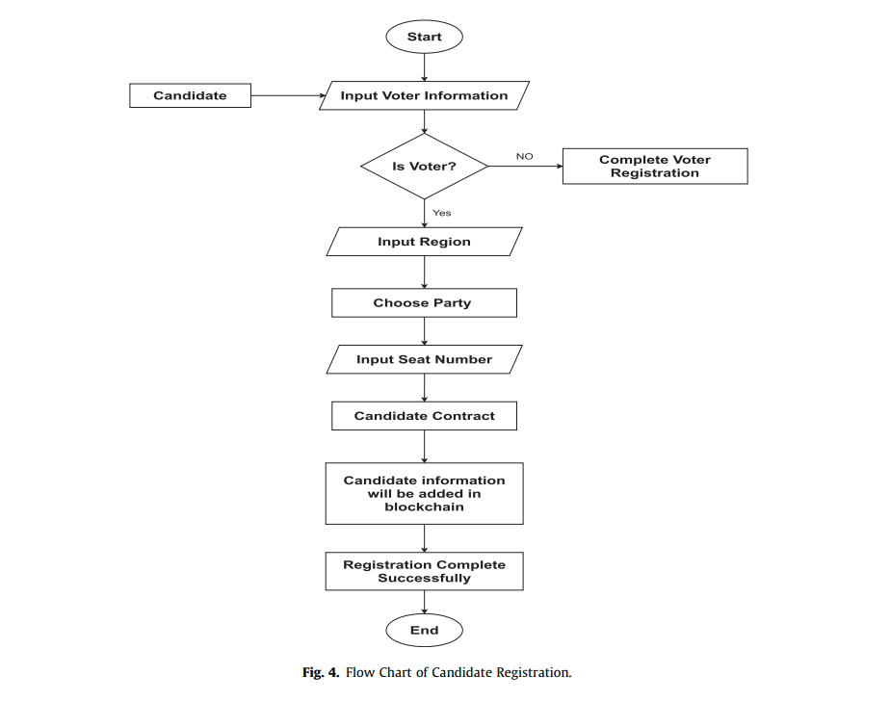
cv
Department of Computer Science & Engineering, DSCE

Slide 13
cv
Second phase
Voting Setup Phase
This phase is divided into two parts:
Create Election
Active Election
Department of Computer Science & Engineering, DSCE

Slide 14
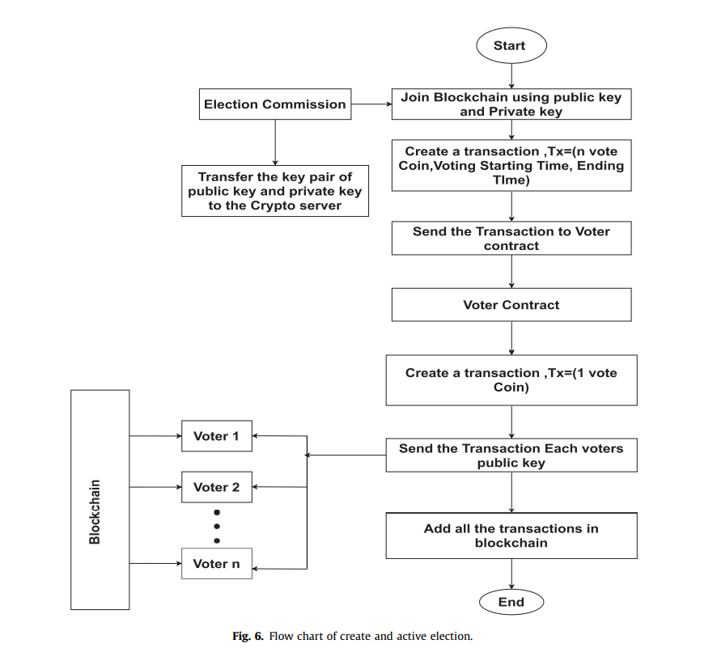
cv
Department of Computer Science & Engineering, DSCE

Slide 15
cv
Third phase
Voting Phase
This phase is divided into two parts:
Voter Authentication
Vote Casting
Department of Computer Science & Engineering, DSCE

Slide 16
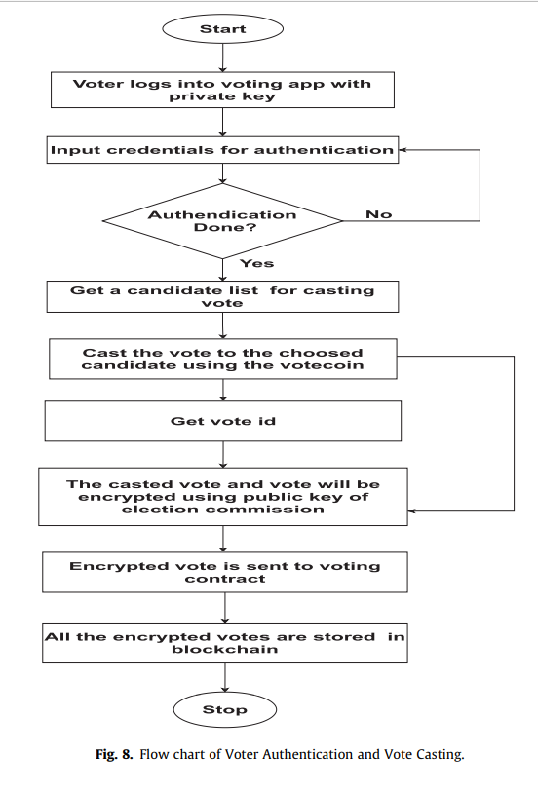
cv
Department of Computer Science & Engineering, DSCE

Slide 17
cv
Fourth phase
Result Phase
This phase consists of:
(i) Vote Counting Unit
(ii) Publish Result
Department of Computer Science & Engineering, DSCE

Slide 18
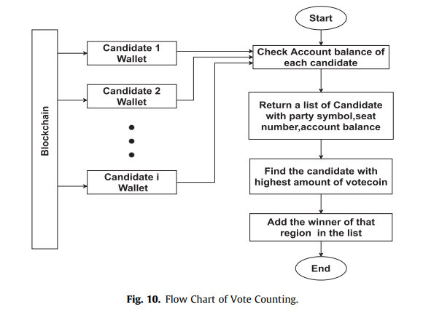
cv
Department of Computer Science & Engineering, DSCE

Slide 19
cv
Individual Contribution
Bhagya A Koushik
Worked on 5 papers
Abstract
Introduction
Deekshitha R S
Worked on 5 papers
Introduction
Conclusion
Gowthami S
Worked on 5 papers
Tabular column
IEEE format for references
Haritha Nandhini
Worked on 5 papers
Tabular column
IEEE format for references
Department of Computer Science & Engineering, DSCE

Slide 20
cv
LITERATURE SURVEY
Department of Computer Science & Engineering, DSCE

Slide 21
cv
PAPER NAME | AUTHOR | ALGORITHM MODEL USED | ADVANTAGES | DISADVANTAGES
A Conceptual Secure Blockchain-Based Electronic Voting System | Ahmed Ben Ayed | SHA-256 algorithm | Provides ability to vote using any device and blockchain and is verified in such a way that it is immutable. | Liable to DDOS attack and make elections not accessable to voter. User can cast vote only once.
A Comparitive Analysis on E-Voting System Using Blockchain | Kanika Garg, Pavi Saraswat, Sachin Bisht, Sahil Kr. Aggarwal, Sai Krishna Kothuri, Sahil Gupta | Cryptography model | Different approaches to tackle the anonymity, security, availablity, fairness verfiablility is discussed. | Does not cover authentication like biometric or unique ID.
Covid-19 Implementation e-voting Blockchain Concept | Mustofa Kamil, Po Abas Sunarya, Untung Rahardja, Nuke Puji Lestari Santoso, Muhammad Iqbal | Cryptography model | Reduce the meeting of humans in election activities during pandemic. Cryptographic protocol makes the results of votes transparent and safe. | Voting is not done effortlessly other than in public network as each transaction of vote takes 15 to 20 seconds.
Implementation of Auditable Blockchain Voting System with Hyperledger Fabric | Michal Pawlak, Aneta Poniszewska Maranda | Consensus algorithm | Hyperledger fabric focuses on providing high customizability, security and modularity. | Verifying the portability of ABVS model is not implemented.
A Systematic Review of Challenges and Oppurtunities of Blockchain for E-Voting | Ruhi Tas, Omer Ozgur Tanriover | Consensus algorithm, Proof-of-Work and Proof-of-Stake model, Governance model | Contributions made for the issues like integrity, privacy and consensus. | Usage of untrusted system, scalability attack, low transparency is not discussed.
Blockchain-Based E-Voting System | Fridrik Hjalmarsson, Gunnlaugur Hreidarsson, Mohammad Hamdaqa, Gisli Hjalmtysson | Byzantine algorithm, Proof-of-Authority model | Smart contract is utilized to enable reliability and cost-effective election as well guarantees voters privacy | Additional procedures has to be taken care of while conducting voting at large number transactions per second.
Department of Computer Science & Engineering, DSCE

Slide 22
cv
PAPER NAME | AUTHOR | ALGORITHM MODEL USED | ADVA25NTAGES | DISADVANTAGES
A Secure end-to-end verifiable e-voting system using blockchain and cloud server | Somnath Panja, Bimal Roy | DRE-ip tally verification algorithm, Fuzzy Vault algorithm. | This protocol has the potential for real-world deployment and provides secure voter registration and authentication. | There is no proposal to reduce the False Rejection Rate of the Fussy Vault algorithm for fingerprint.
Decentralized E-Voting Systems Based on the Blockchain Technology | Jen Ho Hsiao, Raylin Tso, Chien Ming Chen, Mu En Wu | Paillier’s homomorphic encryption algorithm | Transparency of smart contract that allow voters to record and verify ballots. | Voter qualification, protecting the anonymity of voter’s identity, non-repeatable, ballot eligibility and ballot verifiability is not discussed.
Electronic Voting Service Using Block-Chain | Kibin Lee, Joshua I James, Tekachew G Ejeta, Hyoung J Kim | SHA-256 algorithm, RIPEMD160 algorithm | Consensus attack will not be able to steal coins, consume coins or change ownership records and past transactions. | Susceptible to denial-of-service disruptions that can affect the creation of future blocks as bitcoin network has large amount of hash power.
SecEVS: Secure Electronic Voting System Using Blockchain Technology | Ashish Singh, Kakali Chatterjee | SHA-256 algorithm | Voter can be registered only once and employs decentralization. | Difficult to implement on large scale.
Digital Voting: A Blockchain-based E-Voting System using Biohash and Smart Contract | Syada Tasmia Alvi, Mohammed Nasir Uddin, Linta Islam | Hash generation algorithm from fingerprint | Smart contract is used which provides transparency and mobility. The voters information hash is stored in the chain will provide scalability. | Vote counting is not done in real time. There is no encryption technique to boost system’s security.
A Study on Decentralized E-Voting System Using Blockchain Technology | Harsha V Patil, Kanchan G Rathi, Malathi Tribhuwan | SHA-256 algorithm | Allows the voters with an option to cast a protest vote in case they are not satisfied with the current elections or candidature. | More energy is required to validate and process the votes, there will be a shift from the central election commission and building the trust factor is also a challenge.
Department of Computer Science & Engineering, DSCE

Slide 23
cv
PAPER NAME | AUTHOR | ALGORITHM MODEL USED | ADVANTAGES | DISADVANTAGES
Electronic Voting System Using an Enterprise Blockchain | Camilo Denis Gonzalez, Daniel Frias Mena, Alexi Masso Munoz, Omar Rojas, Guillermo Sosa Gomez | Consensus, Cryptographic, Hyperledger Fabric’s nodes | Ensures high reliability by applying enterprise blockchain technology. Secures the secret ballot. Flexible network configuration is presented. Security and reliability issues are handled. | It cannot guarantee that the device from which a vote is cast is free of malicious software. DREs can be frequently attacked by cybersecurity experts.
Decentralized Voting: A Self-tallying Voting System Using a Smart Contract on the Ethereum Blockchain | Xuechao Yang, Xun Yi, Surya Nepal, Fengling Han | Consensus, ElGamal Cryptosystem- Encryption, Decryption, Homomorphism, Distributed Encryption | No hardwired restrictions on possible vote assignments to candidates, protects voter confidentiality by using a homomorphic encryption system and stores proofs for each element of a vote. | The system may suffer abortive issue and assumes that all registered voters submit their valid votes since otherwise, any voter can abort the tally without submitting his/her vote.
Securing e-voting based on blockchain in P2P network | Haibo Yi | Elliptic Curve Cryptography(ECC) model | Users are given option to change their vote before the deadline specified by the model. | ECC model is susceptible to quantum computer attacks.
The Future Of Electronic Voting System Using Blockchain | Md Razu Ahmed, F M Javed Mehedi Shamrat, Md Asraf Ali, Md Rajib Mia, Mst Arifa Khatun | SHA-256 algorithm | Multiple users problem who cast their vote at the same time which will be linked to previous hash using Longest Chain Rule is overcome. | The voting machine is vulnerable to malicious attackers who install malicious software into the device.
Trustworthy Electronic Voting Using Adjusted Blockchain Technology | Basit Shahzad, Jon Crowcroft | MD5 algorithm | Allows the voters to cast multiple votes every-time they vote previous vote is cancelled. | Assumption that all voters are well aware of their rights and strong internet connectivity owned by all.
Implementing Electronic Voting System With Blockchain Technology | Abhishek Kaudare, Milan Hazra, Anurag Shelar, Manoj Sabnis | Consensus algorithm and Proof-Of-Work model | Hyperledger is more efficient taking the performance metrics into consideration. The permissioned blockchain allows the maintenance of privacy of voter by not revealing his credentials. | High duration required to calculate votes, manpower, wastage of paper, ease in manipulation.
Department of Computer Science & Engineering, DSCE

Slide 24
cv
Gas Consumption Comparison
Department of Computer Science & Engineering, DSCE

Slide 25
cv
Security Properties Comparison
Department of Computer Science & Engineering, DSCE

Slide 26
cv
Conclusion
This paper demonstrates the secured blockchain based digital voting system. The framework shows that blockchain overcomes the disadvantages of the present voting model. Ethereum blockchain has been used as a part of the network along with Ganache which acts as the database to store the voters’ accounts, information about the candidates and the votes that has been casted. In this way, blockchain allows us to create a transparent and secured voting model for digital elections.
Department of Computer Science & Engineering, DSCE

Slide 27
cv
References
[1] Somnath Panja, Bimal Roy, “A secure end-to-end verifiable e-voting system using blockchainn and cloud server”, Journal of Information Security and Applications, Vol. 59, June 2021.
[2] Jen Ho Hsiao, Raylin Tso, Chien Ming Chen, Mu En Wu, “Decentralized E-Voting Systems Based on the Blockchain Technology”, Advances in Computer Science and Ubiquitous Computing, Vol. 474, pp. 305-309, Dec 2017.
[3] Kibin Lee, Joshua I James, Tekachew G Ejeta, Hyoung J Kim, “Electronic Voting Service Using Block-Chain”, The Journal Of Digital Forensics Security and Law, Vol. 11, Issue 2, Article 8, 2016.
[4] Ashish Singh, Kakali Chatterjee, “SecEVS: Secure Electronic Voting System Using Blockchain Technology”, 2018 International Conference on Computing, Power and Communication Technologies (GUCON), pp. 863-867, Sep 2017.
[5] Syada Tasmia Alvi, Mohammed Nasir Uddin, Linta Islam, “Digital Voting: A Blockchain-based E-Voting System using Biohash and Smart Contract”, 2020 Third International Conference on Smart Systems and Inventive Technology, pp. 228-233, 2020.
[6] Harsha V Patil, Kanchan G Rathi, Malathi Tribhuwan, “A Study on Decentralized E-Voting System Using Blockchain Technology”, International Research Journal of Engineering and Technology (IRJET), Vol. 5, Issue 11, pp.48-53, Nov 2018.
[7] Haibo Yi, “Securing e-voting based on blockchain in P2P network”, EURASIP Journal on Wireless Communications and Networking, Article 137, 2019.
Department of Computer Science & Engineering, DSCE

Slide 28
cv
References
[8] Md Razu Ahmed, F M Javed Mehedi Shamrat, Md Asraf Ali, Md Rajib Mia, Mst Arifa Khatun,”The Future Of Electronic Voting System Using Blockchain”, International Journal Of Scientific & Technology Research, Vol. 9, Issue 2, Feb 2020.
[9] Basit Shahzad, Jon Crowcroft, “Trustworthy Electronic Voting Using Adjusted Blockchain Technology”, IEEE Access, Vol. 7, pp. 24477-24488, Feb 2019.
[10] Abhishek Kaudare, Milan Hazra, Anurag Shelar, Manoj Sabnis, “Implementing Electronic Voting System With Blockchain Technology”, 2020 International Conference for Emerging Technology, pp. 1-9, 2020.
[11] Ketulkumar Govindbhai Chaudhari, “E-Voting System Using Proof of Voting (POV) Consensus Algorithm Using Block Chain Technology”, International Journal of Advanced Research in Electrical, Electronics and Instrumentation Engineering, Vol. 7, Issue 11, pp. 4051-4055, 2018.
[12] Camilo Denis Gonzalez, Daniel Frias Mena, Alexi Masso Munoz, Omar Rojas, Guillermo Sosa Gomez, “Electronic Voting System Using an Enterprise Blockchain”, Institute of Cryptography, University of Havana, Havana 10400, Cuba, Vol. 12, Issue 2, pp. 531, Jan 2022.
[13] Xuechao Yang, Xun Yi, Surya Nepal, Fengling Han, “Decentralized Voting: A Self-tallying Voting System Using a Smart Contract on the Ethereum Blockchain”, International Conference on Web Information Systems Engineering, Vol. 11233, pp. 18-35, Oct 2018.
[14] Kriti Patidar, Dr Swapnil Jain, “Decentralized E-Voting Portal Using Blockchain”, 2019 10th International Conference on Computing, Communication and Networking Technologies, pp. 1-4, 2019.
Department of Computer Science & Engineering, DSCE

Slide 29
cv
References
[15] Yousif Abuidris, Rajesh Kumar, Ting Yang, Joseph Onginjo, “Secure large-scale E-voting system based on blockchain contract using a hybrid consensus model combined with sharding”, Electronics and Telecommunications Research Institute (ETRI) Journal, Vol. 0(0), pp. 1-14, Nov 2020.
[16] Ahmed Ben Ayed, “A Conceptual Secure Blockchain-Based Electronic Voting System”, International Journal of Network Security & Its Application (IJNSA), Vol.9, No.3, May 2017.
[17] Kanika Garg, Pavi Saraswat, Sachin Bisht, Sahil Kr Aggarwal, Sai Krishna Kothuri, Sahil Gupta, “A Comparitive Analysis on E-Voting System Using Blockchain”, 2019 4th International Conference on Internet of Things: Smart Innovation and Usages (IoT-SIU), pp. 1-4, April 2019.
[18] Mustofa Kamil, Po Abas Sunarya, Untung Rahardja, Nuke Puji Lestari Santoso, Muhammad Iqbal, “Covid-19: Implementation e-voting Blockchain Concept”, International Journal of Artificial Intelligence Research, Vol. 5, No. 1, pp. 25-34, June 2021.
[19] Michal Pawlak, Aneta Pniszewska Maranda, “Implementation of Auditable Blockchain Voting System with Hyperledger Fabric”, International Conference on Computational Science, Vol. 12742, pp. 642-655, June 2021.
[20] Ruhi Tas, Omer Ozgur Tanriover, “A Systematic Review of Challenges and Oppurtunities of Blockchain for E-Voting”, Symmetry, Vol. 12, Issue 8, pp. 1328, July 2020.
[21] F P Hjalmarsson, G K Hreiosarsson, M Hamdaqa, G Hjalmtysson, “Blockchain-Based E-Voting System”, 2018 IEEE 11th International Conference on Cloud Computing (CLOUD), pp. 983-986, July 2018.
Department of Computer Science & Engineering, DSCE

