Slide 1
Customer Analytics
By H Nanji

Slide 2
The Project
I have utilised customer data downloaded from Kaggle to show case my ability in analysing data, find patterns within the data, deriving insights and making recommendations to drive business. This project uses customer behaviour data to analyse the data to gain insights on how different customers react to different marketing strategies. It specifically aims to understand customer behaviour in terms of their response and engagement in marketing strategies. The insights derived would be utilised to inform marketing strategies. The project is structured as follows:
Exploratory Data Analysis – Finding patterns in the data set
Suggested Recommendations

Slide 3
Exploratory Data Analysis
Exploratory data analysis explores the following:
Overall engagement rate
Engagement rate by offer types
Engagement rate by offer types and vehicle size
Engagement rate by sales channels
Engagement rate by sales channels and vehicle size

Slide 4
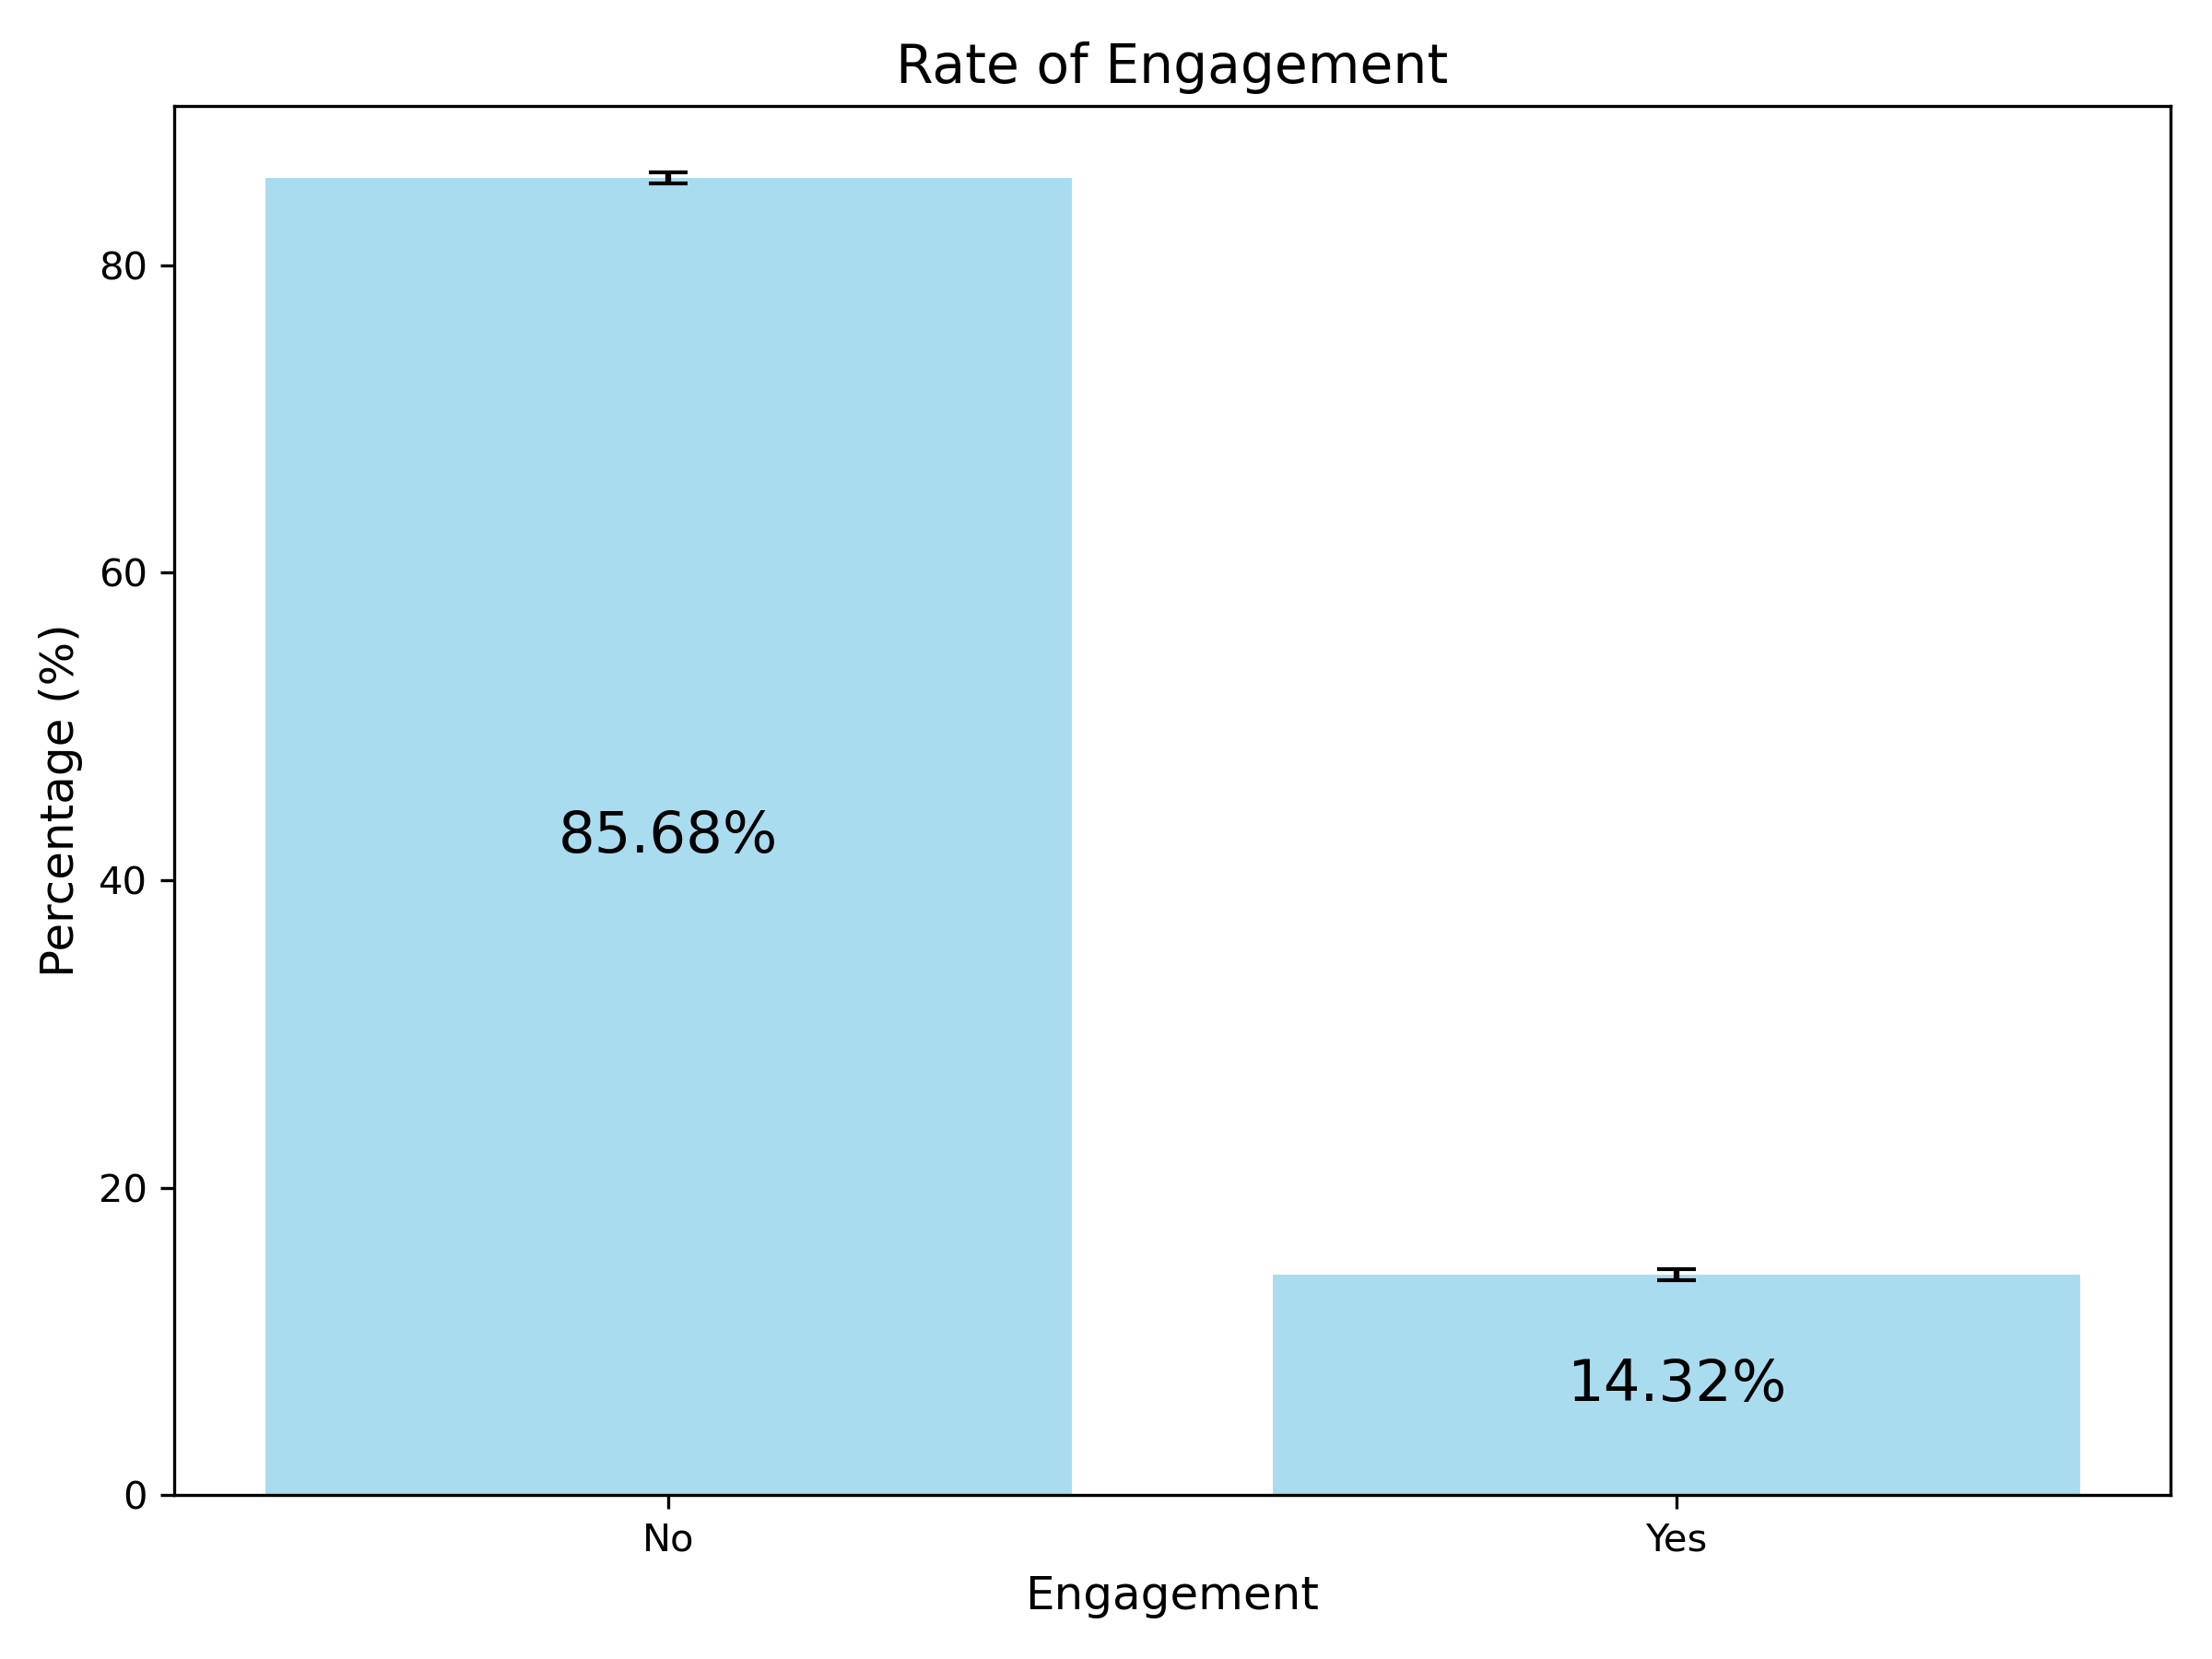
Overall Engagement Rate
: Whether the individual has chronic medical conditions. Possible values are Yes and No.
14% of customers responded to the marketing calls.
86% of customers did not respond to the marketing calls.
20-24 years is 12%.
Majority of customers (86%) did not respond to marketing calls

Slide 5
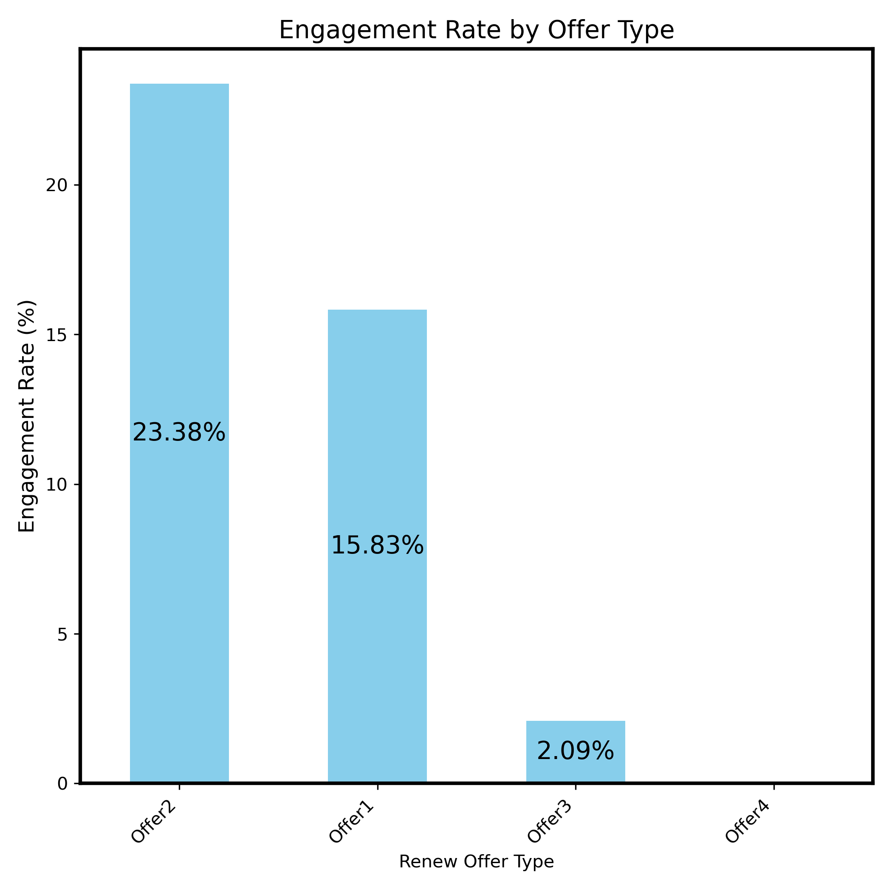
Customer behaviour – Overall Engagement Rate by Offer Type
Engagement rate for customers with offer 2 is 23%
Engagement rate for customers with offer 1 is 16%
Engagement rate for customers with offer 3 is 2%
20-24 years is 12%.
Offer2 had the highest engagement rate among the customers.

Slide 6
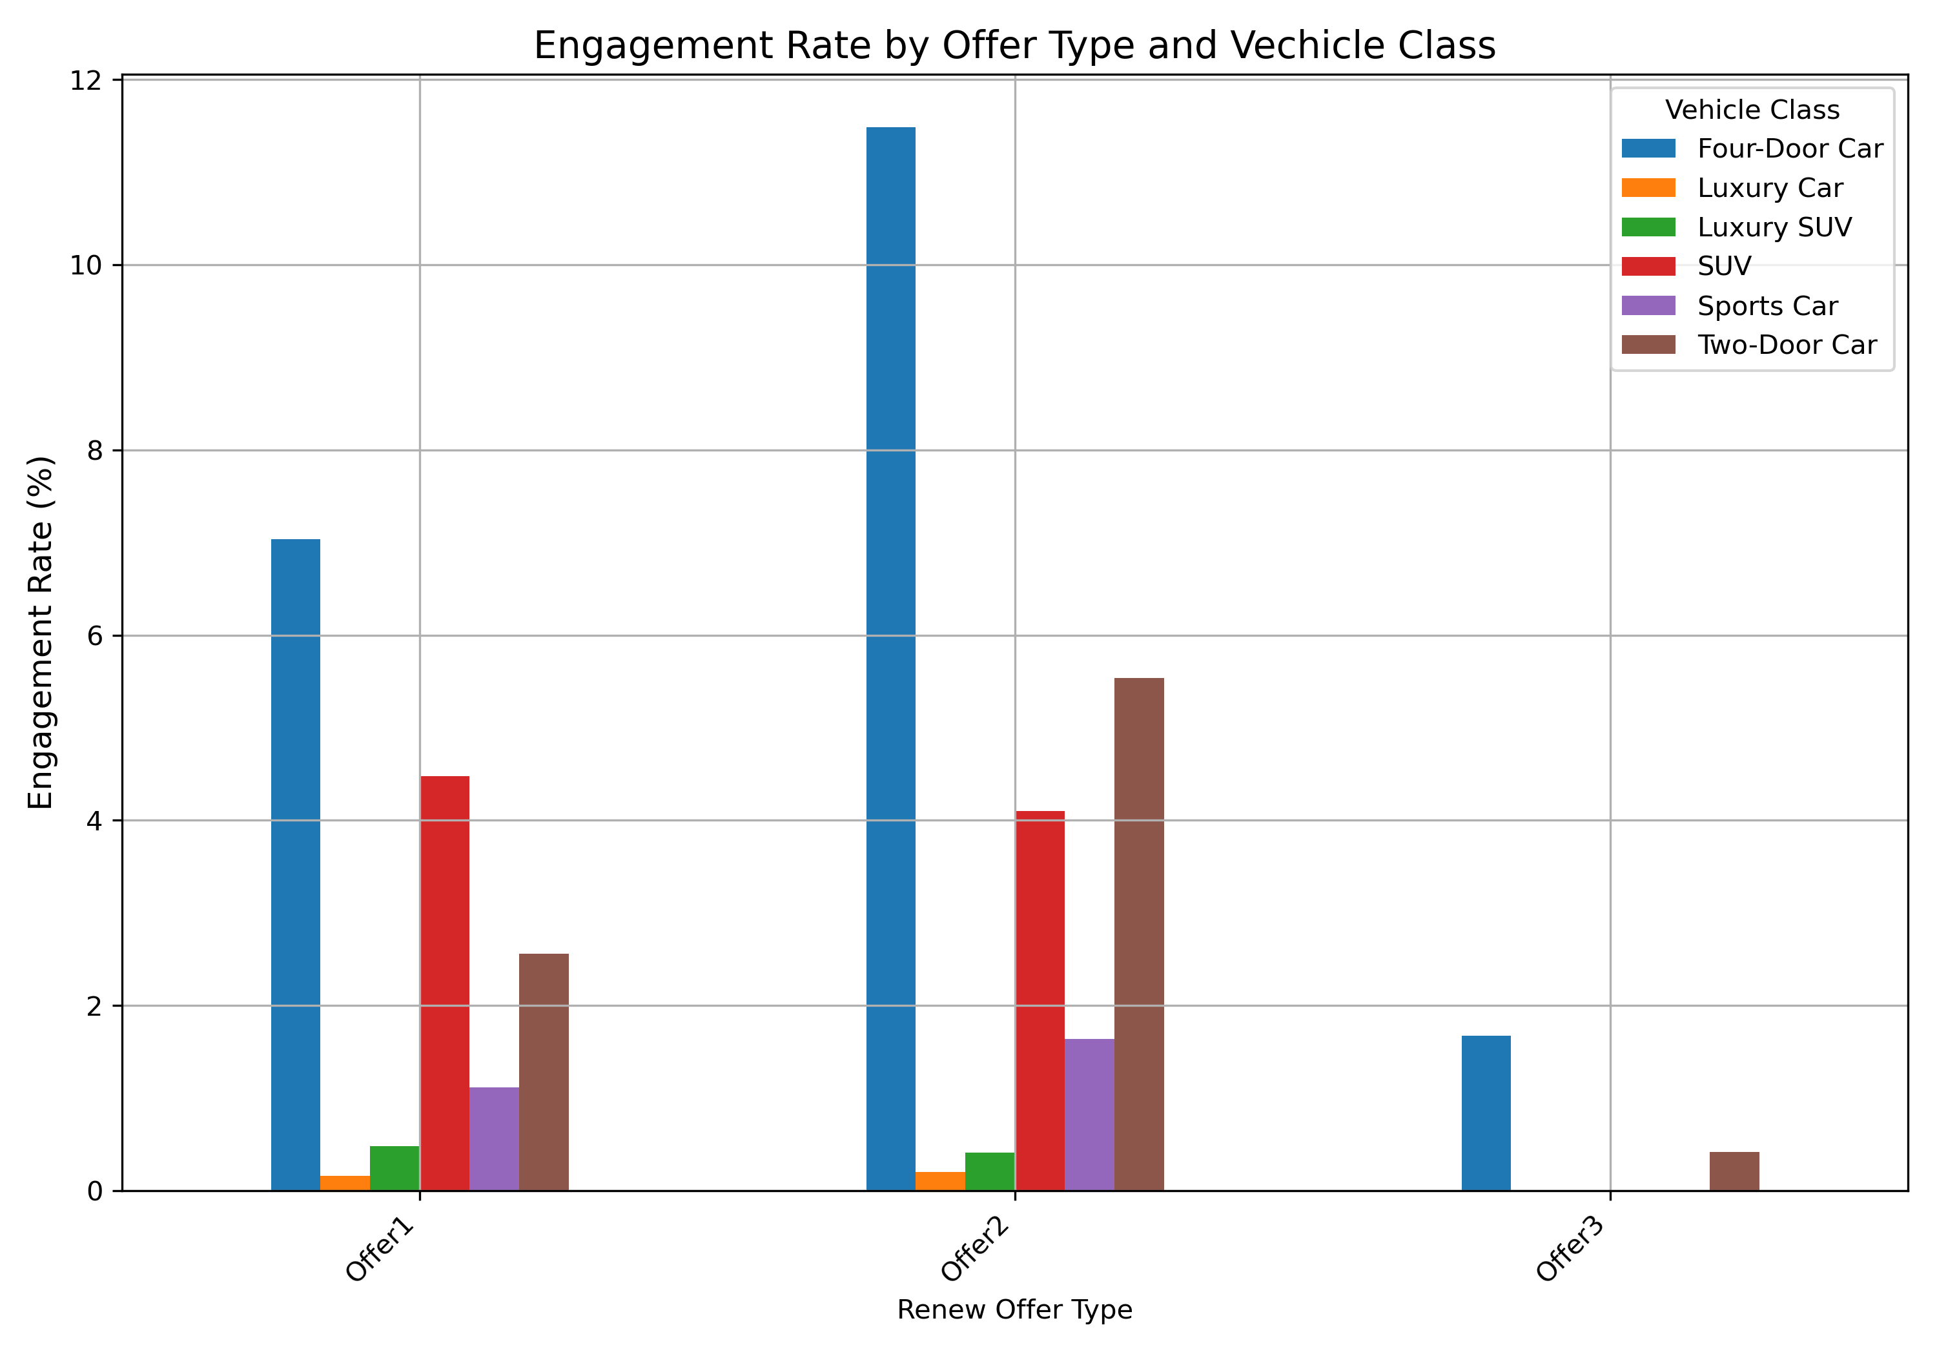
Customer behaviour – Engagement Rates by offer and vehicle type
Customers with different vehicle classes engage differently with other types of renewal offers.
Customers with Four-Door Car respond the most frequently for all offer types. Customers with SUV respond with a higher chance to Offer1 than to Offer2.
Customers with Two-Door Car responded to Offer2 with a higher degree of engagement than to other offer types.

Slide 7
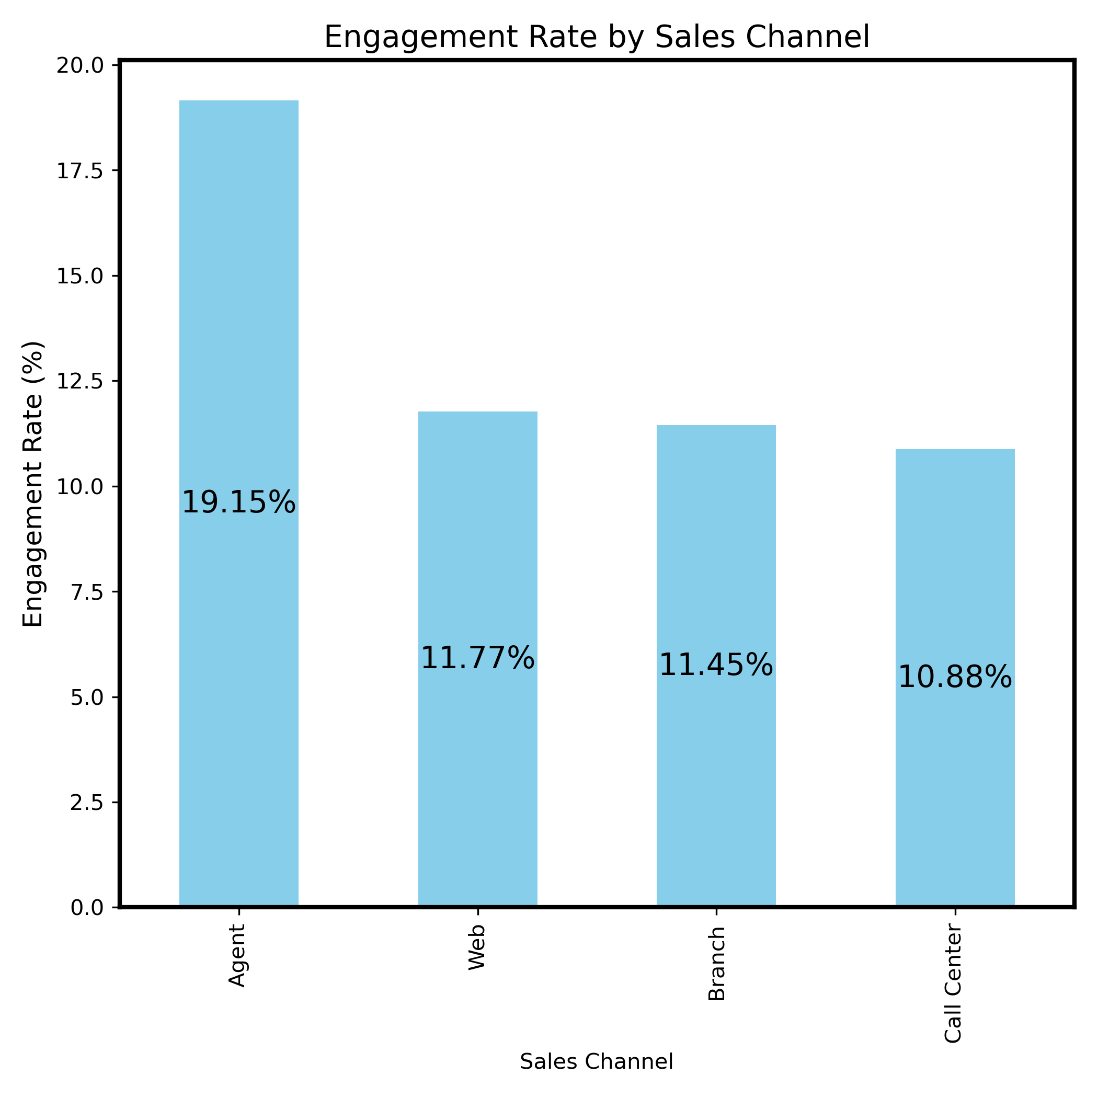
Customer behaviour – Engagement Rates by sales channel
19% response rate from customers was by agent
12% response rate from customers was through the web
Agent works the best in terms of getting responses from the customers followed by sales through Web works that is second best

Slide 8
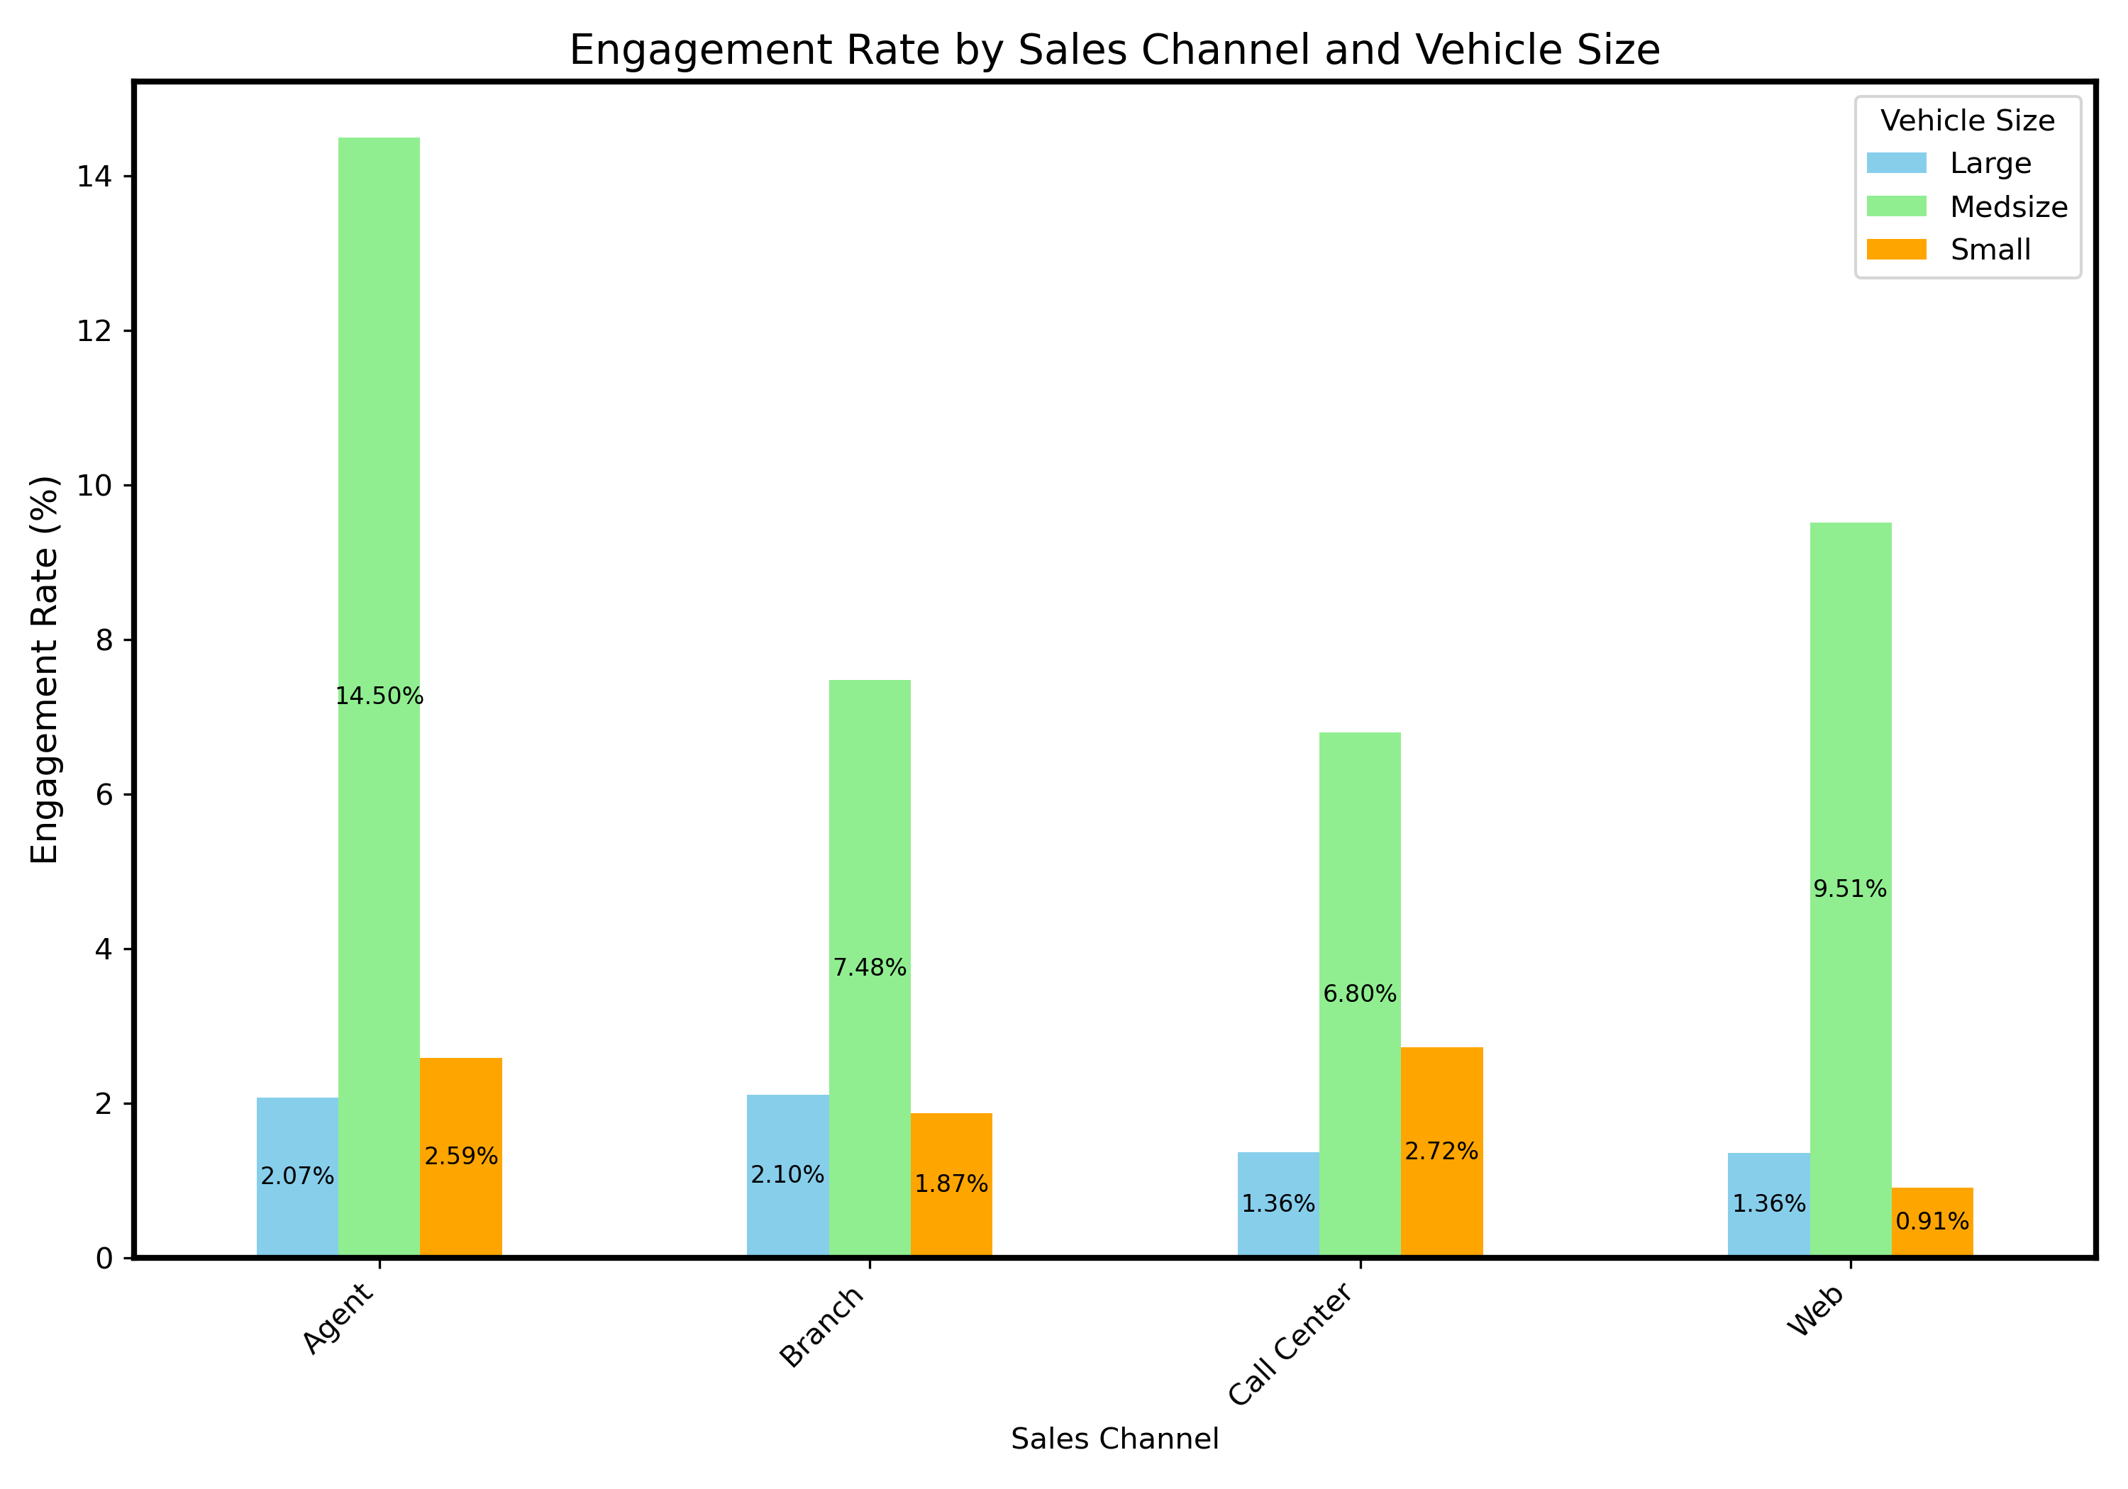
Customer behaviour – Engagement Rate by sales channel and vehicle size
Highest engagement rate is for customers with medium size vehicle
Lowest engagement rate is for customers with small sized vehicles
20-24 years is 12%.
Customers with Medsize vehicles respond the best to all sales channels.
The engagement rates across different sales channels differ slightly between Large and Small vehicle owners.

Slide 9
Key Recommendations
Customers with SUV has the highest engagement rate with offer2, so customers with SUV vehicles should be targeted with offer2.
Customers with SUV has a higher engagement rate with offer1 compared to those with 0ffer2, hence we can target SUV customers with Offer1.
Customers with medium size vehicle should be top propriety for targeting across all channels.
Customers with Two-Door Car has a higher engagement rate with offer2 than to other offer types, hence we can target Two-Door Car owners with Offer2.
For example, small car owners respond with a higher rate through Agent and Call center, hence we can utilize those two channels more heavily for Small car owners.
Web advertisement for small cars should not be used as it has the lowest rate of engagement

