Slide 1
Impact Analysis on Insurance Premiums
Background
For an insurance company to remain profitable, it must collect more in annual premiums than it pays out in medical care for its beneficiaries. Consequently, insurers invest substantial resources in developing models that accurately predict medical expenses. Estimating medical expenses is challenging because the most costly conditions are rare and random. However, certain conditions are more common in specific segments of the population than others. For example, lung cancer is more prevalent among smokers, and heart disease is more likely among individuals with obesity.
Objective
The objective of this analysis is to utilize patient claims data to:
Identify patterns in the data that influence insurance premiums.
Identify and quantify the impact of factors that affect premium costs
Estimate average medical care expenses for various population segments.
Use the estimated cost to create actuarial tables for yearly premiums

Slide 2
Impact Analysis on Insurance Premiums
Data
The insurance.csv file includes 1,338 examples of beneficiaries currently enrolled in the insurance plan, with features indicating characteristics of the patient as well as the total medical expenses charged to the plan for the calendar year
Variables
• age: This is an integer indicating the age of the primary beneficiary
• sex: This is the policy holder's gender, either male or female.
• bmi: This is the body mass index (BMI), An ideal BMI is within the range of 18.5 to 24.9.
• children: This is an integer indicating the number of children / dependents covered by the insurance plan.
• smoker: This is yes or no depending on whether the insured regularly smokes tobacco.
• region: This is the beneficiary's place of residence in the U.S., divided into four geographic regions: northeast, southeast, southwest, or northwest.

Slide 3
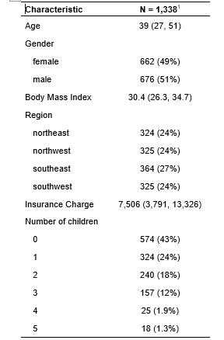
Exploratory Data Analysis (EDA) : Summary Statistics
The average age of the people on the data set was 39 years
There were similar proportions of males and females
Most of the medical expenses (43%) were from people without any child
A slightly higher proportion of the people lived in southeast
The median medical expenses was 7,500 pounds

Slide 4
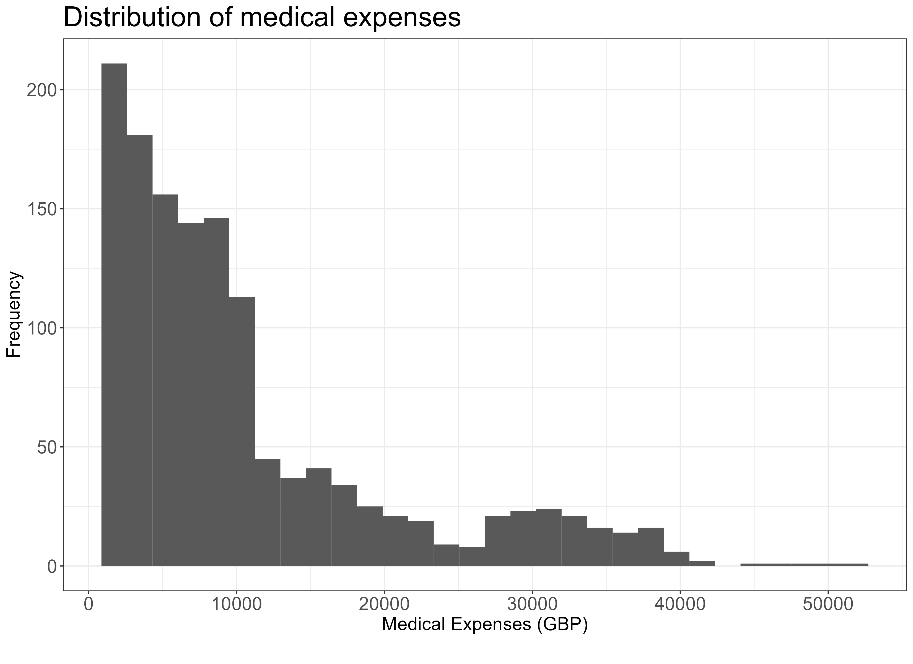
Distribution of medical expenses
How is the medical expenses distributed?
A large majority of individuals in our data have yearly medical expenses between zero and 15,000 pounds
A very small number of residents have yearly medical expenses above 20000 pounds
The median average medical expense is in the region of 9,300 pounds

Slide 5
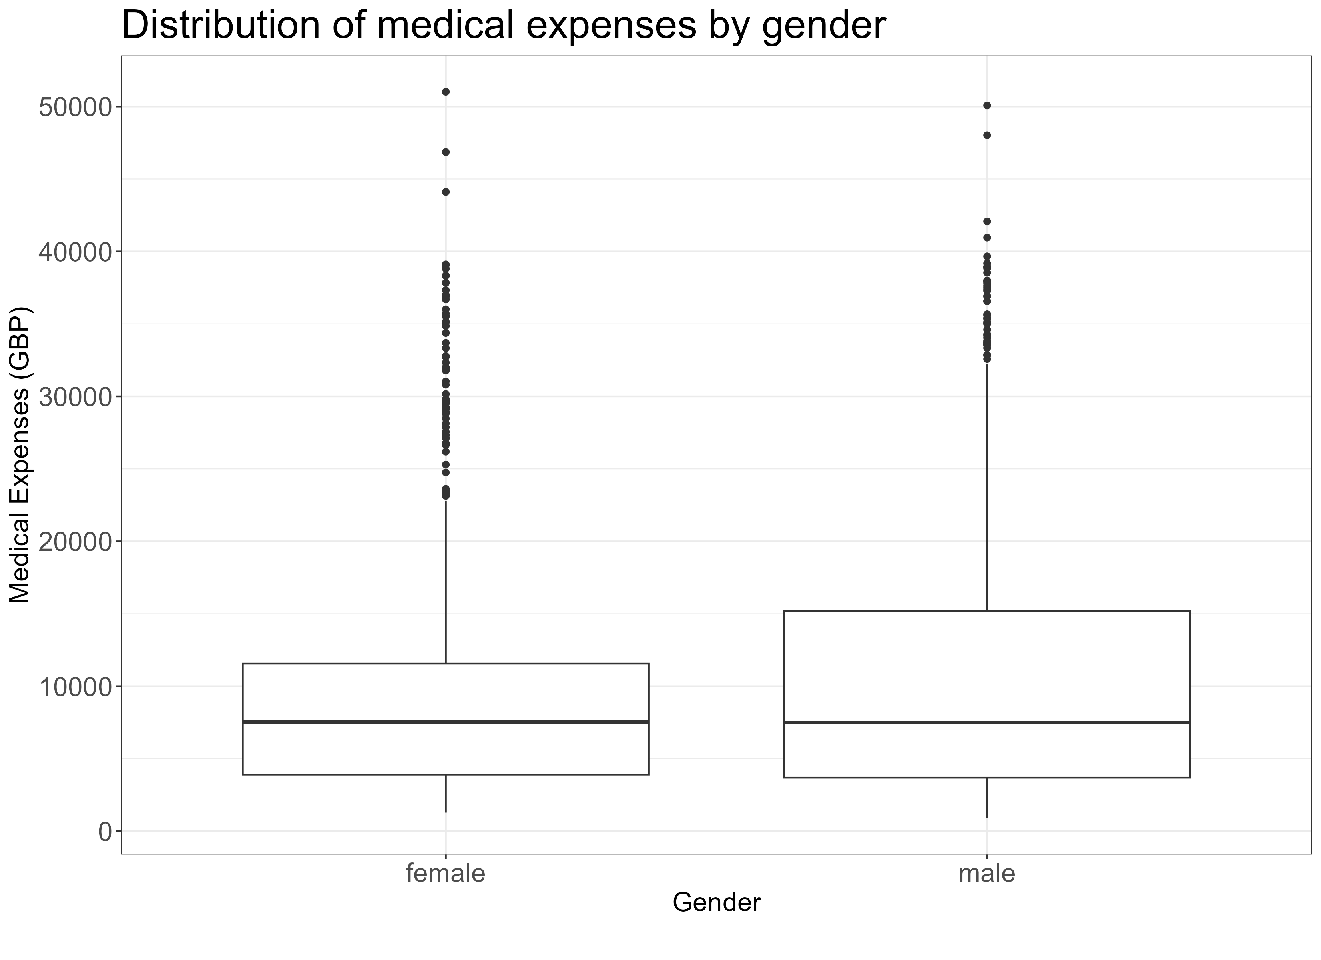
Distribution of medical expenses
How is the medical expenses distributed amongst gender?
Half of all female patients have medical expenses of 7,530
Half of all males patients have medical expenses of 7,496
The median medical expense is very similar for males and females

Slide 6
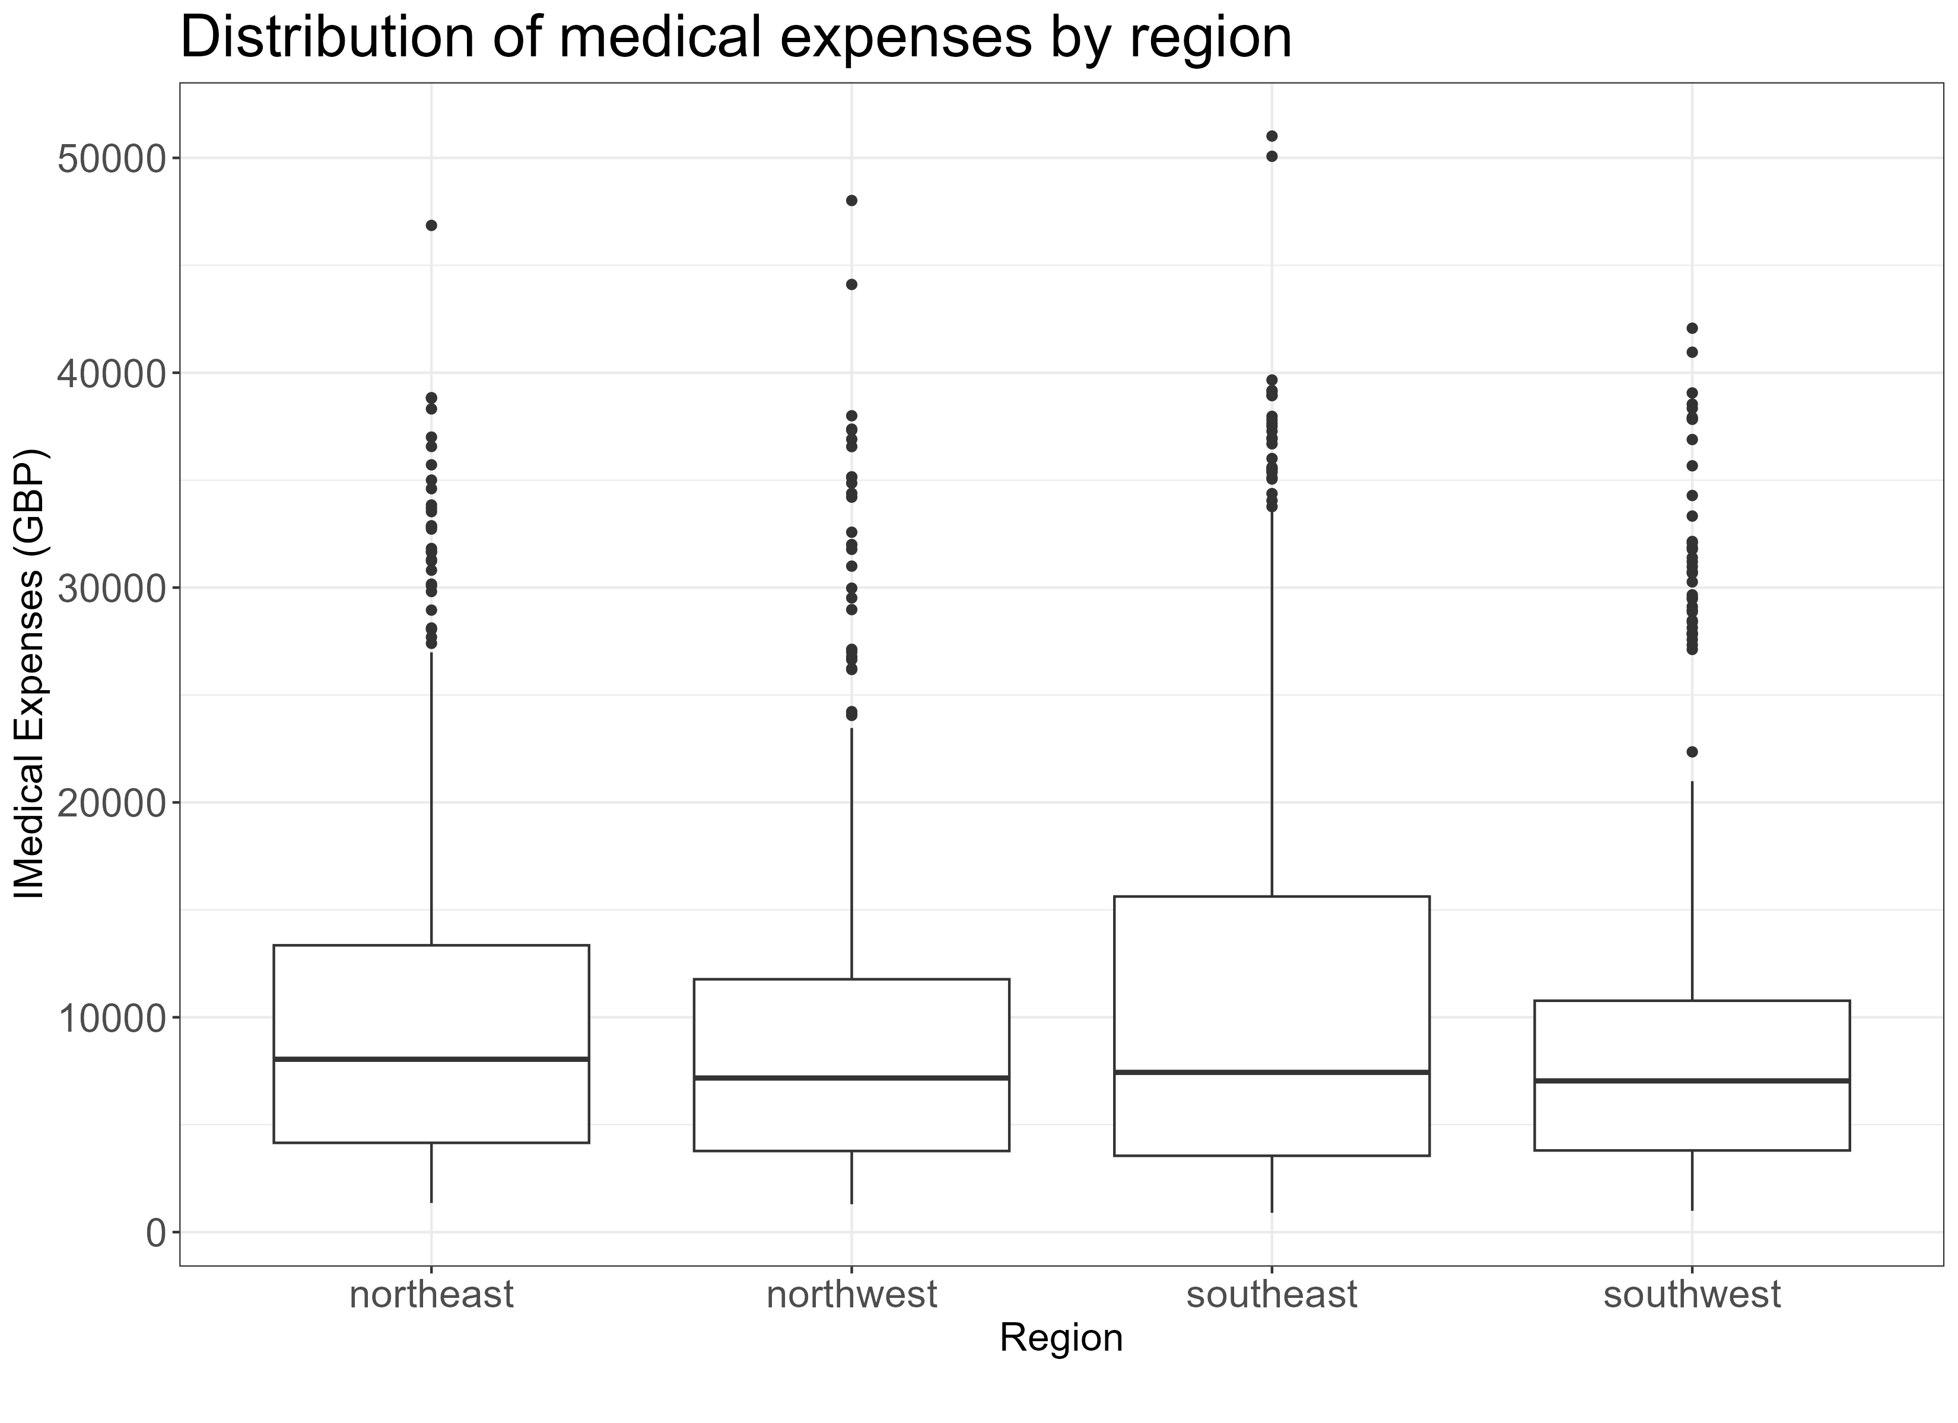
Distribution of medical expenses
How does the medical expenses vary across regions?
Half of all patients in southeast have medical expenses of 7,435 pounds
Half of all patients in northeast have medical expenses of 8,046 pounds
Half of all patients in northwest have medical expenses of 7,046 pounds
Half of all patients in southwest have medical expenses of 7,039 pounds
Median medical expenses appears to be highest in northeast

Slide 7
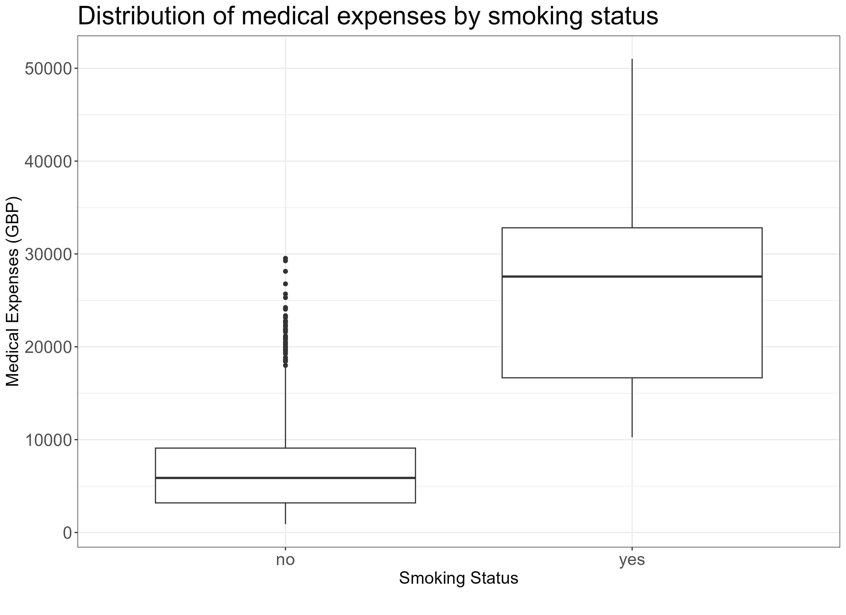
Distribution of medical expenses
How does the medical expenses distribute amongst smokers?
Half of smokers have a medical expense in the region of about 27,565 pounds
Half of non-smokers have a medical expense in the region of about 5,876 pounds
Medical expenses for smokers is significantly higher compared to non-smokers

Slide 8
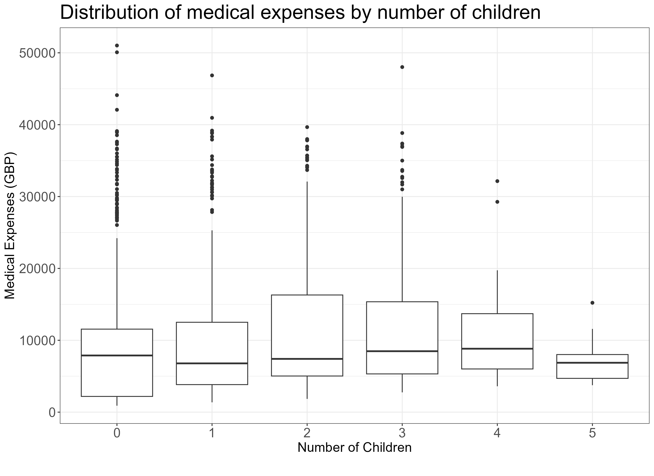
Distribution of medical expenses
How is the medical expensed distributed amongst the number of children?
Half of patients who doesn’t have any child have a medical expense of 7,886 pounds
Half of patients who have one child have a medical expense of 6,787 pounds
Half of patients who five children have a medical expense of 6,872 pounds
Generally, median medical expenditure increases as the number of child increases. After a five children, any additional child doesn’t have any significant increase in medical expenses

Slide 9
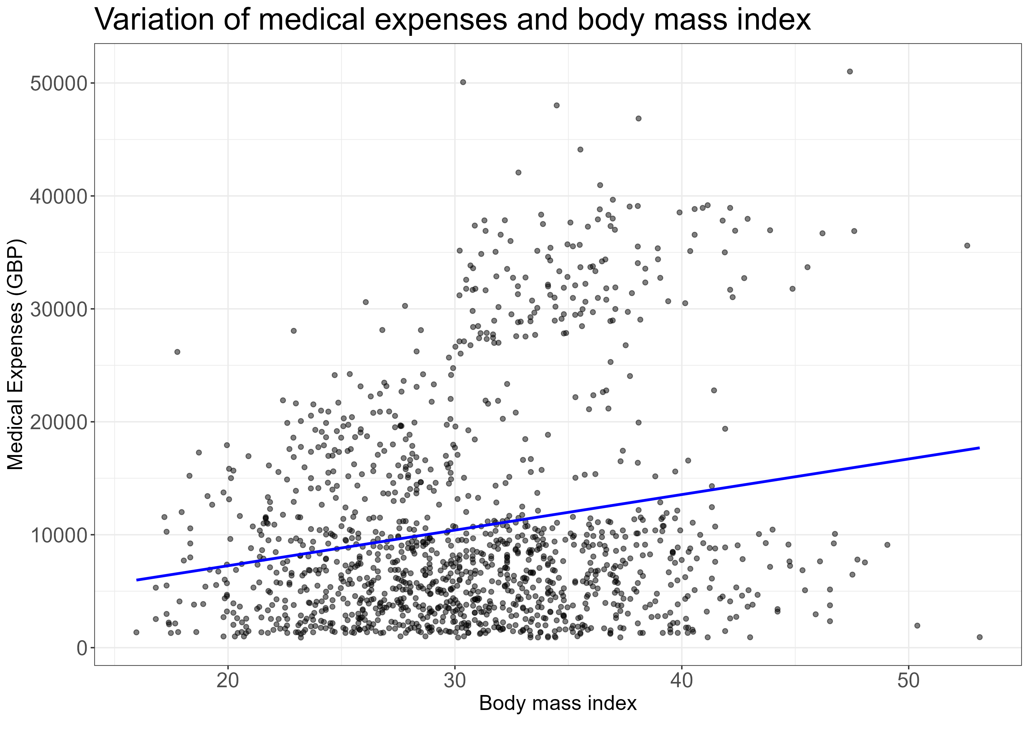
Distribution of medical expenses
How does the medical expenditure vary with body mass index ?
If your body mass is around 20, the average medical expenditure is around 8,500 pounds
If your body mass is around 40, the average medical expenditure is around 15000 pounds
Generally, as BMI increases, medical expenses increases

Slide 10
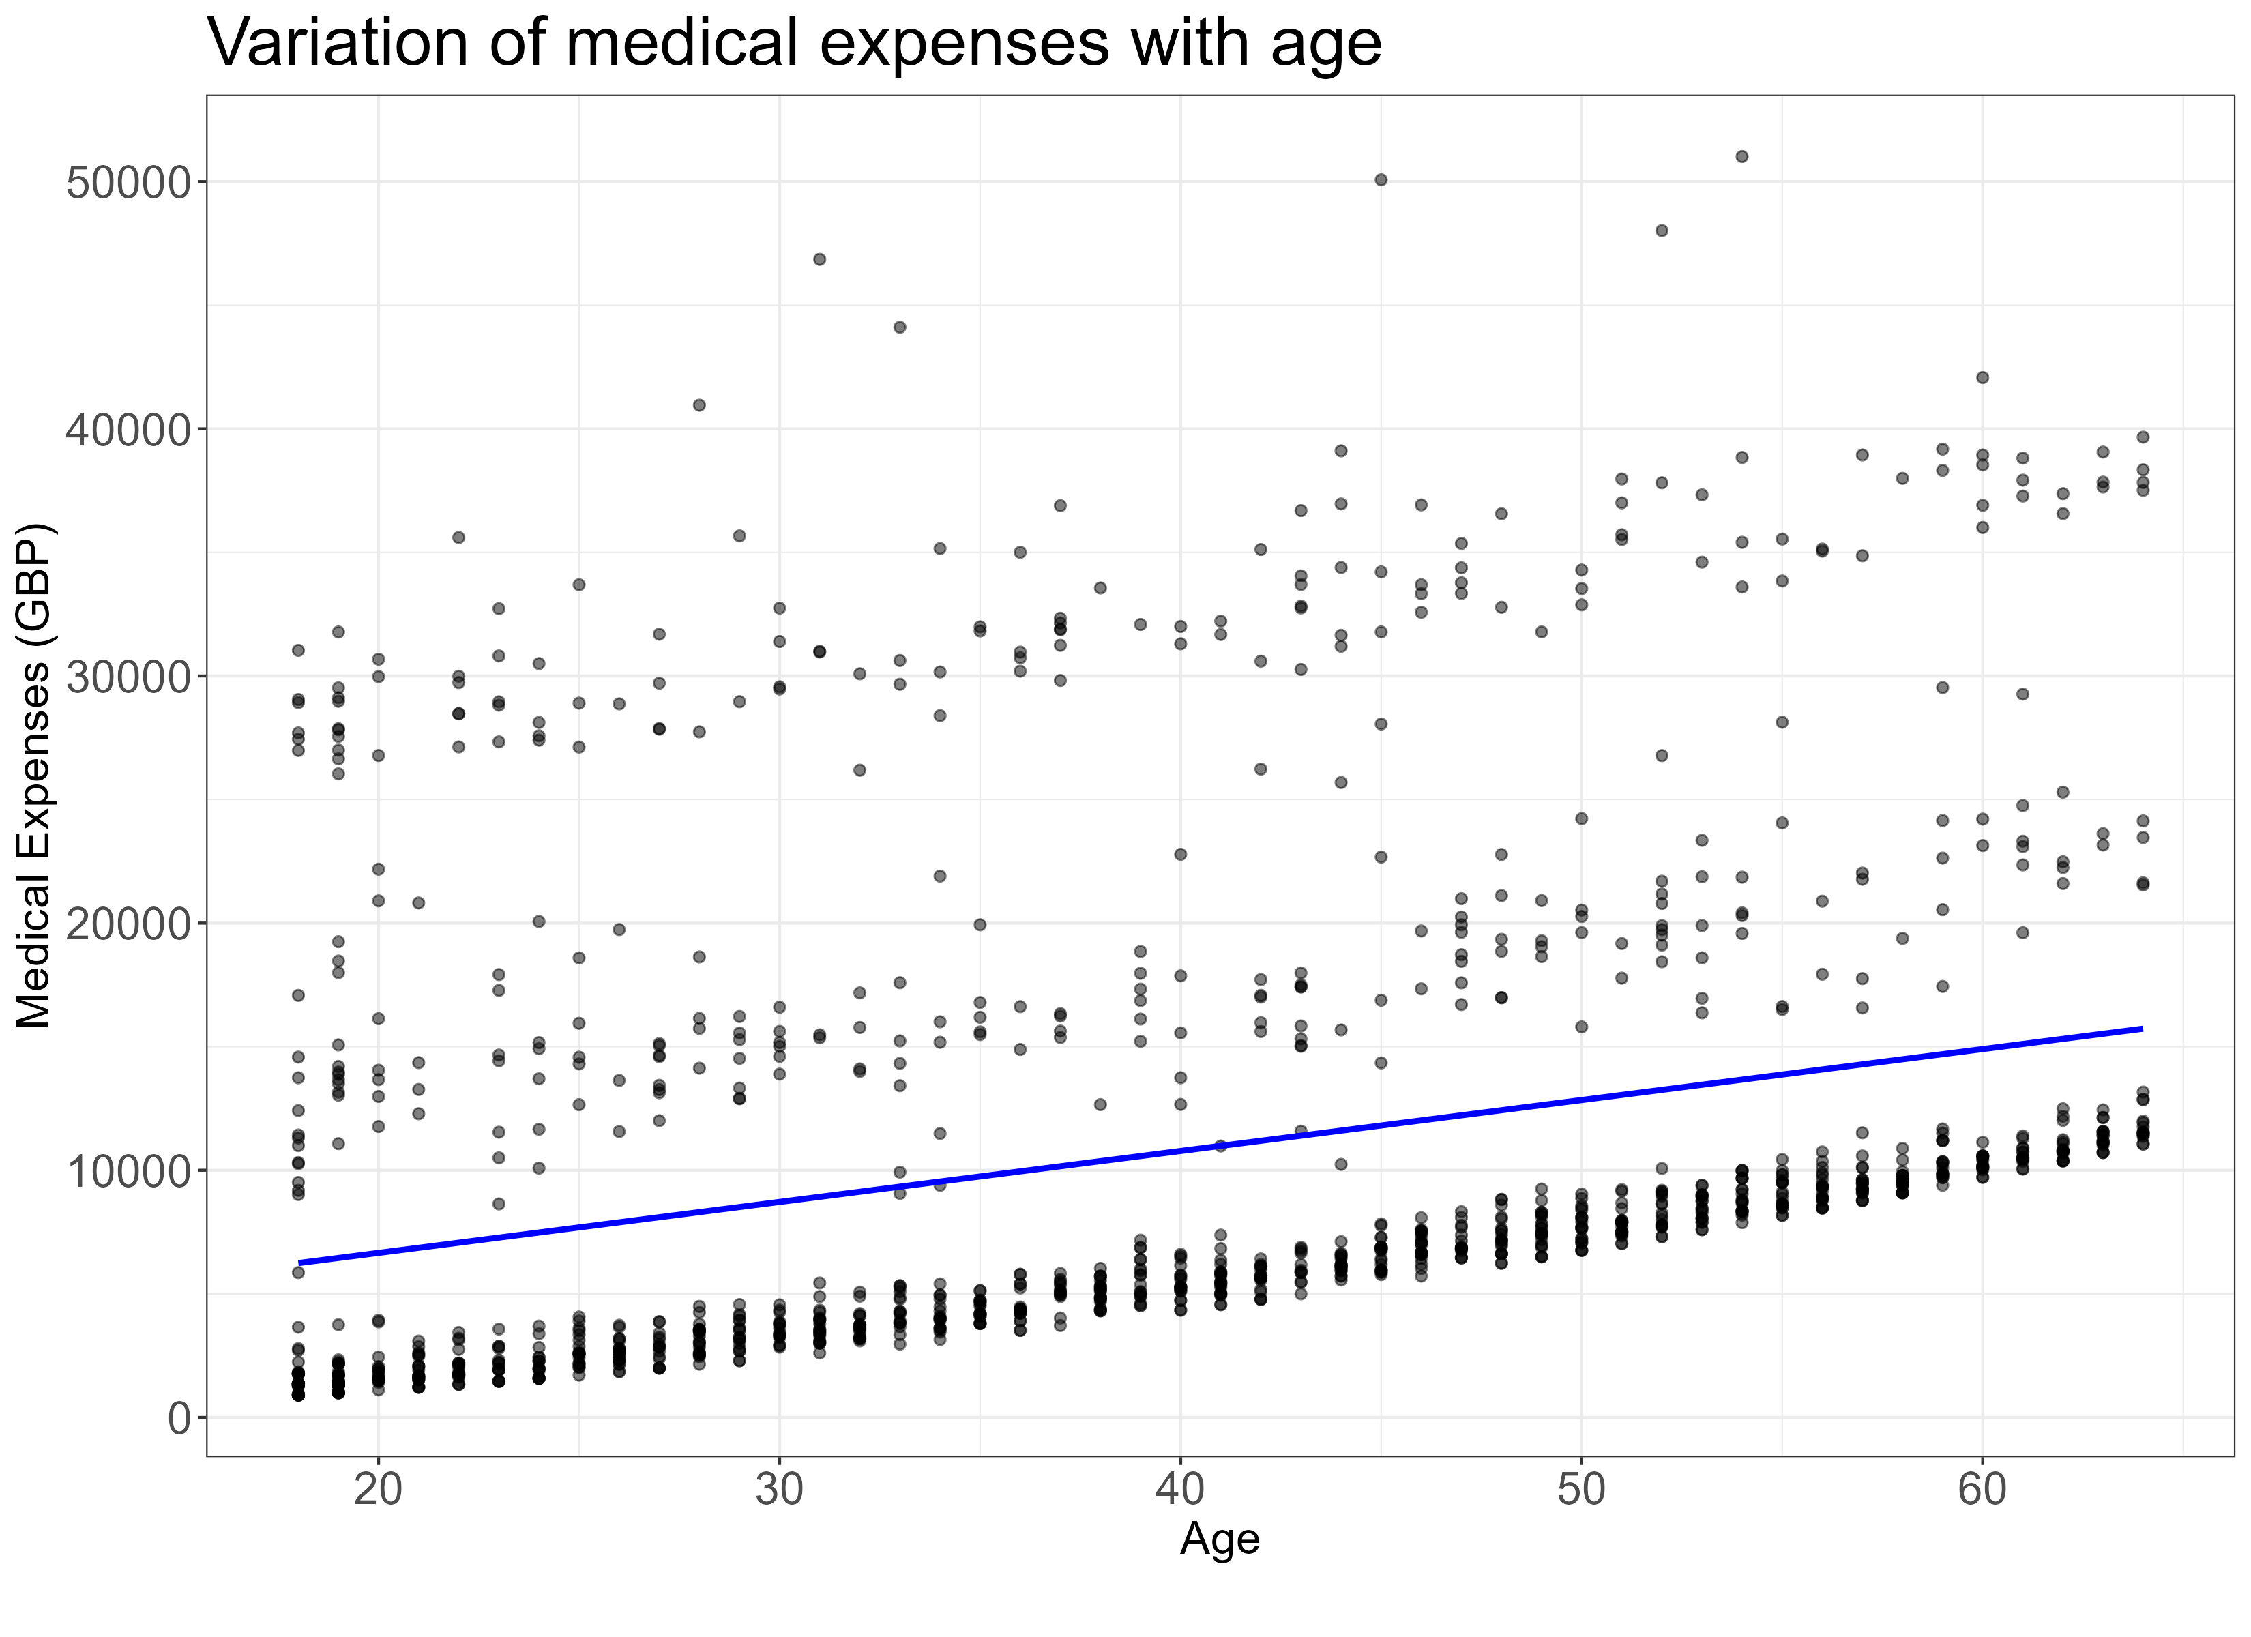
Distribution of medical expenses
How does the medical expenditure vary with age ?
People of some age groups have different medical expenses
Generally, as age increases, medical expenses increases

Slide 11
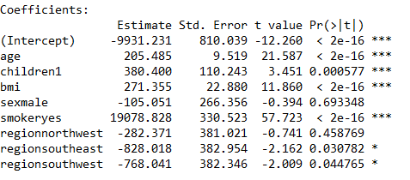
First Regression model – with all predictors
For each year that age increases, we would expect $205 higher medical expenses on average, assuming everything else is equal
Each additional child results in an average of $384 in additional medical expenses each year
Each unit of BMI increase is associated with an increase of $271 in yearly medical costs.
males have $105 less medical costs each year relative to females
smokers cost an average of $19078 more than non-smokers
the coefficient for each of the other three regions in the model is negative, which implies that the northeast region tends to have the highest average medical expenses. than non-smokers.
old age, smoking, and obesity tend to be linked to additional health issues, while additional family member dependents may result in an increase in physician visits and preventive care such as vaccinations and yearly physical exams
Rsquared = 75% - meaning 75% of medical charges is explained by the model

Slide 12
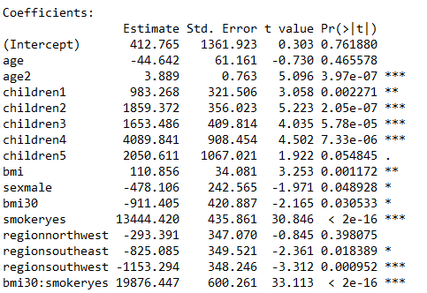
Improving model performance
if we have subject matter knowledge about how a feature is related to the outcome, we can use this information to inform the model specification and potentially improve the model's performance.
the effect of age on medical expenditures may not be constant throughout all age values; the treatment may become disproportionately expensive for the oldest populations
Transformation – converting a numeric variable to a binary indicator
BMI may have zero impact on medical expenditures for individuals in the normal weight range, but it may be strongly related to higher costs for the obese (that is, BMI of 30 or above).
adding interaction effects- What if certain features have a combined impact on the dependent variable? For instance, smoking and obesity may have harmful effects separately, but it is reasonable to assume that their combined effect may be worse than the sum of each one alone. When two features have a combined effect, this is known as an interaction.
To summarize the improvements, we: • Added a non-linear term for age • Created an indicator for obesity • Specified an interaction between obesity and smoking

Slide 13
Regression model
Relative to our first model, the R-squared value has improved from 0.75 to about 0.87. Our model is now explaining 87 percent of the variation in medical treatment costs. Additionally, our theories about the model's functional form seem to be validated. The higher-order age2 term is statistically significant, as is the obesity indicator, bmi30. The interaction between obesity and smoking suggests a massive effect, in addition to the increased costs of over $13,444 for smoking alone, obese smokers spend another $19,876 per year. This may suggest that smoking exacerbates diseases associated with obesity

Slide 14
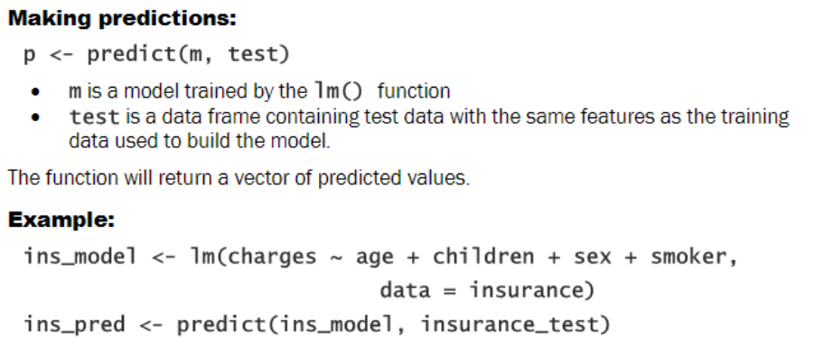
Prediction model

