Slide 1
Predicting Mental Health Illness
By H Nanji
Outline
Data
Data preparation and assumptions
Summary statistics
Data exploration – Association
Machine Learning Model

Slide 2
Data
Introduction – Data description. The depression dataset contains information on individuals with various attributes related to their personal and lifestyle factors.
Features of the data set - 11
Name: The full name of the individual.
Age: The age of the individual in years.
Marital Status: Single, Married, Divorced, and Widowed.
Education Level: High School, Associate Degree, Bachelor's Degree, Master's Degree, and PhD.
Number of Children: one, two three four
Smoking Status: Smoker, Former and Non-smoker.
Physical Activity Level: Sedentary, Moderate, and Active.
Employment Status: Employed and Unemployed.
Income: The annual income of the individual in USD.
Alcohol Consumption: Low, Moderate, and High.
Dietary Habits: Healthy, Moderate, and Unhealthy.
Sleep Patterns: Good, Fair, and Poor.
History of Mental Illness: Whether the individual has a history of mental illness. Possible values are Yes and No.
History of Substance Abuse: Whether the individual has a history of substance abuse. Possible values are Yes and No.
Family History of Depression: Indicates if there is a family history of depression. Possible values are Yes and No.
Chronic Medical Conditions: Whether the individual has chronic medical conditions. Possible values are Yes and No.

Slide 3
Data preparation & Assumptions
Data
Duplicate information with records of mental health illness
Conflicting entries for mental health illness at the same age e,g a patient at 20 years had mental health illness present and absent
Longitudinal nature with duplicate records presented challenges for analysis
Assumptions
I considered only the most recent record of diagnosis regardless of whether the patient had a history of mental health illness (Yes/No). I made this assumption because the latest record represents the true health state of the individual.
Patients that had a history of mental health (Yes) and history of mental illness (No) at the same age were dropped as the outcome was conflicting.
Total records = 413,768 patients (including duplicates) . 52% duplicate records and 48% unique records

Slide 4
Summary Statistics
Attributes |  |  | History of Mental Illness
Age | Mean (SD) |  | 55.2 (18.1)
Income | Mean (IQR) |  | 27,605 (60,295)
Marital Status | Divorced |  | 3,970 (6.7%)
 | Married |  | 35,774 (60.0%)
 | Single |  | 6,916 (11.6%)
 | Widowed |  | 12,982 (21.8%)
Educational Level | Associate Degree |  | 12,790 (21.4%)
 | Bachelor's Degree |  | 16,382 (27.5%)
 | High School |  | 17,888 (30.0%)
 | Master's Degree |  | 10,170 (17.1%)
 | PhD |  | 2,412 (4.0%)
Number of Children | 0 |  | 19,738 (33.1%)
 | 1 |  | 12,986 (21.8%)
 | 2 |  | 13,117 (22.0%)
 | 3 |  | 12,395 (20.8%)
 | 4 |  | 1,406 (2.4%)
Smoking Status | Current |  | 5,146 (8.6%)
 | Former |  | 17,061 (28.6%)
 | Non-smoker |  | 37,435 (62.8%)
Physical Activity Level | Active |  | 8,485 (14.2%)
 | Moderate |  | 23,024 (38.6%)
 | Sedentary |  | 28,133 (47.2%)
There is total of 194,622 unique patients.
Age: Average age of 52 years
Income: Median income is 27,605USD.
Marital status: 60% with a history of mental illness are married.
Educational level: The highest proportion (30%) of patients with a history of mental illness have high school qualification.
Children: The highest proportion (33%) of patients with a history of mental illness don’t have any child
Smoking status: The highest proportion (62%) of patients with a history of mental illness are non-smokers.
Physical Activity. Almost half (47%) of patients with a history of mental illness have level of physical activity as sedentary

Slide 5
Summary Statistics continued
Attributes |  | History of Mental Illness
Employment Status | Employed |  | 29,812 (50.0%)
 | Unemployed |  | 29,830 (50.0%)
Alcohol Consumption | High |  | 15,128 (25.4%)
 | Low |  | 19,772 (33.2%)
 | Moderate |  | 24,742 (41.5%)
Dietary Habits | Healthy |  | 9,069 (15.2%)
 | Moderate |  | 24,679 (41.4%)
 | Unhealthy |  | 25,894 (43.4%)
Sleep Patterns | Fair |  | 28,498 (47.8%)
 | Good |  | 10,815 (18.1%)
 | Poor |  | 20,329 (34.1%)
Substance Misuse | No |  | 41,193 (69.1%)
 | Yes |  | 18,449 (30.9%)
Family History of Depression | No |  | 42,568 (71.4%)
 | Yes |  | 17,074 (28.6%)
Chronic Medical Condition | No |  | 39,874 (66.9%)
 | Yes |  | 19,768 (33.1%)
Employment status: Similar proportions for those employed or unemployed is similar.
Alcohol: The highest proportion had moderate levels of alcohol consumption (42%)
Dietary habits: 43% of patients have dietary habits classed as unhealthy
Sleep Patterns: 47% of patients have sleep patterns classed as Fair
Substance misuse: Almost 70% of these patients have not misused substance before
History of family depression: 70% of these patients doesn’t have a history of depression
Chronic conditions: 67% of these patients doesn’t have chronic medical conditions

Slide 6
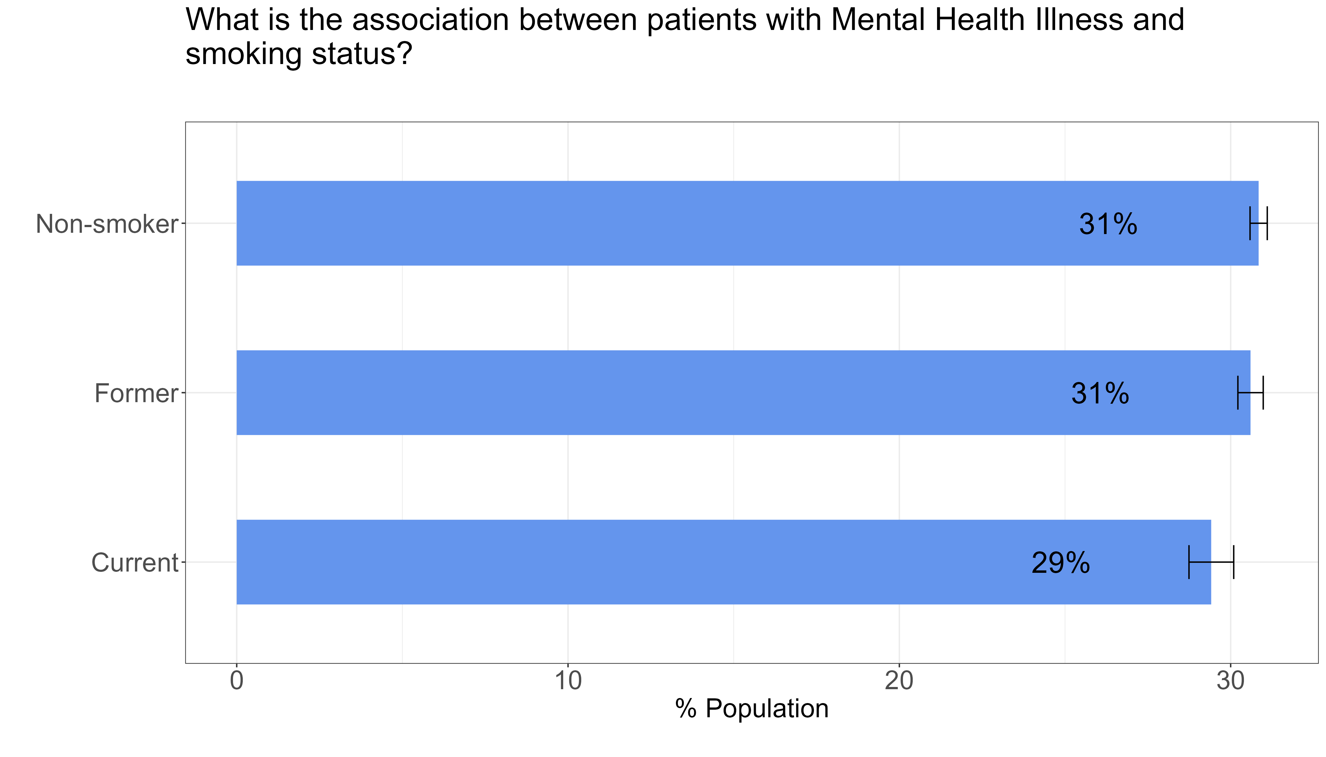
History of mental health illness and smoking status
With respect to the total number of patients in each smoking category, for patients with a history of mental health illness, the rate is 31% for smokers, 31% for former smokers and 29% for current smokers
20-24 years is 12%.
The rate of patients with a history of mental health illness is not statistically different amongst non- smokers, former smokers and current smokers

Slide 7
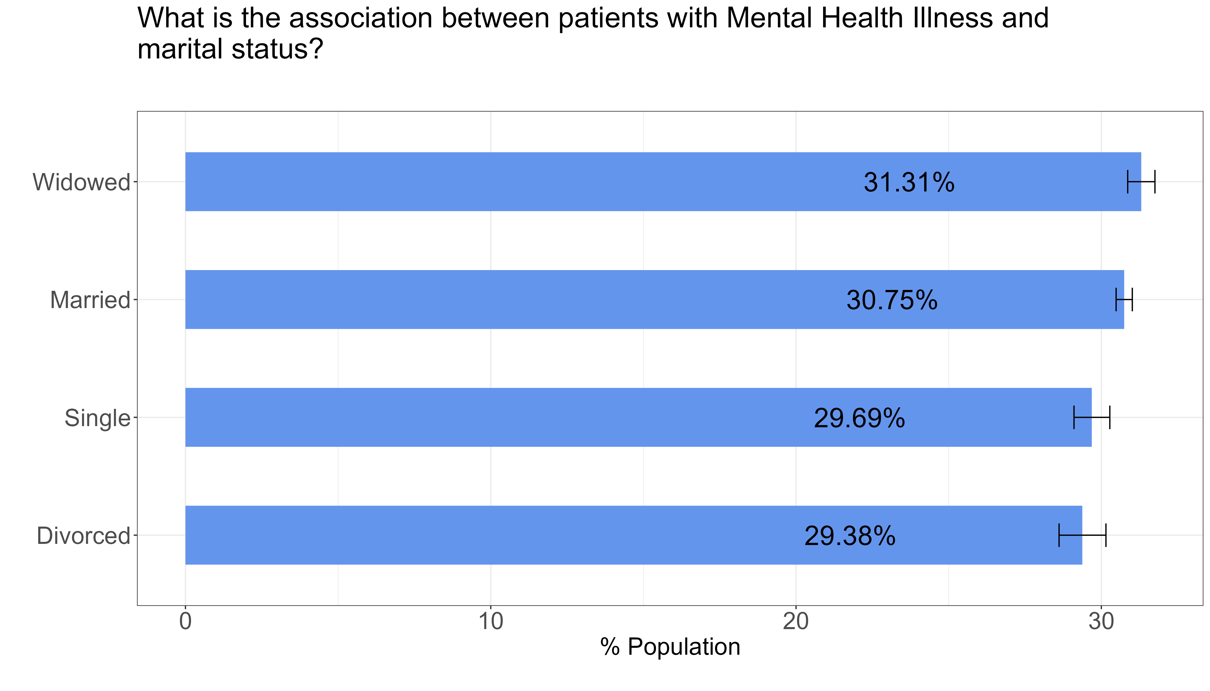
History of mental health illness and marital status
With respect to the total number of patients in each marital category, for patients with a history of mental health illness, the rate is 31% for widowers, 31% for married people and 30% for those single and 29% for those divorced.
or those between 20-24 years is 12%.
The rate of patients with a history of mental health illness is not statistically different amongst those widowed, divorced, married or single 12%.

Slide 8
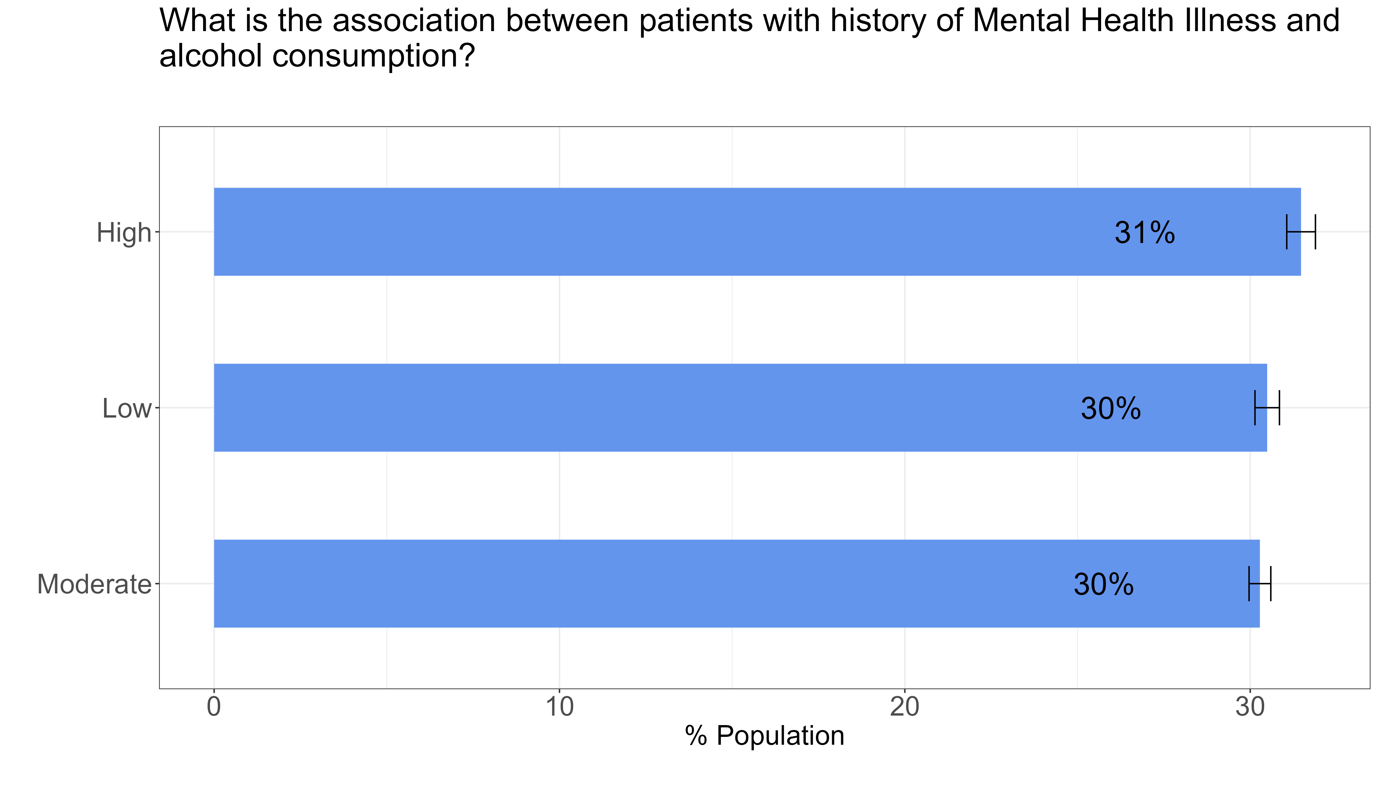
History of mental health illness and alcohol consumption
With respect to the total number of patients in each alcohol consumption category, for patients with a history of mental health illness, the rate is 31% for those with high consumption, 30% for those with low consumption and 30% for those with moderate consumption
or those between
or those between 20-24 years is 12%.
The rate of patients with a history of mental health illness is not statistically different amongst patients with either high, low or moderate alcohol consumption %.

Slide 9
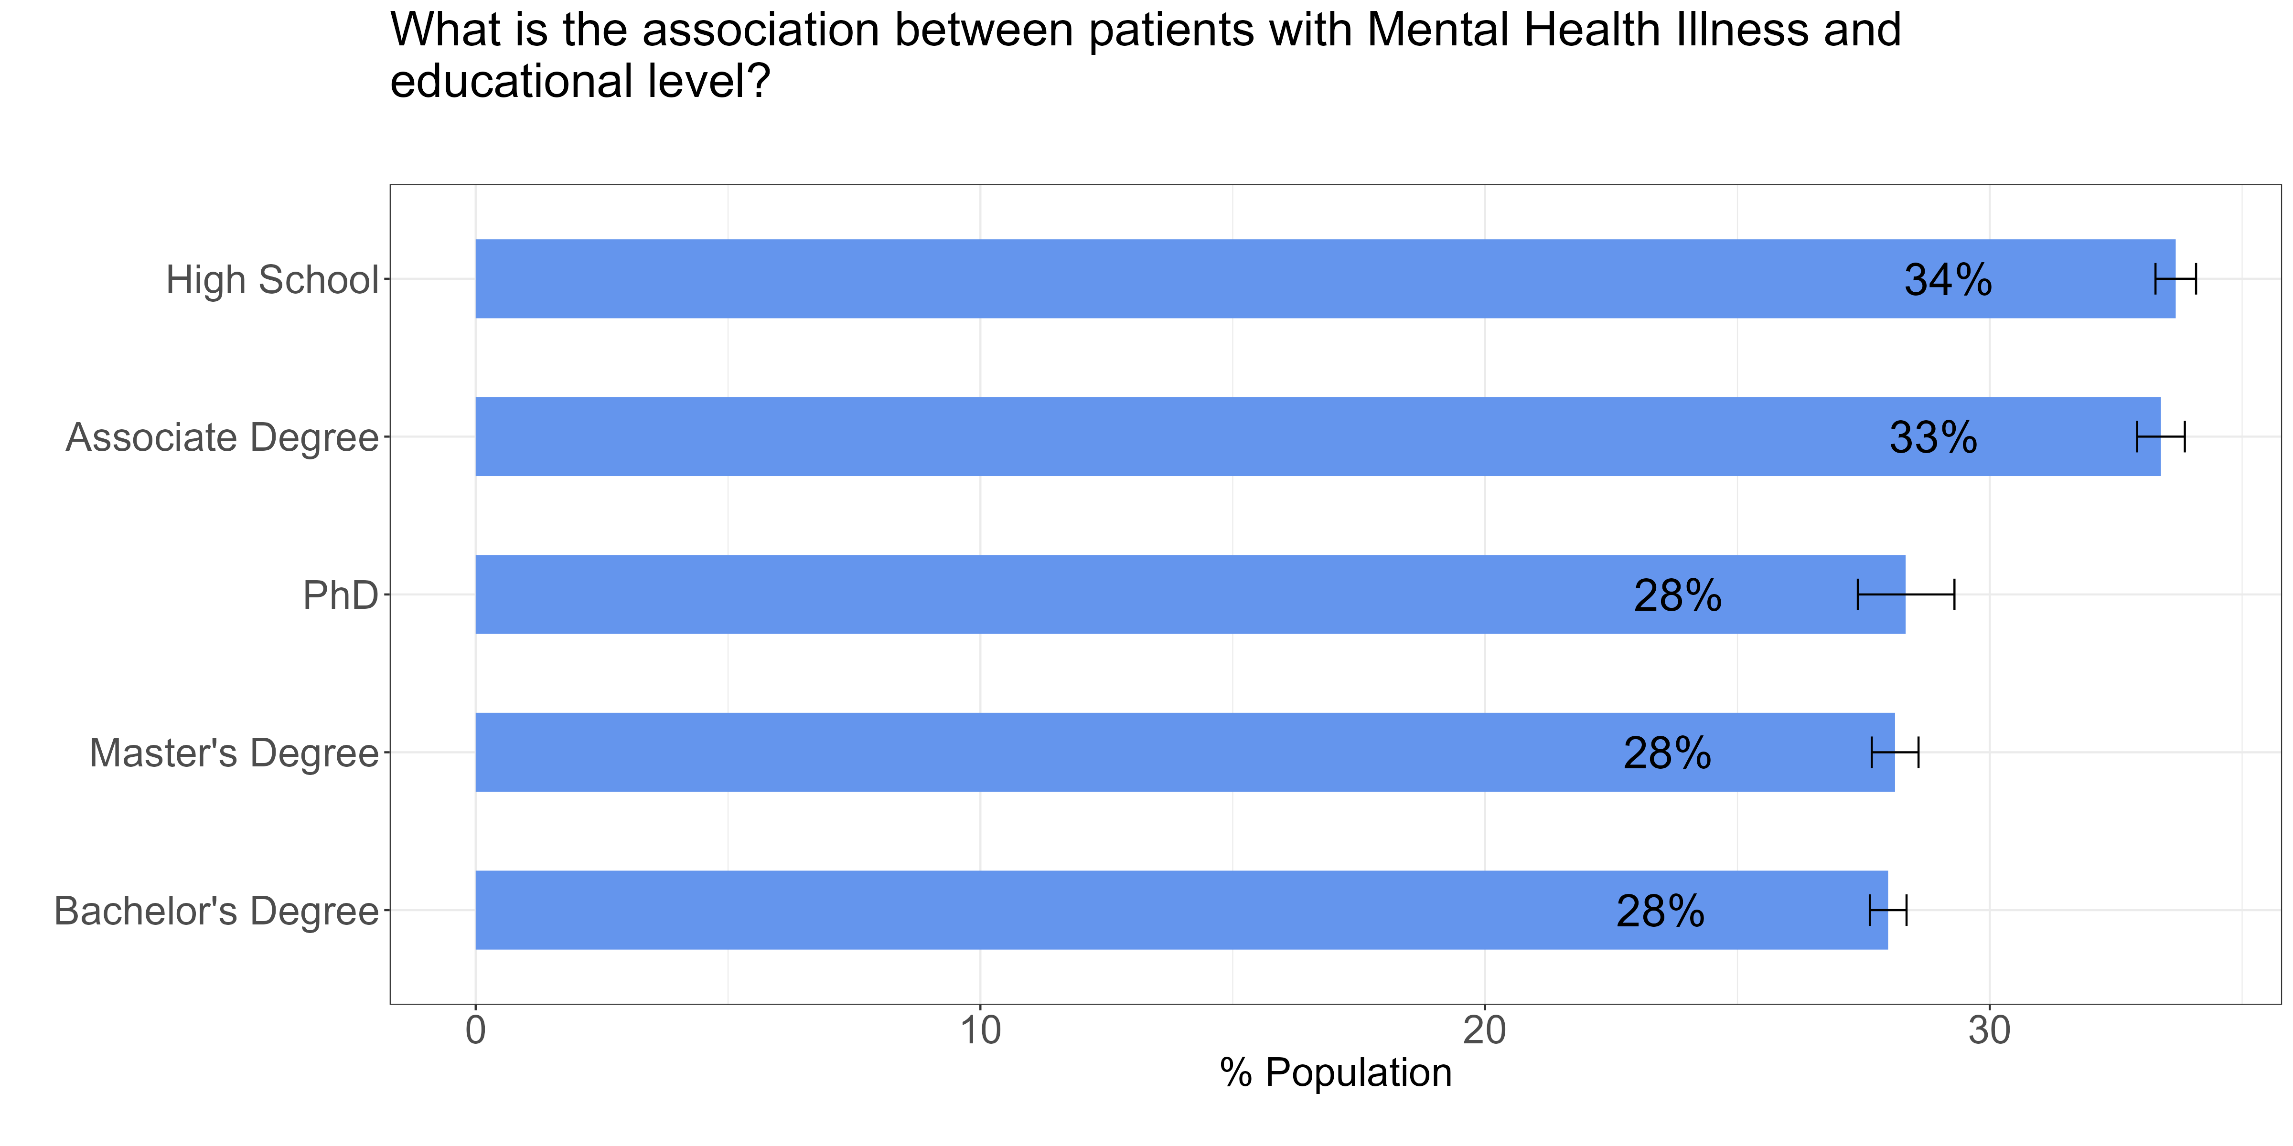
History of mental health illness and education level
With respect to the total number of patients in each level of education, for patients with a history of mental health illness, the rate is similar for high school / associate degree holders (34% / 33%) and much lower for those with PhD / Master/ Bachelors (28%)
or those between
or those between 20-24 years is 12%.
The rate of patients with a history of mental health illness is statistically different amongst patients with high/associate educational level compared to those with PhD/ Master’s Degree/ Bachelor’s degree %.

Slide 10
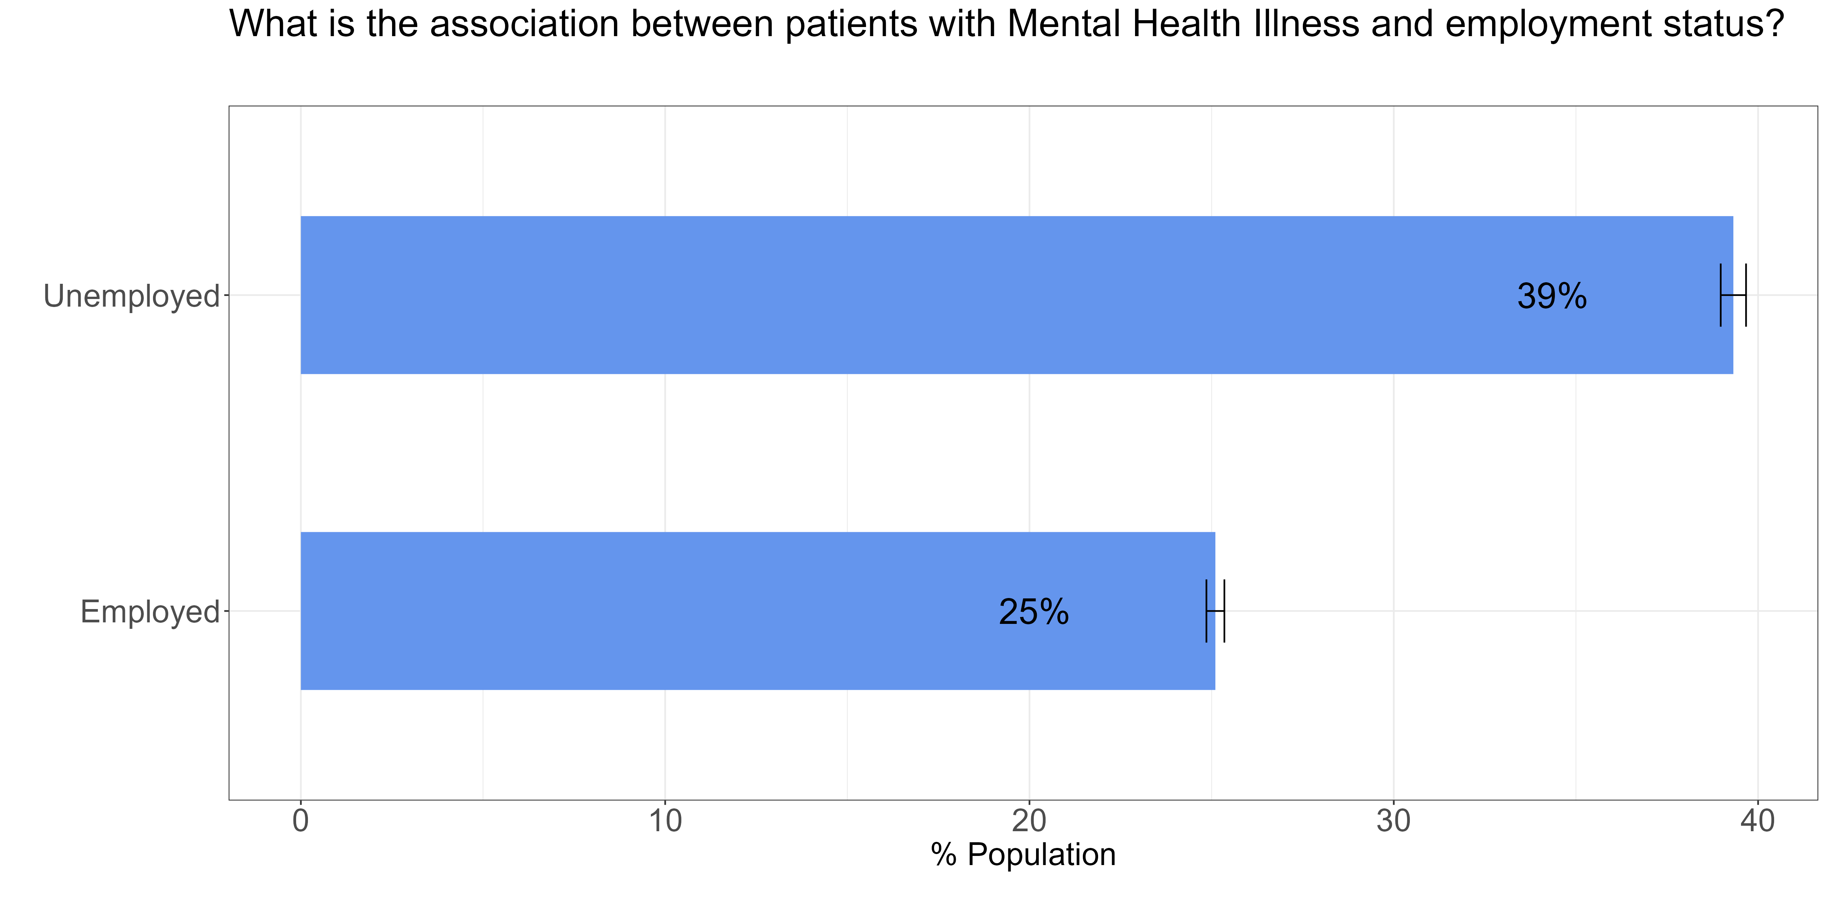
History of mental illness and levels of employment
With respect to the total number of patients in each employment category, for patients with a history of mental health illness, the rate is 39% for those unemployed and 25% for those employed
The rate of patients with a history of mental health illness is statistically different amongst patients who are unemployed and those employed%.

Slide 11
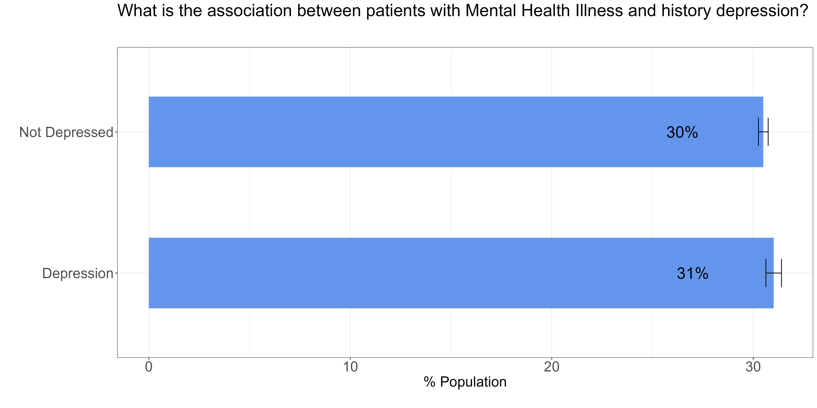
History of mental health illness and history of depression
With respect to the total number of patients in each level of depression, for patients with a history of mental health illness, the rate is 30% for those not depressed and 31% for those depressed
or those between 20-24 years is 12%.
The rate of patients with a history of mental health illness is not statistically different amongst patients who are depressed or not depressed.%.

Slide 12
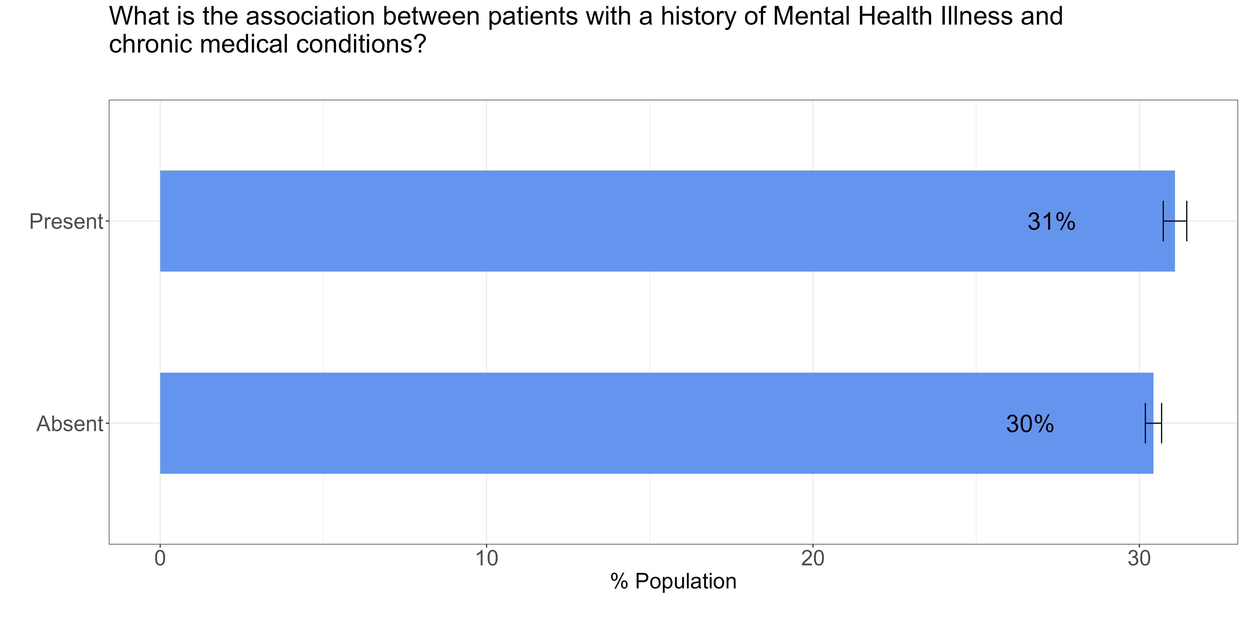
History of mental health illness and chronic medical conditions
With respect to the total number of patients where a chronic condition is absent or present, for patients with a history of mental health illness, the rate is 31% and 30% for patients where the condition is either present or absent respectively
or those between 20-24ars is 12%.
The rate of patients with a history of mental health illness is not statistically different amongst patients with or without chronic medical conditions12%.

Slide 13
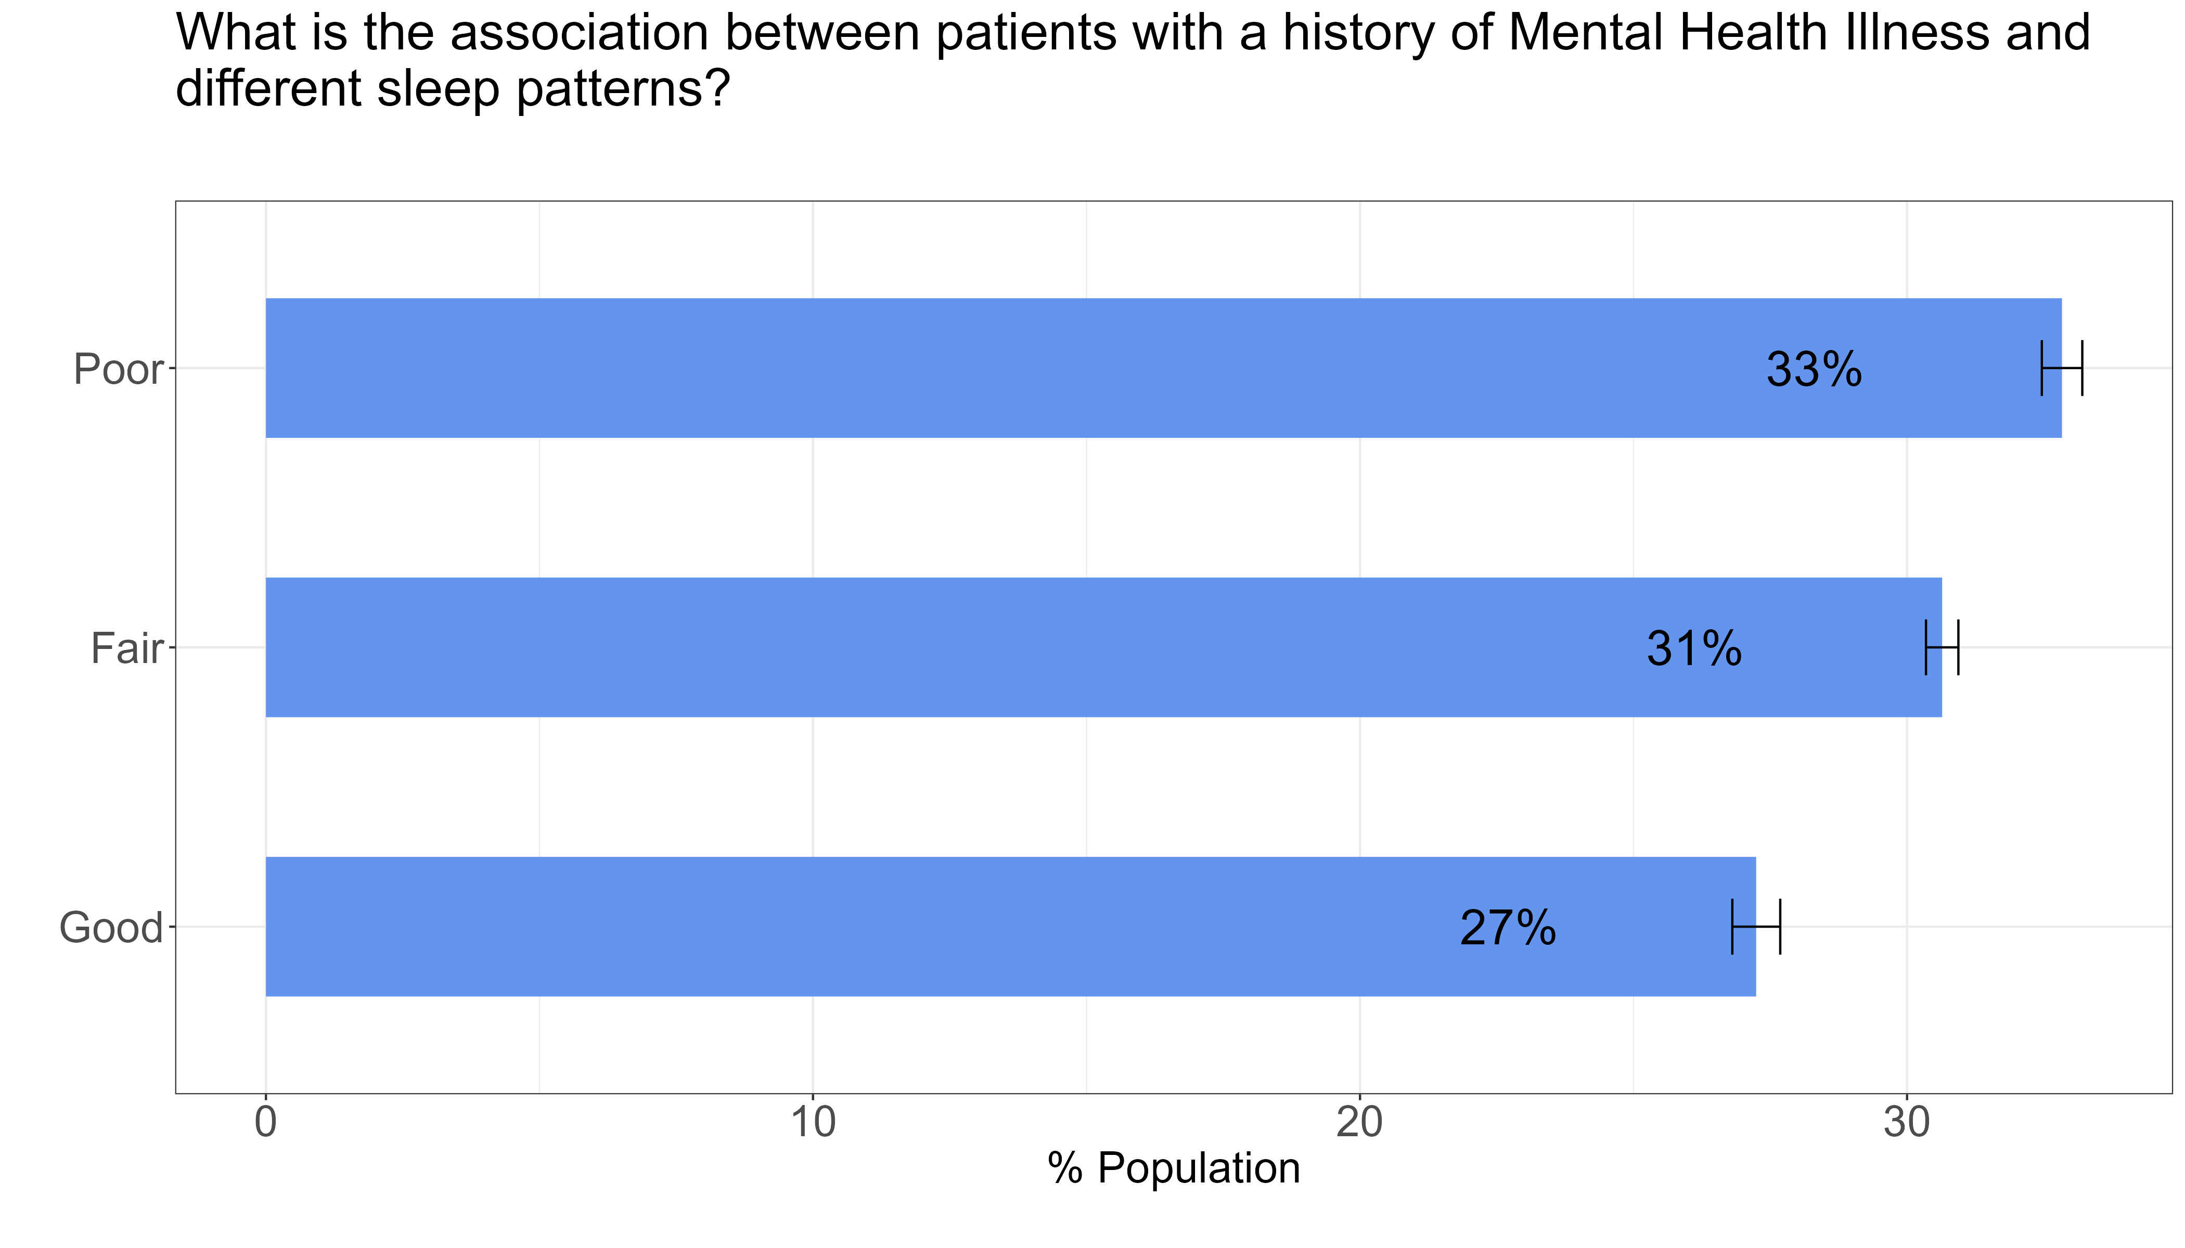
History of mental health illness and different sleep patterns
With respect to the total number of patients with the different sleep patterns, for patients with a history of mental health illness, the rate is 33%, 31% and 27% respectively for patients with either poor, fair or good sleep pattern.
or those between 20-24ars is 12%.
The rate of patients with a history of mental health illness is statistically different amongst patients with either poor, fair or good sleep patterns

Slide 14
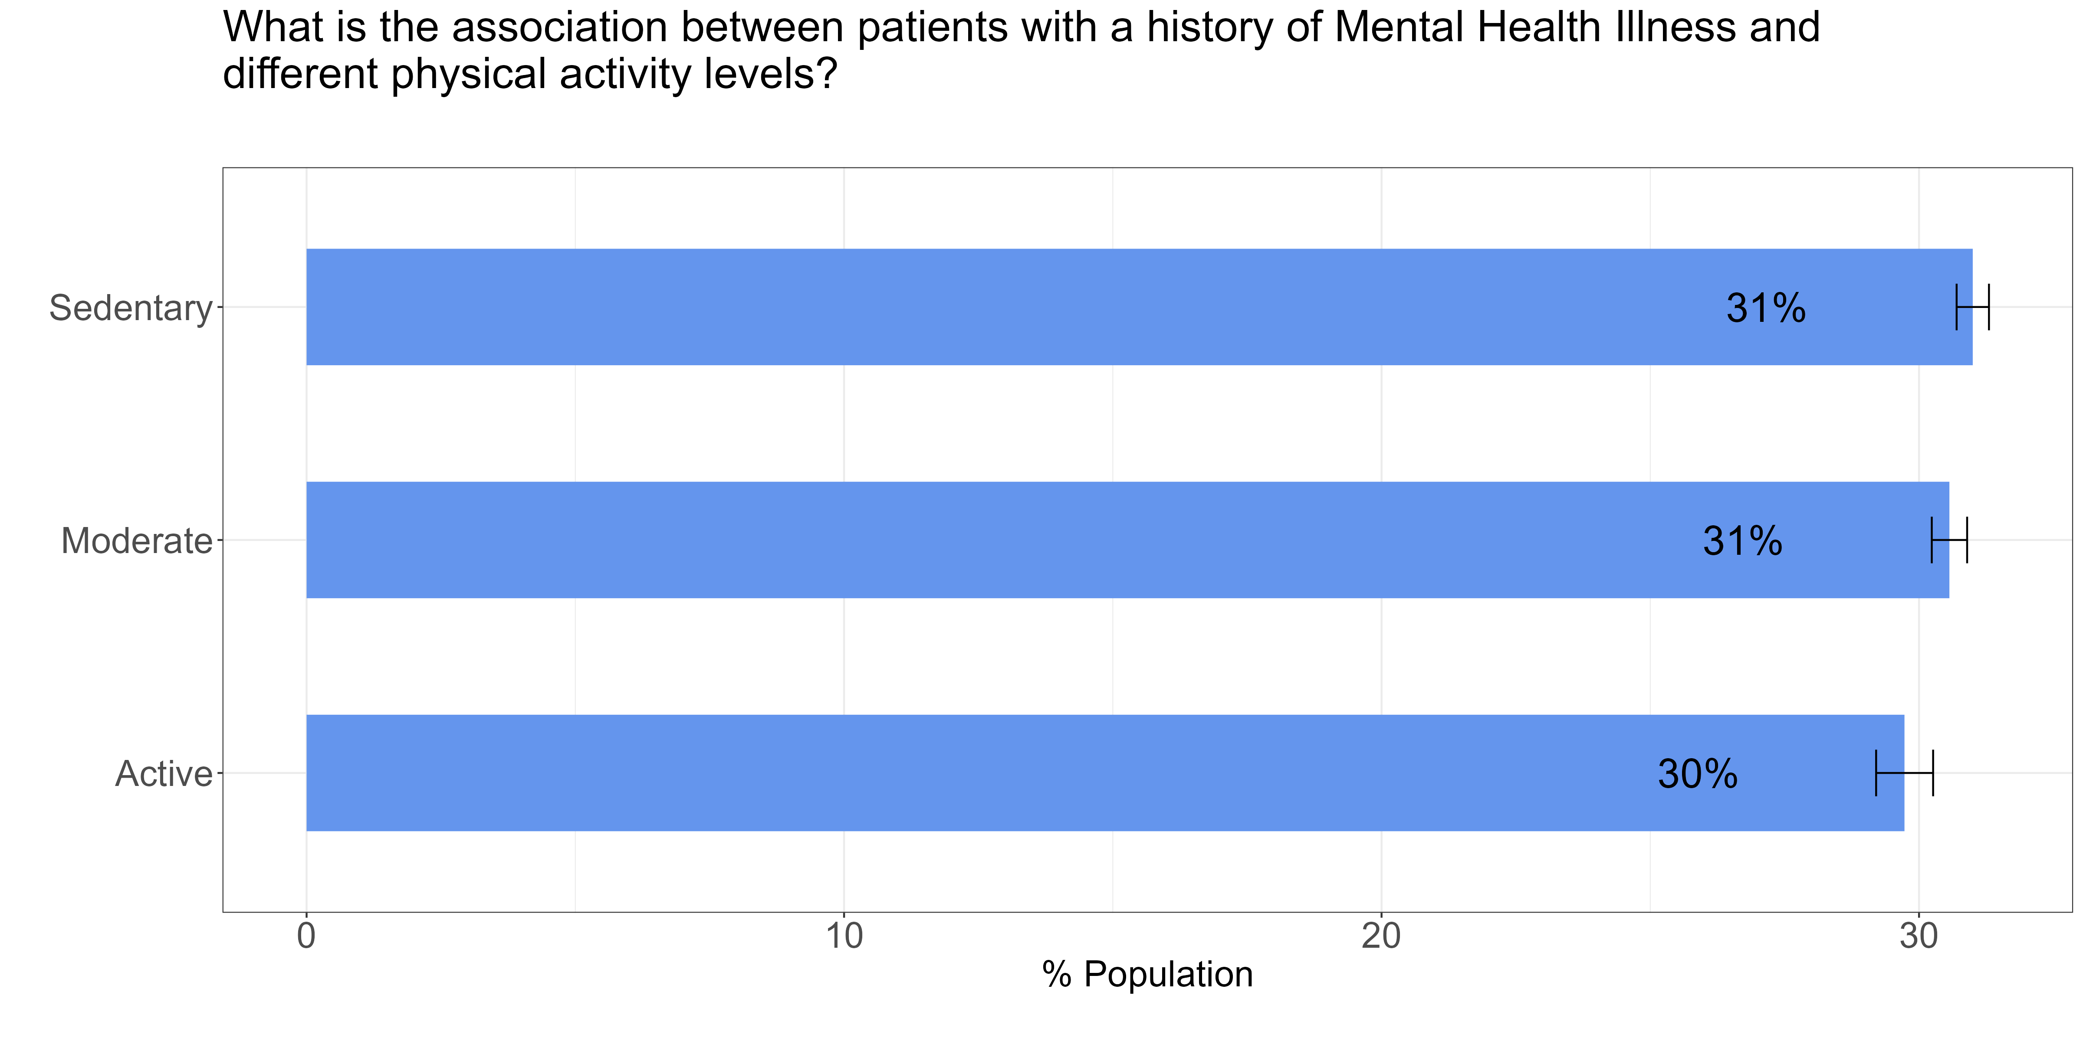
History of mental health illness and different physical activity
With respect to the total number of patients with the different levels of physical activity, for patients with a history of mental health illness, the rate is 31%,31% and 30% respectively for patients with either sedentary, moderate or active physical activity level.
or those between 20-24 years is 12%.
The rate of patients with a history of mental health illness is not statistically different amongst patients with either sedentary, moderate or active physical activity level

Slide 15
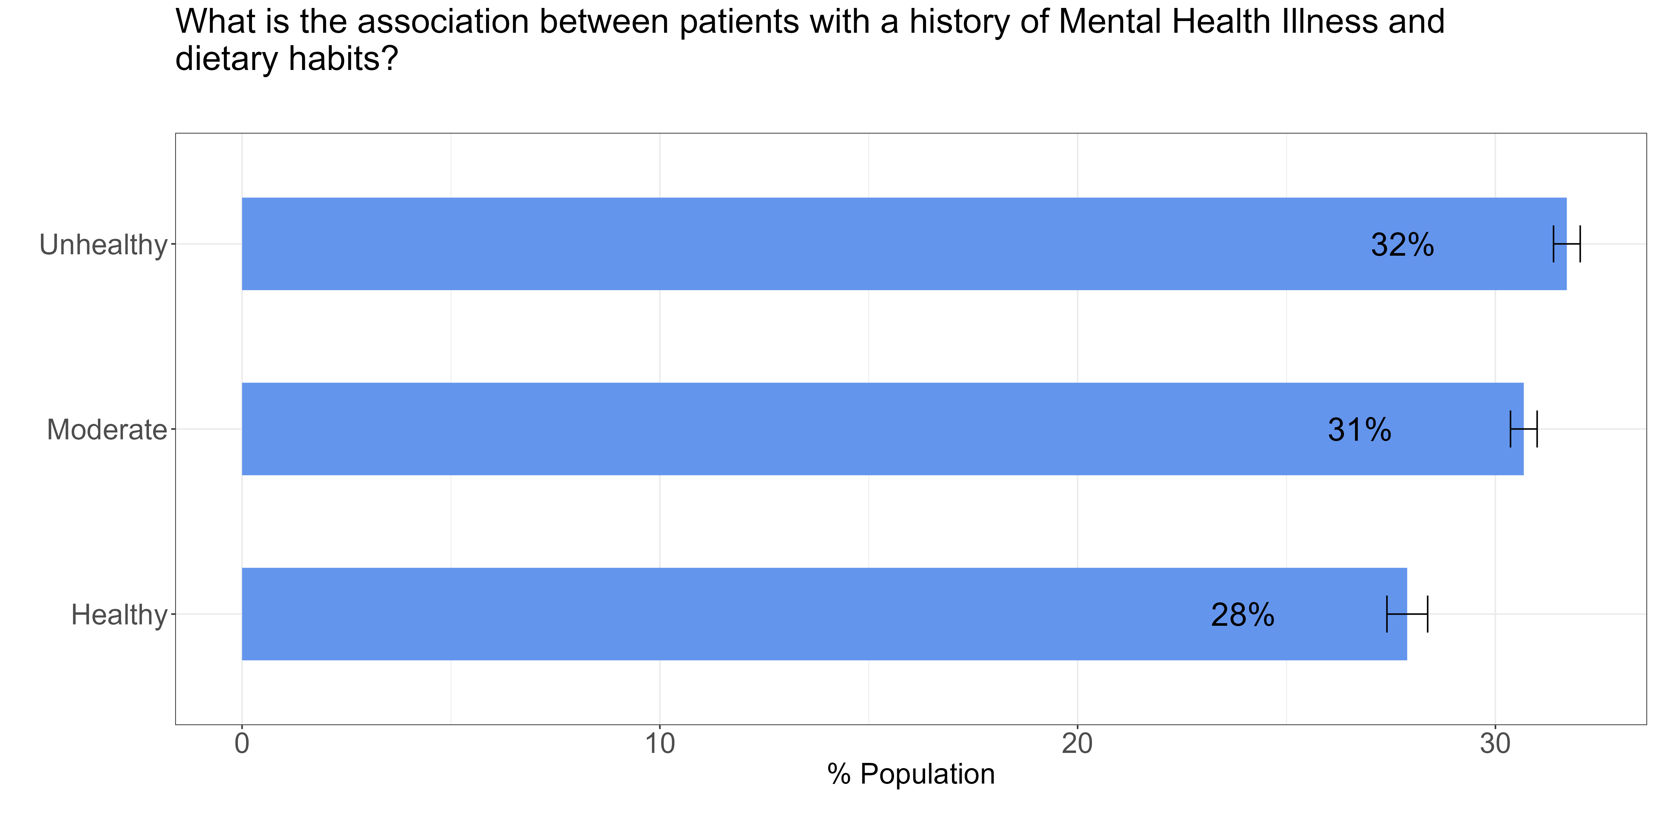
History of mental illness and dietary habits.
With respect to the total number of patients with the different dietary habits, for patients with a history of mental health illness, the rate is 32%,31% and 28% respectively for patients who have an unhealthy, moderate or healthy habit
or those between 20-24ars is 12%.
The rate of patients with a history of mental health illness is statistically different amongst patients with either unhealthy, moderate or healthy dietary habits

Slide 16
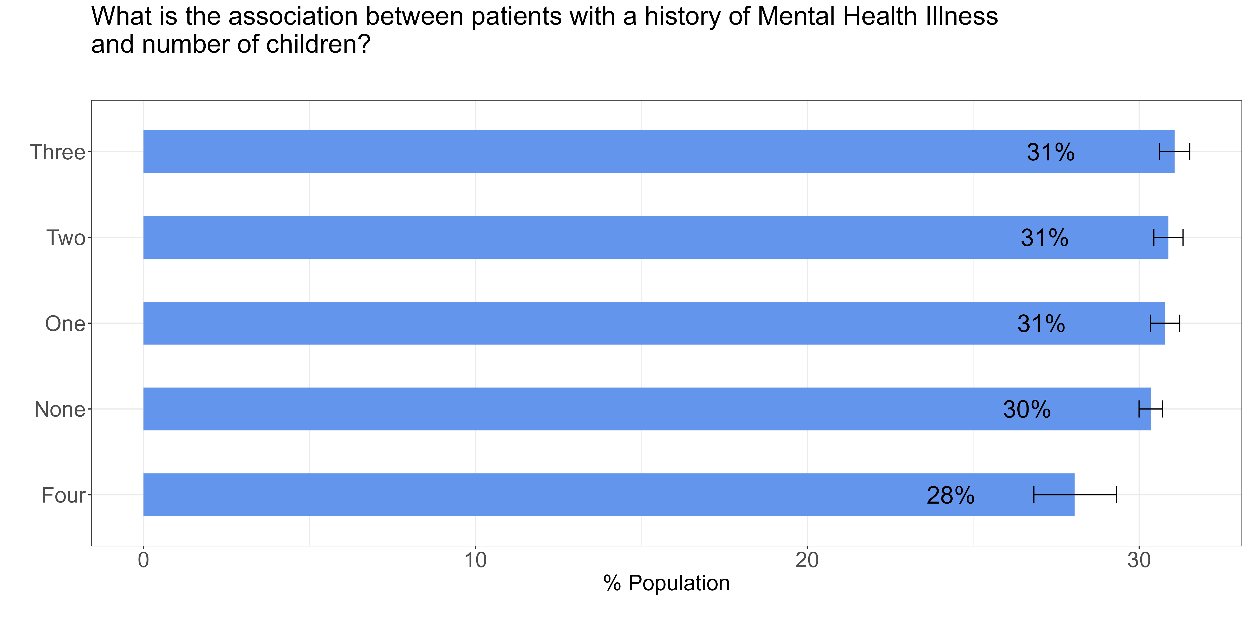
Association between mental illness and number of children.
With respect to the total number of patients with the different number of children, for patients with a history of mental health illness, the rate is 31% respectively for those with one, two, three or no child. The rate is 28% for those with four children. 12%.
The rate of patients with a history of mental health illness is not statistically different amongst patients having either one, two, three or no child.

Slide 17
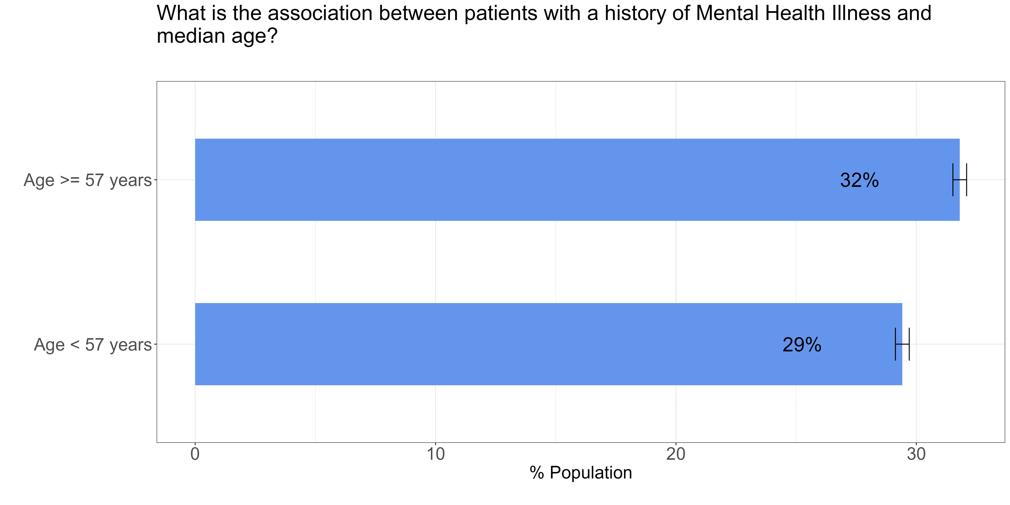
History of Mental Health illness and age.
With respect to the total number of patients within each age band, for patients with a history of mental health illness, the rate is 32% for those aged 57 years and over and 29% for those below 57 years
or those between 20-s is 12%.
The rate of patients with a history of mental health illness is statistically different amongst patients who are aged 57 years and over compared to those below 57 years%.

Slide 18
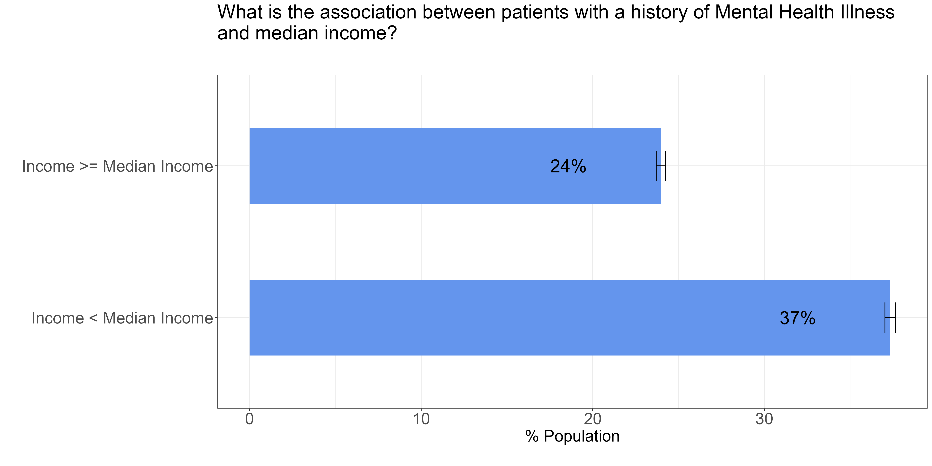
History of Mental Health illness and income.
With respect to the total number of patients within each income band, for patients with a history of mental health illness, the rate is 24% for those with greater than or equal to the median income and 37% for those below the median income
or those between 20-24 years is 12%.
The rate of patients with a history of mental health illness is statistically different amongst patients with less than median income compared to those greater than or equal to median income%.

Slide 19
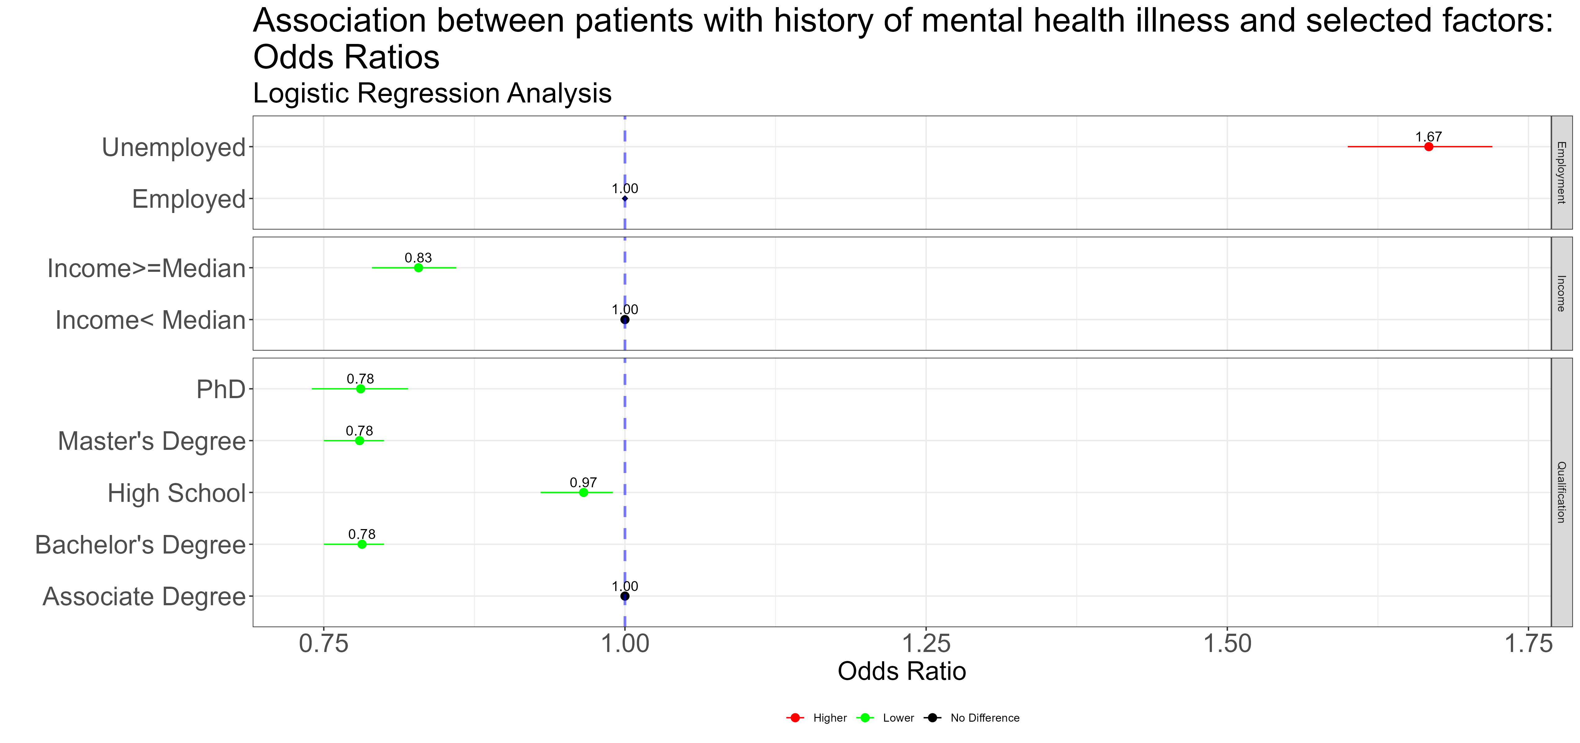
Adjusted Model- Logistic Regression
Logistic regression analysis : Association between patients with a history of mental health illness and some selected factors. This model has been adjusted for all the factors listed. Most models usually adjust for age and sex regardless of significance level.
The likelihood of a person to have history of mental health is 67% higher for those unemployed compared to those employed (reference class)
The likelihood of a person to have history of mental health is 17% lower for those with greater than median income of 58,000USD compared to those less than 58000USD(refence class)
The likelihood of a person to have history of mental health illness is 12% lower each for those with PhD, Master degree and bachelor's degree compared to those with with associate degree (reference class)
or those between 20-24 years is 12%.

Slide 20
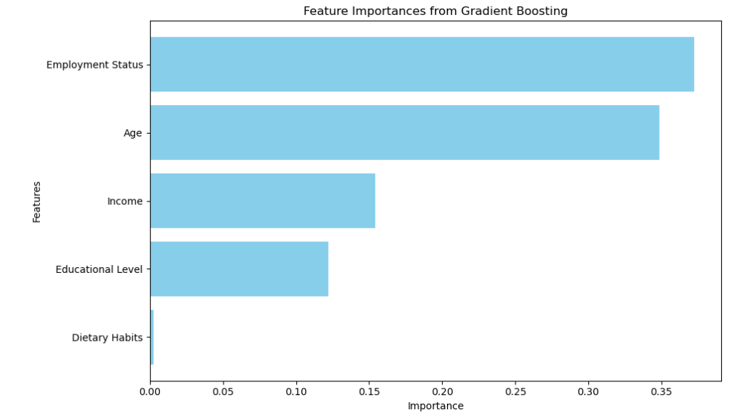
Machine Learning Model
Use case
Classification
Matrix - Recall
Exploratory Data Analysis
Data preparation
- Feature selection, engineering & scaling, SMOTE
Model Training
LR, Random Forest, Decision Tree, Gradient Boosting
Hyperparameters tuning using cross-validation
Fitted Model & serialisation
Recall:70% of patients with mental health illness predicted to have mental health illness.
Future Work: More relevant Data , Feature transformation based on domain knowledge / interactions , Test significance of variables

Slide 21
Predicting Mental Health Illness
Thank you for listening
Questions

