Slide 1
Depression
Introduction – Data description. The depression dataset contains information on individuals with various attributes related to their personal and lifestyle factors.
Features of the data set
Name: The full name of the individual.
Age: The age of the individual in years.
Marital Status: Single, Married, Divorced, and Widowed.
Education Level: High School, Associate Degree, Bachelor's Degree, Master's Degree, and PhD.
Number of Children: one, two three four
Smoking Status: Smoker, Former and Non-smoker.
Physical Activity Level: Sedentary, Moderate, and Active.
Employment Status: Employed and Unemployed.
Income: The annual income of the individual in USD.
Alcohol Consumption: Low, Moderate, and High.
Dietary Habits: Healthy, Moderate, and Unhealthy.
Sleep Patterns: Good, Fair, and Poor.
History of Mental Illness: Whether the individual has a history of mental illness. Possible values are Yes and No.
History of Substance Abuse: Whether the individual has a history of substance abuse. Possible values are Yes and No.
Family History of Depression: Indicates if there is a family history of depression. Possible values are Yes and No.
Chronic Medical Conditions: Whether the individual has chronic medical conditions. Possible values are Yes and No.

Slide 2
Assumptions and Data preperation
The data set had so many records for each patient with history of mental illness recorded at different time points. Also, for a particular patient, there were some conflicting records of history of mental health condition recorded at different at ages. For example, a patient of age 20 years may have two records for history of mental illness, one present and absent. The longitudinal nature of the data set presented challenges for analysis and introduced a lot of duplicate records. To prepare the data for analysis with unique records for each patient, the following assumptions were made:
I considered only the most recent record of diagnosis regardless of whether the patient has a history of mental health illness (Yes/No). I made this assumption because the latest record represents the true health state of the individual.
Patients that had a history of mental health (Yes) and history of mental illness (No) at the same age were dropped as the outcome was conflicting.
These assumptions reduced the data to unique records per patient. The data set contained a total of 413,768 records ( including duplicates) . There were a total of 52% duplicate records and 48% unique records

Slide 3
Summary Statistics
Attributes |  |  | History of Mental Illness
Age | Mean (SD) |  | 55.2 (18.1)
Income | Mean (IQR) |  | 27,605 (60295)
Marital Status | Divorced |  | 3,970 (6.7%)
 | Married |  | 35,774 (60.0%)
 | Single |  | 6,916 (11.6%)
 | Widowed |  | 12,982 (21.8%)
Educational Level | Associate Degree |  | 12,790 (21.4%)
 | Bachelor's Degree |  | 16,382 (27.5%)
 | High School |  | 17,888 (30.0%)
 | Master's Degree |  | 10,170 (17.1%)
 | PhD |  | 2,412 (4.0%)
Number of Children | 0 |  | 19,738 (33.1%)
 | 1 |  | 12,986 (21.8%)
 | 2 |  | 13,117 (22.0%)
 | 3 |  | 12,395 (20.8%)
 | 4 |  | 1,406 (2.4%)
Smoking Status | Current |  | 5,146 (8.6%)
 | Former |  | 17,061 (28.6%)
 | Non-smoker |  | 37,435 (62.8%)
Physical Activity Level | Active |  | 8,485 (14.2%)
 | Moderate |  | 23,024 (38.6%)
 | Sedentary |  | 28,133 (47.2%)
There is total of 194,622 unique patients.
Age: Patients with a history of mental health has a average age of 52 years
Income: The median income for patients with a history of mental health is 27,605USD.
Marital status: Most of the patients (60% ) with a history of mental illness are married.
Educational level: The highest proportion (30%) of patients with a history of mental illness have high school qualification.
Children: The highest proportion (33%) of patients with a history of mental illness have high school qualification don’t have any child
Smoking status: The highest proportion (62%) of patients with a history of mental illness are non-smokers.
Physical Activity. Almost half (47%) of patients with a history of mental illness have level of physical activity as sedentary

Slide 4
Summary Statistics cont
Employment status: The proportion of patients with a history of mental illness who are either employed or unemployed is similar.
Alcohol: The proportion of patients with a history of mental illness with moderate levels of alcohol consumption is highest (42%) compared to those with high and low alcohol consumption levels.
Dietary habits: The proportion of patients with a history of mental illness with a healthy diet is lowest (15%) compared to moderate and unhealthy habits.
Sleep Patterns: The proportion of patients with a history of mental illness with fair sleep patterns is highest (48%) compared to those with good or poor sleep patterns
Substance misuse: The proportion of patients with a history of mental illness who have a substance misuse record is lowest compared to those without a record of substance misuse.
History of family depression: Amongst the people that have a history of mental health illness, there were more without a history of depression (71%) compared to those with depression (28%)
Chronic conditions: Amongst the people that have a history of mental health illness, there were more without a chronic conditions (67%) compared to those with chronic conditions (33%)
Attributes |  | History of Mental Illness
Employment Status | Employed |  | 29,812 (50.0%)
 | Unemployed |  | 29,830 (50.0%)
Alcohol Consumption | High |  | 15,128 (25.4%)
 | Low |  | 19,772 (33.2%)
 | Moderate |  | 24,742 (41.5%)
Dietary Habits | Healthy |  | 9,069 (15.2%)
 | Moderate |  | 24,679 (41.4%)
 | Unhealthy |  | 25,894 (43.4%)
Sleep Patterns | Fair |  | 28,498 (47.8%)
 | Good |  | 10,815 (18.1%)
 | Poor |  | 20,329 (34.1%)
Substance Misuse | No |  | 41,193 (69.1%)
 | Yes |  | 18,449 (30.9%)
Family History of Depression | No |  | 42,568 (71.4%)
 | Yes |  | 17,074 (28.6%)
Chronic Medical Condition | No |  | 39,874 (66.9%)
 | Yes |  | 19,768 (33.1%)

Slide 5
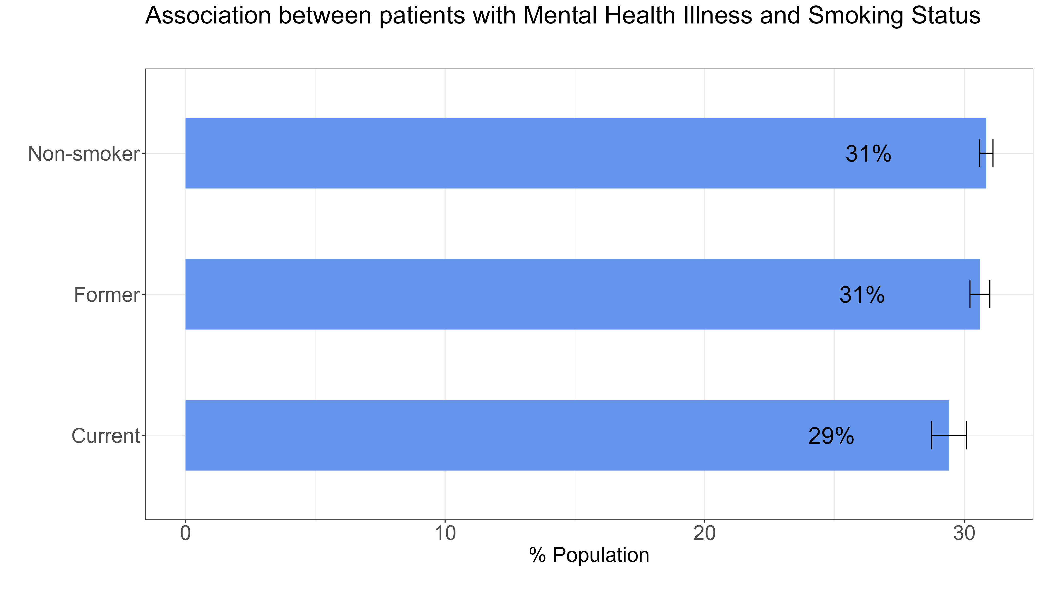
Association between history of mental illness and smoking status
This figures show the crude rate of patients with a mental health illness according to smoking status
After accounting for population size in each smoking segment, the crude rate of mental illness is similar across all smoking status. The crude rate is smaller for current smokers (29%) compared to former and non- smokers (31%)
or those between 20-24 years is 12%.

Slide 6
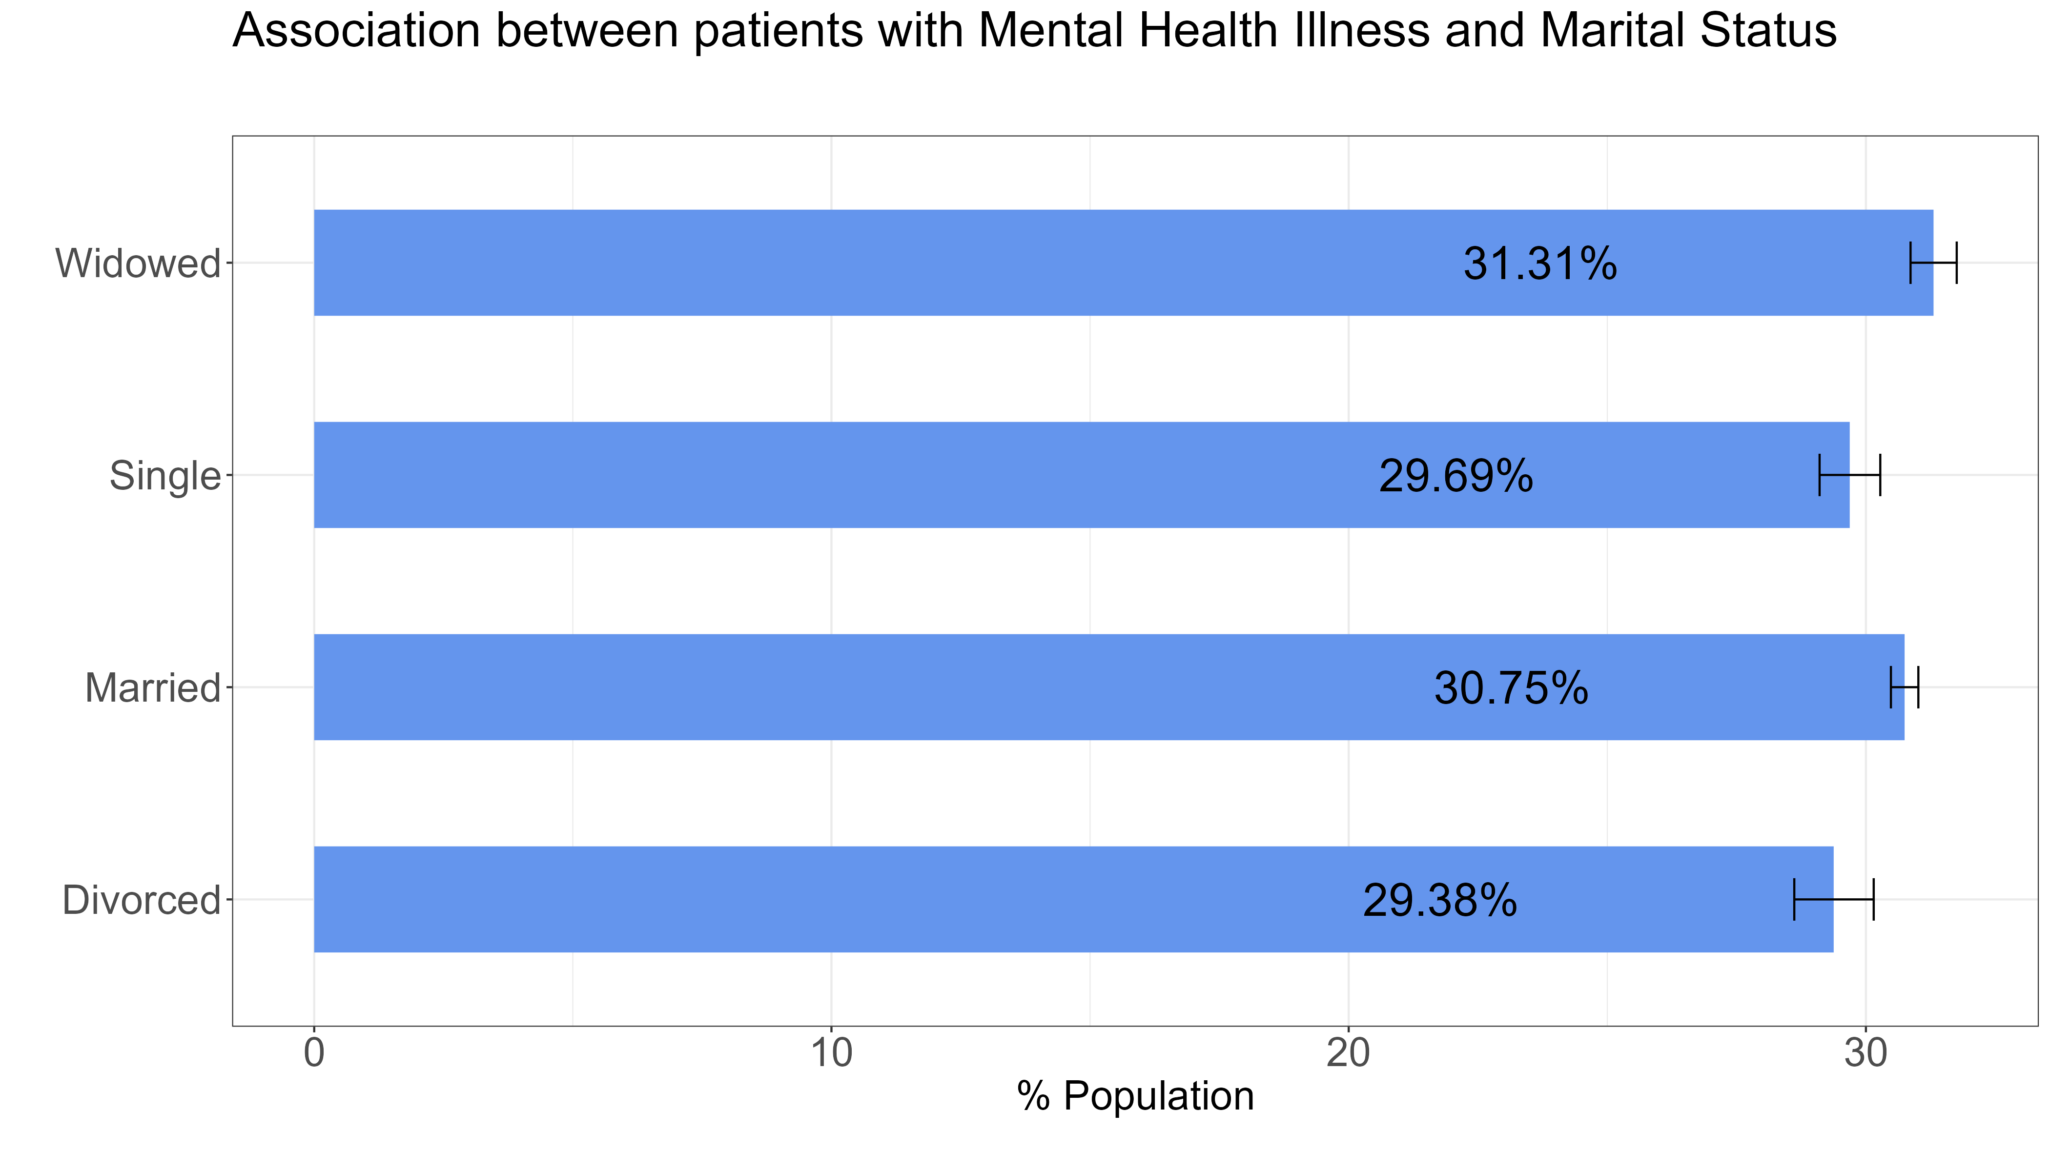
Association between history of mental illness and marital status
This figures show the crude rate of patients with a mental health illness according to marital status.
After accounting for population size in each segment, the crude rate of mental illness is highest amongst those who are widowed (31%) and lowest for those who are divorced (29%).
or those between 20-24 years is 12%.

Slide 7
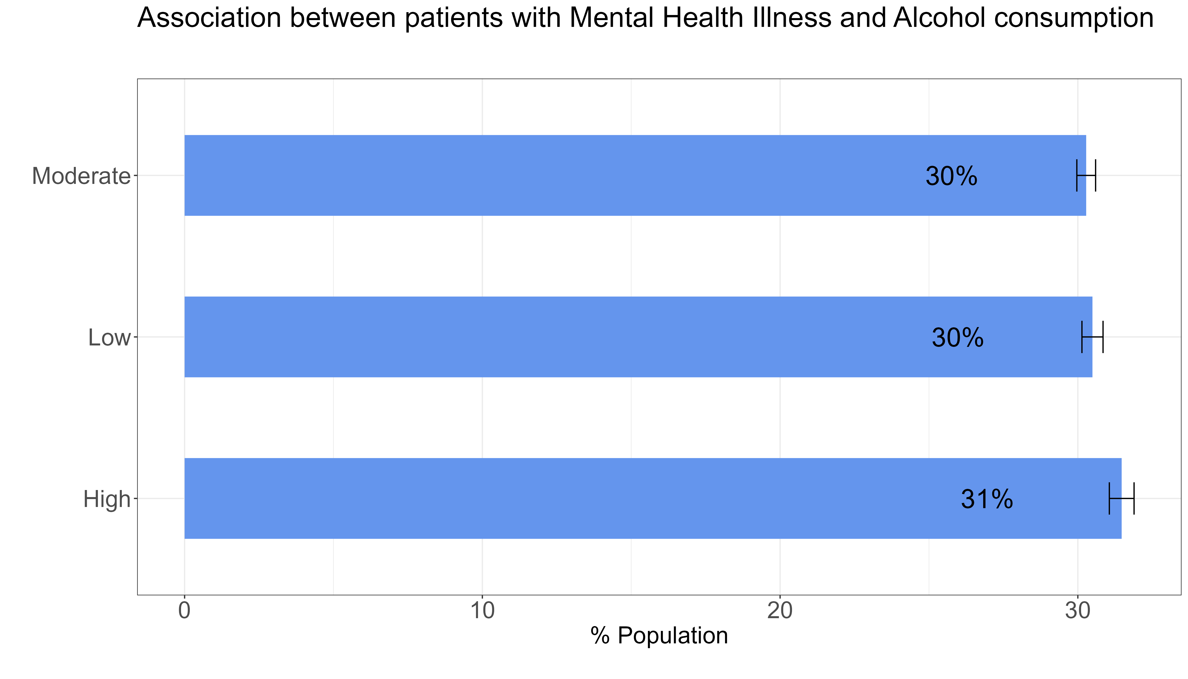
Association between mental illness and alcohol consumption
This figures show the crude rate of patients with a mental health illness according to levels of alcohol consumption
After accounting for population size in each segment, the crude rate of mental illness is similar across the different alcohol consumption levels
or those between 20-24 years is 12%.

Slide 8
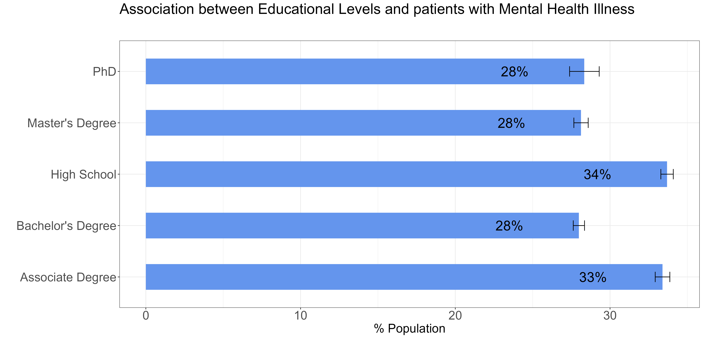
Association between mental illness and education level
This figures show the crude rate of patients with a mental health illness by levels of education
After accounting for population size in each segment, the crude rate of mental illness is highest for patients with High school (34%) and Associate degree(33%) compared to the other levels of education.
or those between 20-24 years is 12%.

Slide 9
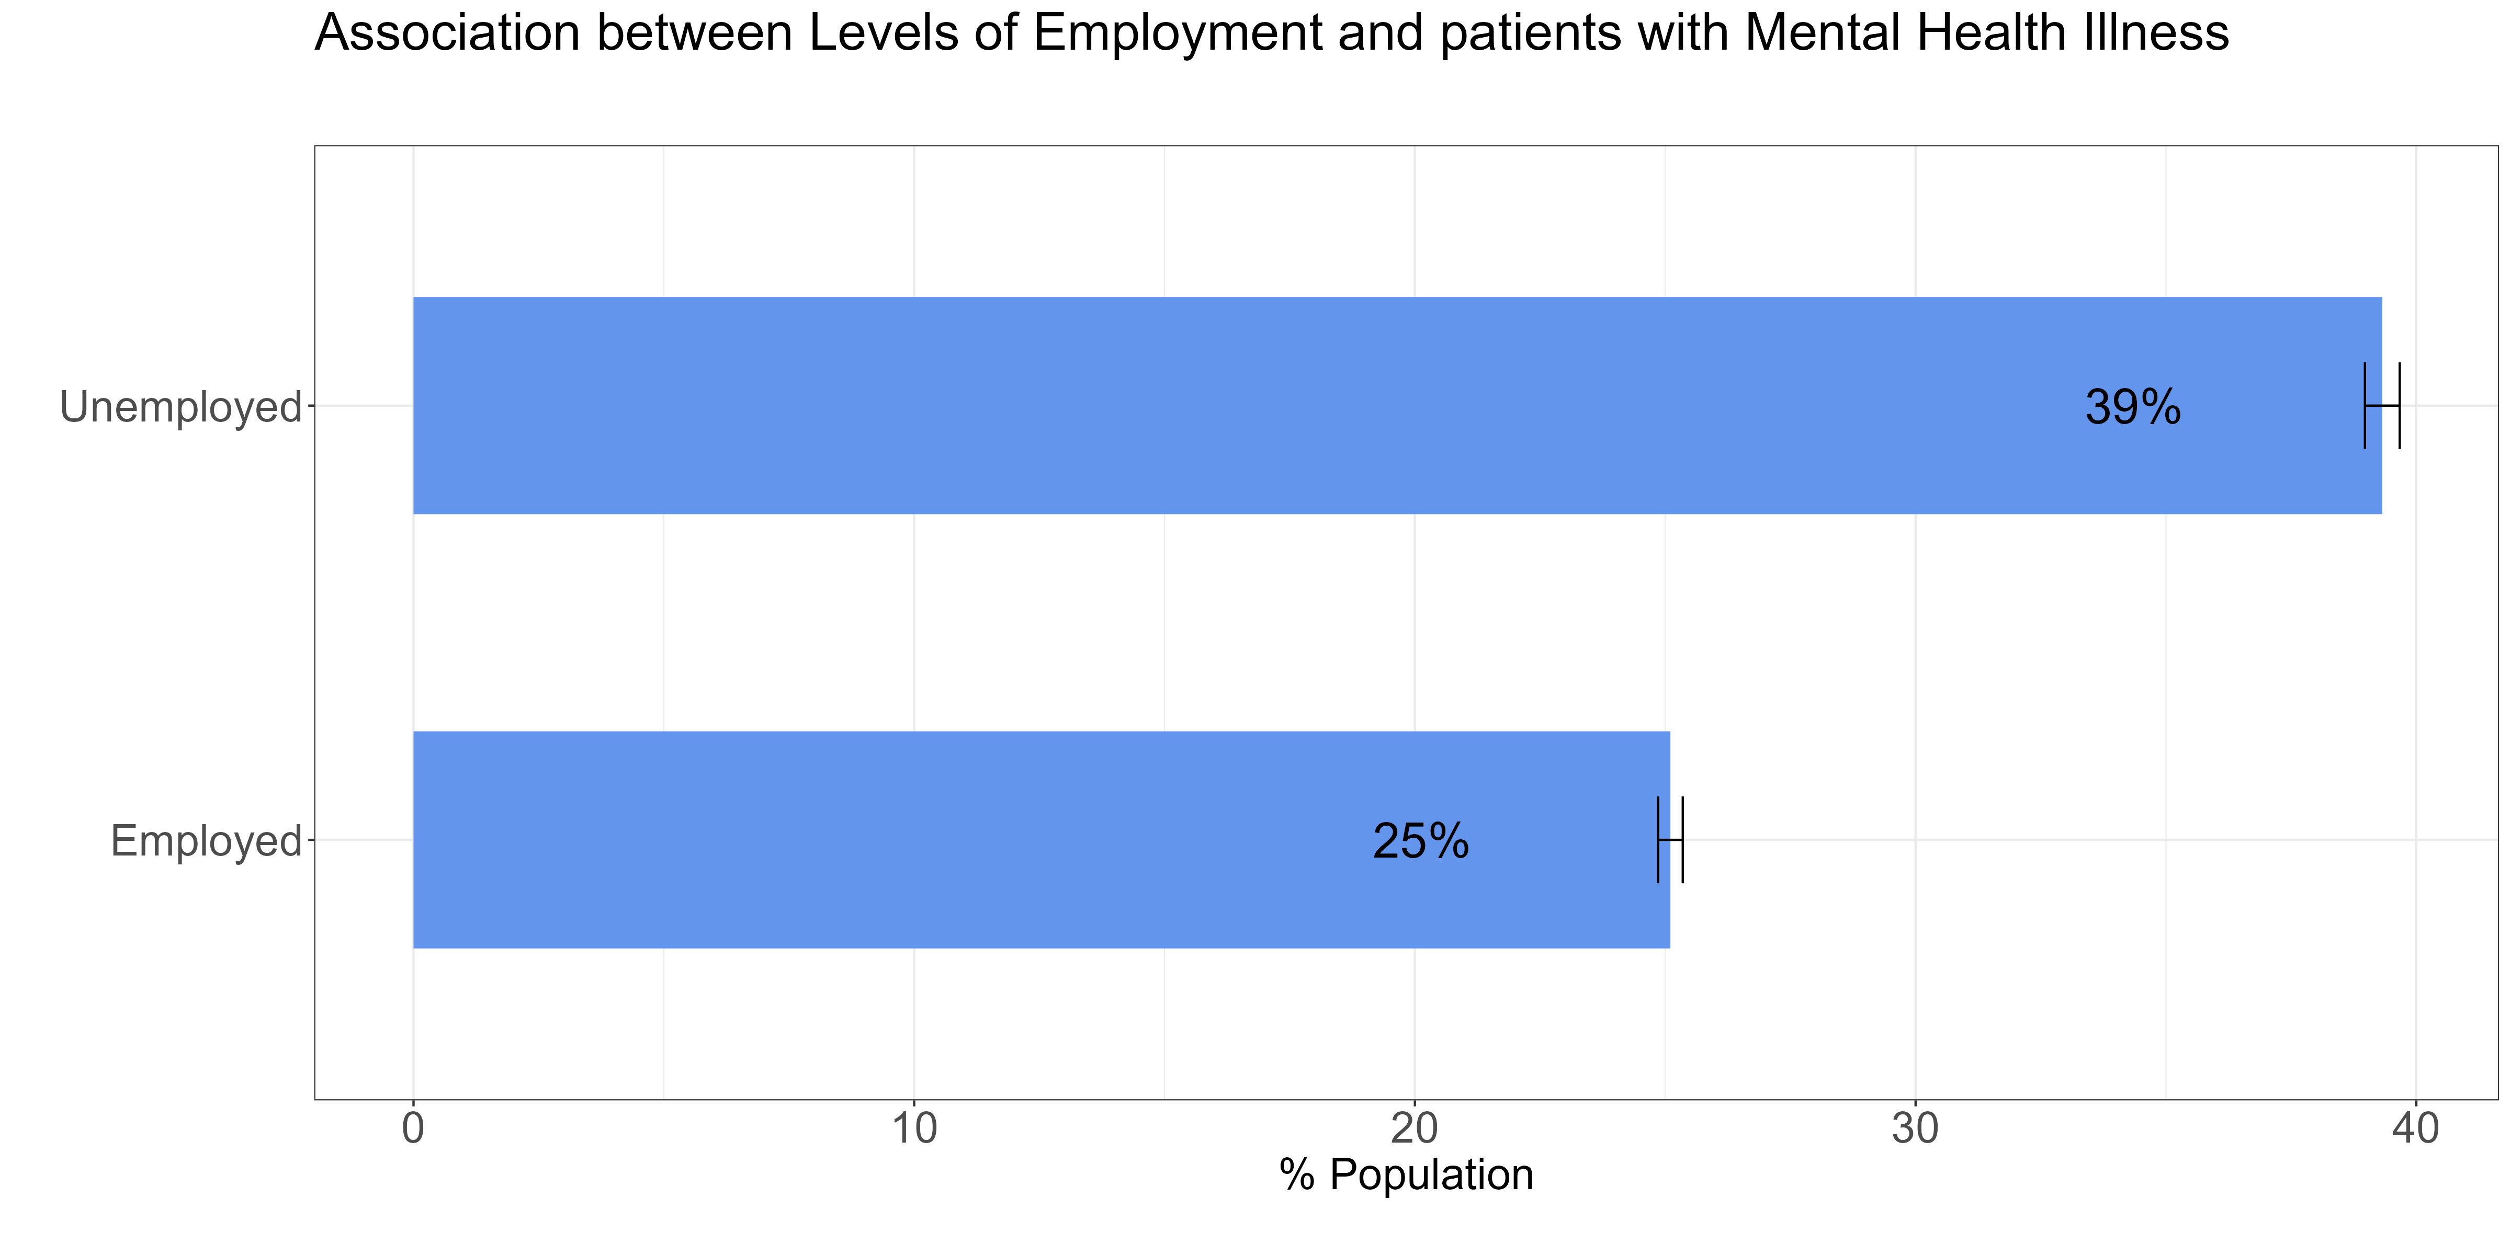
Association between mental illness and levels of employment
This figures show the crude rate of patients with a mental health illness by employment status.
After accounting for population size in each segment, the crude rate of mental illness is highest for patients who are unemployed (39%) compared to those who are employed.
or those between 20-24 years is 12%.

Slide 10
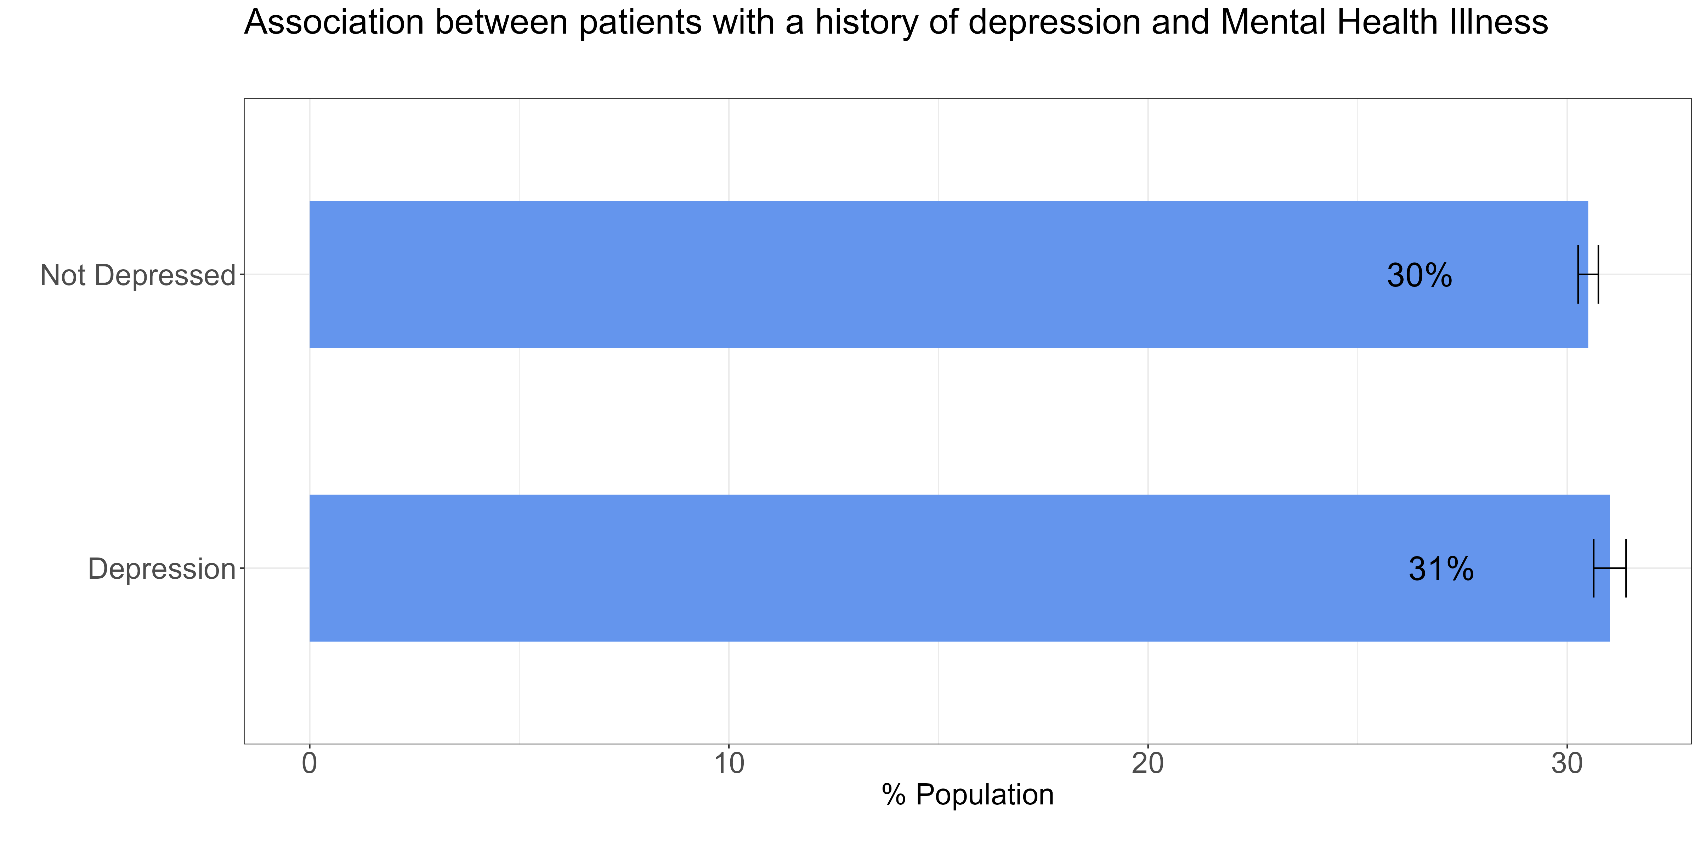
Association between mental illness and history of depression
This figures show the crude rate of patients with a mental health illness according to depression status.
After accounting for population size in each segment, the crude rate of mental illness is similar for those who are depressed and those not depressed, 31% and 30% respectively.
or those between 20-24 years is 12%.

Slide 11
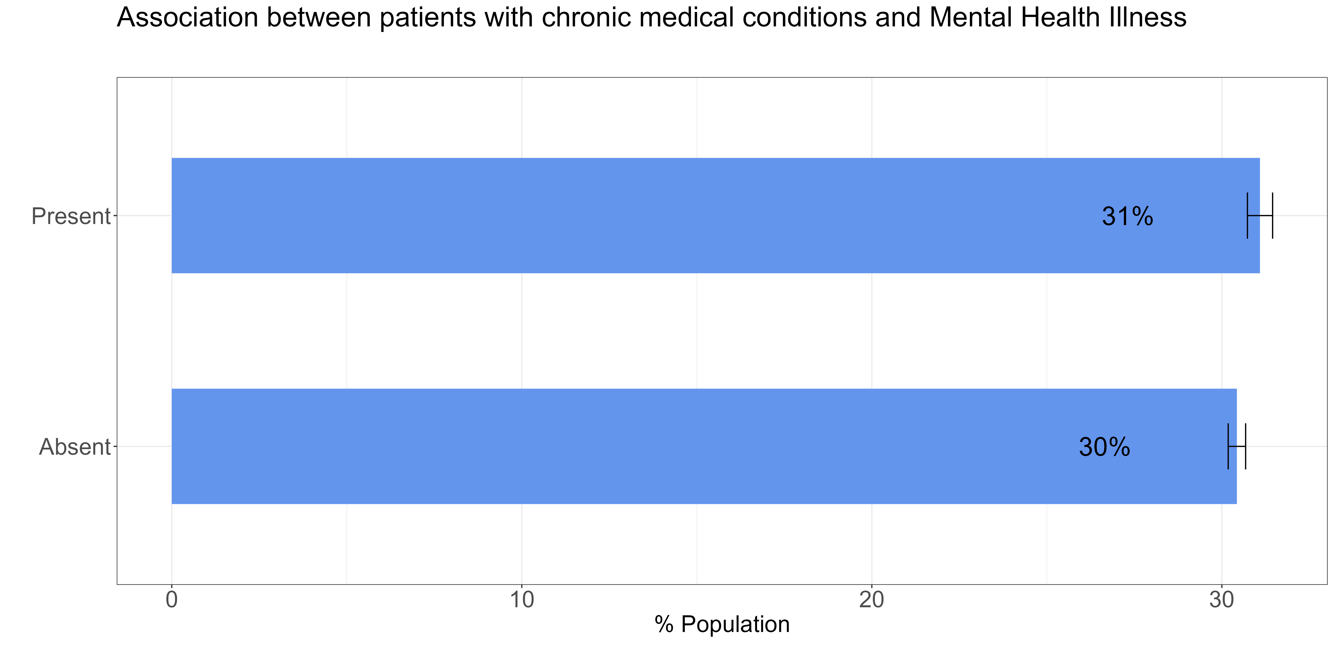
Association between mental illness and chronic medical conditions
This figures show the crude rate of patients with a mental health illness according to whether they have a chronic condition or not.
After accounting for population size in each segment, the crude rate of mental illness is similar for those with chronic medical conditions and those without is similar, 31% and 30% respectively.
or those between 20-24 years is 12%.

Slide 12
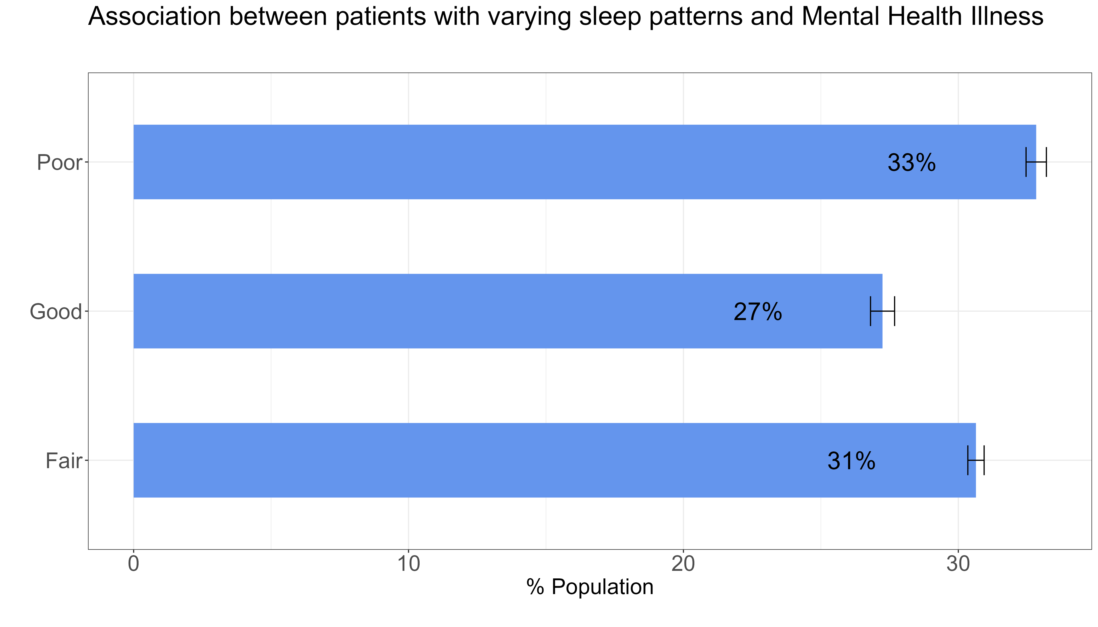
Association between mental illness and different sleep patterns
This figures show the crude rate of patients with a mental health illness according to different sleep patterns
After accounting for population size in each segment, the crude rate of mental illness is highest for patients with poor and fair sleep patterns, 33% and 31% respectively compared to those with a good sleep pattern (27%)
or those between 20-24 years is 12%.

Slide 13
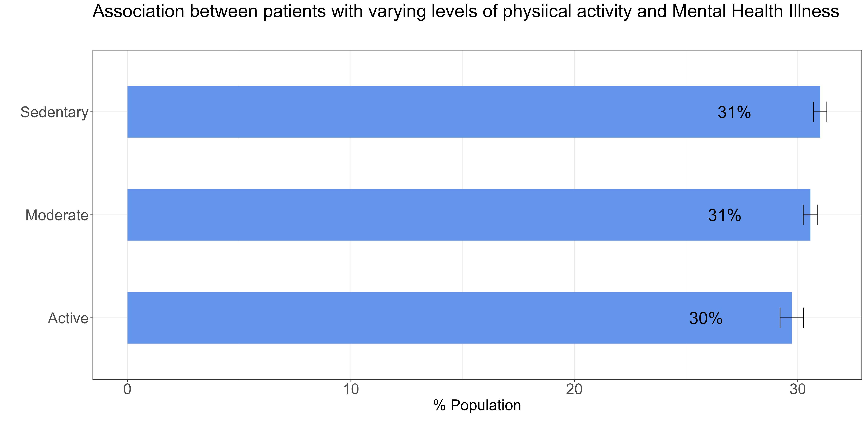
Association between mental illness and different physical activity
This figures show the crude rate of patients with a mental health illness according to different physical activity levels
After accounting for population size in each segment, the crude rate of mental illness is similar across all levels of physical activity.
or those between 20-24 years is 12%.

Slide 14
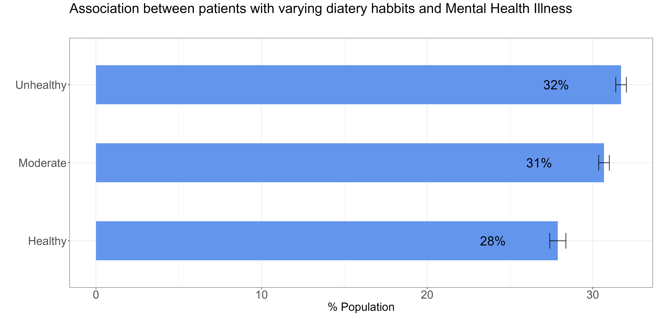
Association between mental illness and dietary habits.
This figures show the crude rate of patients with a mental health illness according to different dietary habits
After accounting for population size in each segment, the crude rate of mental illness is highest for patients with unhealthy diet (32%) compared to those who have a healthy diet (28%).
or those between 20-24 years is 12%.

Slide 15
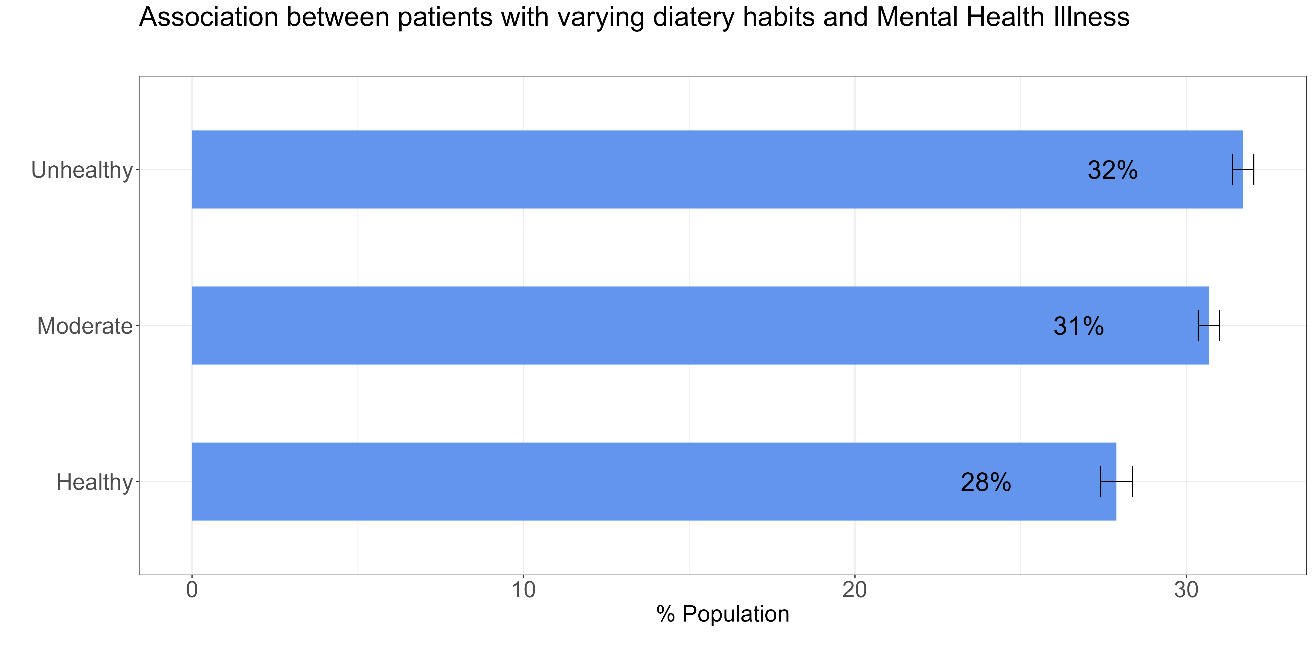
Association between mental illness and dietary habits.
This figures show the crude rate of patients with a mental health illness according to different dietary habits.
After accounting for population size in each segment, the crude rate of mental illness is highest for patients who with unhealthy diet (32%) compared to those who have a healthy diet (28%)
or those between 20-24 years is 12%.

Slide 16
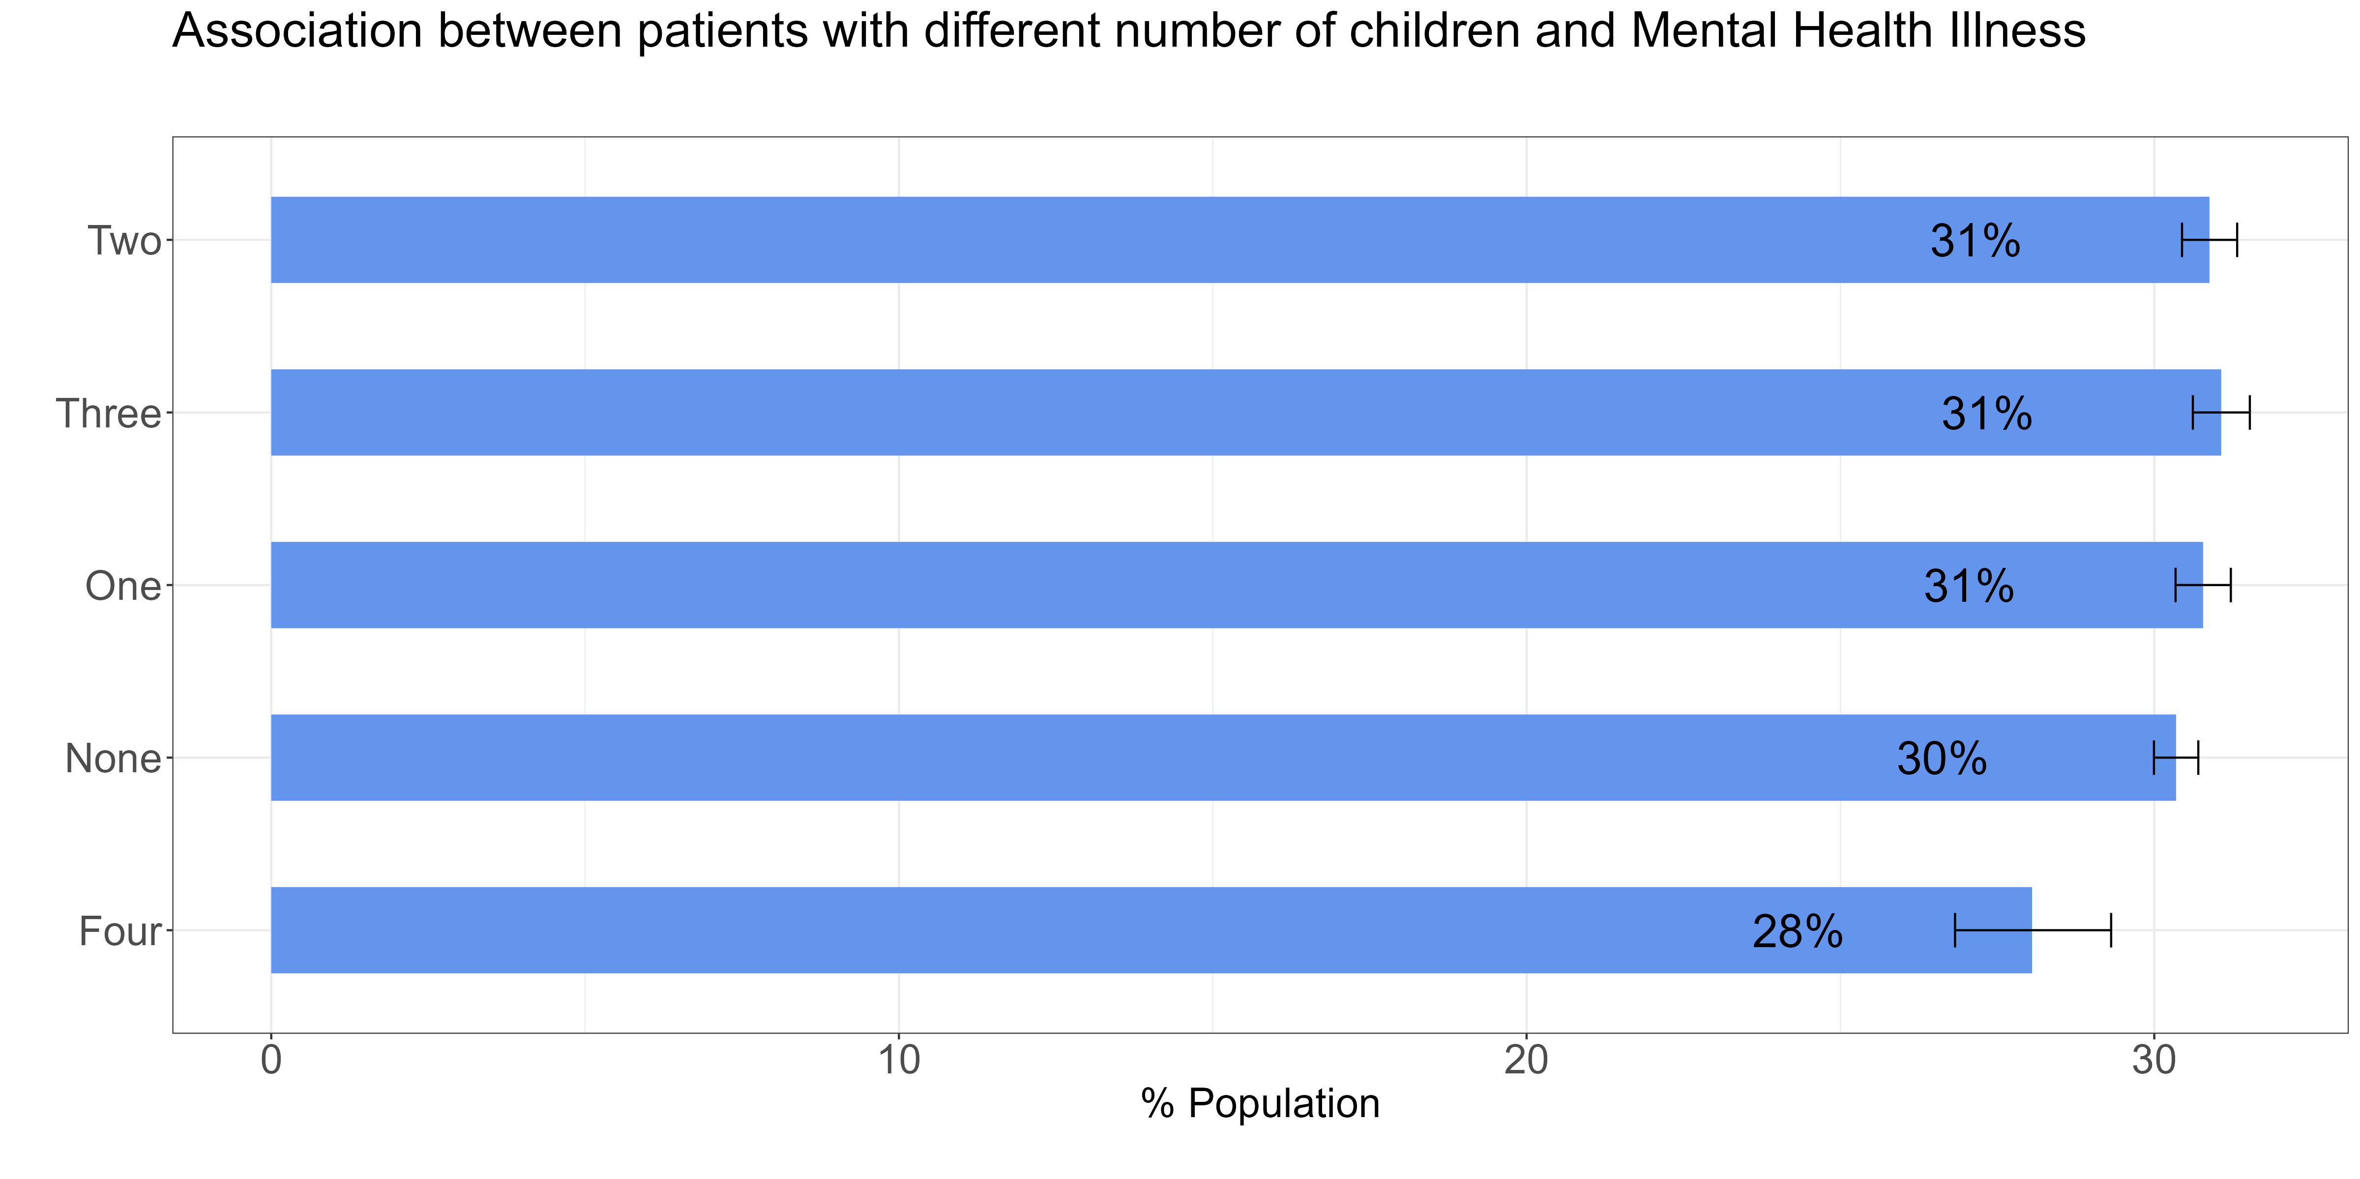
Association between mental illness and number of children.
This figures show the crude rate of patients with a mental health illness according to the number of children
After accounting for population size in each segment, the crude rate of mental illness is highest (31%) for patients without a child one, two and three children and lower in those with four children (28%)
or those between 20-24 years is 12%.

Slide 17
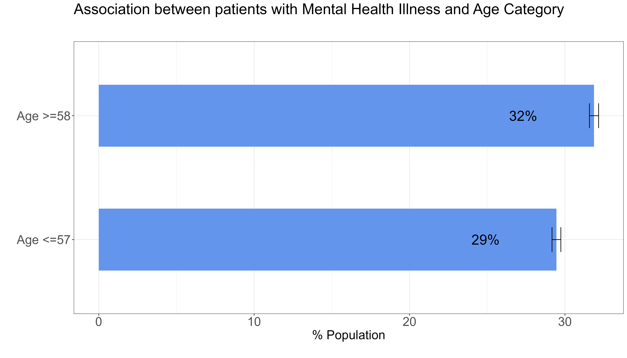
Association between mental illness and age.
This figures show the crude rate of patients with a mental health illness according to age categories based on median age
After accounting for population size in each segment, the crude rate of mental illness is highest (32%) for patients greater than median age of 58 years compared to those less than median age 58 years old (29%).
or those between 20-24 years is 12%.

Slide 18
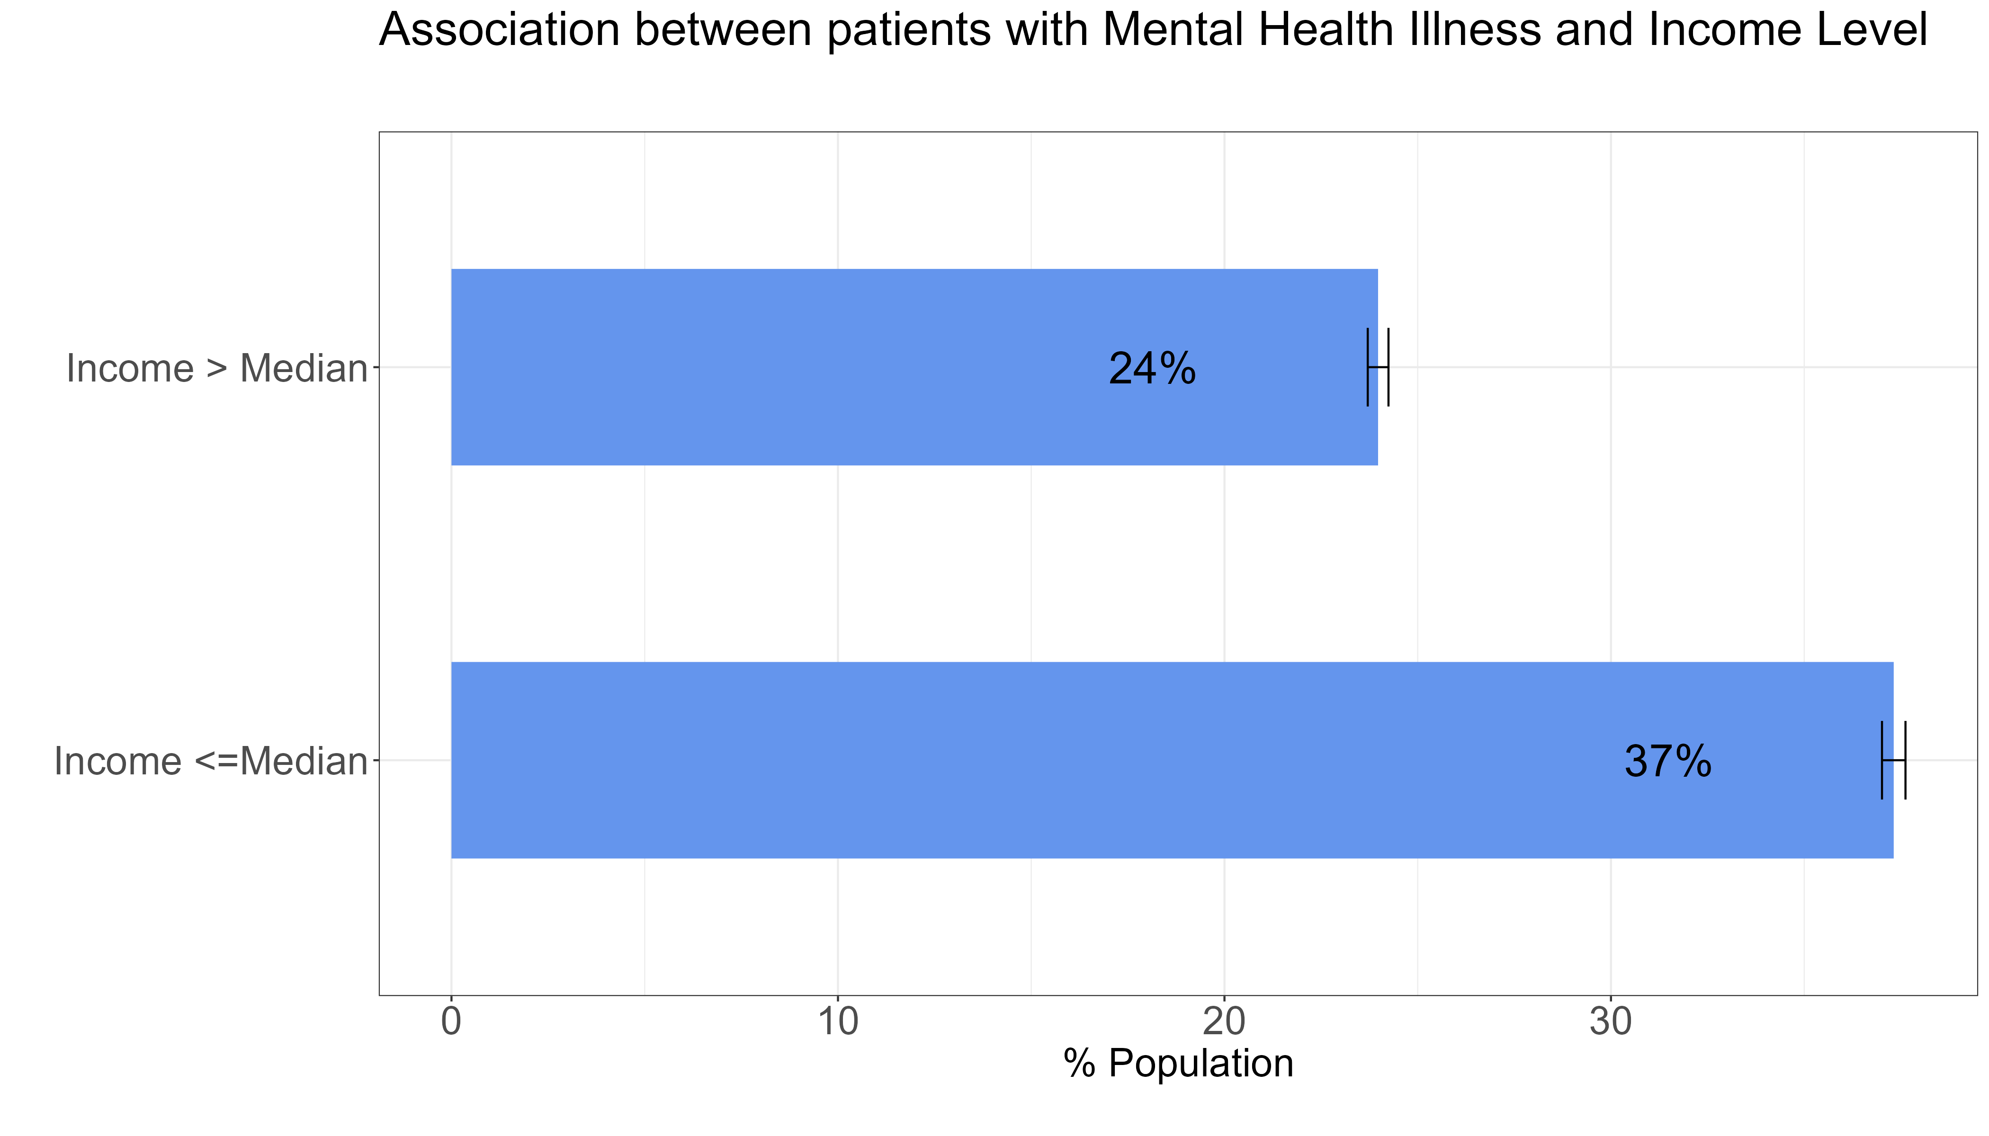
Association between mental illness and income.
This figures show the crude rate of patients with a mental health illness according to income categories based on median income
After accounting for population size in each segment, the crude rate of mental illness is highest (37%) for patients with income levels less than median income compared to those above median income.
or those between 20-24 years is 12%.

Slide 19
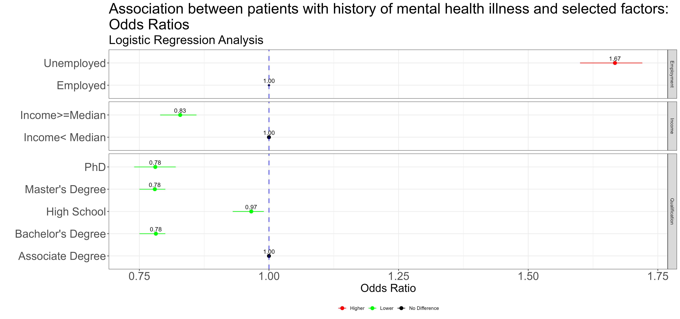
Adjusted Model- Logistic Regression
This figures show association between patients with a history of mental health illness and some selected factors. This has taken into consideration all factors listed. Most models usually adjust for age and sex regardless of significance level.
The likelihood of a person who is unemployed to have history of mental health is 67% higher compared to those who are employed (reference class)
For a patient with equal to or greater than the median income level to have history of mental health is 17% lower compared to those with an income level of less than the median income
People with PHD, Master Degree and Bachelor's degree are less likely (12% each) to have history of mental health compared to those with associate degree
or those between 20-24 years is 12%.

Slide 20
Distribution of

Slide 21
Improving the fitted model
Based on the data, and testing just two algorithms, logistic regression model with an accuracy is 69% was the better performing model. The following are some ideas for how the model can be improved.
Feature selection –using a certain number of predictors that have the highest coefficients that are statistically significant at the 5% level.
Transforming some features and testing if they are more predictive of mental illness.
Using lasso regularization and removing predictors whose coefficients become zero.
For random forests, using the variable importance and selecting a certain number of predictors with the highest importance can improve model accuracy.
Including more variables that are predictive of mental health, but at the same time keeping model simple.
Using more data points is usually a good way forward.
Consider using neural networks to capture more complex patterns in the data set.
Mention about imbalance data set
Age and sleeping habits deleted but not improve the fit

Slide 22
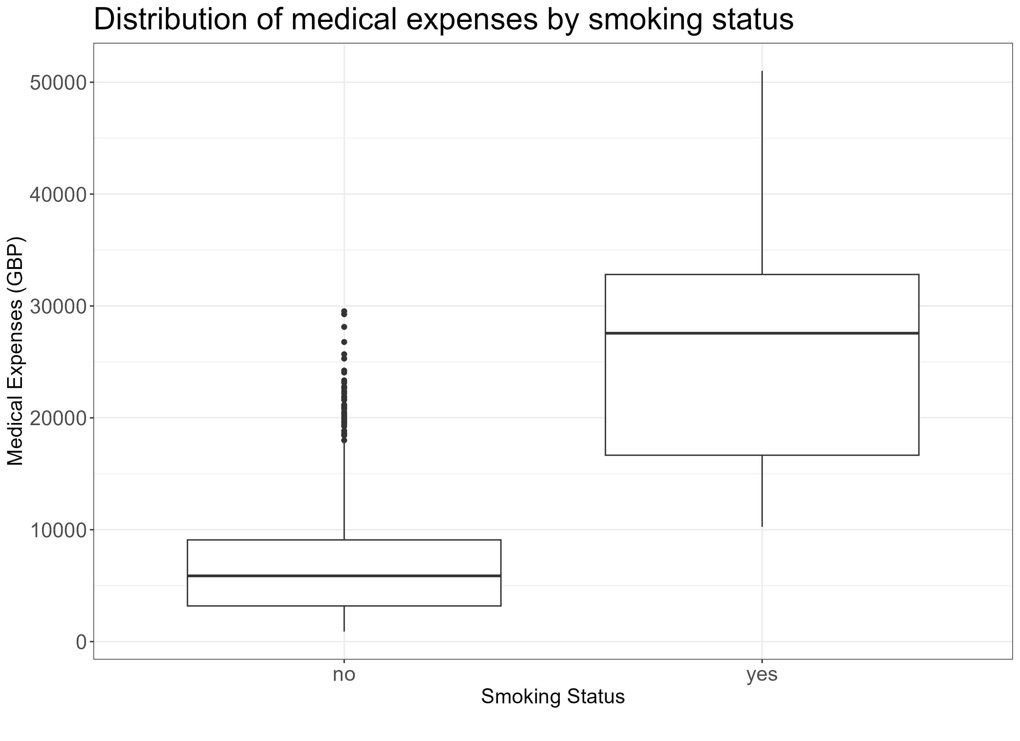
Distribution of medical expenses
How does the medical expenses distribute amongst smokers?
Half of smokers have a medical expense in the region of about 27,565 pounds
Half of non-smokers have a medical expense in the region of about 5,876 pounds
Medical expenses for smokers is significantly higher compared to non-smokers

Slide 23
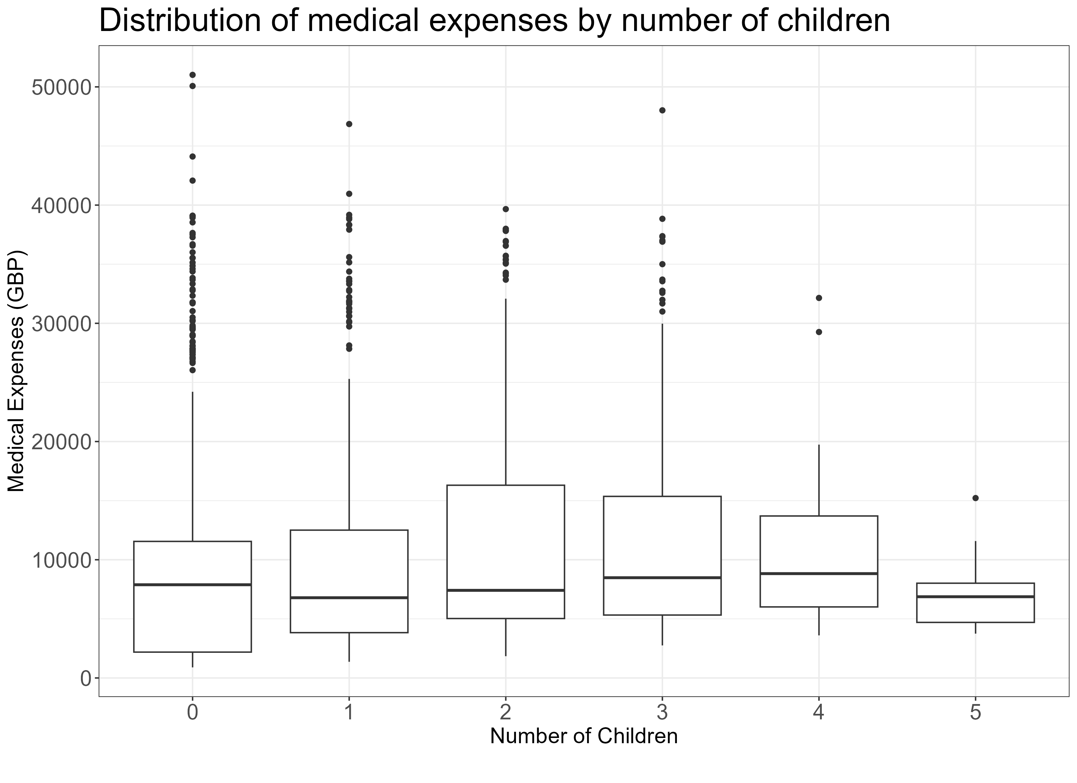
Distribution of medical expenses
How is the medical expensed distributed amongst the number of children?
Half of patients who doesn’t have any child have a medical expense of 7,886 pounds
Half of patients who have one child have a medical expense of 6,787 pounds
Half of patients who five children have a medical expense of 6,872 pounds
Generally, median medical expenditure increases as the number of child increases. After a five children, any additional child doesn’t have any significant increase in medical expenses

Slide 24
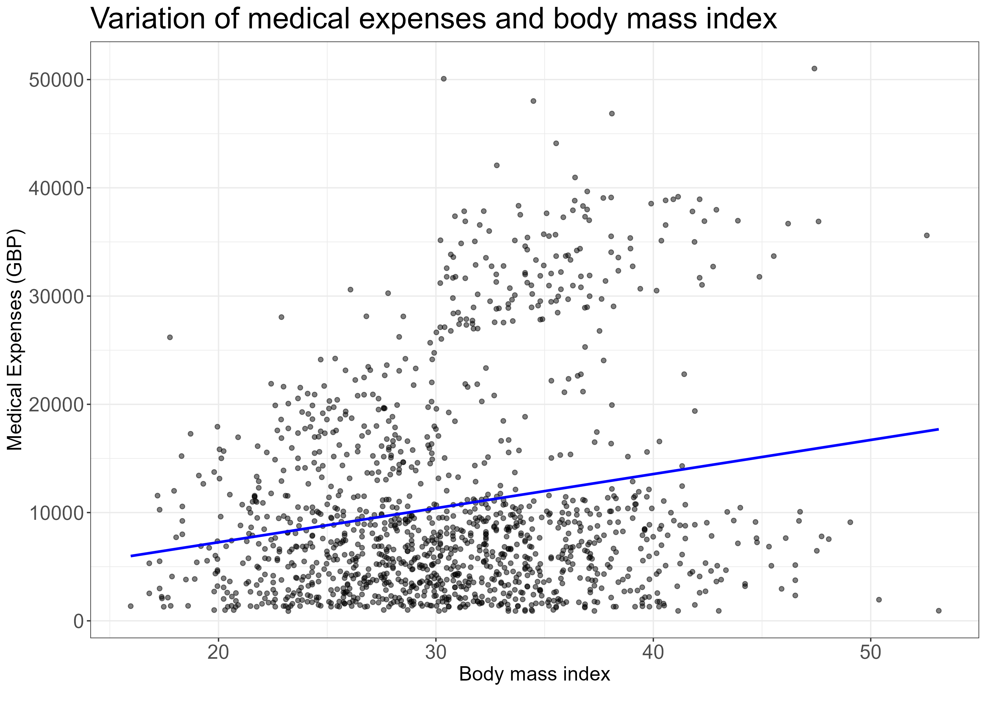
Distribution of medical expenses
How does the medical expenditure vary with body mass index ?
If your body mass is around 20, the average medical expenditure is around 8,500 pounds
If your body mass is around 40, the average medical expenditure is around 15000 pounds
Generally, as BMI increases, medical expenses increases

Slide 25
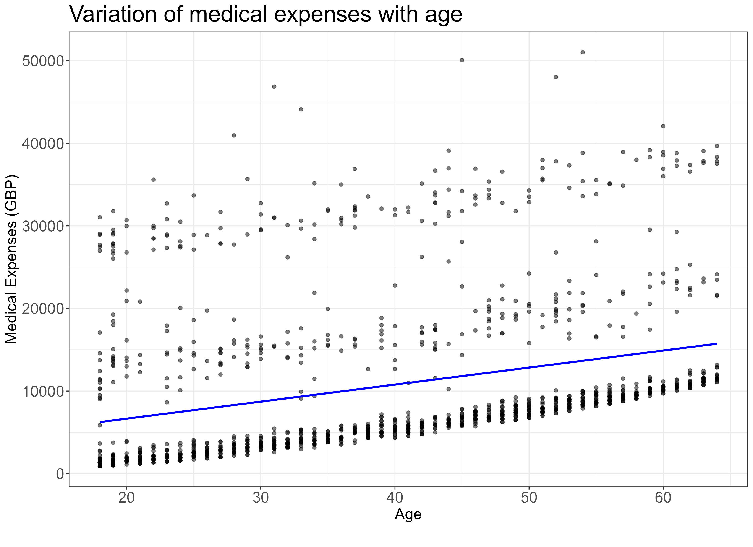
Distribution of medical expenses
How does the medical expenditure vary with age ?
People of some age groups have different medical expenses
Generally, as age increases, medical expenses increases

Slide 26
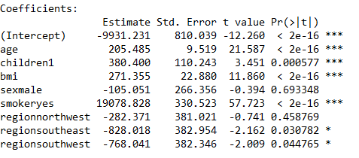
First Regression model – with all predictors
For each year that age increases, we would expect $205 higher medical expenses on average, assuming everything else is equal
Each additional child results in an average of $384 in additional medical expenses each year
Each unit of BMI increase is associated with an increase of $271 in yearly medical costs.
males have $105 less medical costs each year relative to females
smokers cost an average of $19078 more than non-smokers
the coefficient for each of the other three regions in the model is negative, which implies that the northeast region tends to have the highest average medical expenses. than non-smokers.
old age, smoking, and obesity tend to be linked to additional health issues, while additional family member dependents may result in an increase in physician visits and preventive care such as vaccinations and yearly physical exams
Rsquared = 75% - meaning 75% of medical charges is explained by the model

Slide 27
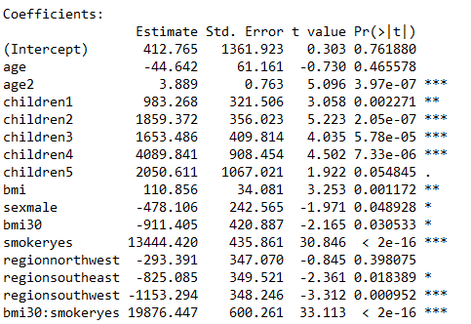
Improving model performance
if we have subject matter knowledge about how a feature is related to the outcome, we can use this information to inform the model specification and potentially improve the model's performance.
the effect of age on medical expenditures may not be constant throughout all age values; the treatment may become disproportionately expensive for the oldest populations
Transformation – converting a numeric variable to a binary indicator
BMI may have zero impact on medical expenditures for individuals in the normal weight range, but it may be strongly related to higher costs for the obese (that is, BMI of 30 or above).
adding interaction effects- What if certain features have a combined impact on the dependent variable? For instance, smoking and obesity may have harmful effects separately, but it is reasonable to assume that their combined effect may be worse than the sum of each one alone. When two features have a combined effect, this is known as an interaction.
To summarize the improvements, we: • Added a non-linear term for age • Created an indicator for obesity • Specified an interaction between obesity and smoking

Slide 28
Regression model
Relative to our first model, the R-squared value has improved from 0.75 to about 0.87. Our model is now explaining 87 percent of the variation in medical treatment costs. Additionally, our theories about the model's functional form seem to be validated. The higher-order age2 term is statistically significant, as is the obesity indicator, bmi30. The interaction between obesity and smoking suggests a massive effect, in addition to the increased costs of over $13,444 for smoking alone, obese smokers spend another $19,876 per year. This may suggest that smoking exacerbates diseases associated with obesity

Slide 29
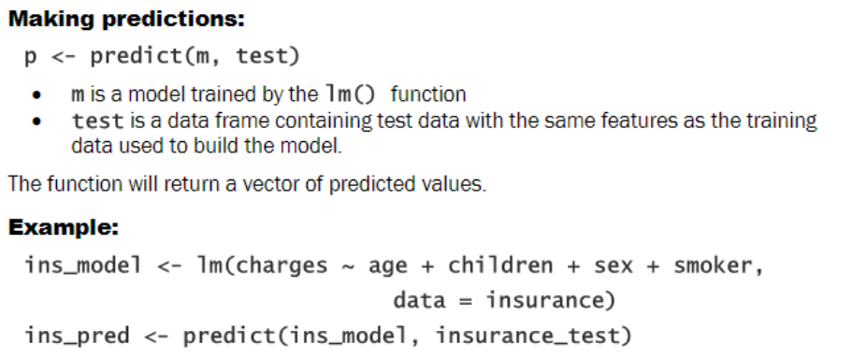
Prediction model

