Slide 1
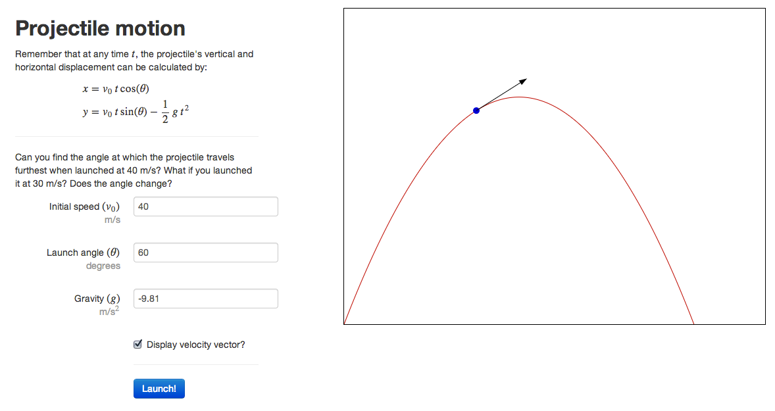
Simulations tied to realistic applications help motivate students to learn
High-school level

Slide 2
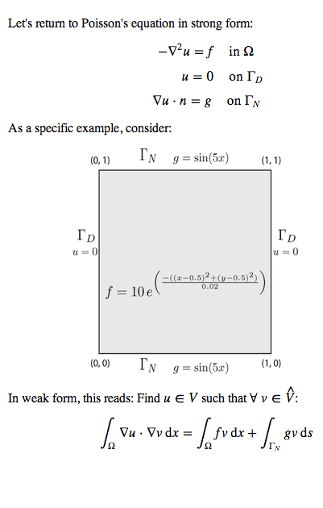
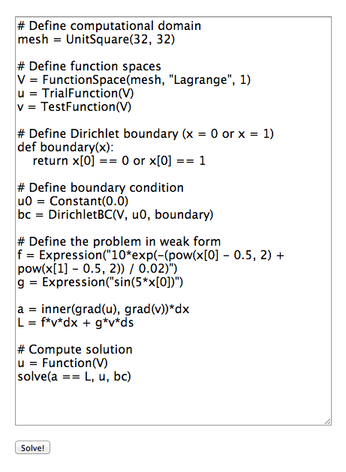
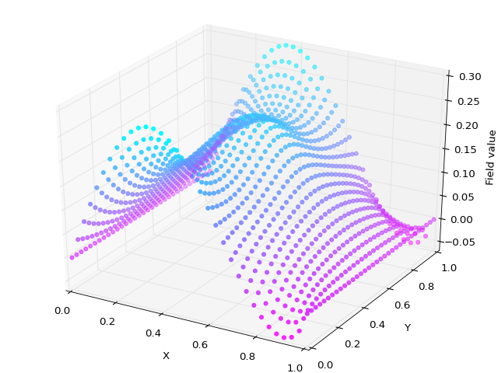
The interactive environment allows instructors to pose exercises to students
University level

Slide 3
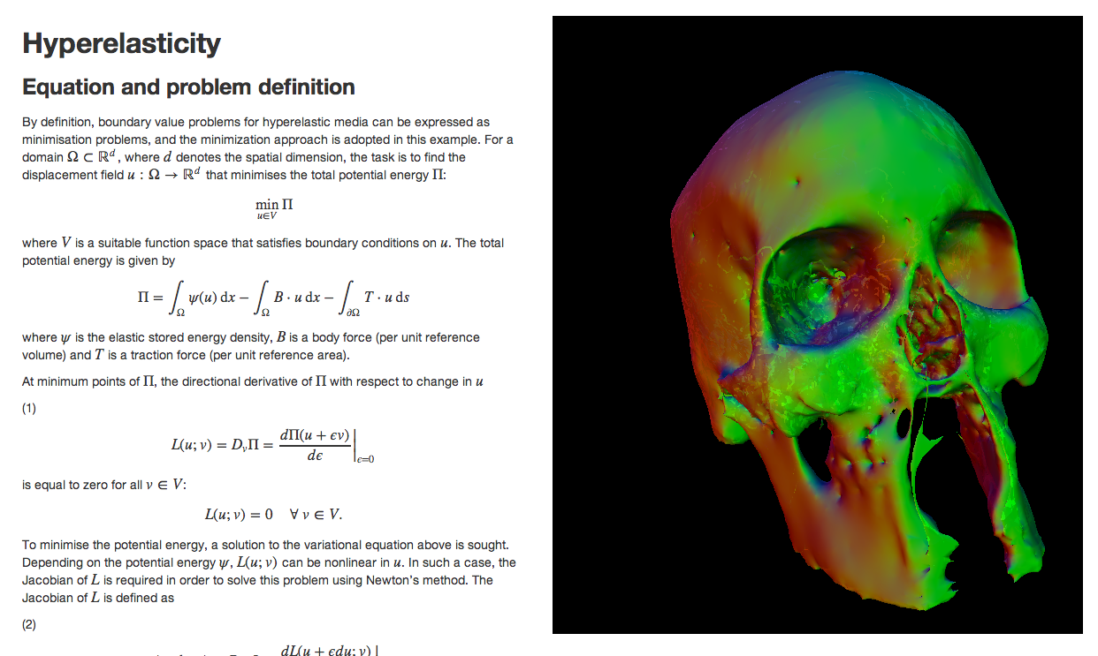
Simulations are presented through standard web technologies and are accessible on any device
Research level

