Slide 1

The goals of Mechanics Academy aligns naturally with the philosophy behind Studix
Mechanics Academy is an online resource that teaches students an exciting blend of applied mathematics, mechanics and scientific computing
It is directed at advanced high-school students, university-level students and industry professionals
It features in-browser simulations tied to realistic applications to motivate students to learn

Slide 2
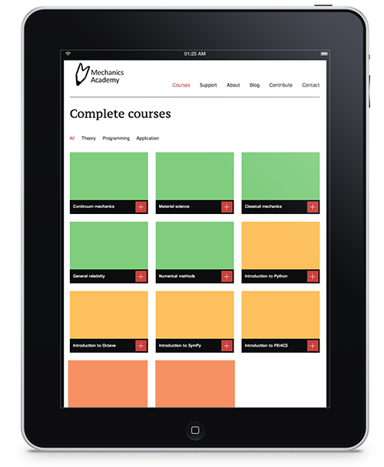
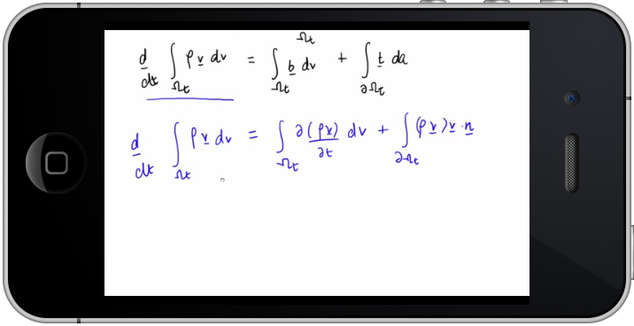
Mechanics Academy builds on the best ideas from previous online learning initiatives
The site acts as a catalogue of high-quality learning resources
  It focuses on competencies relevant to today’s industry
It builds a community of co-learners and experts to approach for help while learning
It uses the simulation technology to test learning and gauge competency
Connects strong students to industrial partners

Slide 3
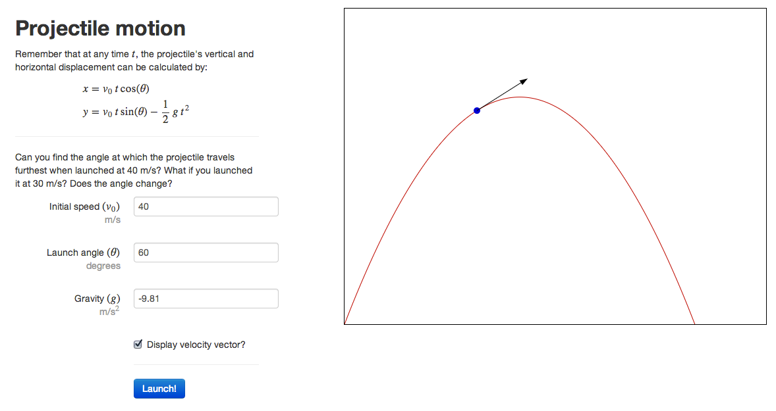
Simulations are presented through standard web technologies and are accessible on any device
High-school level

Slide 4
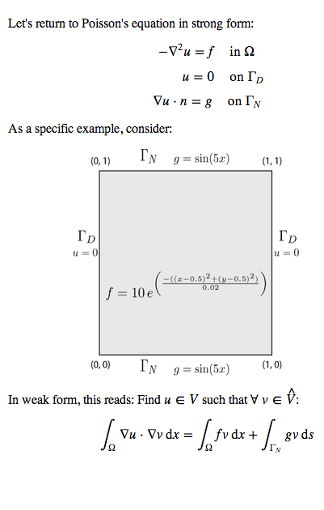
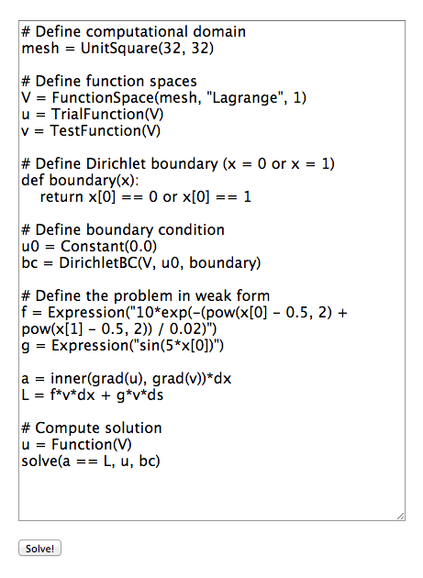
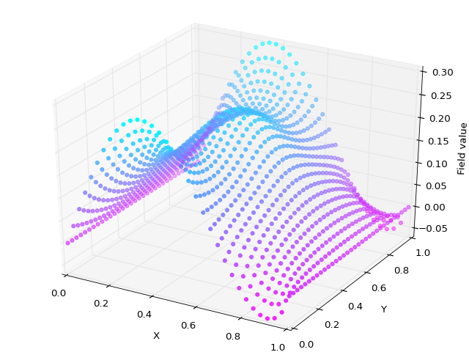
Simulations are presented through standard web technologies and are accessible on any device
University level

Slide 5
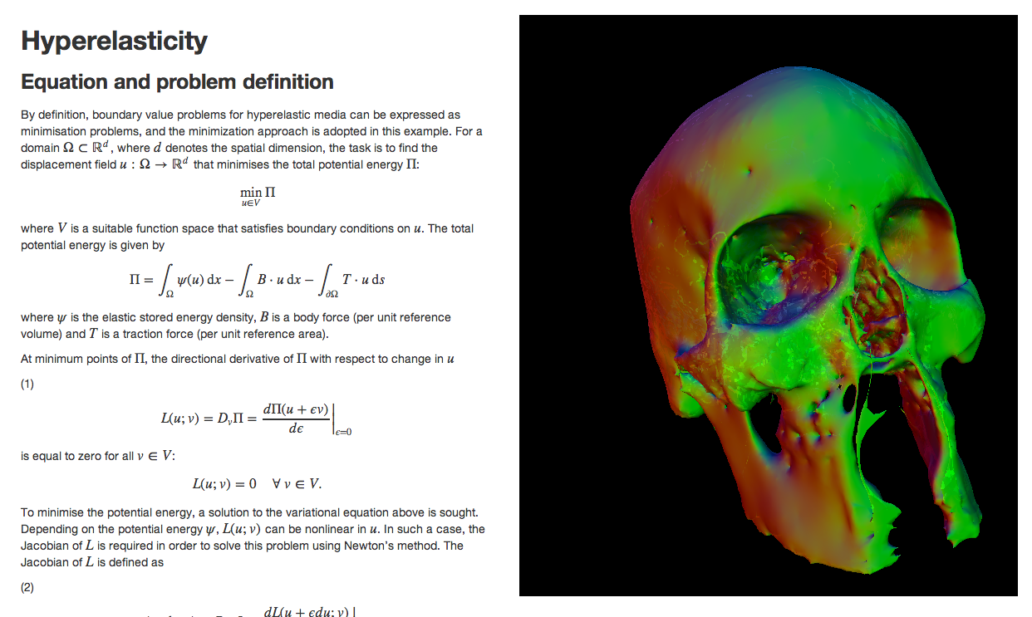
Simulations are presented through standard web technologies and are accessible on any device
Research level

