Slide 1


Reuse C test and UVM sequence utilizing TLM2, register model and interrupt handler
HongLiang Liu andy.liu@amd.com
Teng-Fei Gao teng-fei.gao@amd.com

Slide 2
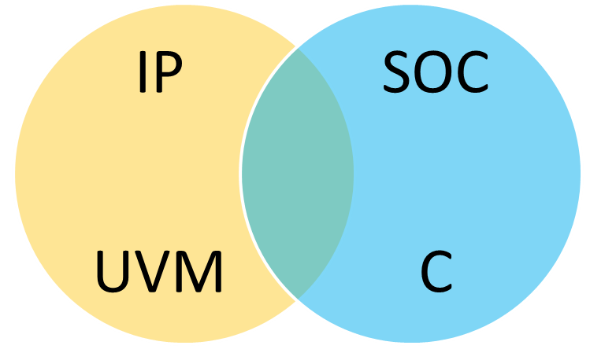
Abstract – Where we are
Reuse C test case and UVM sequence in SOC
reuse
reuse
Reuse happens at three layers in this paper
HongLiang Liu andy.liu@amd.com

Slide 3
Problem Statement
how to reuse SOC C test cases when system bus protocol changes?
how to reuse IP UVM sequence to SOC verification environment?
HongLiang Liu andy.liu@amd.com

Slide 4
Prior Work
When SOC’s system bus protocol changes, such as from PCIE to AXI, SOC C based test bench need be updated
IP UVM is passive in SOC verification environment, not active
  SOC verification engineer creates new C test cases to verify new IP’s register and interrupt
HongLiang Liu andy.liu@amd.com

Slide 5
Approach / Ideas
test stimulus is software, think in software way
a simple communication software prototype
application layer
transaction layer
physical layer
HongLiang Liu andy.liu@amd.com

Slide 6
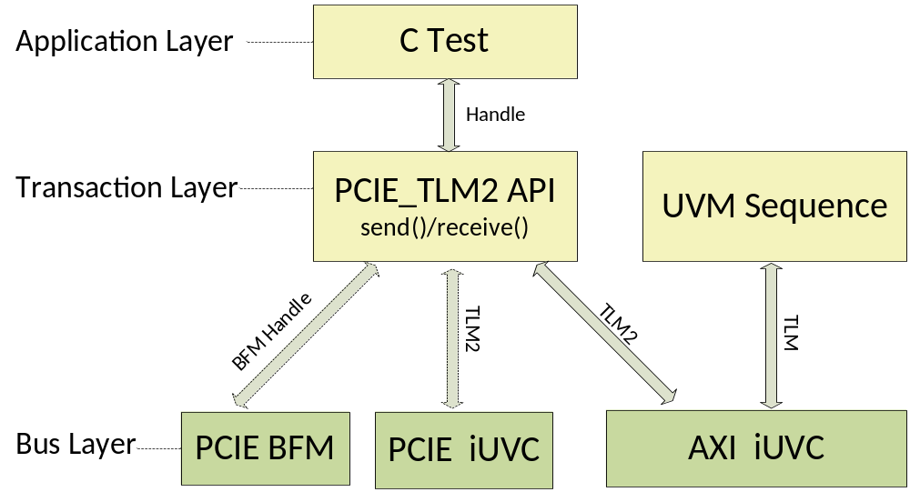
Three-layer C-UVM Reuse Structure
fully reuse
interface UVC
HongLiang Liu andy.liu@amd.com

Slide 7
Three-layer C-UVM Reuse Structure
C test sits on top layer, it is isolated from bus layer by transaction layer, thus, C tests are fully reused regardless of system bus protocol
Transaction layer is implemented with TLM2, including general part and protocol part
Bus layer is a interface UVC, reused from IP UVM environment
HongLiang Liu andy.liu@amd.com

Slide 8
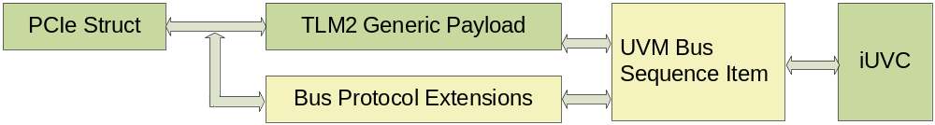
Transaction Layer Flow
tlm_generic_payload *ptr_tlm_trans = new tlm_generic_payload;
gp_extensions_axi *ptr_tlm_extensions = new gp_extensions_axi;
ptr_tlm_trans->set_write(pkt.is_write());
ptr_tlm_trans->set_address(pkt.addr);
ptr_tlm_trans->set_data_length(pkt.len);
ptr_tlm_trans->set_data_ptr(pkt.data);
ptr_tlm_extensions->set_id();
ptr_tlm_extensions->set_burst();
ptr_tlm_extensions->set_cache();
ptr_tlm_extensions->set_user();
general
reuse
Protocol
scalable
HongLiang Liu andy.liu@amd.com

Slide 9
Simple C and UVM Interactive
C is responsible for simulation ending control
C packet is converted to UVM sequence item in transaction layer with TLM2
C test case and the reused IP UVM sequence run on the same iUVC
HongLiang Liu andy.liu@amd.com

Slide 10
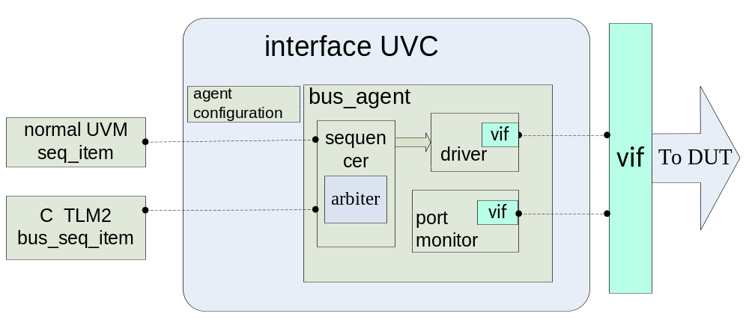
Bus Layer - iUVC
iUVC works in active mode at IP block level
iUVC works in passive mode or active mode at SOC level
HongLiang Liu andy.liu@amd.com

Slide 11

iUVC Reuse
active mode
passive mode
IP
SOC
Master
iUVC
Slave iUVC
Master
iUVC
Slave iUVC
reuse
IP RTL
IP RTL
Device RTL
active mode: executes UVM sequence, generates master request or slave response stimulus
passive mode: monitor, protocol checker, coverage collector
HongLiang Liu andy.liu@amd.com

Slide 12
Bus Layer - iUVC
iUVC uses virtual interface to connect RTL and UVM
HongLiang Liu andy.liu@amd.com

Slide 13
Connection Reuse
Connect static RTL world and dynamic UVM world
  static RTL world: real interface dynamic UVM world: virtual interface
  bind the real interface to RTL module
  uvm_resouce_db pass the real interface handle to virtual interface
interface UVC
uvm_resource_db
interface
IP RTL
virtual interface
HongLiang Liu andy.liu@amd.com

Slide 14
Connection Reuse
Bind connection separate s DV code from RTL, better for reuse
Code segments for bind and uvm_resource_db
  bind `AMBA_MODULE svt_axi_slave_if axi_slave_if ( .araddr(AXI_SLV0_araddr),
  module
  initial begin
  uvmpkg::uvm_resource_db#(virtual svt_axi_if)::set(“interface_registry ",`AMBA_MODULE.axi_slave_if, `AMBA_MODULE.axi_slve_if);
  end
  endmodule
  uvm_pkg::uvm_resource_db#( virtual svt_axi_if) ::read_by_name(" interface_registry ",`AMBA_MODULE.axi_slve_if, axi_slave_if)
HongLiang Liu andy.liu@amd.com

Slide 15
Problem Statement
how to reuse SOC C test cases when system bus protocol changes?
how to reuse IP UVM sequence to SOC verification environment?
HongLiang Liu andy.liu@amd.com

Slide 16
UVM Sequence Reuse Challenge
both sequence and sequencer are adhered to sequence item type – sometimes , a bus protocol
  ip_uvm_seq#(ip_sequence_item) extends uvm_sequence;
  ip_uvm_sequencer #(ip_sequence_item) extends uvm_sequencer;
If IP and SOC bus protocol are same, IP sequence can be directly reused to SOC
If IP and SOC bus protocol are different, only general IP sequence can be reused to SOC
  RAL register sequence
  interrupt sequence
HongLiang Liu andy.liu@amd.com

Slide 17
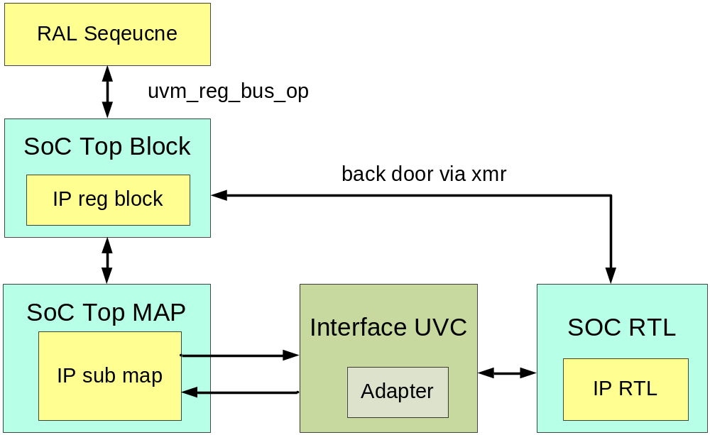
RAL Register Sequence Structure
adapter is the key point when reuse RAL register sequence
HongLiang Liu andy.liu@amd.com

Slide 18
RAL Register Sequence Structure
  ip_reg_model.reg0.write(status, value, .parent(this));
access a register - reg0 by register model hierarchy
  ip_reg = reg_model.get_reg_by_name(reg0);
  ip_reg.write(status, value, .parent(this));
access a register – reg0 by get_reg_by_name()
make sure the register name is unique
HongLiang Liu andy.liu@amd.com

Slide 19
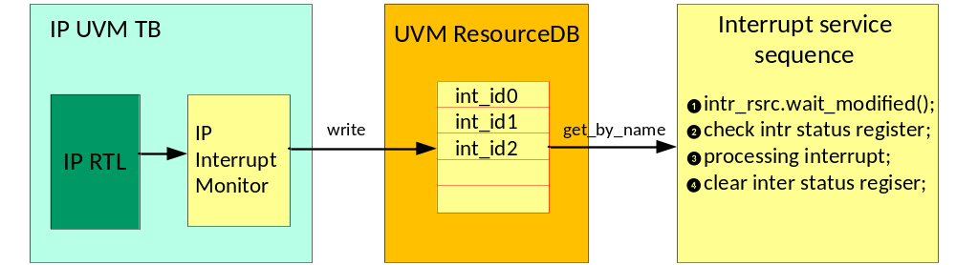
IP Interrupt Sequence Structure
uvm_resource_db is static and globally visible.
uvm_resource provides wait_modified().
  uvm_resource #(int) intr_rsrc;
  intr_rsrc =uvm_resource_db#(int)::get_by_name("","int_id0");
  intr_rsrc.wait_modified();
HongLiang Liu andy.liu@amd.com

Slide 20
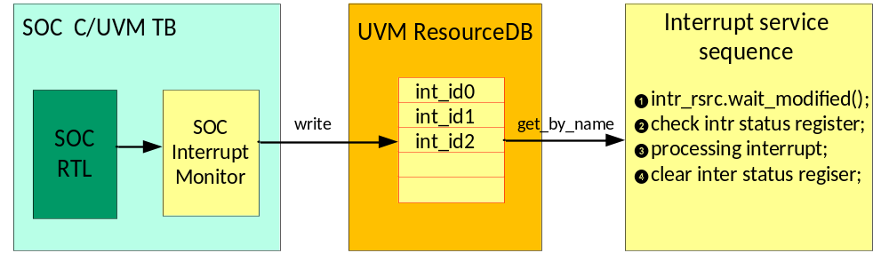
SOC Interrupt Sequence Structure
replace IP interrupt monitor with SOC interrupt monitor
Interrupt service sequence are directly reused from IP block to SOC
HongLiang Liu andy.liu@amd.com

Slide 21
Summary
SOC engineer doesn’t need modify legacy C tests, when system bus changes its protocol
SOC engineer can directly reuse IP UVM RAL register sequence, interrupt sequence, save effort to create new C tests
With this approach, IP UVM environment is active in SOC now.
HongLiang Liu andy.liu@amd.com

Slide 22
Acknowledge
Bodmer, Thomas
Whiting, Karl
Chen, Beryl
Zhang Japheth
Yu, Rocky
Gong XiaoHua
HongLiang Liu andy.liu@amd.com

