Slide 1


Statically Dynamic or Dynamically Static? Exploring the power of classes and enumerations in SystemVerilog Assertions for reusability and scalability
Sachin Scaria - Intel
Sreenu Yerabolu - Intel
Don Mills – Microchip (Presenter)

Slide 2
Abstract
Usage of class data type for SoC level assertions (SV)
Modular code development
Reusable code
Reduce human errors
Can be extended to complex data structures

Slide 3
Motivation
Reusable assertions across IPs/projects/revisions
Minimal changes while scaling up
Ease of plugging into the Testbench

Slide 4
Case Study Attributes
SoC with IPs across interconnect fabrics
IPs have common rules to adhere to
IP design rules can be enhanced
An added feature needed to be verified

Slide 5
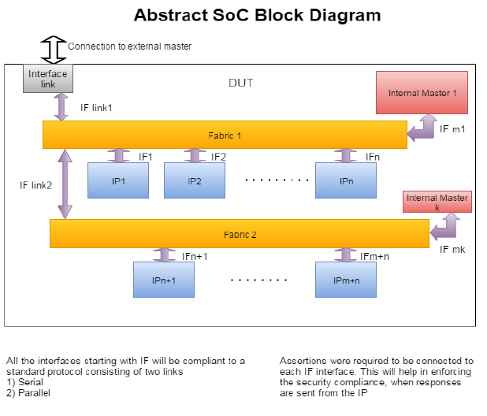
Representative SoC Diagram

Slide 6
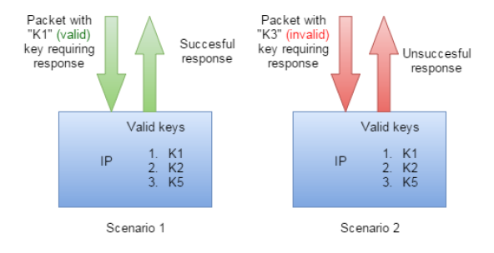
IP Packet Handling
IP has pre-configured key values
Matches incoming packet/command keys
Responds with Success/Unsuccessful response

Slide 7
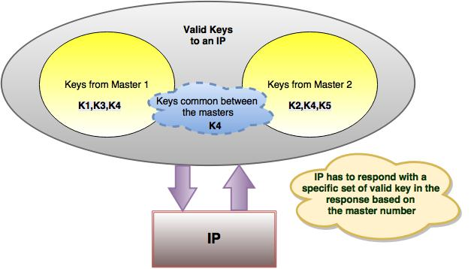
A Sophisticated Scenario

Slide 8
Traditional Approach
One file per interface
More than one assertion module for compilation
But uses a similar templated code
Changes mostly in the keys defined for the IP
Assertion modules proportional to number of IPs
Each IP will require one unique module

Slide 9
Proposed Approach
Type over-ride using parameterized class types
Encapsulating enum “Key” values using virtual classes
Allows for unique scopes for each set of keys
Single assertion file and multiple instances
Configuration changes based on the instantiation
Thus key values for the instance are modified

Slide 10
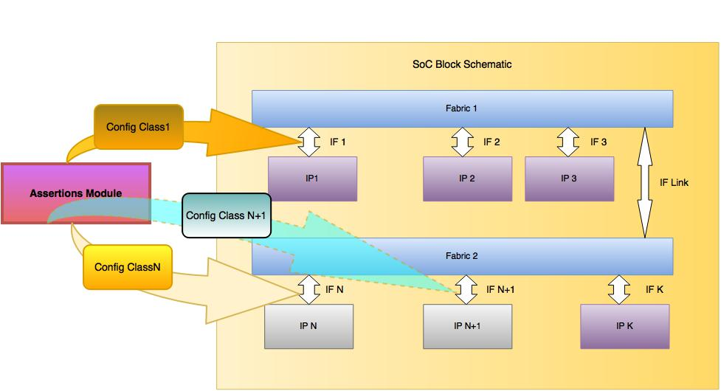
Implementation Details

Slide 11
Sample Code - 1
virtual class a;
typedef enum logic [7:0 ] {
K1 = 8'h01 ,
K2 = 8'h08 ,
K3 = 8'h09
} valid_keys ;
endclass
virtual class b;
typedef enum logic [7:0 ] {
K3 = 8'h9
} valid_keys ;
endclass
Valid Keys in a are
K1(01), K2(08), K3(09)
Valid Keys in b is
K3(09)

Slide 12
Virtual Classes
Declared outside the assertion block
Encapsulate enumerations (keys)
virtual classes are used to restrict accidental access
Class members access using “::” scope resolution operator

Slide 13
Sample Code - 2 Module, IP checks
Valid Keys in b is
K3(09)
Base Concepts
b
module ip_check #(type T1 = int, type T2 = int)
logic [7:0] local_enum;
string my_string;
typedef T1::valid_keys key_g1_enum_t;
typedef T2::valid_keys key_g2_enum_t;
key_g1_enum_t key_g1_enum;
key_g2_enum_t key_g2_enum;
initial begin
local_enum = 8'h8;
key_g1_enum = key_g1_enum_t'(local_enum);
my_string = key_g1_enum.name() ;
$display ("value is %s" ,my_string);
local_enum = 8'h9;
key_g2_enum = key_g2_enum_t'(local_enum);
my_string = key_g2_enum.name() ;
$display ("value is %s" ,my_string);
end
endmodule:ip_check
Instantiation
module tb_ip_check ();
ip_check #(.T1(a), .T2(b)) dut_ip1_check () ;
endmodule
a
Log report
# value is K2
# value is K3
Valid Keys in a are
K1(01),K2(08),K3(09)

Slide 14
Sample Code - 3 IP Implementation
sequence check_key_g2 ;
@(posedge vif.clk)
((vif.cmd_start) && (vif.grp == 2'b1) && (valid2_key));
endsequence
// assertion for grp1
property check_grp1_cmpl;
logic [7:0] local_tag;
@(posedge vif.clk)
disable iff (!vif.rst_b)
(check_key_grp1.triggered, local_tag = vif.tag) |->
(vif.opcode == 2’b0) && (vif.resp_tag == local_tag);
//opcode 2’b0 -> successful operation
endproperty
// assertion for grp2
property check_grp2_cmpl;
logic [7:0] local_tag;
@(posedge vif.clk)
disable iff (!vif.rst_b)
(check_key_grp2.triggered, local_tag = vif.tag) |->
(vif.opcode == 2’b0) && (vif.resp_tag == local_tag);
//opcode 2’b0 -> successful operation
endproperty
endmodule:ip_check
module ip_check #(type T1 = int, type T2 = int)
(my_vif vif);
typedef T1::valid_keys key_g1_enum_t;
typedef T2::valid_keys key_g2_enum_t;
key_g1_enum_t key_g1_enum;
key_g2_enum_t key_g2_enum;
//assuming vif.key is declared in the vif interface
logic valid1_key;
assign key_g1_enum = key_g1_enum_t'(vif.key);
assign valid1_key = (key_g1_enum.name () != "");
logic valid2_key;
assign key_g2_enum = key_g2_enum_t'(vif.key);
assign valid2_key = (key_g2_enum.name () != "");
sequence check_key_g1 ;
@(posedge vif.clk)
((vif.cmd_start) && (vif.grp == 2'b0) && (valid1_key));
endsequence

Slide 15
Notes
Would do the same code to verify “valid” Master
Assists with coverage per the assertion
Cover the enums
Easy to maintian the code for coverage
bind ip_check into each IP instance
The following syntax is not complete
bind ip_check #(.T1(a), .T2(b)) dut_ip1_check () ;

Slide 16
Tool Support
Verified with one of the “big 3” simulators - Questa
Enhancements are filed with remaining vendors

Slide 17
References
SNUG Silicon Valley, 2016, " Thank you VGEN - Complex SoC Assertion Qualification Turnaround Time from Hours to Minutes“, Sachin, Sreenu
IEEE Computer Society, "SystemVerilog--Unified Hardware Design, Specification, and Verification Language (1800-2012)," Section 16.8, 16.12, Assertions.
IEEE Computer Society, "SystemVerilog--Unified Hardware Design, Specification, and Verification Language (1800-2012)," Section 19.8.1, Sample function override.

Slide 18


