Slide 1

Efficient Standard Co-Emulation Modeling Interface (SCE-MI) Usage to Accelerate TBA Performance
Ponnambalam Lakshmanan
Analog Devices, Bengaluru, India

Slide 2
Agenda
Acceleration Concept
Introduction to SCE-MI and SCE-MI Pipes
Testbench Architecture and Existing Challenges
Optimizing SCE-MI pipe usage
SCE-MI Direct Memory and Function Based Interface
Optimized Architecture
Results and Conclusion

Slide 3
Agenda
Acceleration Concept
Introduction to SCE-MI and SCE-MI Pipes
Testbench Architecture and Existing Challenges
Optimizing SCE-MI pipe usage
SCE-MI Direct Memory and Function Based Interface
Optimized Architecture
Results and Conclusion

Slide 4
Acceleration Concept
Hardware assisted acceleration offers better performance over software simulation.
Hardware assisted acceleration techniques:
Signal Based Acceleration (SBA)
Transaction Based Acceleration (TBA)
Embedded testbench
Vector Based Acceleration (VBA)
In-circuit Emulation (ICE)

Slide 5
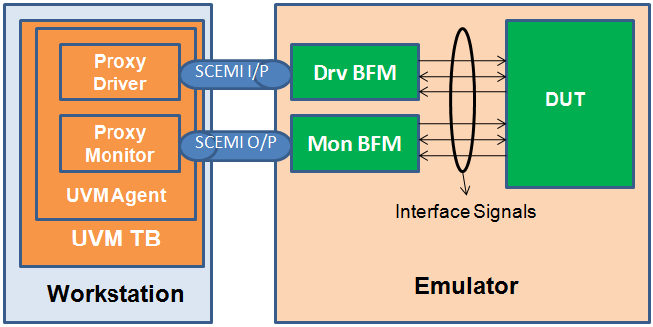

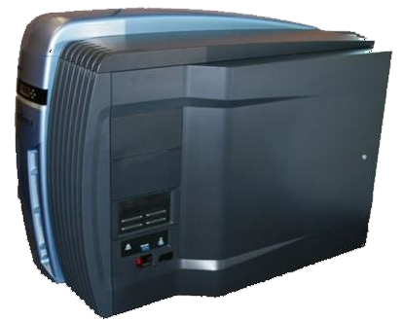
Transaction Based Acceleration
Traditional testbench is split into two domains
Non-Synthesizable domain
Runs on simulator
Synthesizable domain
Runs on emulator
Workstation
Emulator
Synthesizable
Non - Synthesizable

Slide 6
Factors Affecting Acceleration
Various factors directly affect the emulator performance
Inefficient usage of SCE-MI
Behavioral constructs (Not purely-synthesizable)
Memory Handling
Amount of code running on simulator and emulator
Simulator – Emulator synchronizations

Slide 7
Agenda
Acceleration Concept
Introduction to SCE-MI and SCE-MI Pipes
Testbench Architecture and Existing Challenges
Optimizing SCE-MI pipe usage
SCE-MI Direct Memory and Function Based Interface
Optimized Architecture
Results and Conclusion

Slide 8
Introduction to SCE-MI
Standard Co-Emulation Modeling Interface (SCE-MI) is an Accellera standard
Communication interface between BFM and proxy
Different types of SCE-MI use models:
SCE-MI Pipe based interface
SCE-MI Direct memory interface (DMI)
SCE-MI Function based interface

Slide 9
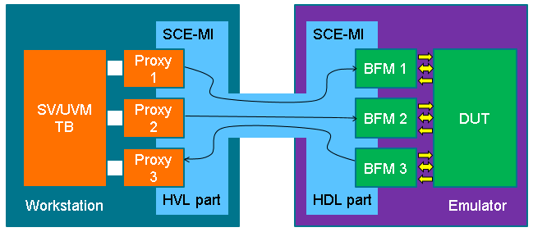
SCE-MI Pipes
Salient Features:
Unidirectional
Batching
Buffering
Flushing
Data shaping
Blocking and Non-Blocking constructs

Slide 10
Agenda
Acceleration Concept
Introduction to SCE-MI and SCE-MI Pipes
Testbench Architecture and Existing Challenges
Optimizing SCE-MI pipe usage
SCE-MI Direct Memory and Function Based Interface
Optimized Architecture
Results and Conclusion

Slide 11
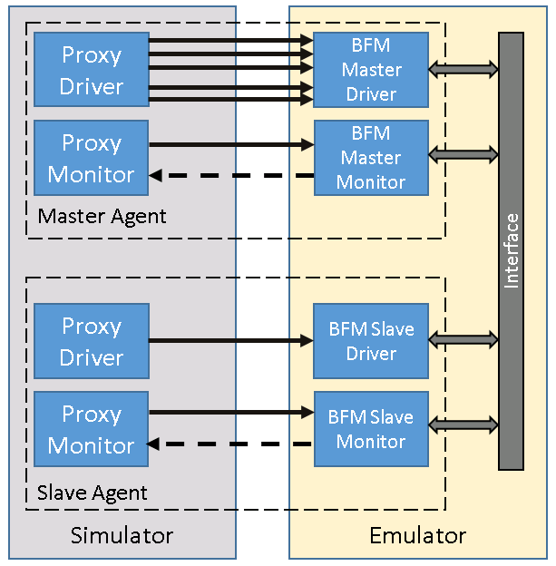
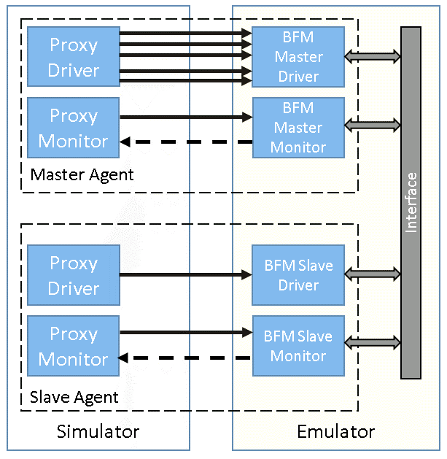
Initial Architecture Challenges
Input SCEMI Pipes
Output SCEMI Pipes
Bottlenecks
Multiple SCEMI pipes
Transmission of small packets frequently
Async loop to clear pipe contents

Slide 12
Agenda
Acceleration Concept
Introduction to SCE-MI and SCE-MI Pipes
Testbench Architecture and Existing Challenges
Optimizing SCE-MI pipe usage
SCE-MI Direct Memory and Function Based Interface
Optimized Architecture
Results and Conclusion

Slide 13
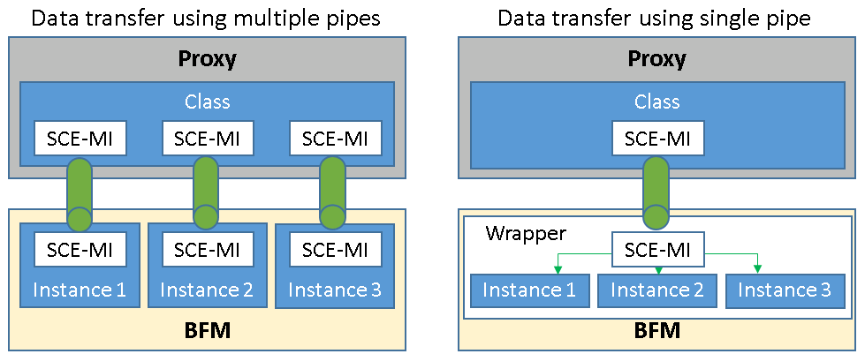
Optimizing SCE-MI Pipe Usage
Merging SCE-MI pipes
Challenge | Solution
Behavioral evals with every SCE-MI access | Send data via a single SCE-MI pipe. Static SCE-MI pipe - Bit vectors Dynamic SCE-MI pipe - Array of data

Slide 14
Optimizing SCE-MI Pipe Usage
Synchronous access
Challenge | Solution
Asynchronous mode creates significant behavioral evals | Synchronous mode of SCE-MI pipe IS_CLOCKED_INTF = 1
Code Snippet
Code Snippet
scemi_input_pipe #(
.BYTES_PER_ELEMENT(20), .PAYLOAD_MAX_ELEMENTS(1),
.VISIBILITY_MODE(2),
.IS_CLOCKED_INTF(0) ) inbox (clk);
scemi_input_pipe #(
.BYTES_PER_ELEMENT(20), .PAYLOAD_MAX_ELEMENTS(1),
.VISIBILITY_MODE(2),
.IS_CLOCKED_INTF(1) ) inbox (clk);
s
s

Slide 15
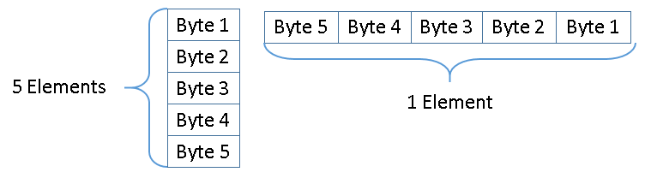
Optimizing SCE-MI Pipe Usage
Optimized data transfer
Challenge | Solution
Accessing more than one element per access results in behavioral evals PAYLOAD_MAX_ELEMENTS = 5; BYTES_PER_ELEMENT = 1; | If the intention is to access 5 Bytes per call then set PAYLOAD_MAX_ELEMENTS = 1; BYTES_PER_ELEMENT = 5;

Slide 16
Optimizing SCE-MI Pipe Usage
Minimal Synchronization
Challenge | Solution
Frequent data transfer causes the emulator to halt frequently Results in degraded acceleration | Accumulate multiple bytes of data and transfer at once Try to buffer the elements Avoid unnecessary flush() usage
Code Snippet
scemi_input_pipe #(
.BYTES_PER_ELEMENT(20), .PAYLOAD_MAX_ELEMENTS(1), .BUFFER_MAX_ELEMENTS(10),
.VISIBILITY_MODE(2),
.IS_CLOCKED_INTF(1) ) inbox (clk);

Slide 17
Optimizing SCE-MI Pipe Usage
Clearing the pipe
Challenge | Solution
Discarding buffer contents on reset No inbuilt functions Increase in step-count | Use the fastest clock available to synchronously fetch data from pipe
Code Snippet : Before
Code Snippet : After
always@(posedge clk, posedge rst) begin
if(rst) begin
// Statements
for(int i=0, i<20), i++)
inbox.receive(1,ve,data,eom);
end
else begin
// statements
end
end
s
always@(posedge fst_clk, posedge rst) begin
if(rst) begin
rst_buff = 1;
// statements
end
else begin
if(rst_buff && !eom)
inbox.receive(1,ve,data,eom);
else
rst_buff = 0;
end
end
s

Slide 18
Agenda
Acceleration Concept
Introduction to SCE-MI and SCE-MI Pipes
Testbench Architecture and Existing Challenges
Optimizing SCE-MI pipe usage
SCE-MI Direct Memory and Function Based Interface
Optimized Architecture
Results and Conclusion

Slide 19
SCE-MI Direct Memory Interface
Software side interface to perform backdoor read/write operations on hardware side memories
Types of interfaces
Block interface
Word interface
Performance Improvement:
HW-SW synchronizations reduced by ~50%
TBA run time decreased by >25%

Slide 20
SCE-MI Direct Memory Interface
Backdoor Access
Memory
Proxy
Agent
C Membrane
BFM
DUT
Simulator
Emulator
Backdoor Access
Memory

Slide 21
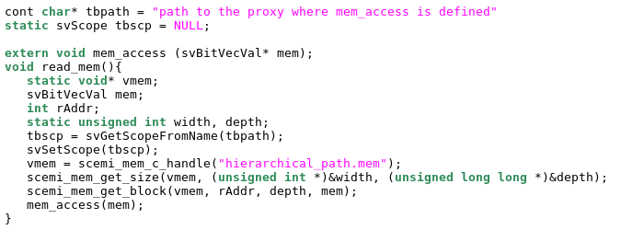
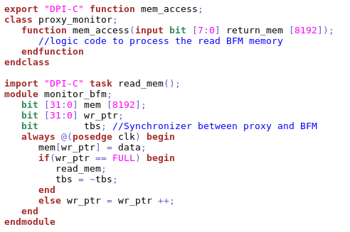
SCE-MI Direct Memory Interface
C - Backdoor memory access through predefined SCE-MI API
C membrane
C-membrane writes the memory contents in to the proxy
Proxy side
Invoke a memory read from BFM
BFM side

Slide 22
SCE-MI Function Based Interface
Adopts SystemVerilog Direct Programming Interface (DPI) concept.
End user is required to implement all the functions
No built in functions
Used to configure BFM registers

Slide 23
SCE-MI Function Based Interface
Circular FIFO
Proxy
Agent
Interface
C Membrane
BFM
DUT
Simulator
Emulator
Write Pointer
Read Pointer

Slide 24
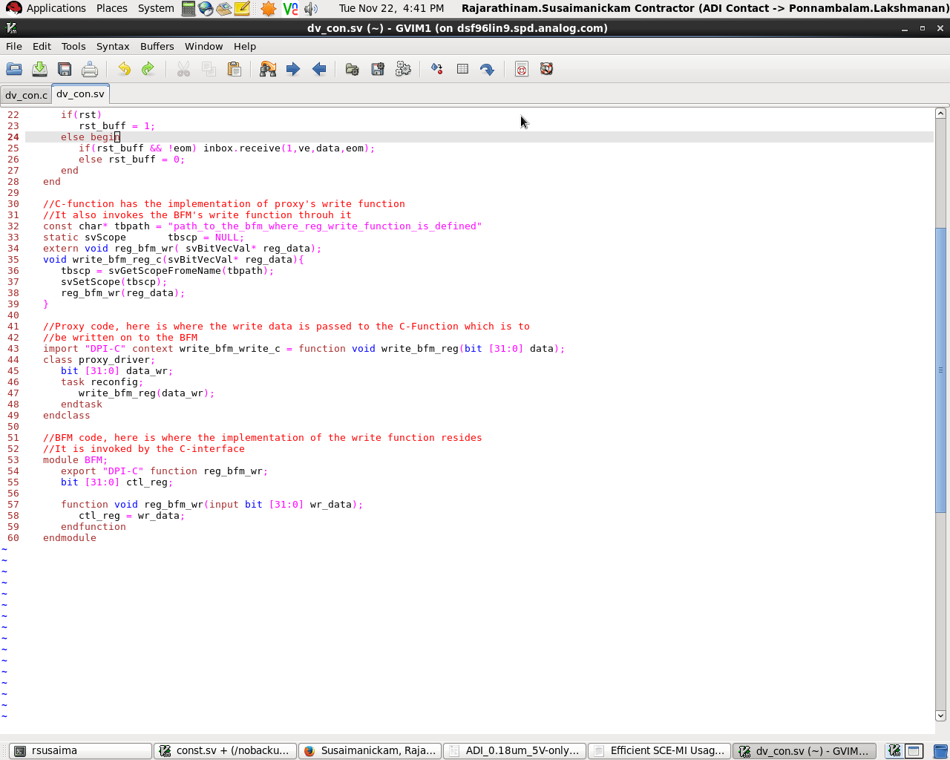
SCE-MI Function Based Interface
BFM register write from C interface
C membrane
C-function imported and used in proxy
Proxy side
Invoke register write from proxy through C
Verilog -function exported and used in the C - interface
BFM side

Slide 25
Trimming Development Time
Factors
Increase in effort and time to implement complex functionality in a synthesizable format.
Increase in area occupied by the BFM on the emulator.
Implement complex functionality that is utilized occasionally as a method in the C membrane and import/invoke from the BFM.

Slide 26
Agenda
Acceleration Concept
Introduction to SCE-MI and SCE-MI Pipes
Testbench Architecture and Existing Challenges
Optimizing SCE-MI pipe usage
SCE-MI Direct Memory and Function Based Interface
Optimized Architecture
Results and Conclusion

Slide 27
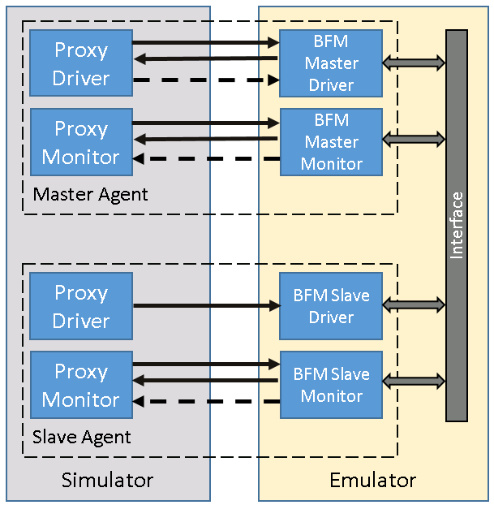
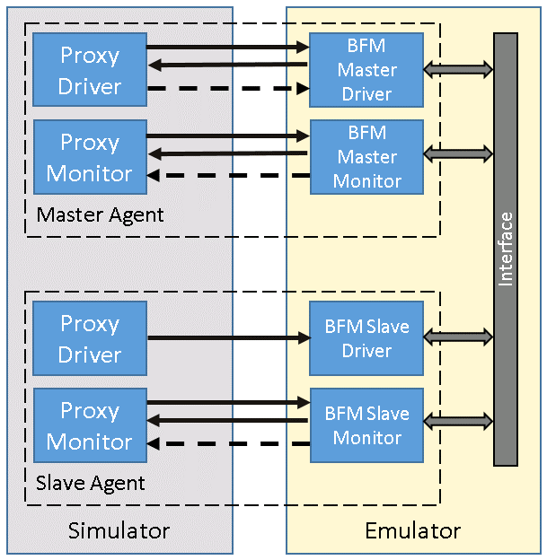

Optimized Architecture
SCEMI Function Based Interface
To configure BFM registers
To update proxy about events in BFM
SCEMI Direct Memory Interface
To write/read data from BFM memory
Pipes are removed

Slide 28
Agenda
Acceleration Concept
Introduction to SCE-MI and SCE-MI Pipes
Testbench Architecture and Existing Challenges
Optimizing SCE-MI pipe usage
SCE-MI Direct Memory and Function Based Interface
Optimized Architecture
Results and Conclusion

Slide 29
Results
TBA Performance improvement
Simulation v/s TBA run-time comparison for usecase
Implementation | TBA properties
 | Gate count | Bevals | HW-SW Sync | TBA Time
Pipe only | ~2 M | 18,299,173 | 4,728,998 | ~60 min
Pipes only (Optimized) | ~2 M | 2,859,320 | 1,284,765 | ~35 min
DMI + Function based Interface | ~1.5 M | 218 | 9,871 | ~4 min
Simulation Time | TBA Time
~360min | ~8min

Slide 30
Conclusion
SCE-MI has multiple interfaces for different use cases
SCE-MI DMI used for backdoor read/write operation
SCE-MI Function Based Interface used to write into registers
SCE-MI Pipes are intended for streaming, variable length messaging, etc.
HW-SW sync and Bevals could greatly deteriorate the performance of emulator.

Slide 31
Conclusion
Efficient usage of SCE-MI helps in leveraging maximum performance from emulator resulting in handsome SPEED-UP.
HW-SW syncs generated using vendor proprietary implementation
Number of syncs are kept to minimum.

Slide 32
Future Work
Porting to SOC environment and analyze the performance
Explore UVM registers support decribed in SCEMI v2.3

Slide 33
Acknowledgements
David Brownell, ADI
Anilkumar T. S, Cadence
Dr. Hans van der Schoot, Mentor Graphics

Slide 34
Questions

