Slide 1

A Simplified Approach
Using UVM Sequence Items for Layering Protocol Verification
Christine Thomson, Haiqian Yu
Microsoft Corporation
Notes:
- Share with you a simplified approach to layered protocol verification

Slide 2
Agenda
Introduction
Example Scenario
Alternative Solutions
Proposed Method
Future Work
Conclusion
Christine Thomson, Microsoft Corporation

Slide 3



Introduction:
What is a layered protocol?
Composed of multiple layers
  Each level is responsible for a subset of the overall functionality
Typically used to define and move data
  Upper level layers operate on meaningful fields
  Lowest level responsible for interface level data transfer
Commonly used for data transfer between IPs, chips, etc
Examples:
Christine Thomson, Microsoft Corporation
Notes:
Composed of various levels where each level is responsible for a subset of the protocol’s functionality to simplify the overall design implementation

Slide 4
Introduction: Verifying a Layered Protocol
Layered protocol approaches in UVM
  Model the design’s structure
  Checking can be done at one/any layer
  Conversion needed between layers
Method should be protocol independent
What approach is the best approach?
  Determine the scoping requirements
  Determine the testbench goal
Intuitive, flexible, controllable, visible!
GOAL:
Verification Reuse!
Christine Thomson, Microsoft Corporation
Notes:
Multiple approaches are available to verify a design using layered protocol(s) using UVM:
Similar layered concept on verification side
Conversions needed between layers for different protocols
Checking can be done at different layers and/or at a particular layer
Regardless of the method you use, it should be protocol independent and enable reuse! You want to consider reuse within the testbench which may have multiple interfaces using the same base layer, or you may need to reuse the testbench is the future and ensure its easily modifiable for future enhancements or adjustments
When verifying a layered protocol, it’s important to determine the scoping and overall goals of your testbench to select the best approach and define the testbench architecture to meet your needs.

Slide 5
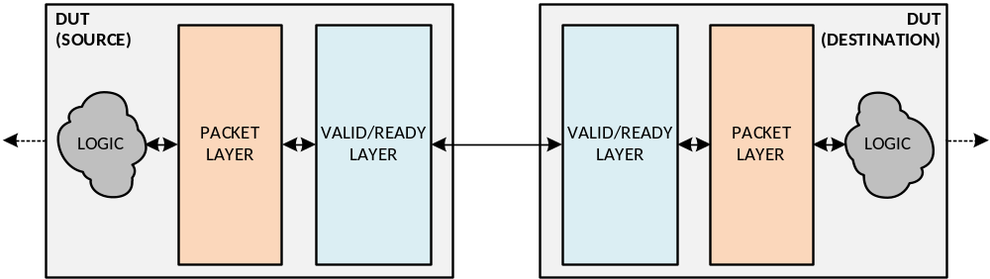
Layered Protocol Example Scenario: Valid/Ready Protocol
Valid/Ready protocol implementation block diagram
Lowest layer which is responsible for following interface signaling rules to transmit/receive data
Highest layer which translates between raw data and the meaningful representation of the data
Christine Thomson, Microsoft Corporation

Slide 6
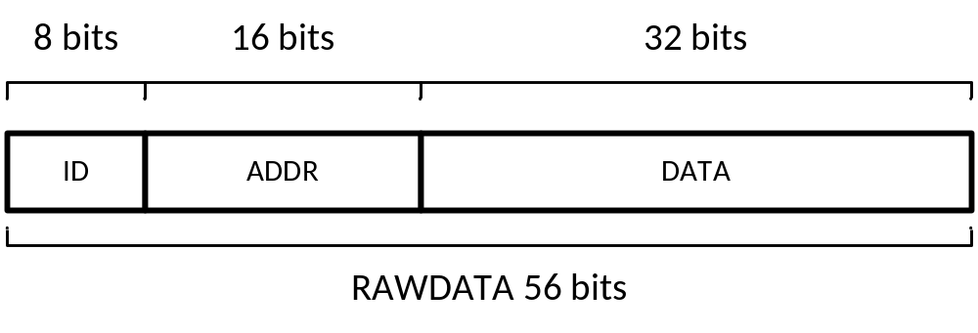
Layered Protocol Example Scenario: Valid/Ready Protocol
Packet Layer’s Data Fields
  ID[7:0]
  ADDR[15:0]
  DATA[31:0]
Valid/Ready Layer’s Data Fields
  RAWDATA[55:0]
The RAWDATA bus width is set to the total width of the Packet layer’s fields. In this case: 8 + 16 + 32 = 56
Christine Thomson, Microsoft Corporation

Slide 7
Layered Protocol Example Scenario: Valid/Ready Protocol
1
2
3
4
5
6
7
8
9
10
11
CLK
READY
VALID
RAWDATA
Valid/Ready Protocol Timing Diagram
Transmitter Driven Signals
Receiver Driven Signals
Christine Thomson, Microsoft Corporation
Notes:
Transmitter places new RAWDATA and asserts VALID on the interface to initiate a new request to the receiver
READY asserts by the receiver when it can accept new data
When VALID and READY are both asserted on a given cycle this completes the request. The data is accepted by the receiver and the transmitter is free to deassert VALID or supply new data

Slide 8
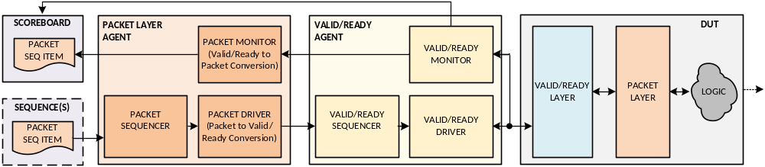
Alternative Solutions: Layered Agents
Testbench architecture models design architecture
  An agent is created for each design layer
  Packet agent translates between protocol layers
    Driver converts Packet seq items to Valid/Ready seq items
    Monitor converts Valid/Ready seq items to Packet seq items
Christine Thomson, Microsoft Corporation
Notes:
There are a few different approaches proposed for verifying layered protocol. and testbench architectures which can be used to verify a layered protocol design.
While researching this scenario I found a couple different suggestions proposed in papers online.

Slide 9
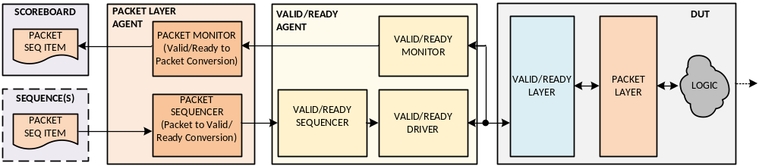
Alternative Solutions: Layered Sequencers
Testbench architecture models design architecture
“Trimmed down” agents are used for the high level layers
Packet agent translates between protocol layers
  Sequencer converts Packet seq items to Valid/Ready seq items
  Monitor converts Valid/Ready seq items to Packet seq items
Christine Thomson, Microsoft Corporation
Notes:
These two approaches would work for the scenario we would like to verify, but they can be time consuming if you do not need that level of visibility in the testbench into each layer or the controllability of injection of errors or specific data at the layer level. In our case, we needed to verify the overall functionality of the design and not verify the layers independently. This also adds a lot of overhead when not verifying independent layers of a design. In our case we were also on a very tight schedule and needed to optimize time for development where possible. Because of our scope requirements and time constraint we developed an alternative approach to expedite development time, simplify the testbench architecture, and still achieve our verification goals.
For more details on these approaches, please see the references section of this paper in the proceedings.

Slide 10
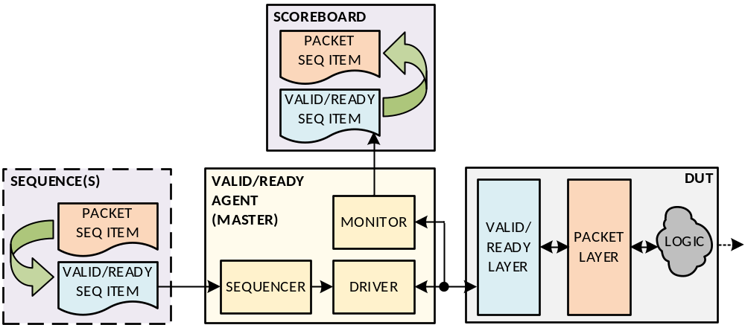
Proposed Method:
Layered Sequence Items
Sequence items are used to model the design architecture
  One sequence item per protocol layer
  Functions perform the translation between layers
unpack_data() is called to translate Valid/Ready data to Packet data
pack_data() is called to translate Packet data to Valid/Ready data
Christine Thomson, Microsoft Corporation
Notes:
We were on a time crunch, needed to find savings where ever possible for initial bring up, so we developed this simplified approach to expedite tb dev time.
The design we verified using this approach was similar to the example scenario in that there was 2 layers in the design. We had 4 unique packet layers which all shared a common base layer.
So there would be a lot of overhead and tb env complexity involved to use layered agents or sequencers.
We also did not need to very each layer independently and our goal was only on the overall complexity.
With the design we could achieve coverage without needing to control the stimulus per layers, so creating custom agents for each unique upper level layer would not be very beneficial for our scenario.

Slide 11
Proposed Method: Valid/Ready Seq. Item Code
class vld_rdy_seq_item #(int DATA_WIDTH=56)
extends uvm_sequence_item;
rand bit valid;
rand bit ready;
rand bit [DATA_WIDTH-1:0] raw_data;
...
// Virtual function to implement translation from
// Packet -> Valid/Ready
virtual function void pack_data();
endfunction
// Virtual function to implement translation from
// Valid/Ready -> Packet
virtual function void unpack_data();
endfunction
...
Christine Thomson, Microsoft Corporation

Slide 12
Proposed Method:
Packet Seq. Item Code
class pkt_seq_item extends vld_rdy_seq_item #(56);
rand bit [7:0] id;
rand bit [15:0] addr;
rand bit [55:0] data;
...
// Packet -> Valid/Ready translation
virtual function void pack_data();
raw_data = {id, addr, data};
endfunction
// Valid/Ready -> Packet translation
virtual function void unpack_data();
{id, addr, data} = raw_data;
endfunction
...
RECOMENDATION:
Call pack_data() at the end of post_randomize() to simplify sequences
Christine Thomson, Microsoft Corporation

Slide 13
Proposed Method:
Example Packet Sequence
class pkt_rand_seq extends uvm_sequence
#(vld_rdy_seq_item #(56));
...
pkt_seq_item pkt_item;
vld_rdy_seq_item #(56) req_item;
vld_rdy_seq_item #(56) resp_item;
task body();
// 1. Create a Packet sequence item and generate the data
pkt_item = pkt_seq_item::type_id::create("pkt_item");
if ( !( pkt_item.randomize() with {...} ) )
`uvm_error("PKTSEQ", "pkt_item.randomize failed!")
...
// continued on next slide
Christine Thomson, Microsoft Corporation

Slide 14
Proposed Method:
Example Packet Sequence
...
// 2. Data conversion from Packet layer
// to the Valid/Ready layer
pkt_item.pack_data();
// 3. Cast the pkt_seq_item to a
// vld_rdy_seq_item
if ( !$cast(req_item, pkt_item.clone()) )
`uvm_error("PKTSEQ","Cast failed!");
// 4. Resume standard sequence flow
start_item(req_item);
finish_item(req_item);
get_response(resp_item);
endtask: body
...
endclass: pkt_rand_seq
Not necessary if pack_data() was added into the Packet seq. item’s post_randomize() function
Christine Thomson, Microsoft Corporation

Slide 15
Proposed Method:
Example Scoreboard
forever begin
// Monitor Valid/Ready for valid transaction's
vld_rdy_fifo.get(vld_rdy_item);
// Create new Packet sequence item
pkt_item = pkt_seq_item::type_id::create("pkt_item");
// Convert to a Valid/Ready sequence item to a Packet
// sequence item to access meaningful fields
pkt_item.raw_data = vld_rdy_item.raw_data;
pkt_item.unpack_data();
// Fields are now populated with correct data
// Sample coverage for meaningful fields
pkt_item.sample();
...
end //end forever loop for vld_rdy_fifo
Christine Thomson, Microsoft Corporation

Slide 16
Benefits of Layering Sequence Items
Eliminates the need for unique agents per layer
Eliminates the need for wrapper UVCs, translation classes or complex layered sequences
Reduces initial development time
Simplifies the overall architecture
Expedites bring-up
Reduces the code base
Reduces the likelihood of bugs
Christine Thomson, Microsoft Corporation
Notes:
In our case we were also limited on resources for the project. So we were able to use this approach to create only 1 parameterized agent and the sequence items associated with each layer, and share them across the IP and subsystem level testbenches.

Slide 17
Future Work
Layered protocols with >2 layers
Individual layer verification
Christine Thomson, Microsoft Corporation
Notes:
See our paper in the DVCon proceeding to read more details on proposal to implement future work.
The paper outlines more conceptual details and diagrams for how this may look.
Future work has not yet had proof of concept by being used to verify a real work design.

Slide 18
Conclusion
Easy to implement solution
Proven in a real world design
  Design contained multiple unique packet layers with a shared base layer
Future work
Saving increases for designs with multiple unique packet layers layered with a common base layer
Save development time and expedite testbench bring up
Saved approximately 8 person-days development time
Christine Thomson, Microsoft Corporation
Notes:
The proposed method is an easy to implement solution for layered protocol verification which can save development time and expedite testbench bring up when compared against alternative proposals
Method has been proven in a real world design
Design had multiple unique packet layers with a shared base layer. In this scenario 8 days of initial testbench development was saved on this project using this approach
More work is needed to determine feasibility for independent layer verification and qualify how much savings can be achieved

Slide 19
Thank You
Christine Thomson, Microsoft Corporation
Notes:
I hope you take some time to check out our paper in the DVCon proceedings for more information and details of using UVM sequence items for layered protocol verification.

