Slide 1
Clustering Project

Slide 2
Objectives
1. create two separate customer segmentations (using clustering) to split them into 3-5 clusters:
- based on demographics (only on the information from twm_customer)
- based on their banking behavior. We can take following things into consideration as banking behavior:
- do they have savings account? How much do they save?
- do they have credit account? How much do they live in debt?
- are they making lot of small transactions or few huge ones?
2. visualize the created clusters using radar charts and compare them against each other
3. visualize segmentations using scatter plot. We will have to use PCA to be able to plot our observations in 2D.

Slide 3
Data Wrangling
The first step is the data wrangling is data collection which consists of the following sheets: - twm_customer - information about customers
- twm_accounts - information about accounts
- twm_checking_accounts - information about checking accounts (subset of twm_accounts)
- twm_credit_accounts - information about checking accounts (subset of twm_accounts)
- twm_savings_accounts - information about checking accounts (subset of twm_accounts)
- twm_transactions - information about financial transactions
- twm_savings_tran - information about savings transactions (subset of twm_transactions)
- twm_checking_tran - information about savings transactions (subset of twm_transactions)
- twm_credit_tran - information about credit checking (subset of twm_transactions)

Slide 4
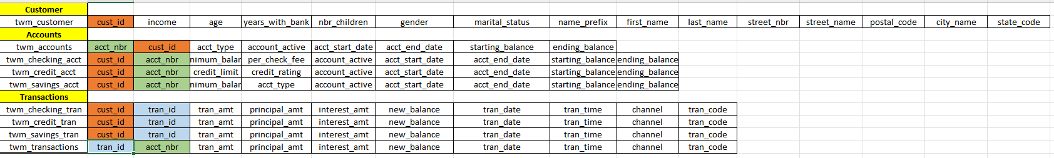
Data Wrangling
The next step was data exploration to get an understanding of the data:
We have two types of sheets.
Accounts information
Transaction information
Below is the information about the columns and their connection with each other

Slide 5
Data Wrangling
Data cleaning:
We checked the dataset for null values
We explored the dataset for customer accounts information and transaction information
We imported the sheets and created two dataframes. One for customer accounts and other for transaction. Tables are joined using cust_id.

Slide 6
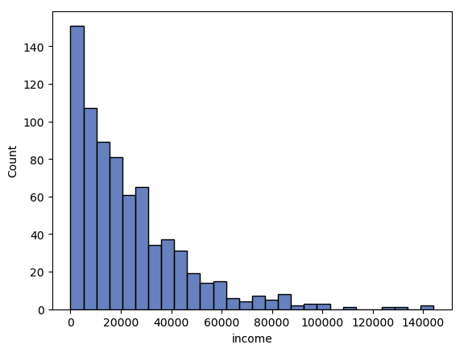
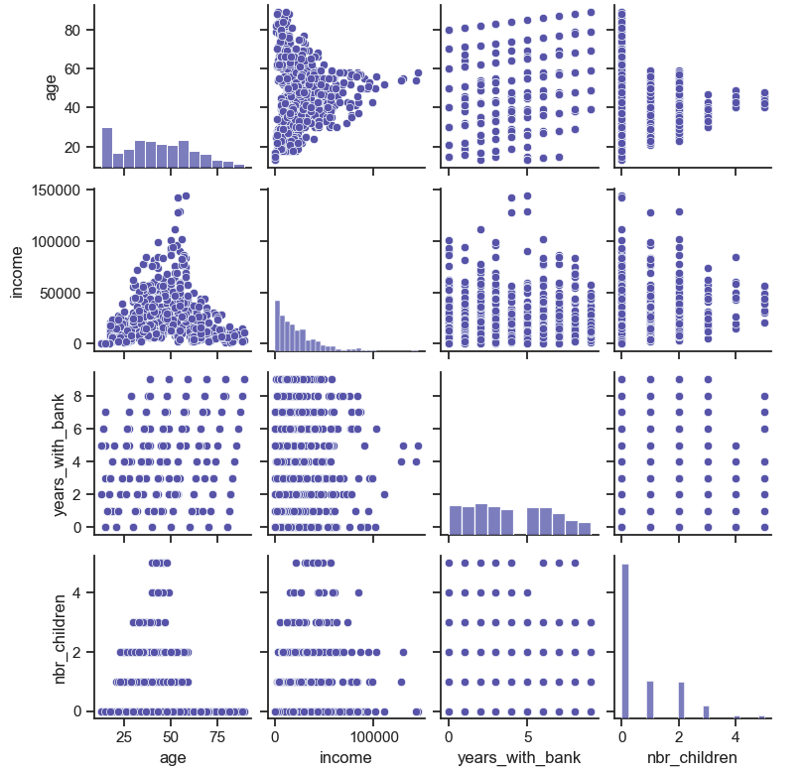
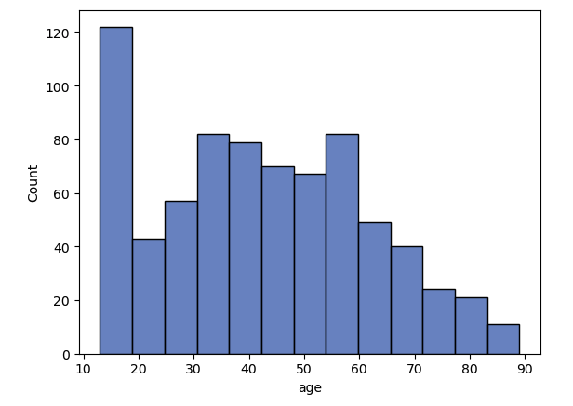
Data Visualization
Histogram Income and Age
Below are the pair plots

Slide 7
Data Preparation and Feature Engineering
Customers demographics
We combined the customers information from saving, checking and credit card dataset into single dataframe.
We selected age,income,marital status,years with bank and number of children as feature.
For State we converted it to Regions by using state_code column to reduce the number of features
We drop the features like street number,street name, postal code that are not useful for analysis

Slide 8
Data Preparation and Feature Engineering
Banking Behavior
We combined the banking information from saving, checking and credit card dataset into single dataframe.
The dataset contain many columns and we need to select relevant features
We created new feature spending that will show the spending behavior of the customer. We calculated the spending for saving, checking and credit card account then merge them to get the overall spending behavior of customers.
Similarly we created debt usage and average transaction amount for each customer
We also calculate number of transaction for each customer

Slide 9
Data Preparation and Feature Engineering
Banking Behavior
Below are the final set of features we selected
income, has_savings, savings_balance,has_credit_card,
credit_limit, credit_balance, debt_usage,
nbr_transactions, average_trans_amt, all_spending

Slide 10
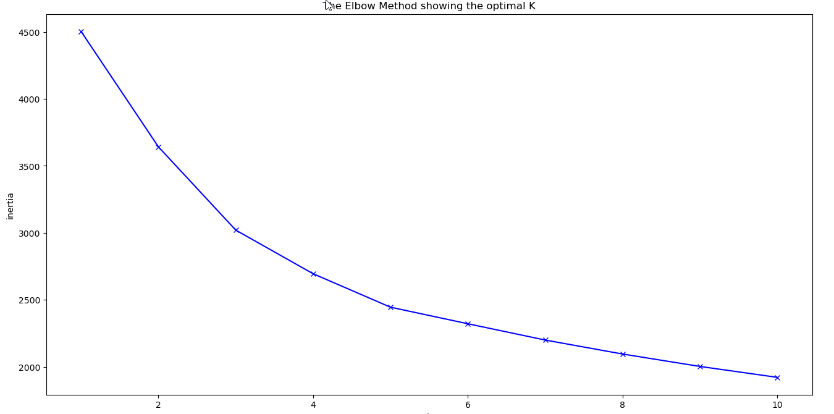
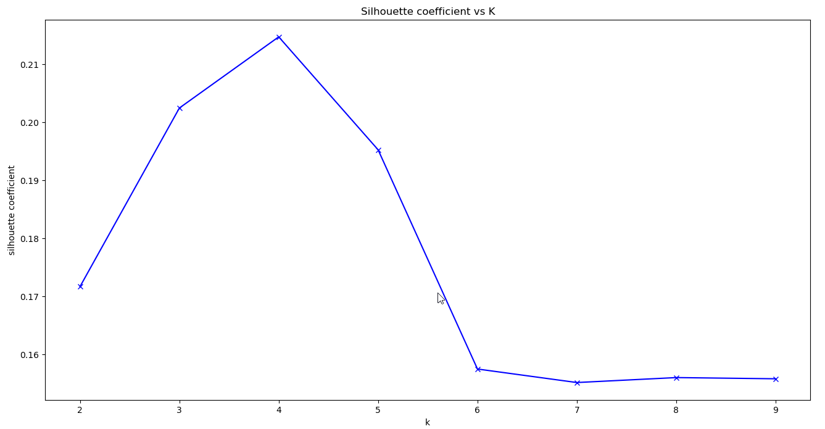
Clustering - K means
Customers demographics
We plot the graph for K means for Elbow method and Silhouette method

Slide 11
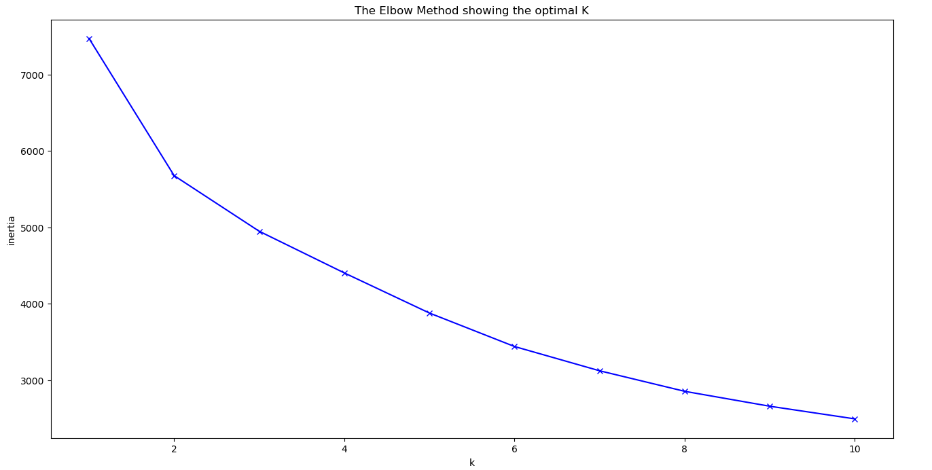
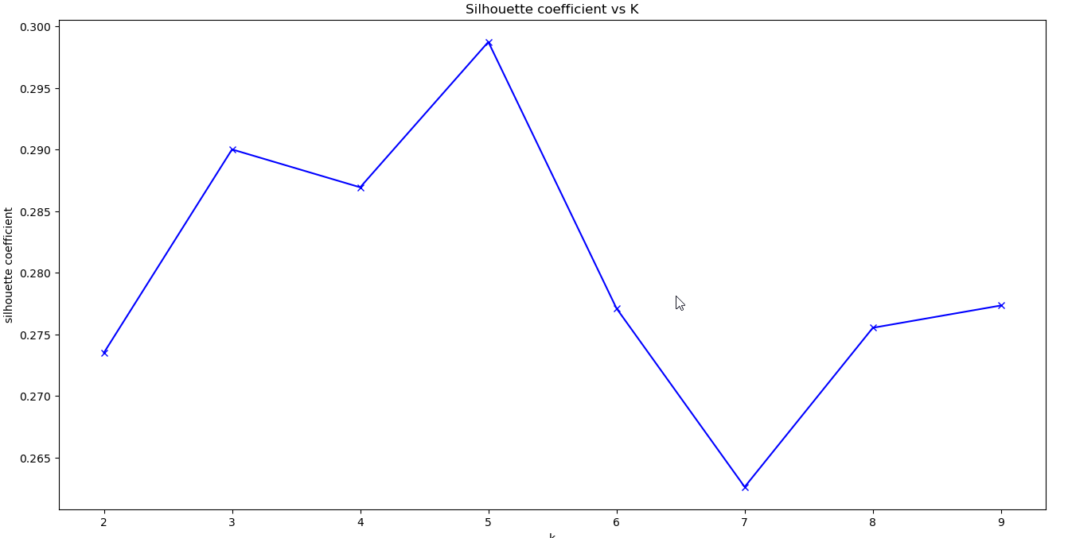
Clustering - K means
Banking Behavior
We plot the graph for K means for Elbow method and Silhouette method

Slide 12
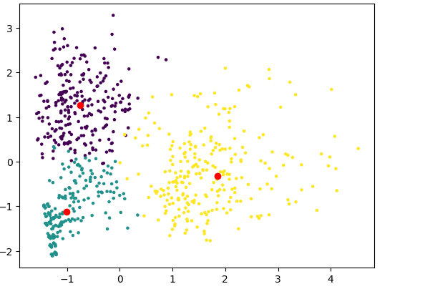
Clustering - Results
After running K means multiple times with 3 and 4 clusters we find that the optimal value was 3 clusters
We used PCA to reduce the dimension and selected PC1 and PC2 for visualization
Below is the cluster for customer demographics

Slide 13
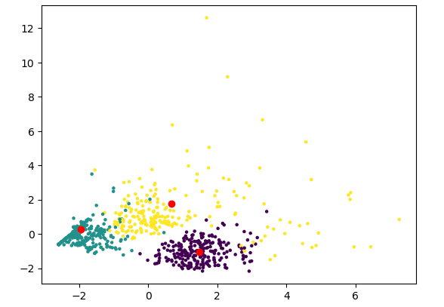
Clustering - Results
Below is the cluster for banking behavior

Slide 14
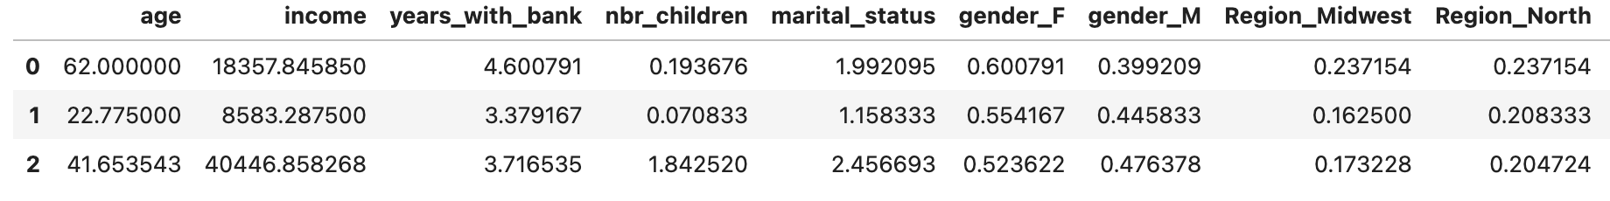
Interpreting the results
One of the downsides to PCA is that although you can create a visualization of the results in a scatter plot as with all the variables considered PCA-1 and PCA-2 are difficult to interpret.
We can view the PCA components to determine what is important.
The mean of each cluster in the data is posted below for customer demographics:

Slide 15
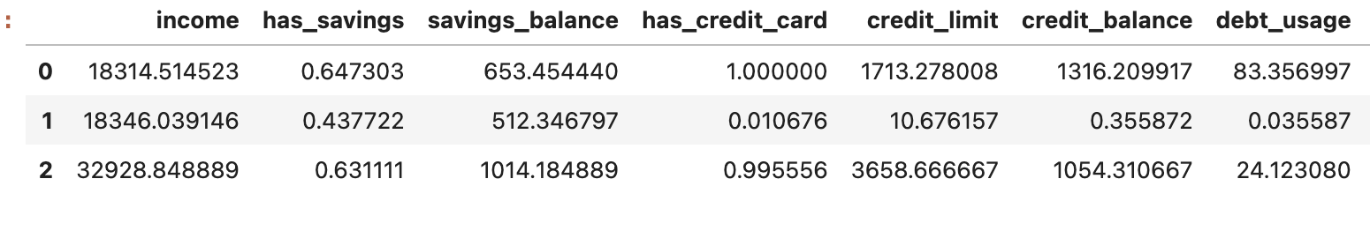
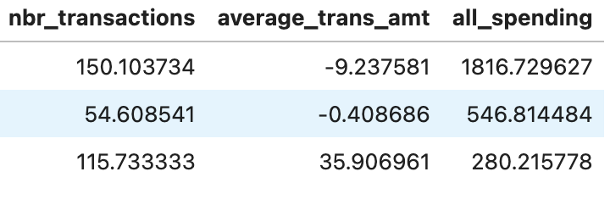
Interpreting results: Banking behaviour

Slide 16
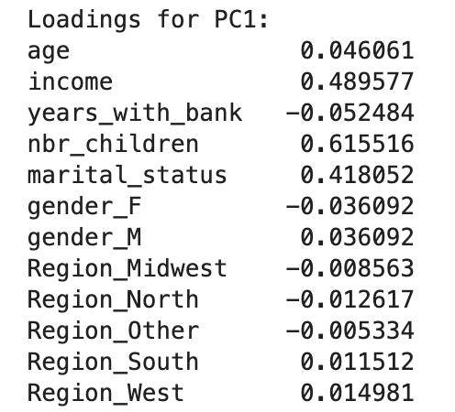
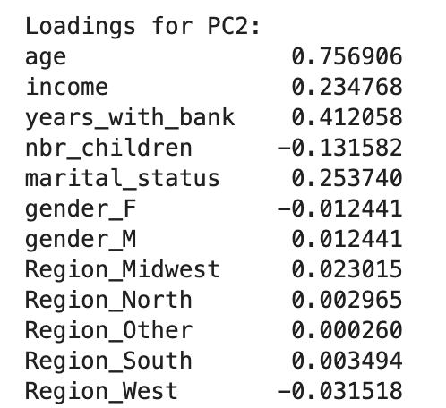
The coefficients used for each component of customer demographics:

Slide 17
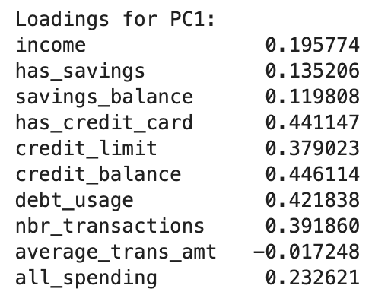
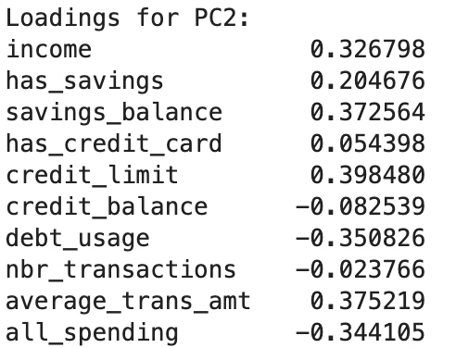
The coefficients used for each component of banking behaviour:

Slide 18
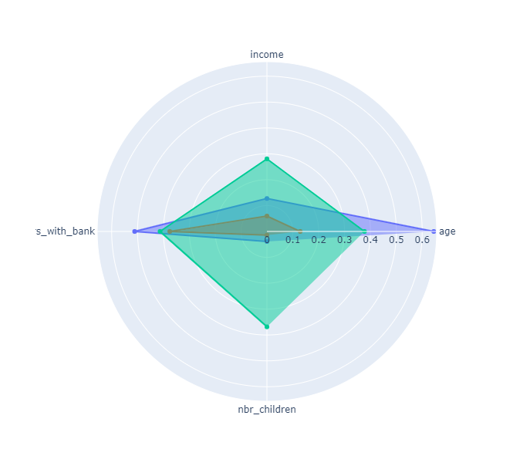
Radar Charts
Below is the radar chart for customer demographics

Slide 19
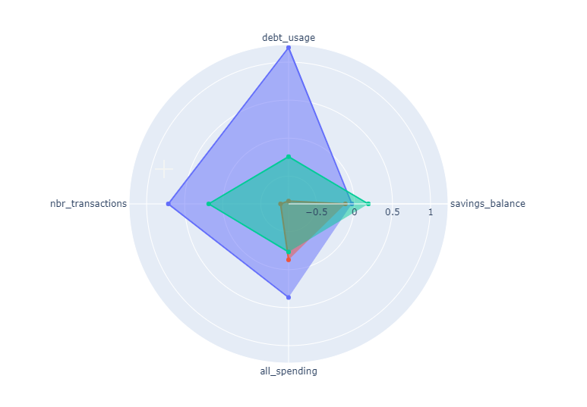
Radar Charts
Below is the radar chart for banking behavior

Slide 20
Comparison & Conclusion (Banking behaviour):
Banking behaviour:
Cluster 0: 241 in cluster, individuals with credit cards, higher debt usage, slightly lower income average, makes more transactions of medium amounts.
Cluster 1: 281 in cluster, majority individuals without credit cards, very low debt usage, lower savings balance, less transactions of lower amounts.
Cluster 2: 225 in cluster, higher income, individuals with credit cards and low debt usage, highest savings balance, makes medium amount of transactions with larger average amounts.

Slide 21
Comparison & Conclusion (Customer demographics)
Cluster 0: 253 in cluster, average age of 62, medium average income,
Cluster 1: 240 in cluster, average age of 22, lower average income.
Cluster 2: 254 in cluster, average age of 41, higher income, higher average of number of children

