Slide 1
What is this Project about?
I spent more than a year developing a smartphone app that helps learning a foreign language.
I volunteer with a non-profit organization called Hindi-USA that teaches Hindi to young students, and this organization is using my app for deploying their educational material.
The app is inspired by an existing app “Quizlet”, however is more focused on image based vocabulary development

Slide 2
What was the need?
As part of volunteering, I started teaching Hindi language to young students. I realized it was not an easy job.
However I noticed how quickly the young generation learns the smartphone games.
So developed a smartphone game that gives incentives to students when they recognized an image and associated it with correct Hindi word.
This further evolved into a full-fledged smartphone app

Slide 3




Technology architecture
EC2 Server in AWS Cloud
for image format conversion, audio compression
Database in AWS Cloud
For storing images, audio files, and application configuration
Consumer Mode
Admin Mode
Authenticate user
Read configuration
Show contents specific to user’s grade level
Store user’s progress, and test scores
Create new users
Create new grade levels
Manage contents - images, text, translation, voice pronunciations
iOS Deployment
iTunes Store
Android
Deployment
Google Play
Unity 3D
Development

Slide 4
Application Functionality
The application allows configuration of contents based on student’s grade level
Contents consists of image based vocabulary associated with meanings, phonetic translations, English translations and audio pronunciations
The contents are used in flash cards as well as multiple games to simulate questions or provide incentive points to students for mastering concepts.

Slide 5
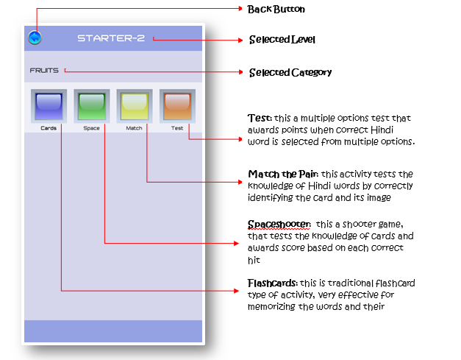
Four learning activities to select

Slide 6
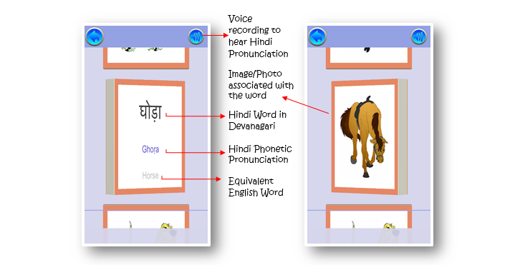
Flashcard activity

Slide 7
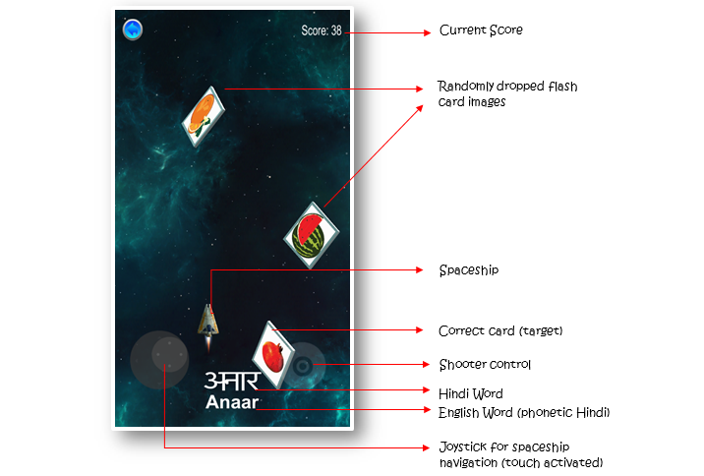
Spaceshooter activity

Slide 8
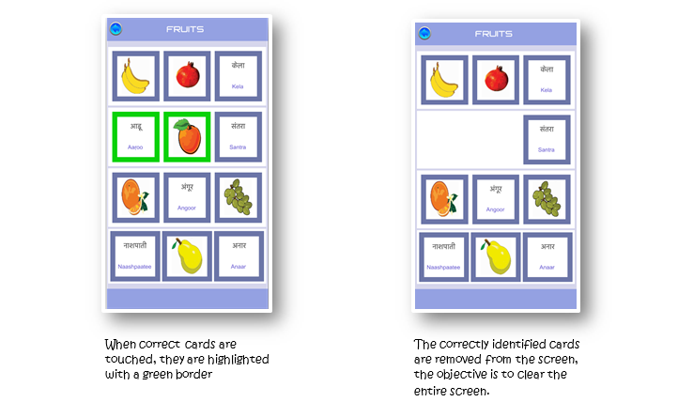
Match-the-pair activity

Slide 9
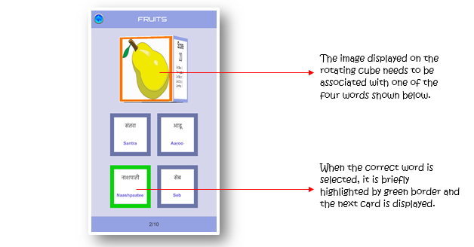
test activity

Slide 10
More information
My journey to development of this app is documented at my living blog at
http://hindiusaflashcards.blogspot.com/
The detailed app functionality is available as a user guide at
http://tinyurl.com/hindiusa

