Slide 1
DLL
Nguyen Van Minh Tam, Tran Huu Anh Dong, Le Trung Luom
March 29th , 2021

Slide 2
I. Contents
Comparison of C and DLL Block
Walkthrough to use method of DLL
Example
- Buck Converter
- Inverter

Slide 3
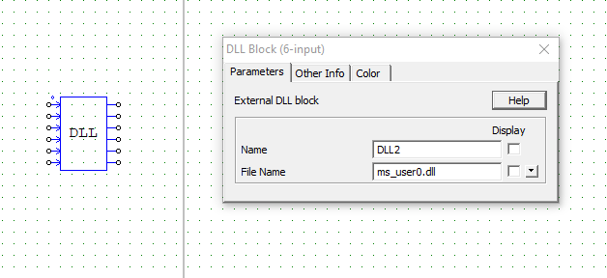
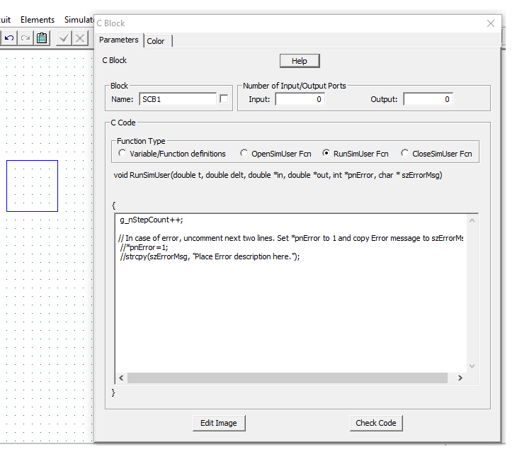
How to do C programming in PSIM
3

Slide 4
Comparison of C block and DLL block
4
We can do C programming by using C Block and DLL Block
 | C Block | DLL Block
Advantages | Easy to use C programming | Short simulation time (about 60% of C Block’s simulation time)
Weakness | Long simulation time | Complex to use C programming (need other program like Visual studio)
In the system including many PI controller and algorithm, DLL Block is more effective than C Block

Slide 5

Walkthrough to use method of DLL
5
Walkthrough to use method of DLL with
Visual Studio 2019

Slide 6
Walkthrough to use method of DLL
6
Step 1. Create a new DLL project file
Step 2. Make source code
Step 3. After compile and build, check if the DLL file is generated
Step 4. Save PSIM file in the path where contain the DLL file
Step 5. Enter to the File Name with DLL file name that we have created earlier.

Slide 7
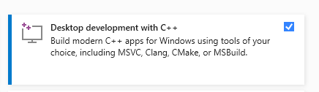
Using method of DLL (Prerequistes)
7
A computer that runs Microsoft Windows 7 or later versions.
Make sure that the Desktop development with C++ workload is checked. Don’t worry if you didn't install this workload when you installed Visual Studio. You can run the Visual Studio Installer again, click to Modify Button and install it now.
An understanding of enough of the fundamentals of the C/C++ language to follow along.

Slide 8
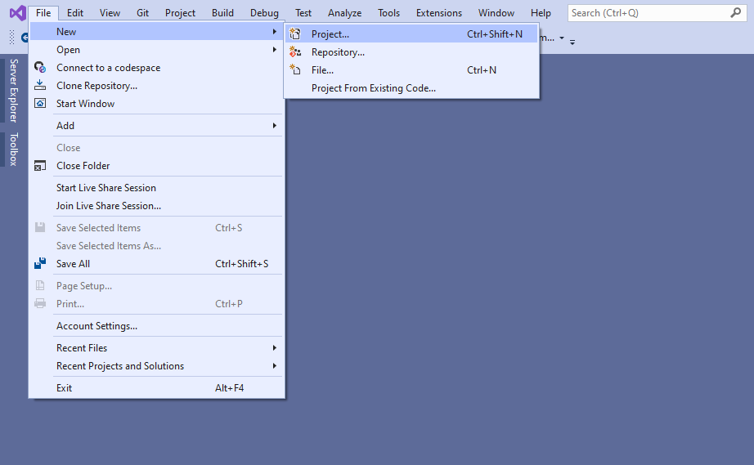
Using method of DLL(1/5)
8
Step 1. Create a new DLL project file
- Set Language to C++, set Platform to Windows, and set Project type to Library.
- Select Dynamic-link Library (DLL), and then choose Next.

Slide 9
Using method of DLL(1/5)
9
Step 1. Create a new DLL project file

Slide 10
Using method of DLL(2/5)
10
Step 2. Make source code

Slide 11

Using method of DLL(3/5)
11
Step 3. After compile and build, check if the DLL file is generated
$∗$Build: ctrl + B

Slide 12
Using method of DLL(4/5)
12
Step 4. Save PSIM file in the path where contain the DLL file

Slide 13
Using method of DLL(5/5)
13
Step 5. Enter to the File Name with DLL file name that we have created earlier.
$$∗Note that if you have unused input pin of DLL block, the input pin must be connected to ground.$$

Slide 14
Transformer PI controller to C code
14
Discrete PI controller
Discrete PI controller as C code
PI controller in continuous
time domain
Approximate the integral term
pi_error = Vo_ref – Vo;
pi_error_sum += pi_error;
pi_out = Kp*pi_error + Ki*Ts*pi_error_sum;
The discretized PI controller

Slide 15
EXAMPLE
15
EXAMPLE – BUCK CONVERTER

Slide 16
System block diagram
16
Parameter of Buck converter: V_{i} = 820V, V_{o} = 180 to 800V, P_{O} = 40kW, L = 400uH, C = 20 uF.
C programs of PI and Limiter block:
Goal is to control output voltage V_{o} in any condition with disturbance.
C code
pi_error = Vo_ref – Vo;
pi_error_sum += pi_error;
pi_out = Kp*pi_error + Ki*pi_error_sum*Ts;
if(pi_out > 1) Duty = 1;
else if(pi_out < 0) Duty = 0;
else Duty = pi_out;
PI controller
Limiter Block

Slide 17
System block diagram
17
C programs of Carrier and Comparator Block
PWM_frequency=50000; // Swithcing frequency
if(PWM_Update > 0){
PWM_Ts=1/PWM_frequency;
PWM_TsCnt = (long)(PWM_Ts/delt);
PWM_CompA = (long)(PWM_TsCnt*Duty);
if(PWM_CompA < 0) PWM_CompA = 0;
PWM_Update = 0;
}
if(PWM_Cnt >= PWM_TsCnt){
PWM_Cnt = 0;
PWM_Update = 1;
}
else PWM_Cnt++;
if(PWM_Cnt > 0 && PWM_Cnt <= PWM_CompA ) {gate = 1;}
else gate = 0;
Carrier
- PWM_TsCnt: is variable count
- PWM_CompA: is comparison waves
Comparator

Slide 18
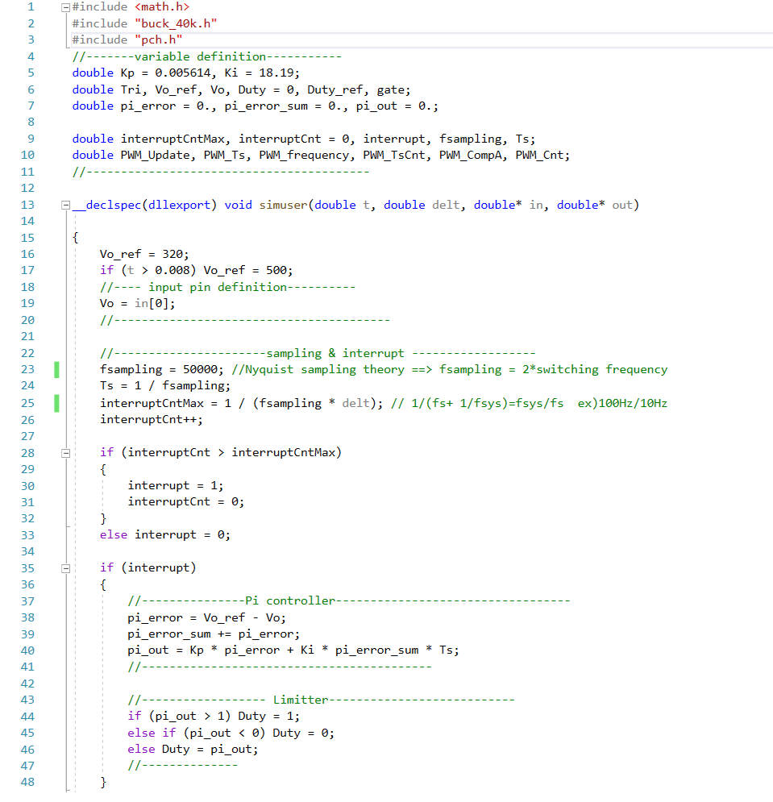
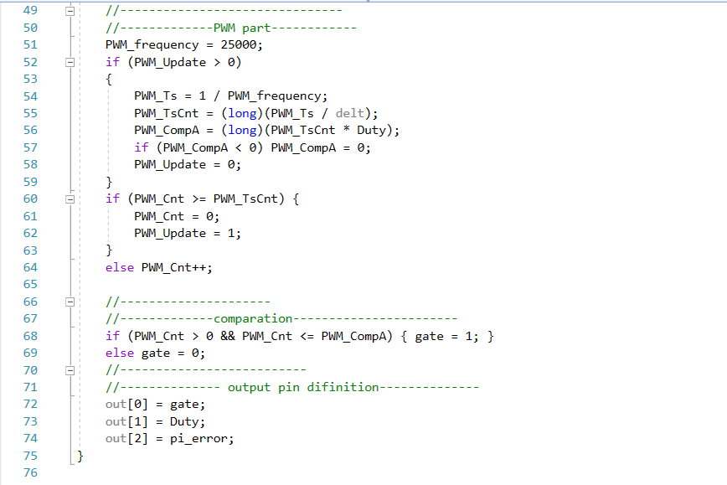
C code for DLL
18
*in
*out
in[0]
out[0]
in[1]
out[1]
in[2]
out[2]

Slide 19
Scheme of Buck converter for PSIM simulation
19
Parameter of Buck converter: V_{i} = 820V, V_{o} = 180 to 800V, P_{O} = 40kW, L = 400uH, C = 20 uF.

Slide 20
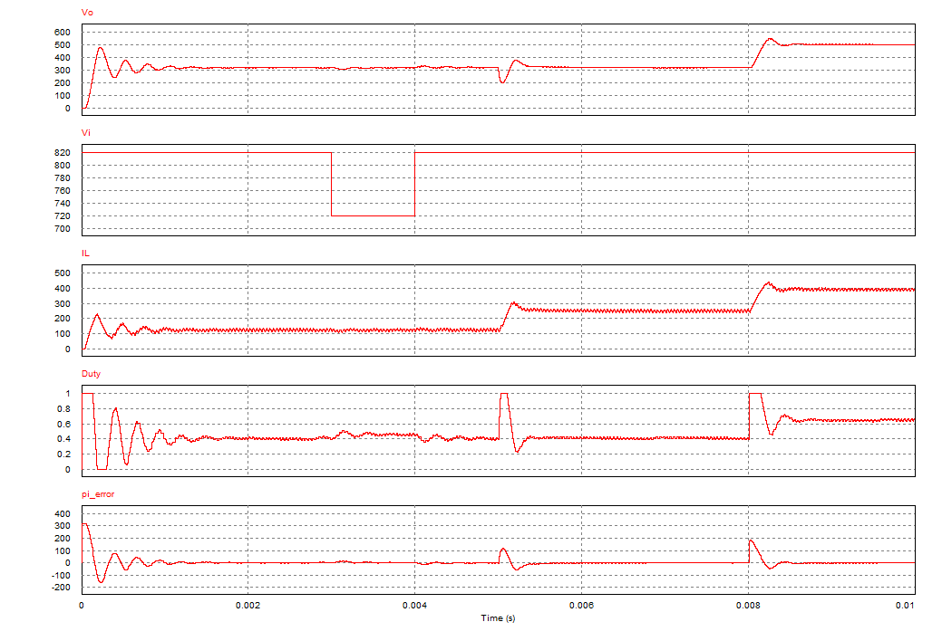
Simulation results
20
Start up
Line regulation
Load regulation
Reference regulation

Slide 21
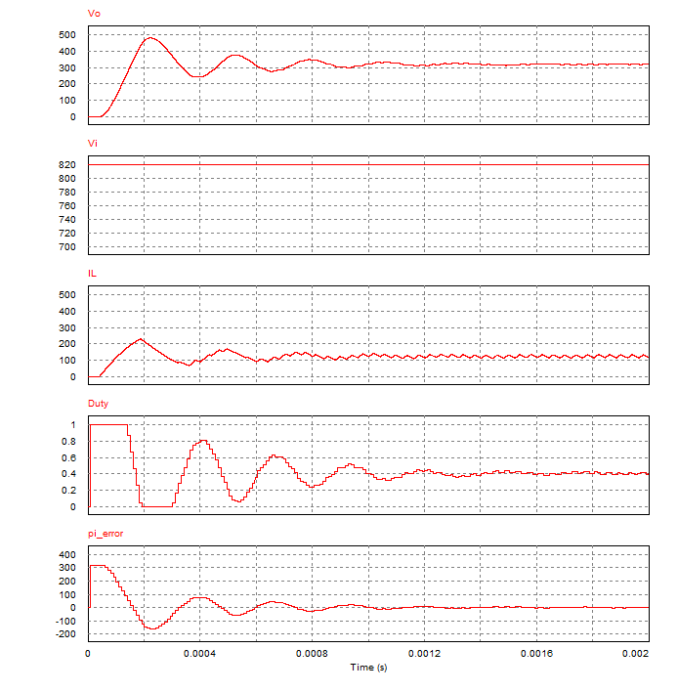
Simulation results – Start up
21
Percent Overshoot = 50%
Settling Time = 2 ms
Steady state of V_{o} = 320V

Slide 22
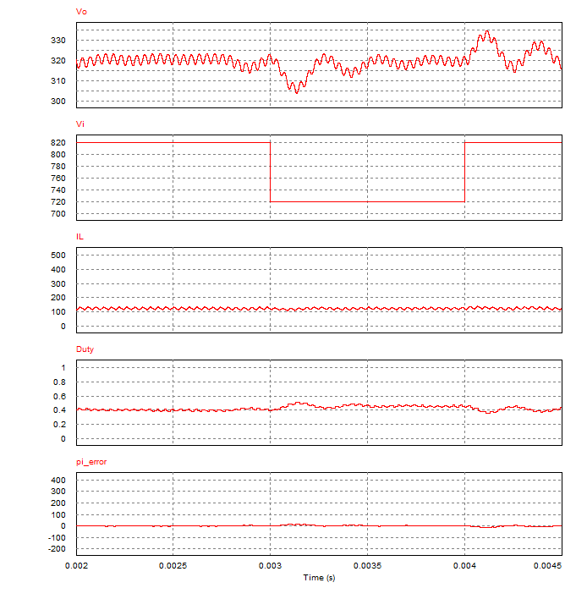
Simulation results – Line regulation
22
V_{i} is decreased from 820V to 720V
V_{o} is decreased
pi_error is increased
( because pi_error = V_{o_ref}-V_{o} )
Duty is increased
V_{o} is decreased to 320V
V_{i} is increased from 820V to 720V
It is similar with before circumstance

Slide 23
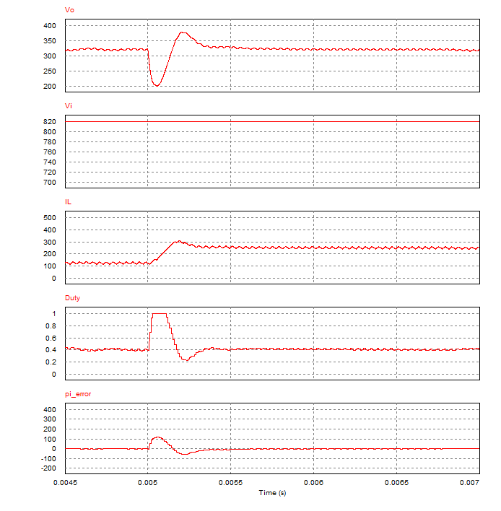
Simulation results – Load regulation
23
Load current (i_{Lf}) is increased
V_{o} is decreased
pi_error is increased
( because pi_error = V_{o_ref}-V_{o} )
Duty is increased
Duty is returned original value

Slide 24
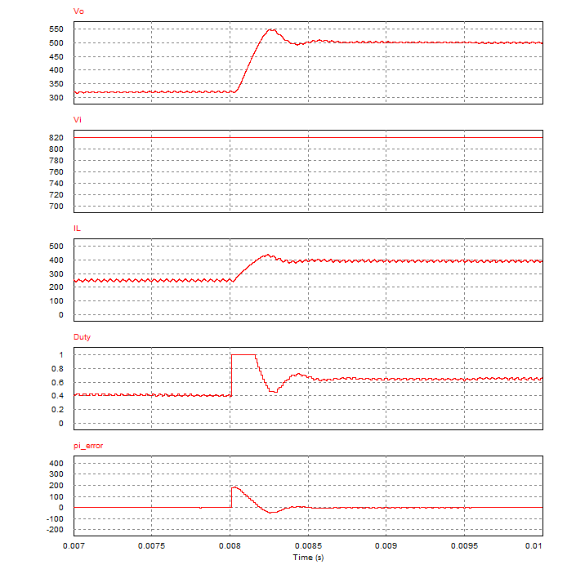
Simulation results – Reference regulation
24
V_{o_ref} is increased from 320V to 500V
pi_error is increased
( because pi_error = V_{o_ref}-V_{o} )
3. Duty is increased
5. V_{o} is increased from 320V to 500V

Slide 25
25
Parameters​ | Values​
Input voltage [V_{L-L,rms}]​ | 360~400​
Battery voltage [V_{dc}]​ | 820±10​
Load [kW]​ | 40​
I_{g,max}​ | 61A_{rms}@220V​
Full-load efficiency [%]​ | 97.5% @,380V_{L_L,rms}​
Peak efficiency [%]​ | 98.5%​
THD​ | ≤ 5%​
PFC​ | ≥ 99%​
EXAMPLE
INVERTER

Slide 26
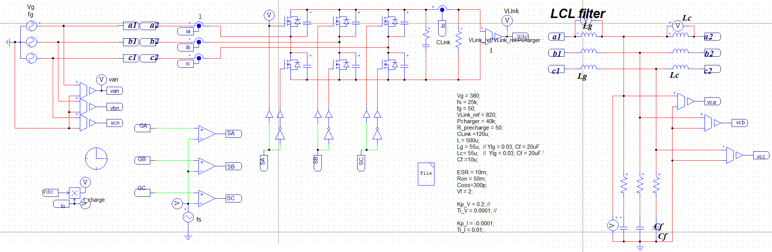
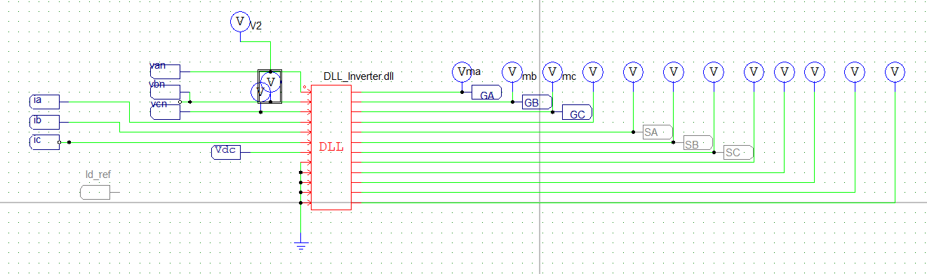
System block diagram
26

Slide 27
C code for DLL
27
C code for DLL (1/4)
C code for DLL (2/4)
//--- include library-----
#include <stdio.h>
#include <math.h>
#include <Clarke.h>
#include <PiCtrl.h>
CLARKE c;
//--- variable definition---
double Kp_I = -0.0118, Ki_I = 4.3009e-04;
double Kp_V = 0.064, Ki_V = 100; // PI Controller outerloop
static double pi_errord = 0., pi_errorq=0., pi_error_sumd = 0.,
pi_error_sumq = 0., pi_error_sumV = 0., pi_errorV = 0.;
double interruptCntMax, interruptCnt = 0, interrupt, fsamling, Ts;
double V_ref = 820.0, Vdc;
//---------------------------
double Van, Vbn, Vcn, Val, Vbe, theta;
double ia, ib, ic, id, iq, io;
double id_ctrl, iq_ctrl;
double ma, mb, mc;
int init = 1; // init functions
#define PI 3.14159
__declspec(dllexport) void simuser(t, delt, in, out)
double t, delt;
double* in, * out;
{
// insert your code here
//-------------------input pin definition----------------------
Van = in[0];
Vbn = in[1];
Vcn = in[2];
ia = in[3];
ib = in[4];
ic = in[5];
Vdc = in[6];
//-------------------abc to alpha beta for Grid Voltage------------
if (init == 1) {
CLARKE_init(&c);
//insert your init funtions
init = 0; }
//-------------------abc to alpha beta for Grid Voltage------------
CLARKE_FUNC(Van, Vbn, Vcn, &c);
theta = c.theta; // Range : -PI --> PI
//-------- abc to DQ axis for current at Converter side------------
id = 0.66667 * (ia * cos(theta) + ib * cos(theta - 2 * PI / 3) + ic * cos(theta + 2 * PI / 3));
iq = 0.66667 * (ia * sin(theta) + ib * sin(theta - 2 * PI / 3) + ic * sin(theta + 2 * PI / 3));
io = 0.66667 * (ia * 0.5 + ib * 0.5 + ic * 0.5);

Slide 28
C code for DLL
28
C code for DLL (3/4)
C code for DLL (4/4)
//---------------------SAMPLING AND INTERRUPT-------------------
fsamling = 50e+3;//Nyquist sampling fsampling >= 2*Fswitching
Ts = 1 / fsamling;
interruptCntMax = 1 / (fsamling + delt);
interruptCnt++;
if (interruptCnt > interruptCntMax) {
interrupt = 1;
interruptCnt = 0;
}
else interrupt = 0;
if (interrupt)
{
//----------------outer loop, Vdc control-----------------------
pi_errorV = V_ref - Vdc;
pi_error_sumV += pi_errorV;
id_ref = Kp_V * pi_errord + Ki_V * pi_error_sumV * Ts;
//--------------PI CONTROLLER Inner-loop-----------------------
// ----------d - control------
pi_errord = id_ref - id;
pi_error_sumd += pi_errord;
id_ctrl = Kp_I * pi_errord + Ki_I * pi_error_sumd * Ts;
if (id_ctrl > 1) id_ctrl = 1;
else if (id_ctrl <-1.0) id_ctrl = -1.0;
else id_ctrl = id_ctrl;
id_ctrl = id_ctrl;
//-----------q - control------
pi_errorq = 0.0 - iq; // iq_ref = 0 for PFC
pi_error_sumq += pi_errorq;
iq_ctrl = Kp_I * pi_errorq + Ki_I * pi_error_sumq * Ts;
if (iq_ctrl > 1.0) iq_ctrl = 1.0;
else if (iq_ctrl < -1) iq_ctrl =-1;
else iq_ctrl = iq_ctrl;
//------------------- end of loop--------------------
//------------dq to abc for 3Phase - SPWM ---------------------
ma = id_ctrl * cos(theta) + iq_ctrl * sin(theta) + io;
mb = id_ctrl * cos(theta - 2 * PI / 3) + iq_ctrl * sin(theta - 2 * PI / 3) + io;
mc = id_ctrl * cos(theta + 2 * PI / 3) + iq_ctrl * sin(theta + 2 * PI / 3) + io;
}
//-------------------------Output definition--------------
out[0] = ma;
out[1] = mb;
out[2] = mc;
}

Slide 29
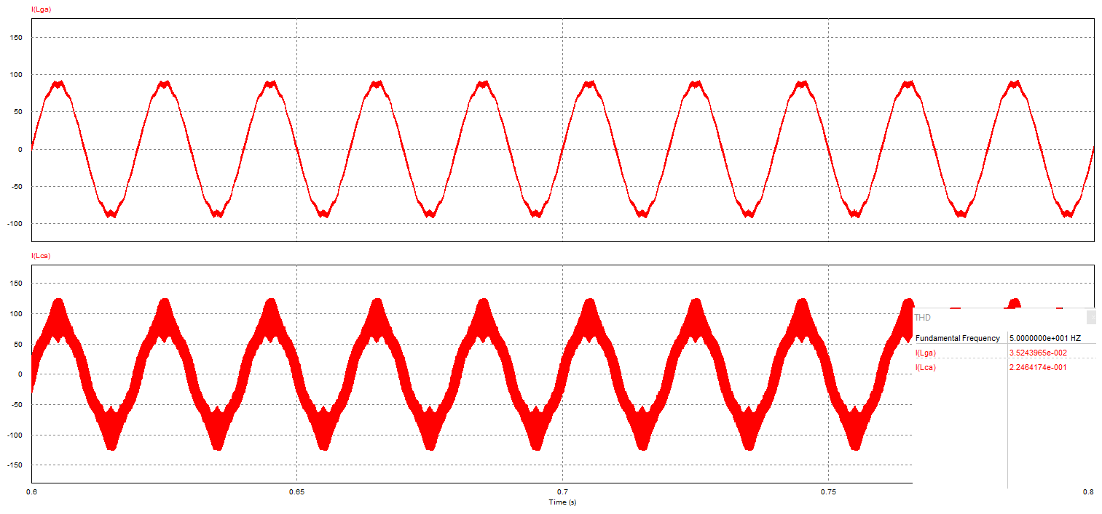
Simulation results - Inverter
29
After passing the LCL filter
Before passing the LCL filter

Slide 30
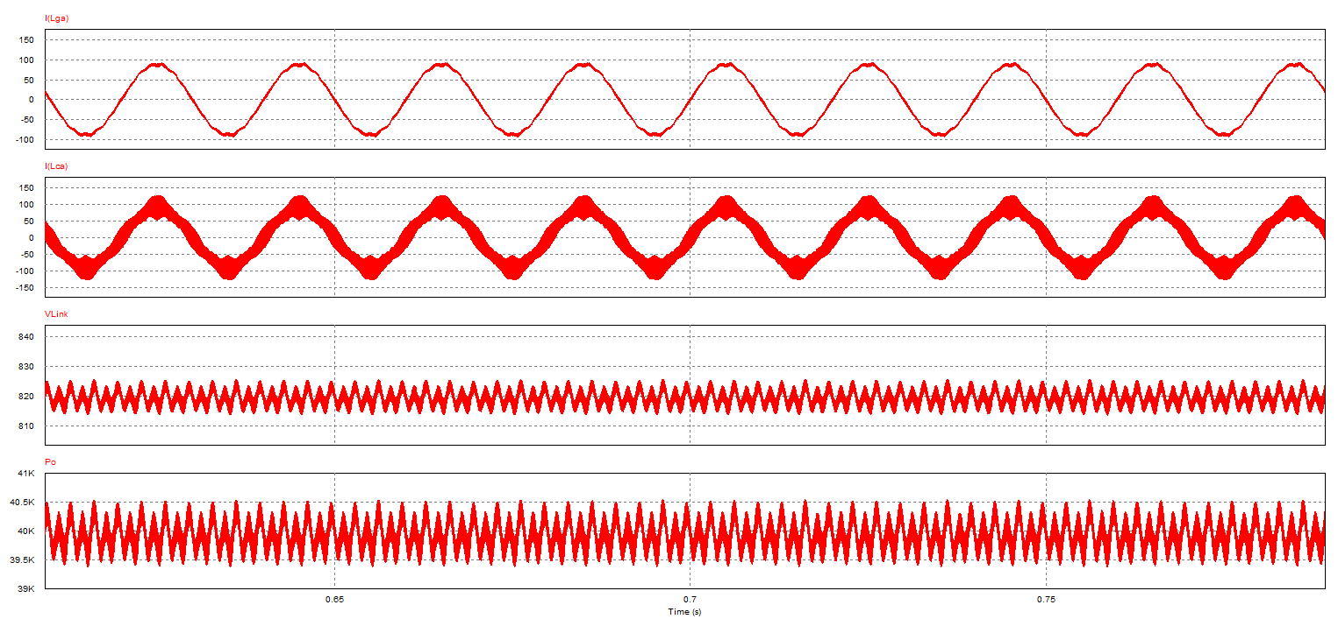
Simulation results - Inverter
30
Vlink (Vout)
Output Power (40kW)

Slide 31
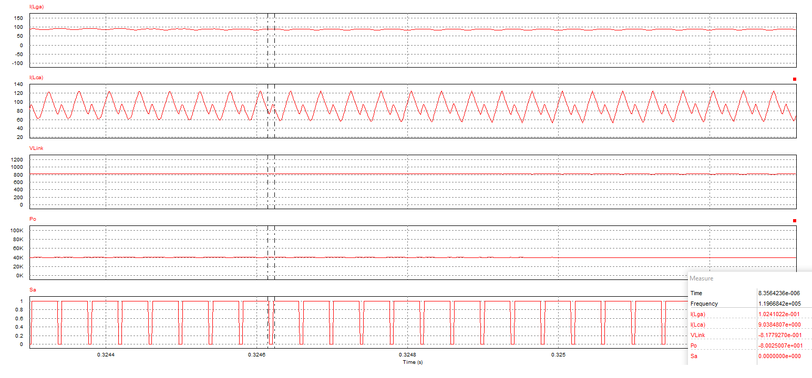
Simulation results - Inverter
31

Slide 32
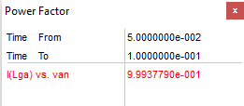

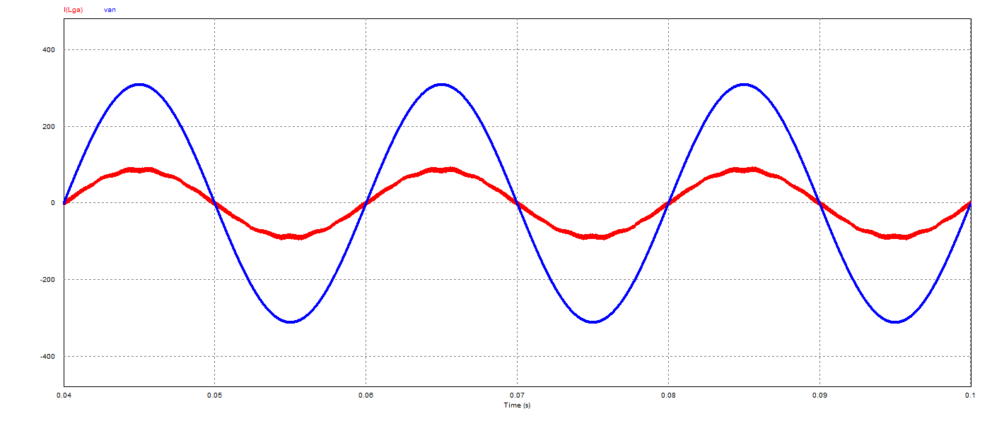
Simulation results - Inverter

